Slide 1
Named Data Networking for
Data Distribution in
High Energy Physics
Edmund Yeh

Slide 2
Data-intensive Science and LHC
Data-intensive science: extract knowledge from massive datasets with growing scale and complexity.
Global data distribution, processing, access, analysis; coordinated use of large but limited computing, storage and network resources.
Named Data Networking (NDN) natural fit for data-intensive science.
Large Hadron Collider (LHC) high energy physics program is world’s largest data intensive application, handles about 1 Exabyte (1 million terabytes) by 2018.
LHC network connects CERN to 500 tiered sites worldwide.
LHC network traffic projected to grow by another 2 orders of magnitude by 2026.
Increased complexity of data.
Present system cannot scale to meet needs of HC Run3 (2021-23).

Slide 3
SANDIE Project
$1M, 2-year US NSF CC* grant starting July 2017.
Northeastern (lead), Caltech (PI: Harvey Newman), Colorado State (PI: Christos Papadopoulos).
Use NDN principles to redesign high energy physics (HEP) Large Hadron Collider (LHC) program network.
Will deploy NDN edge caches with SSDs and 40G/100G network interfaces at 7 sites (Northeastern, Caltech, CSU, Fermilab, ..)
Combine with larger core caches in strategic locations.
Coordinate with compact preprocessing of data objects (e.g. MiniAOD, MicroAOD, data scouting, n-tuples).
Leverages NDN-based tested for climate applications at CSU.

Slide 4
Project Aims
Derive NDN-based operational model for data distribution, processing, gathering, analysis to benefit LHC and other major data-intensive scientific programs (e.g. LSST, SKA).
Simultaneous optimization of caching (“hot” datasets), forwarding, and congestion control in network core and site edges.
Network core and edge node design and performance optimization.
Development of naming scheme and attributes for fast access and efficient communication in HEP and other fields.
Scalability of NDN system in amount and type of data supported as well as geographic extent.

Slide 5
Named Data Networking
$7.9 million Future Internet Architecture grant from NSF.
UCLA, UCSD, UIUC, UC Irvine, PARC, Northeastern, Washington U, U Arizona, Colorado State, U Memphis.
Intellectual leadership by Van Jacobson.
Leading Information-centric Networking (ICN) architecture.
Website: http://named-data.net

Slide 6
Networking Today
Telephone Network (1876): connecting sources to destinations via wires. Main problem: switching.
IP (1974): end-to-end store and forward: focuses on machines talking to machines.
Network usage today is dominated by content distribution
Middleware such as CDNs and P2P try to mediate between applications and TCP/IP.
Need more fundamental solution.

Slide 7
Basics of NDN
Name data instead of endpoints: paradigm shift.
No notion of end to end.
To request data, send Interest Packet (IP) containing data name.
IPs forwarded along routes determined by Forwarding Information Base (FIB) at each node.
Incoming interface for received IPs recorded in Pending Interest Table (PIT) at each node. Multiple requests for same object collapsed/suppressed.

Slide 8
Basics of NDN
When node receives IP it can fulfill, creates Data Packet (DP) containing requested data name, data object and digital signature.
DP is transmitted back along path taken by corresponding IP, as recorded by PIT at each node. DP is multicast by node if corresponding IPs are collapsed/suppressed at node.
Nodes on reverse path optionally cache data objects in received DPs.
Request for data object fulfilled by content source or by any caching node.

Slide 9
NDN Caching Network
Nodes in network store data objects (e.g., files, file chunks)

Slide 10
NDN Caching Network
?
Nodes generate requests (IP) for data objects

Slide 11
NDN Caching Network
?
Requests (IPs) routed towards data source

Slide 12
NDN Caching Network
Data Packets (DPs) routed over reverse path

Slide 13
NDN Caching Network
?
Nodes have caches with finite capacities

Slide 14
NDN Caching Network
?
?
?
Nodes have caches with finite capacities

Slide 15
NDN Caching Network
?
Nodes have caches with finite capacities

Slide 16
NDN Caching Network
?
Requests (IPs) terminate early upon a cache hit

Slide 17
NDN Caching Network
?
?
IPs for same data object collapsed; DP for object multicast

Slide 18
Optimized NDN Algorithms
State-of-the-art, theoretically grounded, high-performance optimization frameworks for optimizing NDN.
Joint optimization of caching, forwarding, and congestion control.
VIP (Virtual Interest Packet) framework (Yeh, et al. 2014).
Adaptive caching and routing framework (Ioannidis and Yeh 2016, 2017).
Algorithms have optimality guarantees.
Algorithms are distributed, adaptive, dynamic.
Superior performance in delay, cache hits, cache evictions.

Slide 19
VIP Framework
VIP (Virtual Interest Packet) framework for optimal caching and forwarding for NDN (first published at ACM ICN 2014).
Comprehensive framework for jointly optimal caching, forwarding, and congestion control for ICN networks.
Stochastic control approach: models queuing and congestion.
Maximizes user demand rate satisfied by NDN network.
Superior performance in user delay, cache hit rate, cache evictions.
Includes duplicate interest suppression.
Distributed, adaptive algorithms for changing content, user demands, and network conditions.
Project supported by NSF FIA NDN grant 2010-2014, NSF NeTS grants 2014-2020, Cisco grants 2013-2018.

Slide 20
VIP Framework
For each Interest Packet for data object k entering network, generate corresponding VIP count for object k.
VIP counts: locally measured demand/popularity for data objects.
VIP counts incremented at request entry nodes, removed at data sources and caching points.
VIP counts maintained for most popular data objects.
Forwarding: at each time and on each link, use all capacity to send data object with largest VIP count difference.
Dynamic, multipath forwarding algorithm.
Caching: at each time and each node, cache data objects (with all chunks) with highest VIP counts.
Number of replicas dynamically optimized; does not always forward to nearest replica.
Both caching and forwarding are adaptive and distributed.
Can incorporate content-centric congestion control.

Slide 21
VIP Evaluation

Slide 22
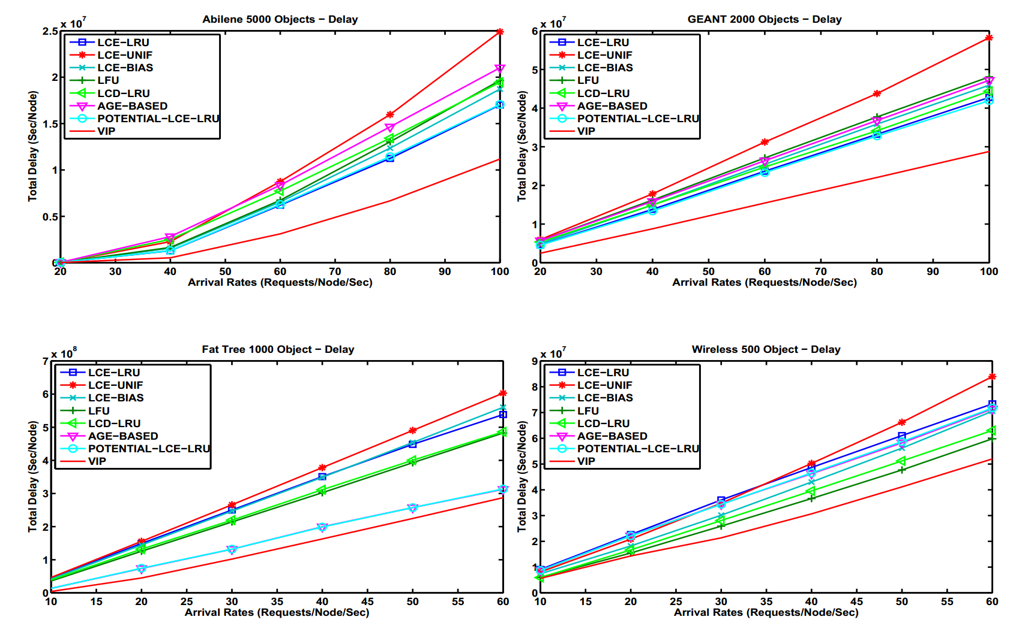
VIP Evaluation: Delay

Slide 23
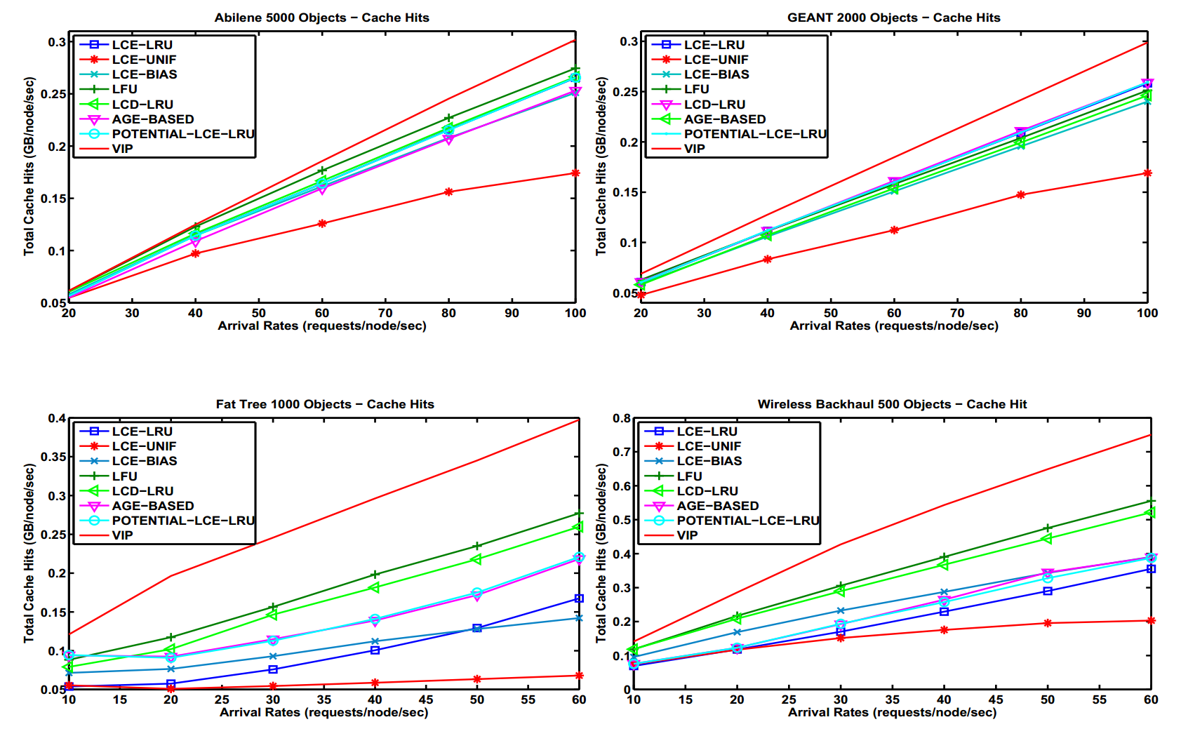
VIP Evaluation: Cache Hits

Slide 24
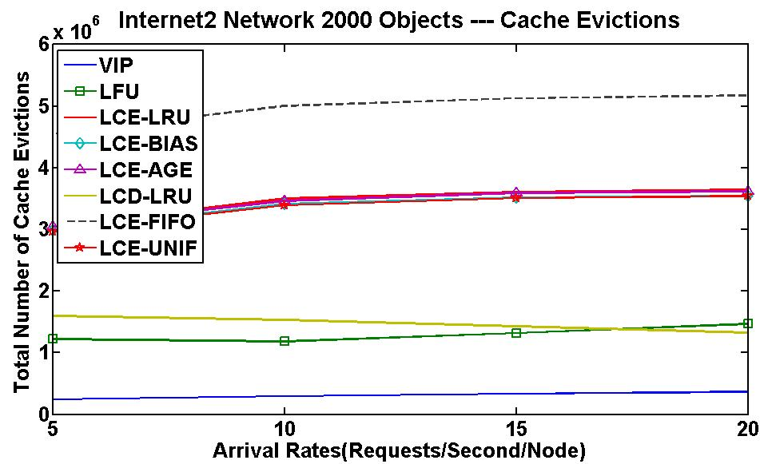
VIP Evaluation: Cache Evictions

Slide 25
LHC Model Map

Slide 26
LHC Model Data Access Pattern
Files | Total Size | Min Size | Max Size | Mean Size | Median Size
58035992 | 149.86 PB | 0.00 MB | 163.82 GB | 2.58 GB | 2.59 GB

Slide 27
VIP Evaluation for LHC Model
Data object: (MiniAOD) dataset (2 TB), each with 100 data block chunks (20 GB).
VIP counts maintained for 200 most popular (hot) datasets, accounting for 87% of requests among 1500 active datasets.
Dataset popularity distribution fitted with Zipf(1.2).
Dataset requests arrive at Tier 1/Tier 2/Tier 3 node at rate λ, according to Zipf(1.2) distribution.
VIP-controlled 60 TByte caches at CHIC, LOSA, ATLA and AMST core nodes.
Source nodes for all datasets: CERN and FNL.
800 TB repositories at all Tier 2 sites: store all 200 hot datasets.
Scenarios: 1) no caching, no tier 2 repositories; 2) caching at 4 core nodes, no repositories at tier 2 nodes; 3) no caching, tier 2 repositories at all tier 2 nodes; 4) caching at 4 core nodes, repositories at all tier 2 nodes.

Slide 28
VIP Evaluation for LHC Model

Slide 29
Adaptive Caching and Routing
New approach for optimizing caching and routing in general multi-hop networks by Ioannidis and Yeh (ACM SIGMETRICS 2016, ACM ICN 2017 Best Paper Award).
Optimize caching and routing to maximize gain in reducing link costs incurred.
Distributed, adaptive algorithm.
Performance guarantee: converges to point within 1-1/e of optimal (NP-hard) solution.
Stochastic projected gradient ascent on concave relaxation.
Route-to-Nearest-Server combined with LRU, LFU, FIFO, … can be arbitrarily suboptimal.
In heterogeneous networks, can decrease network costs by 3 orders of magnitude.
Project supported by NSF NeTS grant 2017-2020, Intel grant 2018-2019.

Slide 30
Optimal Distributed Computation and Storage with NDN
LHC network: distributed computation and data storage network.
Need to optimize usage of bandwidth, storage, and computation resources for performance.
Powerful machines may be congested, may not have needed datasets.
Caching required data where jobs are processed enhances performance.
Ongoing work: use NDN approach to jointly optimize workflow (forwarding and processor scheduling) and data caching.

Slide 31
Conclusion and Ongoing Work
NDN holds great promise for optimizing data-intensive science networks.
State-of-the-art, theoretically grounded, high-performance frameworks (VIP, adaptive caching/routing) developed for jointly optimizing caching, forwarding, and congestion control for NDN.
Algorithms are distributed, adaptive, dynamic.
Superior performance in delay, cache hits.
VIP optimization shows great performance gains for LHC model network.
Ongoing work: optimization with storage management (SSD, disks)
Ongoing work: joint optimization of bandwidth, storage, and computation resources for performance.
Ongoing work: proactive caching strategies using predictions on future demand.
ACM ICN 2018 at Northeastern University, Boston, Sept. 21-23.

