Slide 1
APA Consortium News
Stefan Söldner-Rembold, Alberto Marchionni
September 14, 2017

Slide 2
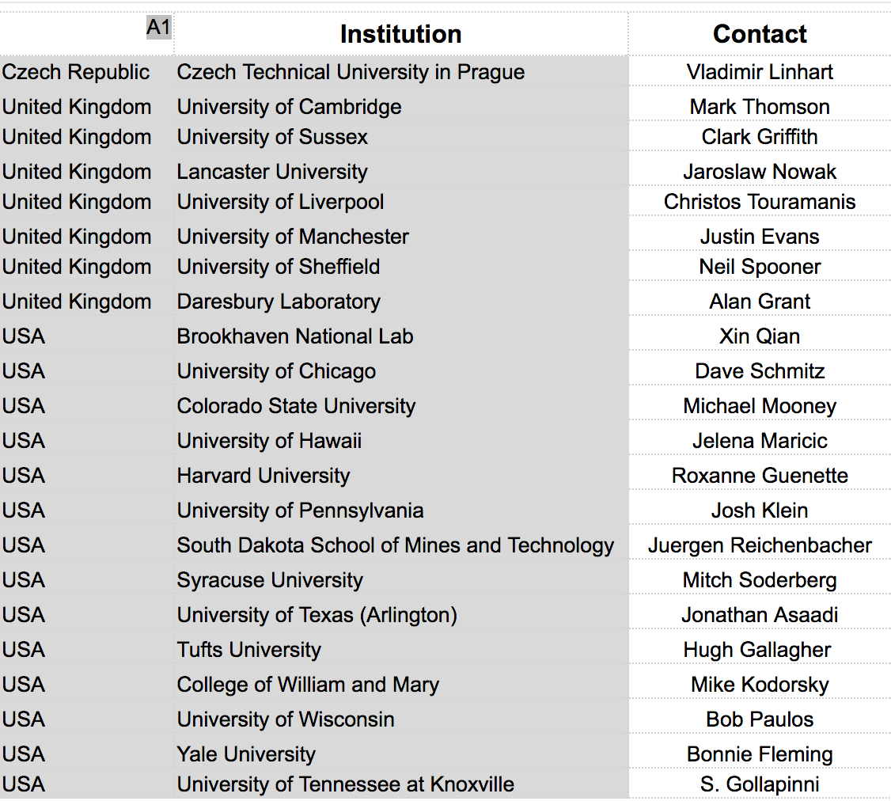
Consortium Membership
Argonne has joined
as new Consortium Member
with Steve Magill as IB rep.
USA Michigan State University Kendall Mahn

Slide 3
Working Group Conveners
Not all appointments have been made (still talking to various groups and candidates), current Status:
TPC Detector Design:
Detector and Hardware: N.N.
Simulation and Software: N.N.
Automatisation and Industrialisation:
Bob Paulos (PSL) and Alan Grant (DL)
Testing, Integration, Installation:
Roxanne Guenette (Harvard) and N.N.
Calibration
Kendall Mahn (MSU)

Slide 4
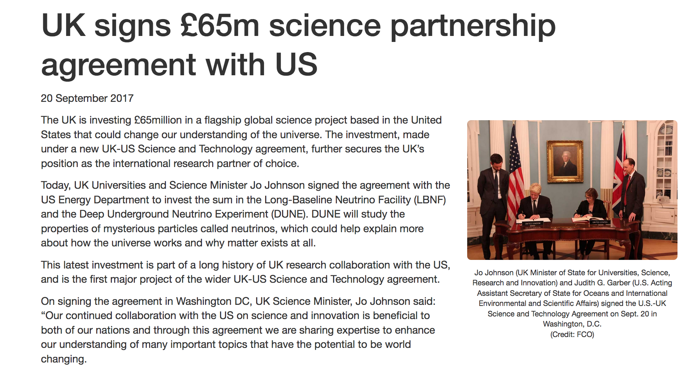

Slide 5
Milestones
2 November 2017, RRB Meeting
First version of the Work Breakdown Structure (WBS) and an assignment of institutional responsibilities.
Zeroth version of WBS sent to Project Office..
Summer 2018
Technical Proposals
Preliminary cost estimates
Updated matrices of institutional responsibilities
Draft schedules for 2020 and beyond
Description of proposed system (can include some alternatives
Spring 2019
Technical Design Report
Finalized version of Technical Proposal
Baseline design with requisite studies to show that proposed subsystem meets DUNE requirements.

Slide 6
Agenda of Meeting this week:

