Slide 1
Background Information
From Victor Guarino
Note, there are already a 20 mm gap between APAs → this is a natural consequence of modular design
Between 3rd and 4th APA, there will be an additional 1 7 mm gap (37 mm in total)

Slide 2
Impact of the Physics
For the primary physics goal: ν_{μ}→ν_{e} oscillation
The essential things are:
Energy reconstruction
Gap may lead to ionization electron loss, or inefficient recombination correction (see more at http://lar.bnl.gov/properties/#particle-pass)
Its value can be estimated by multiple methods:
For track, rely on track length
For shower or non-stopping track, can use the adjacent energy to fill in the gap
Resolution will be dominated by neutrons in the final states
Event ID:
Vertex has to be away from the gap, so that one can rely on the dE/dx at the initial track and gap identification for e/gamma separation
Loss in fiducial volume will be present anyway due to cool down

Slide 3
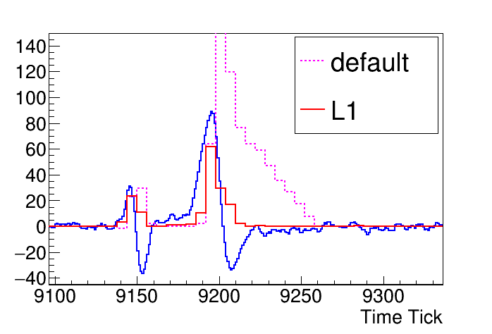
Potential danger of Signal Processing
At the boundary region, the field line will not be uniform, and one worry would be ionization electron collected on the induction wire planes
This will leads to troubles in the signal processing chain
There is a potential solution, L1 signal processing, but the speed is relative slow compared to the signal processing, also charge bias is expected with this approach, so it is better to avoid such problem from its root
The solution would be diverter design from Bo Yu
Collect all the charge drifting towards the gap
MicroBooNE

Slide 4
Using Field Shaping Electrodes to Eliminate the Dead Space Between APAs
Bo Yu
9/22/2017

Slide 5
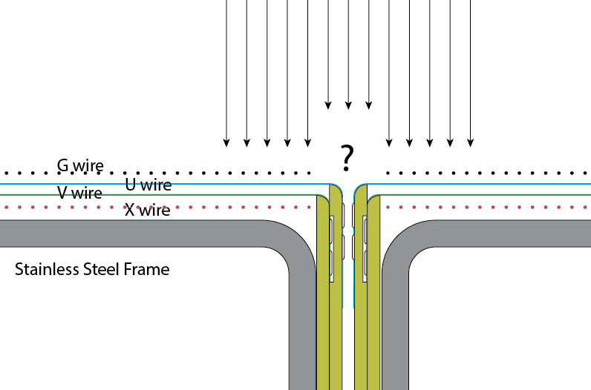
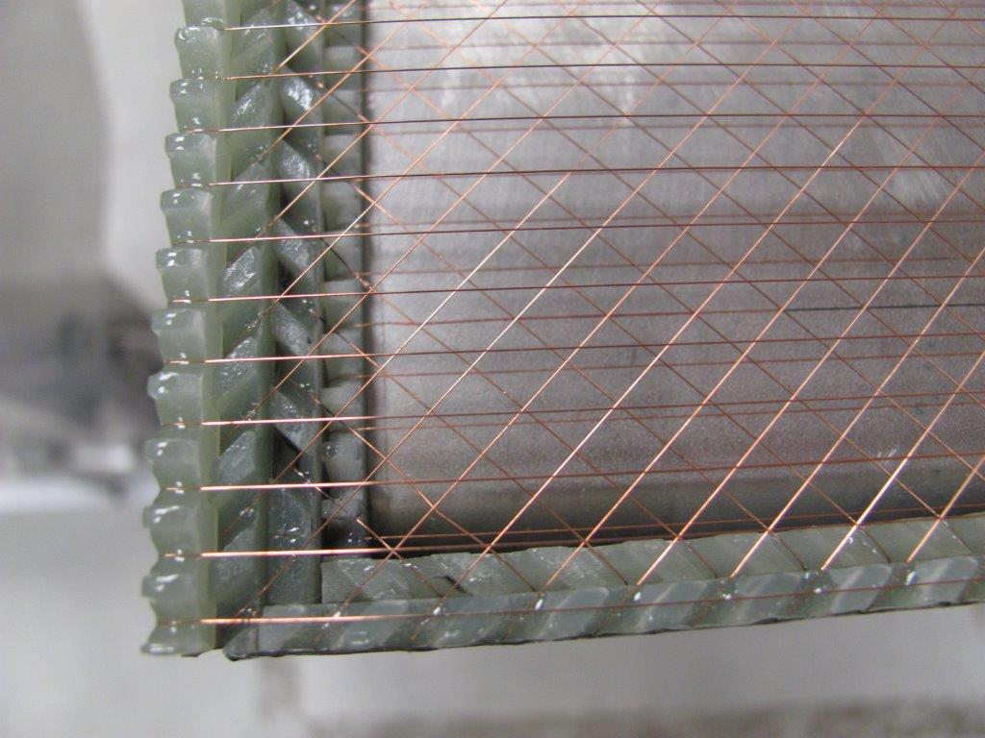
Dead Space Between APAs
The LBNE APAs use a set of 1/8” thick FR4 boards to bond the wires at the 3 butting edges of the APAs. On the long edges, there are two layers of such boards (U & V), while on the short edge, there are 4 layers (G,U,V & X).
The electric field near the gap between APAs is difficult to calculate due to the possible charging of insulating surfaces and a mix of conductors and insulators. As a result, the electron drift paths in that area are also difficult to predict.
Up to now, the drift volume above these gaps are considered inactive from the point of view of charge signal collection. Although we can expect mixed collection and induction type signal over the gaps. The collection type signal on the induction wires (U & V) may cause confusion in the pattern reconstruction.

Slide 6
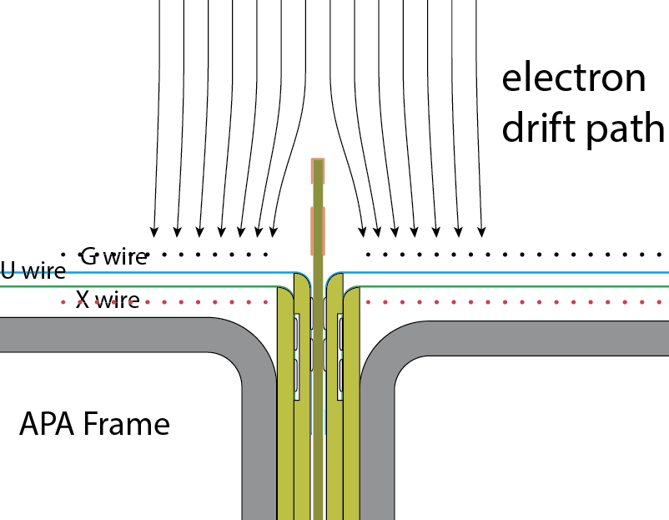
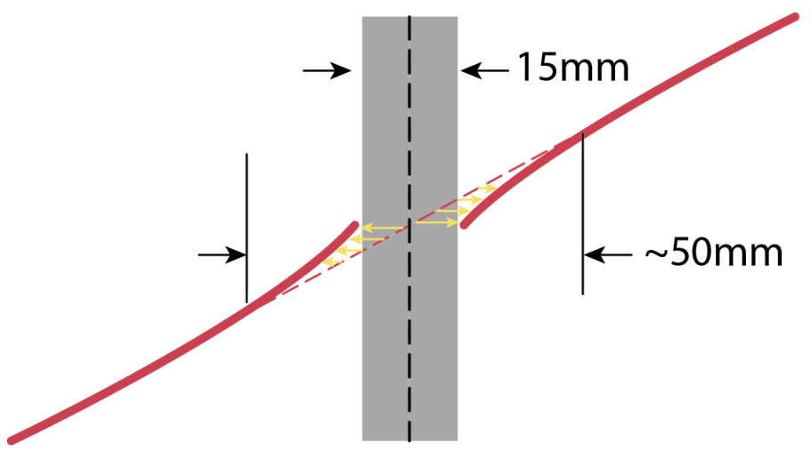
Field Shaping Near the Gap Between APAs
Instead of living with the uncertainties in the electron drift path near the gaps, we can instrument a simple field shaping electrode above the gap to better define the electric field above the gap:
Insert a printed circuit board with some strip pattern in the physical gap between the two APAs, and bias the strips in a voltage distribution such that the incoming electrons will be deflected away from this gap and land in the active region of the wire frame.
In this field configuration, we do not lose any electrons, but reconstructed inclined tracks will appear distorted at this gap. The width of this distorted region could reach ~5cm. This is a fixed distortion that can be easily mapped out and corrected.
20mm

Slide 7
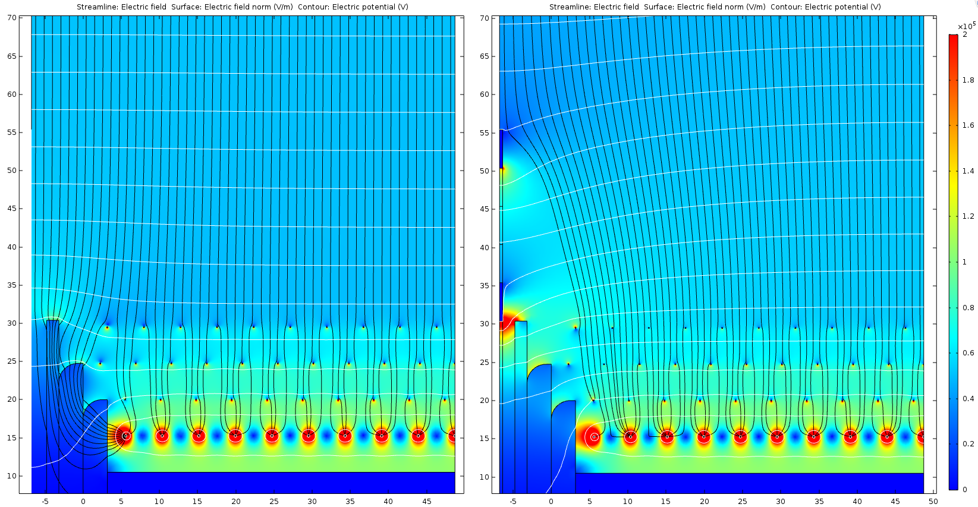
Electron Drift Paths with or without the E-Diverter
Left: current NP04 APA long edge without e-diverter
Right: NP04 APA long edge with 2 electrode e-diverter (-2300V and -1300V)

Slide 8
New simulation for the Gap to be explained by Bo

Slide 9
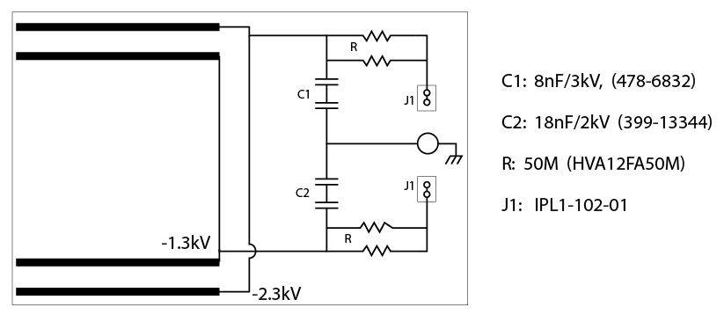
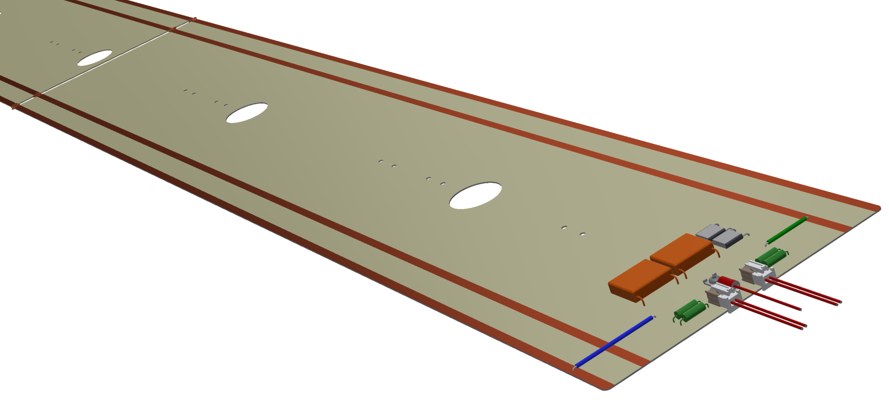
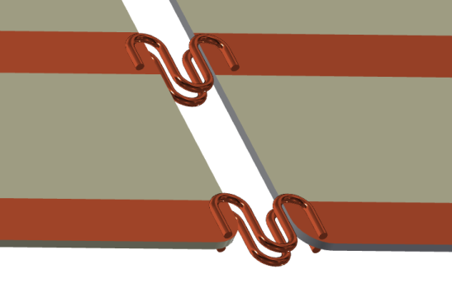
Electron Diverter Board
Each APA gap requires 1 full board, and 9 chopped boards to reach the 6m length.
Interconnection between boards made by soldering 2 copper wires per strip.

Slide 10
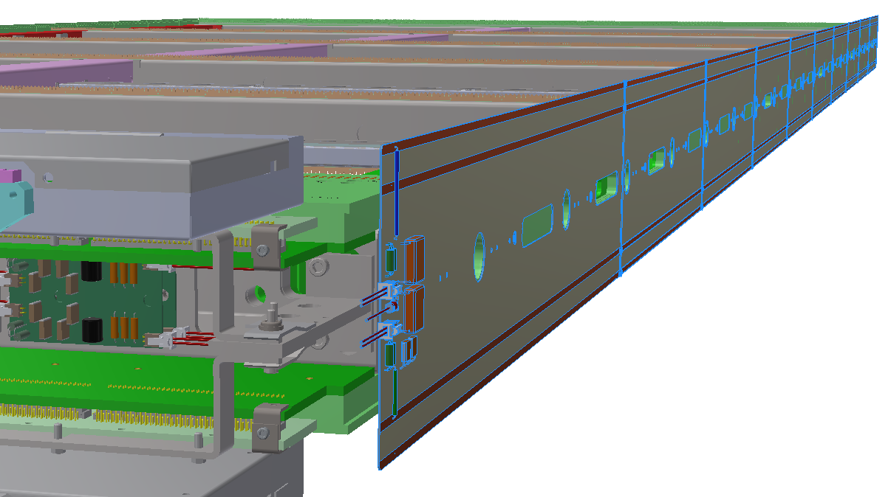
Implementation in NP04
A total of 10 printed circuit boards are interconnected to form a set of e-diverter between a pair of APAs.
Simple RC networks provide filtering for the ripples in the bias voltage supplies.

Slide 11
Summary
A field shaping method that can eliminate the dead gap between APAs appears to be effective and easy to implement, if we don’t mind the distortion it creates.
One field shaping board was be installed in the 35ton TPC between the smallest (3 unit high) APA and its neighbor with adjustable bias voltages. However, no experimental data is available
Two sets of field shaper boards are planned to be installed between the beam right APAs in NP04.

Slide 12
Summary
The diverter would
Enable all charge collection, and minimize the information loss in the gap
The fixed electric field distortion allows for a calibration to be done to recover the space dislocation of the track in 3D
Should be straight forward
Needs to ensure the design can work with the additional 17 mm gap, no show stopper is expected though

