Slide 1
Hi Lumi Cryogenic System Modifications
for
MQXFA Testing
Marone
9/28/17

Slide 2
Outline
Summary – first!
Conditions / results for Mirror cold Test, MQXFA1 quench #1/ Changes for MQXFA1 quench #2
Other preparations

Slide 3
Summary
Existing volume / configuration has been used without incident for RHIC, LHC, LARP Mirror, etc.
Cryogenic helium return piping, valve operations were not optimized for maximum flow / minimum pressure
Simple changes are being implemented to dramatically improve performance for MQXFA1 continued testing

Slide 4
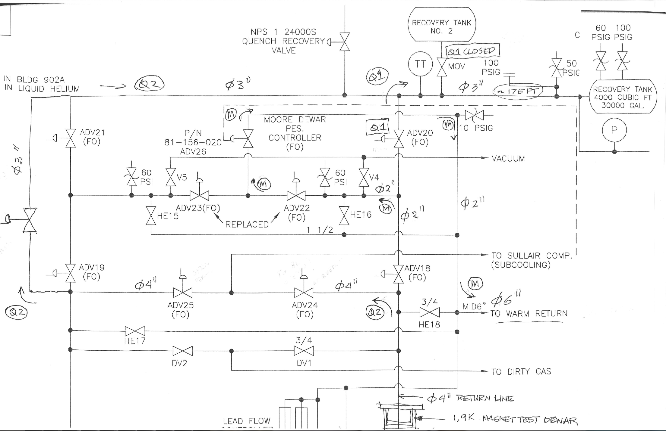
Helium Return / Vent Schematic
Mirror – quench valve not opened
Q2 open
Q1 – quench valve opened manually after pressure observation; small Ø lines
Q1
manual valve
open
open
Update - This automatic valve is checked and operational
Q2 automatic valve
Q2 – quench valve to open automatically w/quench; large Ø lines; recovery tank added

Slide 5
Other efforts
A (new!) liquid helium transfer line failed & was delivered to the vendor for repair
Is back at BNL, pressure and leak tested and ready for next test
A larger helium return vent (to atmosphere) is installed in place of the existing; in the event of pressure buildup, will result in momentary loss of helium (instead of complete loss through burst disc)
Sullair 500 hp compressor motor has been repaired and is being reinstalled, will be ready for test (Sullair 500 was not available for previous test)

