Slide 1
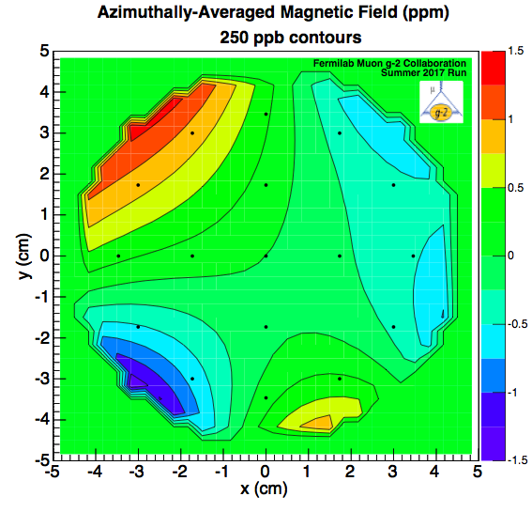


Experimental Technique, Error Tables, Rates
David Hertzog
Operational Readiness Review
Oct 2, 2017

Slide 2

Will illustrate the many pieces required to measure g-2 to 140 ppb precision
Recall, this is largely a “1 number” experiment … thus
  “We are all measuring g-2”
The E989 Collaboration is built from 4 communities of physicists:
  Accelerator
  Atomic
  Nuclear
  High-Energy

Slide 3
Two frequencies are measured
Each with systematic error budget: 70 ppb
Statistical error budget: 100 ppb
Total error budget: 140 ppb
In E821 ≡ [540 ppb]
Muonium Hyperfine Splitting
-2.002 319 304 361 53(53) [0.26 ppt]
Electron g-2 + QED
--[658.210 6866 (20)] ⁻¹ [3 ppb]
206.768 2826(46) [22 ppb]
Muonium 1S-2S
ω_{a} : Precession frequency
ω_{p} : Magnetic field (averaged, convoluted with muon distribution)

Slide 4
Statistical Requirement in ω_{a} Measurement
Statistical error: goal vs BNL: 460 ppb → 100 ppb
  1.8 x 10¹¹ events in final fit, x21 compared to BNL
  10% of stored muons decay to e⁺ in (E, t) acceptance
  Deep understanding of beam production, polarization, phase space properties, storage ring dynamics, etc, are as critical as obtaining the counts. We have a lot of people working on this

Slide 5
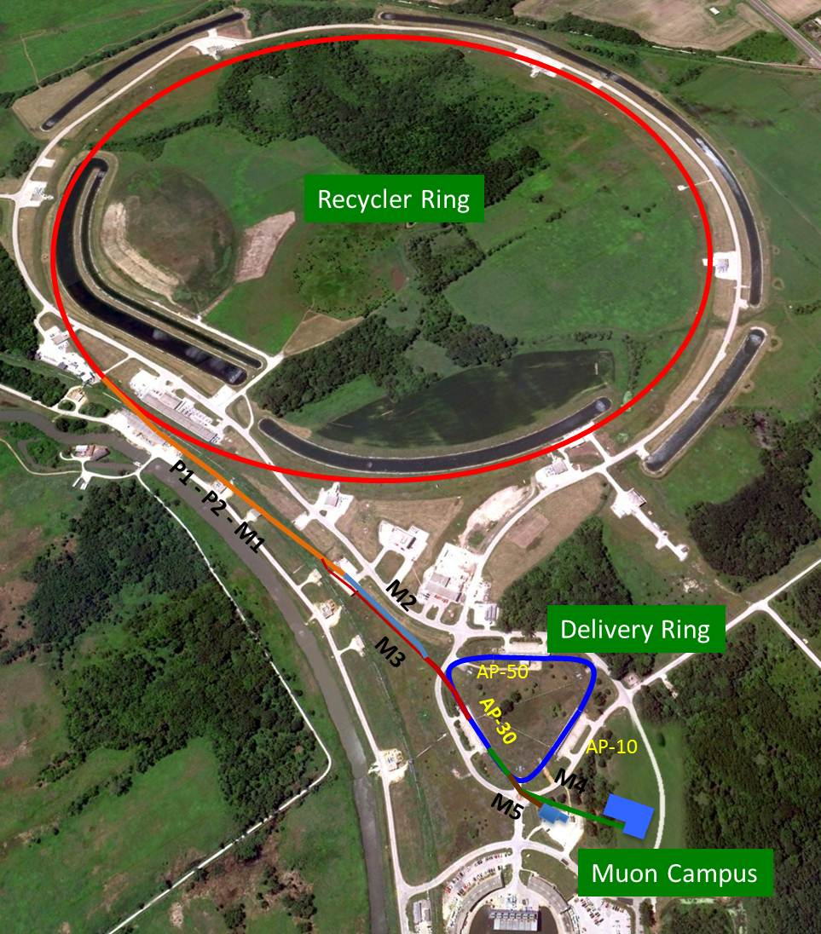
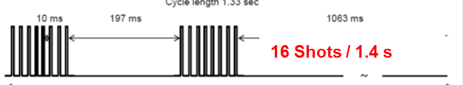
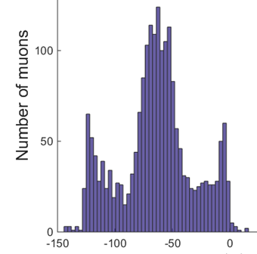
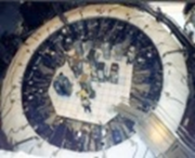
Creating the Muon Beam for g-2
8 GeV p batch into Recycler
Split into 4 bunches
Extract 1 by 1 to strike target
Long FODO channel to collect π ◊ μν
p/π/μ beam enters DR; protons kicked out; π decay away
μ enter storage ring
Intensity profile is 120 ns wide with “W” shape

Slide 6
Muon Arithmetic (source: TDR 2015)
2
3
1
Three critical numbers not yet achieved in commissioning
  12 fills / s
  ~730k muons / fill to SR
  Capture / storage fraction goal of ~2.5%

Slide 7
Injection and Muon Storage: The key to statistics
The steps:
  Steer beam through SR magnet backleg corridor and through Inflector into ring
  Provide well-timed angular kick to direct muons into storage region
  Asymmetrically power quads to gently scrape edge muons on collimators
  Relax quads to symmetric configuration for stable vertical containment
The Tuning Knobs:
  Final quads and steering magnets adjustments in M5 beamline (Twiss parameters)
  Inflector field strength
  Kicker voltages (field strength) and timing with respect to incoming beam
  Quad voltages (tune) and scraping settings
The instrumentation:
  Timing and intensity scintillating paddle in front of incoming beam (T0)
  3 scintillating fiber hodoscopes placed along corridor (IBMS system)
  2 XY fiber hodoscopes that can rotate into the μ storage region (Fiber Harps)
  In-vacuum trackers to image the muon storage from tracing back the decay e⁺ to their approximate origin (Trackers)
  A scalar count of high-energy e+ decays in the calorimeters which is proportional to the number of stored muon (online CTAGs)
See Rubin Talk for Commissioning Experience

Slide 8
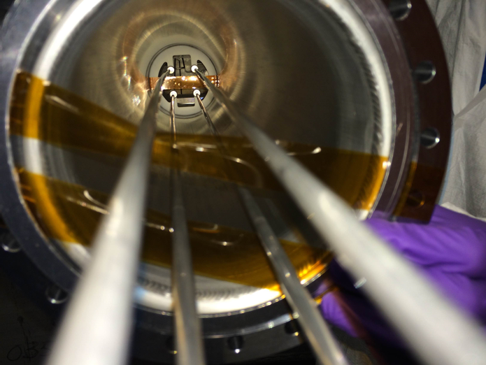
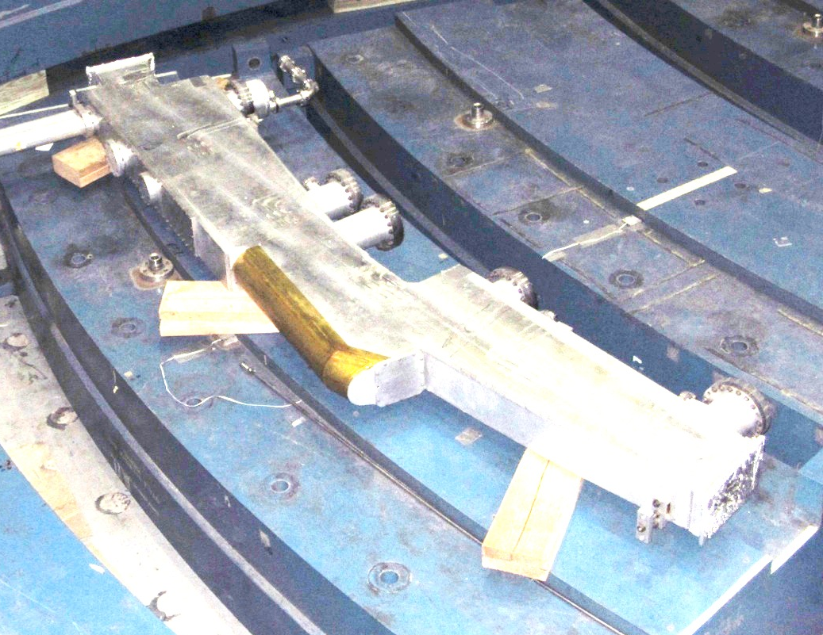
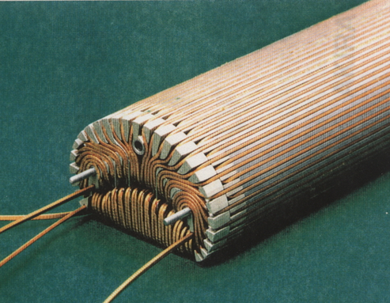
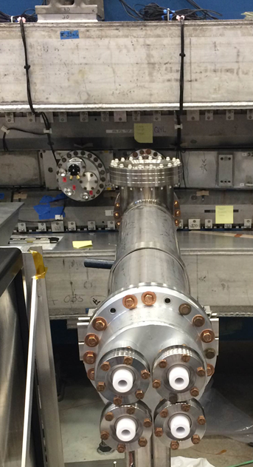
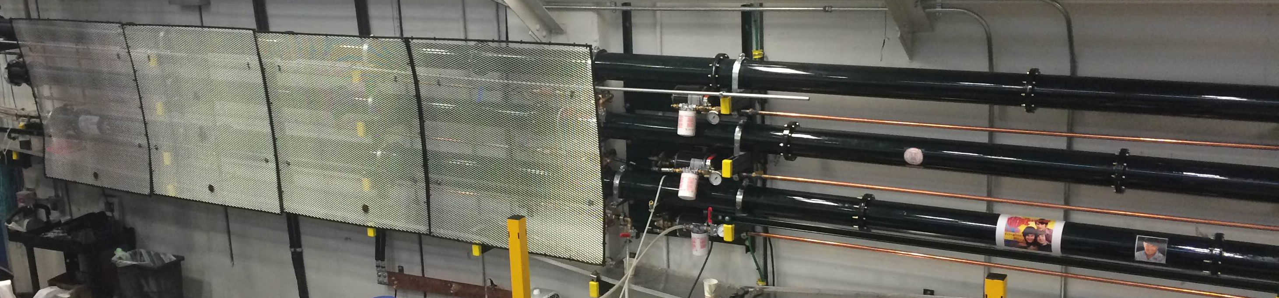
The injection hardware
Inflector field cancels the main g-2 magnet
Precisely aligned electrostatic quads for vertical containment. Delicate HV connections.
Muons enter
Quad Connected
The 3 pulsed Kickers deflect the beam onto the storage orbit
Kicker Plates
Kicker Pulse
Triaxial Blumlein Kicker Tubes Mounted and Connected in MC1

Slide 9
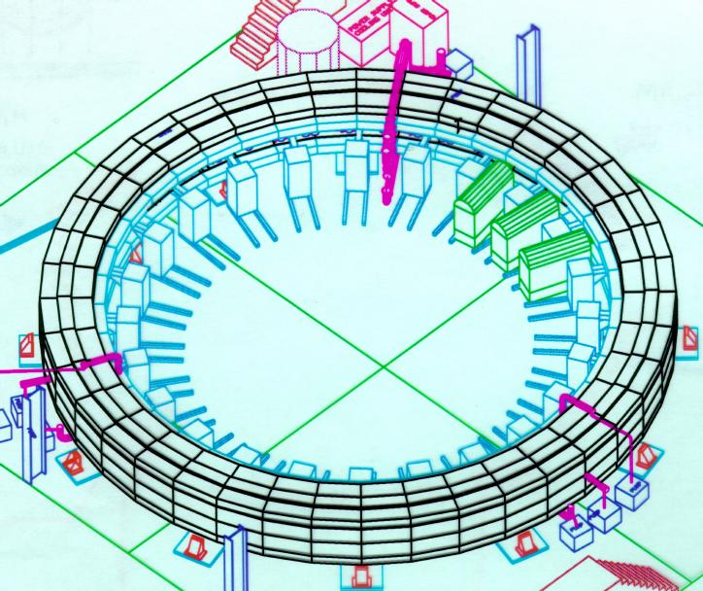
Equipment to provide muon injection and storage
Superconducting inflector magnet
Fast Kickers
incoming muons
Electrostatic Quadrupoles (41%)
1.45 T Storage Ring
Oct 2, 2017
Experimental Technique
Notes:
microscopic Penning device from advanced lab

Slide 10
IBMS detectors help steer muon beam through Inflector
Simulation
X
Y
Measurement

Slide 11
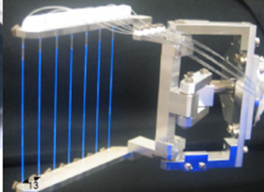
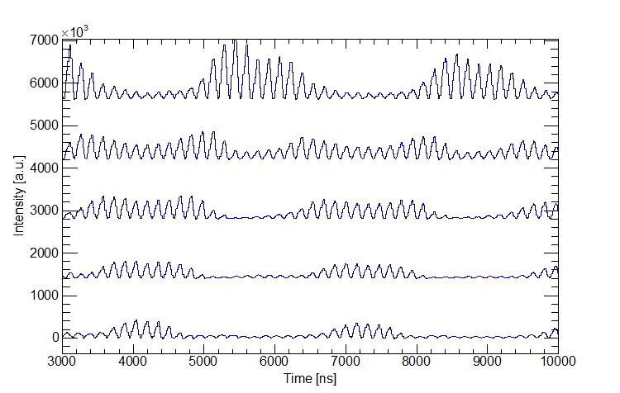
In-vacuum scintillating Fiber Harp (hodoscopes) image stored beam dynamics*
muons
Example measurement: June 2017
X Harp
Radial and Vertical Widths and Means vs time give the Coherent Betatron frequencies and amplitudes, needed for ωa analysis
*Destructively; extracted during normal data taking

Slide 12
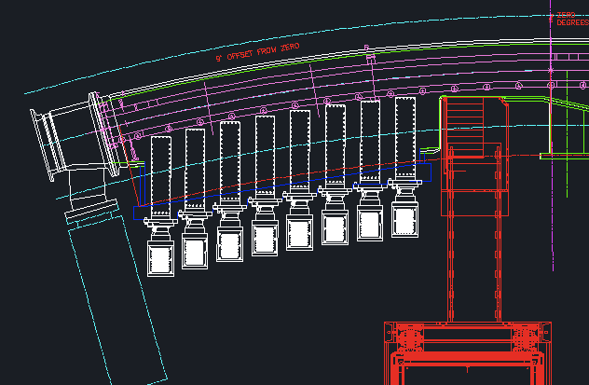
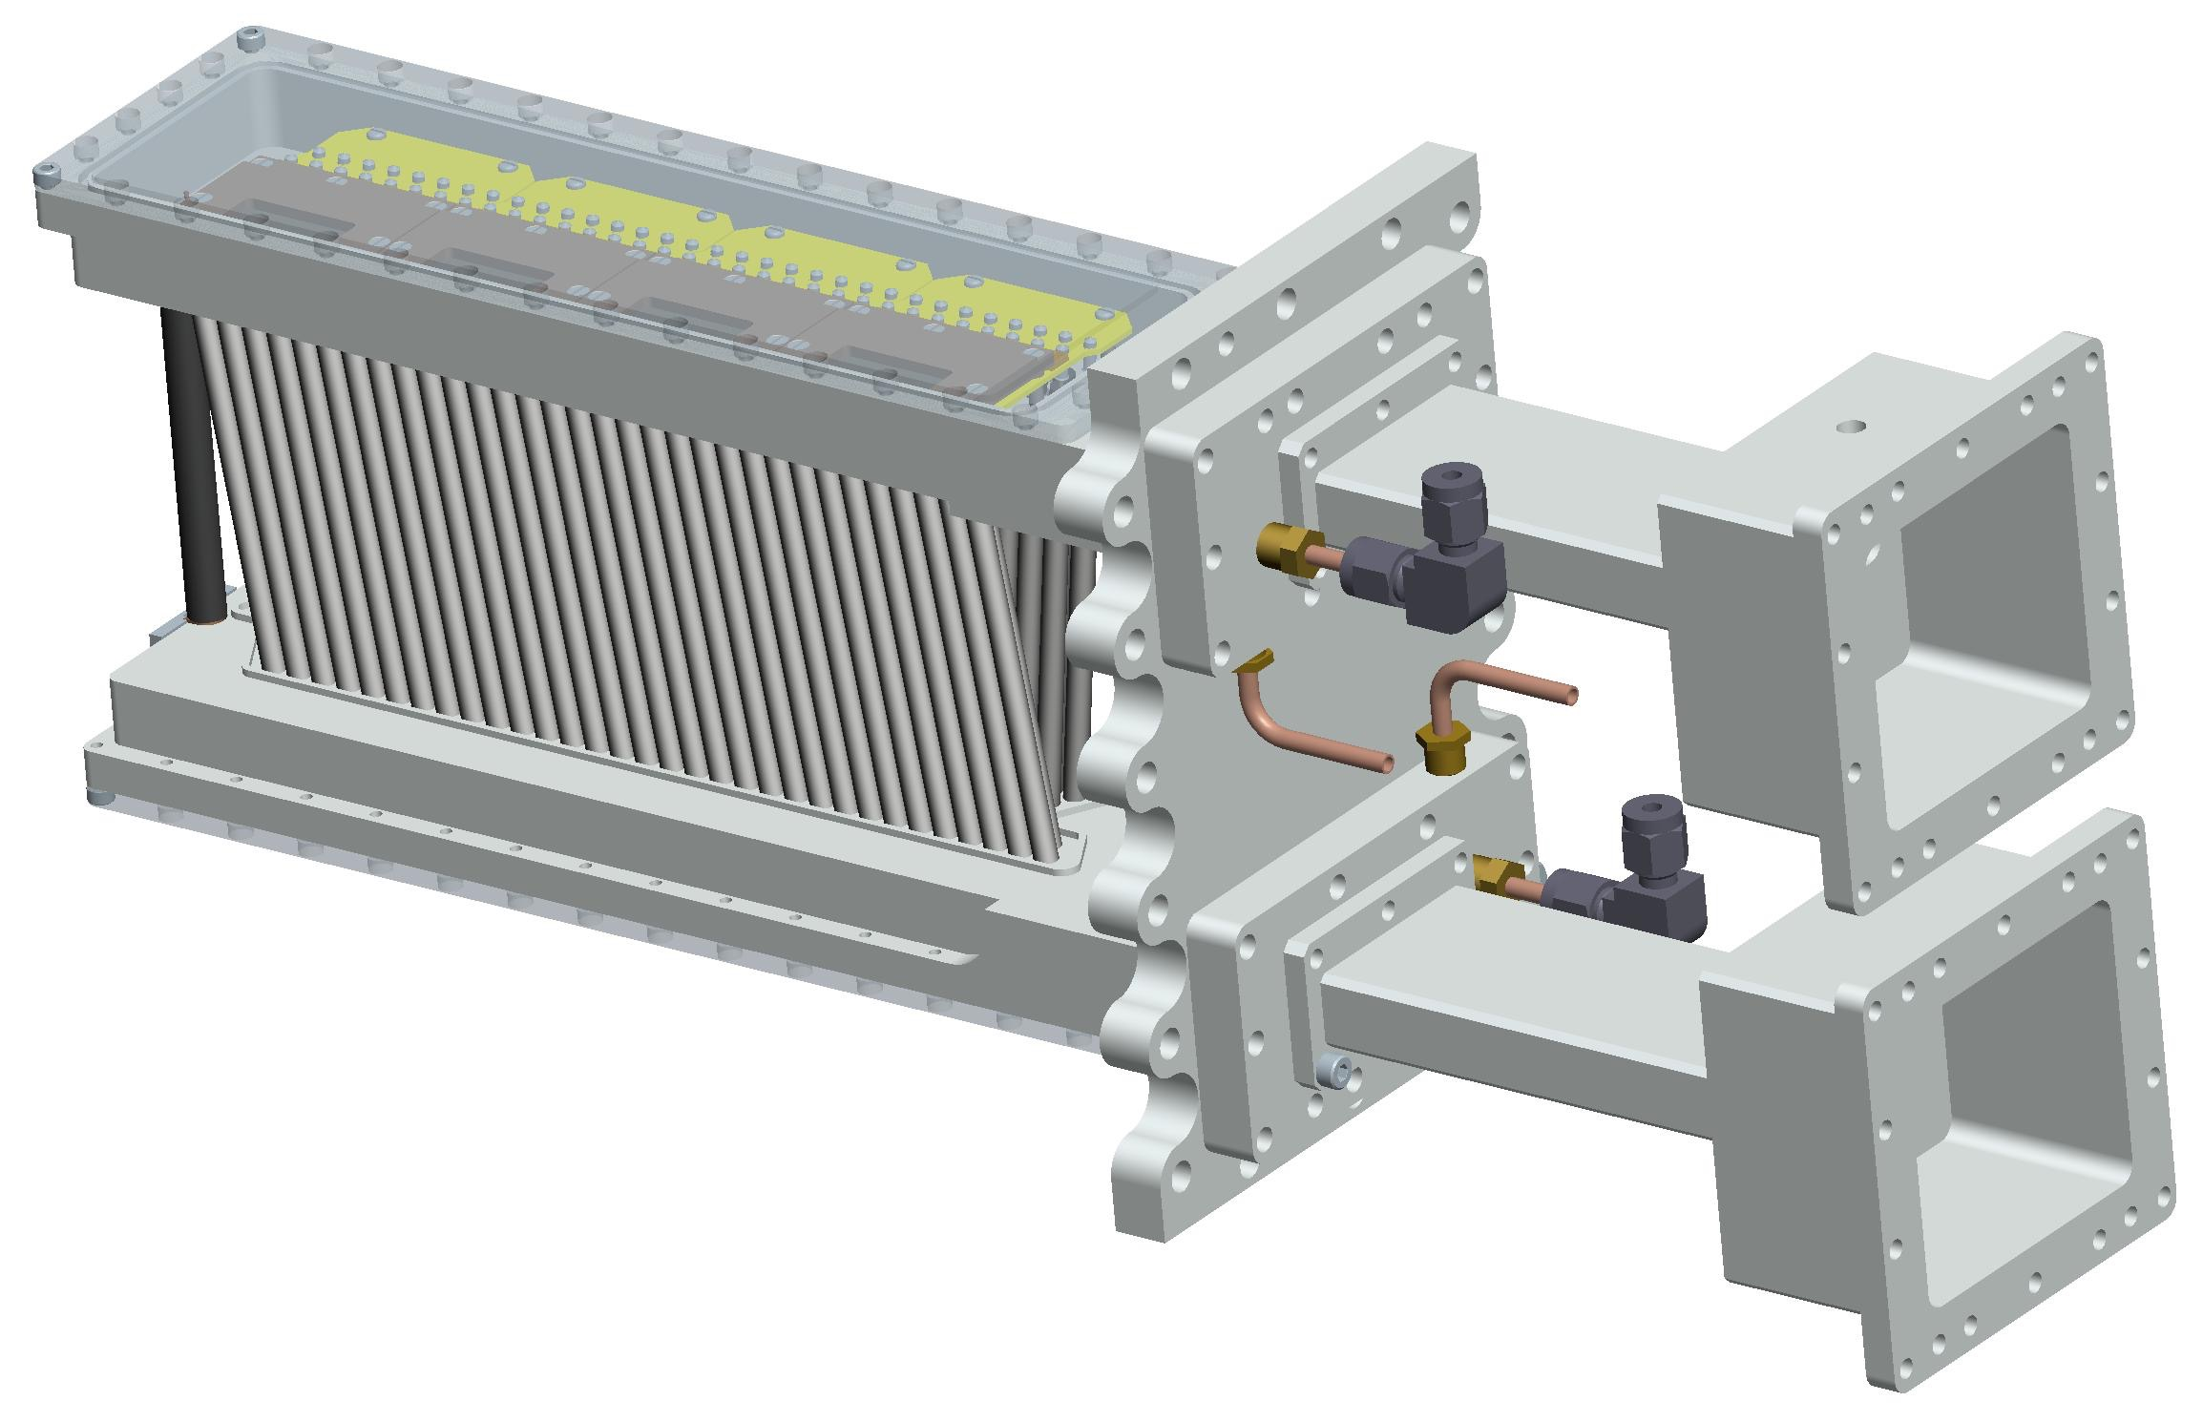
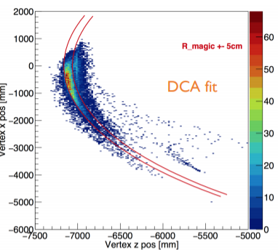
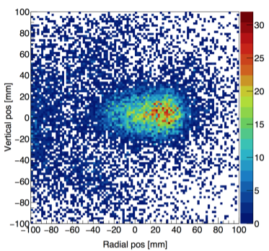
In-vacuum Trackers reconstruct decay positron tracks; gives muon storage profile for ω_{p} and for E/pitch corrections
3 locations planned
8 UV stations
Where do Muon Decays come from?
Beam Profile Extrapolated
128 straws per station
Oct 2, 2017
Experimental Technique

Slide 13
Muon Storage per POT low by 12.7 ± 2.3 during 1st Commissioning experience
Part of this is understood and expected, and part simply requires a detailed tuning campaign with well functioning equipment
Related information will be provided in the following talks:
  Convery: Protons & Beamlines
  Casey: Our instrumentation and measurement functionality
  Nguyen: Inflector, Vacuum, Quads, and Kicker status
  Rubin: Tuning sensitivities and Modeling experience
A Task Force was established to study Muon Storage rate from a global perspective: Protons, Beamlines, Storage Ring.
Oct 2, 2017
Experimental Technique

Slide 14
How do we know we are low? And by how much?
Detected e⁺ > 1.8 GeV by calorimeters, after 30 μs, and after initial muon scraping, for a 10¹² POT fill:
  Technical Design Report 1067± 33
  Best hour of tuning: 84 ±16
Ratio: 12.7 ± 2.3
Where are the missing factors?
Intrinsic losses (known and recoverable)
  Under performing or wrongly tuned equipment
    Vacuum did not meet spec
      Quads & Kickers could not run at design voltages
    Magnets mistuned or not final versions
    Proton spot on target not yet as small as used in the model
    Other beamline transmission losses
Tuning losses (Not known; requires our work to recover)
  Emittance growth prior to inflector channel
  Angle and position control arriving at inflector
  Kicker pulse strength fluctuation and timing jitter
  Proton pulse shape/width from Recycler not optimized
~3.7
~3.3

Slide 15
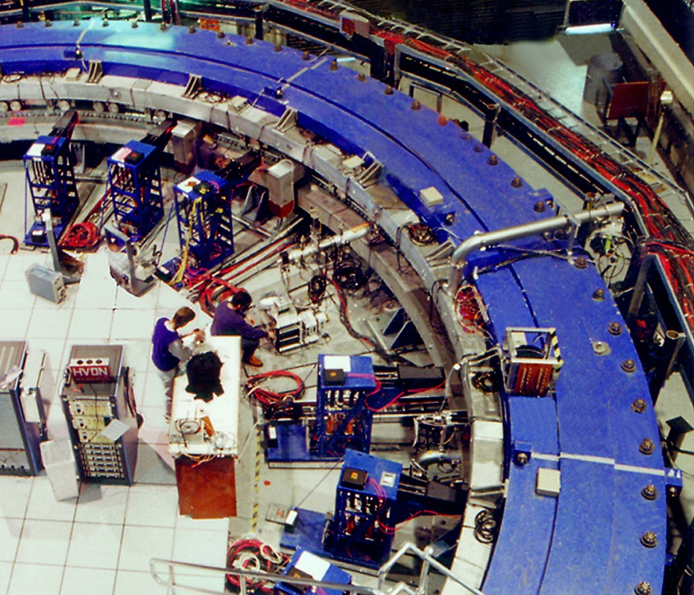
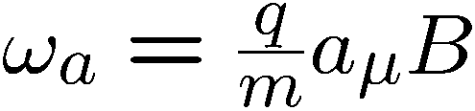
Muons are now “in” the Storage Ring
e
Momentum
Spin
The experiment must measure the precession frequency and the magnetic field experienced by muons during storage

Slide 16
Measuring ω_{a} systematic errors and how we are addressing them (recall 70 ppb is total budget)
  Coherent betatron oscillations [ 70 ppb → <30 ppb ]
    Optimized kicker, Tune choice; Fiber Harps
  E and pitch corrections [ 50 ppb → 30 ppb ]
    In-vacuum Trackers; Precision spin-tracking simulations
The simulations and measurements Rubin discusses enables this
  Gain stability [ 120 ppb → 20 ppb ]
    See Calibration effort
  Pileup resolution [ 80 ppb → 40 ppb ]
    Cherenkov, Fast SiPMs; Fast digitizers & Segmentation
  Lost muons [ 90 ppb → 20 ppb ]
    Beamline, Collimators, Monitors
Kaspar will discuss the hardware that enables this

Slide 17
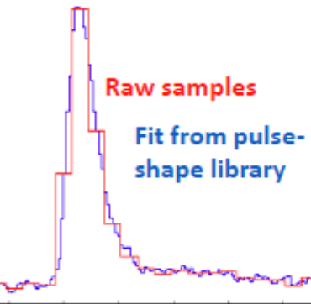
Calorimeters record decay e⁺ Time and Energy.
PbF₂ xtals
Digtizers
e⁺
Power
supplies
Events above threshold
Software threshold
High rates exacerbate pileup & gain stability issues
17

Slide 18
24 Calos with 54 PbF₂ crystals and fast SiPMs
Segmentation and short pulse duration are aimed at Pileup reduction

Slide 19
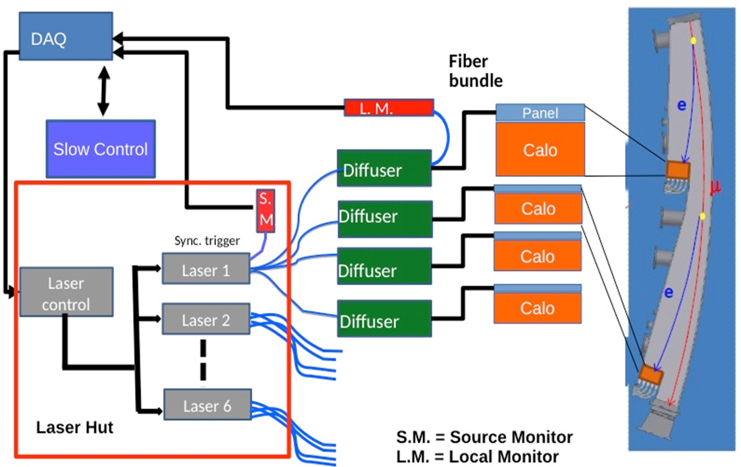
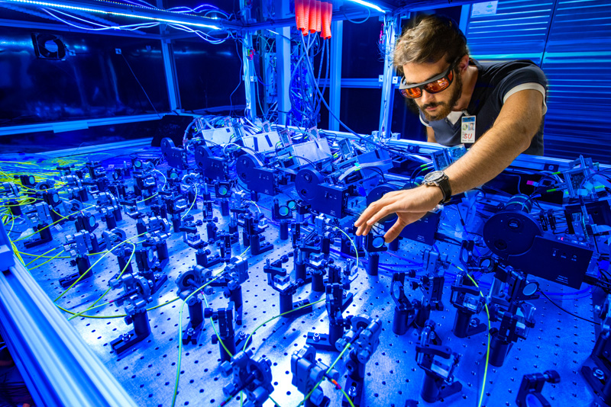
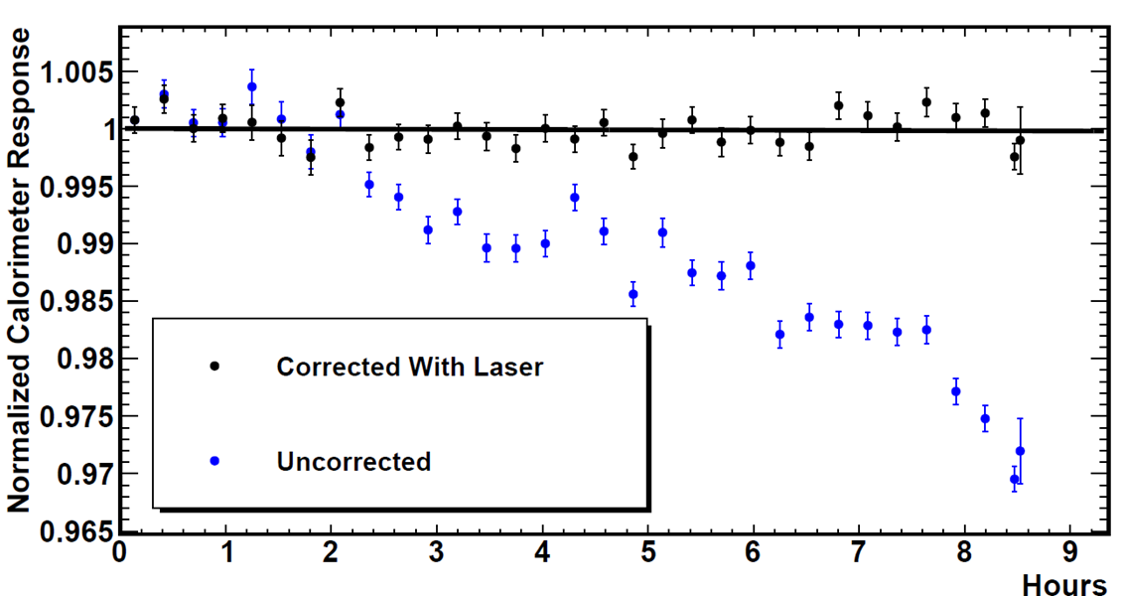
GAIN stability has been established to ~few x 10⁻⁴
State-of-the-art Laser-based calibration system also allows for pseudo data runs for DAQ
Inside the laser hut
10⁻⁴ / h demonstrated
(in Test Beam)
Oct 2, 2017
Experimental Technique
- p. 19

Slide 20
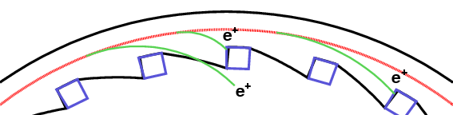
The “escaping muon rate” is measured by coincidences in adjacent calorimeters: Muon Loss
For example, a triple coincidence of MIPs
μ
Muon Loss is problematic only if it is correlated to where muons were created in the beamline line sequence from Target to FODO, to DR … because their average spin direction is different

Slide 21
Measuring ω_{p} systematic errors and how we are addressing them (recall 70 ppb is total here as well)
  Absolute value of magnetic field [ 50 ppb → 35 ppb ]
    Special probes, also used in muonium hyperfine experiment
  Trolley probe calibrations [ 90 ppb → 30 ppb ]
  Fixed probe interpretation [ 70 ppb → 30 ppb ]
  Trolley measurements [ 50 ppb → 30 ppb ]
  Muon Distribution [ 30 ppb → 10 ppb ]
These things become much easier for a more uniform magnetic field
See Flay: Hardware, quality of prepared, monitored, and measured magnetic field
See Hong: Analysis plans on how ω_{p} is obtained
Oct 2, 2017
Experimental Technique

Slide 22
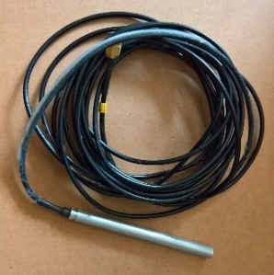
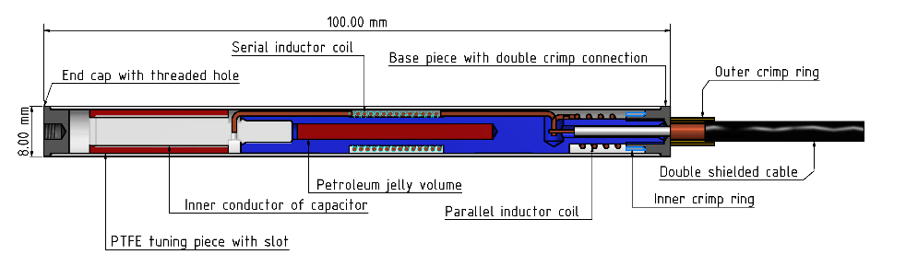
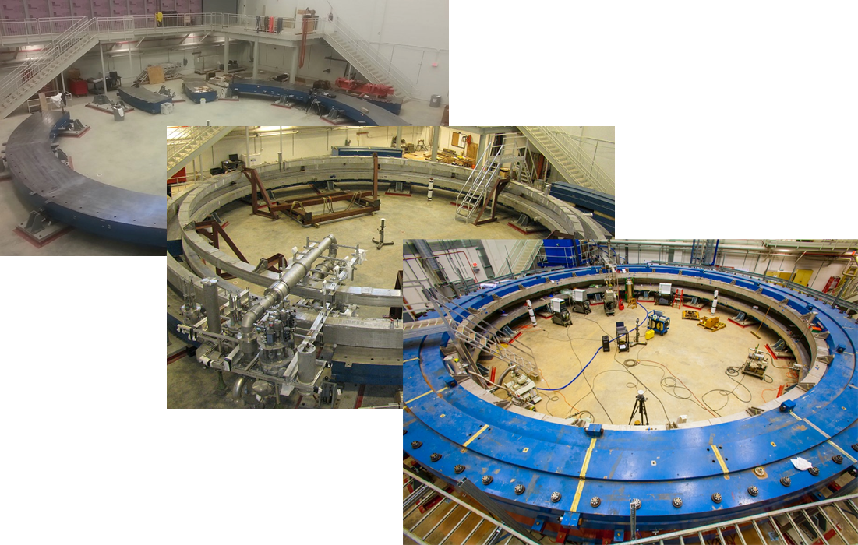
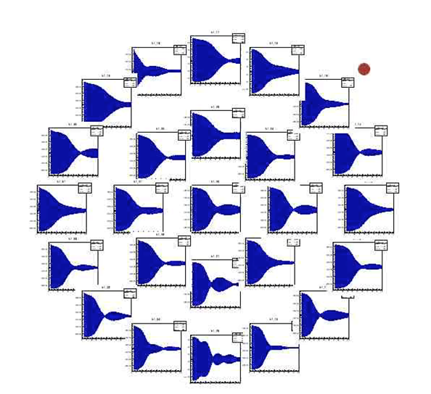
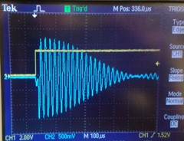
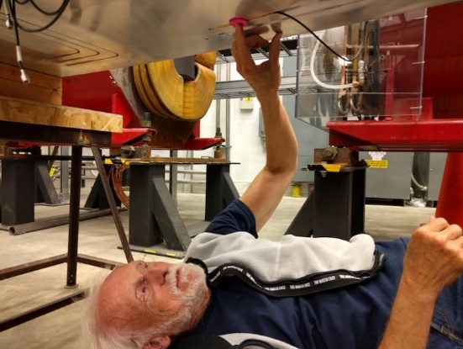
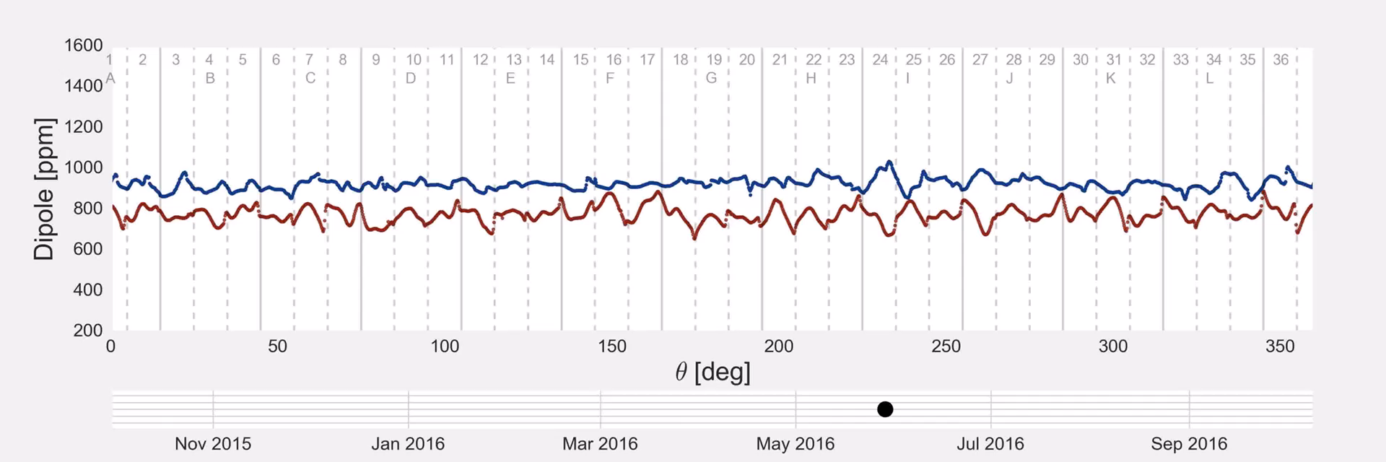
Field “eye candy”
E989 is ~x3 more uniform
BNL
Fermilab
(our last big shimming trick)
Oct 2, 2017
Experimental Technique

Slide 23
Conclusions and Plan for the Day
We have a very broad set of technical requirements to make a precision g-2 measurement
The equipment is running quite well and teams are in place for each and every component and task
The muon storage optimization has just barely begun; it will take a few months to complete this
We believe we are ready for our first Physics Campaign following the completion of commissioning
Oct 2, 2017
Experimental Technique

