Slide 1
Muon Storage Experience and Plans
David Rubin
g-2 Operational Readiness Review
2 October 2017

Slide 2
Injection, Storage and Beam dynamics
The experimental method requires that we
Manipulate the beam distribution to optimize muon capture
Measure/simulate the stored distribution to compute systematic uncertainties of ω_{a}
To that end we model ring, guide field, detectors … enabling
Simulation of dependencies (muon capture)
Evaluation of systematics
Beam based measurements inform the model

Slide 3
Beam related systematics
E-field correction
  Momentum distribution
Pitch correction
  Vertical distribution
  Target: uncertainty in E-field and pitch correction combined < 30 ppb
Coherent modulation of beam width and mean (CBO)
  CBO frequency (ω_{CBO}), amplitude (A) and de-coherence time (τ_{CBO})
  Betatron motion decoheres due to quadrupole nonlinearity and momentum spread
Depend on measurements and detailed modeling of the circulating distribution

Slide 4
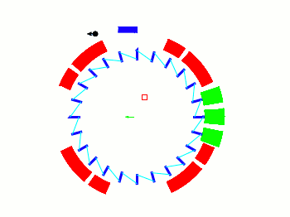

Injection and Storage in g-2 ring
Muons injected through backleg iron
Traverse fringe field of g-2 magnet
Inflector compensates (nulls) dipole field
Beam exits inflector tangential to ring
Muons cross design orbit in the gap of the kicker magnets with an angle of 10.8 mrad
Kickers rise and fall in 120 ns to steer muons onto design orbit.
Ring guide field consists of uniform field of g-2 magnet and focusing from electrostatic quadrupoles
Stored muons execute betatron motion
inflector
M5 line
ES quad
Fiber (H) harps (V)
kickers
Fiber harps
24 calorimeters

Slide 5
Final focus –> injection channel
iron
fringe field
Inflector aperture = 18mm
Transmission through inflector depends on
Offset and angle at entrance to tunnel through iron
Inflector field
M5 final focus
5
Commissioning - March 20, 2017

Slide 6
Final focus
Beam is focused to narrow waist to clear inflector
M5 line
Storage ring
through
iron
inflector
fringe
inflector
Final focus

Slide 7
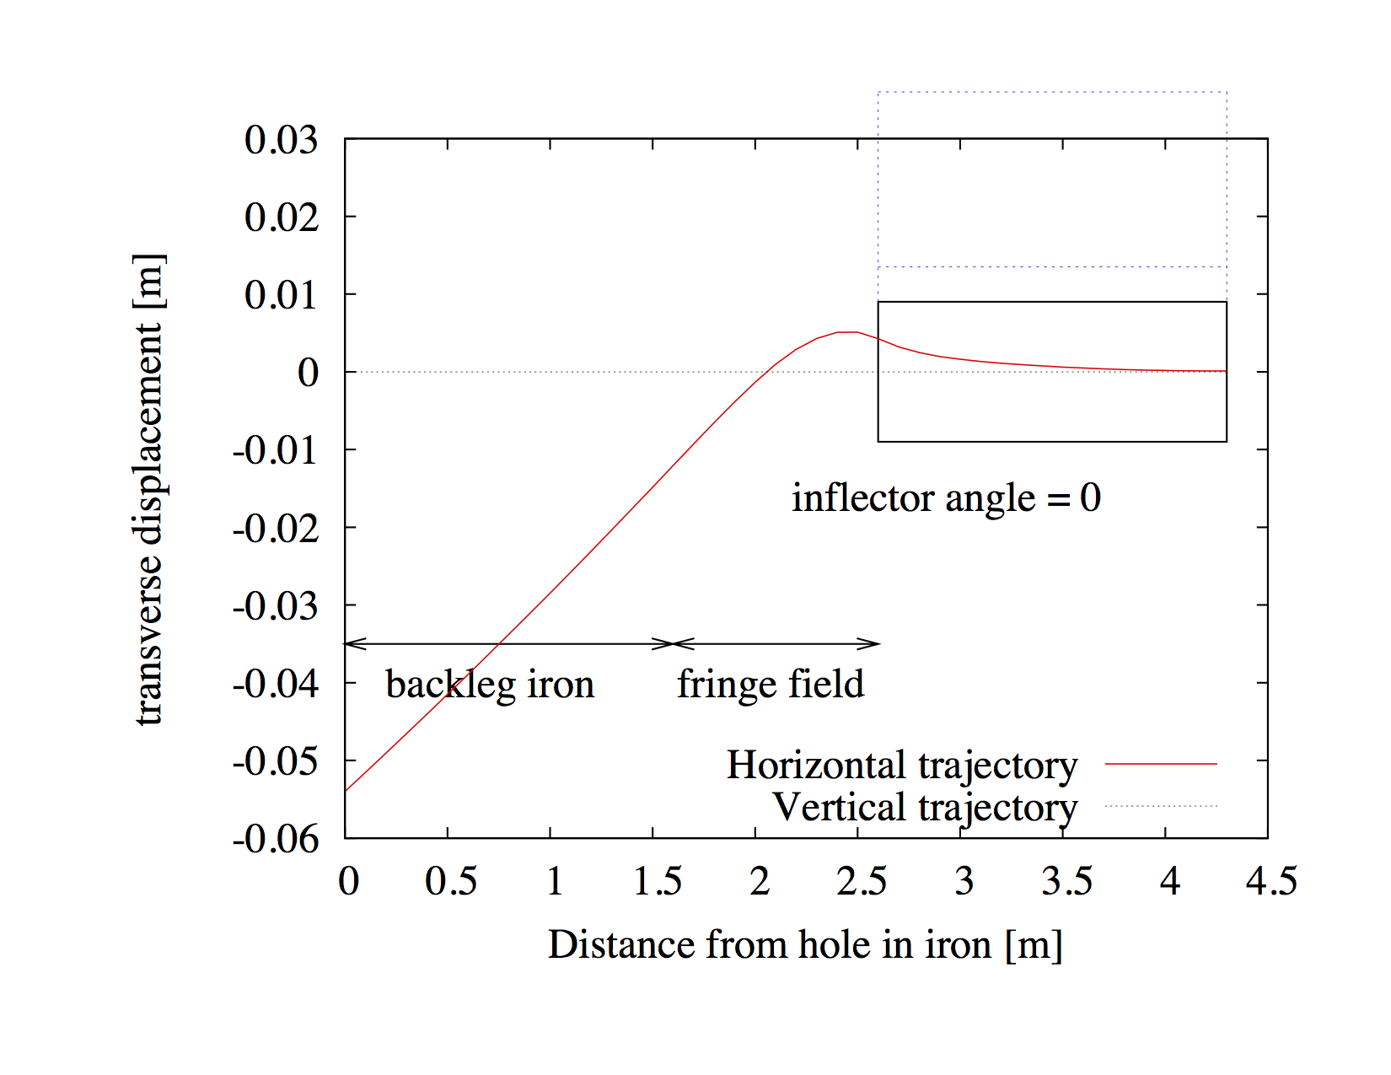
Final focus –> injection channel
inflector
77 mm
Closed orbit
7
7
Commissioning - March 20, 2017
Commissioning - March 20, 2017

Slide 8
Final focus –> injection channel
Scintillating fiber (IBMS) det
Centroid and size
Tune trajectory with steering magnets in M5 line (IBMS positions)
Tune phase space parameters β,α with final focus quads (IBMS profile)
Tune inflector field – IBMS position
inflector
IBMS2
IBMS3
IBMS1
8
8
Commissioning - March 20, 2017
Commissioning - March 20, 2017

Slide 9
Final focus –> injection channel
Scintillating fiber (IBMS) det
=> Centroid and size
iron
fringe field
Inflector aperture = 18mm
Transmission through inflector depends on
Offset and angle at entrance to iron
Inflector field
M5 final focus
9
Commissioning - March 20, 2017

Slide 10
Dependence on injection angle and offset
Δx’ ~ 1 mrad
Δx ~ 4mm
Simulation of dependence of capture efficiency on injection angle and offset
(assuming other parameters are fixed)

Slide 11
Acceptance
Efficient transmission through inflector and into ring depends on
Phase space (α,β)
emittance
At entrance to injection channel
We have the tools to measure and correct α,β,ε, Δx ,Δx’ to optimize transmission
Number captured vs emittance at entrance to injection channel
(simulation)

Slide 12
Measure α,β,ε in M5 line
Measure profile on PWC021 vs quad current => α,β,ε

Slide 13
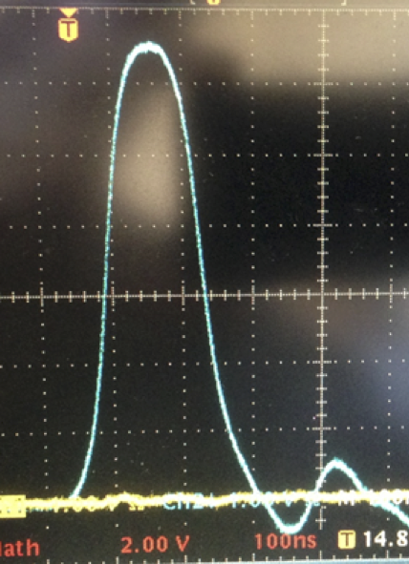
Muon capture
Capture in ring depends on
Kicker field & timing
Quad voltage
+25kV
-25kV
-25kV
+25kV
Kicker pulse will be characterized with Faraday magnetometer
Electrostatic quadrupoles

Slide 14
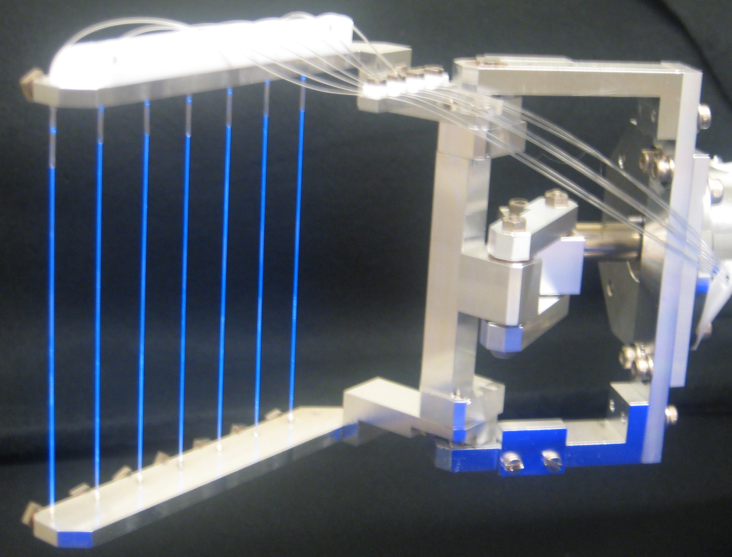
Fiber Harp – beam position and profile monitors
Only direct measure of muon distribution (destructive)
Horizontal harps at 180 and 270 deg
Harps measure position of centroid and beam width / time
Vertical harps at 180 and 270 deg

Slide 15
Injection and Storage in g-2 ring
Fiber Harps
inflector
betatron period
ES quad
Revolution period
inner fiber
Fiber (H) harps (V)
kickers
central fiber
outer fiber
Fiber harps
24 calorimeters

Slide 16
Simulation
Model includes
  Injection channel, fringe and inflector fields, apertures, scattering
  Kicker fields, temporal and spatial profile
  Quadrupole fields
  Collimators define aperture
  Fiber harps, Calorimeters, trackers
Model enables simulation of dependencies
  Trajectory (x, x’, y, y’) and phase space (α,β) at entrance to injection channel
  Inflector field
  Ring field
  Quadrupole voltage, nonlinearity, misalignment
  Kicker field, timing, pulse shape, etc.

Slide 17
Fiber Harp – horizontal centroid
simulation
Measurement
Data + Simulation
Commissioning data and simulation
kicker field ~ 70% nominal => large betatron oscillation
Quadrupoles 19kV
Consistency of measurement and simulation => we understand our experiment
Inconsistencies => there are details that we need to get right

Slide 18
Dependence of CBO amplitude on kicker voltage
Nominal kick
Model predicts with kickers at design voltage CBO amplitude is small

Slide 19
Capture vs kick voltage
Simulation
Number captured vs kicker voltage
Measurement and simulation of dependence of muon capture on kicker field => X 1.4 at design

Slide 20
CBO frequency - horizontal
voltage ramp
Steady state
measurement
simulation
Temporal spectrum of fiber intensity => CBO frequency
CBO frequency depends on quad voltage
Consistency of measurement with model indicates quads are performing as anticipated

Slide 21
Horizontal CBO frequency
simulation
measurement
Comparison of measured and modeled CBO frequency => fine calibration of quad E-field

Slide 22
Fiber Harp – horizontal width
simulation
Modulation of the beam width is a measure of the phase space mismatch at the inflector exit
Spectral analysis => betatron vs energy mismatch

Slide 23
Vertical centroid – closed orbit and vertical CBO
simulation
Features
Quad ramp
Amplitude of CBO
Displaced closed orbit

Slide 24
Summary
Diagnostic instrumentation working well and providing measurements of injected and stored beam
Simulation reproduces many of the features in the data and indicates significant gain in muon capture efficiency is realized with correct quad and kicker voltage, trajectory, emittance and α,β of injected beam, etc.
Discrepancies between data and simulation indicate that
  reconstruction of data (fiber harp) requires more sophistication and
  model of beam line and storage ring some refinement
In preparation for startup
  Develop reconstruction algorithm for fiber harp data - including correction for undershoot, cross talk, etc.
Plan to measure:
  phase space, closed orbit, beam centroid, modulation of the width, spectra of centroid and width, chromaticity, fast rotation (momentum distribution) with harps, calorimeters and trackers --- and dependencies to constrain our model
=> Informs further refinement of model and simulations
Online data management tools for harps, calorimeters and trackers allow real time measurement and analysis
  Enabling diagnosis of ring hardware, optimization of muon capture, and start of characterization of muon distribution that will be critical for evaluating systematics of ω_{a}

Slide 25
END

Slide 26
Fiber Harp data
3-10 us
5-50 us
Intensity on each of 5 inner fibers of 270 degree horizontal harp

Slide 27
Dependence on final focus

Slide 28
Magnetic Field through injection channel
B(fringe) + B(inflector)
The vertical magnetic field of the dipole and the inflector along the axis of the injection channel separately(left) and summed(right). The horizontal component is zero due to midplane symmetry. There is net steering and significant focusing
- Horizontally defocusing, vertically focusing

Slide 29
Matching
Emittance of the muon beam is large
The number of captured muons is limited by apertures
Inflector aperture (18 mm) << ring aperture (90 mm)
Mismatch of twiss parameters at inflector-ring interface => peak β & η in the ring are always greater than closed ring values:
=>
Inflector exit
Closed ring
Mismatch

Slide 30
Simulation vs measurement
Ring parameters in simulation match measured values
Quad initial and final voltages (start and end of ramp)
3 Kicker voltages and timing
Radial and dipole field errors
Twiss parameters & emittance of injected beam
We assume
Optimal angle and offset at entrance to injection channel
Inflector field as designed
Ring <B> as designed
Beam exits inflector on center and tangential to ring

Slide 31
Fiber Harp - measurements and simulation
Measurement
Simulation
Intensity on 5 inner fibers of 270 deg horizontal harp 3-10 us

Slide 32
Fiber Harp – measurement and simulation
Measurement
Simulation
Intensity on 5 inner fibers of 270 deg horizontal harp 5-50 us

Slide 33
Fiber Harp – Beam width
Simulation
measurement
Cross talk – between bundled clear fibers can reduce apparent modulation depth
Investigating

Slide 34
Cyclotron frequency
Measurement
simulation
FFT intensity of middle fiber - revolution frequency

Slide 35
chromaticity

Slide 36
Simulation with nominal 290 G kick

