Slide 1
Proton Source Week 12
Joe Compton
9am Meeting
9/29/2017

Slide 2
RIL/Linac
RIL
Pulled/cleaned source A due to sparking at lower than operational voltages
Source A is now up and running and bringing up the extractor slowly
Linac
Marx modulator testing at LRF2 in progress
LRF5 Marx modulator testing in progress
Running on the 7835 tube
Disassembly of LRF3 almost finished
General maintenance

Slide 3
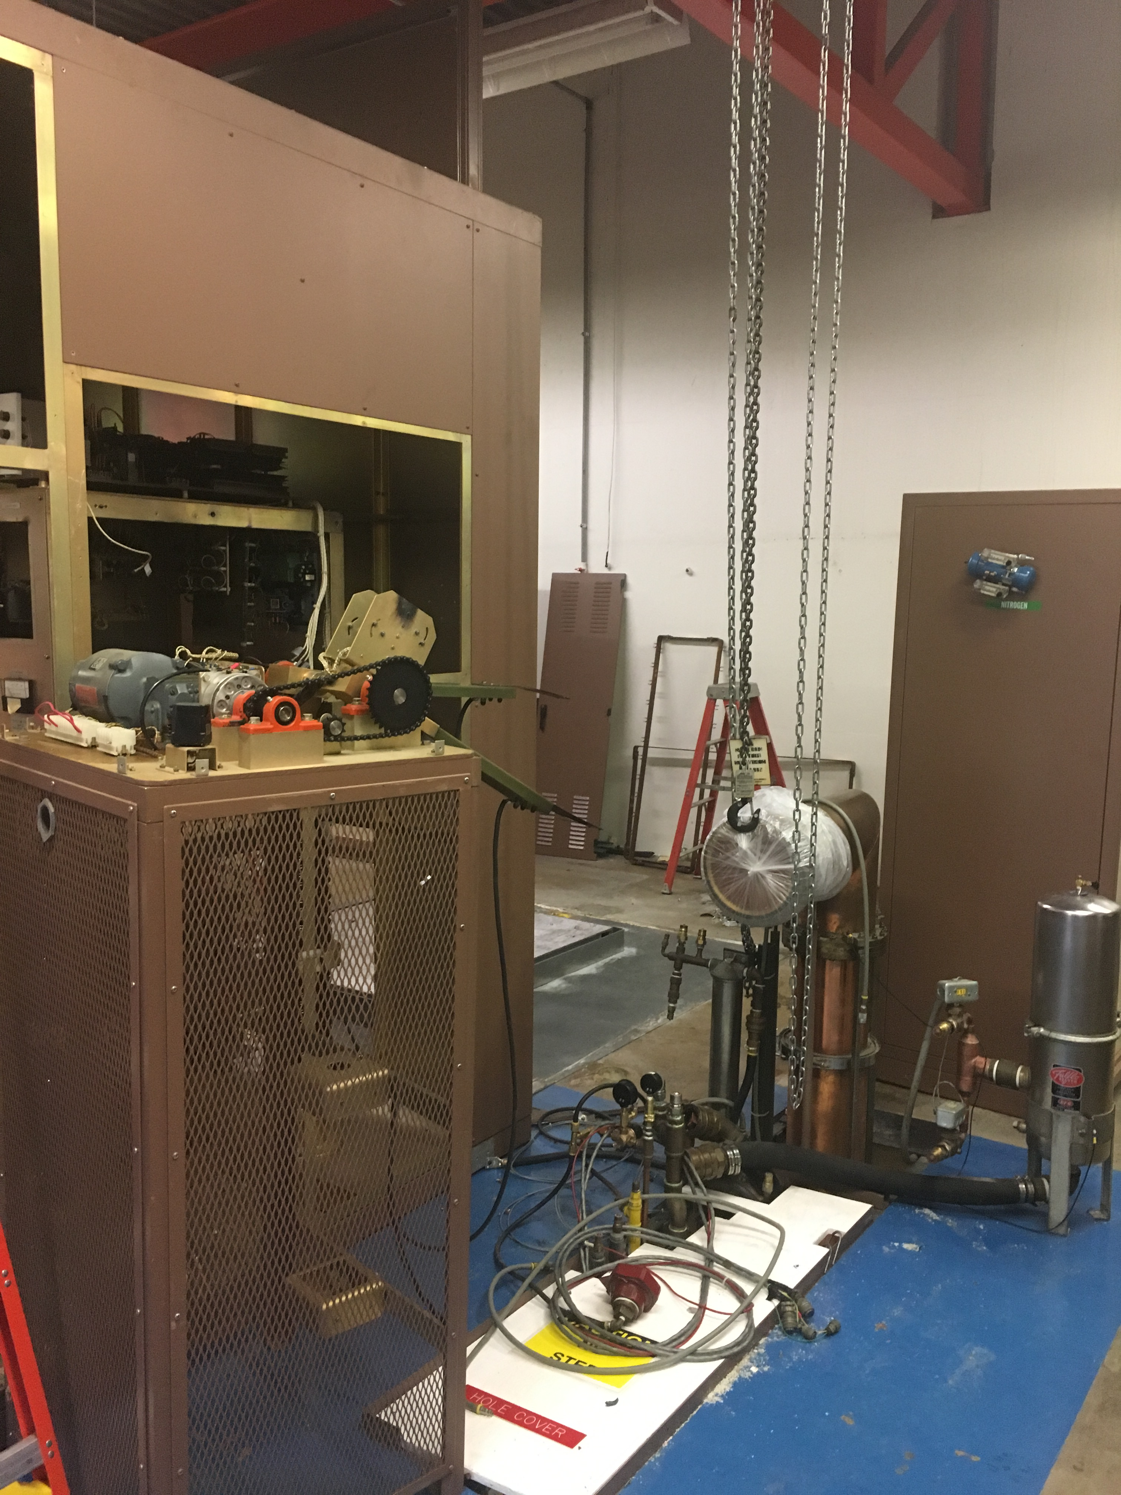
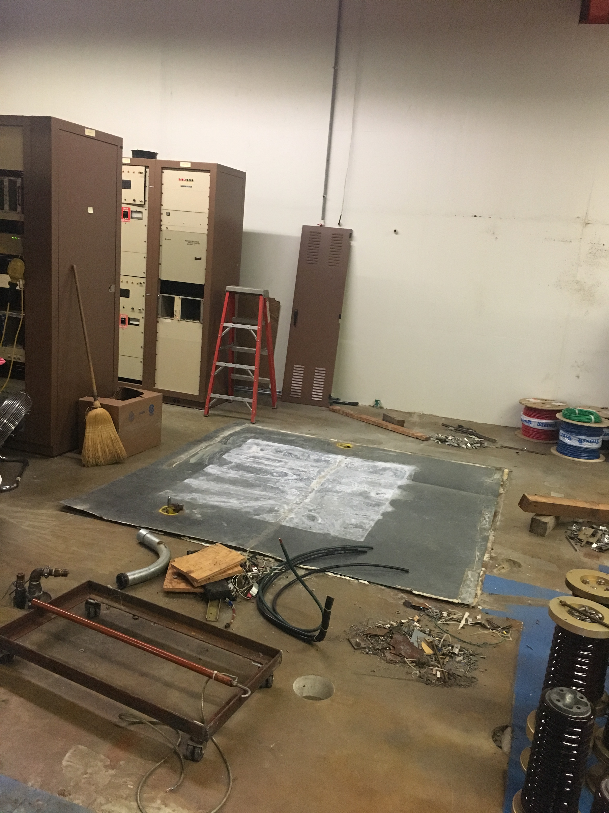
LRF3 Disassembly

Slide 4
Booster
One stripping foil was replaced
It was discovered that the horizontal crawling wire was broken
It was removed/repaired and then placed back in service
Thanks to Dan Schoo and Gianni from Instrumentation
Marble absorber shielding was put in place
New chopper cooling interlocks were installed
IPMP02 was replaced
GMPS transformer work continues
Having vacuum issues near IP802
Will perform leak checks
CHG0 torroid work continues
General maintenance

Slide 5
Booster LCW
Have slowly been increasing LCW pressure
However, Booster 95 will be shut down Monday ~0800 for two jobs
Valve replacements at CUB
Valve manipulation in utility tunnel to further isolate the SY water system from Booster
LCW system will come back up after the jobs are completed
Come up at lower pressures and flow until the loads become balanced

Slide 6
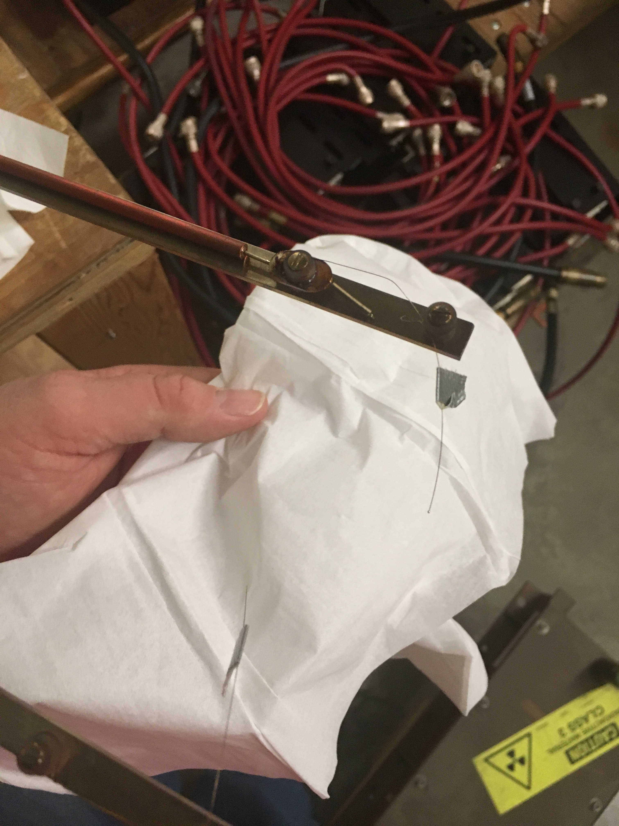
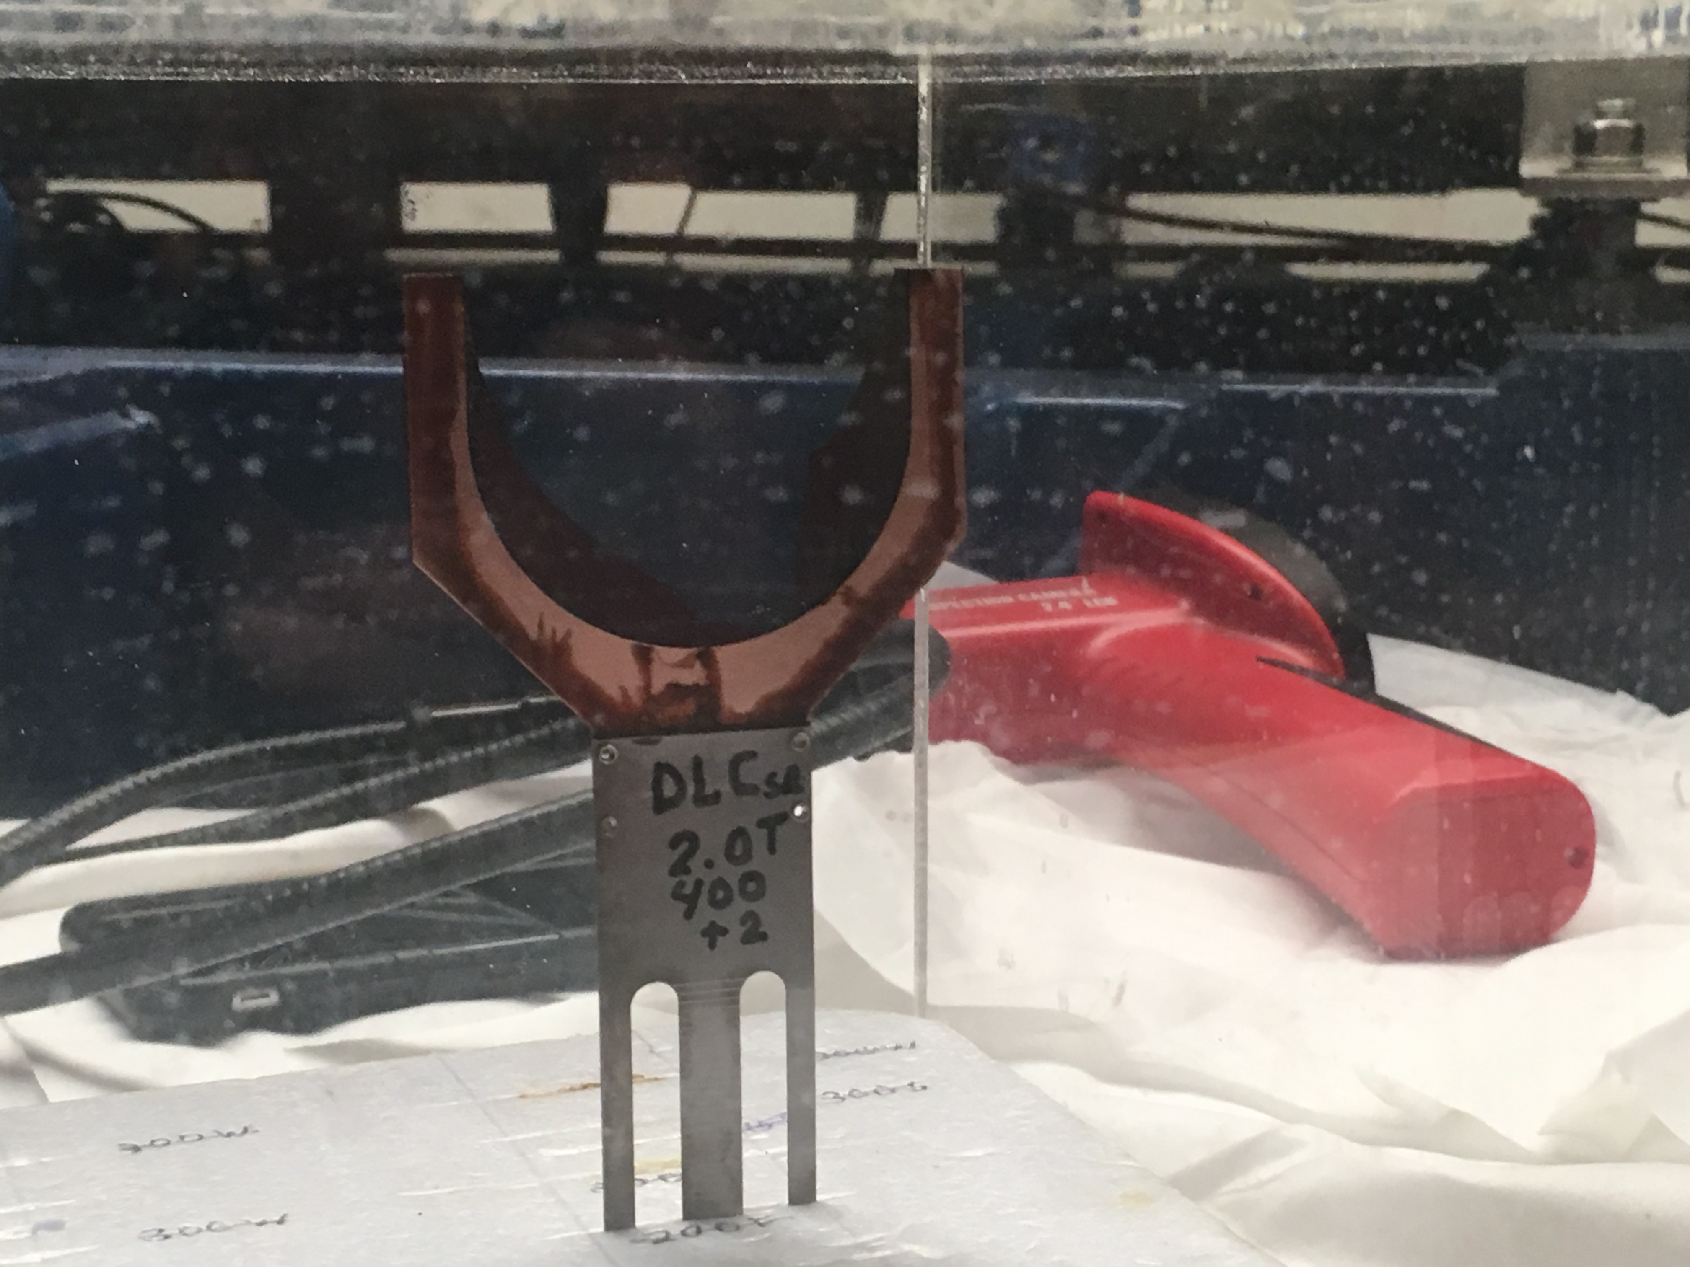
Booster

