Slide 1
Delivery Ring Update
Jerry Annala
Muon Campus Shutdown Status - week 12
29 September 2017

Slide 2
Major shutdown efforts
Install the M4 line
Magnets installed past the temp shield wall (100%)
Cables are being installed (100%)
Cable terminations (50%)
Water connections (0%)

Slide 3
Install new pulsed septa magnets
First Magnet is installed
Alignment complete
Septa is under vacuum (4.6 e-6 torr)
Cables are pulled and waiting strip line installation
Water connections needed later
Second Magnet is at NWA
Under vacuum since September 19
Vacuum pressure at 1.1e-5 torr (as of Thursday morning)
Third Magnet ready for delivery
Not a shutdown priority unless one of the other magnets develops an issue

Slide 4
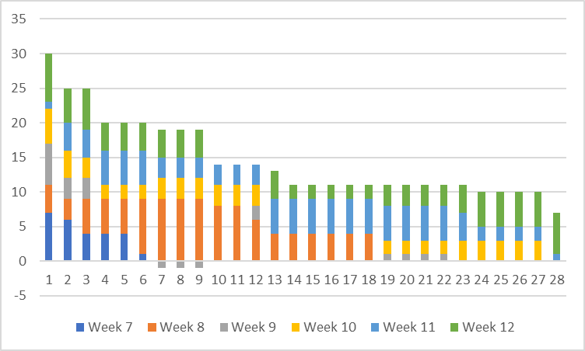
Repair of PWCs and Ion Chambers

Slide 5
Additional jobs (unchanged)
Installation of 5 correction elements (3 relocated and 2 new)
3 Stands being plated
2 trims have been installed
All cables have been pulled
Search for aperture restrictions
M2 and M3 lines (100%)
M4 line (100%)
M5 line (50%)

Slide 6
Schedule
Electricians terminating cable in M4 line and pulling new cable downstream of shield wall
AP-0 pulse testing
Success pulsing at 100 Hz at reduced duty cycle
Burst of 8 pulses every 5 seconds at full current
Presently locked out for controlled access
Installation of 30 straight section components
Leak check of Abort Septum magnet at NWA
Production line repair of PWCs and Ion Chambers continues with corrosion problem as an additional delay.

