Slide 1
121.3.3 Linac – Warm Front End
Linear Accelerator Support Systems, Installation and Commissioning
Lionel PROST
PIP-II Director’s Review
10-12 October 2017

Slide 2
Outline
Requirements
Conceptual Design, Maturity
Scope/Deliverables
Interfaces
Technical Progress to Date
ESH&Q
Risk
Cost
Schedule
Summary

Slide 3
About Me:
Level 3 Manager for the Linac Warm Front End
  Senior Scientist (>15 years experience with accelerator systems)
  Contributed to the Recycler Electron Cooler project at Fermilab
    Highest energy electron cooler in the world
    Beam power ~4MW
IS/LEBT Design and commissioning at PIP2IT
WFE commissioning at PIP2IT

Slide 4
Warm Front End
Charge #1
The Warm Front End (WFE) prepares a H⁻ beam optimized for injection into the Booster and provides capabilities for future CW operation
  It is composed of two identical Ion Sources (IS), a Low Energy Beam Transport (LEBT), a Radio-Frequency Quadrupole (RFQ) and a Medium Energy Beam Transport (MEBT)
  A low emittance beam is required to minimize beam loss in the SRF linac and at injection into the Booster (KPP #1)
Significant fraction of the components has already been fabricated, installed and operated with beam

Slide 5
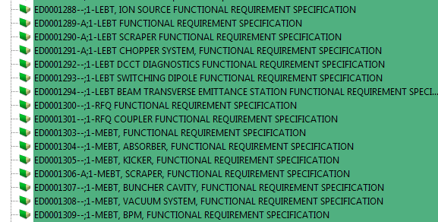
WFE Requirements Documentation
Charge #1
Requirements are captured in a set of Functional Requirement Specifications (FRS) within our Project Document Database (Teamcenter)
  ED0001288 (IS)
  ED0001289 (LEBT)
  ED0001300 (RFQ)
  ED0001303 (MEBT)
    Many more FRSs have been written for the various subsystems that make up the WFE (e.g.: choppers, absorber…)
Partial list from Teamcenter

Slide 6
WFE Main Requirements
Charge #1
Parameter | Requirement | Units
Particle species | H⁻
Output beam energy (kinetic) | 2.1 | MeV
Bunch repetition rate | 162.5 | MHz
Nominal output beam current (average) | 2 | mA
Nominal charge per bunch (RFQ current) | 30 | pC
Sequence of bunches | Programmable
Beam pulse duration* | 0.55 | ms
Beam pulse repetition rate* | 20 | Hz
Normalized rms beam emittance - Transverse | ≤ 0.23 | mm mrad
Normalized rms beam emittance - Longitudinal | ≤ 0.31 | mm mrad
* For injection into the Booster
Emittance requirements are specified for an ion source beam current (DC) in the range of 2-5 mA

Slide 7
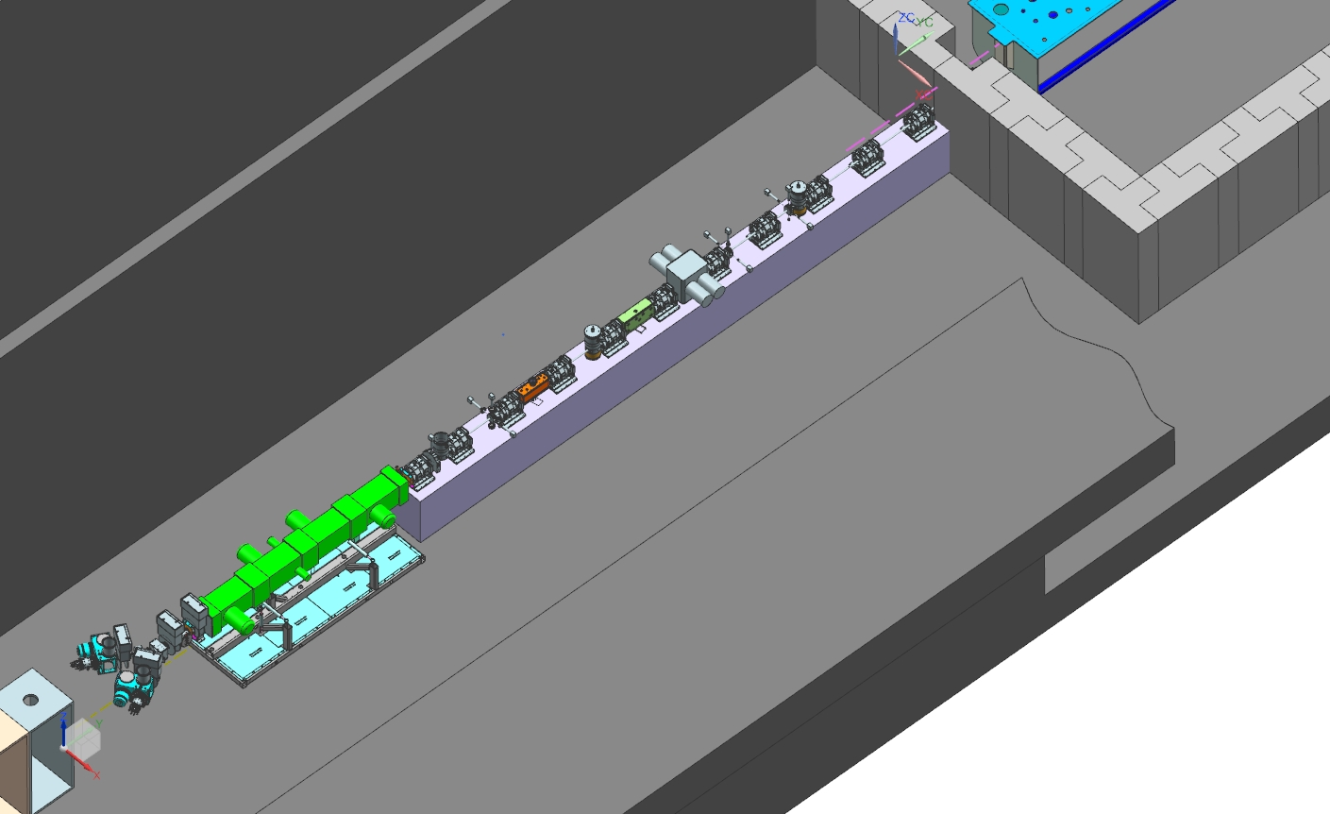
Conceptual Design
Charge #1
Mature and stable design with focus on factors that may determine reliability and uptime
  Two ion sources with switching magnet (30 keV, 10 mA DC)
  2-m long LEBT with partial neutralization transport scheme
  4.4-m long, 4-vane RFQ, 2.1 MeV, 162.5 MHz CW
  14-m long MEBT with bunch-by-bunch chopping system; radiation protection
  wall; scraping
  system; differential
  pumping section
  after absorber
HWR
MEBT
121.3.3.4
121.3.3.6
LEBT
RFQ
121.3.3.5
Two ion sources
121.3.3.3

Slide 8
Critical design issues
Charge #1
LEBT with low emittance growth compatible with chopping ✓
  Vacuum management in the LEBT/RFQ region ✓
Reliable CW RFQ, including couplers (partially ✓)
Bunch-by-bunch selection in MEBT (kickers) (partially ✓)
  Bunch extinction, effective emittance growth
Compatibility of high-power deposition in MEBT absorber with SRF downstream
  Absorber reliability & lifetime
All will be addressed at the PIP-II Injector Test (PIP2IT) being constructed at the Cryo-Module Test Facility (CMTF)

Slide 9
Scope of this WBS
Charge #1
Project Management and Coordination of the WFE (121.3.3.2)
Development of the PIP-II 2.1-MeV normal conducting front-end (121.3.3.3 – 121.3.3.6), including :
  the construction and commissioning (with beam) of the entire warm front-end at CMTF (i.e. PIP2IT front-end)
  support for the commissioning of the cryo-modules (HWR and SSR1) with beam
    Requires the construction and commissioning of a High Energy Beam Transport line and adequate beam dump
It concludes with the completion of the PIP2IT program (FY20) except for final procurement of a few components
  E.g.: a 2nd ion source
Decommissioning of PIP2IT, transport to and installation of the WFE in the PIP-II building high-bay are not part of this WBS

Slide 10
List of deliverables
Charge #1
Ion Source assembly (1) including power supplies (WBS #121.3.3.3)
  IS and its vacuum chamber will be procured
Components to complete the 2nd leg of the LEBT (WBS #121.3.3.4)
  Includes a scraping electrode and a vacuum valve
New RFQ power couplers (2 + 2 spares) and new tuner slugs (80) to bring the RFQ to the proper resonant frequency (WBS #121.3.3.5)
MEBT (WBS #121.3.3.6)
  Focusing and steering elements (14 + 3 spares long quadrupoles, 20 + 2 spares short quadrupoles, 12 + 2 spares 2—plane dipole correctors), kickers (2), absorber (1), scraping systems (16 scraper paddles and associated drive mechanisms), bunching cavities (4 + 1 spare), differential pumping section (DPI)
    Does not cover vacuum equipment and supporting infrastructures (e.g.: water distribution, electrical power, alignment)
  In addition, this WBS covers the High Energy Beam Transport at PIP2IT
    Focusing elements (4 long quadrupoles)
    Radiation shield for the beam dump

Slide 11
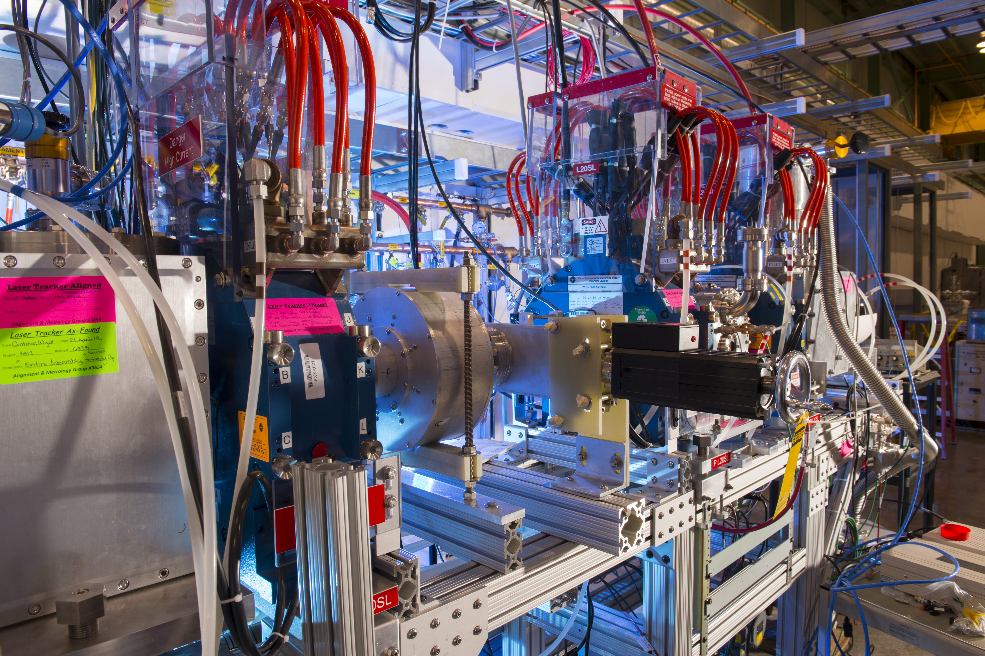
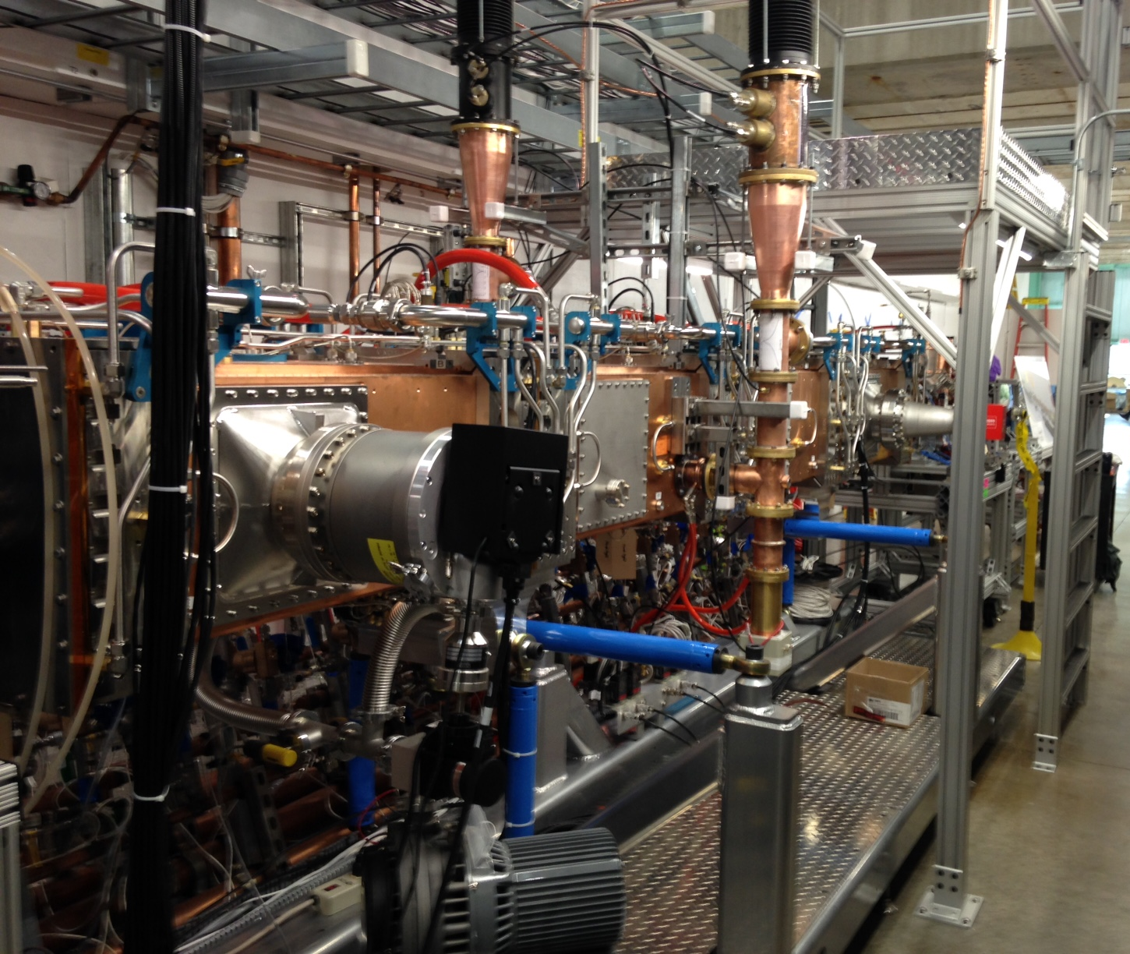
List of deliverables (cont’)
Charge #1
Most of the PIP2IT hardware will be used for PIP-II
  Significant fraction acquired pre CD-0 and not explicitly in WBS
    Ion source assembly (1) including an emittance scanner
    Solenoids (4), chopping system (1) and scraping electrodes (4, including 1 movable) (LEBT)
    RFQ including PAs and water cooling skids for resonance control
IS & LEBT
RFQ

Slide 12
Indian Contribution
Charge #1
Bhabha Atomic Research Centre (BARC) has designed the MEBT focusing and steering elements (quadrupole and dipole magnets)
  Fabricated and delivered most of them for PIP2IT already
    Last shipment (expected Q1FY18): 11 long quadrupoles and two short quadrupoles
      Includes quadrupoles for HEBT
  Built to specs, as verified by magnetic measurements both at BARC and Fermilab (upon reception)
  In addition, it is assumed that BARC will provide 3 long quadrupoles and 6 short quadrupoles for PIP-II
    Longer than PIP2IT by 3 ‘sections’
    The details concerning deliverables and schedule will be finalized by CD-2

Slide 13
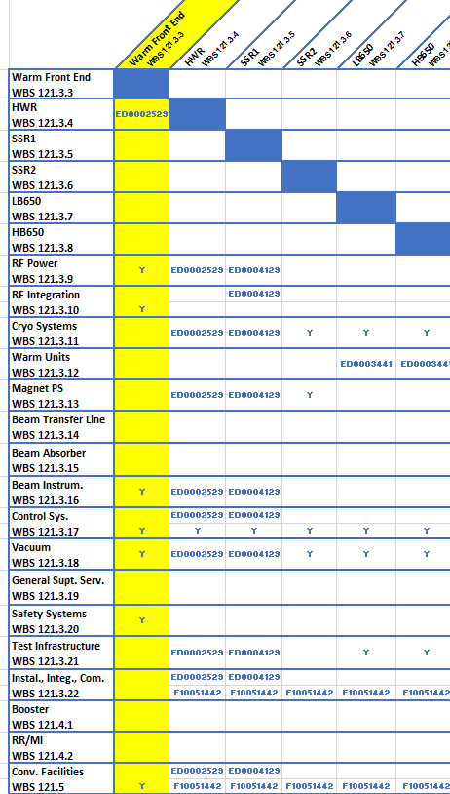
Interfaces
Charge #1
Interfaces are identified
  Most critical for PIP2IT installation has been drafted (HWR)

Slide 14
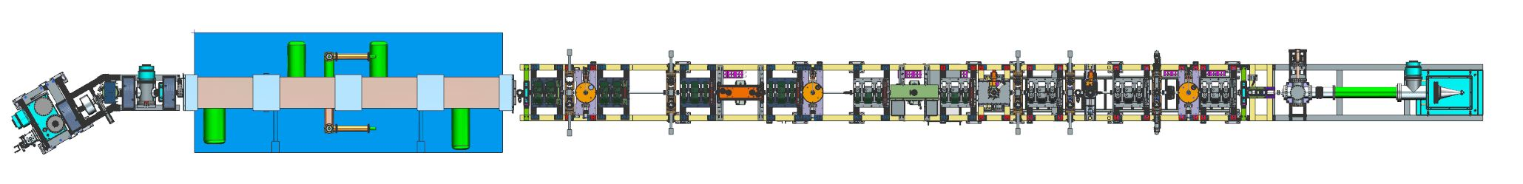
PIP-II Injector Test (PIP2IT)
Charge #1
Nearly full-length WFE installed at CMTF
  Ion Source, complete LEBT (including switching dipole magnet), RFQ, MEBT with all focusing elements (transverse and longitudinal)
    Note: PIP-II MEBT is longer by 3 more sections
  Prototype scraping systems, prototype kickers (2 different designs), prototype absorber (1/4 length)
  Diagnostics girder (Fast Faraday Cup, Time-Of-Flight Beam Position Monitor, Resistive Wall Current Monitor)
Ion Source
LEBT
RFQ
MEBT
Dump
Diagnostics girder

Slide 15
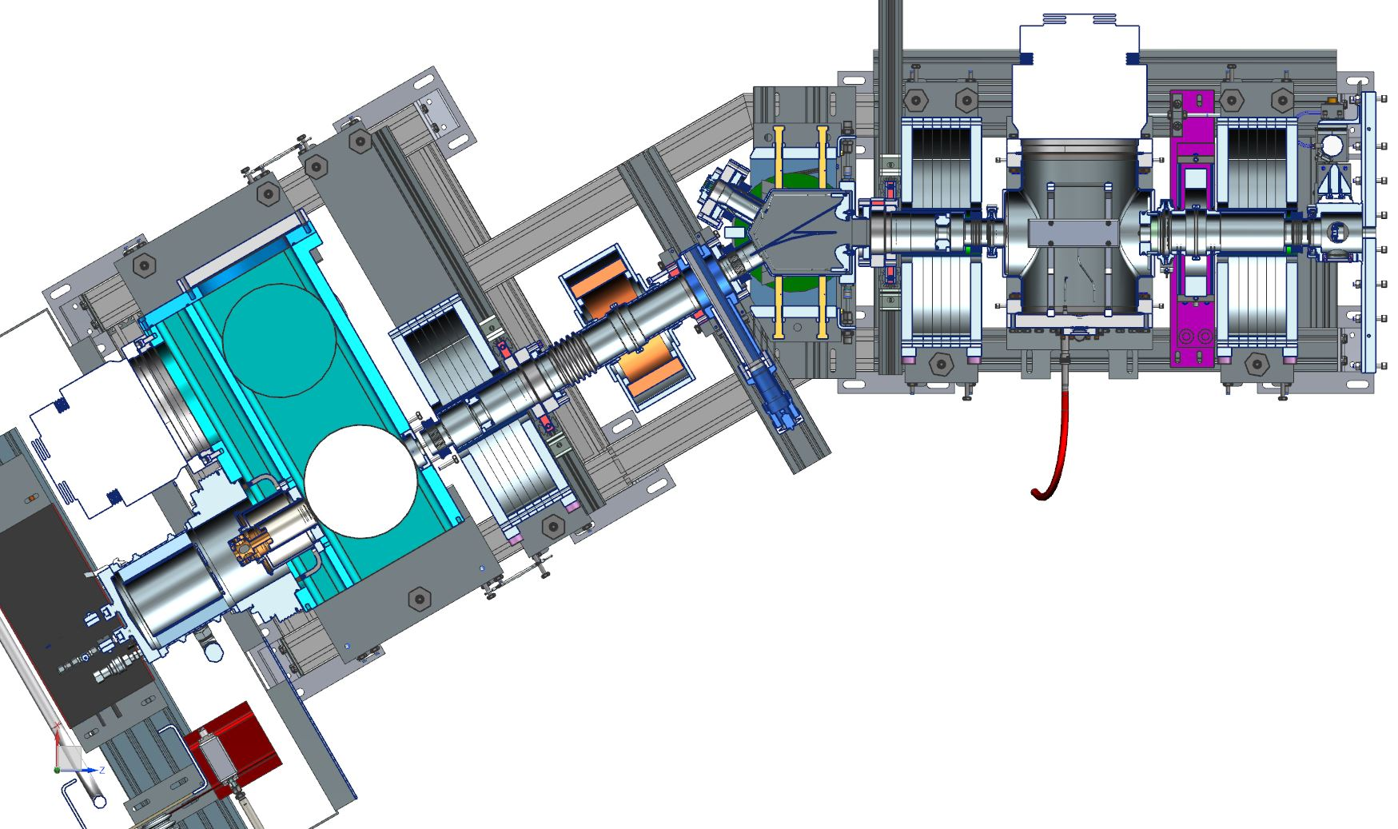
Ion Source and LEBT
Charge #1
30 keV, 15 mA (max) DC H⁻ Ion Source from D-Pace Inc.
  Mostly operated with long pulses at
  PIP2IT
Partially neutralized transport
scheme demonstrated
  Low emittance (<0.11 mm mrad
  rms, normalized) at the end of
  the LEBT with low vacuum
  pressure (~10⁻⁷ torr) at the interface with
  the RFQ
Demonstrated 10 mA DC operation
PIP2IT Ion Source and LEBT
50
0
y’, mrad
-50
6/29/2015
ε_{rms} = 0.105 mm mrad
1% cut
-10
0
10
y, mm

Slide 16
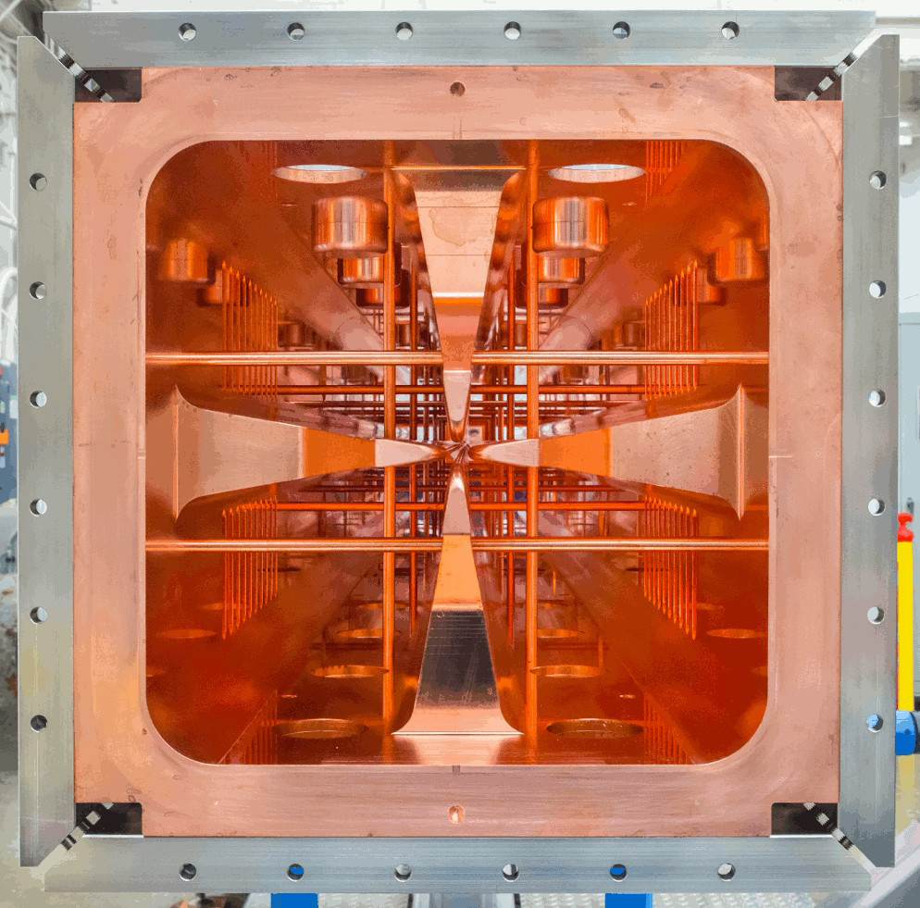
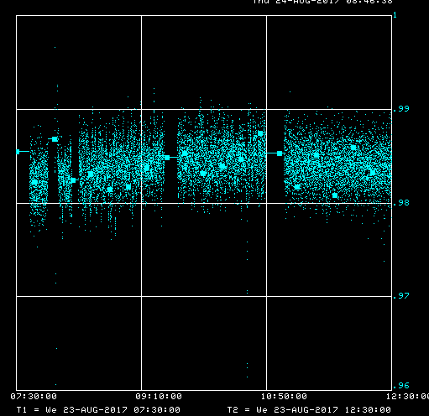
RFQ
Charge #1
2.1 MeV, 162.5 MHz CW RFQ
  Four-vane copper structure (LBNL design and
  fabrication)
Operated CW at full RF power ⇒ Coupler
failure
  Design weakness identified at the ceramic window (vacuum/atmosphere interface) ⇒ New design (parts now in procurement)
RFQ transmission >98% (pulse mode)
  Specs: ≥ 95%
RFQ energy measured with
Time-Of-Flight Beam Position Monitor:
2.11 MeV ±0.5%
  Specs: 2.1 MeV (±1%)
100%
RFQ Transmission efficiency
99%
98%
97%
5 hours

Slide 17
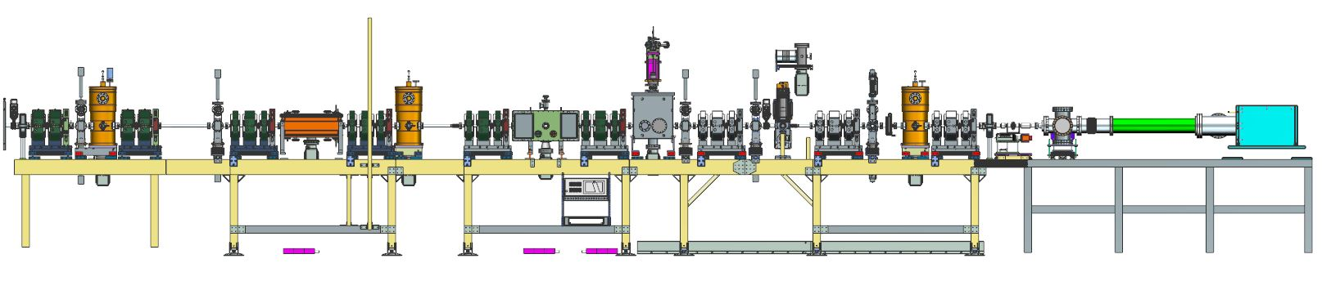
MEBT
Charge #1
10-m long (14-m at PIP-II) MEBT to accommodate chopping scheme and isolate SRF from absorber
  Transverse focusing with quadrupoles (doublets and triplets)
  Prototype kickers installed
    One of each design (“50-Ohm” and “200-Ohm”)
  Prototype particle-free compatible scraping systems installed
Demonstrated >5 mA to the dump with ~100% transmission
  Emittance (rms, normalized) ~0.2 mm mrad
Bunching cavity #1
Bunching cavity #2
Emittance scanner
Fast Faraday Cup
Bunching cavity #3
Prototype absorber
“50-Ohm” kicker
“200-Ohm” kicker
Beam dump
TOF BPM
Prototype particle-free scraper
Resistive Wall Current Monitor
Beam

Slide 18
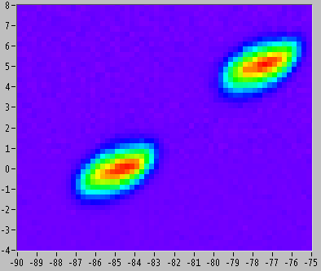
Bunch-by-bunch chopping
Charge #1
Demonstrated deflection of bunches with
“200-Ohm” kicker by applying a 25 μs
pulse train of (250ns ON/ 250ns OFF)
pulses over a 20 μs beam pulse
  Deflection is seen as 2 distinct
  distributions in phase space
Recorded “arbitrary” bunch pattern
by intercepting kicked bunches with
a scraper downstream
  Observable with Resistive Wall
  Current Monitor (RWCM)
8
7
6
5
4
3
Angle (y’), mrad
2
1
0
-1
-2
-3
-4
-6
-4
-2
0
2
4
6
-8
Position (y), mm
‘Missing’ bunches

Slide 19
Design Reviews
Charge #3
Yearly overall design reviews via the Machine Advisory Committee
  2017 PIP-II Machine Advisory Committee serves as the Independent Design Review for the purpose of getting to CD-1
Follow Division/Department Design Review procedures
  Critical components (complexity and/or cost) go through formal design reviews
    LEBT switching dipole magnet Final Design Review (ED#0003548)
    RFQ main body Final Design Review (ED#0001657)
    RFQ RF couplers Final Design Review (ED#0005909)
    MEBT scrapers Final Design Review (ED#0005913)
    Differential Pumping Insert (ED#0006709)

Slide 20
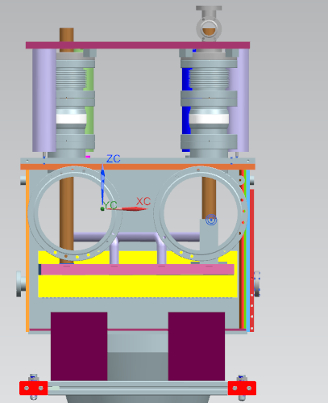
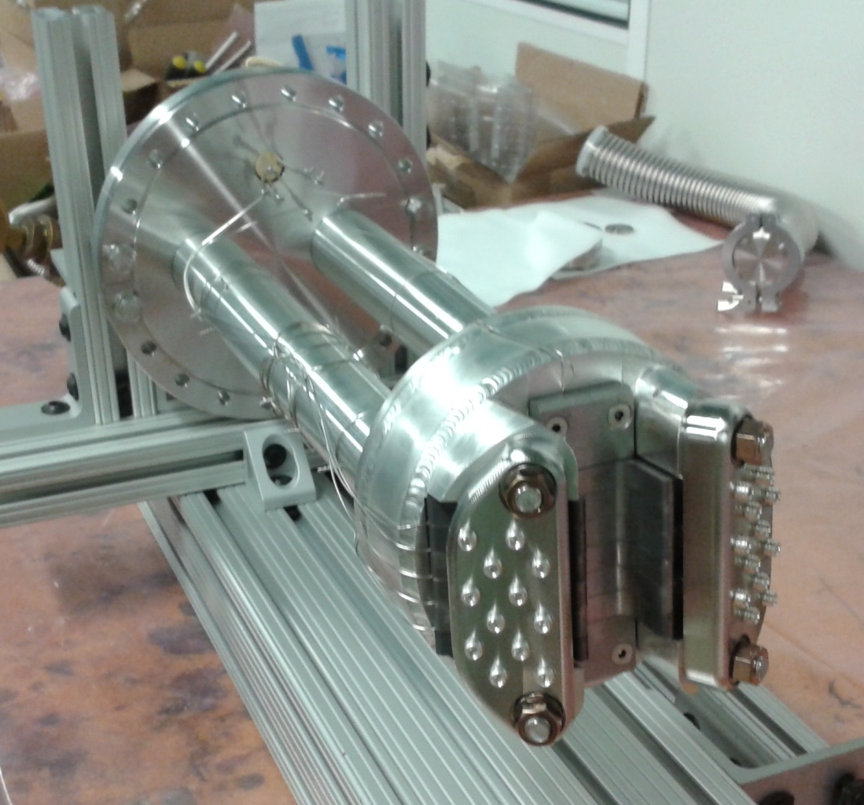
Upcoming and foreseen design reviews
Charge #3
MEBT absorber Final Design
Review in FY18
Additionally, because the PIP-II MEBT is slightly different from the PIP2IT MEBT, there is provision for a limited-in-scope review of the MEBT as a whole
  Following the completion of the PIP2IT program
CAD model
¼ length prototype

Slide 21
ESH&Q
Charge #4
Follow the Project ISM and QA plans (DocDB #141 and 142)
  Components procured from outside vendors or provided by collaborators undergo tests in accordance to the terms specified in the contract/agreement
Preliminary Hazard Analysis for PIP2IT (DocDB #40)
  Up to 2.1 MeV for now
Operation Readiness Clearance (ORC) walk-throughs are carried out at PIP2IT each time a new component is installed in the beam line or the mode of operation changes
  Technical and administrative limits are imposed following the same procedures as for the other accelerator systems
  Radiation surveys are conducted as the beam power increases
    Cave is monitored with radiation detectors and film badges located around the accelerator (within the enclosure)

Slide 22
Relatively low impact risks
Unable to maintain proper vacuum between MEBT absorber and SRF
MEBT scrapers unable to absorb amount of beam loss
MEBT kickers performance is unsatisfactory
PIP2IT program will retire most of the risks

Slide 23
BOE Summary
Charge #2
Basis of Estimates are located in the PIP-II Document Database (a.k.a. Docdb)
  Electronic signoffs for revision control
  Convenient way to gather BoEs and all relevant supporting documentation in a single place
WBS Number | Title | Docdb #
121.3.3.2 | Linac – WFE Project Management and Coordination | 563
121.3.3.3 | Linac – WFE – Ion Sources | 569
121.3.3.4 | Linac – WFE – Low Energy Beam Transport (LEBT) | 569
121.3.3.5 | Linac – WFE – Radio Frequency Quadrupole (RFQ) | 572
121.3.3.6 | Linac – WFE – Medium Energy Beam Transport (MEBT) | 575
Note: Combined BoE document for 121.3.3.3 & 121.3.3.4

Slide 24
Cost Summary
Charge #2
Costs generated from resource loaded schedule
  Fairly detailed given the status of this part of the project
Estimate Uncertainty follows project guidelines

Slide 25
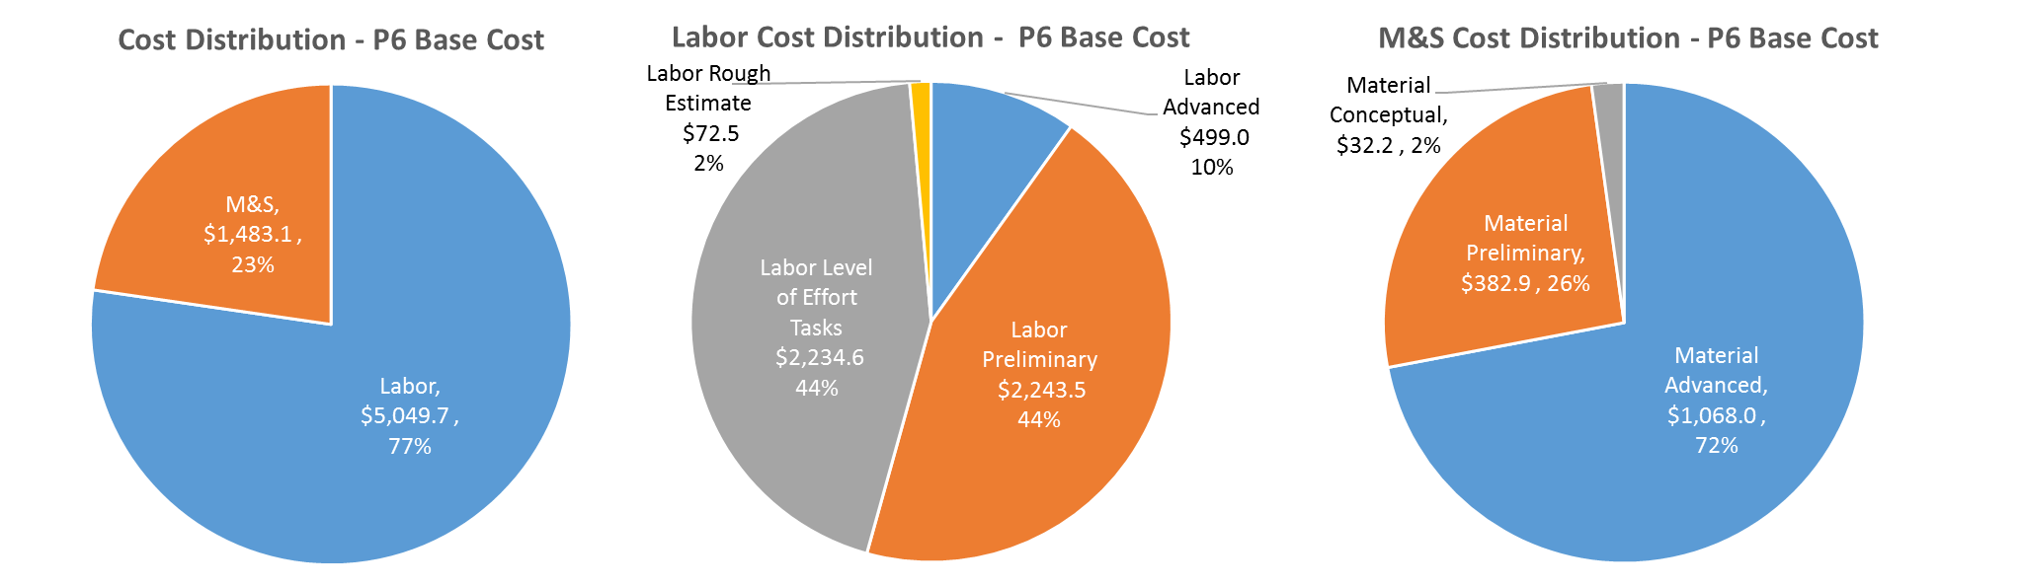
Cost Drivers and Estimate Maturity
Charge #2
P6 Base Costs = BOE + Overheads + Escalation
Cost driven by Labor
  Major M&S expenses (e.g.: RFQ) have already occurred
    2nd ion source and bunching cavities only large procurements remaining
      Cost is quite well known

Slide 26
Cost Profile – P6 Base Cost Only
Charge #2
P6 Base Costs = BOE + Overheads + Escalation
Labor-dominated early during PIP2IT activities
Peak in FY21 (carried over into FY22) for procurements and fabrication of the 2nd ion source assembly

Slide 27
Labor Profile – P6 Hours/FTE
Charge #2
Fabrication of MEBT (production ) components in FY18 & part of FY19 → Technicians and Engineers time

Slide 28
Schedule Overview
Charge #2
This WBS is not on the critical path but tied to external factors
  Delivery of HWR and SSR1 cryomodules
  Critical Decisions
  Beneficial Occupancy of the PIP-II High-Bay

Slide 29
Summary
The PIP-II Warm Front End design is complete and an integrated system is being constructed and tested (i.e. PIP-II Injector Test at the Cryo-Module Test facility)
  Most sub-systems have been fabricated (at least at the prototype level) and assembled
    Several design requirements have been met
Cost, schedule, and risks/opportunities for PIP2IT are well defined
  Most of PIP2IT is destined for installation in the PIP-II building ⇒ cost scope is limited (and so are risks)
We are ready for CD-1 and look forward to your feedback

Slide 30
Thank you for your attention

