Slide 1
121.4.2 Recycler Main Injector
Recycler and Main Injector
L3 Manager Joseph E. Dey
PIP-II Director’s Review
10-12 October 2017

Slide 2
Outline
Requirements
Conceptual Design, Maturity
Scope/Deliverables
Technical Progress to Date
ESH&Q
Cost
Schedule
Summary

Slide 3
About Me:
Joseph E. Dey : Senior RF Design Engineer
  NOvA - Main Injector RF Cavities L3 Manager
  Mu2e - Delivery Ring RF L3 Manager
  Recycler RF AIP L2 Manager
  Accelerator Division RF Department

Slide 4
WBS L3 System Requirements
Charge #1
Recycler Requirements
  Slip Stack at 20 Hz
    Slip stacking cavities with higher voltage.
  Support Main Injector operations from 60-120 GeV.
    Slip stacking cavities should be able to work CW.
Main Injector requirements
  Have enough RF power to accelerate up to 7.5E13ppp with a 1.2 sec cycle time.
    Increase the RF power in all 20 MI RF stations.

Slide 5
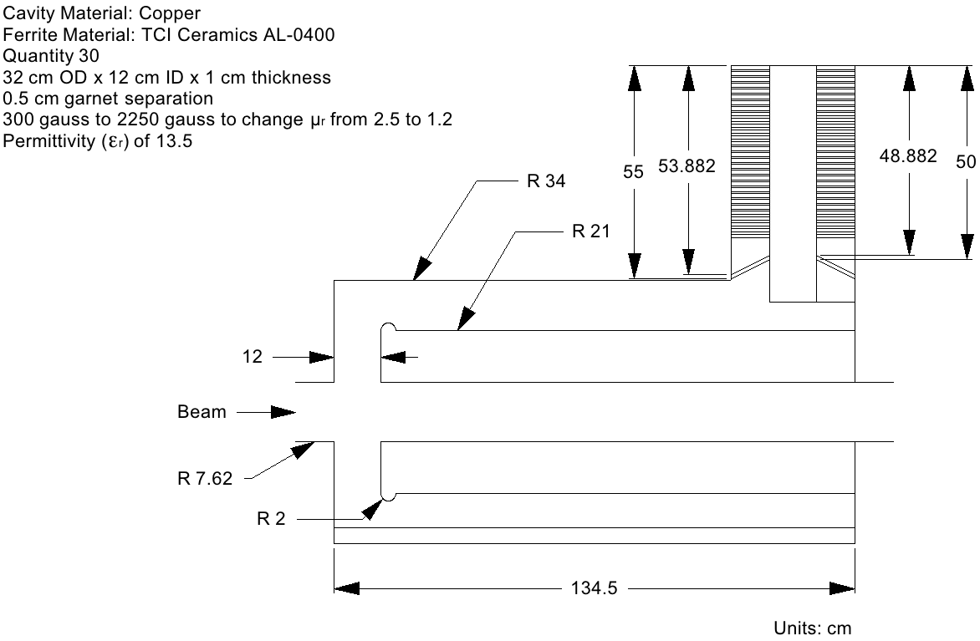
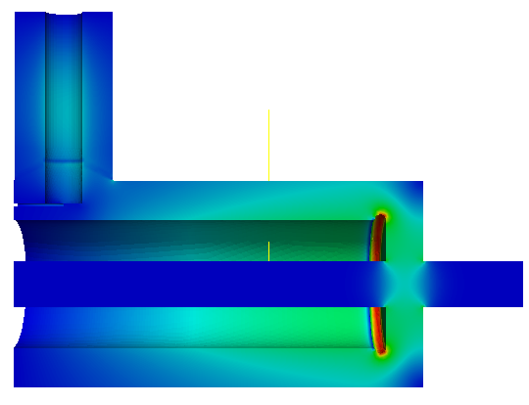
Conceptual Design and Design Maturity
Charge #1
Recycler 53 MHz Cavity
maxEs=7.4MV/m
@ μr=2.5 and μr=1.2
with 20mm gap rounding
Second Harmonic Cavity Design for Project X Main Injector
IPAC 2012, New Orleans, Louisiana
Liling Xiao, Cho-Kuen Ng, SLAC
J. Dey, I. Kourbanis, FNAL

Slide 6
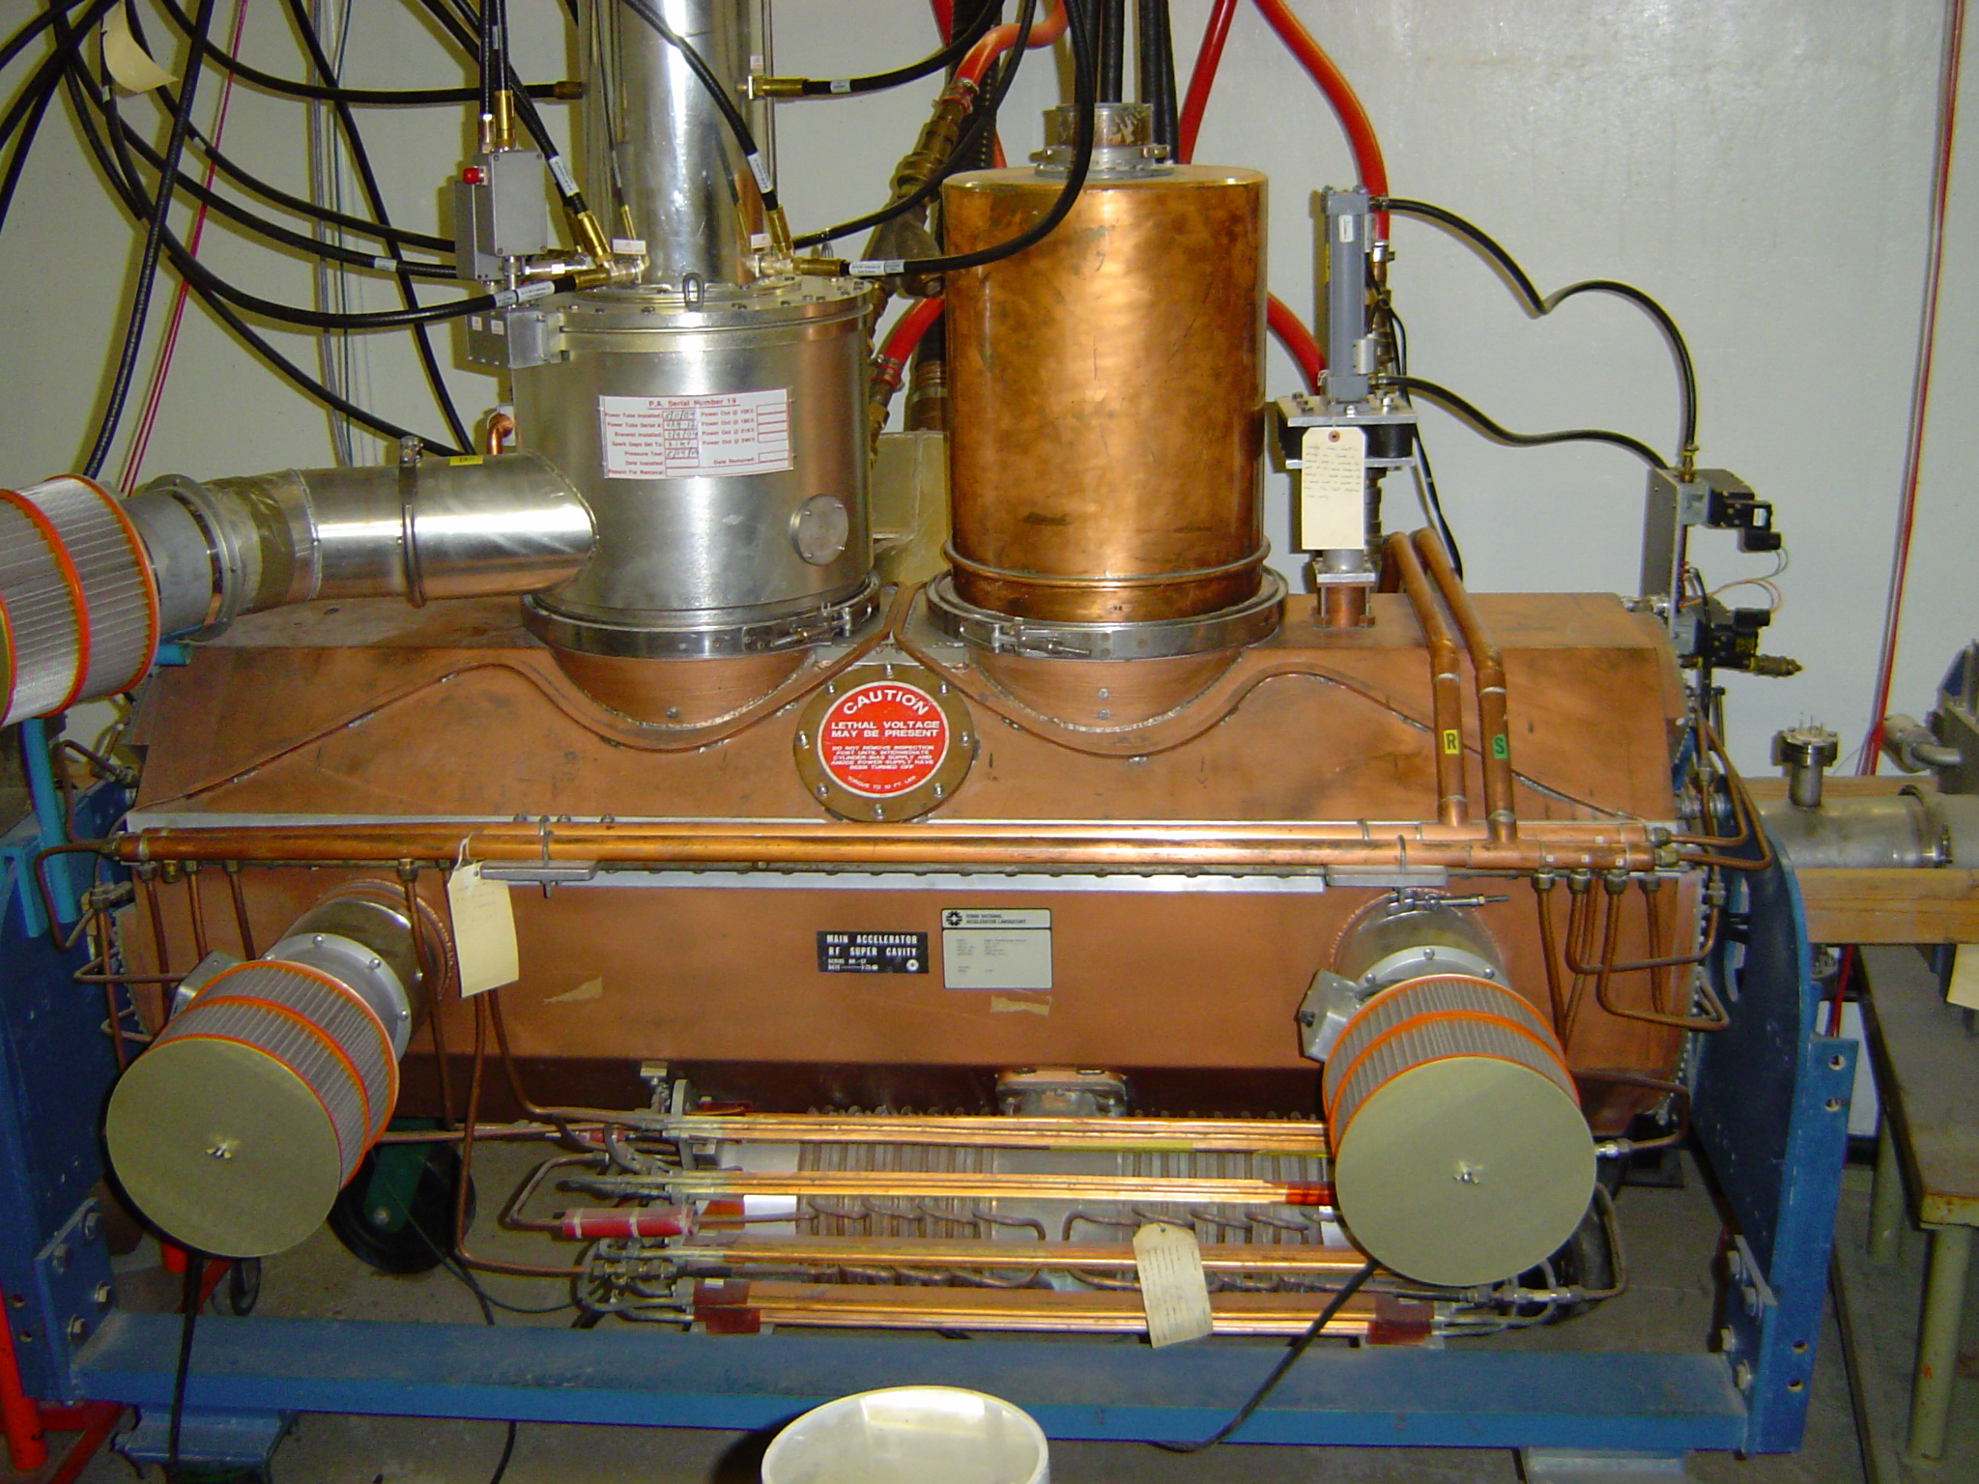
Conceptual Design and Design Maturity
Charge #1
MI-RF Power Upgrade
Option 1 - Two Power Amplifier

Slide 7
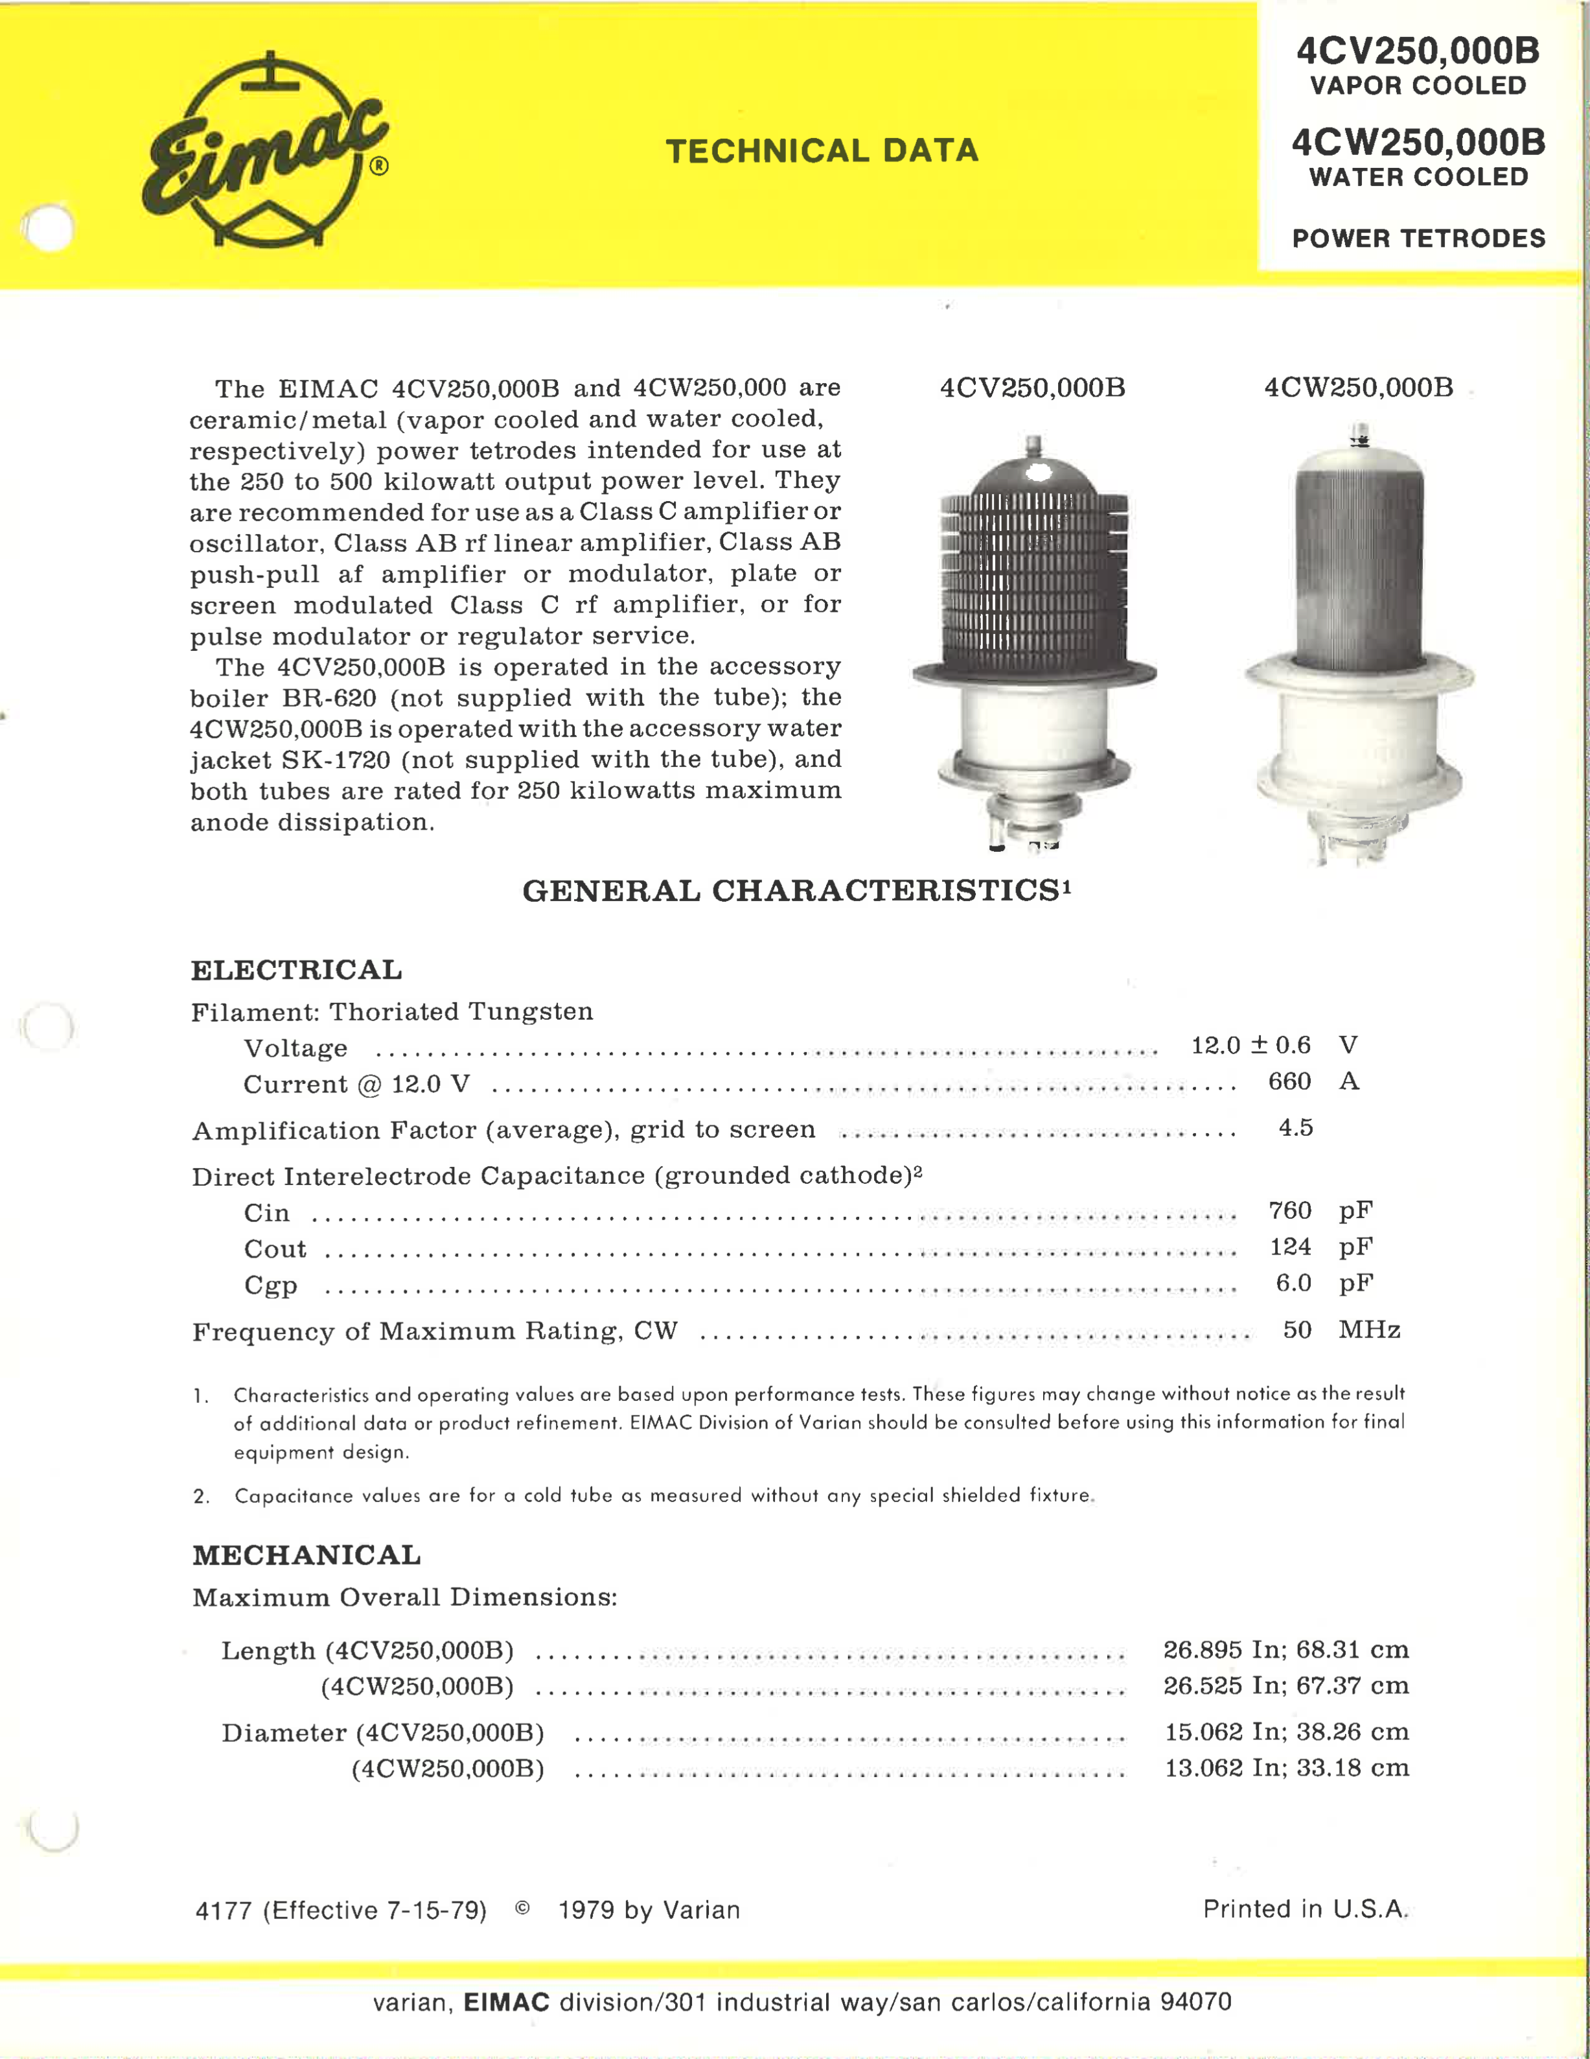
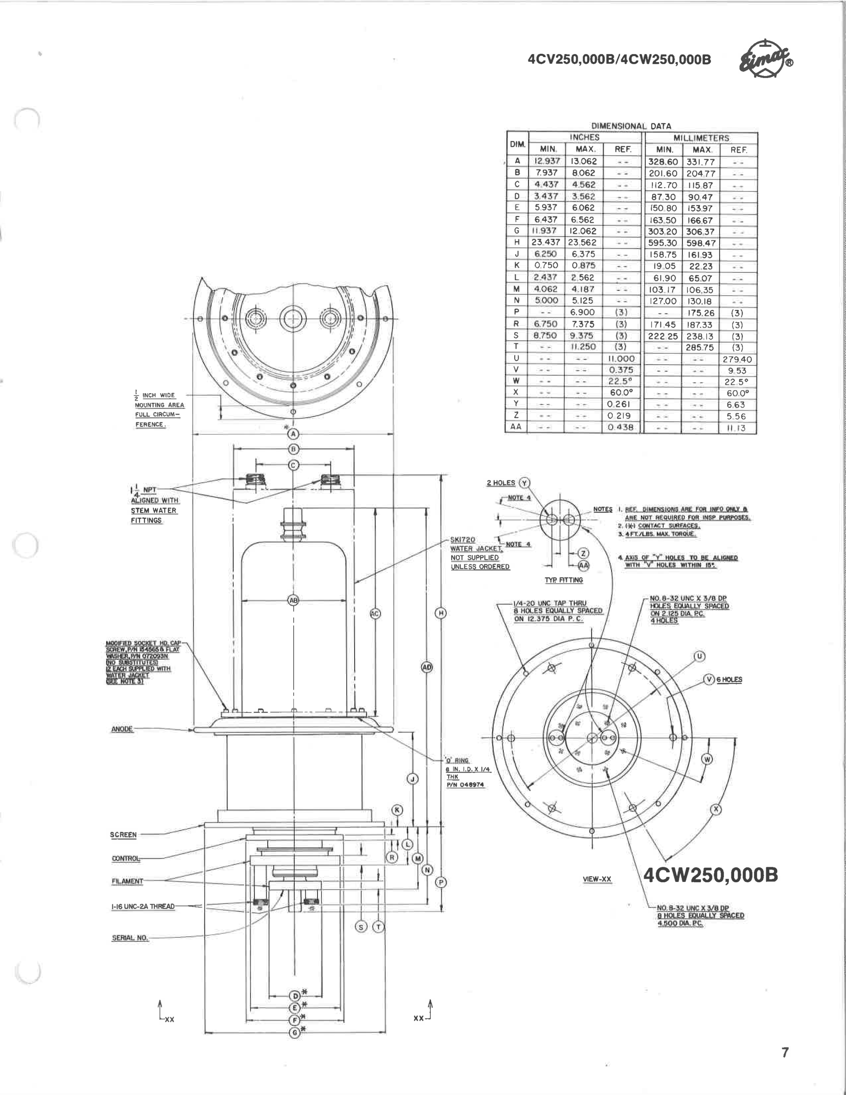
Conceptual Design and Design Maturity
Charge #1
MI-RF Power Upgrade
Option 2 - One Power Amplifier

Slide 8
Scope and Deliverables
Charge #1
Deliver 3 new 53 MHz cavities that meet their design requirements along with their driver amplifiers.
Remove the old 53 MHz cavities and install the 3 new cavities in their place.
Deliver 20 upgraded MI RF stations along with their corresponding modulators and their solid state drivers.

Slide 9
Interfaces
Charge #1

Slide 10
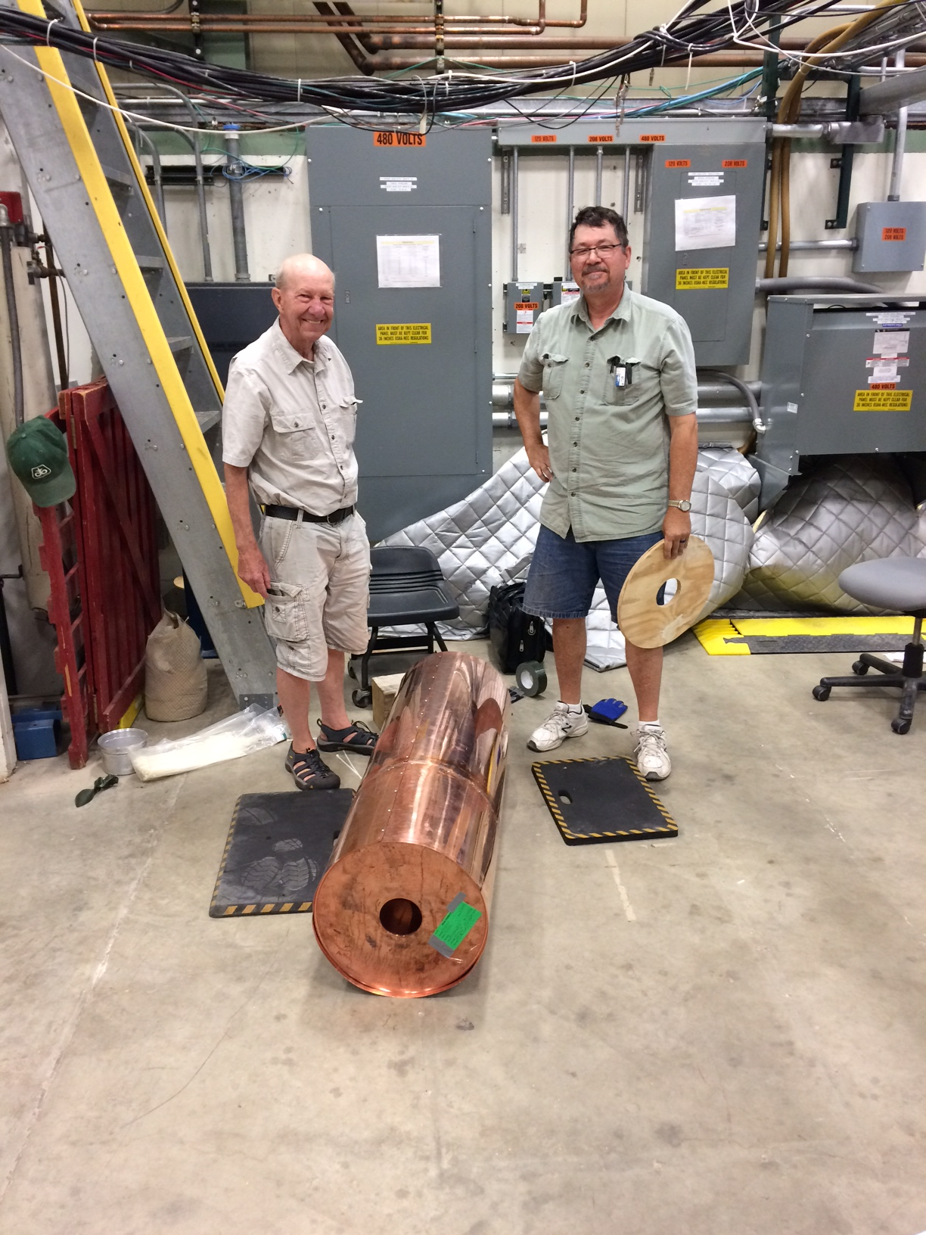
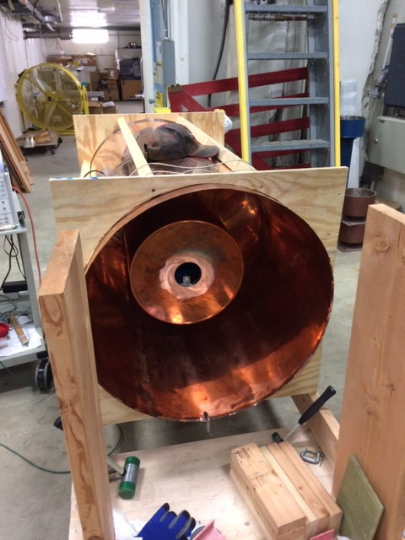
Progress to date
Charge #1
Mock-up of Recycler Ring Cavity

Slide 11
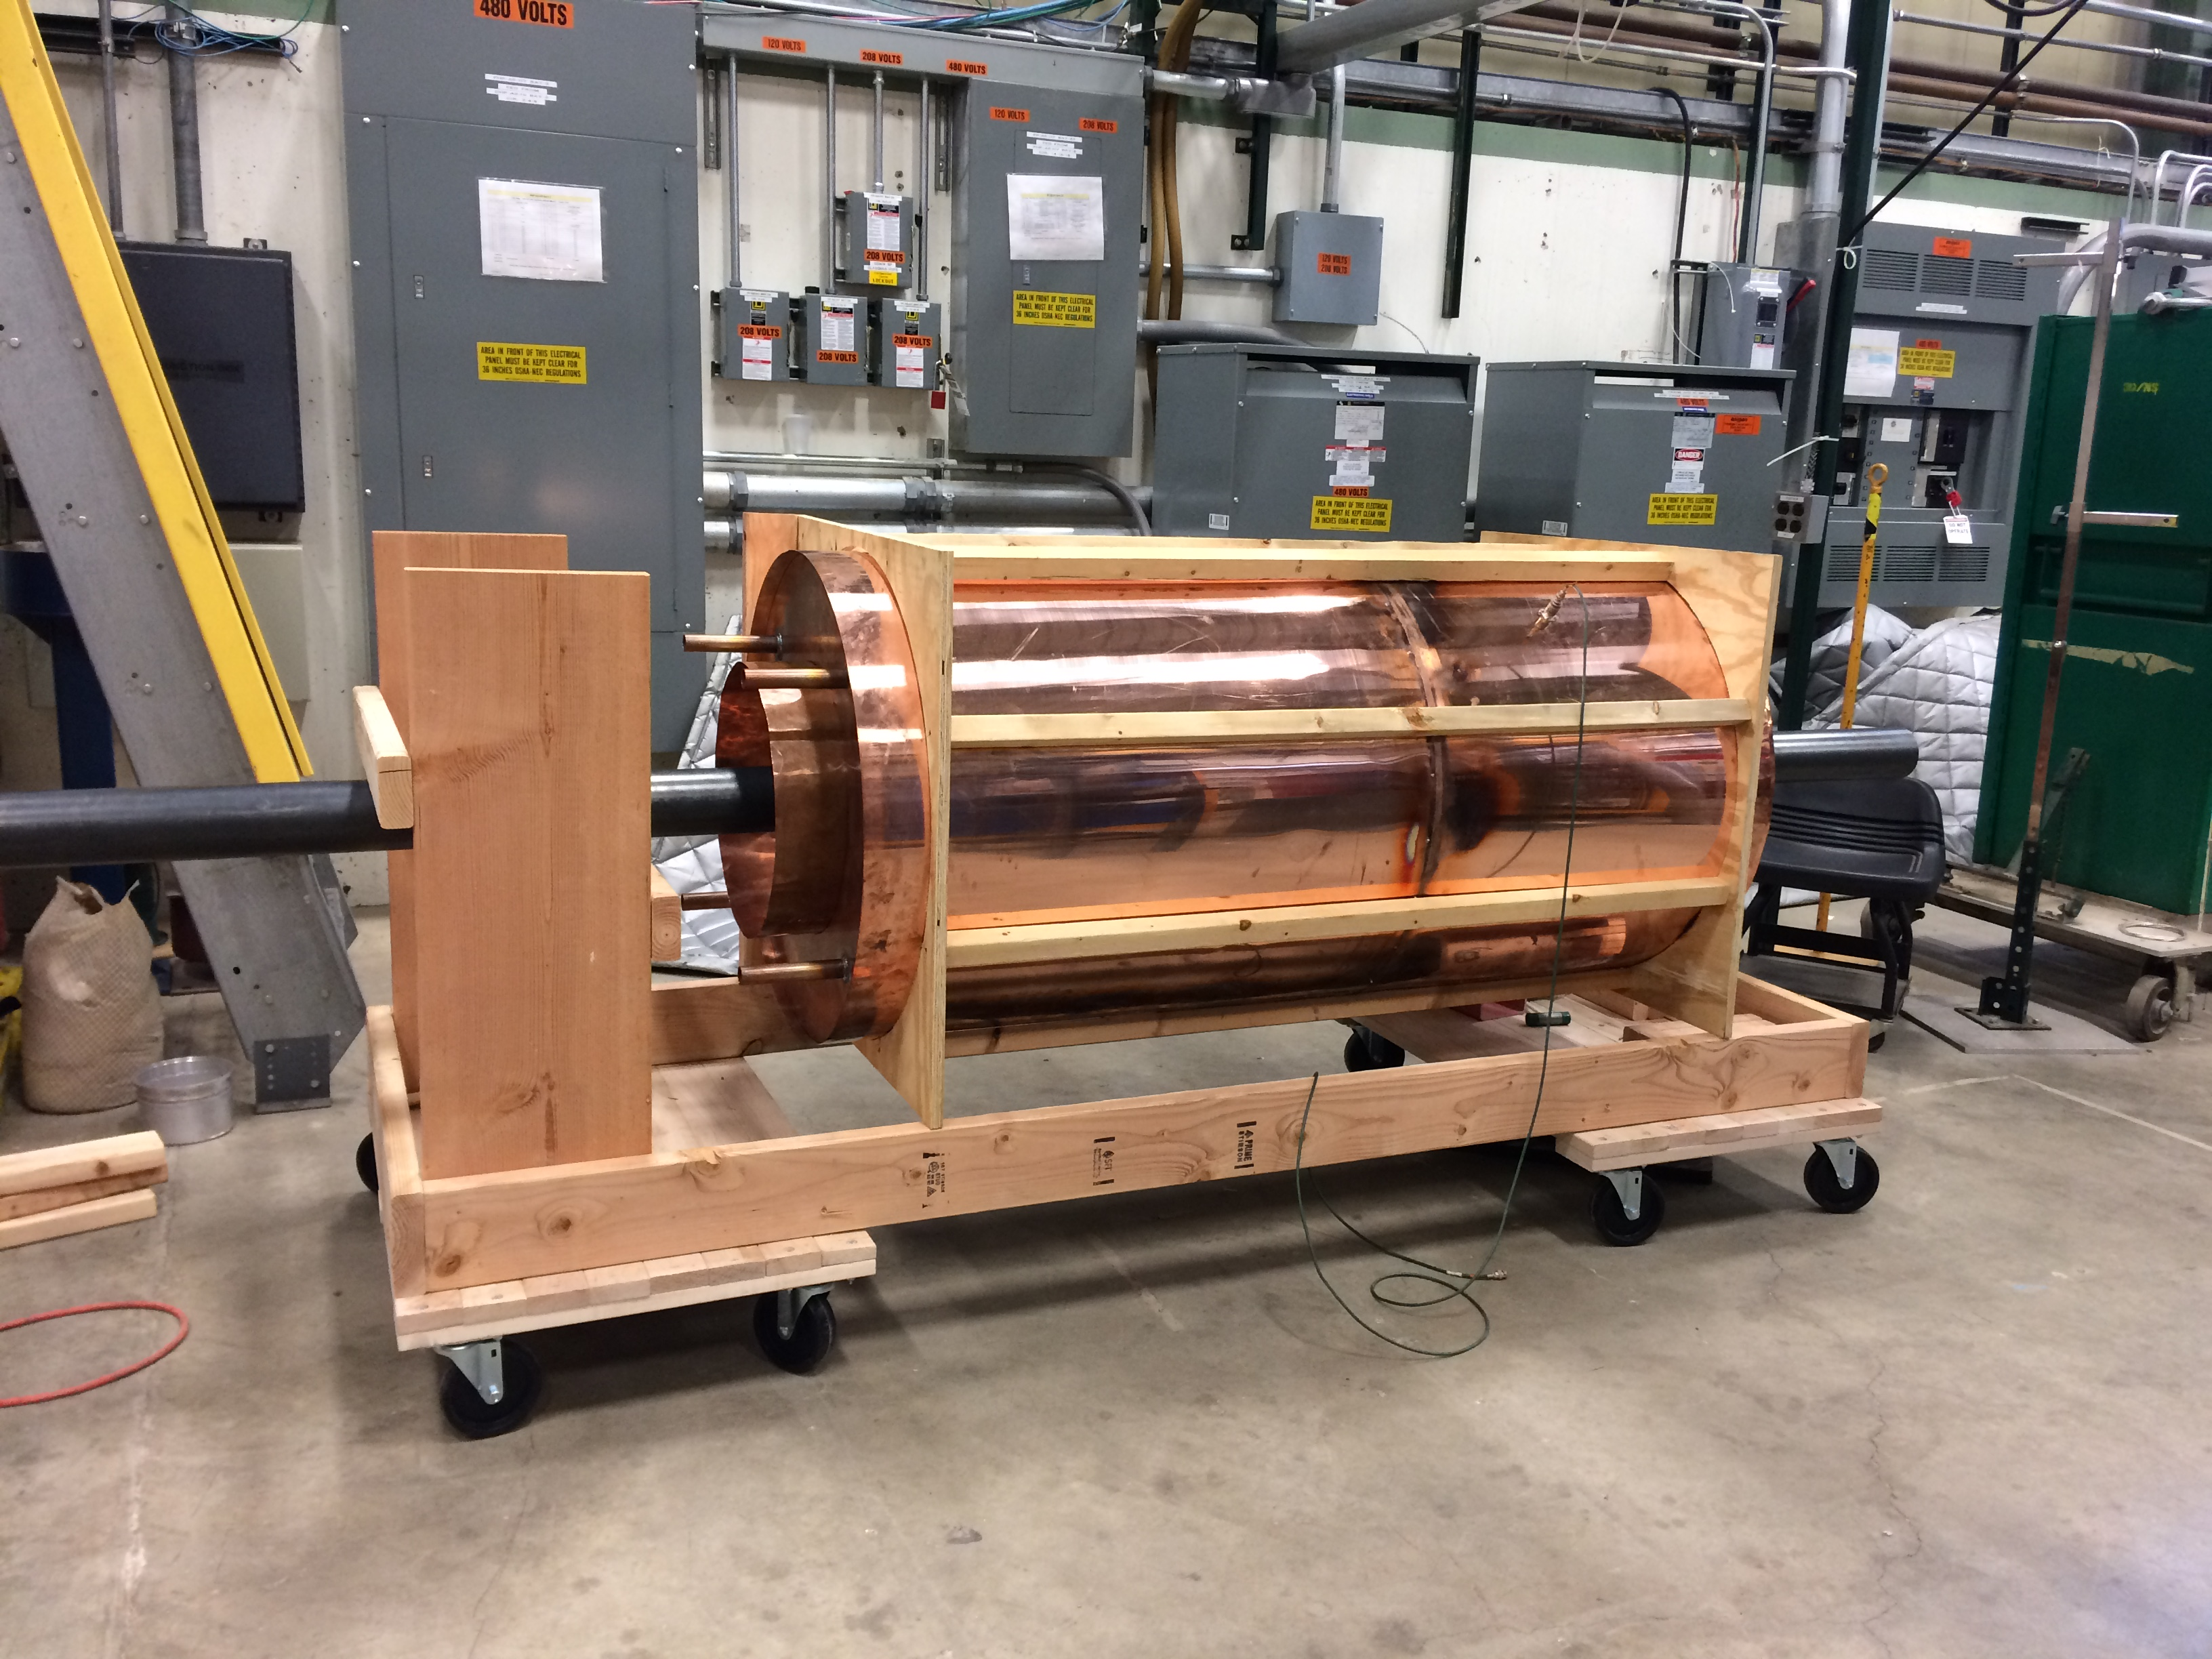
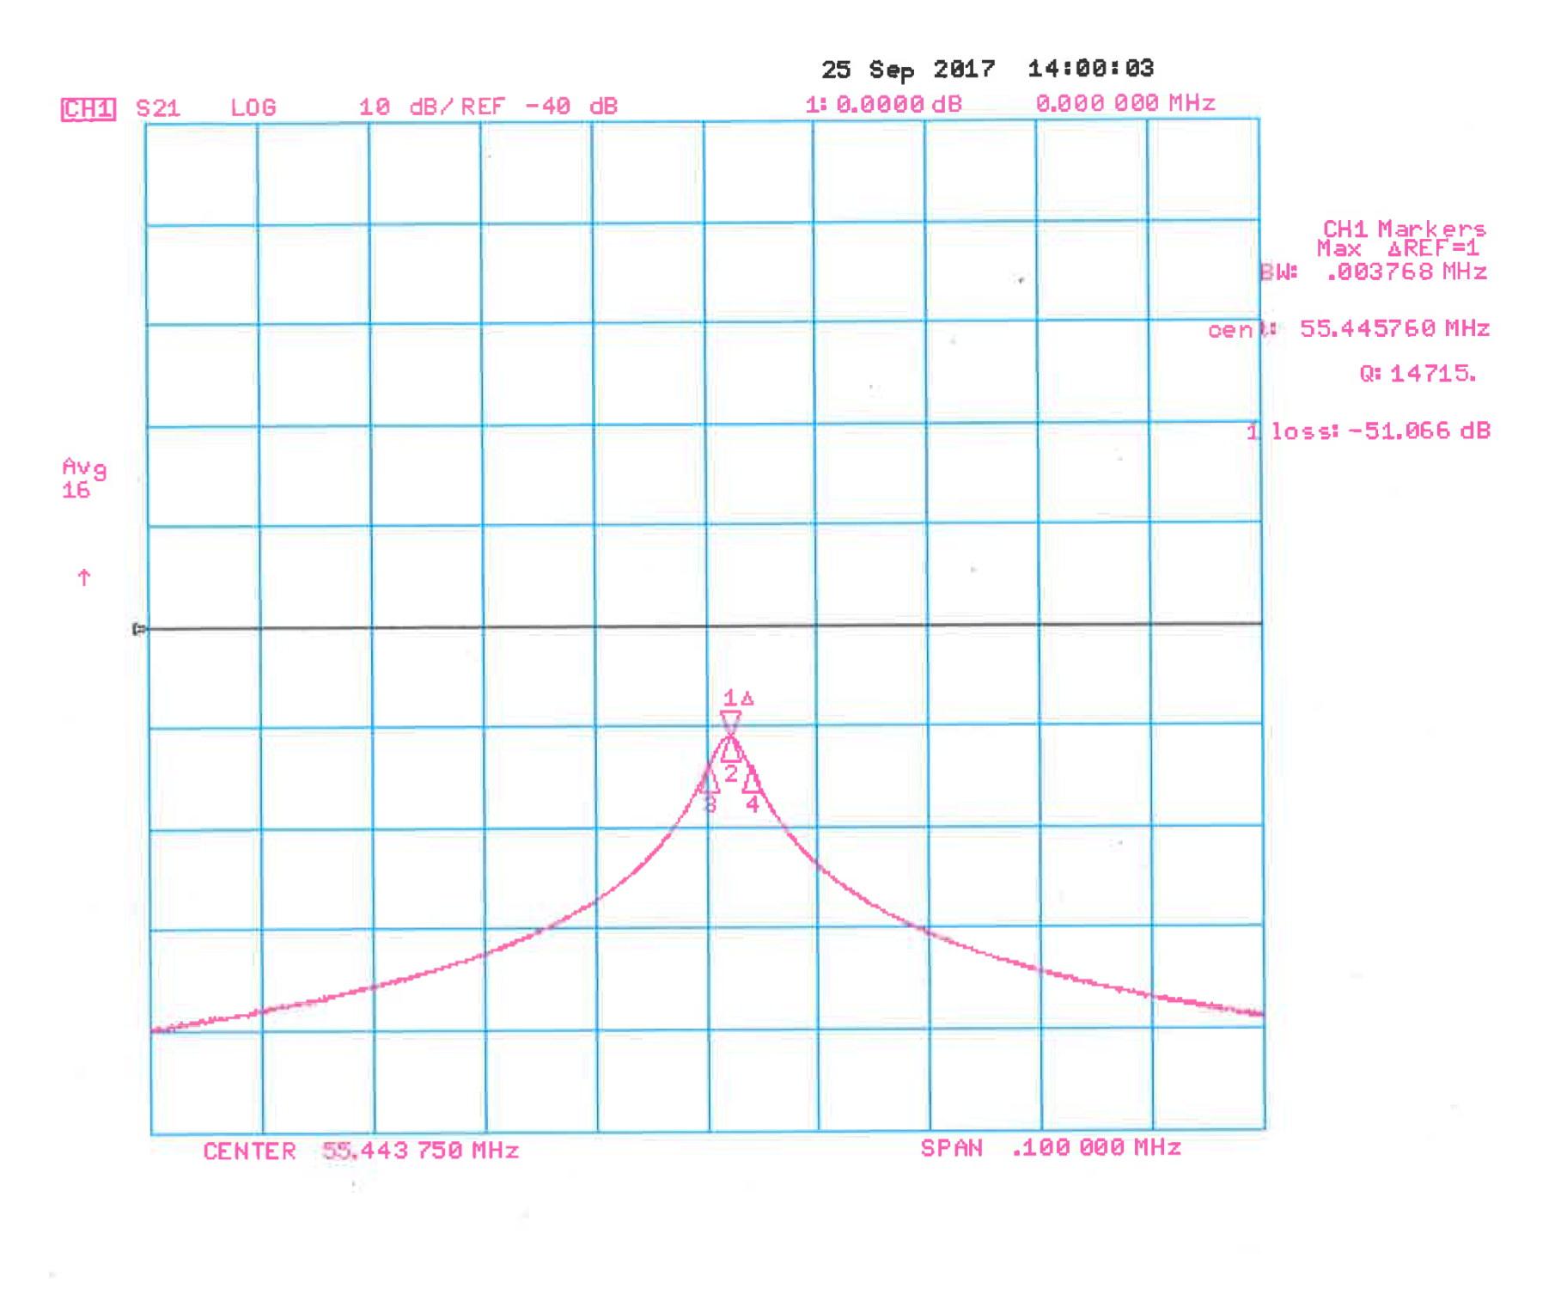
Progress to date
Charge #1
Mock-up of Recycler Ring Cavity
Mathematica Transmission Line Model: Q = 16,283
CST Microwave Studio Model: Q = 15,860
Mock Cavity Measurement: Q = 14,715

Slide 12
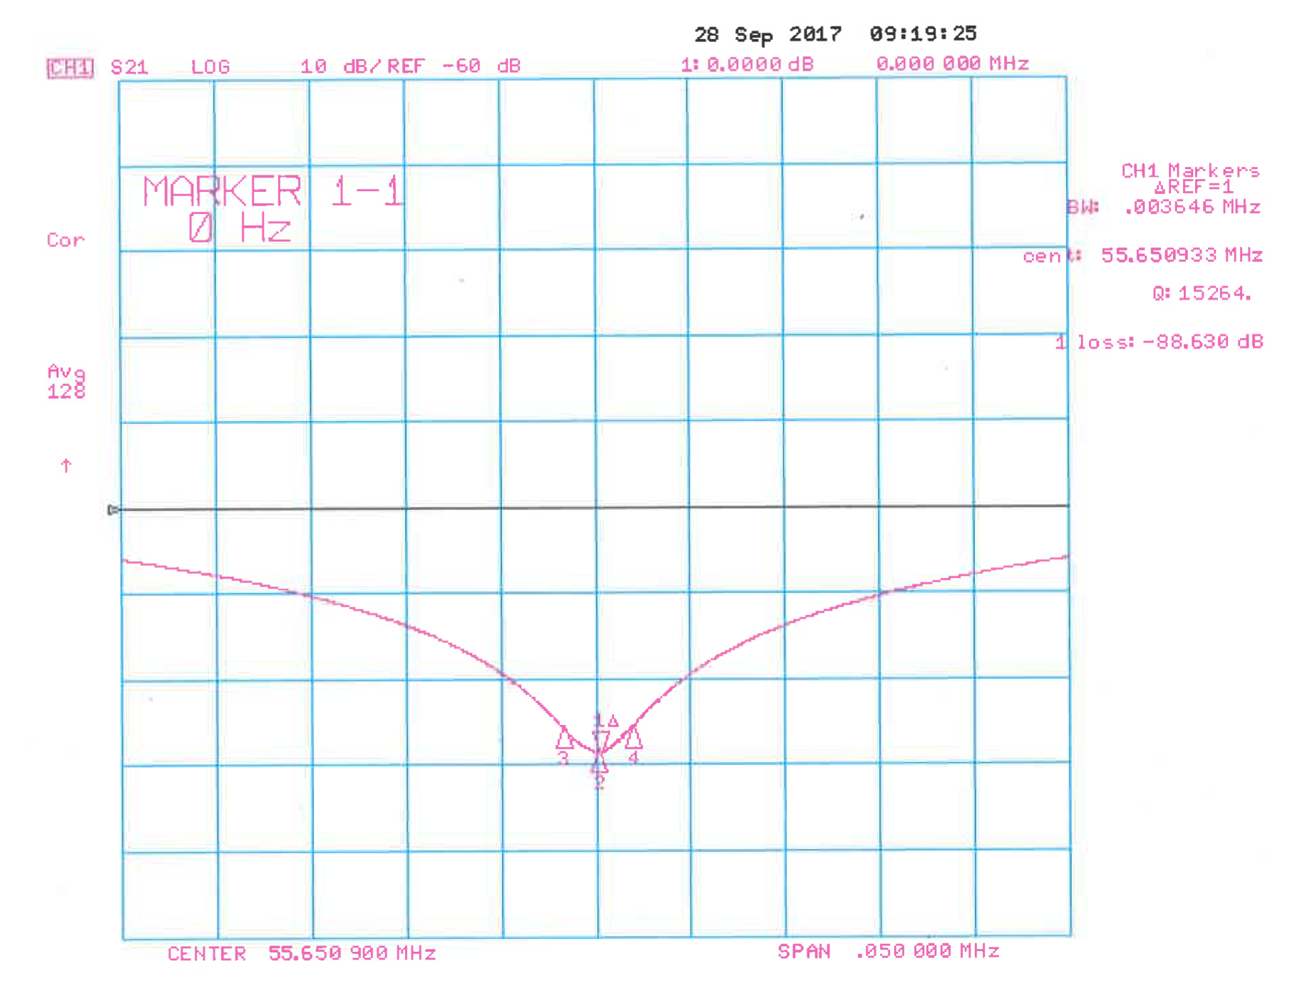
Progress to date
Charge #1
Mock-up of Recycler Ring Cavity
Shunt Impedance
Mathematica Transmission Line Model: 700.2 kΩ
CST Microwave Studio Model: 705.8 kΩ
Stretched Wire Method on Mock Cavity: 717.5 kΩ
Stretched Wire Method

Slide 13
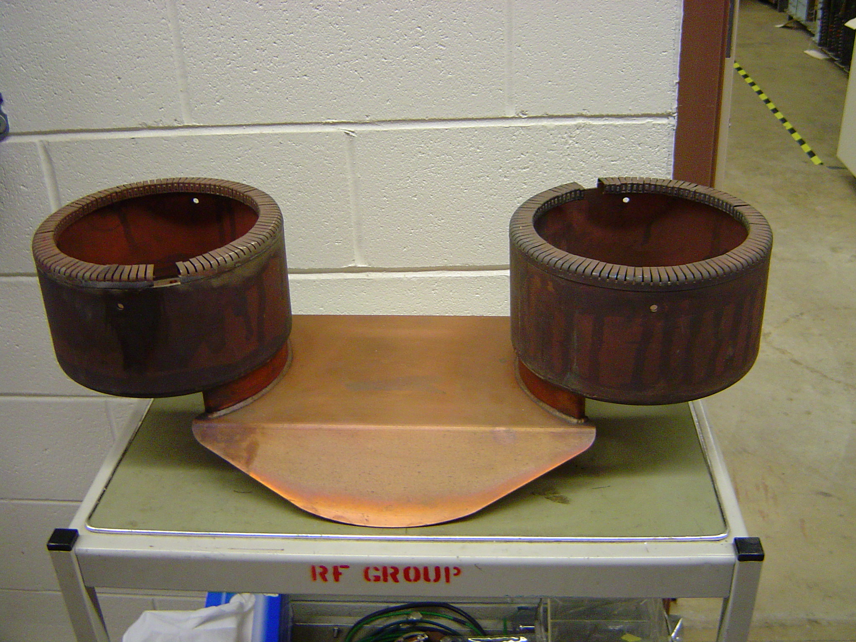
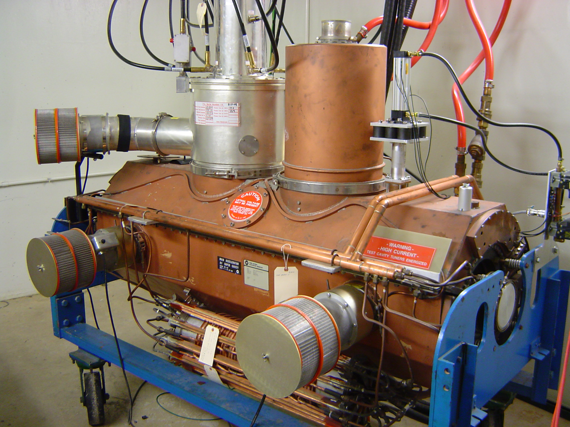
Progress to date
Charge #1
MI-RF Power Upgrade
Option 1 - Two Power Amplifier
Two PA Coupling Loop
Main Injector Test Stand
Low-level Test with MI Test Stand Cavity Modified
with Two Power Amplifiers.

Slide 14
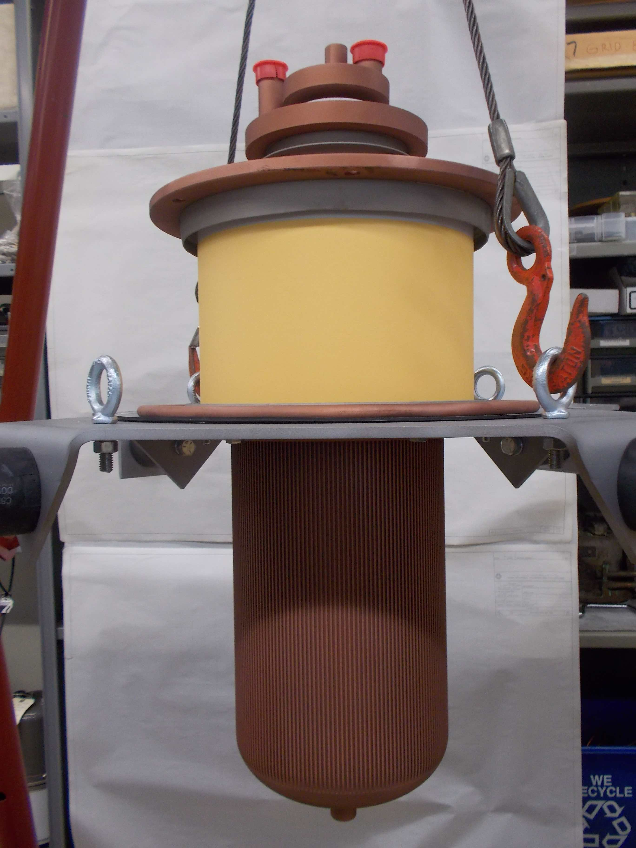
Progress to date
Charge #1
MI-RF Power Upgrade
Option 2 - One Power Amplifier
4CW250,000B Received from Eimac.

Slide 15
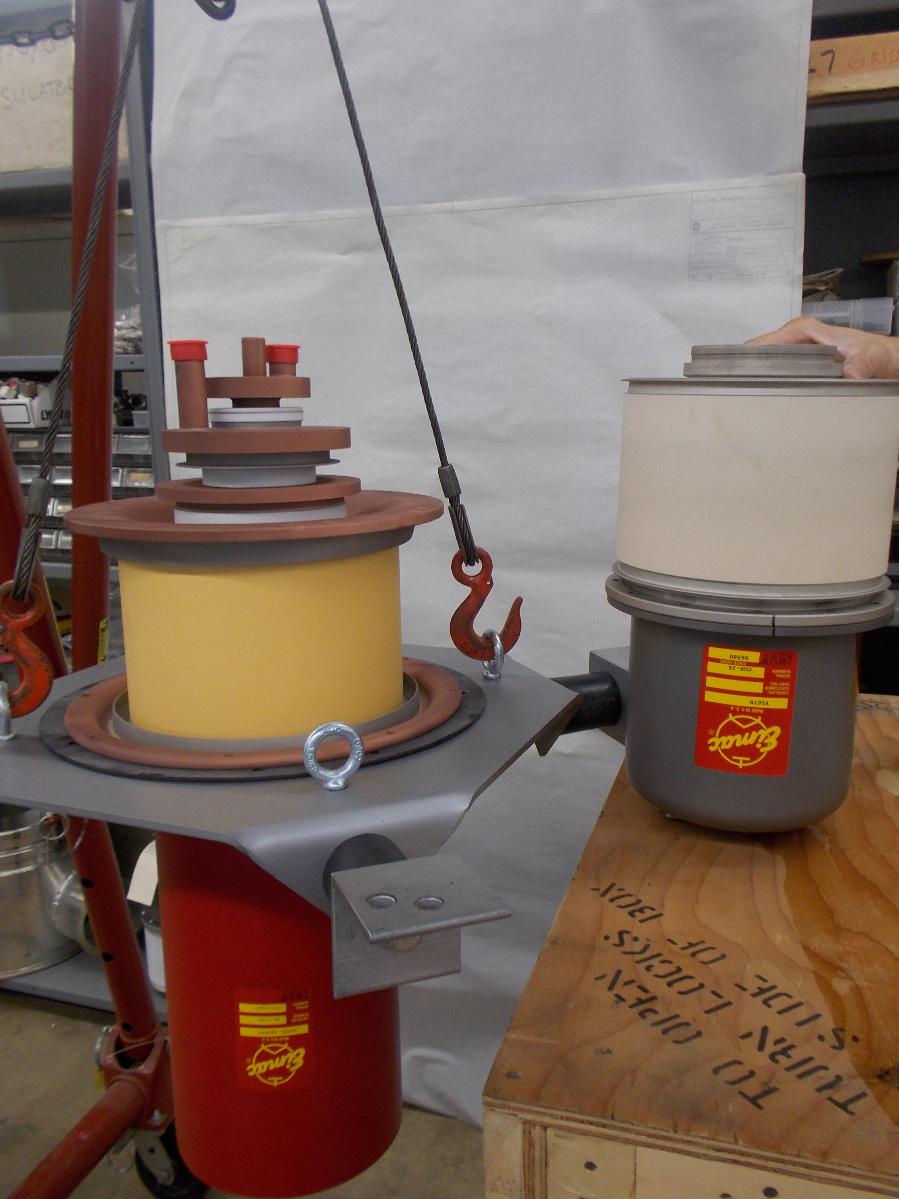
Risk Management
Charge #2
MR RF System Upgrade
  Default option (two tubes) does not work.
  Backup option (single tube) costs more.
4CW250,000B
next to
presently used
Y567B

Slide 16
Design Review Plan
Charge #3
Design reviews are organized as follows:
  Critical component, subsystem, and primary system all progress through Preliminary (PDR), Final (FDR), and Production Readiness Reviews (PRR). This cycle enables the procurement cycle to begin.
  Non-critical components or subsystems are managed within the Division or Department review process as indicated by the FNAL Engineering Manual.
PIP-II Machine Advisory Committee (P2MAC) Review (April 2017).
Recommendations
  “Develop milestones for hardware upgrade R&D including Main Injector RF system design down-selection and Recycler new 53 MHz RF cavity design”.

Slide 17
ESH&Q
Charge #4
ESH is integrated into all phases of the Project
  Design, Construction, Installation
ESH requirements are clearly defined within the Project
  FESHM, FRCM
Design & installation review process includes an ESH component
Utilize Fermilab’s work planning requirements & processes
  Hazard analysis
  Daily work planning meeting
QA/QC activity such as:
  Follow the project quality program
  Flowdown to vendors/collaborators
  Test protocols in development

Slide 18
Cost Summary
Charge #2

Slide 19
BOE Summary
Charge #2
WBS Number | Title | Docdb #
121.4.2.2 | Recycler/MI Project Management and Coordination | 620-v5
121.4.2.3-4 | Recycler/MI RR Cavity and MI RF System Upgrade. | 623-v8

Slide 20
Summary
Requirements are well defined.
Plans for Prototypes and Testing in Place.
Teams Organized to Make Progress on Every Front.
Interfaces, Risks, ES&H Issues are Actively Managed.

