Slide 1
121.2.20 Linac Safety Systems
Linac Safety Systems
L3 Manager Name John E. Anderson
Presenter Chuck Worel
Director’s Review
10-12 October 2017

Slide 2
Outline
Requirements
Conceptual Design, Maturity
Scope/Deliverables
Interfaces
Technical Progress to Date
ESH&Q
Risk
Cost
Schedule
Summary

Slide 3
About Us:
The Conceptual Design for the Electrical & Radiation Safety Interlock System (RSIS) and Oxygen Deficiency Hazard (ODH) Monitoring System is provided by:
  Chuck Worel Operations Specialist Sr.
  Randy Zifko Operations Specialist
  Glenn Federwitz Operations Specialist
Chuck, Randy & Glenn have a combined 100 years experience in design, implementation & installation of RSIS
Projects worked on include: Main Injector, MiniBooNE, NuMI, Meson RSIS Upgrade, K TeV, SeaQuest, CMTS-1, PIP II Injector Test Area & Muon Campus
ODH systems at CMTF & HAB/B0

Slide 4
WBS 121.3.20 Linac Safety System
Charge #1
Linac Safety Interlock System
  Safety System Design & Implementation follows
    Fermilab Radiological Control Manual Chapter 10
    “Radiation Safety Interlock Systems” Standards
  Radiation Safety Interlock System Components
    Will use standard Fermilab designed and approved RSIS and ESS system components and assemblies
  Oxygen Deficiency Hazard Monitoring System
    Will use Fermilab approved Safety Rated
    PLC ODH Monitoring System

Slide 5
WBS 121.3.20 Linac Safety System
Charge #1
Linac Safety Interlock System
  PIP-II IT (Injection Test) Safety Interlock System
    Personnel Radiation and Electrical Safety Systems
    (RSIS and ESS)
    Oxygen Deficiency Hazard (ODH) Monitoring System
  PIP-II Linac & Transport Safety Interlock System
    Personnel Radiation and Electrical Safety Systems
    (RSIS & ESS)
    Enclosure Access Radiological Scanning Stations
    MUX Stations
    Oxygen Deficiency Hazard (ODH) Monitoring System

Slide 6
Conceptual Design and Design Maturity
Charge #1
PIP II Injector Test Area
  The PIP II Injection Test RSIS is in place & functional
    Extension of the existing enclosure will require relocation of the South Emergency Exit Labyrinth to its new location
    Presently installed safety system reset box cables at the emergency exit were installed with enough cable length to be pulled & re-terminated to the new Emergency Exit Labyrinth location
    Installation of future required Radiation Monitors will be added to the existing Critical Device Controller as an input
  The PIP II Injection Test ODH Monitoring
    Extension of the existing enclosure will require the installation of ODH Monitoring within the enclosure, this will be implemented as a new “Zone” in the existing
    building ODH Monitoring System

Slide 7
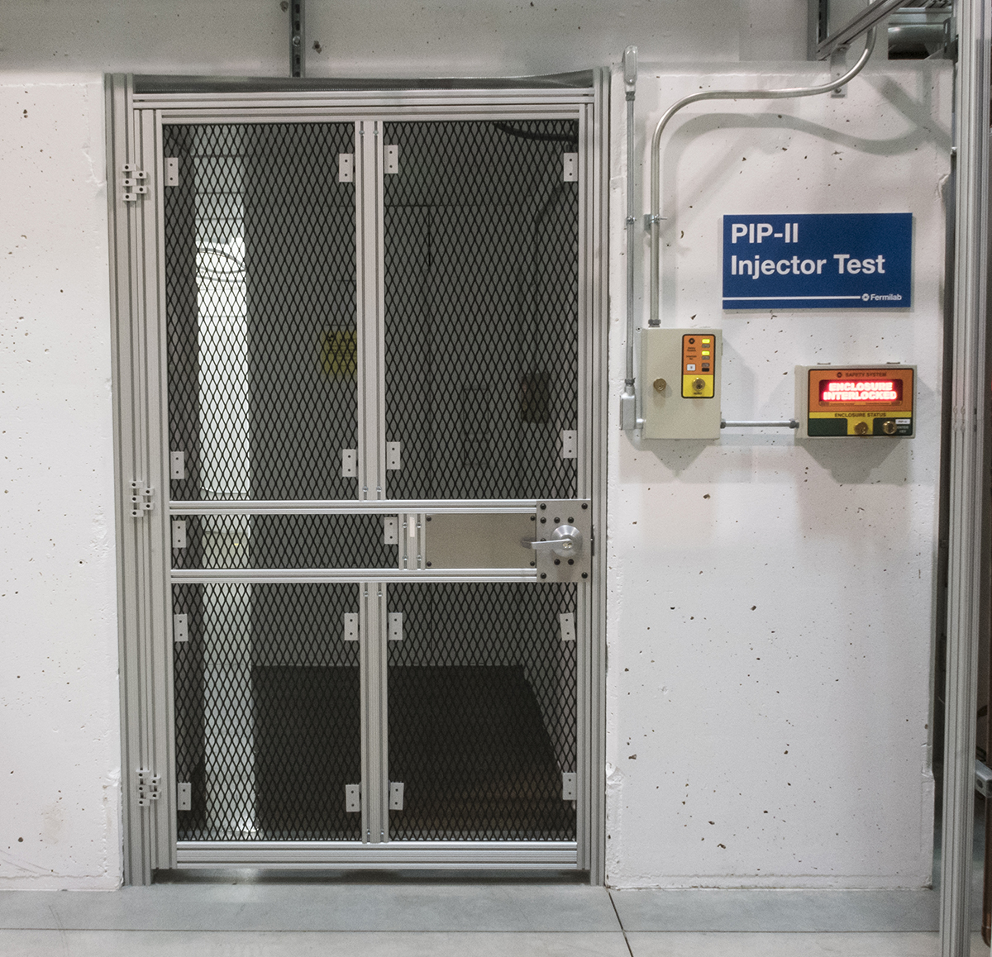
PIP-II Injector Test Enclosure Entrance at CMTF
Reset Box
Controlled
Access
Display Box
Interlocked
Gate is Designed for RSIS Use

Slide 8
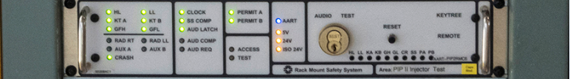
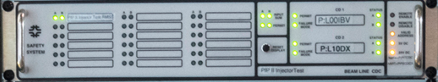
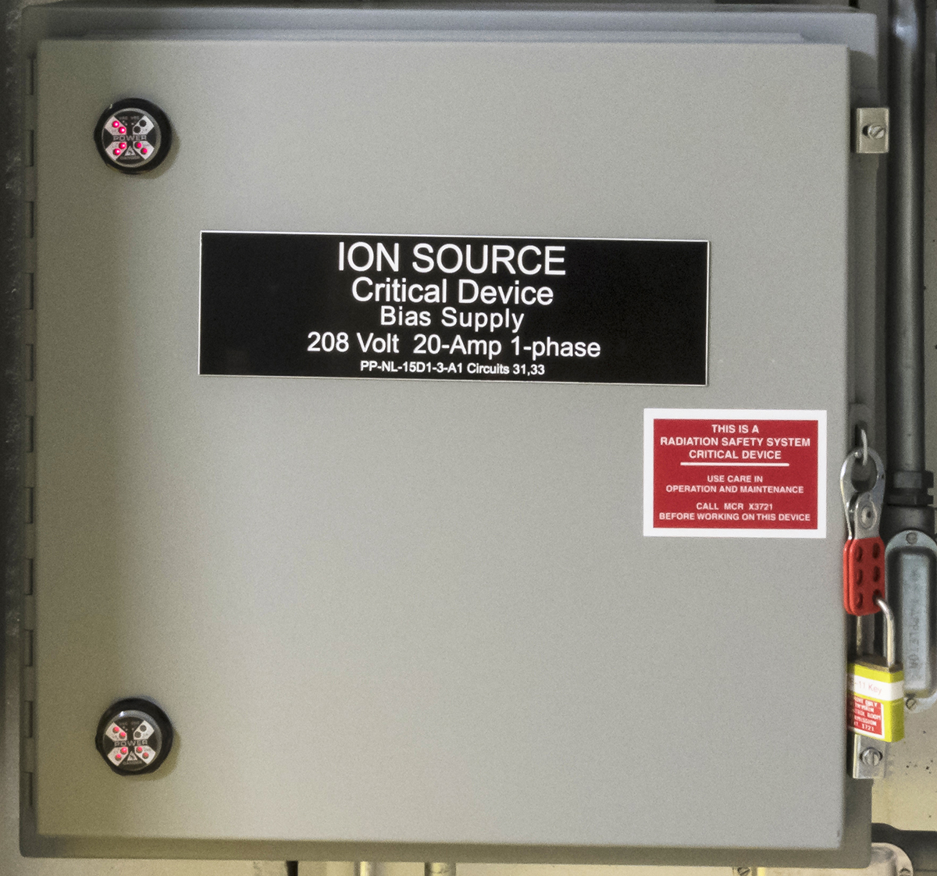
PIP-II IT RMSS, CDC & CD Contactor JB at CMTF
RMSS Chassis
CDC Chassis
Ion Source High
Voltage AC Contactor

Slide 9
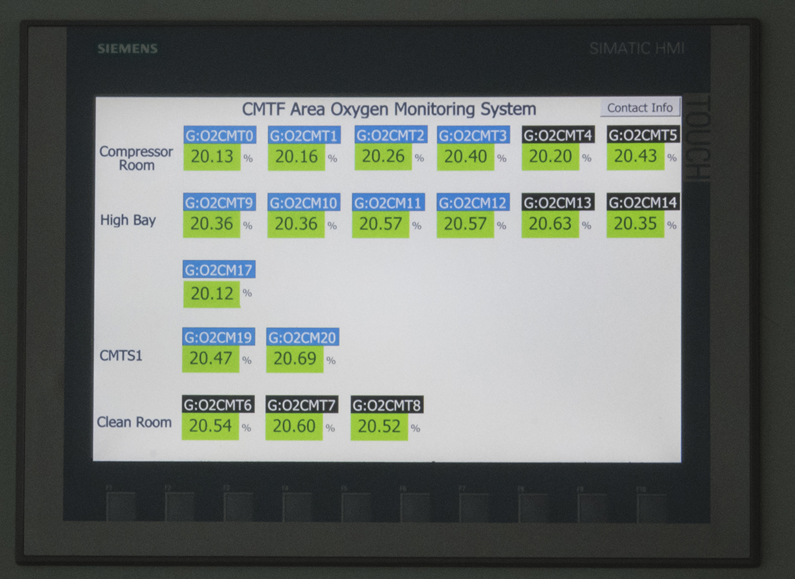
ODH Monitoring System Display at CMTF
Four Monitoring Zones Presently Displayed

Slide 10
Conceptual Design and Design Maturity
Charge #1
PIP II Linac and Transport
  Conceptual Design of the Linac and Transport RSIS
    Based upon civil drawing package and
    RSIS operational experience
    Linac and Transport enclosures will be sectioned into four radiological enclosures based upon operational needs
    The Four Enclosures are Identified as
      (Note: Ion Source area is not interlocked)
      The RFQ Includes the MEBT
      The Linac
      The Transport
      The Absorber

Slide 11
Conceptual Design and Design Maturity
Charge #1
    Total Loss Monitors (TLMs) are included in the design
      A TLM is a cable based ionization chamber used for a beam loss measurement system
      Loss measurement is in real time and scalable
      TLMs are fail safe
      Location of TLMs have not been identified

Slide 12
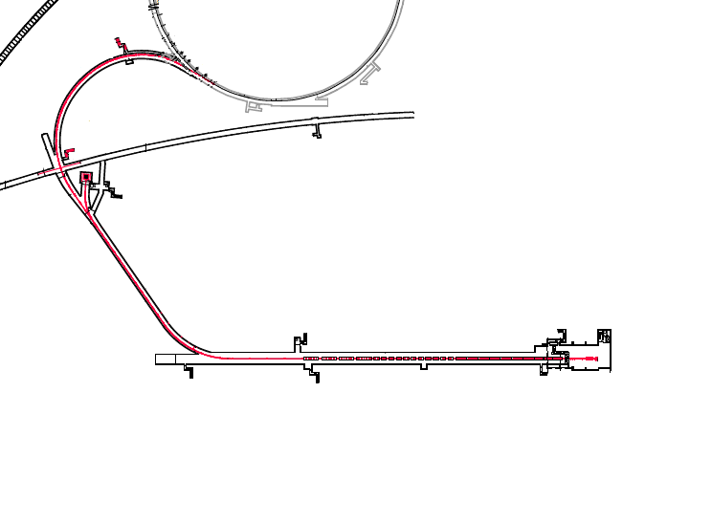
PIP-II Enclosure Identification
Booster
Transport
Absorber
Linac
RFQ
Ion Source

Slide 13
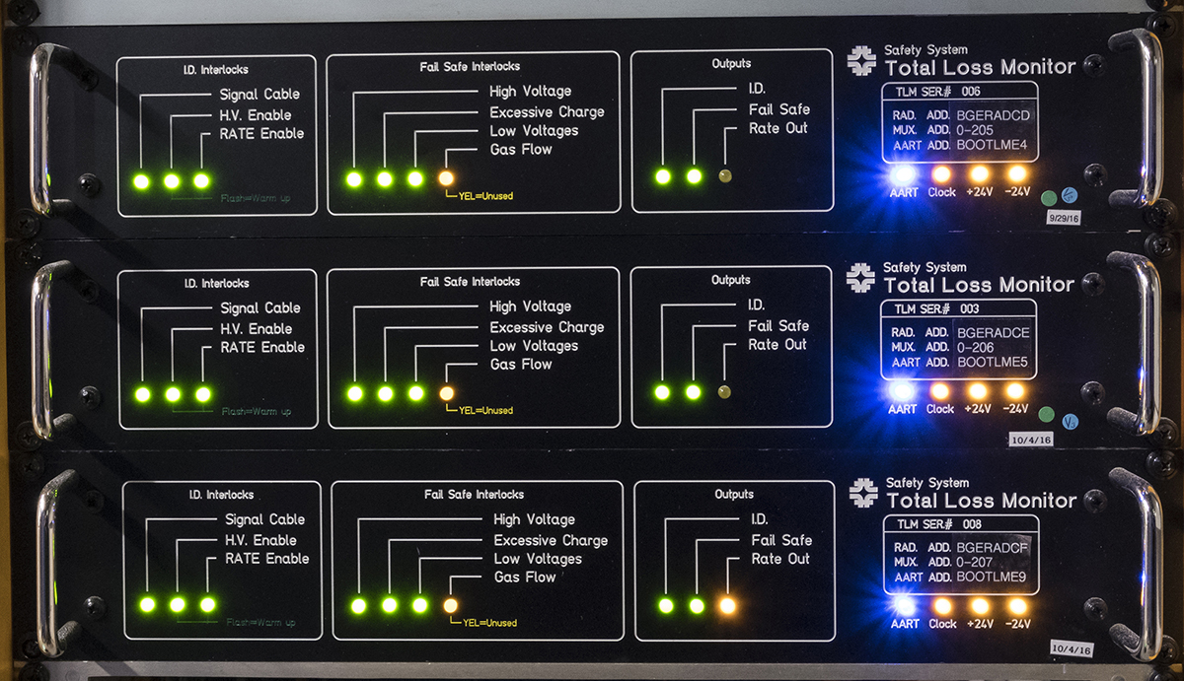
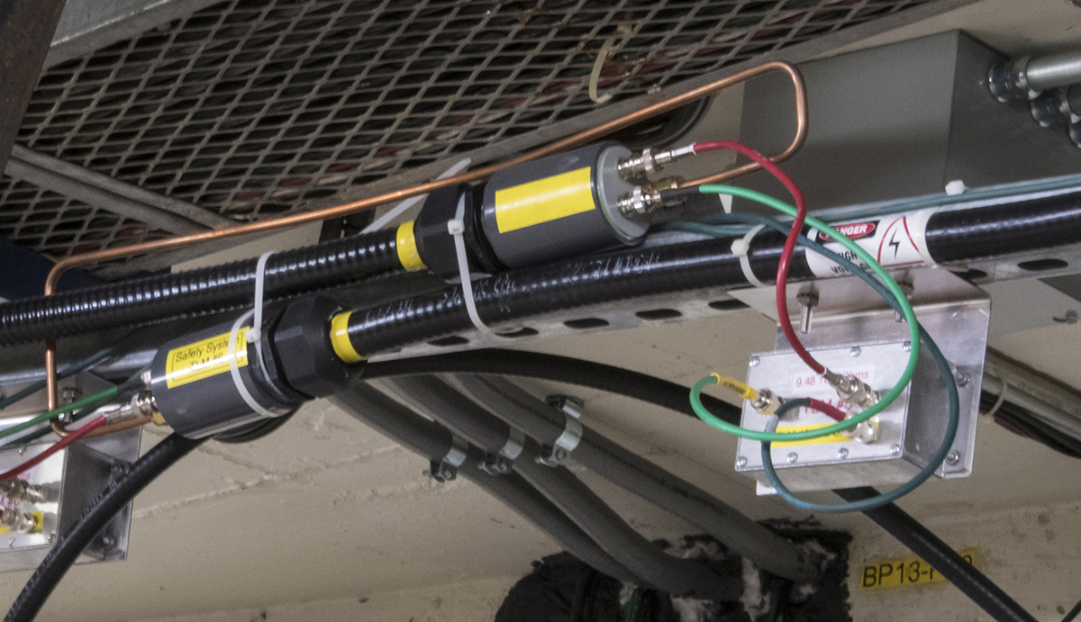
Total Loss Monitor Chassis & Cable
TLM Chassis
TLM Cable and
Resistor Box Installation

Slide 14
Conceptual Design and Design Maturity
PIP II Linac and Transport
  Conceptual Design of The Linac and Transport RSIS
    Critical Device locations are included in the design
      Critical Devices will need to be installed between the RFQ Enclosure and the Linac Enclosure to allow RFQ Operation while Linac Enclosure access is being performed
      Critical Devices will need to be installed in the Absorber Enclosure to allow Linac Operation while Booster Enclosure access is being performed
  Conceptual Design of the Linac ODH Monitoring System
    The ODH Monitoring System will have three “Zones”
      Cryogenics Warm Compressor Building
      Cryogenics Cold Compressor Building
      Linac Enclosure

Slide 15
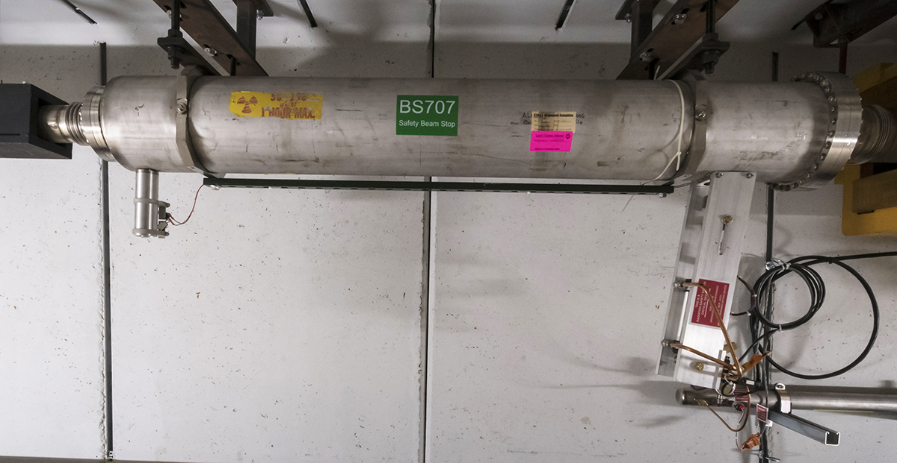
Beam Stop Installation in Muon Campus

Slide 16
Scope and Deliverables
Charge #1
PIP II Injection Test & PIP II Linac and Transport RSIS Includes
  Interlock System Gates
  Gate / Door Interlock Hardware
  Access Keys & Cores
  Audio Warning System
  Interlock System Cable
  TLM System
  ESS System
  Critical Devices
  CDCs Including Logic Modules
  Data Acquisition System

Slide 17
Scope and Deliverables
Charge #1
Radiological Scanning Devices Includes
  Friskers
  Wall Flower Radiation Monitors
MUX Monitoring System Includes
  This is Fermilab’ s Monitoring System for legal archiving of radioactive losses and emissions
  MUX Station
  MUX Cable
ODH Monitoring System Includes
  Safety Rated PLC
  Oxygen Monitor Sensors
  Audio & Visual Warning

Slide 18
Interfaces
Charge #1
Radiation Safety System interface with the AD Controls System
  Assignment of relay racks for RSIS & ODH by AD Controls Group
    The RSIS will need two relay racks for the RSIS in the Linac Gallery
    We will need one relay rack in the Linac Gallery Control Room &
    one relay rack at the South end of the Linac Gallery
    The ODH Monitoring System will need one relay rack
      Location of the ODH relay rack is yet to be determined
  Critical Device Controller interface to the AD Control System
    The RFQ CDC will use the repurposed PIP II Injector Test Area PLC for it’s interface, to be located in the Linac Gallery Control Room
    The Linac CDC will require a new PLC to Interface it to the Control System. This PLC will also be located in the Linac Gallery Control Room
    The Booster CDC will use the repurposed existing Booster controls card for its interface to the Control System

Slide 19
Interfaces
Charge #1
Critical Device interface With AD Mechanical Support Dept.
  Beam Stop Control interface to the Critical Device Controller will need to be addressed
    Pneumatic activation of Fail Safe Beam Stop
    Pneumatic operation controlled by the Critical Device Controller
RSIS Gate interface with the PIP II Project Office & AD Mechanical Support Dept.
  RSIS gates are designed by the AD Mechanical Support Department using standard RSIS gate requirements
  The AD Mechanical Support Department installs all RSIS gates
  We will need to work with Steve Dixon (PIP II Project Office) on the Absorber Gate requirements as Absorber Gates are part of the civil construction contract
Radiation Monitor Interface to MUX System
  Address MUX Station location needs
    Insure the Instrumentation Team of the ESH&Q Section knows estimated MUX Channels needed & location for stations

Slide 20
Progress to date
Charge #1
PIP II Injector Test Area
  The PIP II Injection Test RSIS is in place & functional
    Minor change needed for enclosure extension
    Radiation Monitor Interface Chassis & Cabling for Radiation Monitors will need to be installed due to beam energy increase
    ODH Monitoring will require a “Zone” addition to the CMTF ODH Monitoring System

Slide 21
Progress to date
Charge #1
PIP II Linac and Transport
  Conceptual Design of the Linac and Transport RSIS
    Based upon civil drawing package and RSIS operational experience
    Critical Device discussions with Beam Line Physicist and the Area RSO is needed
    Will use Standard Fermilab designed and approved RSIS & ESS system components and assemblies
    Existing RSIS assemblies do have the risk of components becoming obsolete which would require design changes. We have experienced needed design changes in the past and do not consider this to be a significant risk
  Have identified areas where more work is needed
  We believe we have a sound Conceptual Design

Slide 22
Design Review Plan
Charge #3
Design Review for PIP II IT
  Present operation PIP II IT RSIS
    Completed and approve March of 2017
  Future operation to 25 MeV design
    Will require the installation of Radiation Monitors. Positions to be determined by RSO (Radiation Safety Officer) before revised RSIS design can be submitted
    Design review of RSIS is completed and approved by SRSO (Senior) or their delegate as per the FRCM Chapter 10 Part 1002
  Radiation Safety Interlock System L3
    John Anderson the L3 oversees the RSIS design efforts

Slide 23
ESH&Q
Charge #4
PIP-II Integrated ES&H Management Plan (pip2-doc-141)
  PIP-II Integrated Environmental, Safety & Health Plan
  Will be followed
    Will outline the work scope and identify possible risks associated with the work
    ESH&Q Interlock Group Technicians are well versed in identifying possible hazards in their normal work activities
    Installation of RSIS hardware is done by Fermilab Time & Materials (T&M) Electricians who are required to take the Labs ES&H Training associated with the work
    The T&M Electricians are familiar with RSIS installations which allows them to start with a general overview of the work effort before an RSIS installation task is assigned

Slide 24
Cost Summary
Charge #2

Slide 25
BOE Summary
Charge #2
WBS Number | Title | Docdb #
121.3.20.2 | Linac Safety Systems Project Mang. and Coordination | 956
121.3.20.3 | PIP2IT Radiation Interlock System | 959
121.3.20.4 | PIP2IT ODH Monitoring System | 962
121.3.20.5 | PIP2IT Safety Systems Validation | 965
121.3.20.6 | Linac & Transport Radiation Safety Interlock System | 968
121.3.20.7 | Linac & Transport Access Radiological Scanning Station | 971
121.3.20.8 | Linac & Transport MUX Monitoring System | 974
121.3.20.9 | Linac ODH Monitoring System | 977
121.3.20.10 | Linac & Transport Safety Systems Validation | 980

Slide 26
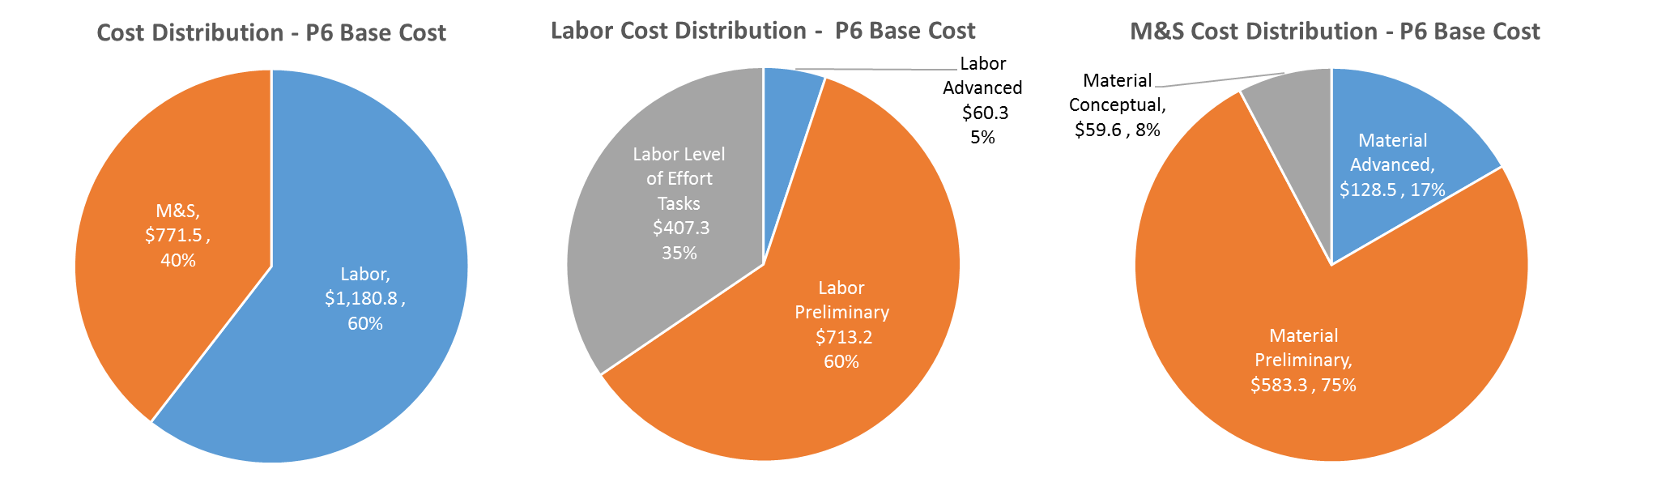
Cost Drivers and Estimate Maturity
Charge #2
P6 Base Costs = BOE + Overheads + Escalation
We have identified Safety System cost drivers
Contingencies assigned are appropriate for CD-1 level based upon past experiences

Slide 27
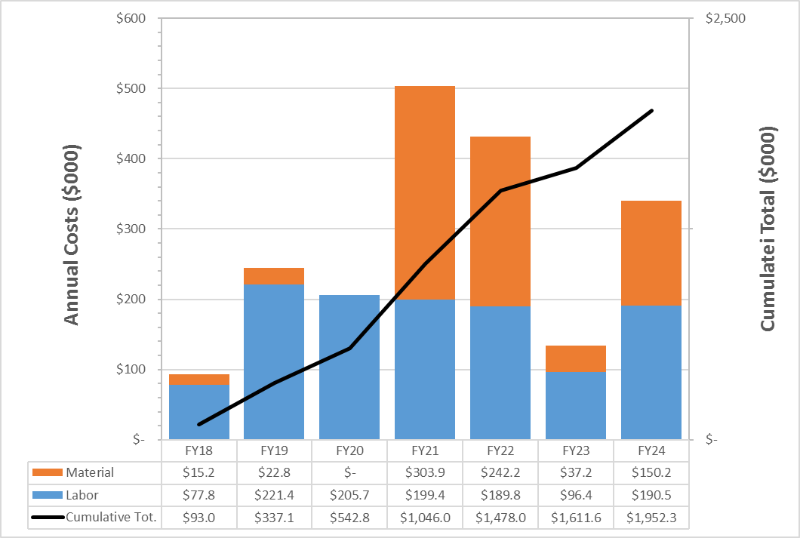
Cost Profile – P6 Base Cost Only
Charge #2
P6 Base Costs = BOE + Overheads + Escalation
Labor and material funding for each year of project duration is identified and understood for the life of the project

Slide 28
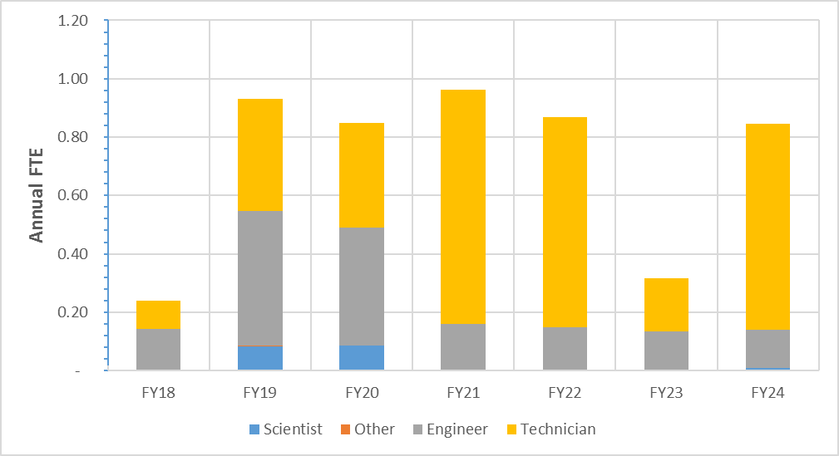
Labor Profile – P6 Hours/FTE
Charge #2
Labor needs of the project are understood and can be supported

Slide 29
Schedule – Safety Systems
Charge #2

Slide 30
Summary
Fermilab ESS, RSIS and ODH Monitoring Systems
  Use approved components and assemblies as building blocks for these systems
  Conceptual design of the RSIS is sound and takes into account operational needs of the PIP II Beam Line
  Cost estimates provided for this design are sound
  Our risk of individual components becoming obsolete are understood and solvable with design change
  The Interlock Group has been involved with many RSIS and ODH Monitoring Systems
  We look forward to our efforts required in bringing a new accelerator on line
  Thank you

Slide 31
END

