Slide 1
121.3.17 – Linac Controls
RF Systems, Controls and Instrumentation
Jim Patrick
PIP-II Director’s Review
10-12 October 2017

Slide 2
Outline
Requirements
Conceptual Design, Maturity
Scope/Deliverables
Interfaces
Technical Progress to Date
ESH&Q
Risk
Cost
Schedule
Summary

Slide 3
About Me:
Level 3 Manager for PIP-II Linac Controls
Relevant Experience:
  Head of Accelerator Controls Department since 2001
  Previously head of CDF experiment data acquisition group

Slide 4
Linac Controls WBS Scope
Charge #1
Covers PIP-II Linac, transfer line, interface to current complex
Control System Infrastructure
  Computing
  Networks – central and remote
  Software Frameworks – front-ends, services, applications
  Core Services – data acquisition, alarms, archiving, database
  Core and technical applications
Technical Subsystems
  Vacuum, LCW, motion control, high level power supply control
Timing System
  Central timing generator and distribution network
Machine Protection System

Slide 5
WBS L3 System Requirements
Charge #1
Control and monitor equipment for PIP-II linac
  With very high availability
  Data acquisition, alarms, logging, save/restore, control and status user interfaces
Support 20 Hz pulsed operation
  Implications for timing and machine protection
Interface to existing complex
  Timing
  Machine Protection
  Data acquisition, alarms, logging, etc.
Scale is a moderate expansion to current complex

Slide 6
Machine Protection Requirements
Charge #1
Manage beam intensity and permit limits of MPS devices
Save data on trips and provide to control system on request
Provide a global synchronization trigger on faults
Provide a comprehensive overview of the machine state and readiness status to subsystems and the broader complex
Provide high availability and fail-safe operation
Manage and report MPS alarms
Fast Protection Response time ~ 10 μs
FRS - Teamcenter ED0004250

Slide 7
Conceptual Design – General Controls
Charge #1
Incorporate the PIP-II Linac in the existing control system
Enhance and modernize as needed
  Both hardware and software
Unified system for the entire complex
Supports diverse simultaneous modes of operation
Should easily adapt to additional scale
Large investment and long experience
Very modular
  Long history of adapting to new accelerators and beam lines
  And upgrading components without disrupting operations

Slide 8
Conceptual Design – General Controls
Charge #1
Console
Applications
Java
Applications
Web
Applications
Database
Central
Services
Servlets
Open Access
Clients
Consolidators
MOOC
Front-Ends
Erlang
Front-Ends
HRM/IRM
Front-Ends
Field Hardware
Ethernet, CAMAC, VME, PMC, IP, CIA, GPIB, …

Slide 9
Conceptual Design - Timing
Charge #1
New global accelerator clock ACLK
Event + data payload
1 GHz link
Support 20 Hz pulsed operation
  Current complex based on 15 Hz
Generates TCLK to service existing complex
8 bit event only
Generates LCLK to service PIP-II linac
Synchronized with RF
Accelerator Clock
(ACLK)
Linac RF
TCLK
Linac Clock
(LCLK)
Existing
Accelerator
Complex
PIP-II Linac

Slide 10
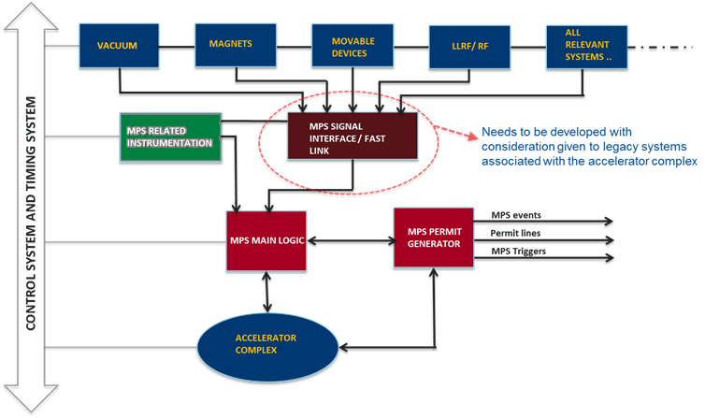
Conceptual Design – Machine Protection
Charge #1
Interfaces with the accelerator control system and machine timing system for configuration management, timing, and post mortem analysis.

Slide 11
Scope and Deliverables
Charge #1
Network Infrastructure
  Central switch plus 26 remote switches for field equipment
  Also switches for video cameras, voice over internet
Computing Infrastructure
  Consoles for linac area (13 permanent + 10 mobile)
  Addition servers for central processes (35)
    Including servers and storage for waveform logging
Console and Server software
  Updated application framework, data logging, and other infrastructure software
Front-End Systems
  Both hardware and software
  Long list in BOE document

Slide 12
Scope and Deliverables
Charge #1
PLC Based Controls
  Vacuum, LCW, RAW controls matched to accelerator design
General Purpose DAQ
  General purposed digitization/digital I/O for basic control, monitoring.
  Updated version of current Hotlink Rack Monitor
  Dedicated power supply control for higher density systems
  Quantities matched to full PIP-II design
Motion Control
  For collimators, scrapers, cavity tuners
  Similar system to PIP2IT, matched to full PIP-II design

Slide 13
Scope and Deliverables
Charge #1
Timing
  New central timing system (ACLK)
  New linac timing system (LCLK) with distribution network to local hardware that needs it
Machine Protection
  Dedicated instrumentation, interfaces to other instrumentation distributed through the linac
  Central system to process inputs and generate permit signal

Slide 14
Scope and Deliverables
Charge #1
Application Software
  High level software for control and monitoring of the above
  Drag and drop framework for basic things
    Mainly basic status and control, limited logic capability
    Can be created by non-programmers
  Application framework for more complicated things
    Requires programming skills
  Long list in BOE document

Slide 15
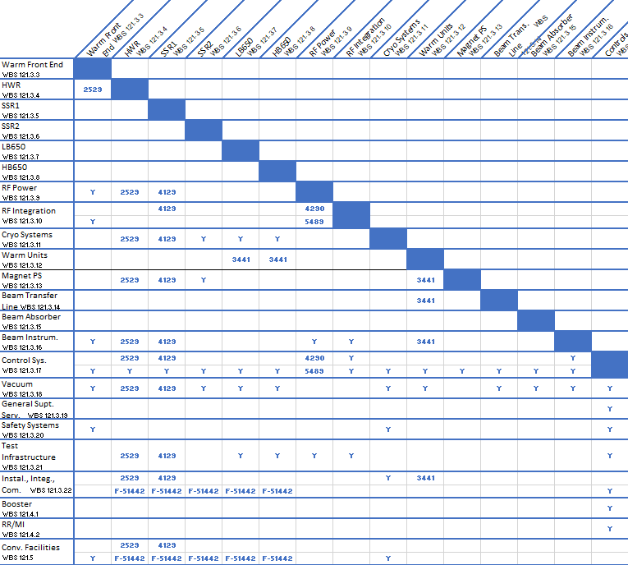
Interfaces

Slide 16
Interfaces
Charge #1
With most other WBM categories
Field Hardware
  PLCs
  RF amplifiers
  Low Level RF
  Instrumentation
Cryomodule Connections
Existing complex
  Particularly for timing and machine protection
Machine Protection interfaces to all the above
Boundaries especially with RF, Instrumentation
Some documents in Teamcenter – see previous slide
IIFC deliverables to be formalized in advance of CD-2

Slide 17
Progress to date
Charge #1
Primary effort has been PIP2IT
Routine beam operation through MEBT
Part of general complex control system
  Newly developed machine protection system
  Adaptation of current timing system
    Parallel to/independent of main complex
Dedicated applications written
  Basic status and control displays
  Dedicated scan and measurement applications
Machine Protection System functional
  Monitoring LEBT chopper and beam coming out
  Monitoring beam transmission to the dump w/ring pickups

Slide 18
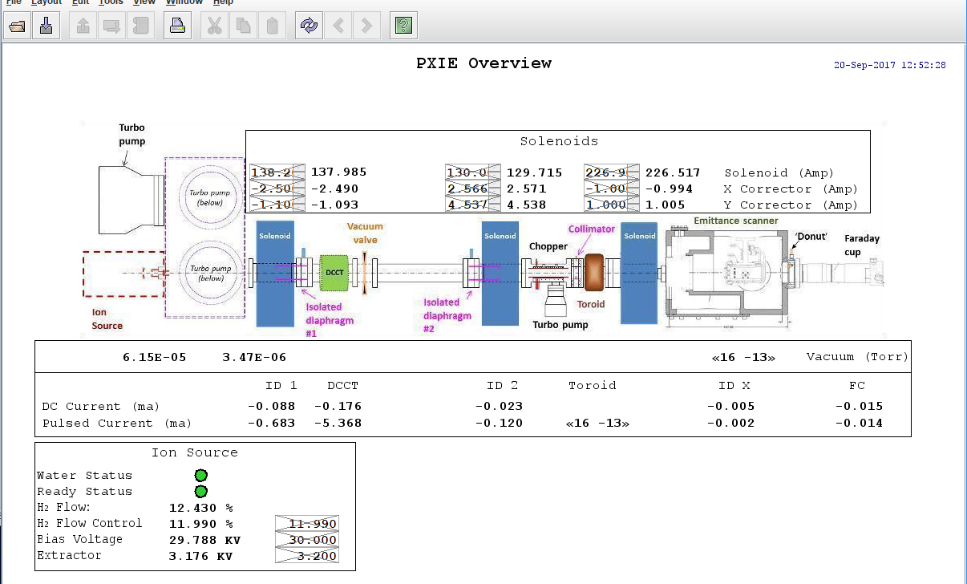
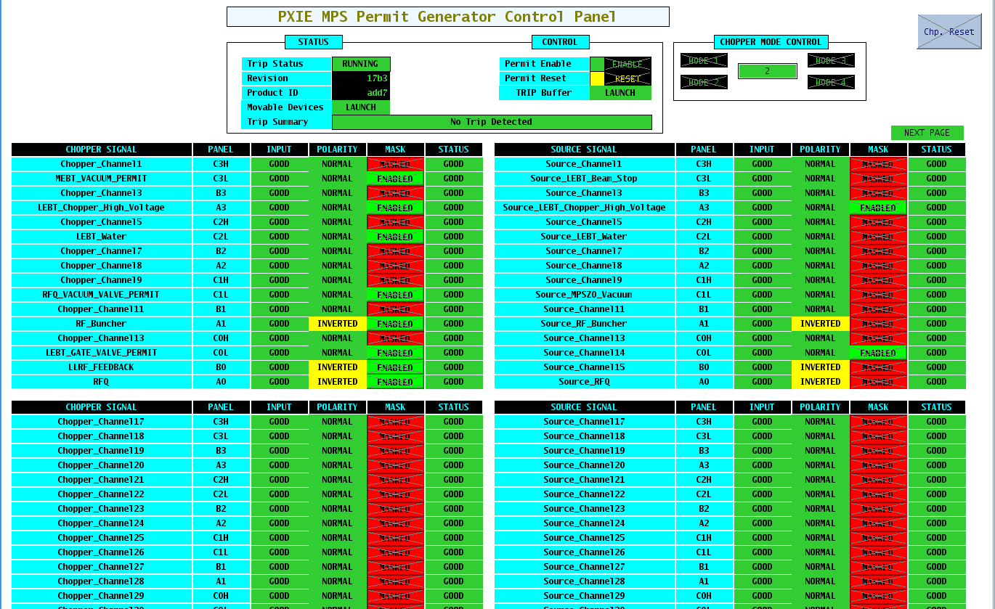
PIP2IT Displays

Slide 19
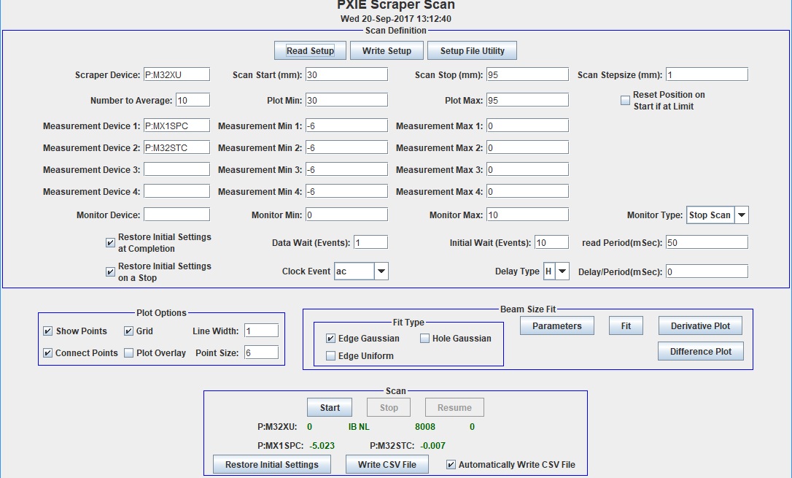
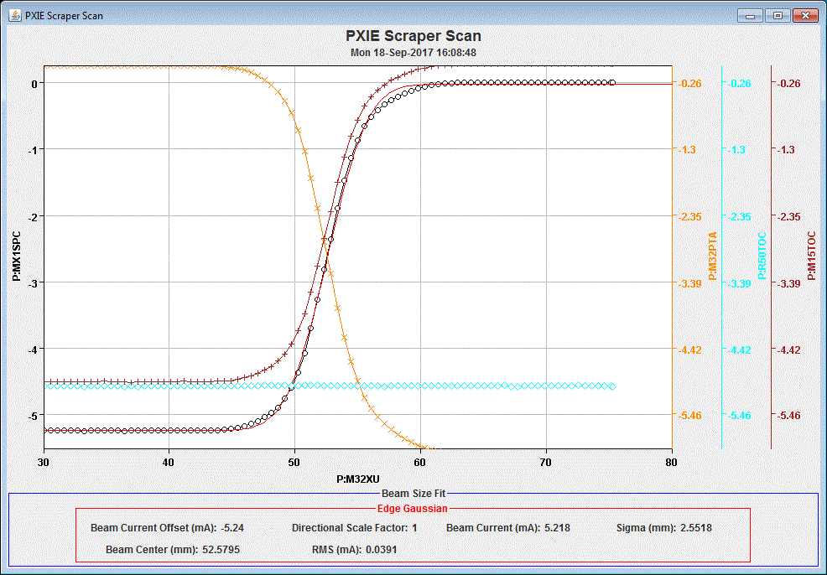
PIP2IT Scraper Scan Application

Slide 20
ESH&Q
Charge #4
Personnel Safety and environmental and equipment protection are the highest priorities in the PIP-II Project.
All activities will be in full compliance with the PIP-II ISM program defined in DocDb# 141.
–Laboratory and DOE standards and practices
    Fermi ES&H Manual
    Division/Area specific Hazards Analyses and Training
Procurement, fabrication, and acceptance of components will follow the Project’s QA Plan (DocDB# 142) utilizing established Project/Division mechanisms regarding acceptance testing, control of non-conformances, and vendor feedback.

Slide 21
Risk: Controls
Machine Protection System Fails (Allows Beam Event)
Machine Protection System Not Allowing Operation
Controls interface to existing complex

Slide 22
Cost Summary
Charge #2
Project Management
PIP2IT (4 Level-5 categories)
PIP-II (10 Level-5 categories)

Slide 23
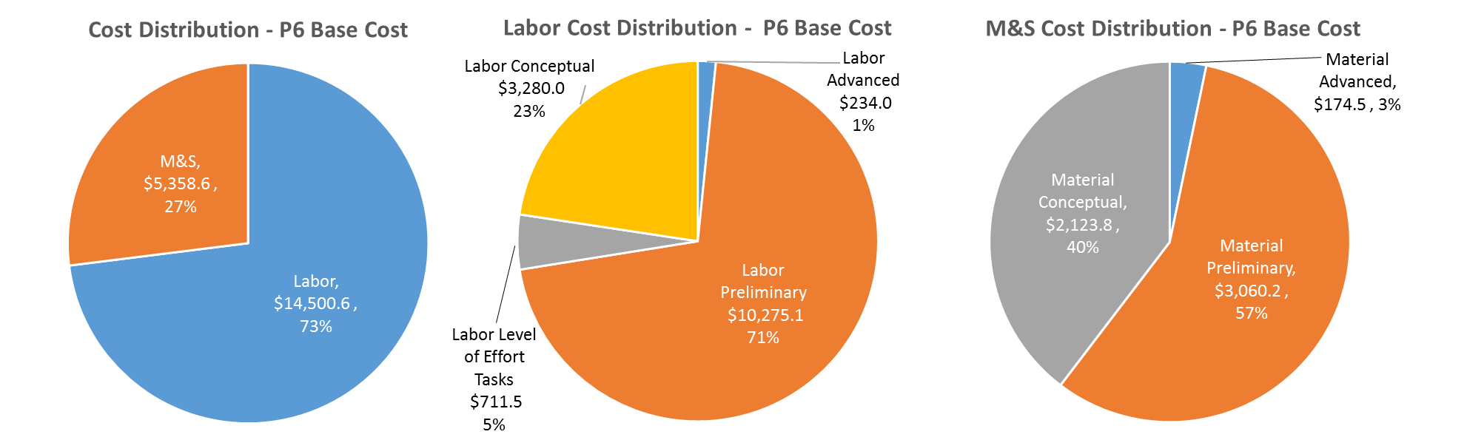
Cost Drivers and Estimate Maturity
Charge #2
P6 Base Costs = BOE + Overheads + Escalation
Substantial labor for software, Machine Protection development
Timing, Machine Protection is at conceptual level
Rest mostly at preliminary level

Slide 24
Cost Profile – P6 Base Cost Only
Charge #2
P6 Base Costs = BOE + Overheads + Escalation
Mostly PIP2IT, timing and machine protection development through FY23
Spending on computing and network infrastructure, and software ramps up in FY24-5

Slide 25
Labor Profile – P6 Hours/FTE
Charge #2
Software work accounts for much of the FY24 jump
Also installation after beneficial occupancy
This is a first pass, better leveling needs to be done

Slide 26
Schedule – Controls
Charge #2

Slide 27
Summary
General plan is to incorporate PIP-II into the existing accelerator control system
Update and modernize components as needed
PIP2IT is operational using this model
Experience there will influence the final designs
Timing and Machine protection will be new systems
We are ready for CD-1 and look forward to your feedback
Thank you for your attention

Slide 28
END

