Slide 1
121.4.1 Booster
W. Pellico
PIP-II Director’s Review
10-12 October 2017

Slide 2
Outline
Requirements
Conceptual Design, Maturity
Scope/Deliverables
Interfaces
Technical Progress to Date
ESH&Q
Risk
Cost
Schedule
Summary

Slide 3
About Me:
Content:
  Manager for Accelerator Upgrades - Booster
  Proton Source Department Head
  Manager of Proton Improvement Plan (PIP)

Slide 4
Conceptual Design and Design Maturity
Charge #1
Supp. Talk
Design a new Booster Injection Girder operating at 800 MeV with a new foil system and a new dump.
  Design in CDR is based on current design and is not optimal.
  Need a new optimized design.
  Only a sketch of an optimized design exists.
  Injection beam simulations
Modifications to the Booster magnet system required to run at 20 Hz.
  Tests and measurements on a Booster magnet were done.
  Design for modifications is mature.
Modifications and Upgrades to the Accelerator Control System to operate at 20 Hz.
  Studies are needed to understand all the required work.
Beam Physics simulations at PIP II intensities

Slide 5
Scope and Deliverables
Charge #1
New Booster Injection Girder operating at 800 MeV
  New stripping foil
  Accommodate phase space painting
  New dump
New Booster Magnet system operating at 20 Hz.
Pulsed systems 20 Hz capable.
Upgraded Accelerator control system operating at 20 Hz.

Slide 6
Interfaces
 | Warm Front End WBS 121.3.3 | HWR WBS 121.3.4 | SSR1 WBS 121.3.5 | SSR2 WBS 121.3.6 | LB650 WBS 121.3.7 | HB650 WBS 121.3.8 | RF Power WBS 121.3.9 | RF Integration WBS 121.3.10 | Cryo Systems WBS 121.3.11 | Warm Units WBS 121.3.12 | Magnet PS WBS 121.3.13 | Beam Trans. Line WBS 121.3.14 | Beam Absorber WBS 121.3.15 | Beam Instrum. WBS 121.3.16 | Controls WBS 121.3.17 | Vacuum WBS 121.3.18 | Gen.l Supt. Serv. WBS 121.3.19 | Instal. Integ. Com. WBS 121.3.22 | Safety Systems WBS 121.3.20 | Test Infra. WBS 121.3.21 | Booster WBS 121.4.1 | RR/MI WBS 121.4.2 | Conv. Facilities WBS 121.5
Warm Front End WBS 121.3.3
HWR WBS 121.3.4 | ED0002529
SSR1 WBS 121.3.5
SSR2 WBS 121.3.6
LB650 WBS 121.3.7
HB650 WBS 121.3.8
RF Power WBS 121.3.9 | Y | ED0002529 | ED0004129
RF Integration WBS 121.3.10 |  |  | ED0004129 |  |  |  | ED0004290
 | Y |  |  |  |  |  | ED0005489
Cryo Systems WBS 121.3.11 |  | ED0002529 | ED0004129 | Y | Y | Y
Warm Units WBS 121.3.12 |  |  |  |  | ED0003441 | ED0003441
Magnet PS WBS 121.3.13 |  | ED0002529 | ED0004129 | Y |  |  |  |  |  | ED0003441
Beam Transfer Line WBS 121.3.14 |  |  |  |  |  |  |  |  |  | ED0003441
Beam Absorber WBS 121.3.15
Beam Instrum. WBS 121.3.16 | Y | ED0002529 | ED0004129 |  |  |  | Y | Y |  | ED0003441
Control Sys. WBS 121.3.17 |  | ED0002529 | ED0004129 |  |  |  | ED0004290 | Y |  |  |  |  |  | Y
 | Y | Y | Y | Y | Y | Y | ED0005489 | Y | Y | Y | Y | Y | Y | Y
Vacuum WBS 121.3.18 | Y | ED0002529 | ED0004129 | Y | Y | Y |  |  | Y | Y |  | Y | Y | Y | Y
General Supt. Serv. WBS 121.3.19
Safety Systems WBS 121.3.20 | Y |  |  |  |  |  |  |  | Y |  |  |  |  |  | Y
Test Infrastructure WBS 121.3.21 |  | ED0002529 | ED0004129 |  | Y | Y | Y | Y |  |  |  |  |  |  | Y
Instal., Integ., Com. WBS 121.3.22 |  | ED0002529 | ED0004129 |  |  |  |  |  | Y | ED0003441
 |  | F10051442 | F10051442 | F10051442 | F10051442 | F10051442 |  |  |  |  |  |  |  |  | Y | Y
Booster WBS 121.4.1 |  |  |  |  |  |  |  |  |  |  |  |  |  |  | Y
RR/MI WBS 121.4.2 |  |  |  |  |  |  |  |  |  |  |  |  |  |  | Y
Conv. Facilities WBS 121.5 |  | ED0002529 | ED0004129 |  |  |  |  |  |  |  |  |  |  |  |  |  |  |  |  |  | Y
 | Y | F10051442 | F10051442 | F10051442 | F10051442 | F10051442 |  |  | Y

Slide 7
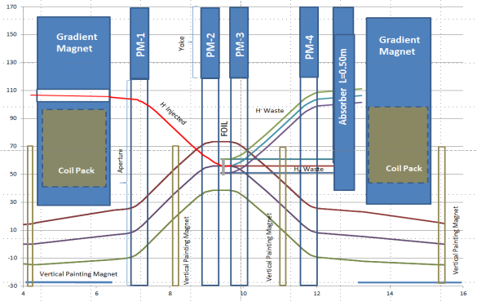
Progress to date
Booster Injection Girder (New Concept Design)
Absorber moved away from aperture
Reduce GMAG length ~ 30% -> increase SS length by 0.86m
4 bump design with separate painting magnets
ORBUMP L_{eff}= 0.422m B=2.7 kG (23.56 mr) fixed inj. field
Painting magnets L_{eff}= 0.195m B~ 500-750 G (2-3 mr)
Requires 4 new, shorter gradient magnets

Slide 8
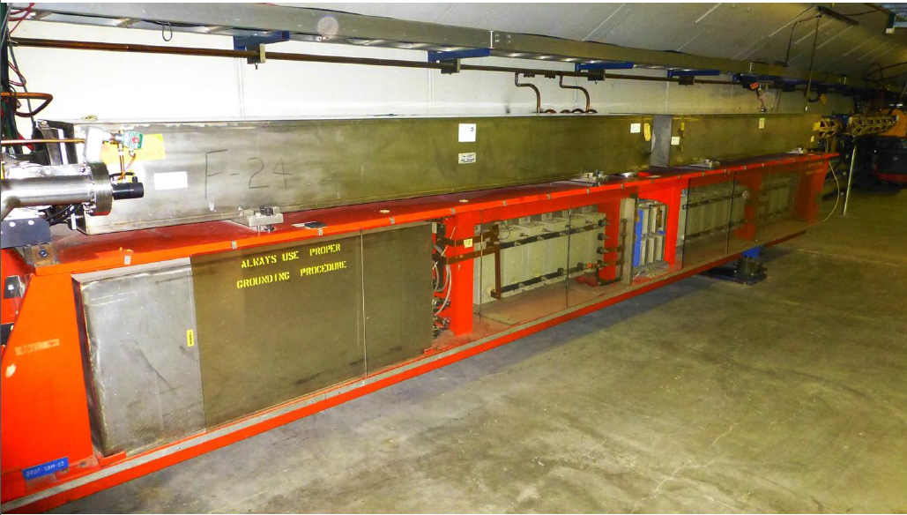
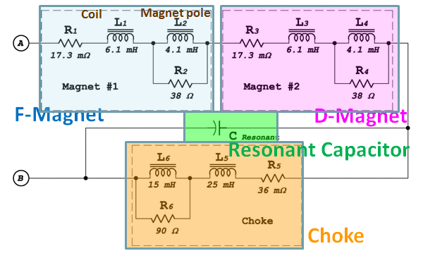
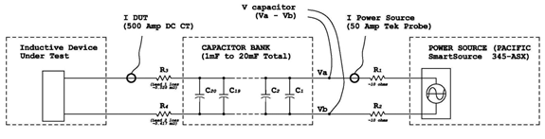
Progress to date
Booster Gradient Resonant Magnet 20 Hz Testing
  Measurements were performed on both a Booster gradient magnet and a Booster choke with the intent to compare the 15 Hz losses with the 20 Hz losses for a proposed Booster upgrade. A complete girder measurement still needs to be done to confirm numbers.

Slide 9
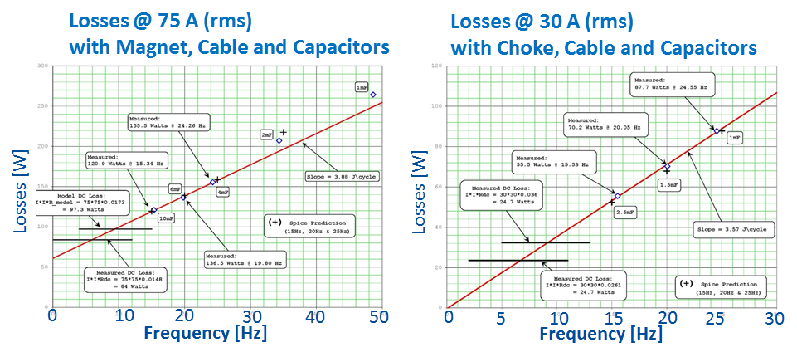
Progress to date
Booster GMPS Magnet 20 Hz testing
Require about 3.9% more power.
Resonant capacitor at each “Girder” must decrease from ~8.33 mF to 4.69 mF.
Capacitor voltage will increase by about 32%
Require same measurements at high current ~500A(rms)

Slide 10
Progress to date
Booster Pulsed Systems 20 Hz
Kickers/Notchers
Average anode current for the Extraction Kickers will go from ~15mA at 15 hertz at 55KV on the PFL to ~20mA at 20 hertz. Well within the allowed limit for the cx-1168 thyratron.
Average power into resistive loads will rise from ~400 watts to ~540 watts The present system has been tested and resulted in minor modification to kicker systems to provide reliable 20 Hz operations.
Septa Magnets
Thermal testing was done on the two spare septa, BSE-105 and BSE-106. The testing on BSE-105 was the most thorough and included 15hz equivalent runs at 200, 400, 600 and 800 Amps rms.
Additional cooling plates showed that the magnet skin temperature for 20 Hz plateaued nicely with a temperature reduction of ~8 deg C at the 2.5 hour point.
Septa Power Supplies
The present pulse power supplies were designed to handle higher operating voltages for 15 Hz. To run at higher voltage or 20 Hz means one could reduce the output pulse width to reduce the rms current.
More Testing required to verify the power supplies and magnets operating points.

Slide 11
ESH&Q
Charge #4
Safety is an essential element in all the work we do.
  We follow Laboratory and DOE standards and practices.
  Apply “Lessons Learned” from project work.
  Hazards and mitigations associated with L2 work scope.
  Quality Assurance and Control:
    Following the Project Quality Assurance Plan
    Communicate with vendors/collaborators
    Test protocols in development
  We are working with the project’s ESH&Q coordinator
    Hazard Analysis Document

Slide 12
Design Review Plan
Charge #3
Design reviews are organized as follows:
  Critical component, subsystem, and primary system all progress through Preliminary (PDR), Final (FDR), and Production Readiness Reviews (PRR). This cycle enables the procurement cycle to begin.
  Non-critical components or subsystems are managed within the Division or Department review process as indicated by the FNAL Engineering Manual.
PIP-II Machine Advisory Committee (P2MAC) Review (April 2017).
Recommendation
  “Flesh out and finalize the Booster injection girder design

Slide 13
BOE Summary
Charge #2
WBS Number | Title | Docdb #
121.4.1.2 | Booster Project Management and Coordination | 611-v6
121.4.1.3-4 | Booster 800 MeV Injection and 20 Hz Upgrade | 614-v6

Slide 14
Schedule – Booster
Charge #2

Slide 15
Cost Summary
Charge #2

Slide 16
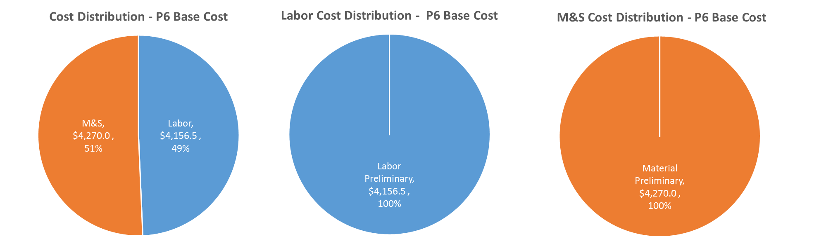
Cost Drivers and Estimate Maturity
Charge #2
P6 Base Costs = BOE + Overheads + Escalation

Slide 17
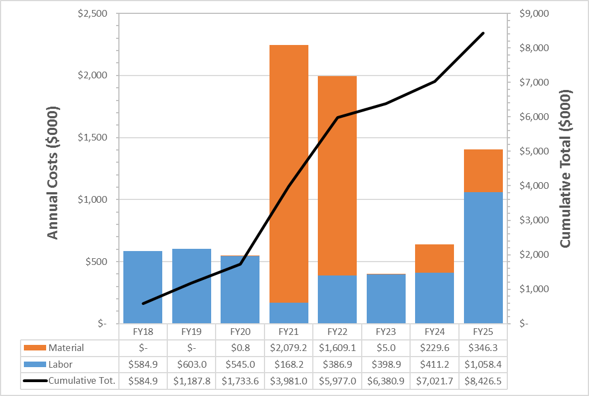
Cost Profile – P6 Base Cost Only
Charge #2
P6 Base Costs = BOE + Overheads + Escalation

Slide 18
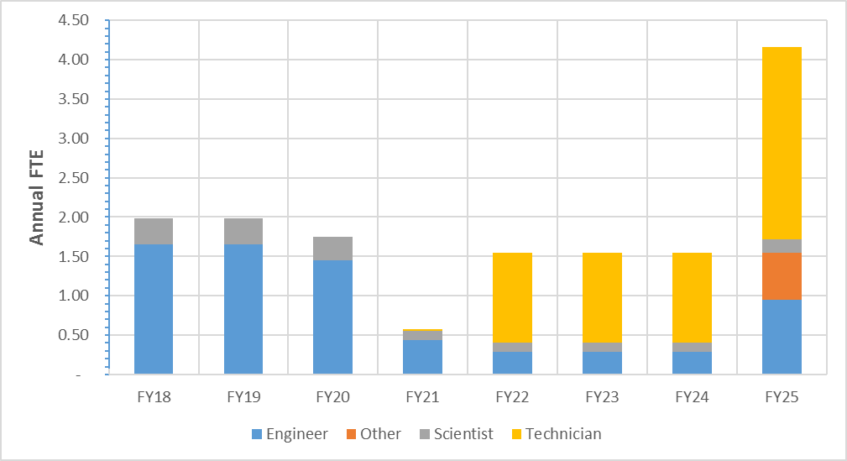
Labor Profile – P6 Hours/FTE
Charge #2

Slide 19
Summary
Requirements are defined.
We have conceptual designs that meet the requirements, and working on finalizing them.
  Improved design for Booster Injection Area.
  20 Hz operations
Cost, schedule, and risks are understood
ESH&Q elements addressed.

