Slide 1
Procurement
Thomas R. Powers
PIP-II Director’s Review
10-12 October 2017

Slide 2
Outline
Procurement Functions
Operations
Responsibilities
Cycle Times
Advanced Procurement Planning and Communications
Procurement Obligations
Summary

Slide 3
About Me:
Procurement Manager – PIP-II
Relevant experience:
FNAL Procurement Supervisor – Construction Group
Procurement Manager – US HL-LHC AUP
SBN Procurement Liaison
Former LBNF Procurement Manger
27 Years of Procurement Management

Slide 4
Procurement Functions
Support the PIP-II Project by providing subcontracting services in a helpful, effective, and timely manner.
This includes a strong emphasis on advance acquisition planning for large, and complex procurement actions.
Support Procurement Requirements from Initial Development to Closeout
Adhere to a Best Value Philosophy

Slide 5
Procurement Functions
Procurement Administrator Responsible
“From Cradle to Grave”:
Planning
Developing
Negotiating
Awarding
Administration
Close-Out

Slide 6
Procurement Operations
Procedural Requirements based on:
FRA Prime Contract
Commercially Accepted Practices
DOE Acquisition Regulations
Federal Acquisition Regulations
DOE Property Management Regulations

Slide 7
Procurement Responsibilities
Staffing Resources
Initial support to be augmented by existing Procurement Manager associated with the project team
Supplemented by existing specialized procurement support, as required
Lab and University
Fabrication
Construction
Standard Commercial Items
Future direct support of the PIP-II project team by the Procurement Manager will be on a part time (50%) basis

Slide 8
Procurement Responsibilities
Procurement Staff Responsibilities
Weekly and Ad-Hoc project team meetings
Provide guidance and support to the PIP-II project team
Communication with Fermilab Procurement Manager, and Acquisition Officer
Reach out to other DOE Science Laboratories and facilities
Review of major procurement project schedule on an ongoing basis
Metrics on Procurement Performance

Slide 9
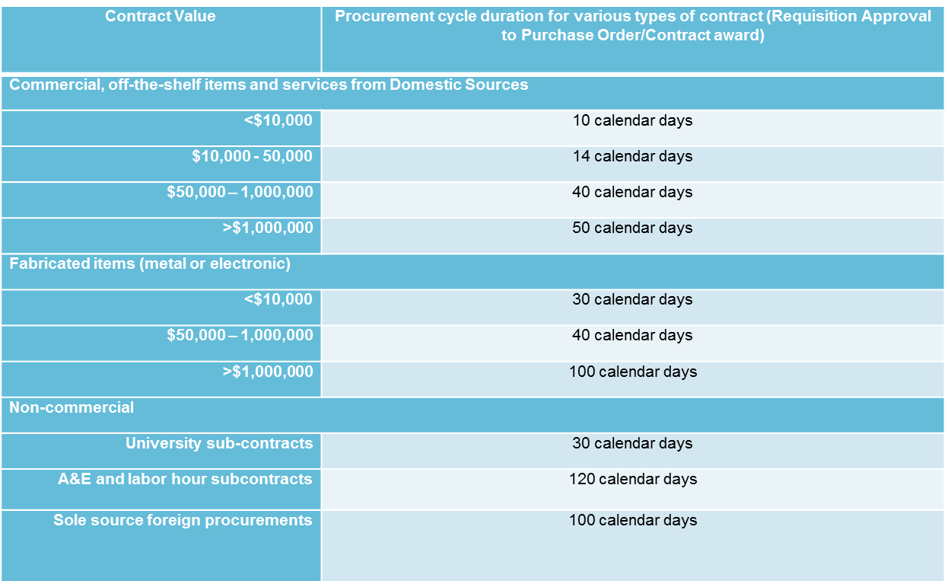
Procurement Cycle Times

Slide 10
Advanced Procurement Planning and Communications
Advanced Procurement Plans are required for acquisitions greater than $500K, and also for acquisitions greater than $100K that are on the critical path, have extended procurement periods, or unique requirements
Acquisition Plans are required for acquisitions greater than $10M
Procurement schedules include consideration for procurement methods and approval requirements
Close Communication with Project and Technical Staff
Communication with Procurement Counterparts from partner and other DOE Laboratories will take place as required

Slide 11
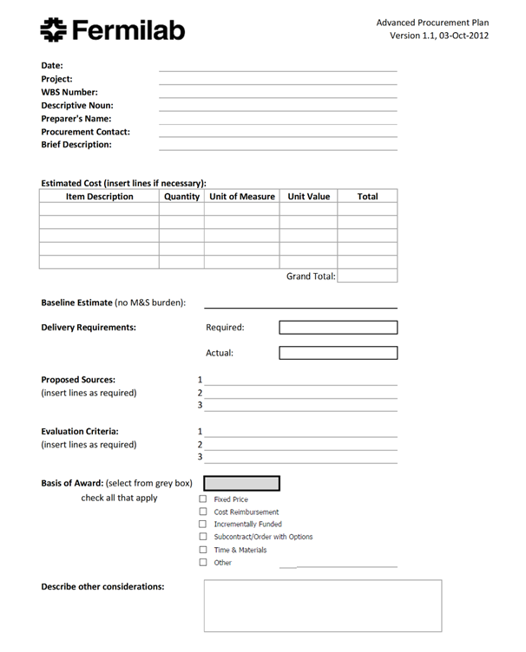
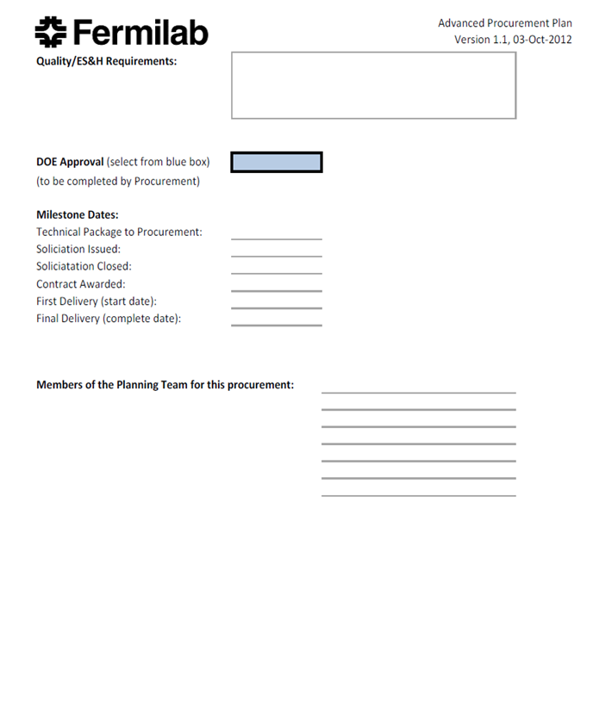
Advanced Procurement Plans

Slide 12
Fiscal Year Counts by Procurement Type
Procurement Classification | FY18 | FY19 | FY20 | FY21 | FY22 | FY23 | FY24 | FY25 | Total
Major |  | 1 | 4 | 1 | 1 |  |  |  | 7
Significant |  | 4 | 1 | 3 | 9 | 1 | 3 |  | 21
Critical | 15 | 10 | 3 | 7 | 9 | 2 | 1 |  | 47
Total | 15 | 15 | 8 | 11 | 19 | 3 | 4 | 0 | 75

Slide 13
PIP-II Major Procurements
Activity Name | Scheduled PO Issue Date | Budgeted Cost ($FY16)
Conventional Facilities
CF – SitePrep – CoS: Site Prep Construction Subcontract - ConstrPh | 6/19 | 18,429,000
CF – CryoBldg – CoS: Cryo Plant Construction Subcontract - ConstrPh | 3/20 | 12,906,000
CF – UtilityBldg – CoS: Utility Plant Construction Subcontract - ConstrPh | 9/20 | 5,980,000
CF – HighBay – CoS: High Bay Bldg Construction Subcontract - ConstrPh | 4/20 | 12,939,000
CF – LTunnel – CoS: Linac Tunnel Construction Subcontract - ConstrPh | 10/20 | 8,918,000
CF – LGallery – CoS: Linac Gallery Construction Subcontract - ConstrPh | 8/21 | 13,549,000
CF – BTL – CoS: Beam Transfer Line Enclosure Subcontract - ConstrPh | 4/22 | 8,771,000

Slide 14
PIP-II Significant Procurements
Activity Name | Scheduled PO Issue Date | Budgeted Cost ($FY16)
SSR1
Linac - SSR1 - 2ndCM - BCAV - Cav - 9CavProdCONTR (FV) - ConstrPh | 5/19 | 618,710
Linac - SSR1 - 2ndCM - DCAV - 9CouplProdCONTR (FV) - ConstrPh | 6/19 | 592,448
SSR2
Linac – SSR2 –1stCM – BCAV – Cav – 20NbProdCONTR (FV) – ConstrPh (for 4 Pre-Prod + 16 Prod Cavities) | 2/20 | 1,965,000
Linac – SSR2 – 2nd-7thCM – BCAV – Cav – 16CavProdCONTR (FV) – ConstrPh | 8/22 | 1,572,000
Linac – SSR2 – 2nd-7thCM – DCAV – 14CouplProdCONTR (FV) – ConstrPh | 4/22 | 825,300
Linac - SSR2 – 2nd-7thCM - DCAV – 16HeVProdCONTR - ConstrPh | 7/22 | 786,000
Linac - SSR2 - 2nd-7thCM - INT - CMComp - 6MagnShCONTR - ConstrPh | 1/24 | 589,500
Linac - SSR2 - 2nd-7thCM - INT - CMComp - 6VacuumVCONTR (FV) - ConstrPh | 1/24 | 884,250
HB650
Linac - HB650 - 1stCM - DCAV - 8CouplProdCONTR (FV) – ConstrPh | 9/19 | 510,900
Linac - HB650 - 2nd-4thCM - BCAV - 10NbProdCONTR (FV) - ConstrPh | 1/19 | 736,875
Linac - HB650 - 2nd-4thCM - BCAV - Cav - 10CavProdCONTR (FV) - ConstrPh | 1/22 | 982,500
Linac - HB650 - 2nd-4thCM - DCAV - 8CouplProdCONTR (FV) - ConstrPh | 7/21 | 510,900
Linac - HB650 - 2nd-4thCM - DCAV - 18MagShCONTR - ConstrPh | 6/21 | 618,975

Slide 15
PIP-II Significant Procurements
Activity Name | Scheduled PO Issue Date | Budgeted Cost ($FY16)
RF Power
Linac - RF - PIP-II/325MHz - 20kWRFDistCONTR - ConstrPh | 7/21 | 707,000
Linac - RF - PIP-II/650MHz - 33CircProdCONTR (FV) - ConstrPh | 7/22 | 583,605
Linac - RF - PIP-II/650MHz - 40kWRFDistCONTR - ConstrPh | 11/21 | 1,455,300
Linac - RF - PIP-II/650MHz - 21CircProdCONTR (FV) - ConstrPh | 7/23 | 589,500
Linac - RF - PIP-II/650MHz - 70kWRFDistnCONTR - ConstrPh | 3/22 | 1,099,200
Cryogenics
Linac – CRYO - PIP-IICDS: PIP-II CDS Contract (FV) - ConstrPh | 3/22 | 3,629,112
Linac - CRYO - PIP-IICryoP – InstCONTR (FV) - ConstrPh | 1/22 | 4,863,413
Conventional Facilities
CF – BoosterConn – CoS: Booster Connection Construction Subcontract - ConstrPh | 4/24 | 4,147,000

Slide 16
PIP-II Critical Procurements >$100K
Activity Name | Scheduled PO Issue Date | Budgeted Cost ($FY16)
WFE
Linac - WFE – IS – ISrc2CONTR - ConstrPh | 1/21 | 201,331
Linac - WFE – MEBT – forPIP-II – 5BunchCavProdCONTR - ConstrPh | 1/21 | 400,000
SSR1
Linac - SSR1 - 2ndCM - BCAV - Cav - 9NbProdCONTR (FV) - ConstrPh | 4/18 | 497,833
Linac - SSR1 - 2ndCM - DCAV – 9TunersProdCONTR (FV) - ConstrPh | 1/19 | 265,275
Linac - SSR1 - 2ndCM - DCAV - 9HeVProdCONTR - ConstrPh | 1/19 | 451,950
Linac - SSR1 - 2ndCM - STRING - FocElem - 4SolProdCONTR - ConstrPh | 9/19 | 178,422
Linac - SSR1 - 2ndCM - INT - CMComp - 1VVProdCONTR (FV) - ConstrPh | 5/20 | 147,375
SSR2
Linac - SSR2 - 1stCM - BCAV - Cav – 2NbProtCONTR (FV) – R&DPh | 7/18 | 196,500
Linac - SSR2 - 1stCM - BCAV - Cav – 2CavProtCONTR (FV) – R&DPh | 7/19 | 196,500
Linac - SSR2 - 1stCM - BCAV - Cav – 4CavProdCONTR (FV) – ConstrPh | 3/21 | 393,000
Linac - SSR2 - 1stCM - DCAV – 2CouplProtCONTR (FV) – R&DPh | 10/17 | 117,900
Linac - SSR2 - 1stCM - DCAV – 6CouplProdCONTR (FV) – ConstrPh | 3/22 | 353,700
Linac - SSR2 - 1stCM - DCAV – 5TunersProdCONTR- ConstrPh | 3/22 | 176,850
Linac - SSR2 - 1stCM - DCAV – 4HeVProdCONTR – ConstrPh | 3/22 | 196,500
Linac - SSR2 - 1stCM - STRING - FocElem - 4SolenCONTR - ConstrPh | 7/22 | 142,560
Linac - SSR2 - 1stCM - INT - CMComp – 1VVCONTR (FV) –ConstrPh | 1/23 | 147,375
Linac - SSR2 – 2nd-7thCM - DCAV – 14TunersProdCONTR- ConstrPh | 3/22 | 412,650
Linac - SSR2 - 2nd-7thCM - COLDMASS - CMComp - 6ThShCONTR - ConstrPh | 1/24 | 206,325

Slide 17
PIP-II Critical Procurements
Activity Name | Scheduled PO Issue Date | Budgeted Cost ($FY16)
RF Power
Linac - RF – PIP2IT – HWR/162.5MHz - 7of7kWSSAprodCONTR – R&DPh | 1/18 | 425,098
Linac - RF – PIP2IT - SSR1/325MHz - 9CircProdCONTR (FV) – R&DPh | 2/19 | 125,000
Linac - RF - TI - CMTS/650MHz - 6CircProdCONTR (FV) – R&DPh | 2/19 | 141,480
Linac - RF - PIP-II/325MHz - 7kWRFDistnCONTR - ConstrPh | 1/22 | 256,000
Linac - RF - PIP-II/325MHz - 30CircProdCONTR (FV) - ConstrPh | 1/22 | 294,750
Cryogenics
Linac – CRYO – PIP2ITCDS – CavTL – R&DPh | 3/22 | 384,157

Slide 18
PIP-II Critical Procurements
Activity Name | Scheduled PO Issue Date | Budgeted Cost ($FY16)
RF Power
Linac - RF – PIP2IT – HWR/162.5MHz - 7of7kWSSAprodCONTR – R&DPh | 1/18 | 425,098
Linac - RF – PIP2IT – HWR/162.5MHz – 5CircProdCONTR (FV) – R&DPh | 1/18 | 36,050
Linac - RF – PIP2IT - SSR1/325MHz - 9CircProdCONTR (FV) – R&DPh | 2/19 | 125,000
Linac - RF - PIP2IT - SSR2/325MHz - 5CircProdCONTR (FV) - ConstrPh | 2/19 | 90,000
Linac - RF - TI - CMTS/650MHz - 6CircProdCONTR (FV) – R&DPh | 2/19 | 141,480
Linac - RF - PIP-II/162.5MHz – 7kWRFDistrCONTR – ConstrPh | 1/22 | 72,000
Linac - RF - PIP-II/325MHz - 8CircProdCONTR (FV) - ConstrPh | 1/22 | 78,600
Linac - RF - PIP-II/325MHz - 7kWRFDistnCONTR - ConstrPh | 1/22 | 256,000
Linac - RF - PIP-II/325MHz - 30CircProdCONTR (FV) - ConstrPh | 1/22 | 294,750
Cryogenics
Linac – CRYO – PIP2ITCDS – CavTL – R&DPh | 3/22 | 384,157

Slide 19
PIP-II Foreign Procurements
Activity Name | Scheduled PO Issue Date | Budgeted Cost ($FY16)
SSR1
Linac - SSR1 - 2ndCM - BCAV - Cav - 9CavProdCONTR (FV) - ConstrPh | 5/19 | 618,710
SSR2
Linac – SSR2 – 1stCM – BCAV – Cav – 20NbProdCONTR (FV) – ConstrPh (for 4 Pre-Prod + 16 Prod Cavities) | 2/20 | 1,965,000
Linac – SSR2 – 2nd-7thCM – BCAV – Cav – 16CavProdCONTR (FV) – ConstrPh | 8/22 | 1,572,000
Linac – SSR2 – 2nd-7thCM – DCAV – 14CouplProdCONTR (FV) – ConstrPh | 4/22 | 825,300
Linac - SSR2 - 2nd-7thCM - INT - CMComp - 6VacuumVCONTR (FV) - ConstrPh | 1/24 | 884,250
HB650
Linac - HB650 - 1stCM - DCAV - 8CouplProdCONTR (FV) – ConstrPh | 9/19 | 510,900
Linac - HB650 - 2nd-4thCM - BCAV - 10NbProdCONTR (FV) - ConstrPh | 1/19 | 736,875
Linac - HB650 - 2nd-4thCM - BCAV - Cav - 10CavProdCONTR (FV) - ConstrPh | 1/22 | 982,500
Linac - HB650 - 2nd-4thCM - DCAV - 8CouplProdCONTR (FV) - ConstrPh | 7/21 | 510,900
RF Power
Linac - RF - PIP-II/650MHz - 33CircProdCONTR (FV) - ConstrPh | 6/23 | 583,605
Linac - RF - PIP-II/650MHz - 21CircProdCONTR (FV) - ConstrPh | 5/24 | 589,500
Cryogenics
Linac – CRYO - PIP-IICDS: PIP-II CDS Contract (FV) - ConstrPh | 3/22 | 3,629,112
Linac - CRYO - PIP-IICryoP – InstCONTR (FV) - ConstrPh | 1/22 | 4,863,413

Slide 20
Summary
Messages:
Procurement policies and procedures are well established
Procurement staff have experience in procurement of the supply, fabrication, and construction requirements of this project
The procurement department is motivated, qualified, and ready to deliver
We are ready for CD-1 and look forward to your feedback
Thank you for your attention

Slide 21
END

