Slide 1
WBS 121.5 – Conventional Facilities
Cost and Schedule
Steve Dixon
PIP-II Director’s Review
10-12 October 2017

Slide 2
Outline
Cost Estimate Process
  Construction Base Cost;
  Engineering Design and Inspection;
  Project Management and Coordination;
Schedule Estimate Process
  Construction Durations;
  Procurement Durations;
Contingency
Basis of Estimate Form
Risk Uncertainty
Charge 2:
In establishing the cost range for the DOE scope, has the project clearly identified all scope for which the DOE will be responsible? Are the estimated cost and schedule ranges credible and realistic for this stage of the project? Is adequate scope, cost, and schedule contingency included?

Slide 3
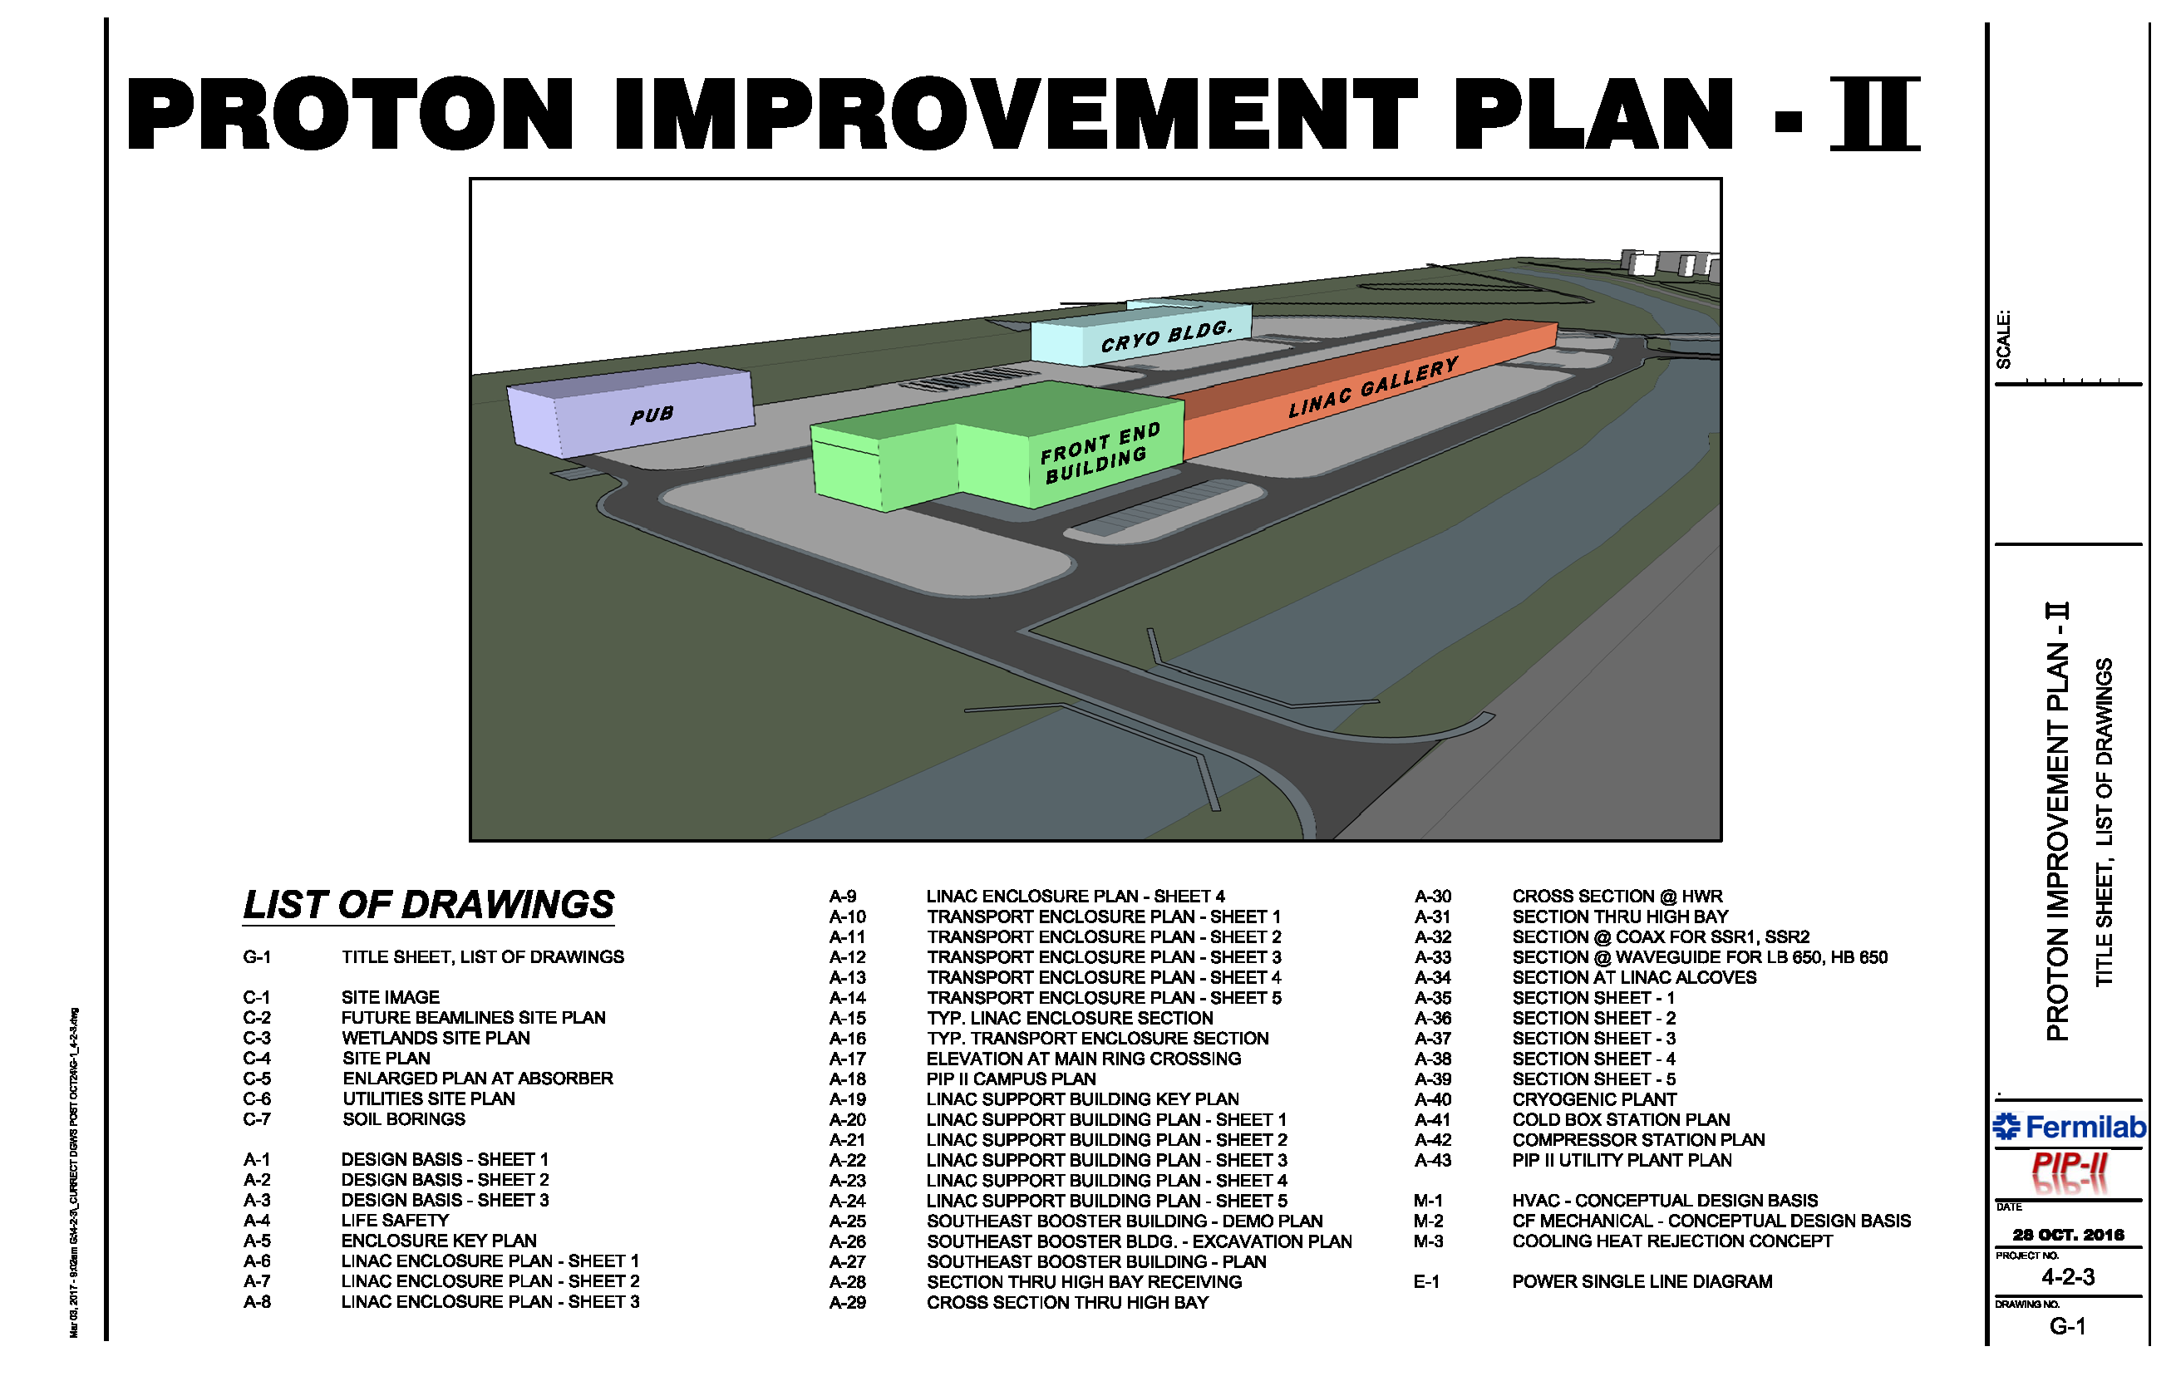
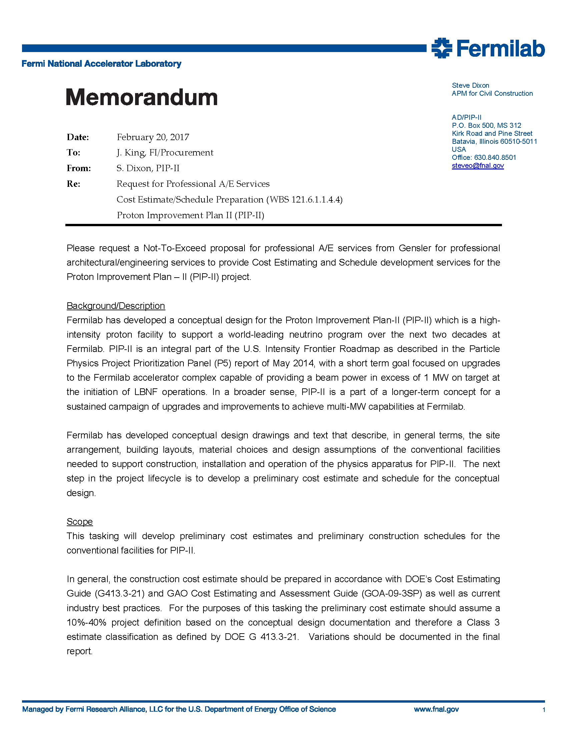
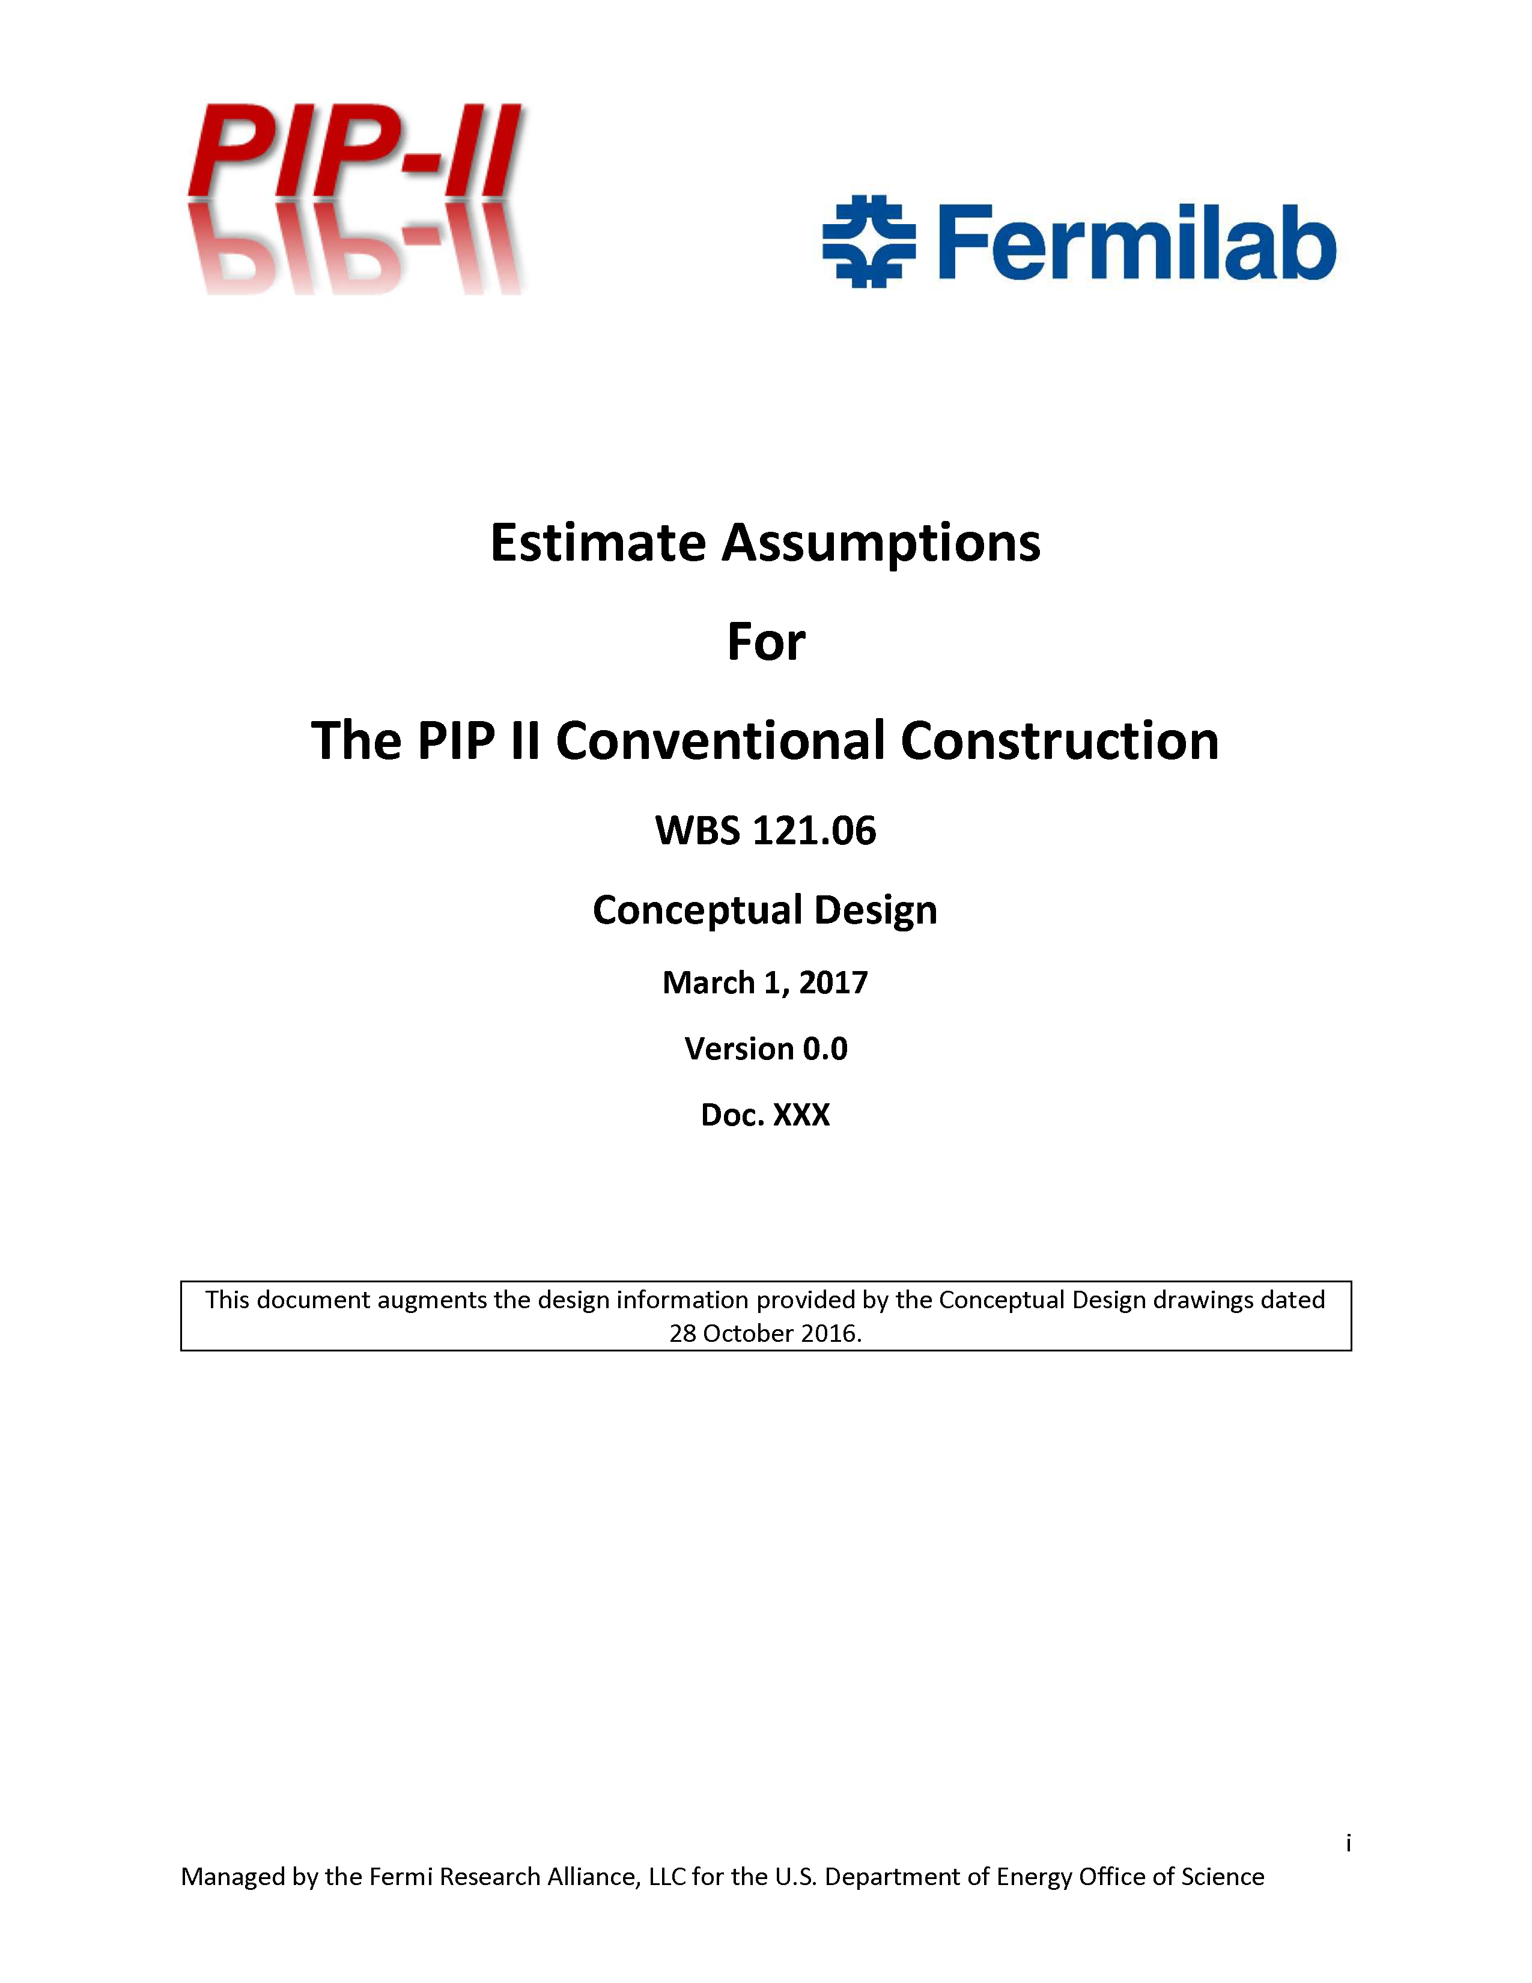
Cost Estimate Process – Construction Base Cost
Drawings from PIP-II-doc-1155
Initial Tasking for A/E Team
Conceptual Design drawings and Estimate Assumptions developed with input from stakeholders
the construction cost estimate should be prepared in accordance with DOE’s Cost Estimating Guide (G413.3-21) and GAO Cost Estimating and Assessment Guide (GOA-09-3SP) as well as current industry best practices. For the purposes of this tasking the preliminary cost estimate should assume a 10%-40% project definition based on the conceptual design documentation and therefore a Class 3 estimate classification as defined by DOE G 413.3-21
Documentation can be found at PIP-II-doc-333

Slide 4
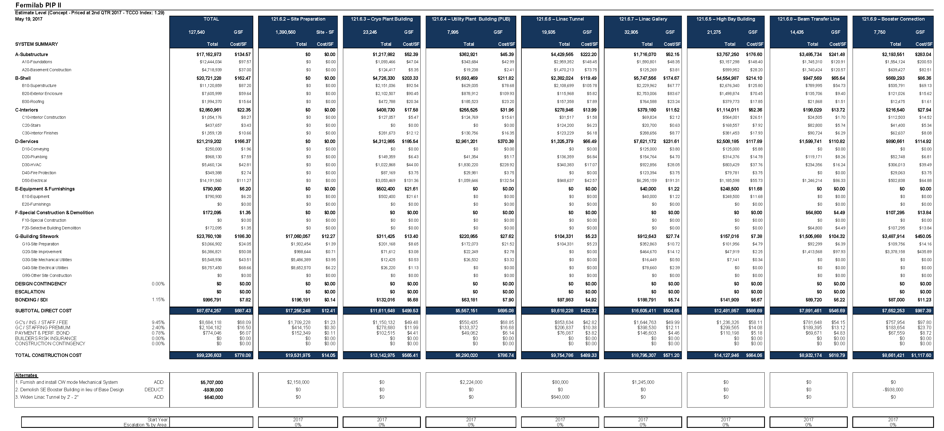
Cost Estimate Process – Base Cost
Estimate completed in May 2017;
Broken down by work package;
Costs in FY17 dollars, de-escalated to FY16 dollars for overall project consistency;
Included several initial scope alternates.
Documentation can be found at PIP-II-doc-333

Slide 5
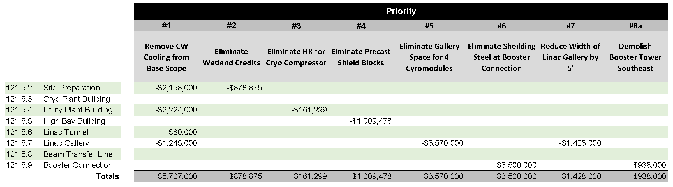
Cost Estimate Process – Early Scope Reductions
Prioritized List of Scope Reduction (high level);
Reductions to Base Cost, broken down by work package;
Costs in FY17 dollars, de-escalated to FY16 dollars;
Discussed and reviewed by PIP-II project;
Documented in Basis of Estimate forms.
Documentation can be found at PIP-II-doc-1025

Slide 6
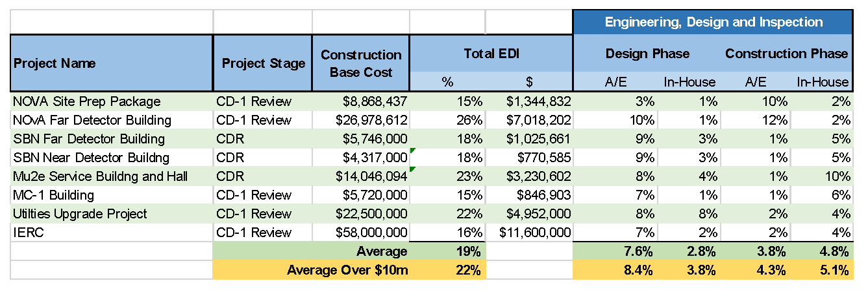
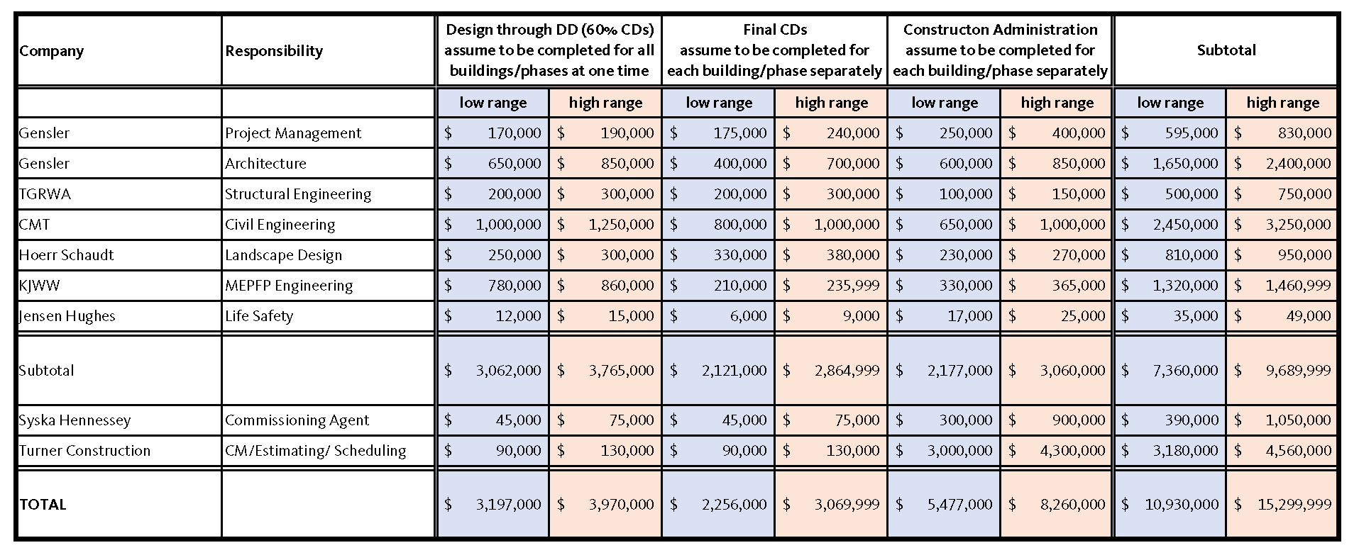
Cost Estimate Process – ED&I
Engineering Design and Inspection (EDI)
  Based on Construction Cost;
  Review of Historic Data from Fermilab projects;
  Initial Range from architect/engineer;
Range: 10.4% to 14.6%
Historic data from previous projects
Documentation can be found at PIP-II-doc-327

Slide 7
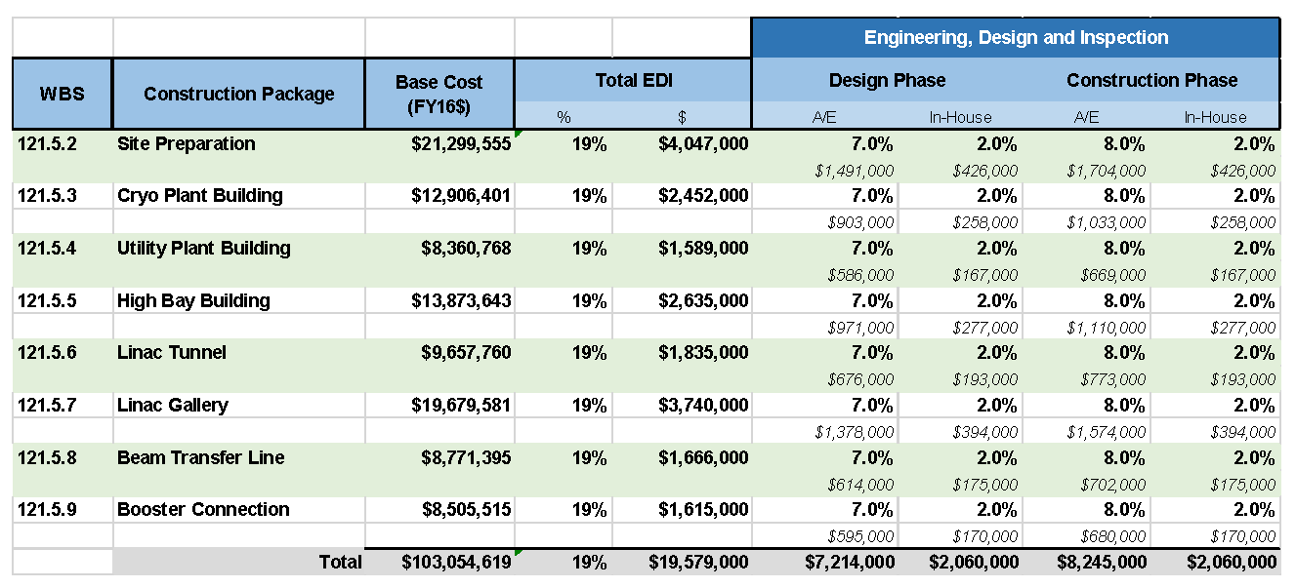
Cost Estimate Process – ED&I
Engineering Design and Inspection (ED&I) – 19% Overall
  In-house: 2% for Design, 2% for Construction Phase
  Architect/Engineer: 7% for Design, 8% for Construction Phase
Documentation can be found at PIP-II-doc-327

Slide 8
Cost Estimate Process - Administration
Project Management and Coordination Costs (PM&C)
“Administration” costs are primarily management and oversite activities during the design and construction phases;
Consist of one (1) full time equivalent (FTE) for the Associate Project Manager for Conventional Facilities (APM-CF) from FY18 until the end of the project;
An additional one (1) FTE for a deputy APM-CF position assumed to begin in ~FY19 coinciding with CD-2/3a and extends until the end of the project;
This PM&C cost is divided between:
  40% - Project Office Support
  10% - Conventional Facilities Management and Coordination
  50% - Individual work packages
Documentation can be found at PIP-II-doc-327
Project Office Support basis of estimate can be found at PIP-II-doc-229
Conventional Facilities Management and Coordination basis of estimate can be found at PIP-II-217

Slide 9
Schedule Estimate Process
Drawings from PIP-II-doc-1155
Initial Tasking for A/E Team
Conceptual Design drawings and Estimate Assumptions developed with input from stakeholders
The preliminary construction schedule should instead focus on the completion of major milestones (eg: excavation complete, foundation complete, building shell complete, beneficial occupancy, etc.) within the overall schedule to provide a reasonable prediction of one possible construction scenario. This schedule information will be included in the PIP-II resource loaded schedule as a planning package that will be updated with further information and details as they become available.
Documentation can be found at PIP-II-doc-581

Slide 10
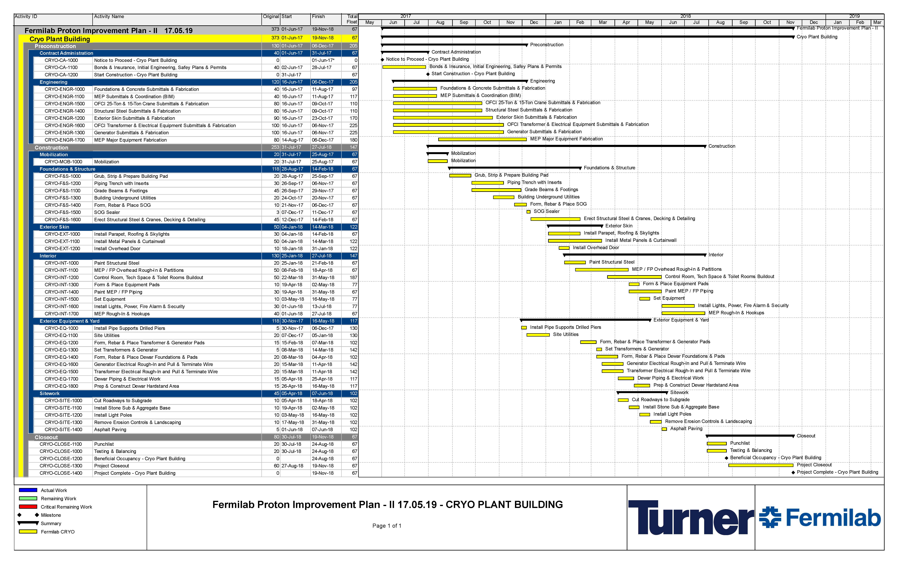
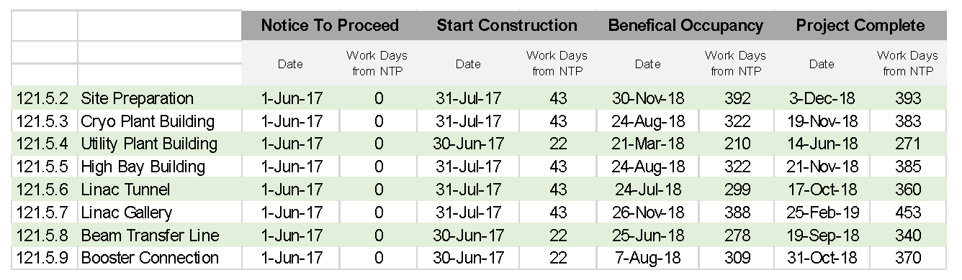
Schedule Estimate Process
Considered Planning Packages;
Technically driven schedules;
Focused on interface milestones.
Documentation can be found at PIP-II-doc-581 and in each Basis of Estimate file

Slide 11
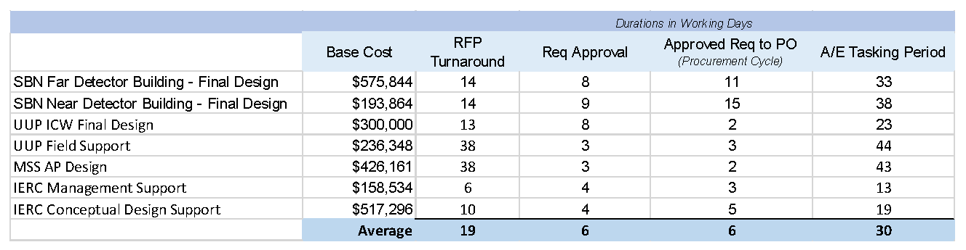
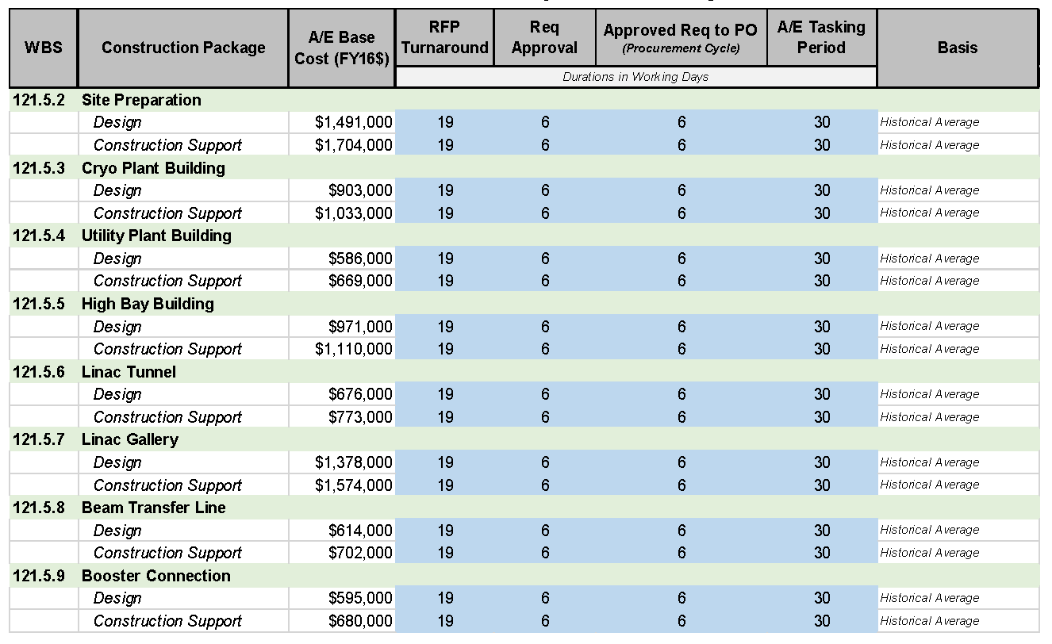
Procurement Durations – A/E Firms
Architect/Engineering Firm;
  Review of Historic Data from Fermilab projects;
  Includes turnaround times for Request for Proposal (RFP), Requisition Approval and Issue PO;
  Average of 30 working days.
30 Working Days
Historic data from previous projects
Documentation can be found at PIP-II-doc-318

Slide 12
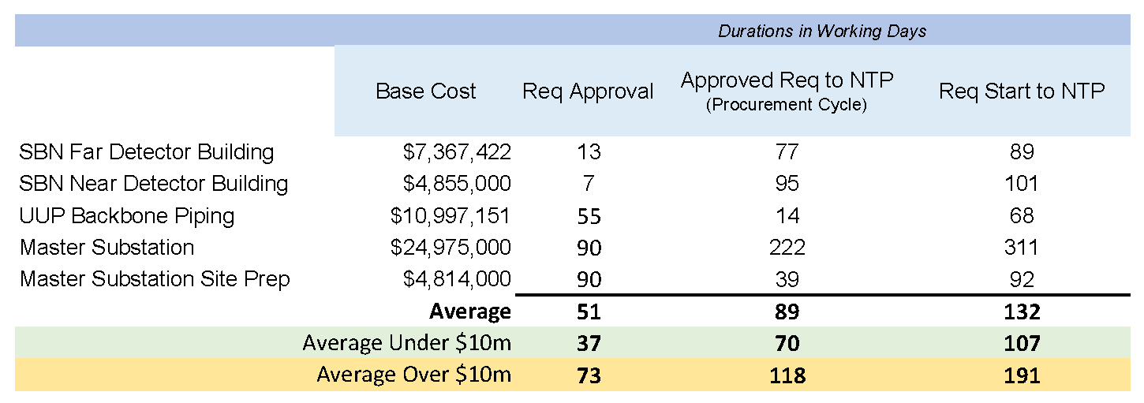
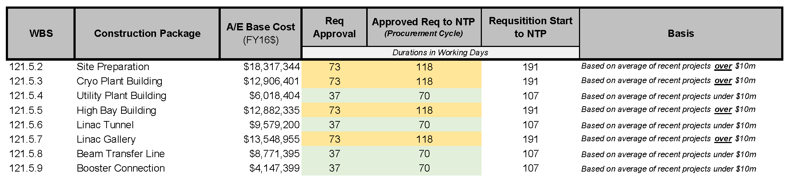
Procurement Durations – Construction
Construction Subcontracts;
  Review of Historic Data from Fermilab projects;
  Includes turnaround times for Requisition Approval, Request for Proposal (RFP) and Issue Notice To Proceed (NTP);
  Average of 107 working days for under $10m;
  Average of 191 working days for over $10m;
Historic data from previous projects
Documentation can be found at PIP-II-doc-321

Slide 13
Contingency
Cost Estimate Uncertainty:
Based on level of definition and design maturity;
A/E team provided input;
20% cost contingency applied to most construction subcontracts;
25% cost contingency applied to Booster Connection construction subcontract;
20% cost contingency applied to design work;
Schedule Uncertainty:
-10% to +20% schedule contingency provided by A/E team.

Slide 14
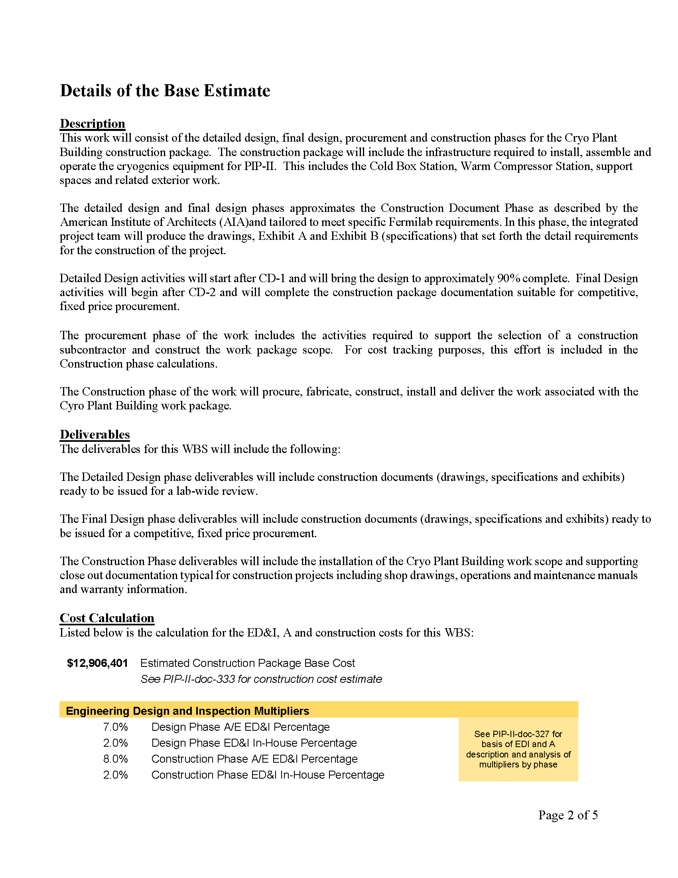
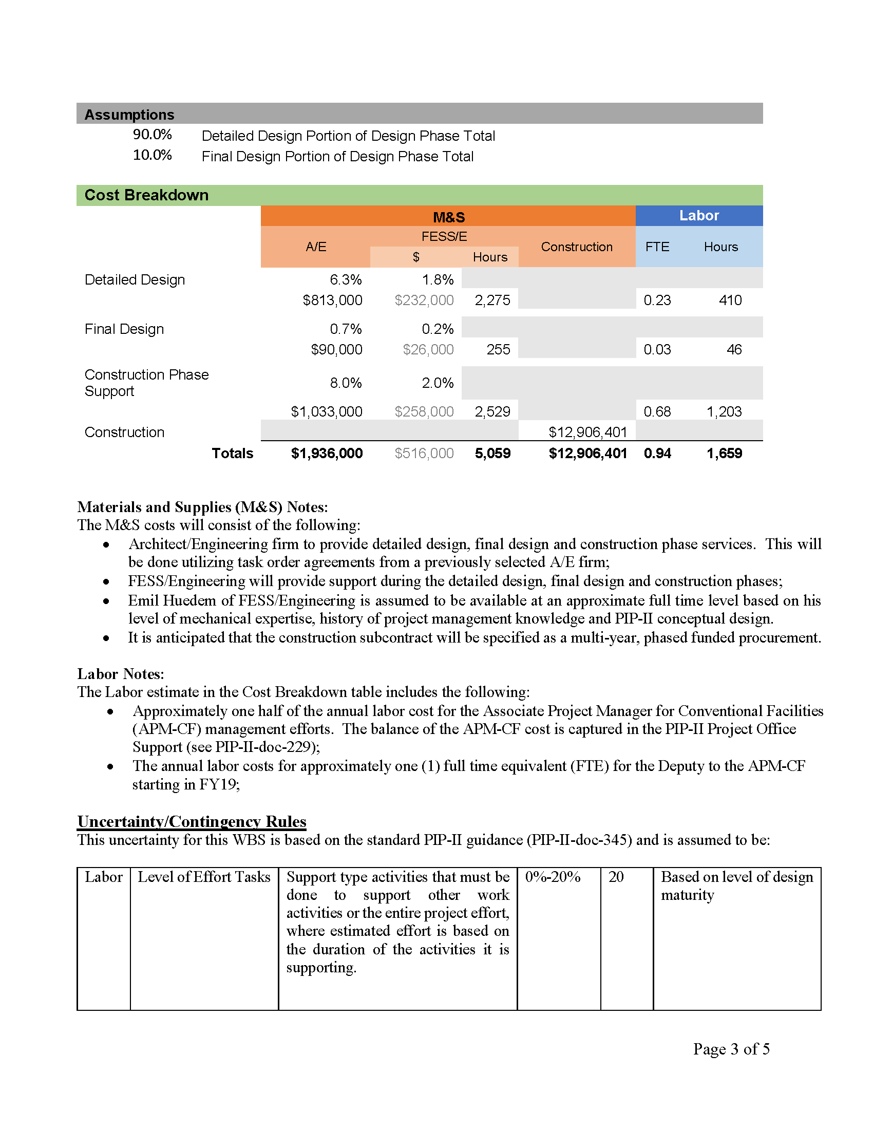
Basis Of Estimate
Project Management and Coordination Costs
(PIP-II-doc-327)
ED&I Costs
(PIP-II-doc-327)
Construction Cost
(PIP-II-doc-333)
including
Scope Reduction Options
(PIP-II-doc-1025)
Typical Basis of Estimate form
Contingency

Slide 15
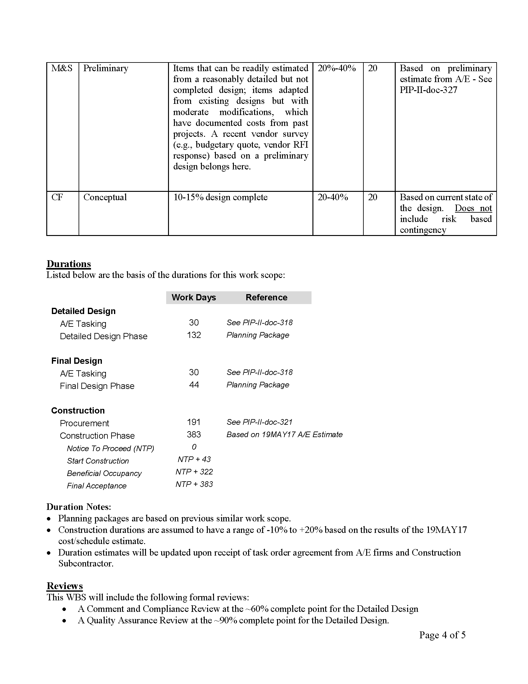
Basis Of Estimate
Contingency
A/E Tasking Durations
(PIP-II-doc-318)
Construction Subcontract Procurement Duration
(PIP-II-doc-321)
Construction Subcontract Duration
(PIP-II-doc-581)
Typical Basis of Estimate form

Slide 16
Basis Of Estimate List

Slide 17
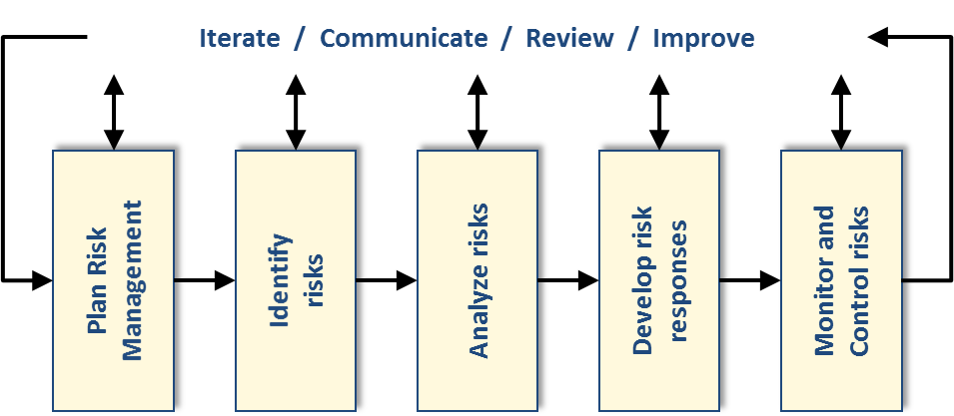
Risk Uncertainty
Follow the PIP-II Risk Management Plan
  (see Shekar's Presentation)
Process:
  Reviewed past projects at Fermilab;
  Reviewed lessons learned from other labs;
  Met with the Conventional Facilities project team including A/E and Procurement (April 2017);
  Formal Risk Management Workshop with outside reviewers;
  Input, tracked and updated in the Fermilab Risk Register;
PIP-II Risk Management Plan can be found at PIP-II-doc-163
Fermilab Risk Register can be found at https://fermipoint.fnal.gov/organization/ocoo/ippm/Lists/Risk%20Register/all-risks.aspx

Slide 18
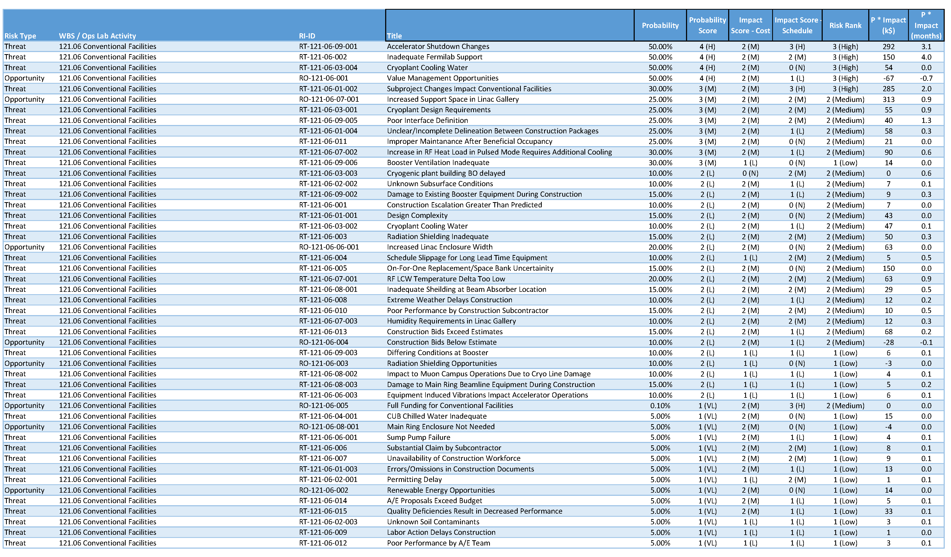
Risk Uncertainty Results
44 Threats and 9 Opportunities

Slide 19
Risk Uncertainty – RT-121-09-002
Accelerator Shutdown Changes
Summary
  If the planned accelerator shutdown changes then the construction of the booster connection will be impacted and jeopardizes the cost/schedule.
Cause/Trigger
  The PIP-II transport line scope includes a connection to the existing booster enclosure. This connection is scheduled to occur concurrently with the LBNF accelerator shutdown. Changes, especially sooner than anticipated, could impact the cost and schedule of the connection work
Mitigation
  Coordination with LBNF and accelerator operations should be ongoing to understand the latest schedule. In addition, the design of the booster tower connection should be completed early and packaged as a stand-alone work scope to provide flexibility in executing the work.

Slide 20
Risk Uncertainty – RT-121-06-002
Inadequate Fermilab Support
Summary
  ​If there is inadequate Fermilab support during design and construction then the construction activities will be impacted which jeopardizes the completion of the work.
Cause/Trigger
  Construction activities require Fermilab support during the design and construction phases for reviews, shop drawing tracking/review, response to subcontractor questions, Fermilab interfaces and construction coordinator duties. Traditionally, these functions are provided by FESS/E.
Mitigation
  The PIP-II conventional facilities will develop a memorandum of understanding between the project and FESS to detail the responsibilities and expectations.
  As part of the architect/engineer selection, the design team will be able to supplement the support functions during design and construction.

Slide 21
Risk Uncertainty – RT-121-03-002
Cryoplant Cooling Water
Summary
  ​If there is insufficient ICW for cooling the cryogenic equipment then cooling towers/fluid coolers will be required which jeopardizes the cost assumptions
Cause/Trigger
  The baseline design for the cooling of the cryogenic compressors assumes a 1,400 gpm flow of industrial cooling water (ICW) from the existing sitewide ICW system. If the existing system is unable to meet this requiement a cooling tower or fluid cooler system is required.
Mitigation
  The project team has provided the process load requirements to FESS for input into the sitewide ICW flow model.
  The project team will continue to discuss the use of ICW with FESS personnel and include this requirements in the assumption document.

Slide 22
Risk Uncertainty – RO-121-06-001
Value Management Opportunities
Summary
  ​If the design of the conventional facilities can be changed/modified to achieve the same performance at a lower cost and schedule duration then the project will realize a cost/scheduling improvement
Cause/Trigger
  Convene Value Engineering exercise with project team
Mitigation
  Encourage designs that are able to achieve the required performance at reduced life cycle cost.
  Conduct formal value management/engineering workshops during the design process. (Purchase order in place with A/E team)

Slide 23
Risk Uncertainty – RT-121-06-01-002
Subproject Changes Impact Conventional Facilities
Summary
  ​If the subproject requirements changes then the design of the conventional facilities will need to be modified jeopardizing the cost and schedule objectives
Cause/Trigger
  ​Changes to the subproject requirements
Mitigation
  ​Include subproject managers in design meetings;
  Include subproject managers in formal design reviews;
  Management control of changes through a change/configuration control process;

Slide 24
Summary
Scope
  Conceptual Design based on stakeholder input which identifies the scope of the conventional facilities required to support the project.
Cost Estimate
  Construction Cost estimate was done by professional contractors independent from the team that developed the conceptual design;
  Engineering, Design and Inspection (ED&I) costs were based on historic Fermilab project data and initial cost ranges provided by the architect/engineer.
Schedule
  Work packages schedules were developed based on historic data and input from professional contractors.
Basis of Estimate
  Contain the information needed as input for the resource loaded schedule.
Risk
  Developed risks based on past project team experience following the project’s Risk Management Plan.

Slide 25
Questions?

