Slide 1
121.3.9 Linac - RF Power
Breakout Session: RF Systems, Controls, and Instrumentation
David W. Peterson
PIP-II Director’s Review
10-12 October 2017

Slide 2
Outline
Requirements
Conceptual Design, Maturity
Scope/Deliverables
Interfaces
Technical Progress to Date
ESH&Q
Risk
Cost
Schedule
Summary

Slide 3
About Me:
David Peterson, PIP-II RF Power, Level 3
Electrical Engineer – MSEE 1983, University of Illinois, Urbana
Fermilab – 1984 Tev I Project -> Antiproton Source
  Involved with RF amplifiers, Low Level RF, Stochastic Cooling systems and Acnet control of those systems. Also RF cavity design, Beam Instrumentation and Motion Controls.
2011 AD/RF
  Involved with Muon Ionization Cooling Experiment (MICE).
  Involved with PIP2IT RF system design, installation, controls and testing.
  Oct 2016 - PIP-II RF Power, Level 3.
About Him:
Jim Steimel, PIP-II Project Electrical Engineer

Slide 4
WBS L3 System Requirements
Charge #1
RF Power shall provide
  Amplifiers
    with linear gain within the operating bandwidth of LLRF system
    and sufficient power to maintain required field in a tuned cavity.
  Circulators
    with sufficient power handling capability to withstand cavity transients and continuous operation at full reflected power,
    and with sufficient reverse isolation, bandwidth, and input match to meet reflected power requirements of the amplifiers.
  Controls & Interlocks (where not otherwise provided, see WBS 121.3.10)
    for detection of reflected power and RF leakage
    and amplifier interface to the Accelerator Control Network.
  RF Distribution
    including coax transmission lines and waveguide,
    connectors, elbows, adapters, etc.,
    directional couplers,
    loads

Slide 5
WBS L3 System Requirements
Charge #1
This WBS entry covers design, procurement, fabrication, and testing of the linac RF power amplifiers and transmission hardware. It includes development of systems at 162.5 MHz, 325 MHz, and 650 MHz, for both test infrastructure and linac systems.
FRS
ED0003671-162.5 MHz SOLID STATE 75 KW AMPLIFIER, FRS
ED0003672-162.5 MHz SOLID STATE 3 KW AMPLIFIER, FRS
ED0003673-162.5 MHz SOLID STATE 7 KW AMPLIFIER, FRS
ED0003408-325 MHz SOLID STATE 7kW AMPLIFIER, FRS
ED0003669-325 MHz SOLID STATE 20 kW AMPLIFIER, FRS
ED0003413-650 MHz SOLID STATE 40 kW AMPLIFIER, FRS
ED0003680-650 MHz SOLID STATE 70 kW AMPLIFIER, FRS
TRS
ED0002015-RFQ, AMPLIFIER TRS
ED0002016-RFQ, CIRCULATOR TRS
ED0004290-7 kW RF POWER AMPLIFIER, TRS - SSR1 325 MHz
ED0005489-TRS 40 kW, 650 MHz Solid State RF Power Amplifier System
DAE Deliverables
DAE Deliverables

Slide 6
Scope and Deliverables
Charge #1
Scope:
  Amplifiers (122 total)
  Circulators
  RF Distribution
    Coax transmission lines and waveguide
    Connectors, elbows, adapters, etc.
    Directional Couplers
    Loads
  Controls & Interlocks (where not otherwise provided)
    Reflected power and RF leakage detection
    Interface to Accelerator Control Network
Deliverables:
  Fermilab provides Circulators, RF distribution and Controls and Interlocks for all systems.
  Fermilab provides amplifiers for systems up through HWR. (14/122)
  IIFC provides amplifiers for SSR1, SSR2, LB650 and HB650. (108/122)
  The current plan assumes the delivery of 108 DAE amplifiers. The details concerning deliverables and schedule will be finalized by CD-2.

Slide 7
Scope and Deliverables
Charge #1
Section | Qty | Freq (MHz) | Power (kW) | Duty | Source
RFQ | 2 | 162.5 | 75 | CW | FNAL
Buncher | 4 | 162.5 | 3 | CW | FNAL
First HWR | 1 | 162.5 | 3 | CW | FNAL
Other HWR | 7 | 162.5 | 7 | CW | FNAL
SSR1 | 16 | 325 | 7 | Pulse/CW | DAE
SSR2 | 35 | 325 | 20 | Pulse/CW | DAE
LB650 | 33 | 650 | 40 | Pulse/CW | DAE
HB650 | 24 | 650 | 70 | Pulse/CW | DAE
DAE Deliverables
= Room Temperature Cavities
= Superconducting Cavities
V. Lebedev, FNAL, The PIP-II Conceptual Design Report

Slide 8
Interfaces
Charge #1
RF Integration (WBS 121.3.10)
  RF signals
    LLRF into HLRF
    Directional Coupler signals back to LLRF
    HLRF into Cavity Coupler
  RF Protection
    SC Cavity Permit Status to PLC
    PLC & RF Fast Interlock Permit to LLRF
Controls (WBS 121.3.17)
  Amplifier Interlocks and Controls
    Communications between Amplifier and Control System
    Communications with PLC
    PLC communications with Control System
Cavity Input Couplers
  HWR (WBS 121.3.4)
  SSR1, SSR2 (WBS 121.3.5-6)
  LB650, HB650 (WBS 121.3.7-8)
Conventional Facilities (WBS 121.5)
  Equipment footprints
  Cooling Water and HVAC
  AC Power

Slide 9
System Interfaces
Charge #1
 | Warm Front End WBS 121.3.3 | HWR WBS 121.3.4 | SSR1 WBS 121.3.5 | SSR2 WBS 121.3.6 | LB650 WBS 121.3.7 | HB650 WBS 121.3.8 | RF Power WBS 121.3.9 | RF Integration WBS 121.3.10 | Cryo Systems WBS 121.3.11 | Warm Units WBS 121.3.12 | Magnet PS WBS 121.3.13 | Beam Trans. Line WBS 121.3.14 | Beam Absorber WBS 121.3.15 | Beam Instrum. WBS 121.3.16 | Controls WBS 121.3.17 | Vacuum WBS 121.3.18 | Gen.l Supt. Serv. WBS 121.3.19 | Instal. Integ. Com. WBS 121.3.22 | Safety Systems WBS 121.3.20
Warm Front End WBS 121.3.3
HWR WBS 121.3.4 | 2529
SSR1 WBS 121.3.5
SSR2 WBS 121.3.6
LB650 WBS 121.3.7
HB650 WBS 121.3.8
RF Power WBS 121.3.9 | Y | 2529 | 4129
RF Integration WBS 121.3.10 |  |  | 4129 |  |  |  | 4290
 | Y |  |  |  |  |  | 5489
Cryo Systems WBS 121.3.11 |  | 2529 | 4129 | Y | Y | Y
Warm Units WBS 121.3.12 |  |  |  |  | 3441 | 3441
Magnet PS WBS 121.3.13 |  | 2529 | 4129 | Y |  |  |  |  |  | 3441
Beam Transfer Line WBS 121.3.14 |  |  |  |  |  |  |  |  |  | 3441
Beam Absorber WBS 121.3.15
Beam Instrum. WBS 121.3.16 | Y | 2529 | 4129 |  |  |  | Y | Y |  | 3441
Control Sys. WBS 121.3.17 |  | 2529 | 4129 |  |  |  | 4290 | Y |  |  |  |  |  | Y
 | Y | Y | Y | Y | Y | Y | 5489 | Y | Y | Y | Y | Y | Y | Y
Vacuum WBS 121.3.18 | Y | 2529 | 4129 | Y | Y | Y |  |  | Y | Y |  | Y | Y | Y | Y
General Supt. Serv. WBS 121.3.19
Safety Systems WBS 121.3.20 | Y |  |  |  |  |  |  |  | Y |  |  |  |  |  | Y
Test Infrastructure WBS 121.3.21 |  | 2529 | 4129 |  | Y | Y | Y | Y |  |  |  |  |  |  | Y
D. Peterson | 121.3.9 Linac - RF Power | RF Systems, Controls, and Instrumentation

Slide 10
Conceptual Design, Maturity
Charge #1
With all of the circulators purchased commercially and the amplifiers either being commercial products or supplied by IIFC, the bulk of the design work is RF distribution layout and amplifier controls.
The PIP-II RF distribution uses commercial components. The configurations use standard RF practices.
The amplifier controls use commercial Programmable Logic Controllers (PLCs). Software features are standardized and well documented.

Slide 11
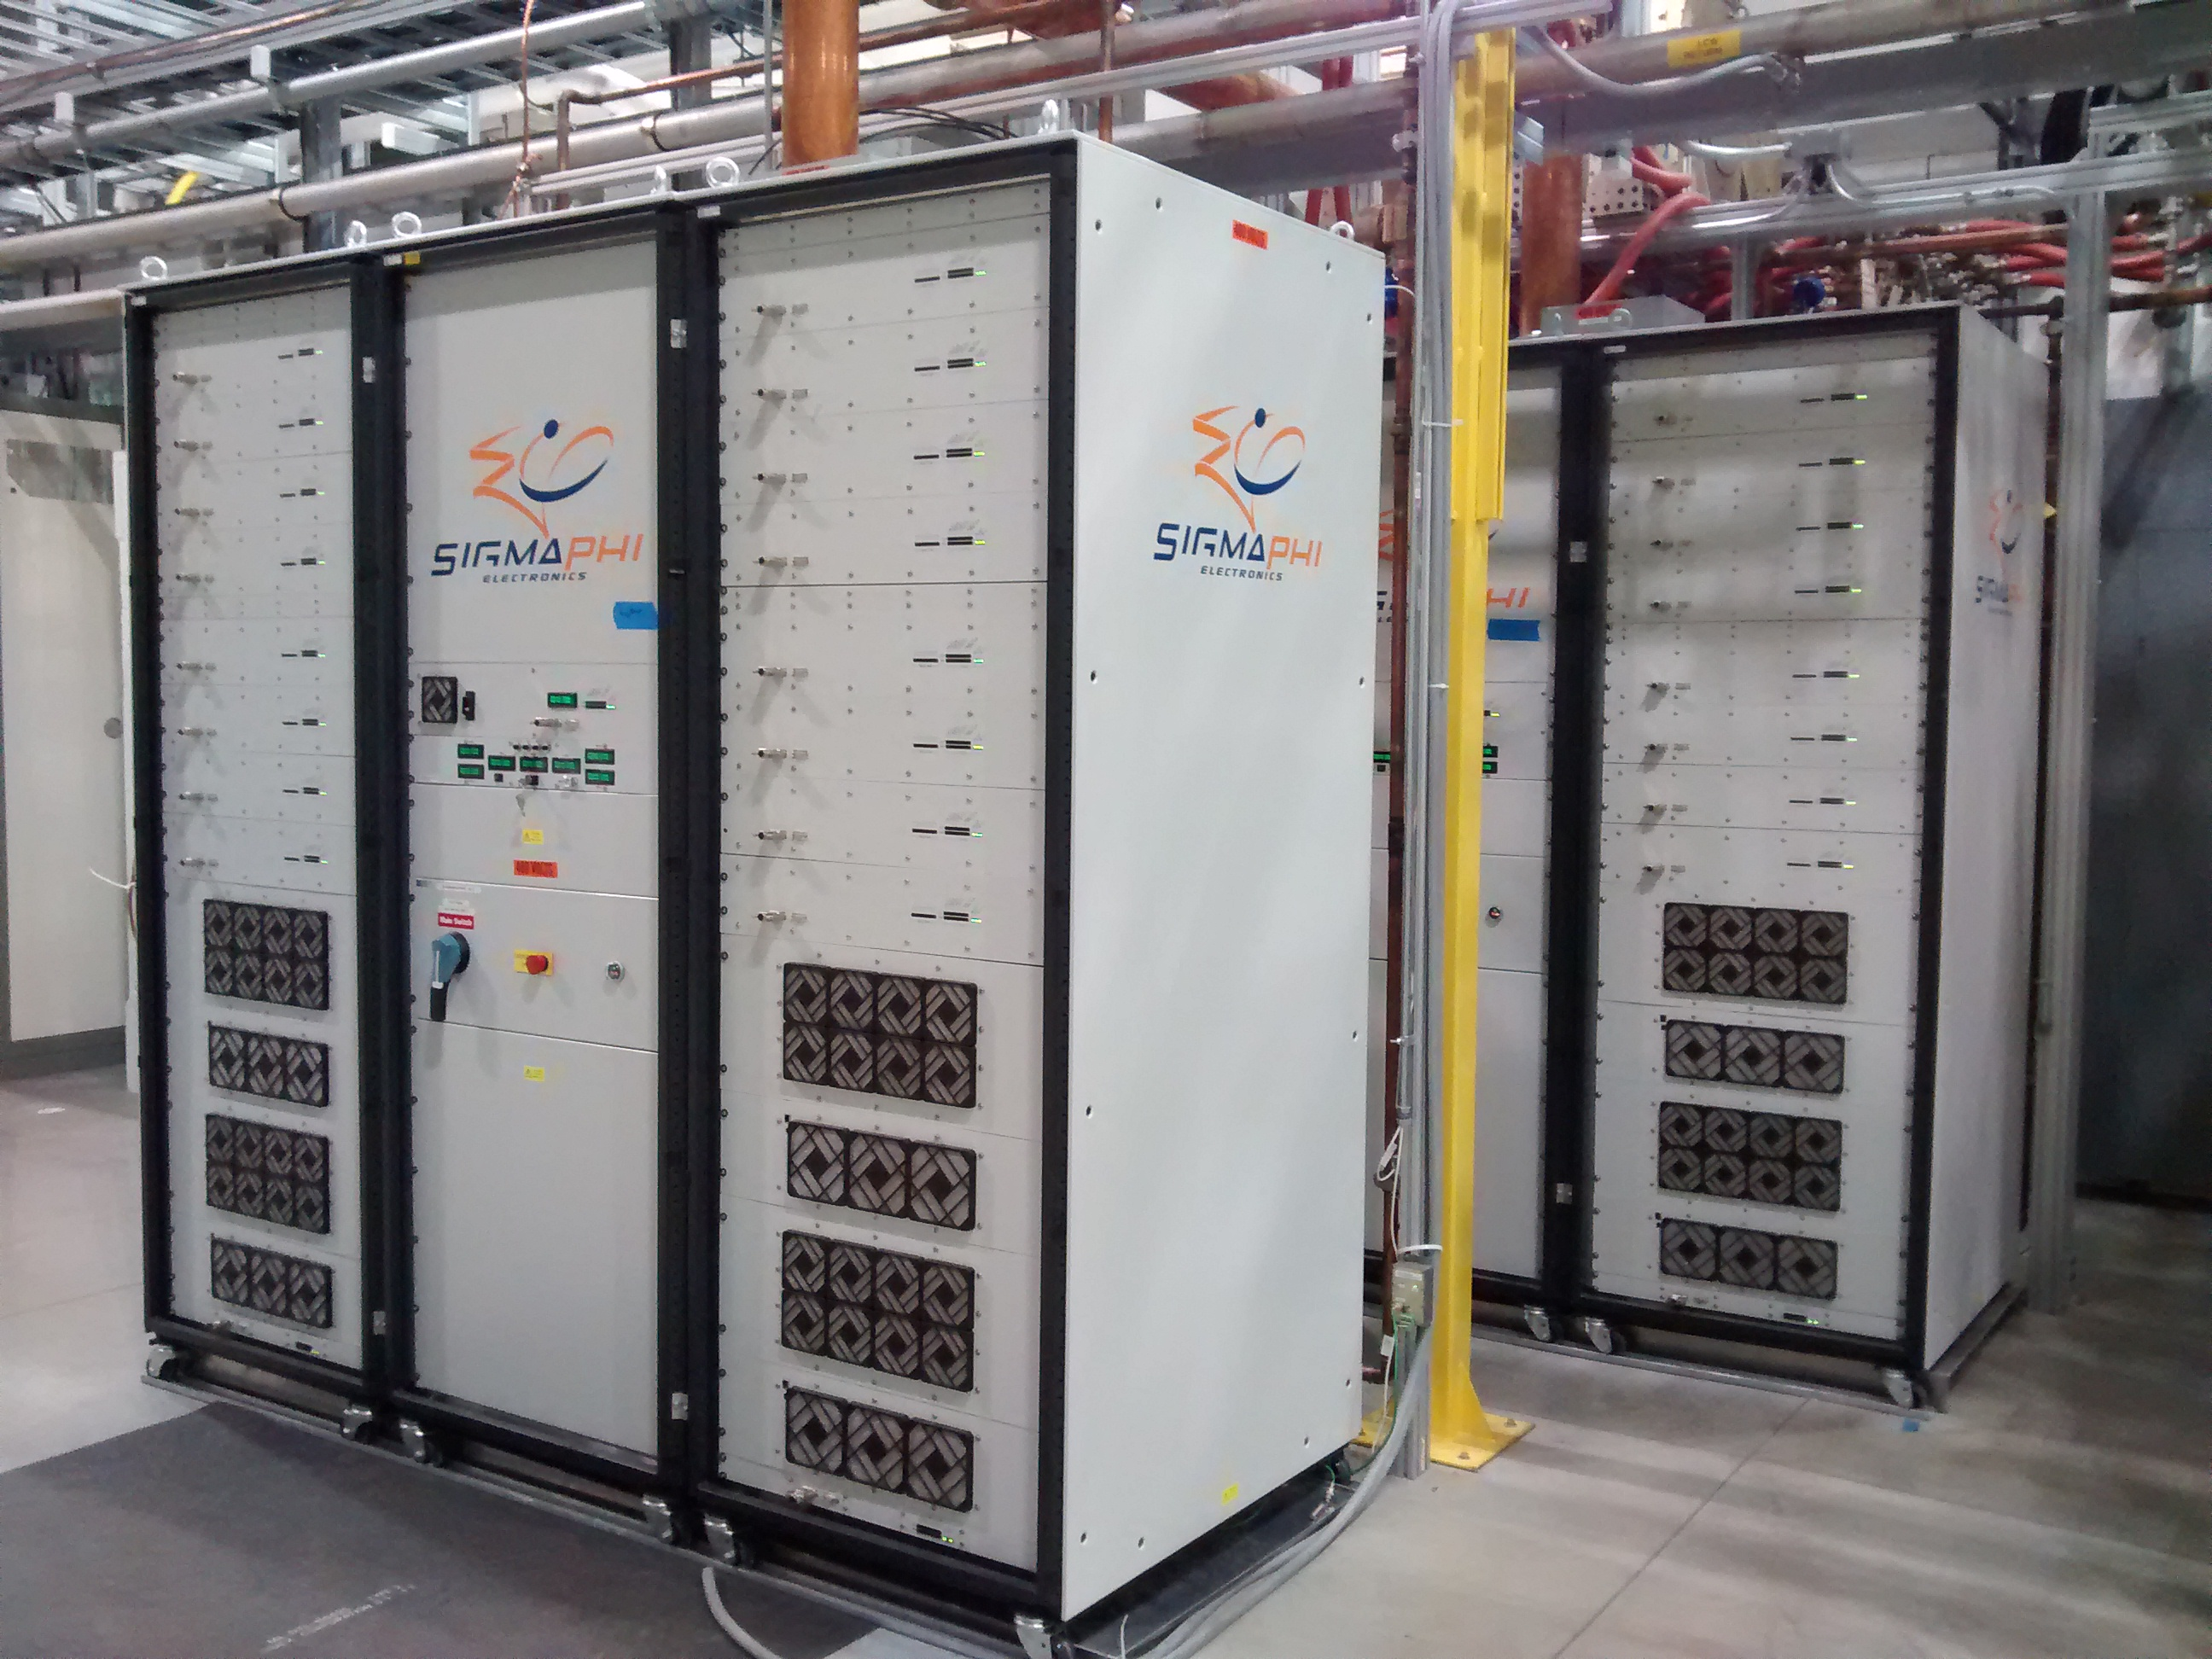
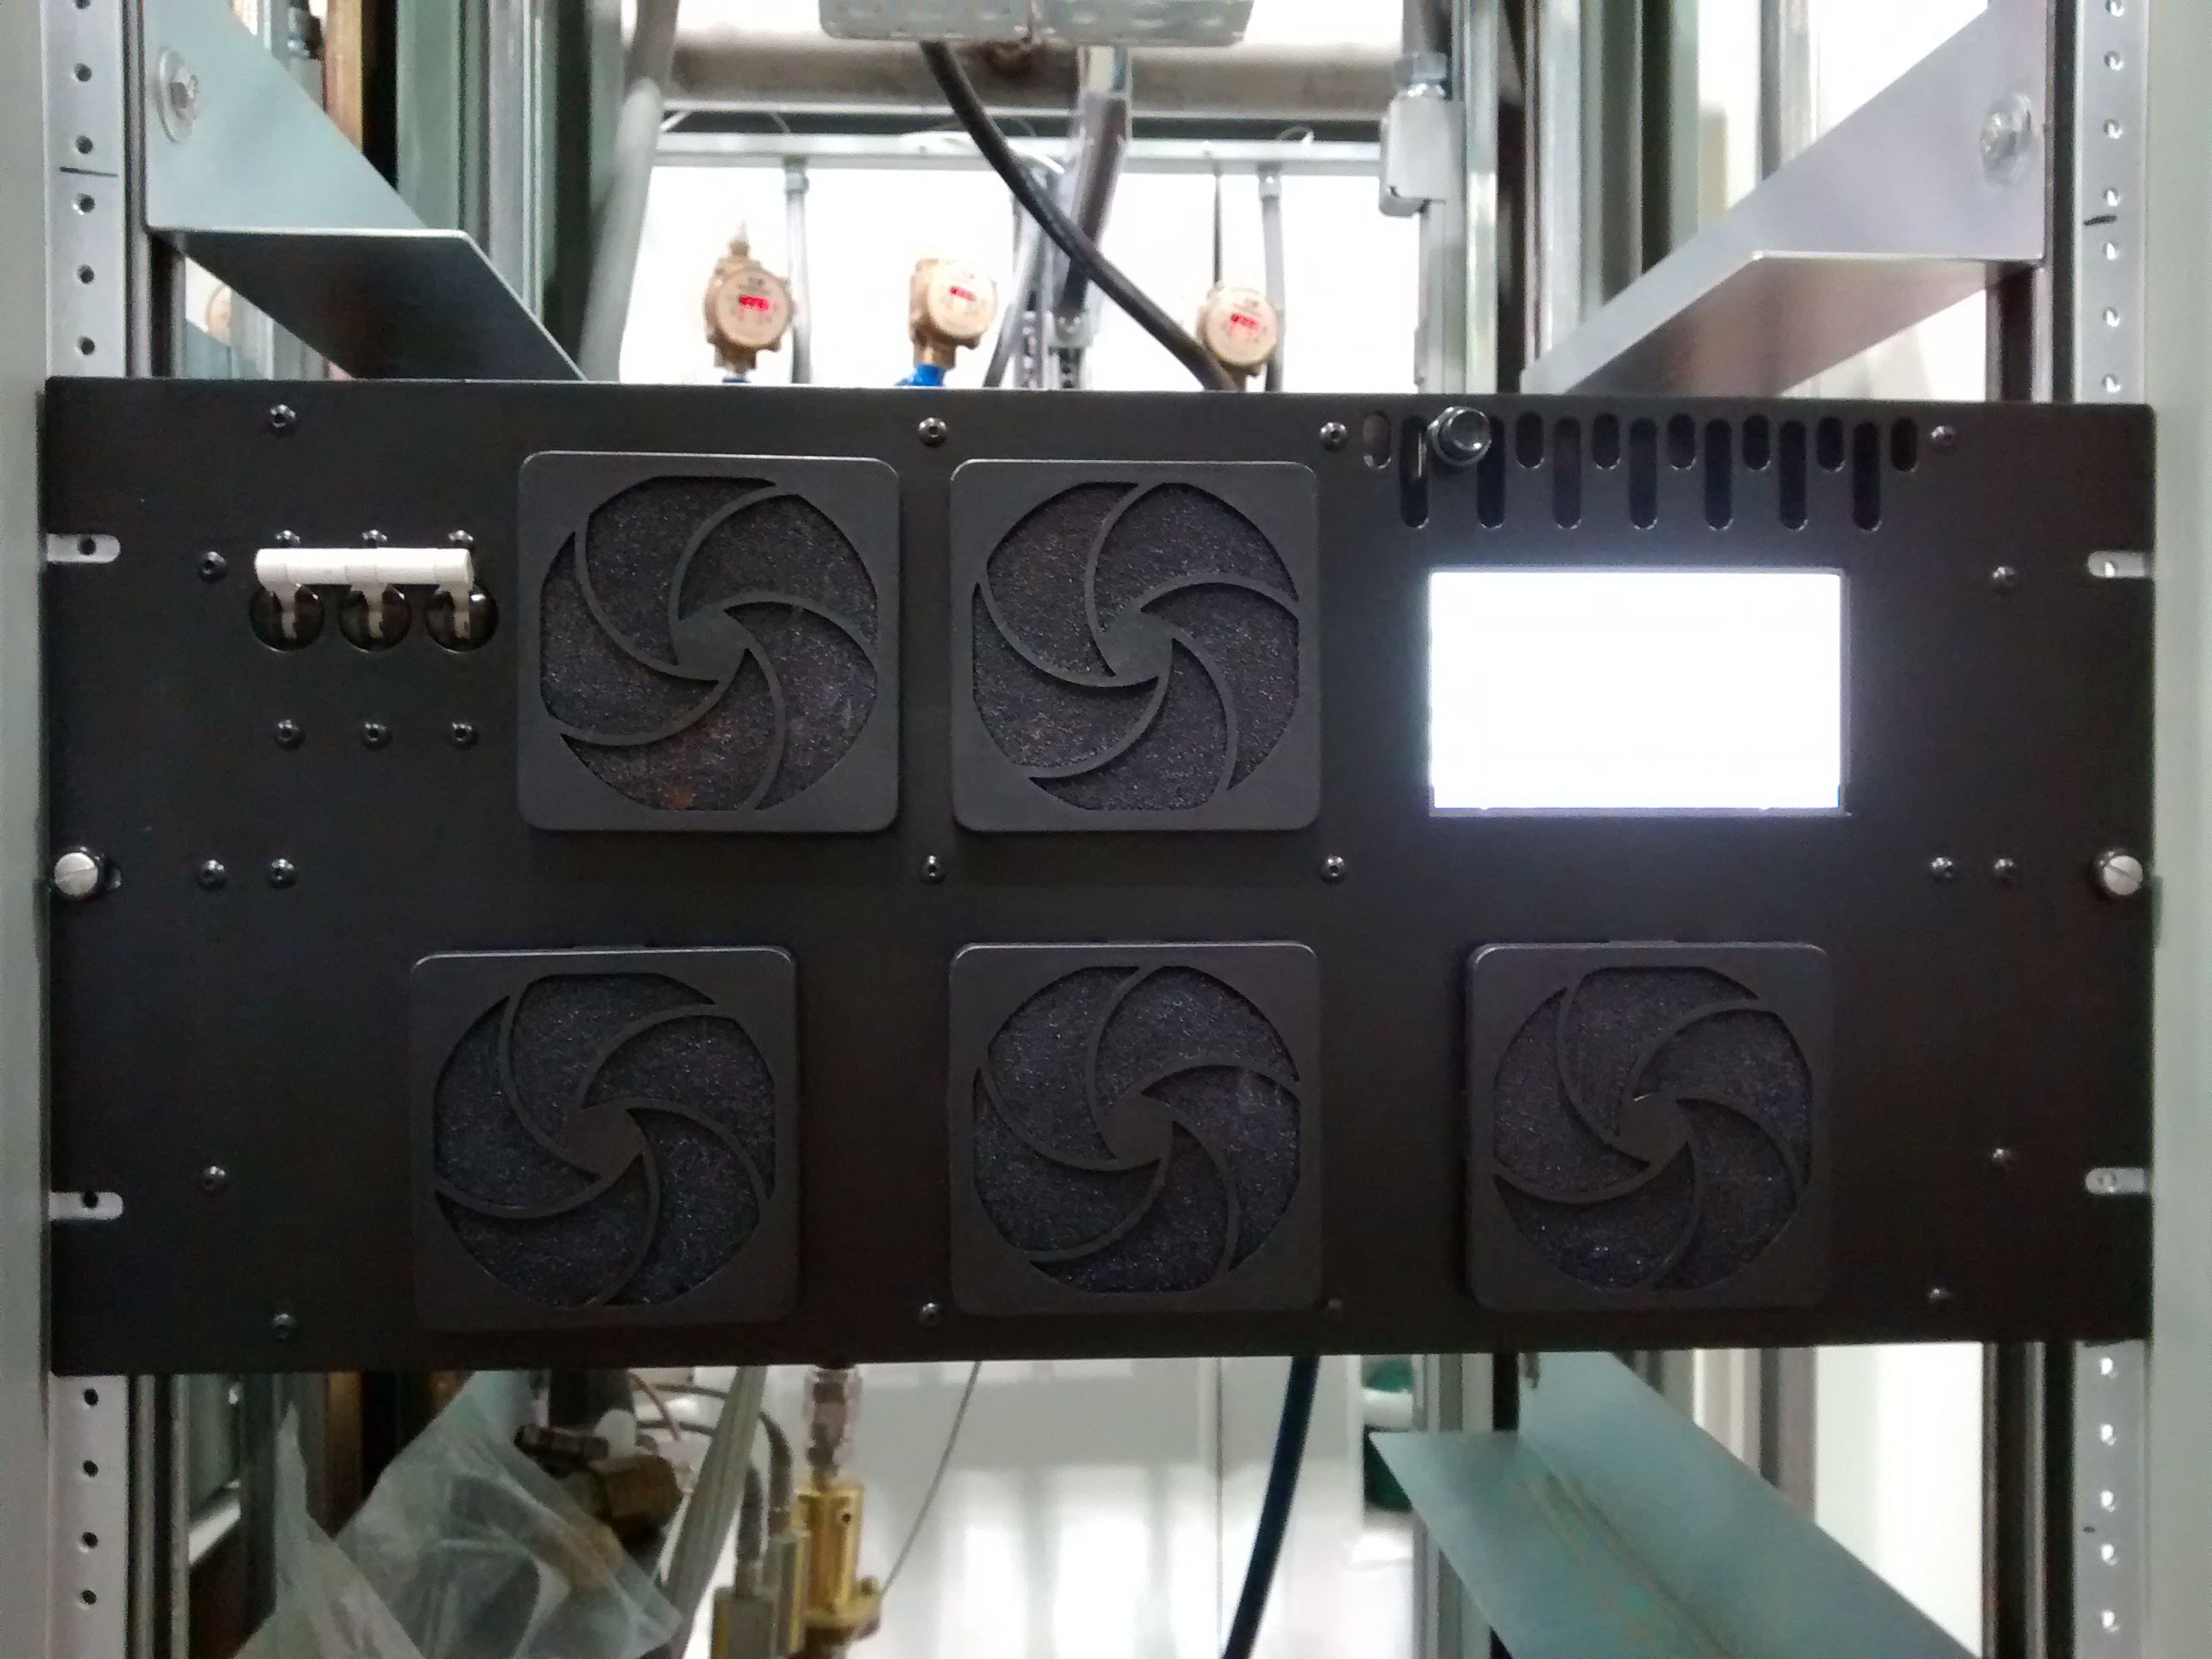
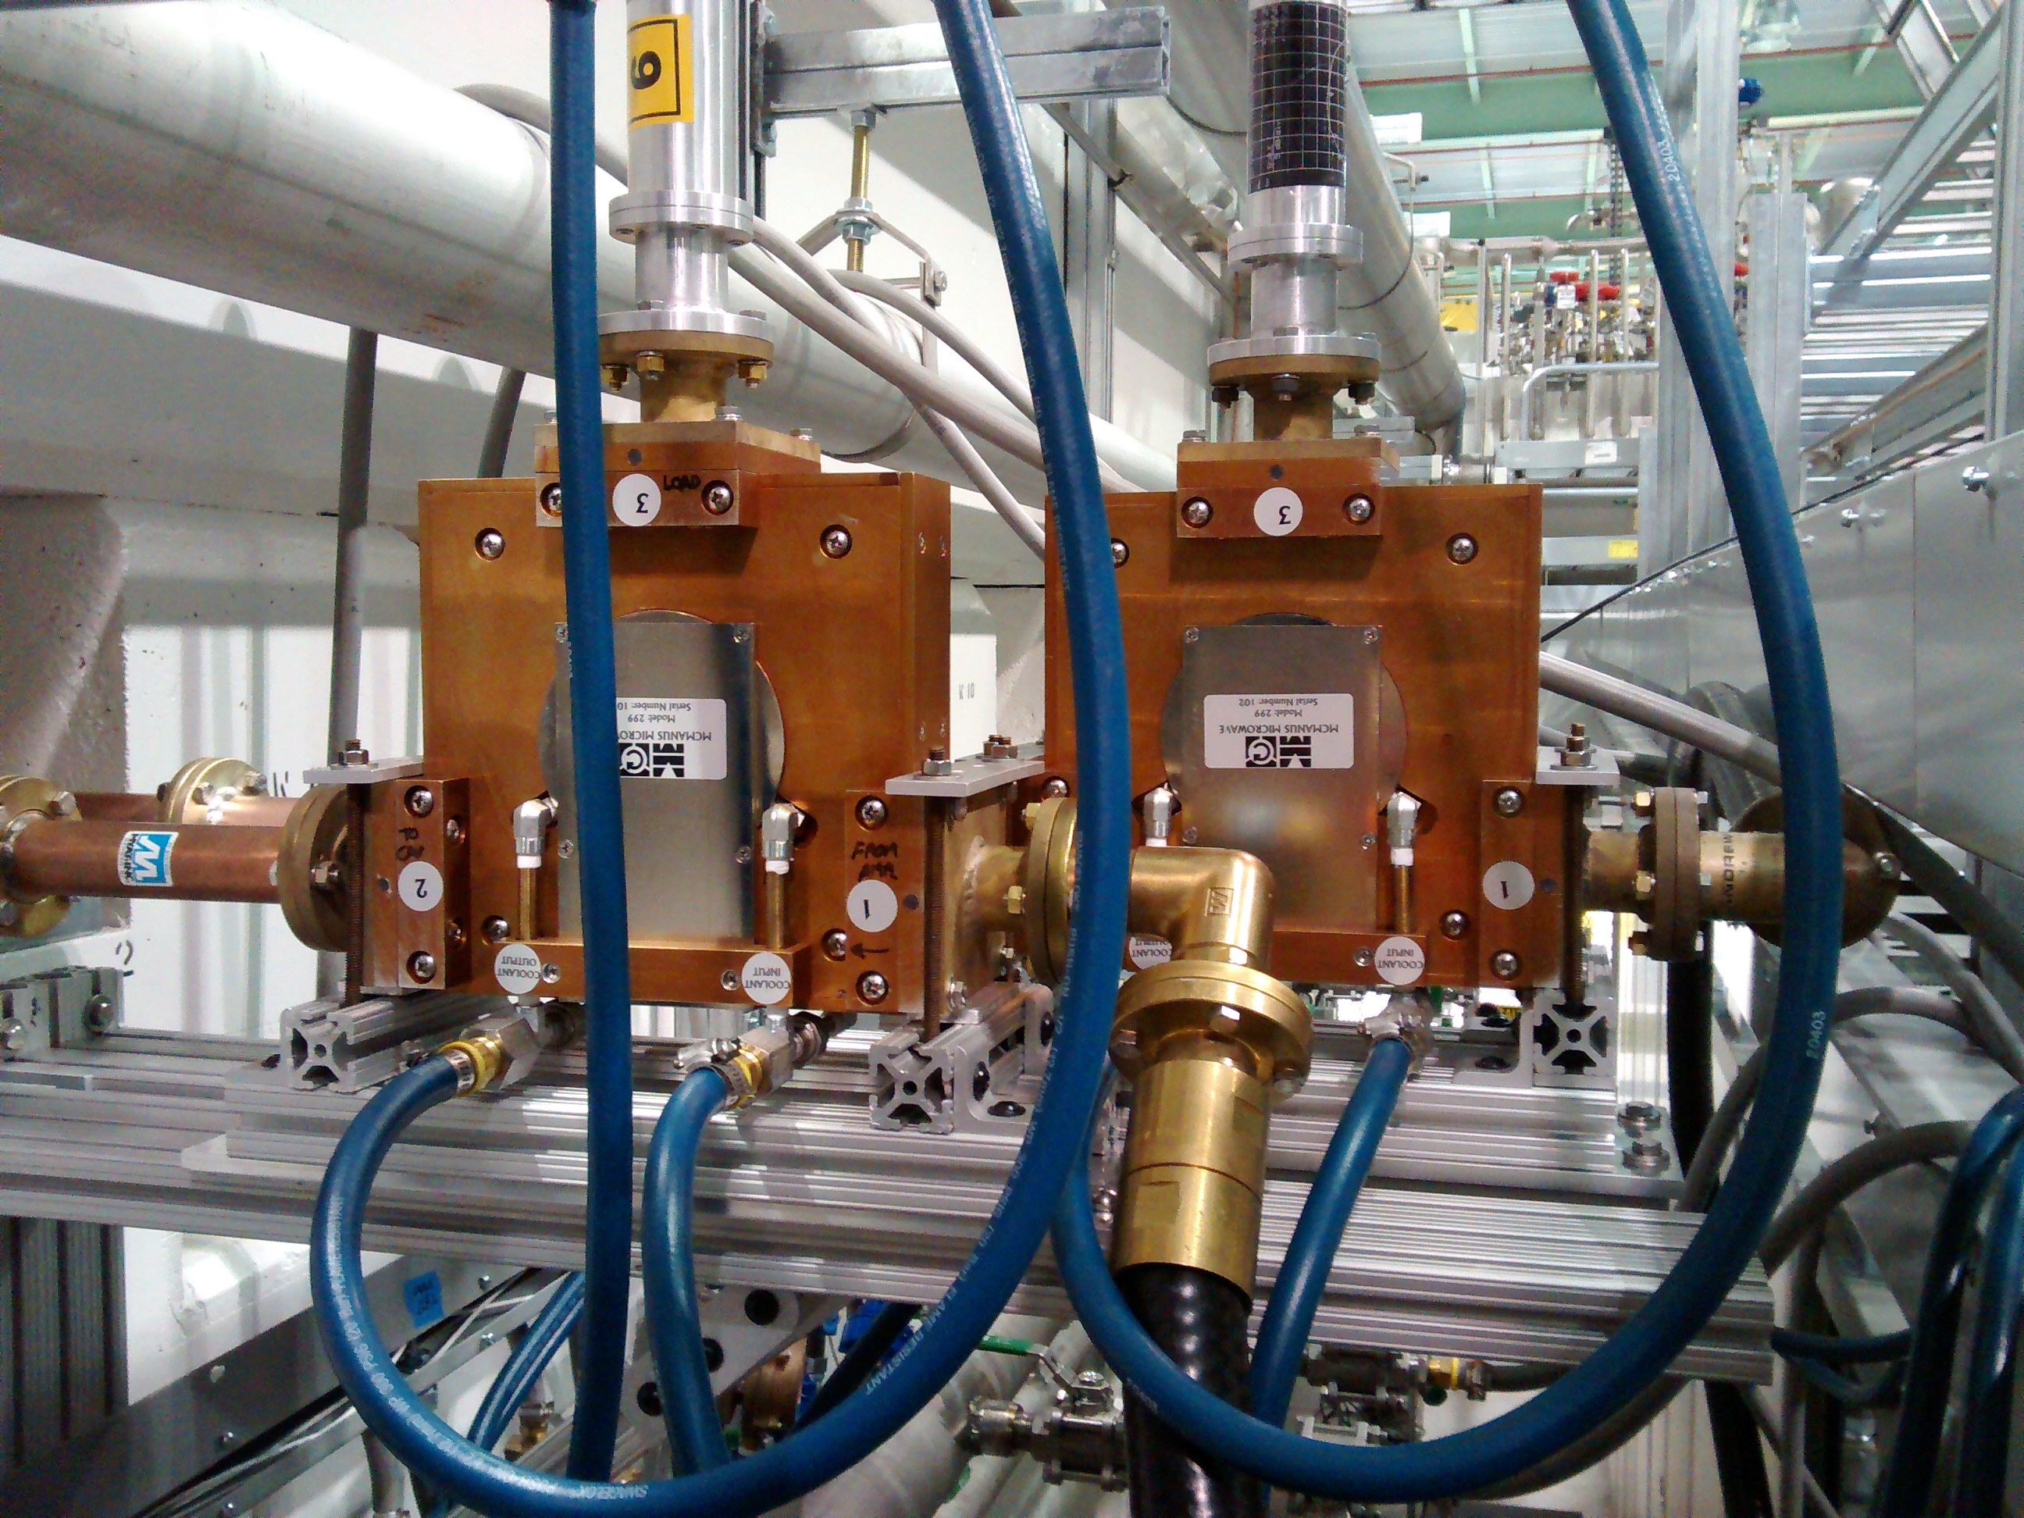
Progress to date
Charge #1
SigmaPhi 162.5 MHz, 75 kW amplifiers for RFQ are operational.
Comark/Technalogix 162.5 MHz, 3 kW amplifiers
    Buncher 1, 2 & 3 operational
    All five amplifiers at Fermilab
RF Distribution in place for RFQ and Buncher 1, 2 & 3.
Four McManus 162.5 MHz, 7 kW circulators arrived in May. Two are in use for Buncher 2 and Buncher 3.
First 162.5 MHz, 7 kW CW amplifier is due by mid October. Up to 7 more units to be procured in FY2018.

Slide 12
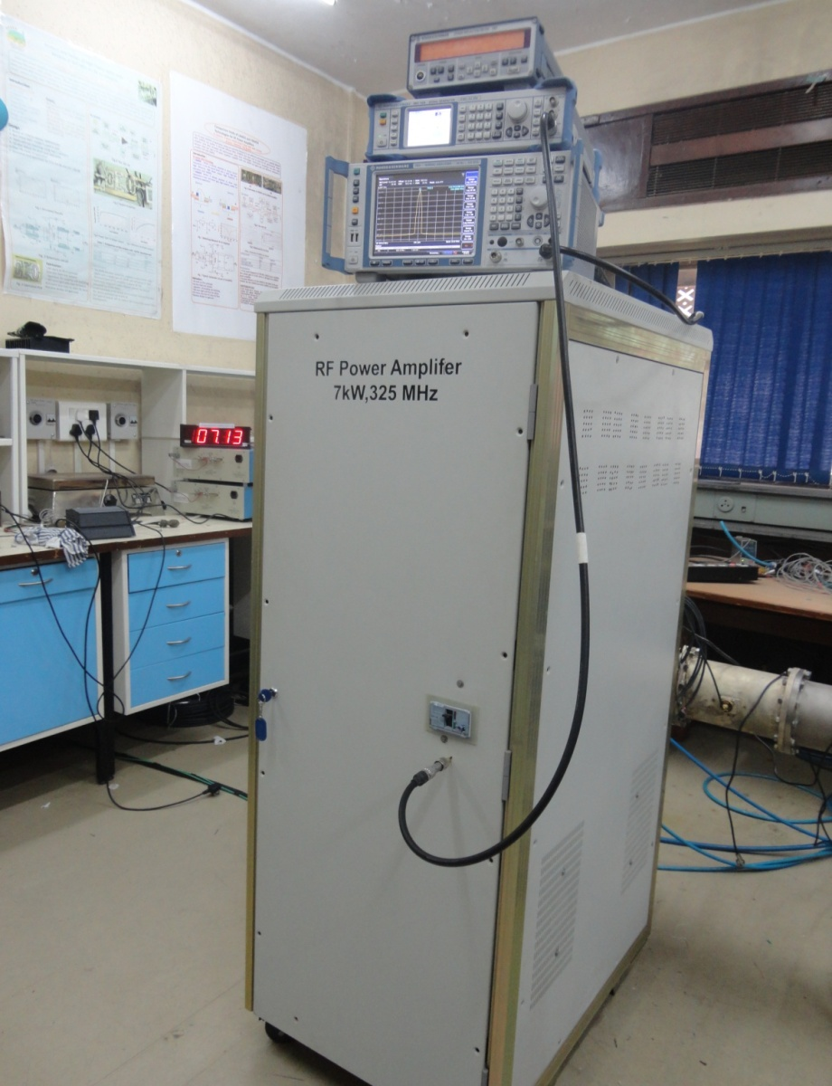
Progress to date
Charge #1
7kW prototype based on original specifications already tested at BARC.
New specifications based on experience with 3kW prototype complete.
7kW RF Power Amplifier TRS in Teamcenter ED0004290-Rev A.
Development and Testing in the scope of the R&D phase of PIP-II.
325 MHz, 7 kW Solid State Amplifier at BARC

Slide 13
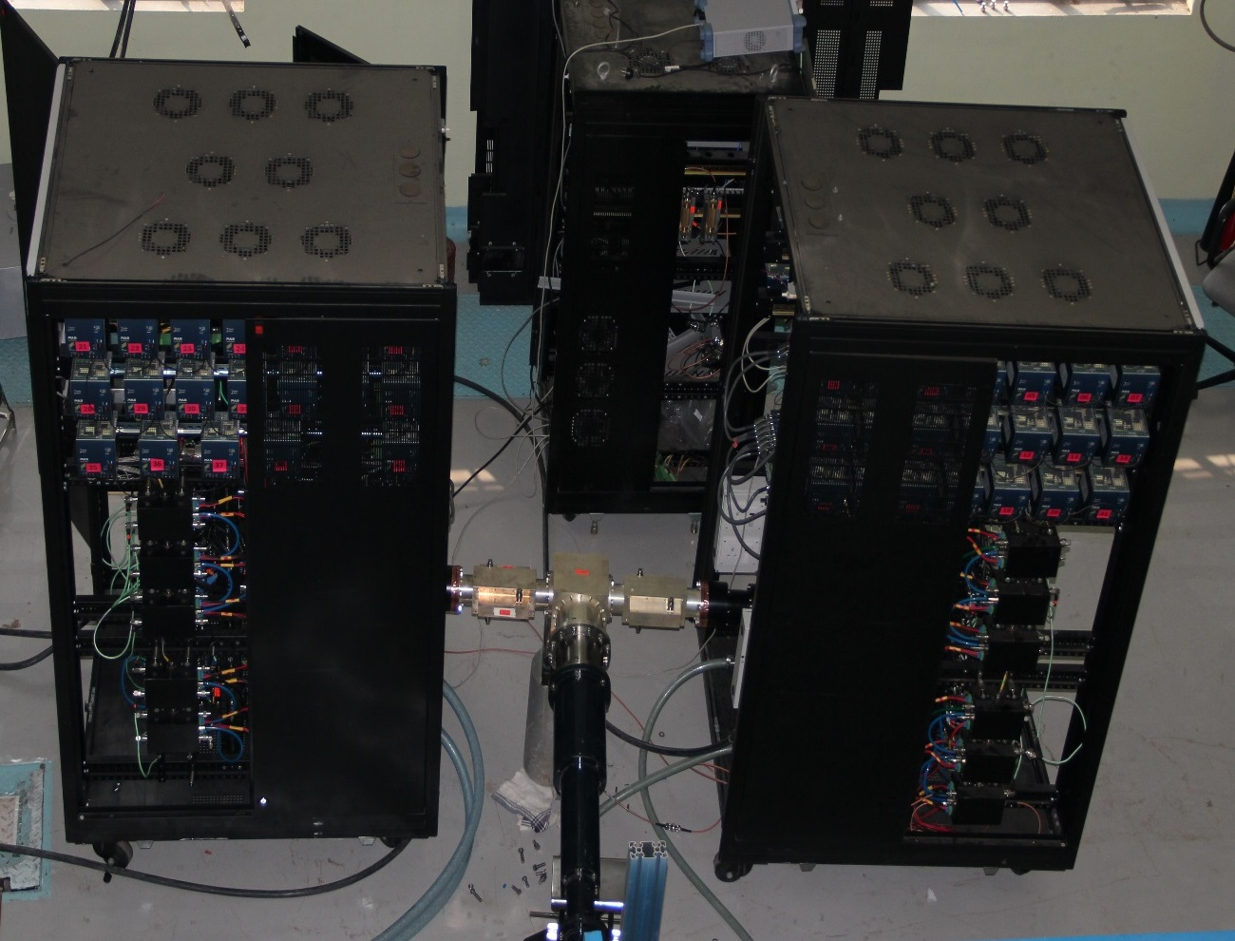
Progress to date
Charge #1
30 kW prototype based on early specifications constructed and tested.
Design modifications for 40 kW prototype underway; final specifications nearly complete.
40kW, 650 MHz Solid State RF Power Amplifier TRS in Teamcenter ED0005489-Rev (-).
Development and Testing in the scope of the R&D phase of PIP-II.
650 MHz, 30 kW Amplifier at RRCAT

Slide 14
Progress to date
Charge #1
Solid State Amplifier technology continues to rapidly improve
  Increasing efficiency thus reducing size and power needs.
  Increasing individual device output power.
  Improved power combining schemes.
  System costs are dropping.
Amplifier external control interface standards and protocols vary widely
  Remote control is essential.
  Some vendors understand the requirements and use industry standards, others use odd protocols or marginal circuitry. Lesson Learned: We shall provide guidance as needed.
RF Circulators require careful evaluation
  Manufacturers of quality high power units are rare. Lesson Learned: We must choose carefully.
  Many of them do not have the capability of testing their units at design power. Lesson Learned: We need to be prepared to test the units when they arrive.
  Some effects are only fully revealed at high power
    Detuning
    Poor reverse isolation
    Arcing
    Poor insertion loss
  Circulators are temperature sensitive and the thermal effects are difficult to compensate. Lesson Learned: We may want to consider bias coils and alternative temperature regulation.

Slide 15
ESH&Q
Charge #4
All RF Power systems will conform to Fermilab safety standards
  All necessary LOTO procedures will be documented
  All cabling will be in accordance with National Electric Code
  Grounding will be reviewed as systems are installed
  Operational Readiness Clearance (ORC) is required before powering any new cavity installation. Areas include
    Electrical safety inspection
    Interlock verifications
    RF leakage checks
    Cavity X-ray measurements
IIFC amplifiers will conform to
  Workmanship: IPC-A-610E
  Standards for PCBs: Lead free, IPC-A-600
  Environmental standards: ROHS Compliant
  EMI/EMC standards: IEC-61204-3; IEC61010-1 (safety rules)
  Vibration standards for transportation only: IEC-61068-27 & 64
Project ISM and QA plans (docdb #141 and 142)
Safety is the highest priority and we will coordinate activities with ESH&Q

Slide 16
Risk: RF Power
Minor Modifications Required for IIFC RF Power Amps
162.5 MHz, 7 kW RF amplifier procurement delayed
Failure of High Power Circulator

Slide 17
BOE Summary
Charge #2
WBS Number | Title | Docdb #
121.3.9.2 | RF Power PM and Coordination | 474
121.3.9.3 | PIP2IT RF Power | 477
121.3.9.4.1 | Linac – RF – TI – Spoke Test Cryostat modified – 650 MHz RF Power (STC/650MHz) | 480
121.3.9.4.2 | RF Power Test Infrastructure Coupler Test Stand 650 MHz Upgrade | 486
121.3.9.4.3 | RF Power Test Infrastructure CryoModule Test Stand (CMTS/650MHz) | 489
121.3.9.5.1 | RF Power 162.5 MHz PIP-II Construction Labor | 495
121.3.9.5.2 | RF Power 162.5 MHz PIP-II Construction Procurement | 498
121.3.9.6.1 | RF Power 7kW, 325 MHz for PIP-II Construction | 501
121.3.9.6.2 | RF Power 20 kW, 325 MHz for PIP-II Construction | 504
121.3.9.7.1 | RF Power 40 kW, 650 MHz for PIP-II Construction | 507
121.3.9.7.2 | RF Power 70 kW, 650 MHz for PIP-II Construction | 510

Slide 18
Cost Summary
Charge #2
Uncertainty based on project guidelines
Costs come from P6 and are estimated down to the L6 activity level with RF Power down to the L6-8 activity level

Slide 19
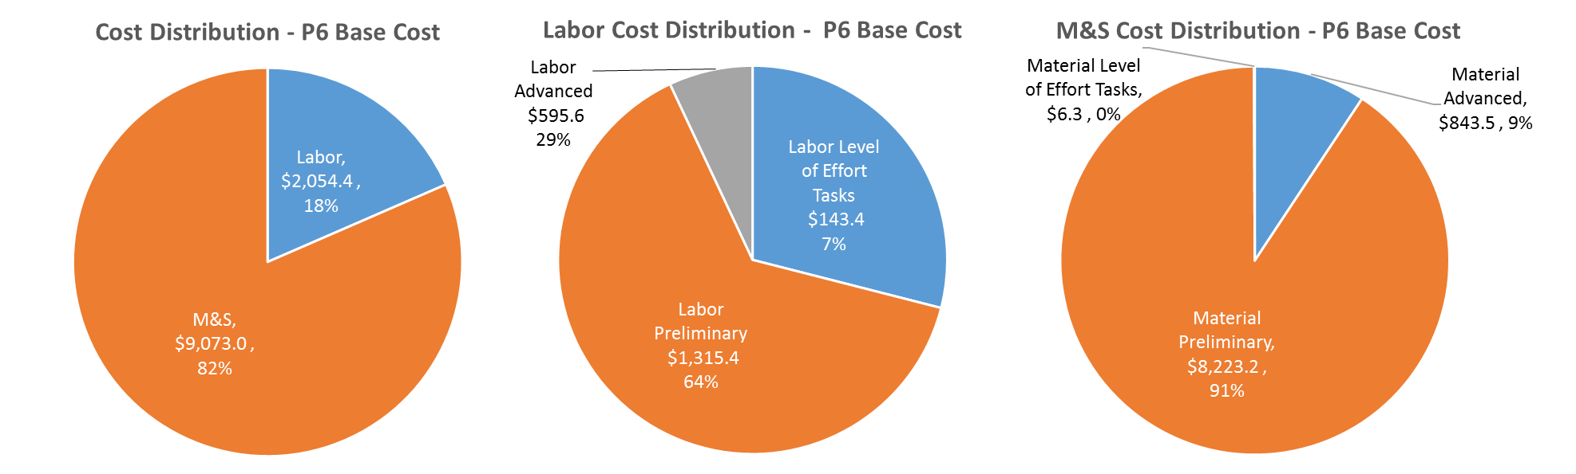
Cost Drivers and Estimate Maturity
Charge #2
P6 Base Costs = BOE + Overheads + Escalation
Labor is focused on collaboration effort and procurement management.
Majority of value from WBS category coming from in-kind contribution of DAE collaboration.

Slide 20
Cost Profile – P6 Base Cost Only
Charge #2
P6 Base Costs = BOE + Overheads + Escalation
Material cost ramps up significantly to start procurement of high power circulators and RF distribution hardware.

Slide 21
Labor Profile – P6 Hours/FTE
Charge #2
Labor profile technically driven.
Labor is focused on collaboration effort and procurement management.

Slide 22
Schedule – RF Power
Charge #2

Slide 23
Summary
RF amplifiers along with circulators and RF distribution are installed and running for the PIP-II Injector Test RFQ and Bunchers 1, 2 & 3.
7 kW 162.5 MHz amplifier will be coming in October.
India has working amplifiers at 7 kW 325 MHz and 30 kW 650 MHz. They have experience with a 75 kW 505.8 MHz amplifier and are designing a 70 kW, 650 MHz SSA.
The R&D phase is providing valuable experience with solid state amplifiers and related high power technology.
  We are ready for CD-1 and look forward to your feedback
  Thank you for your attention

Slide 24
END

