Slide 1
WBS 121.5 – Conventional Facilities
Design and Scope
Steve Dixon
PIP-II Director’s Review
10-12 October 2017

Slide 2
Design and Scope
Charge 1:
Does the acquisition strategy document a carefully considered analysis of alternatives that supports the preferred alternative?
Does the conceptual design satisfy the performance requirements?
Does the conceptual design support the stated cost range and duration?

Slide 3
Agenda
Conceptual Design Process
Alternates Investigated
  Siting
  ICW Cooling
  Pulsed Mode vs. Continuous Wave Operatio
Next Steps

Slide 4
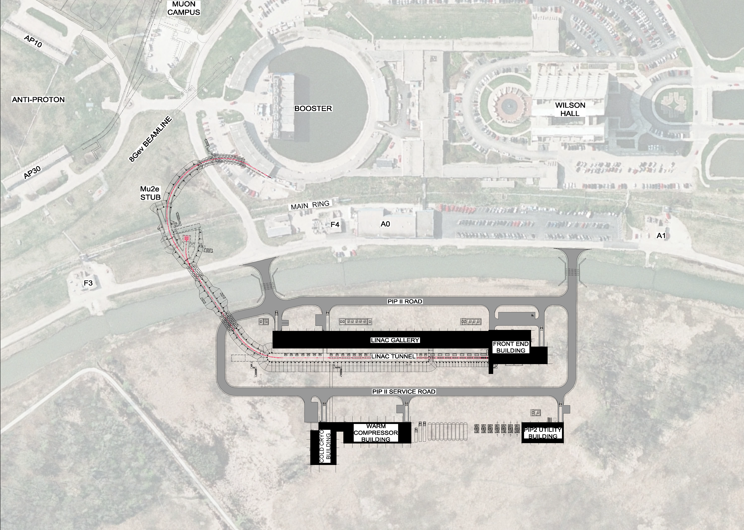
Conventional Facilities Overview
Work Breakdown Structure
121.5.2 Site Preparation
121.5.3 Cryo Plant Building
121.5.4 Utility Plant Building
121.5.5 High Bay Building
121.5.6 Linac Tunnel
121.5.7 Linac Gallery
121.5.8 Beam Transfer Line
121.5.9 Booster Connection
Booster Connection
Beam Transport Line
Linac Gallery
High Bay Building
Linac Tunnel
Cryo Plant Building
Utility Plant Building

Slide 5
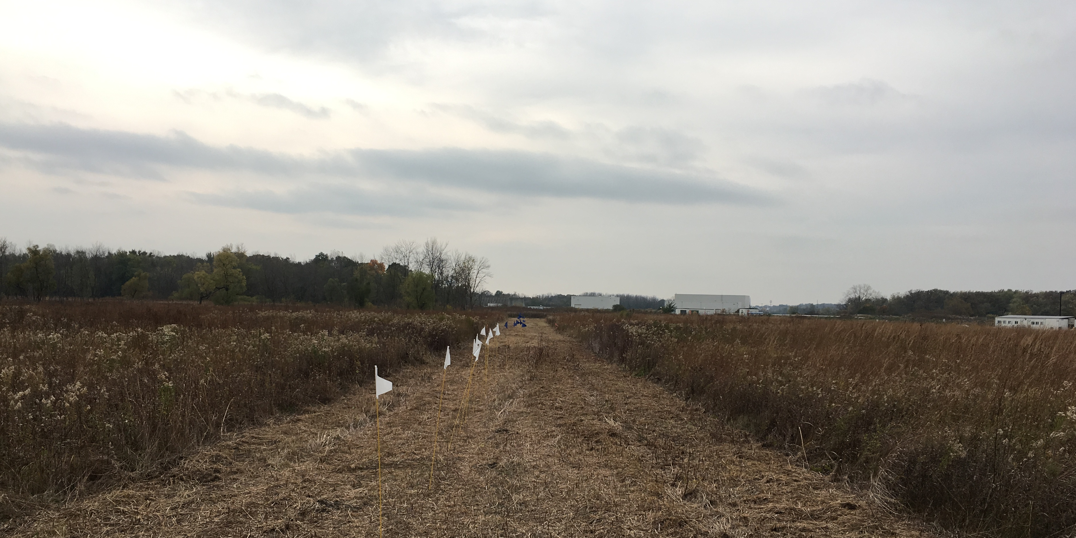
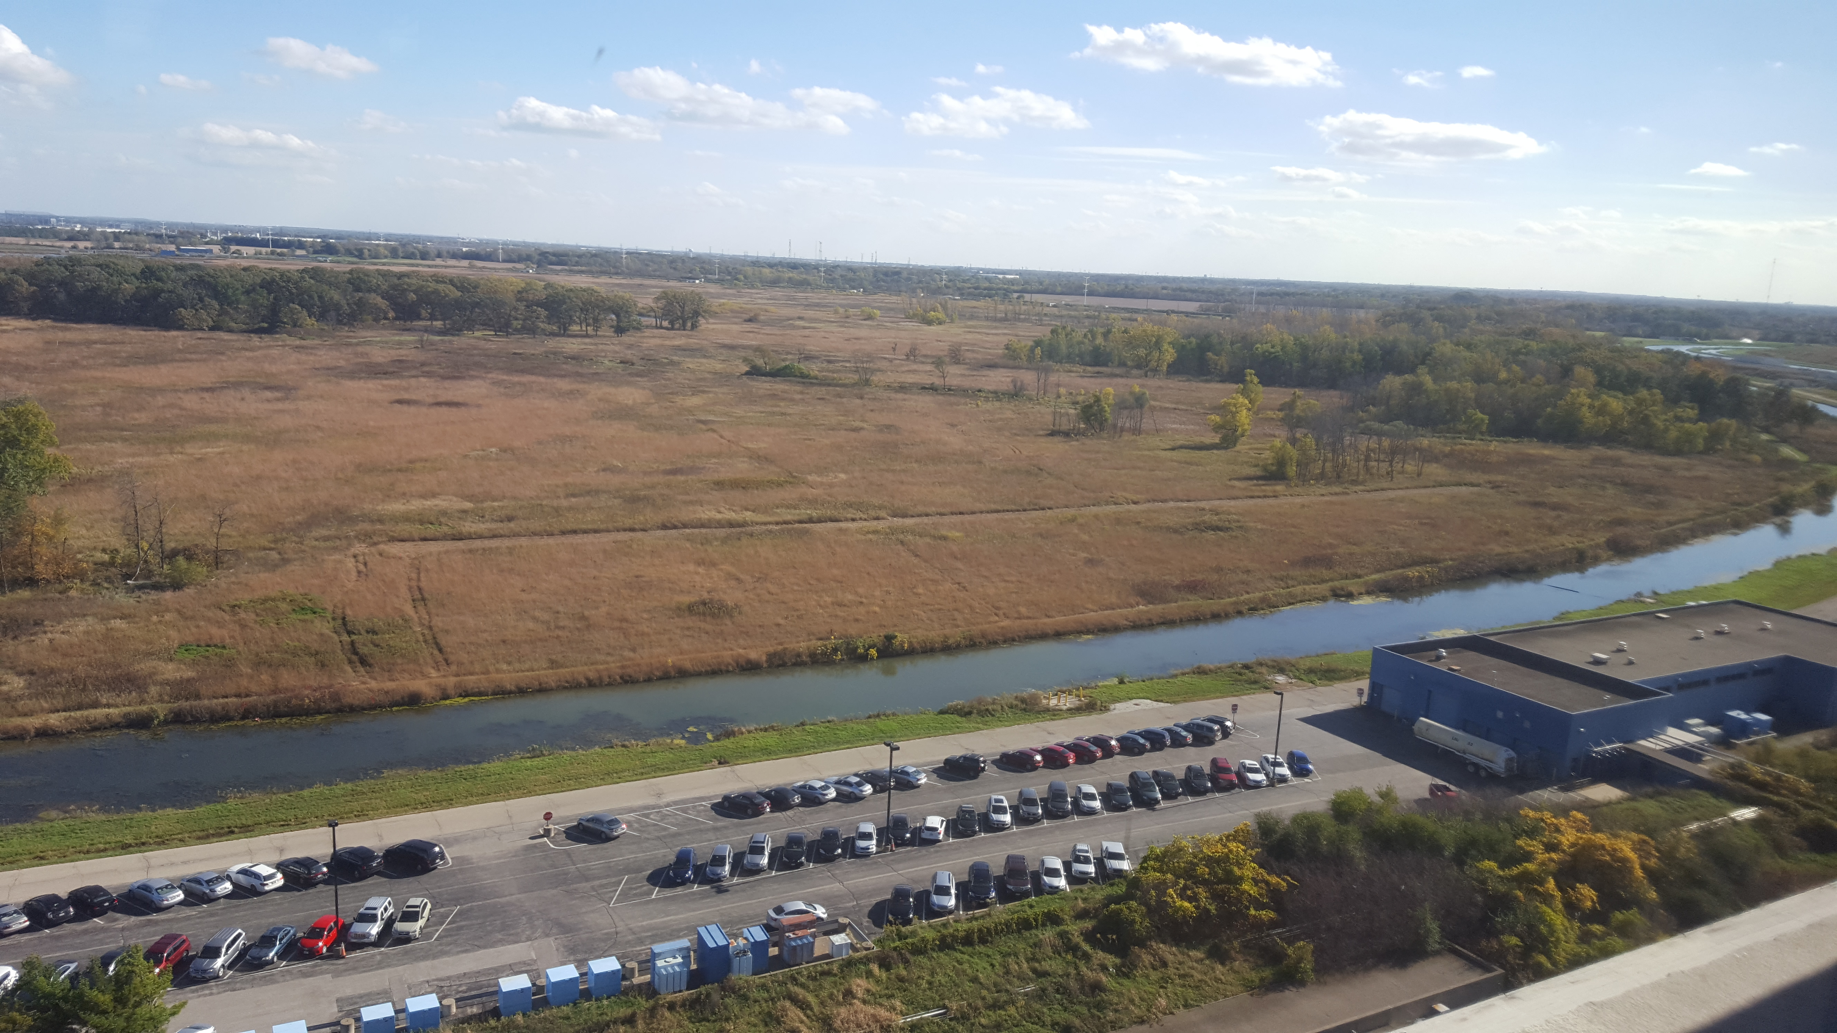
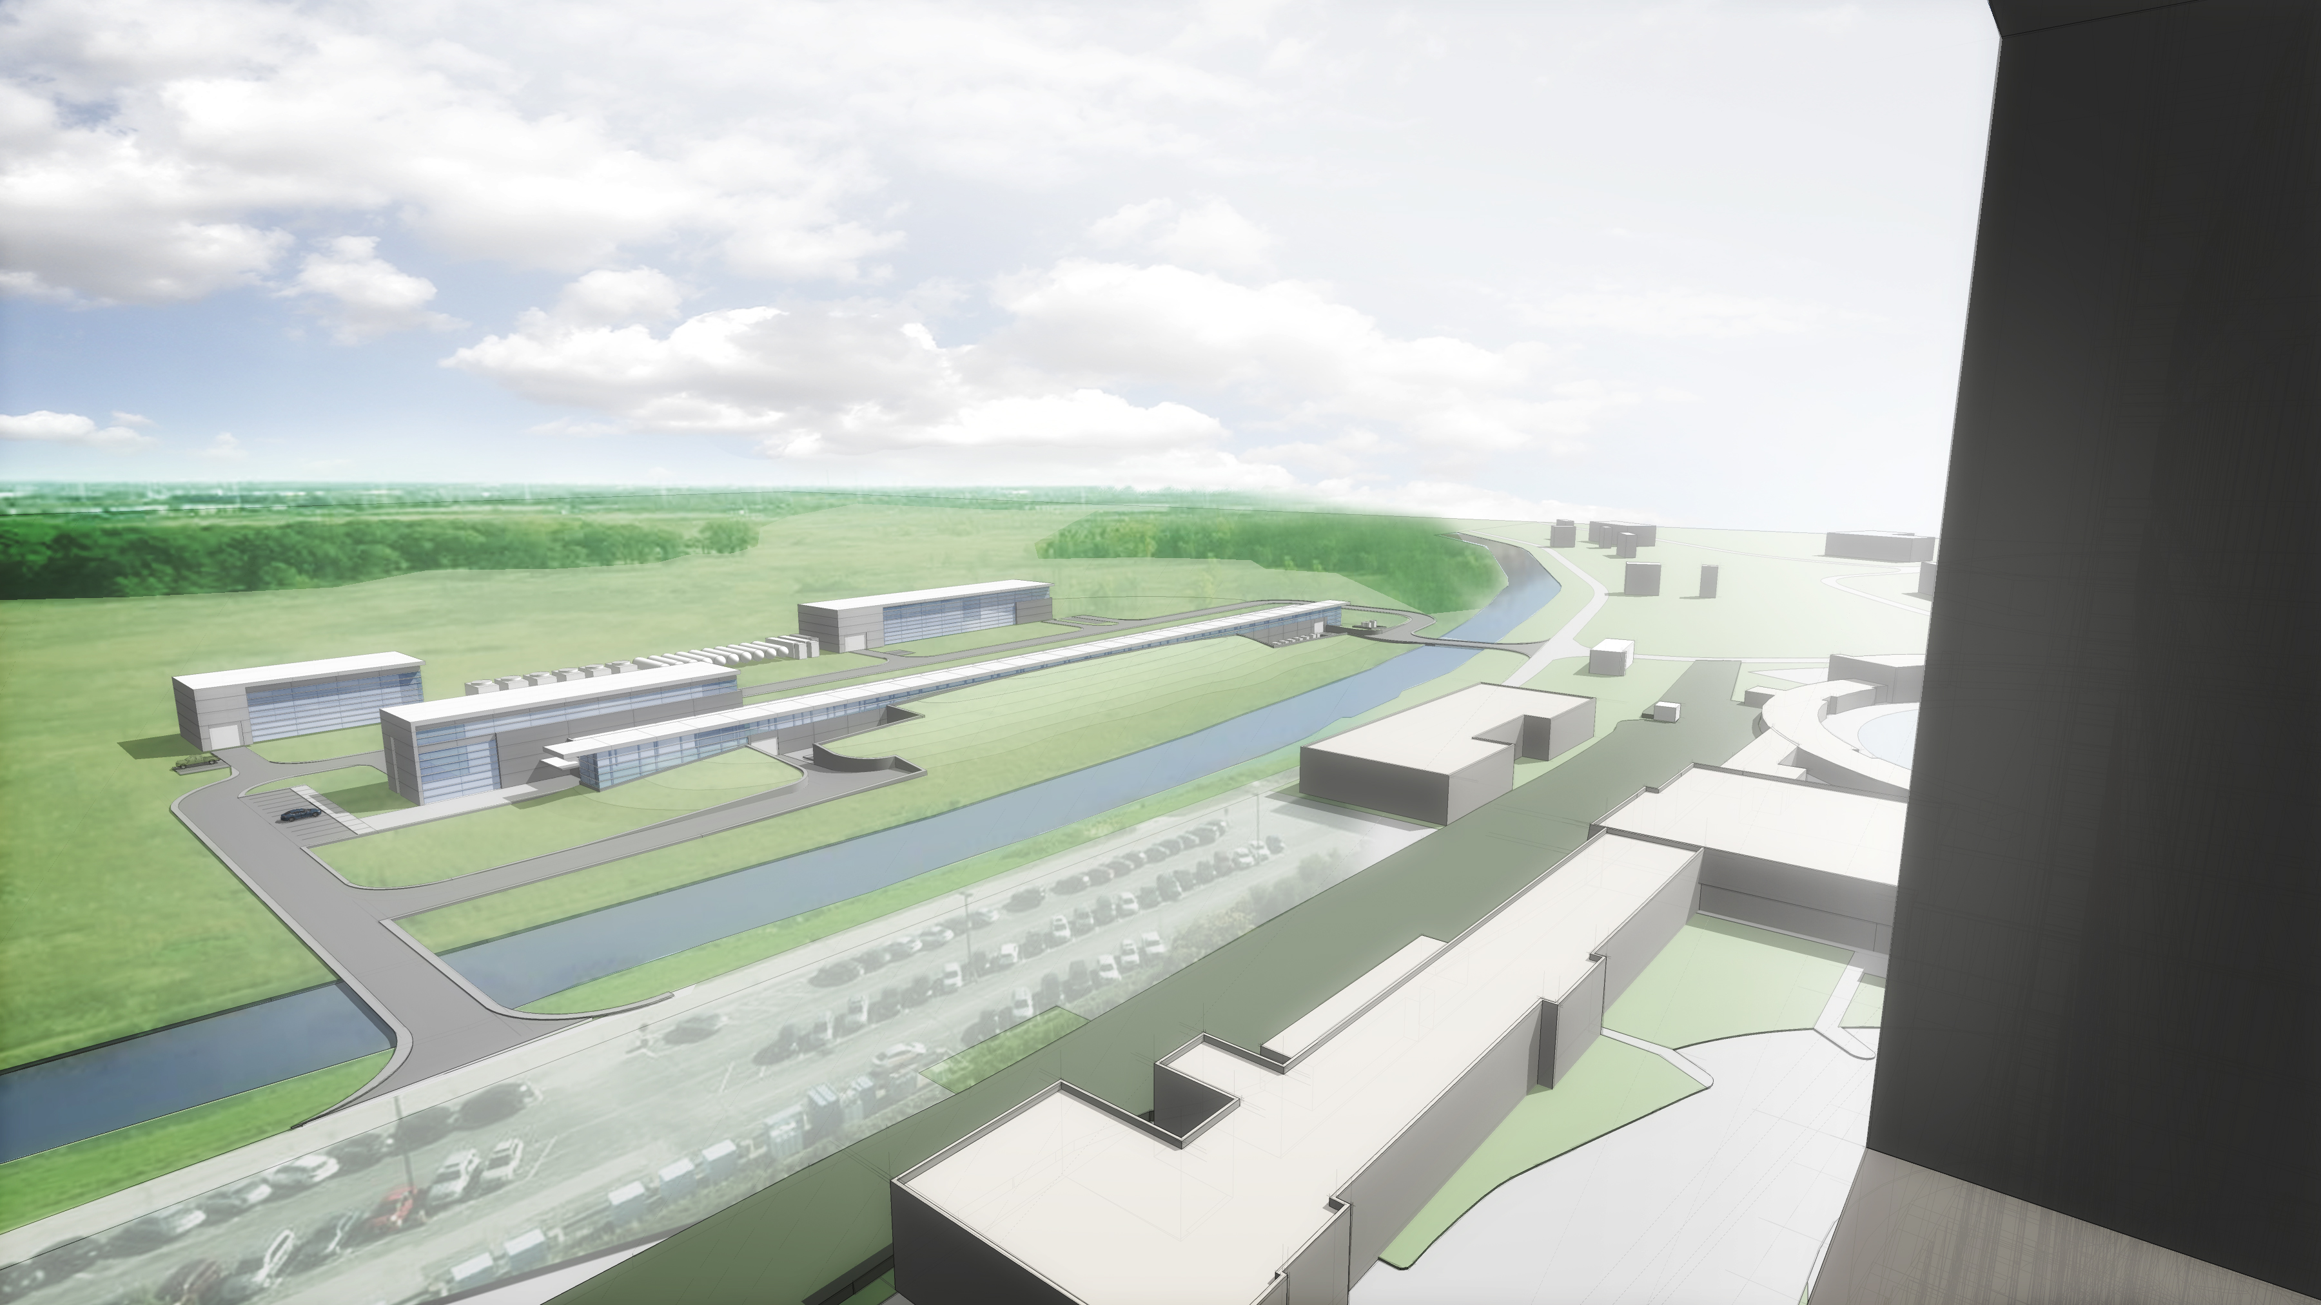
Conventional Facilities Overview
White Flags = Warm Components
Blue Flags = Cold Components
Linac
Looking South Along Beamline
AZero Service Building
Tevatron Enclsoure Berm
Looking Southeast From Wilson Hall
View from Wilson Hall

Slide 6
Process
Functional Requirements Specification (Project Level)
Functional Requirements Specification (Subproject Level)
Technical Requirements Specifications
Conceptual Design
  Drawings [1]
  Text [2]
  Estimate Assumptions [3]
Cost/Schedule Estimate (Separate Breakout Presentation)
  [1] – Conceptual Design Drawings can be found in PIP-II-doc-1155
  [2] – Conceptual Design Report can be found at PIP-II-doc-113
  [3] – Estimate Assumptions can be found at PIP-II-doc-333, Item D

Slide 7
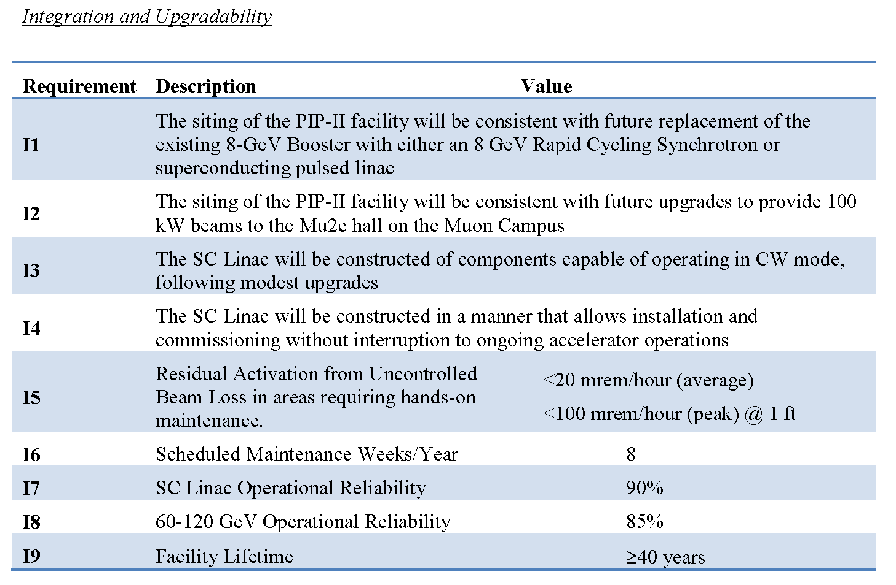
PIP-II Functional Requirements Specifications
“PIP-II is focused on upgrades to the Fermilab accelerator complex capable of providing proton beam power in excess of 1 MW on target at the initiation of the Long Baseline Neutrino Facility/Deep Underground Neutrino Experiment (LBNF/DUNE) program, currently anticipated for the mid-2020s”
TeamCenter document ED0001222, signed in March 2017
Conventional Facilities specific requirements

Slide 8
Conventional Facilities FRS and TRS
Functional Requirements Specification (FRS) define the function of each component (what);
Technical Requirements Specification (TRS) define the critical technical requirements for each components (how);
Support the PIP-II Project FRS;
Developed for each conventional facilities work package;
Ensures design meets the requirements;
Currently in the review/approval process.

Slide 9
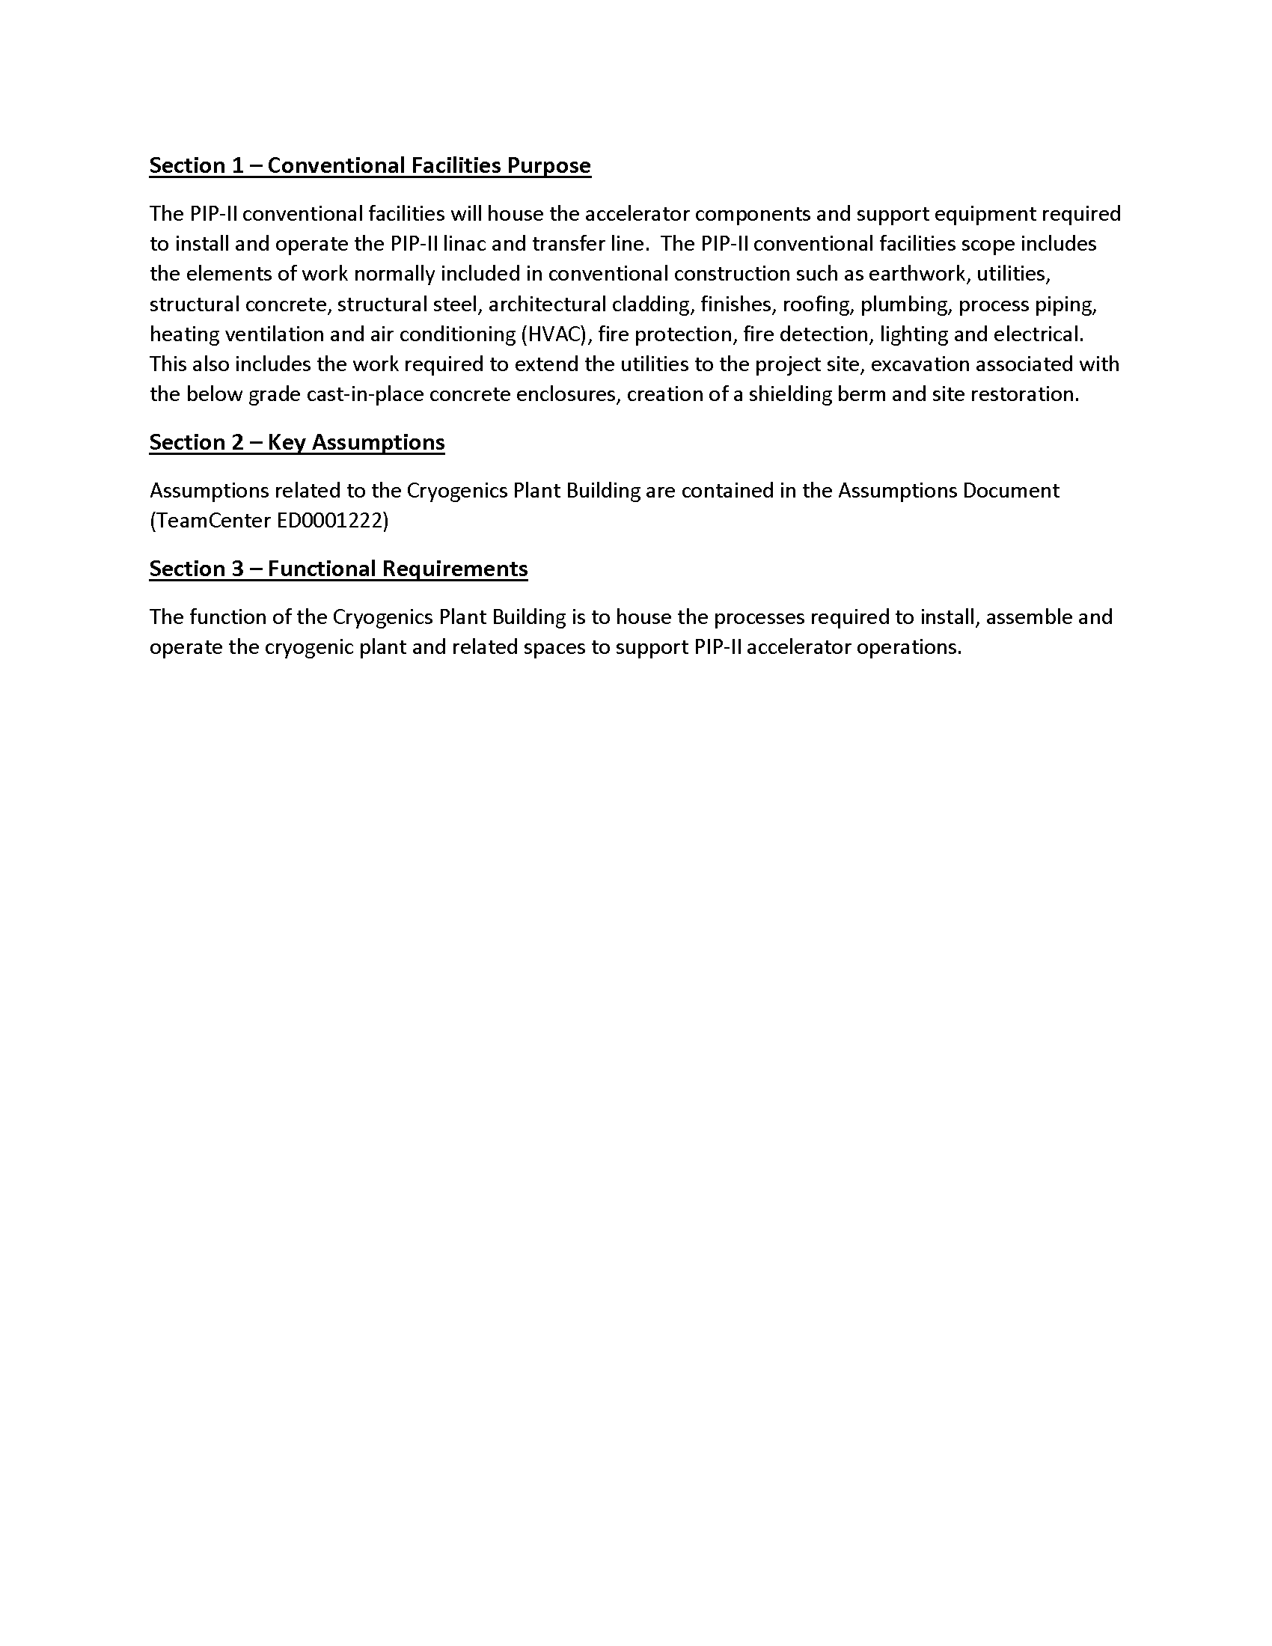
Typical FRS
The function of the Cryogenics Plant Building is to house the processes required to install, assemble and operate the cryogenic plant and related spaces to support PIP-II accelerator operations.

Slide 10
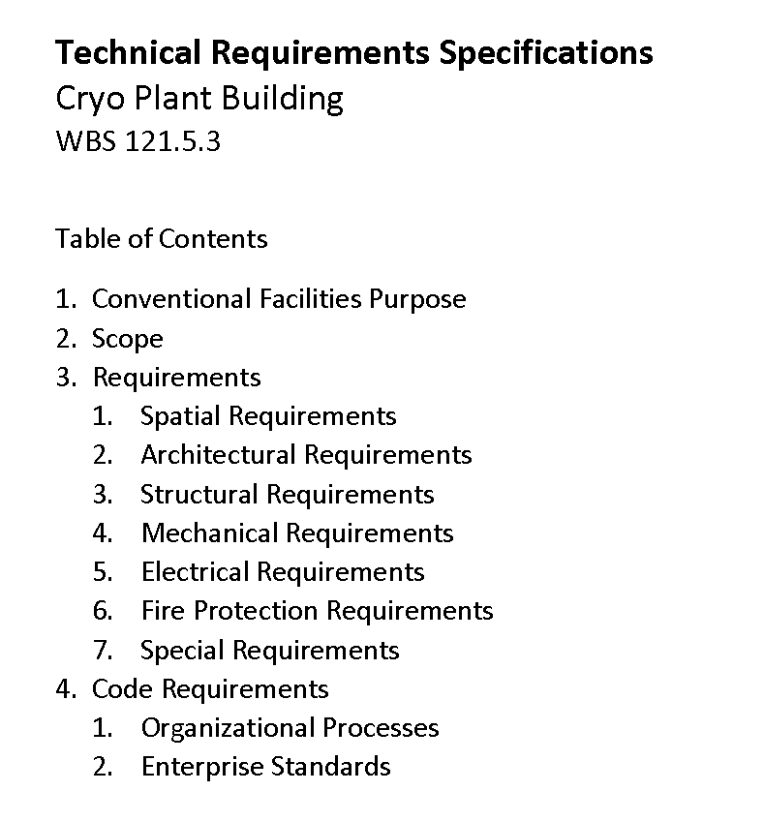
Typical TRS Contents
Typical Technical Requirements Specification Table of Contents

Slide 11
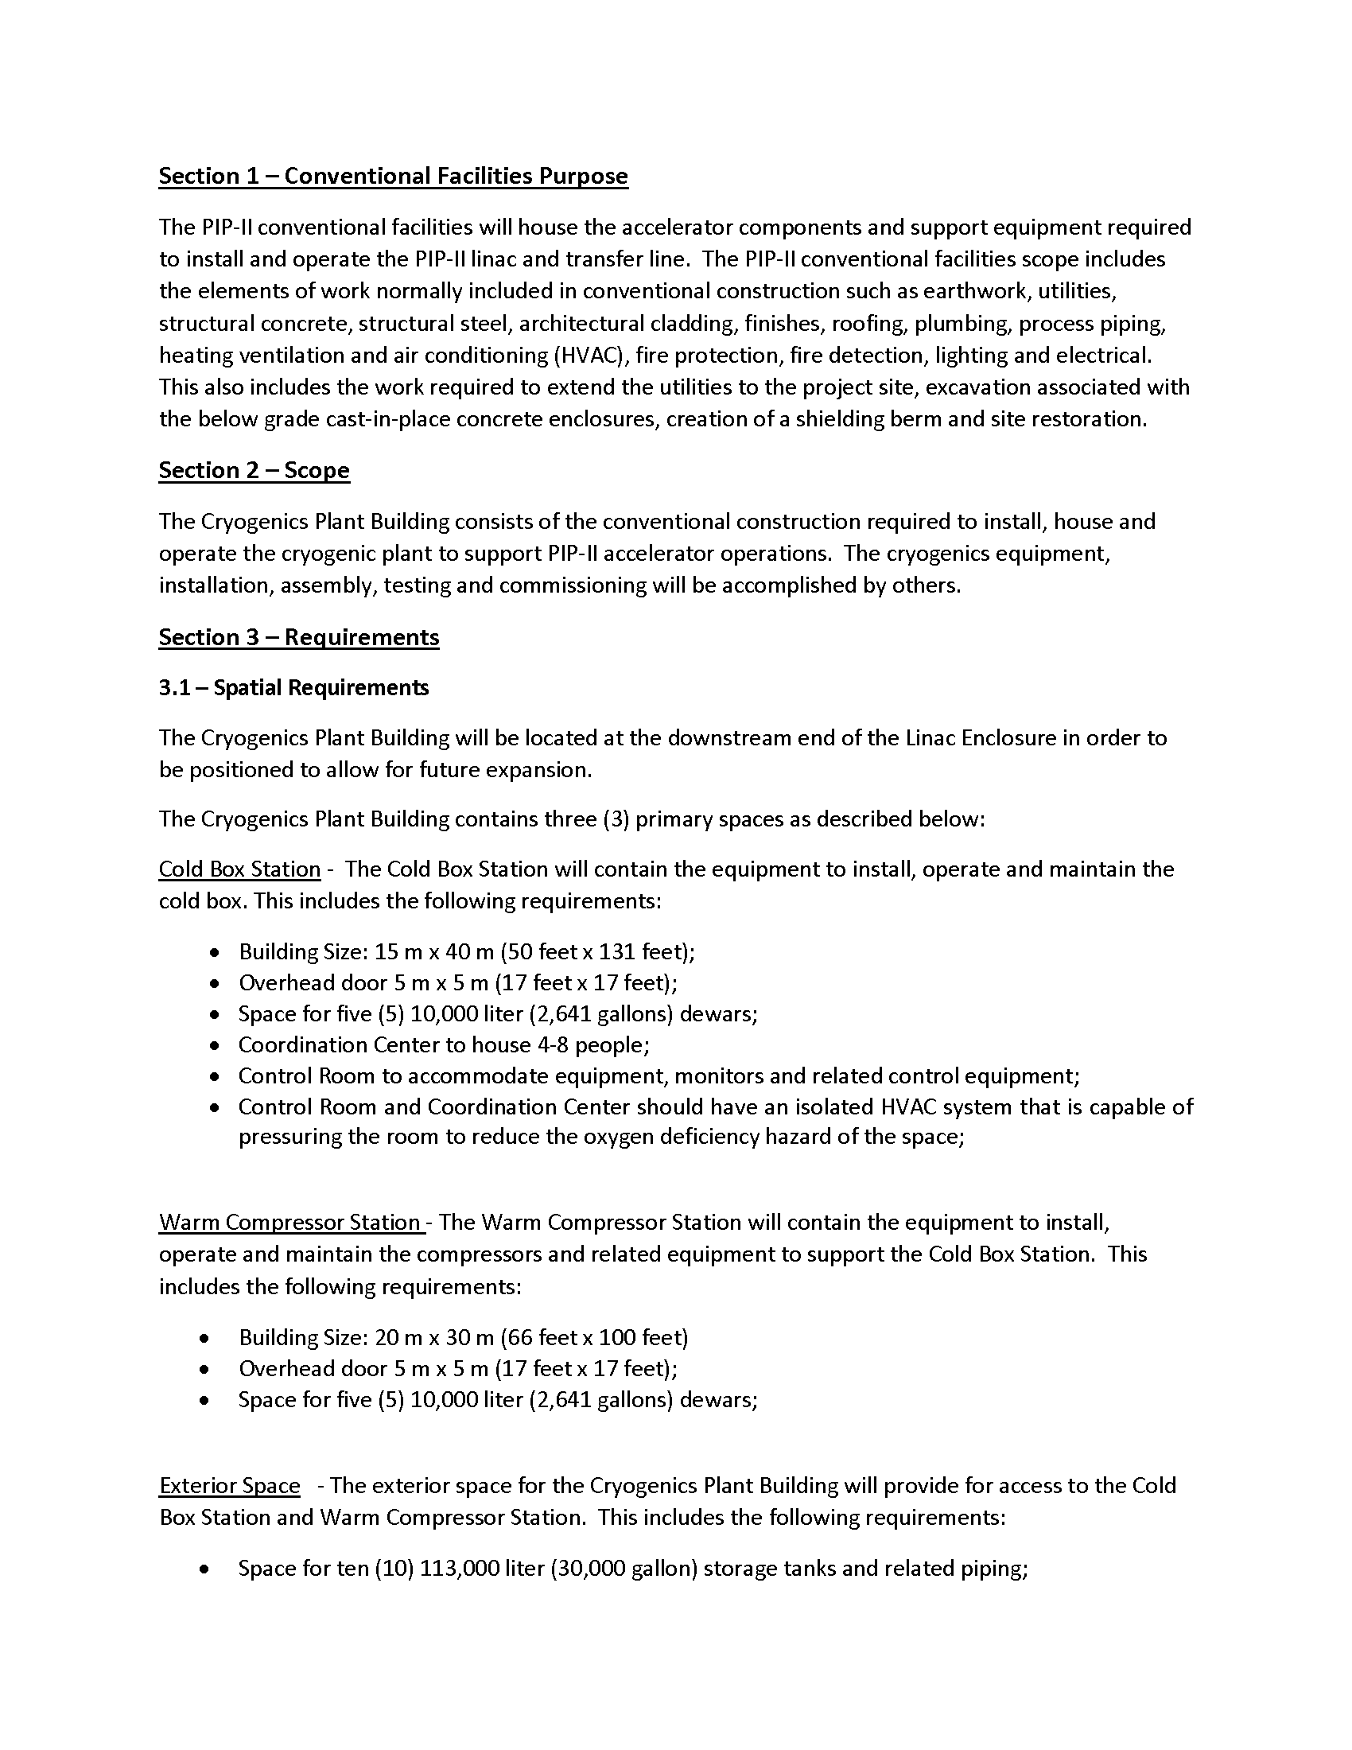
Typical TRS
Typical Technical Requirements Specification page

Slide 12
Conceptual Design Process
Meetings with Stakeholders:
  Goal: Document the spatial and infrastructure requirements for PIP-II facilities; [4]
  Started in January 2016;
Results:
  Conceptual Design drawings and text that described the sizes/arrangement of spaces and buildings to accommodate the functional requirements; [5]
  Cost Estimate Assumptions; [6]
  Life Safety Analysis; [7]
  Developed cooling strategies for pulsed mode and continuous wave operation;
  Conventional facilities are similar to typical Fermilab construction;
  [4] – Meeting Minutes can be found in PIP-II-doc-70
  [5] – Conceptual Design Drawings can be found in PIP-II-doc-1155
  [6] – Assumptions can be found at PIP-II-doc-333
  [7] – Final LSA can be found at PIP-II-doc-120

Slide 13
Conceptual Design Process
Stakeholders:
  Fermilab:
  Alessandro Vivoli, Anindya Chakravarty, Anthony F Leveling, Arkadiy L Klebaner
  Beau F. Harrison, Curtis M. Baffes, David E Johnson, David W Peterson
  Don Cossairt, Donald V Mitchell, Emil Huedem, Jim Niehoff, Fernanda G Garcia
  Jerry R Leibfritz, Jerzy Czajkowski, John E Anderson Jr, Luisella Lari
  Matthew Quinn, Maurice Ball, Paul Derwent, Ralph J Pasquinelli
  Todd M Sullivan, Valeri A Lebedev, William A Pellico
  Consultants:
  Tom Lackowski, TGRWA
  Ron Jedziniak, LG Associates
  Rick Glenn, Jensen Hughes

Slide 14
Meeting Minutes (PIP-II-doc-70)
01 - Coordination Meeting - 17FEB16 (pdf)
02 - Cryogenic Department Meeting 19FEB16 (pdf) – Cryo Meeting
03 - Coordination Meeting - 02MAR16 (pdf) – Linac Enclosure
04 - Coordination Meeting - 09MAR16 R1 (pdf) – Linac Enclosure and Cooling
05 - Coordination Meeting - 24MAR16 R1 (pdf) – Linac Enclosure and Cryo Plant
06 - Cryo Coordination Meeting - 01APR16 (pdf) – ICW Cooling and Cryo
07 - Coordination Meeting - 14APR16 (pdf) – Penetrations and Cooling Strategy
08 - Coordination Meeting - 28APR16 (pdf) – Cooling Strategy
09 - Coordination Meeting r1 - 12MAY16 (pdf) – Shielding and Transport Line
10 - Coordination Meeting - 09JUN16 (pdf) – Shielding Summary
11 - Coordination Meeting - 07JUL16 (pdf) – RF Distribution and LCW Cooling
12 - Coordination Meeting - 21JUL16 (pdf) – High Bay Equipment
13 - Coordination Meeting - 04AUG16 (pdf) – Cryo Summary and Linac Gallery
14 - Coordination Meeting - 15SEP16 (pdf) – Sitewide Electrical Distribution

Slide 15
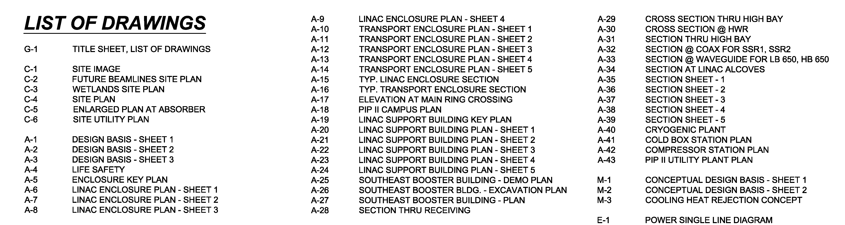
Drawings (PIP-II-doc-1155)
55 Drawings
One (1) General sheet
Seven (7) Civil sheets
Forty-Three (43) Architectural sheets
Three (3) Mechanical sheets
One (1) Electrical sheet

Slide 16
Typical Design Basis Sheet
Base Design: Eliminates this portion of the Linac Gallery (included as an Additive Alternate)

Slide 17
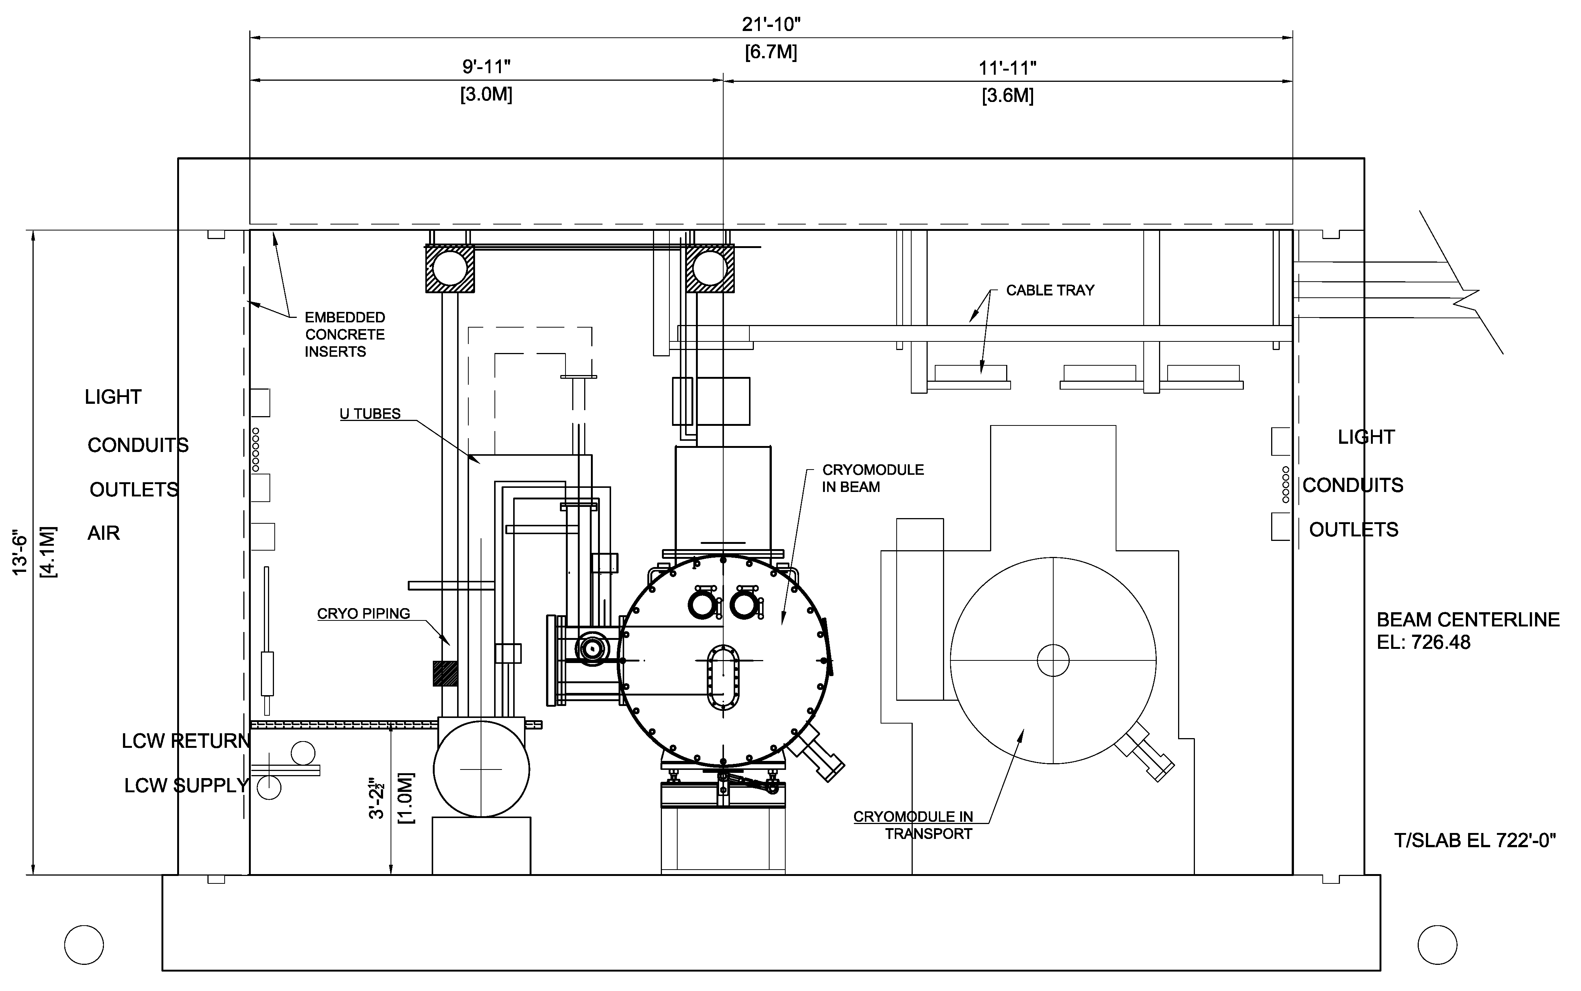
Typical Linac Tunnel Cross Section
1’-10”
Aisle
LCW Zone
1’-10”
Aisle
RF Zone

Slide 18
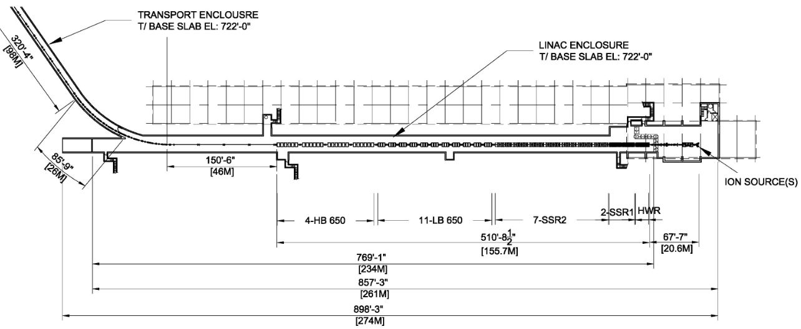
Linac Tunnel Plan (WBS 121.5.6)
~75’
Plan at Enclosure Level
FRS Section 5 (Facility Scope):
The linac enclosure will be constructed with a length to accommodate two (2) HB650 cryomodules beyond the nominal compliment required for 800 MeV

Slide 19
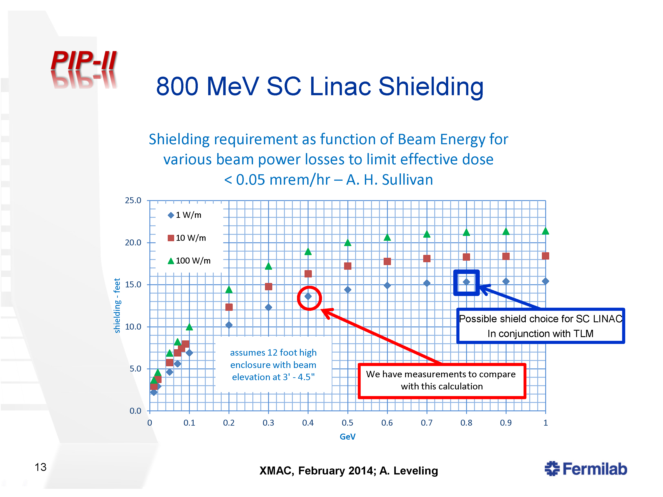
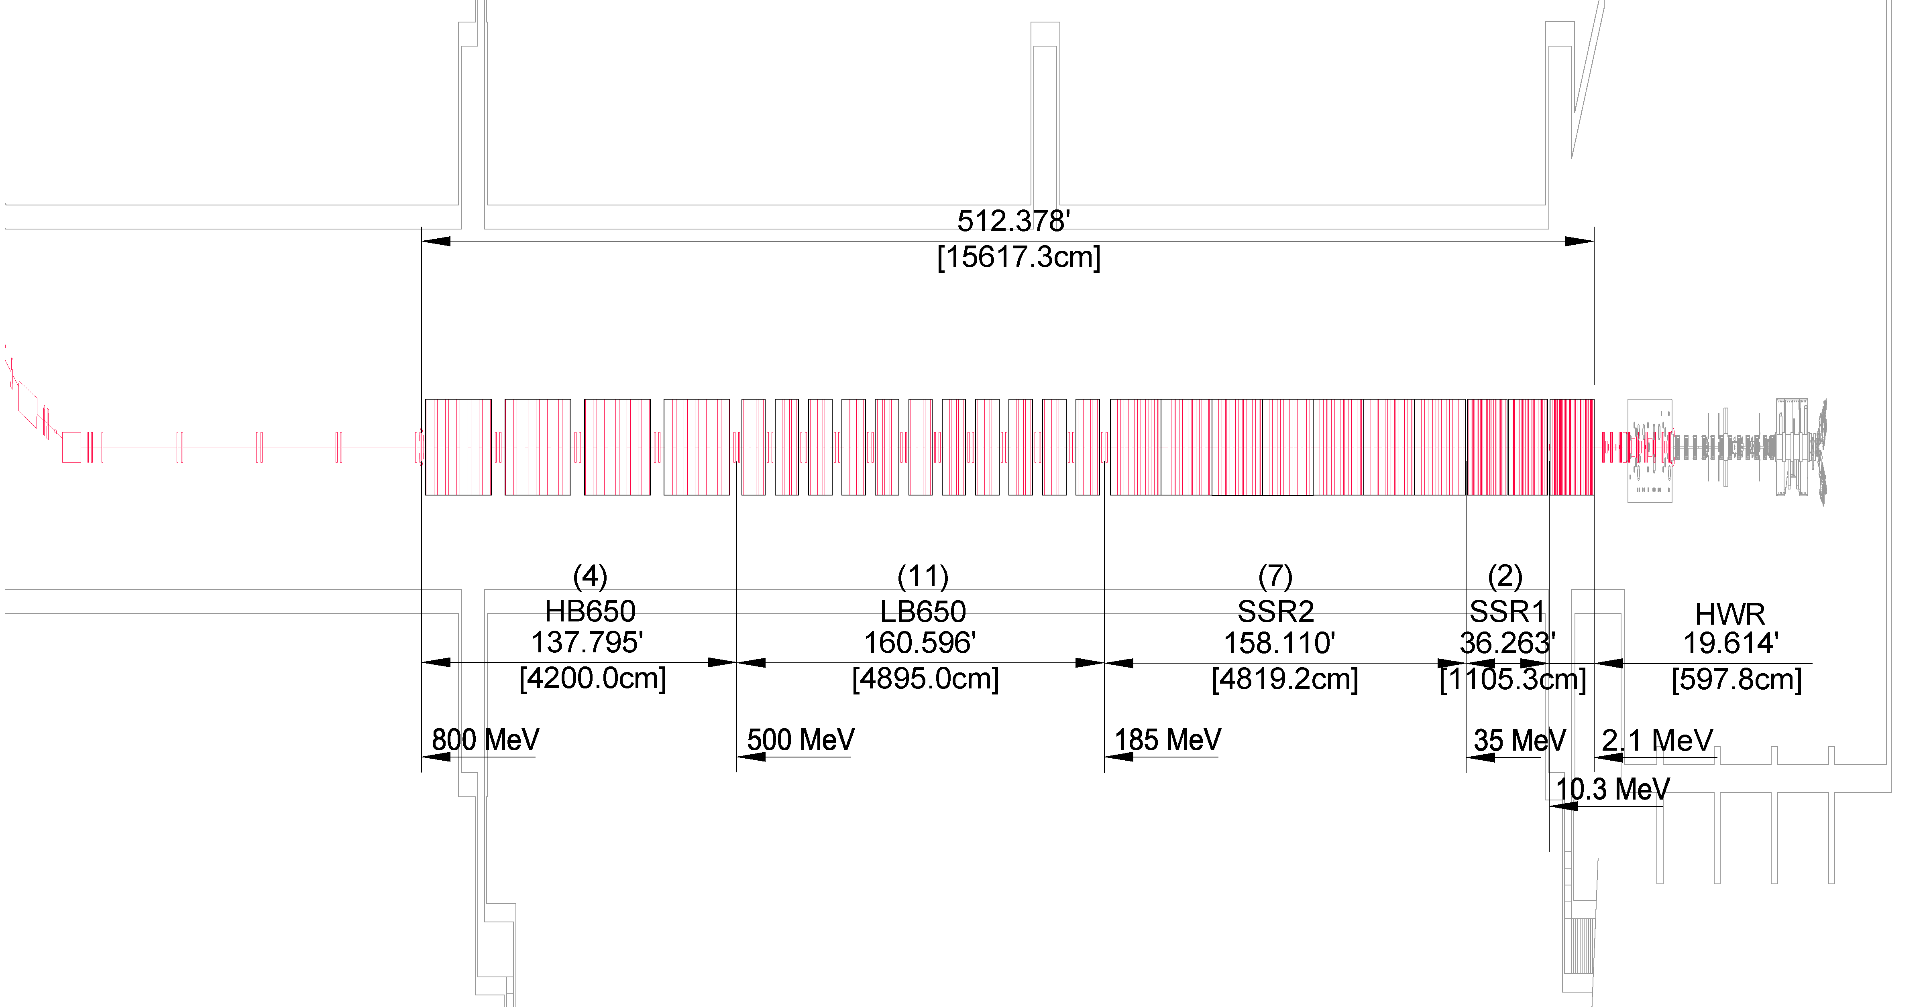
Preliminary Shielding Considerations
Preliminary Shielding Depths shown below. Further analysis required, especially at the Booster.
Used the 10W/m curve for the conceptual design
18.5’
(transport line and absorber)
18.5’
17.5’
7.5’
6’
Thanks to D. Cossairt, T. Leveling and M. Quinn

Slide 20
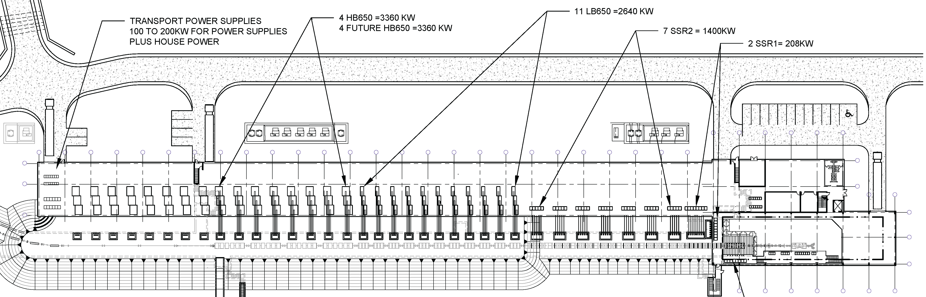
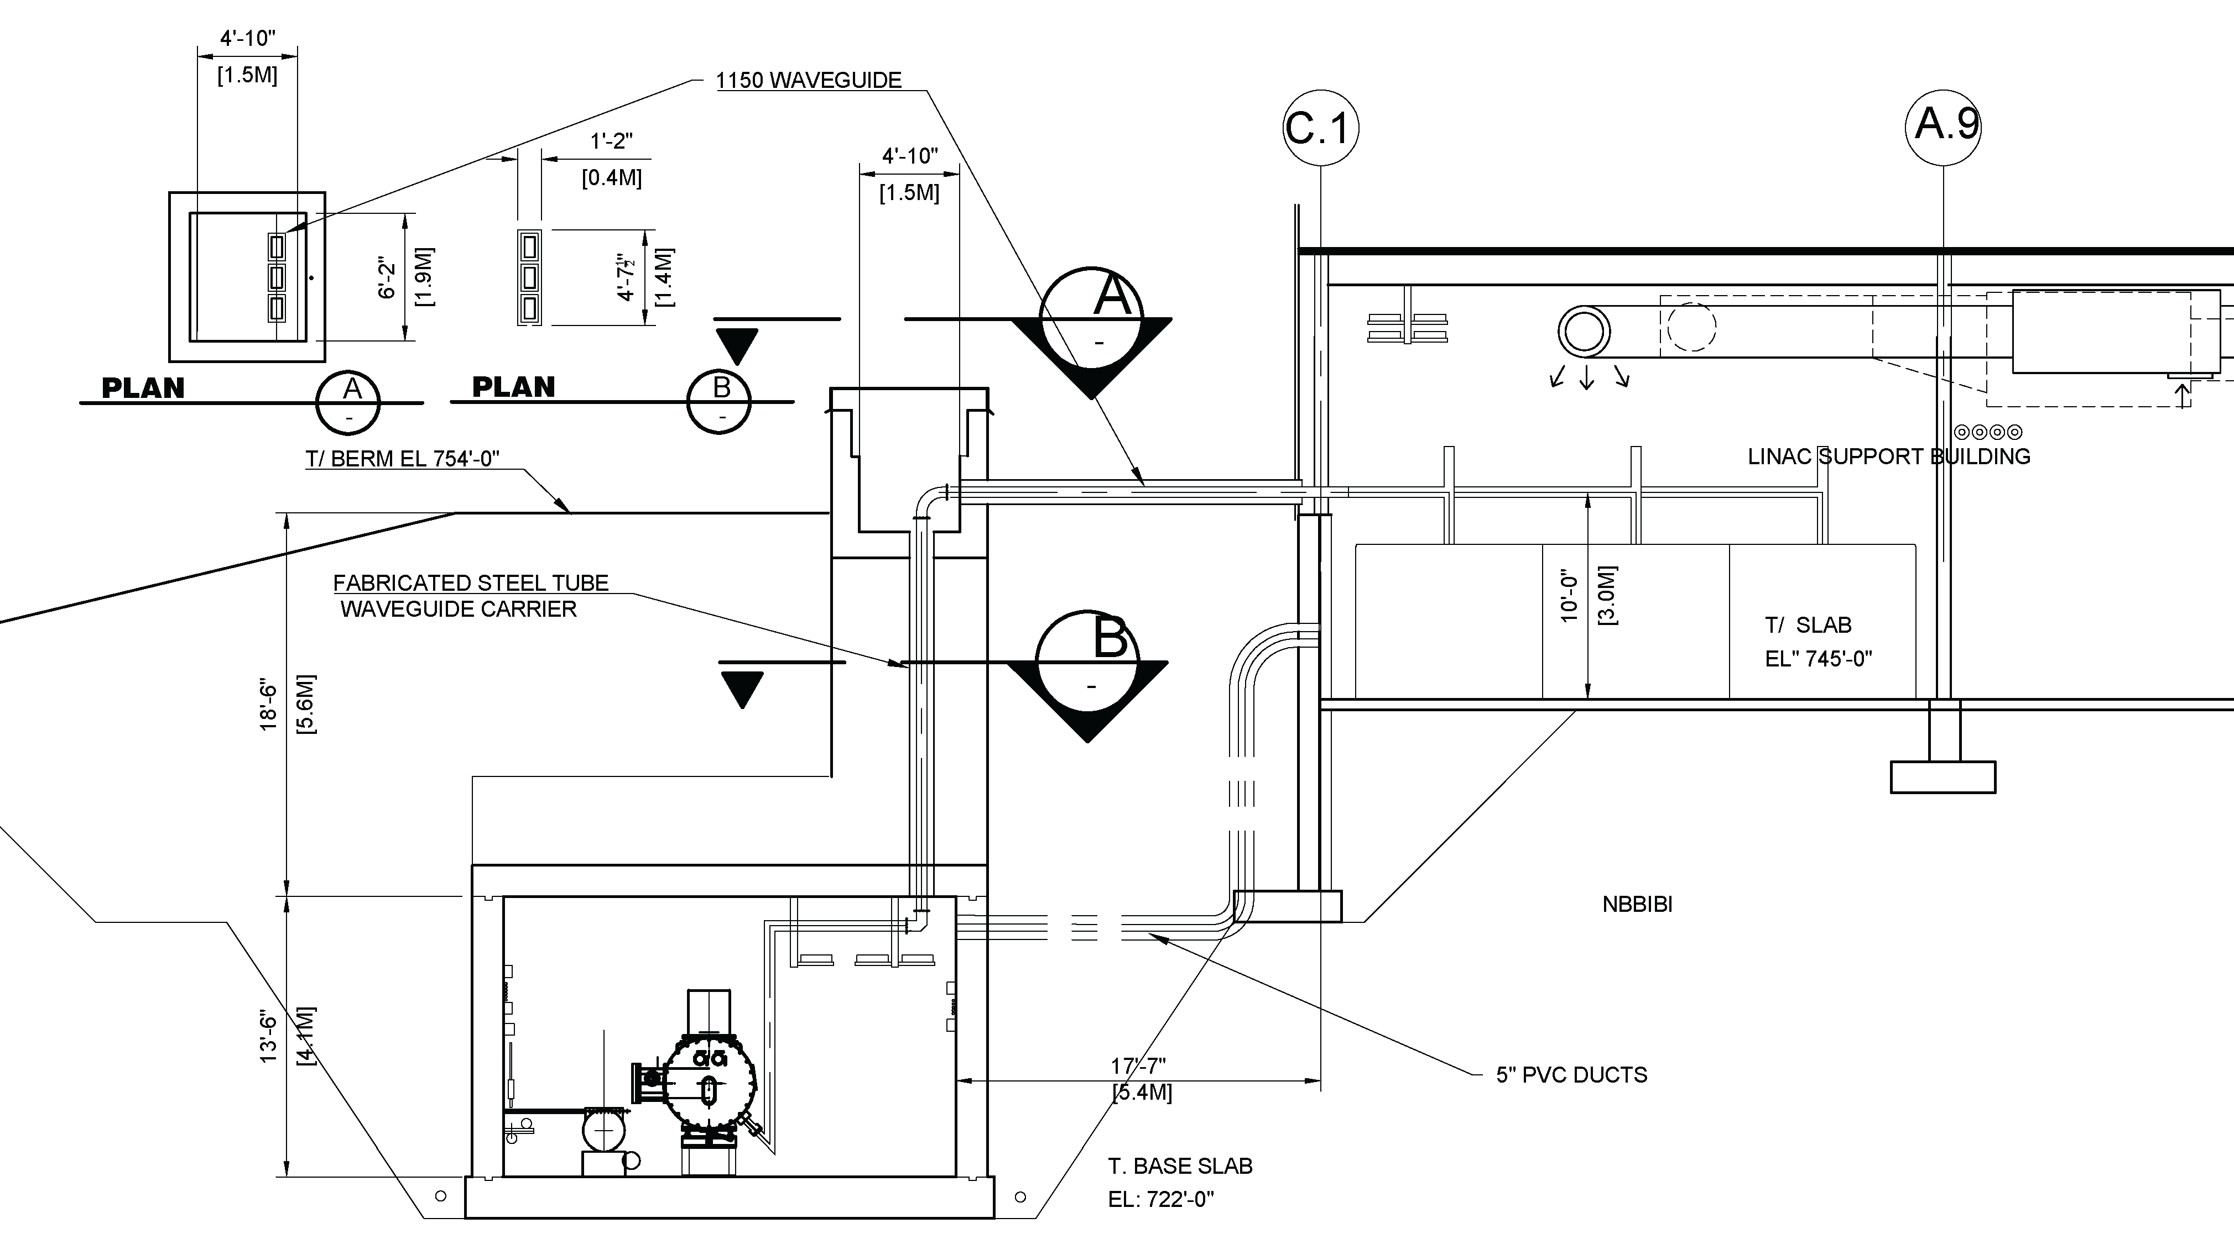
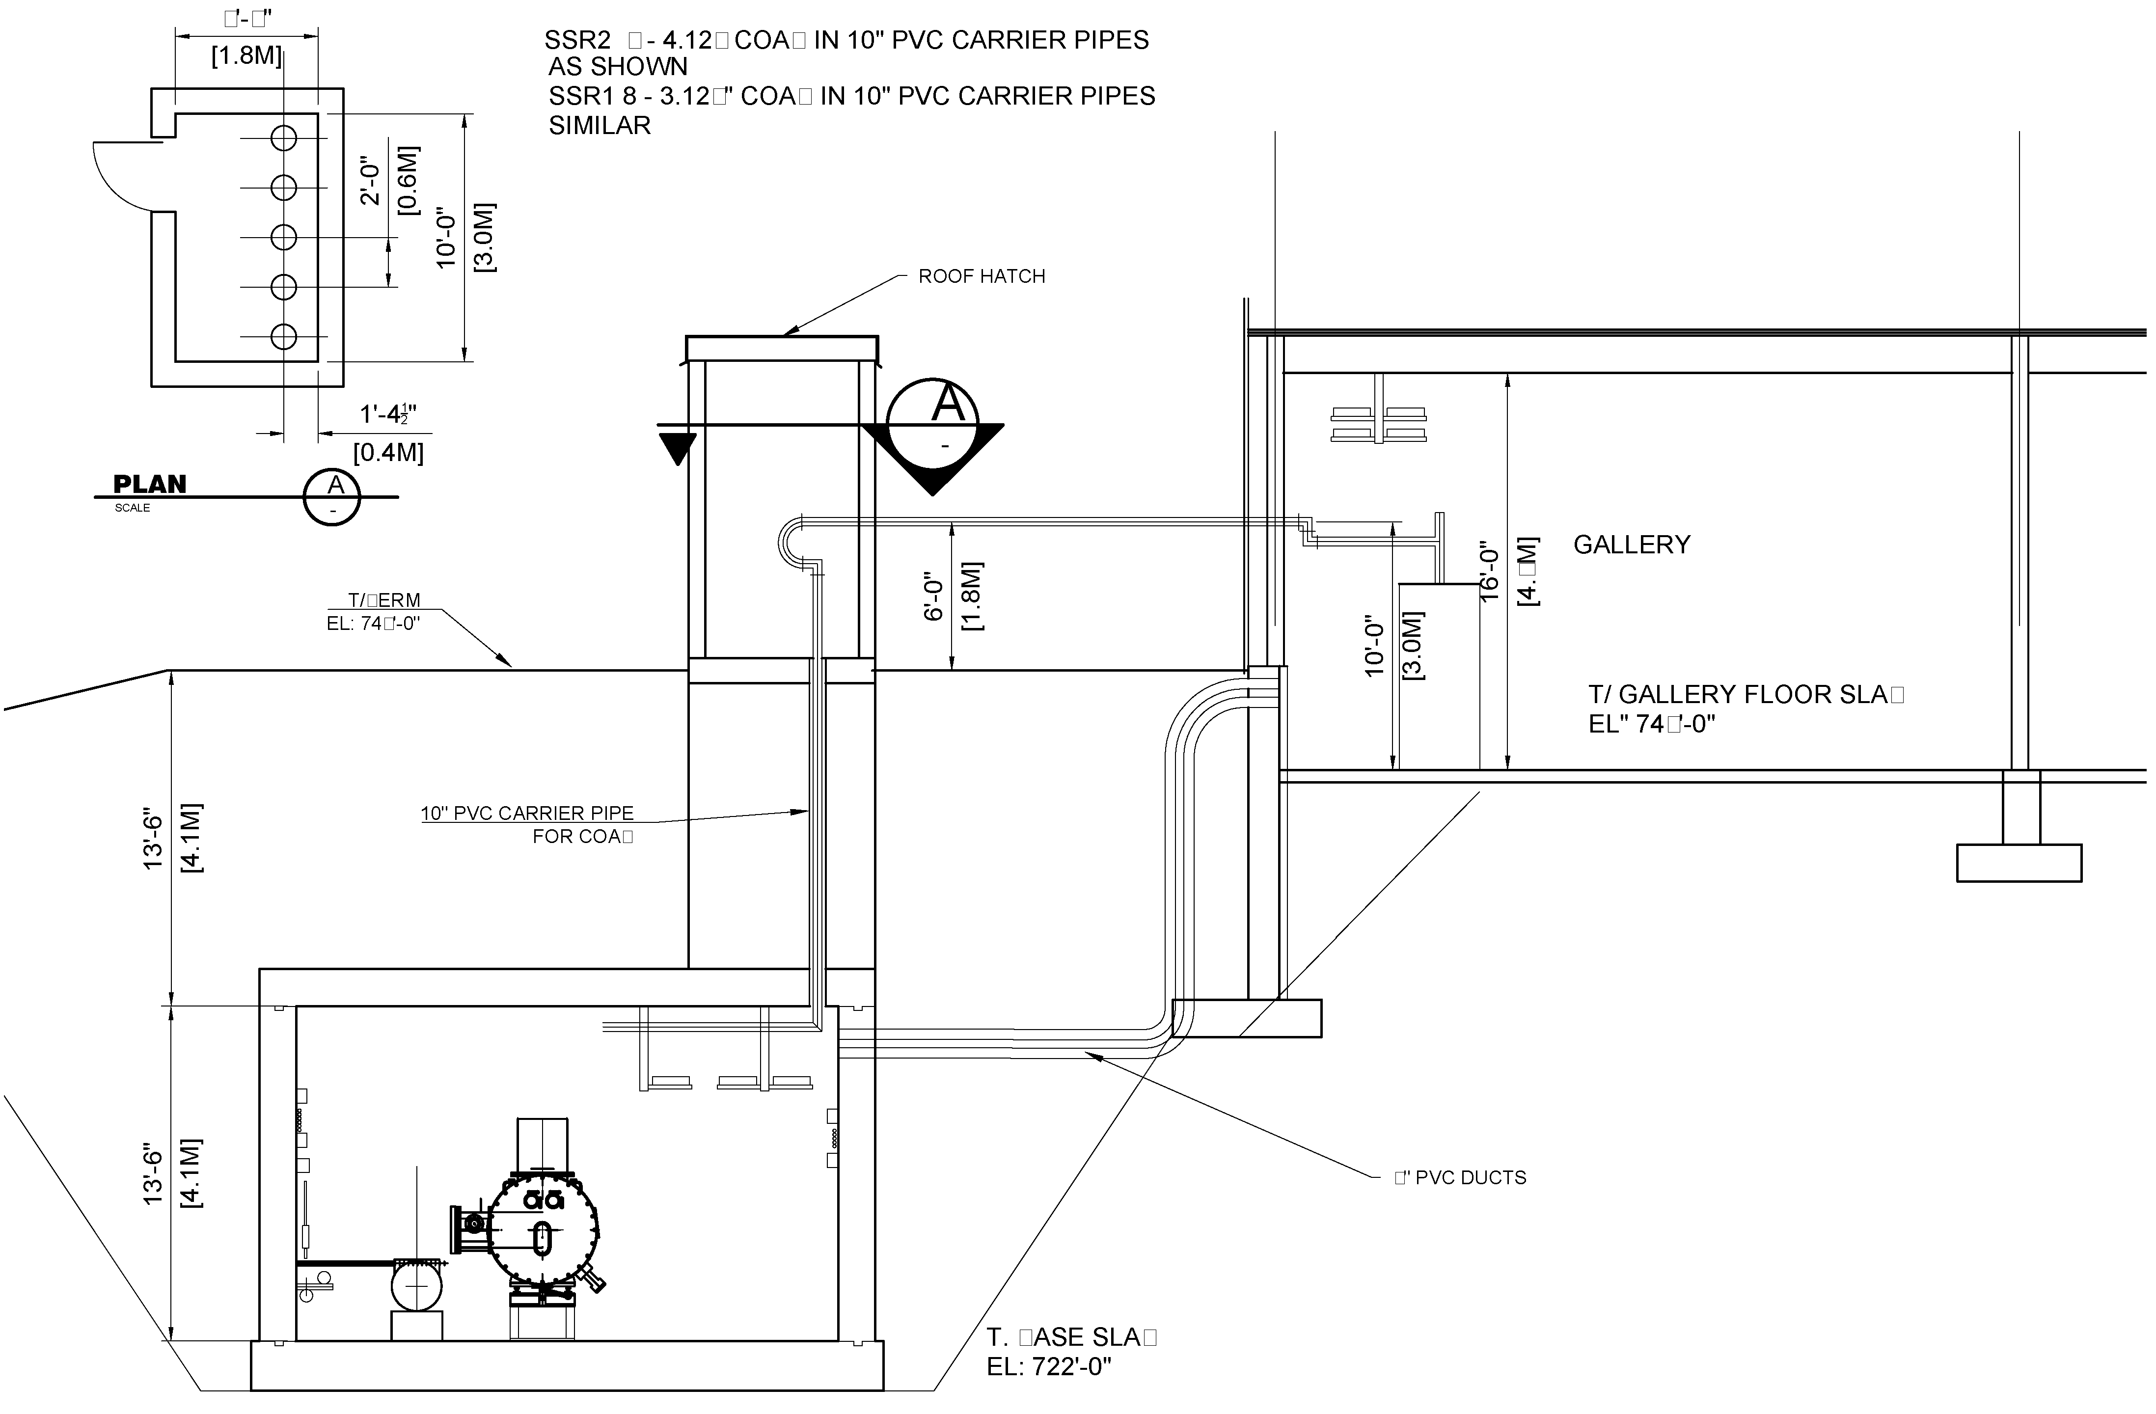
Linac Gallery Plan (WBS 121.5.7)
Cross Section Looking South at Waveguide Penetrations
Cross Section Looking South at Coax Penetrations

Slide 21
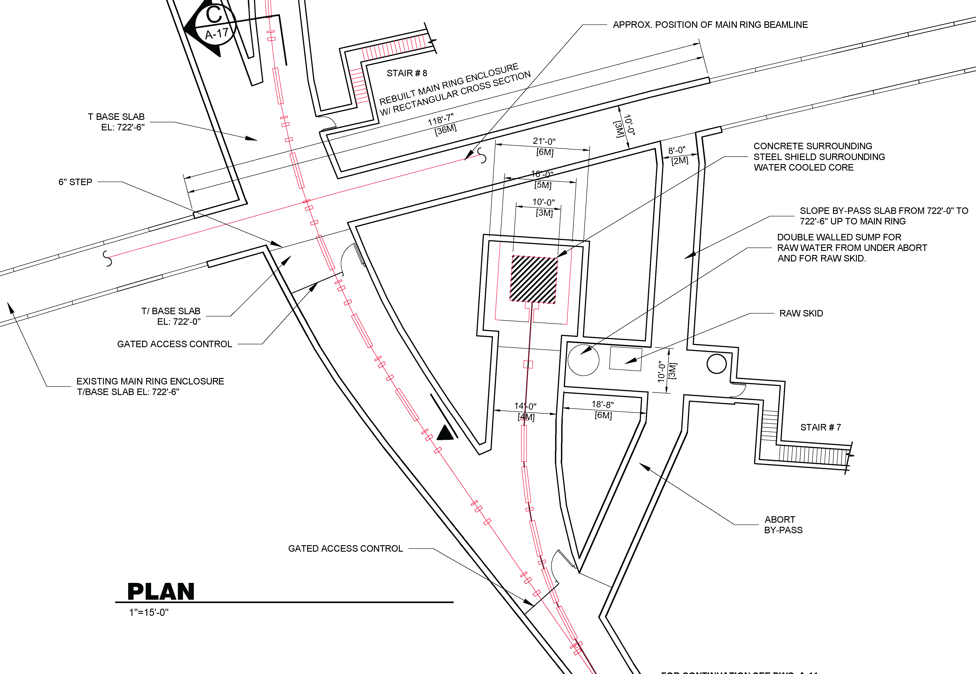
Beam Transfer Line (WBS 121.5.8)
FRS Integration and Upgradability:
I2: The siting of the PIP-II facility will be consistent with future upgrades to provide 100 kW beams to the Mu2e hall on the Muon Campus

Slide 22
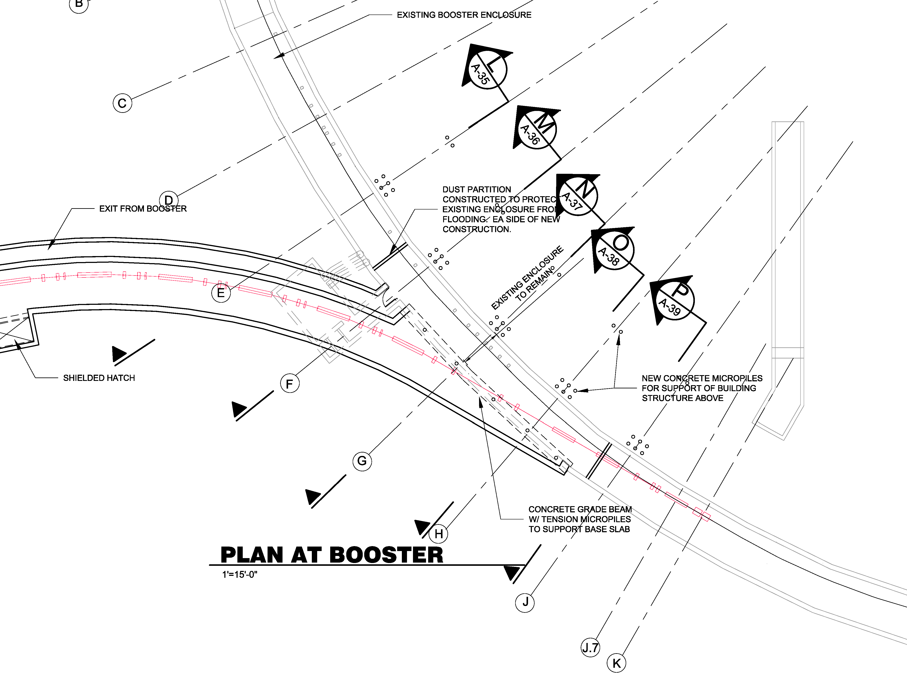
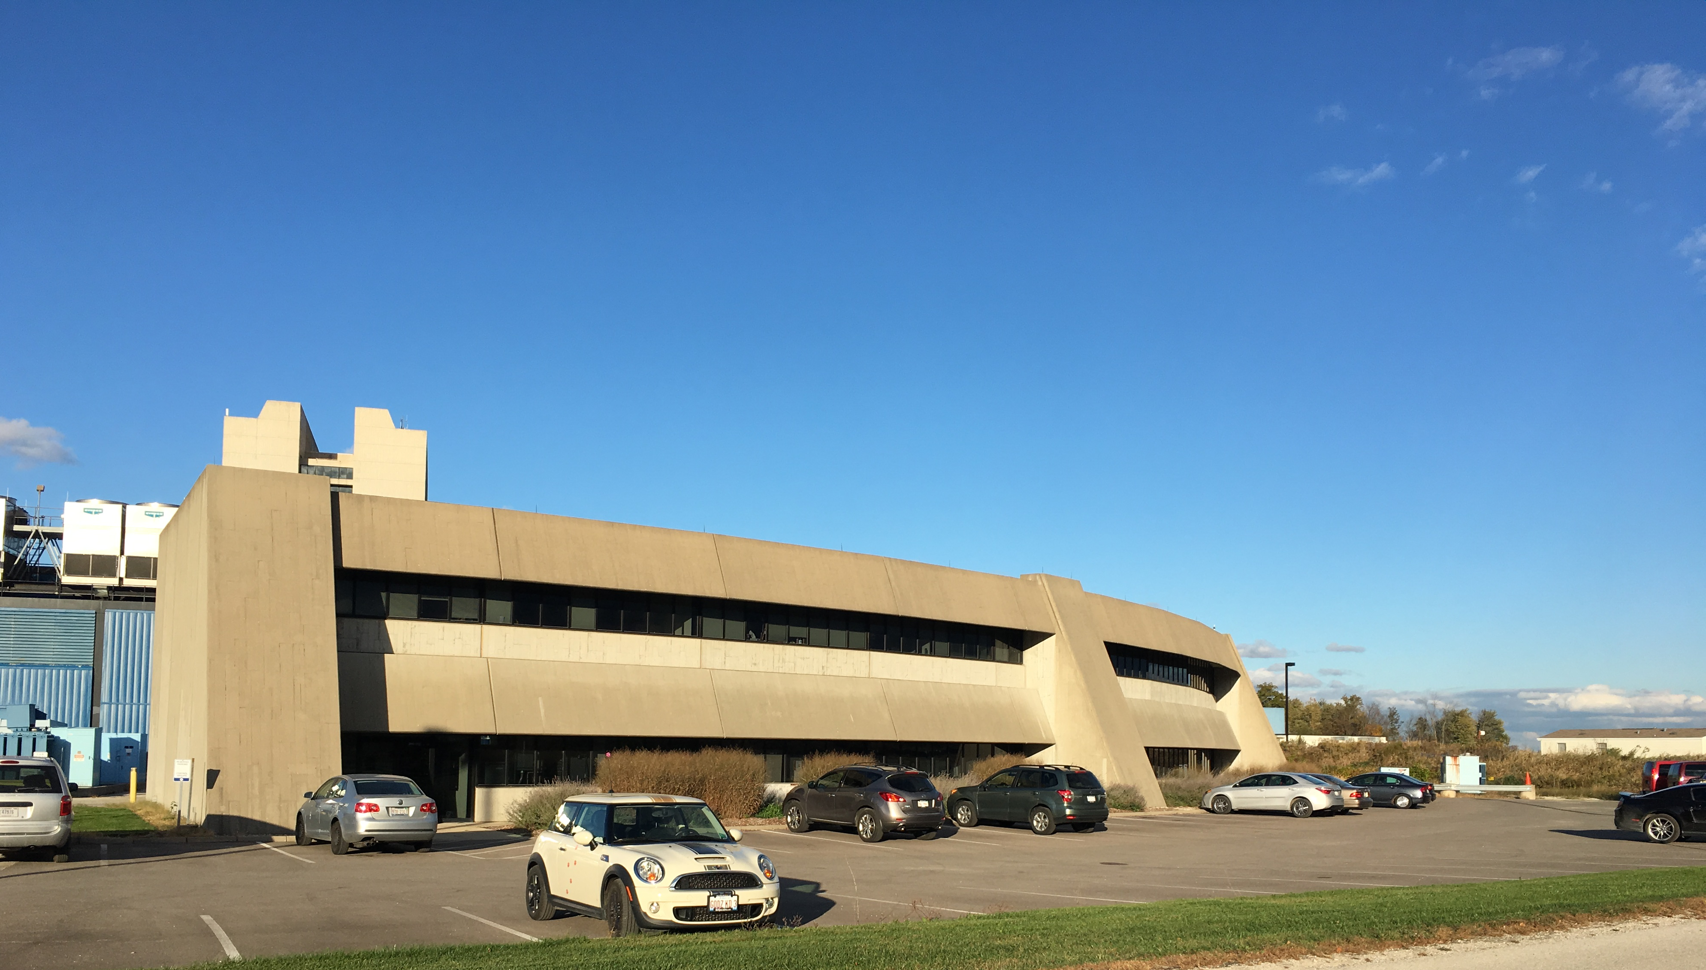
Booster Connection (WBS 121.5.9)
FRS Integration and Upgradability:
I4: The SC Linac will be constructed in a manner that allows installation and commissioning without interruption to ongoing accelerator operations
Looking Northeast Towards Booster Tower Southeast

Slide 23
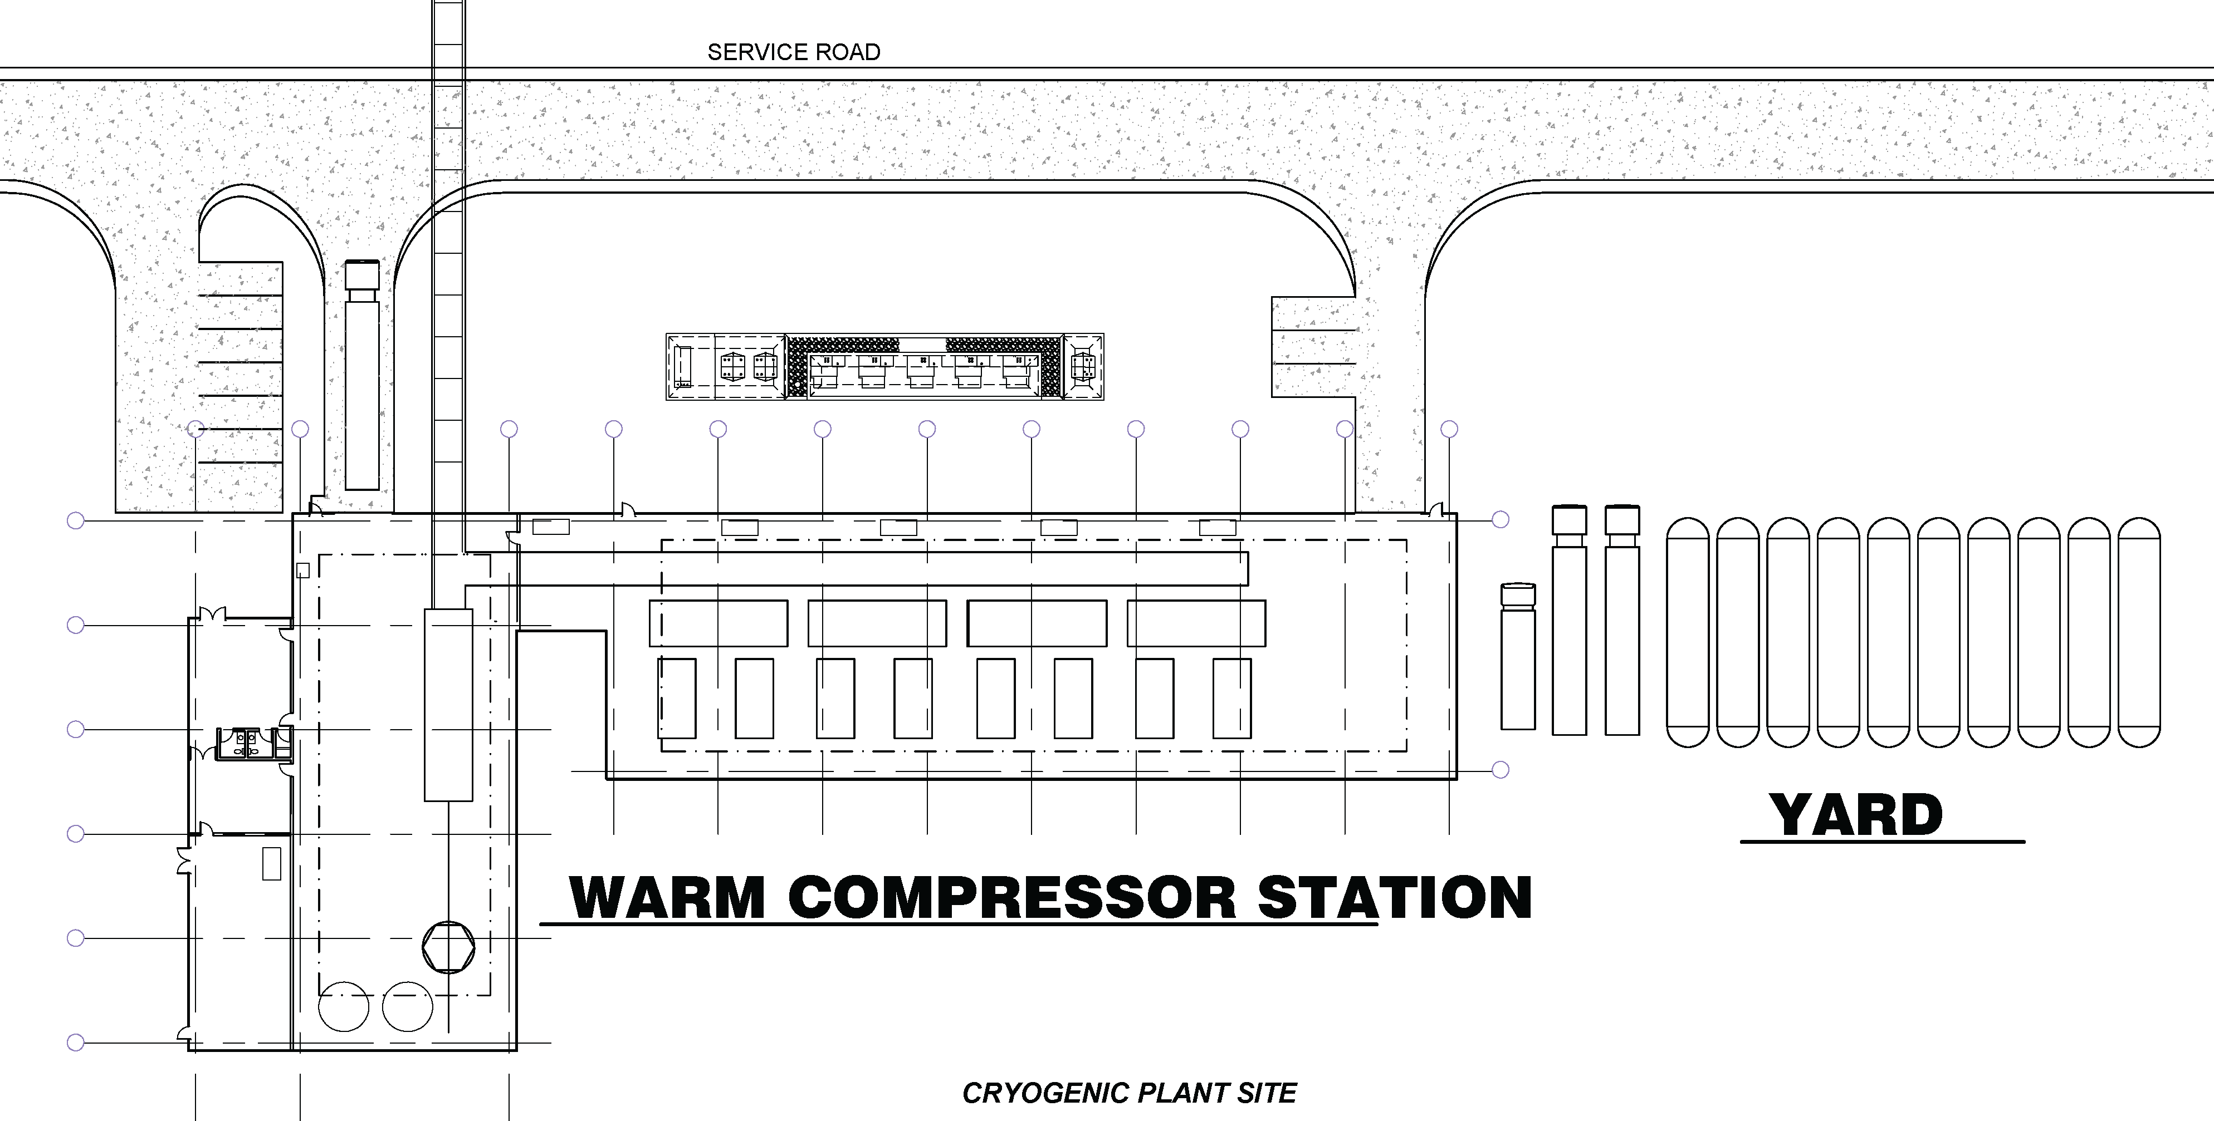
Cryo Plant Building (WBS 121.5.3)
Tank Farm
Warm Compressor Station
Cold Box Station

Slide 24
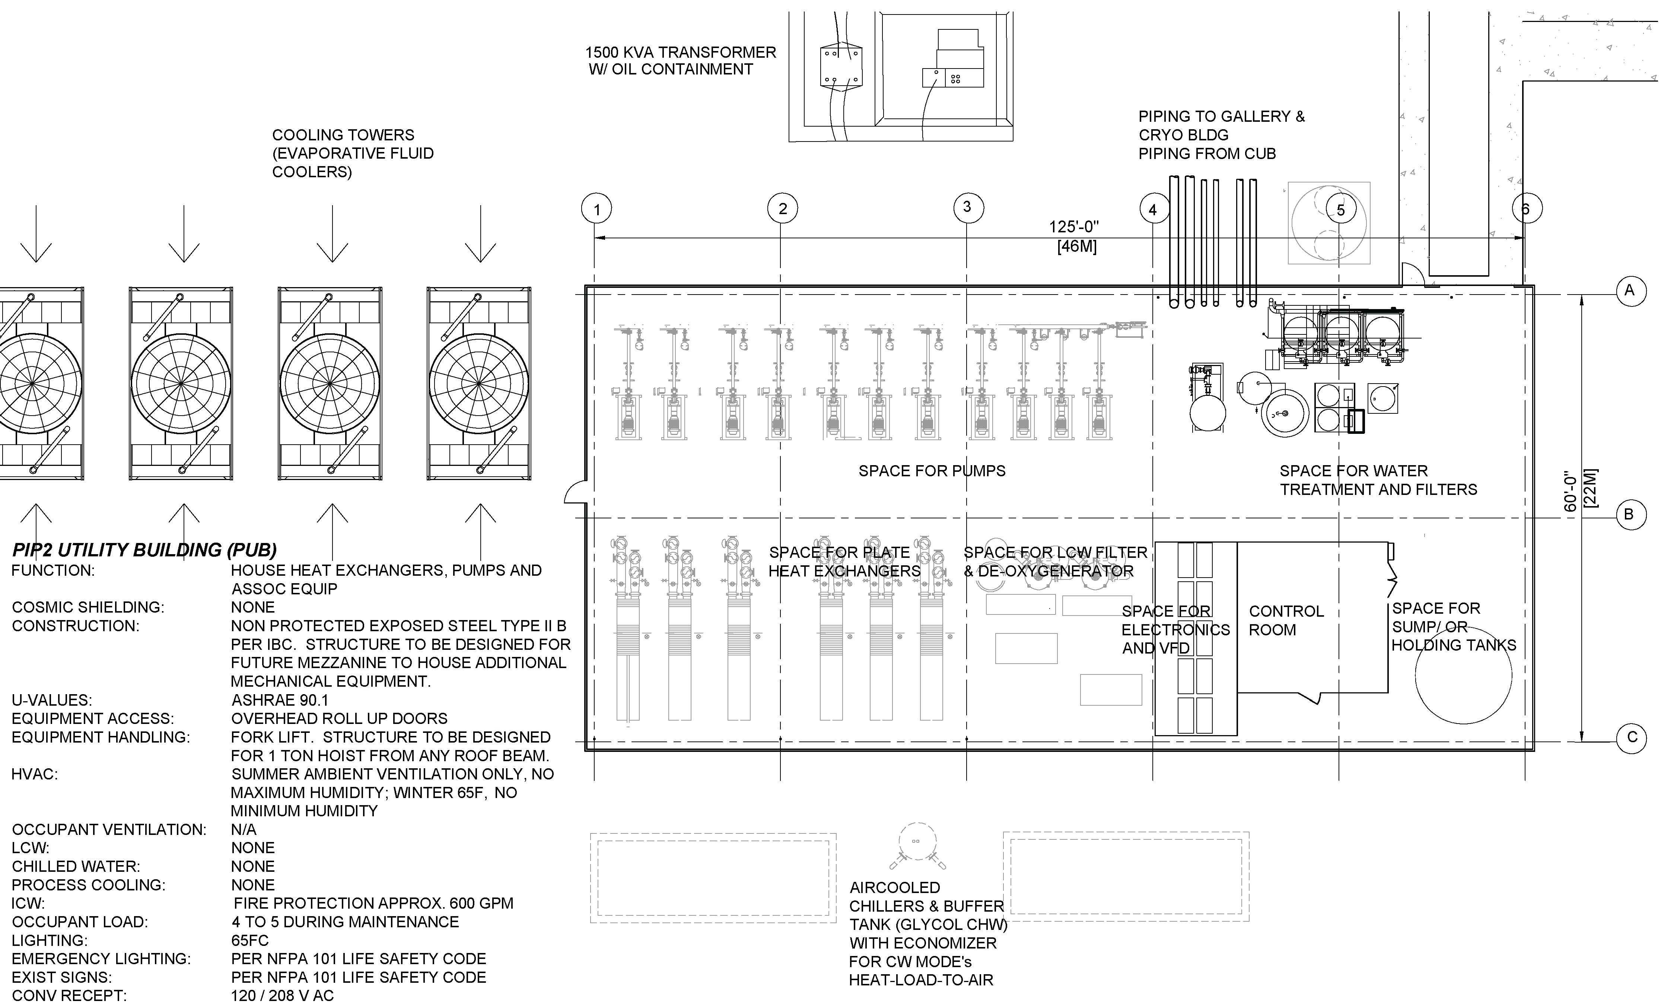
Utility Plant Building (WBS 121.5.4)

Slide 25
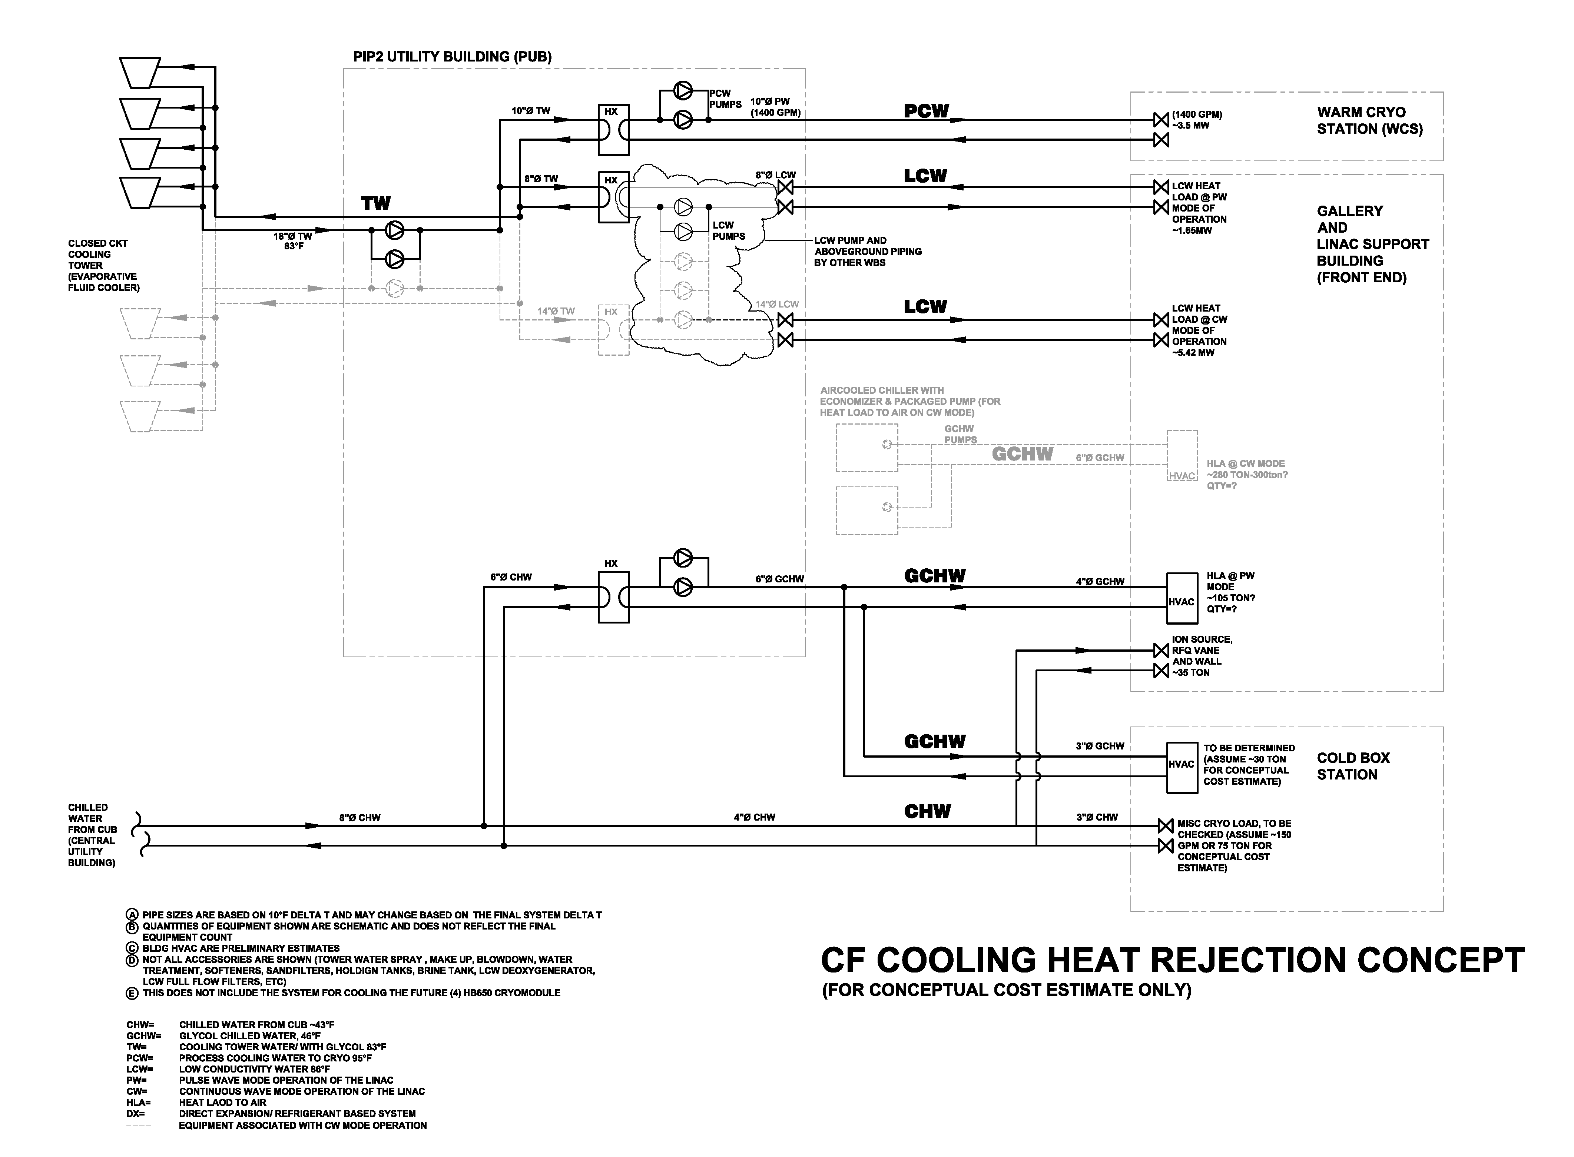
Cooling Concept
Base Design
Direct ICW flow through cryo compressors
Base Design
Cooling for pulsed mode.
Additive Alternate for continuous wave cooling

Slide 26
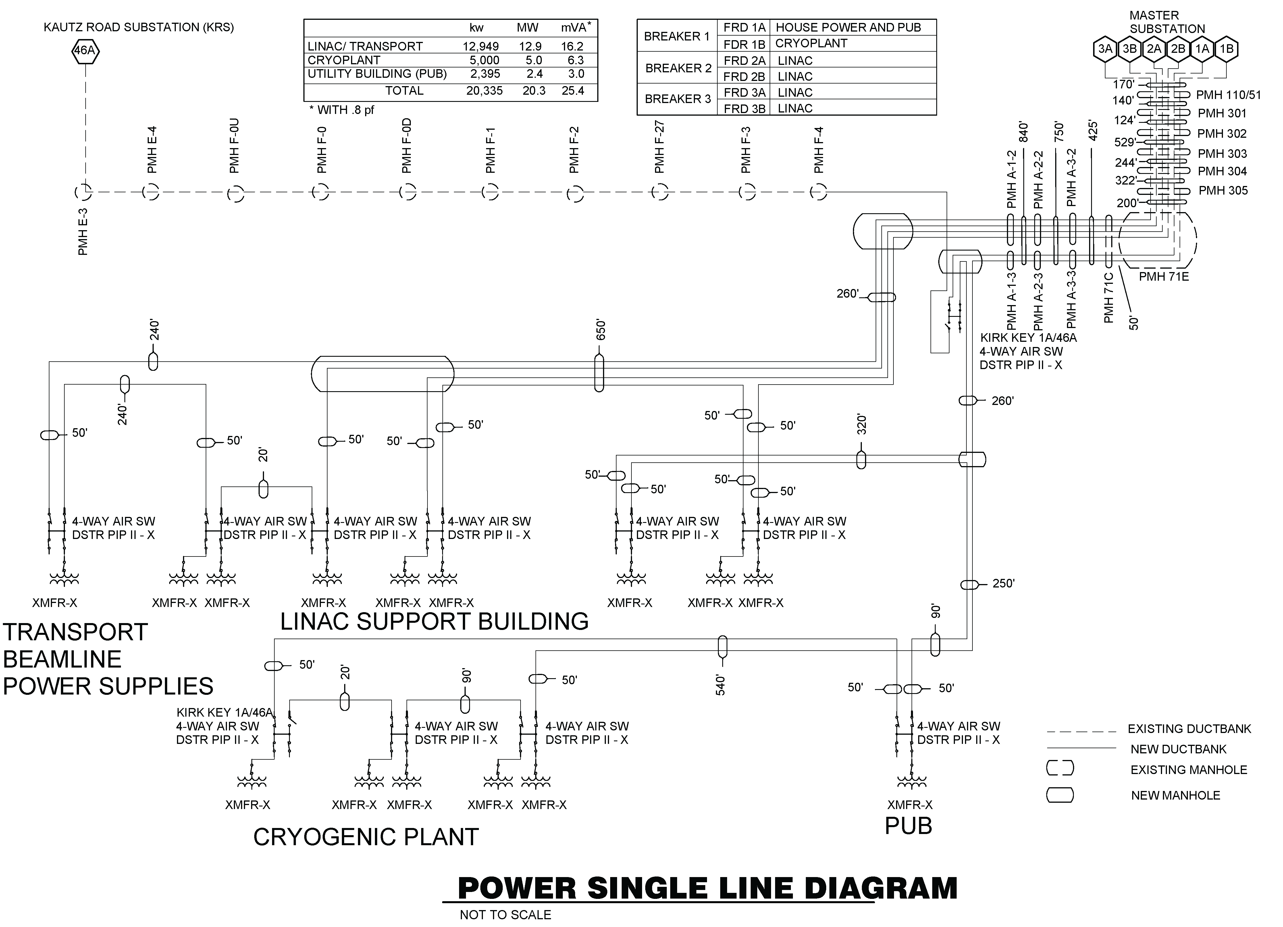
Electrical Distribution Concept
Manhole P71

Slide 27
Alternates Considered
Siting
ICW Cooling
Pulsed Mode vs. Continuous Wave Operation

Slide 28
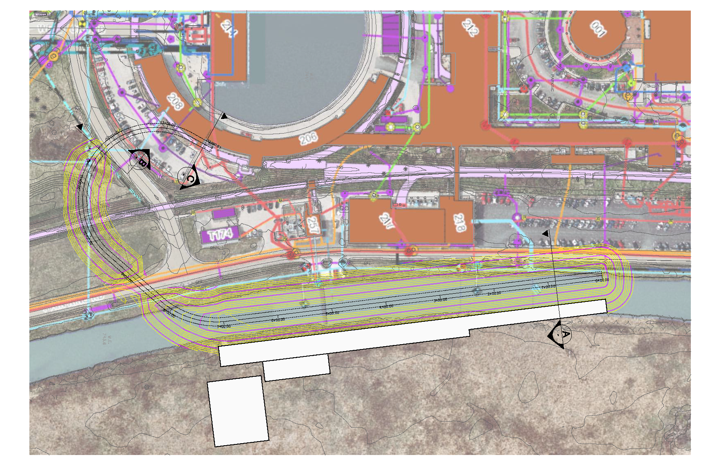
Preconceptual Location
2014 Location

Slide 29
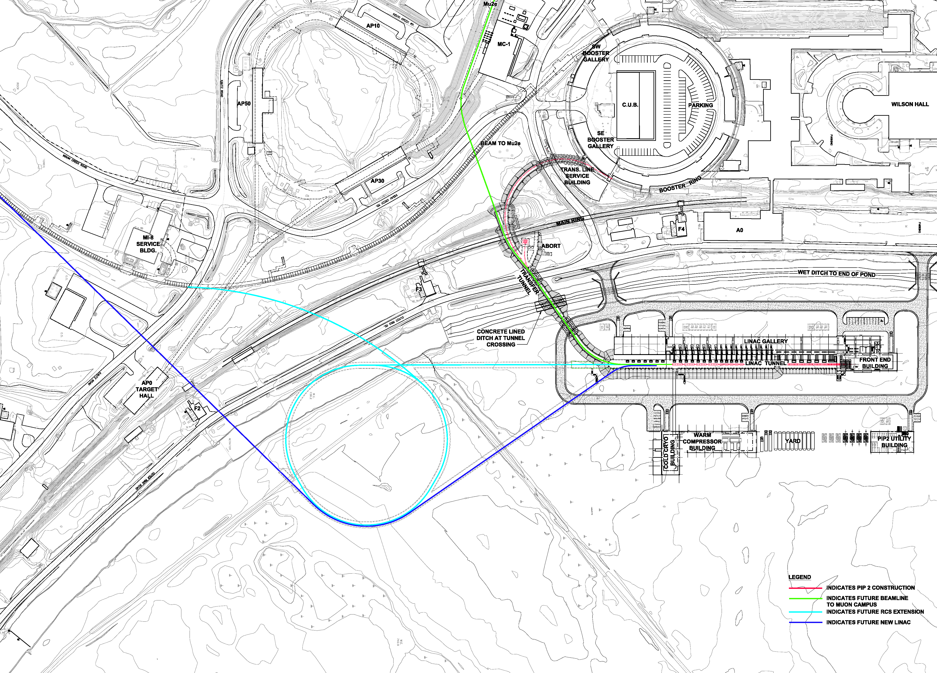
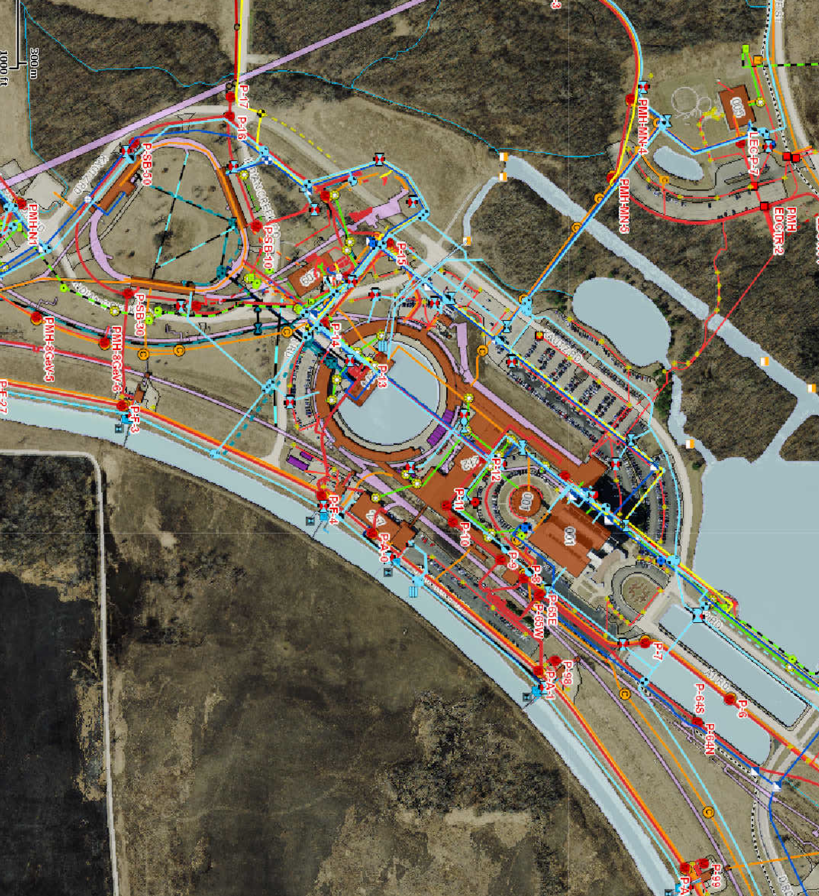
Siting Considerations
I2
Existing Utilities
and Services
I1
5
FRS Integration and Upgradability:
I1: Future RCS or Pulsed Linac
I2: Future 100 kW beam to Mu2e;
I4: Installation/Commissioning during ongoing operations
FRS Section 5 (Facility Scope):
Linac length to accommodate two (2) additional HB650 cryomodules

Slide 30
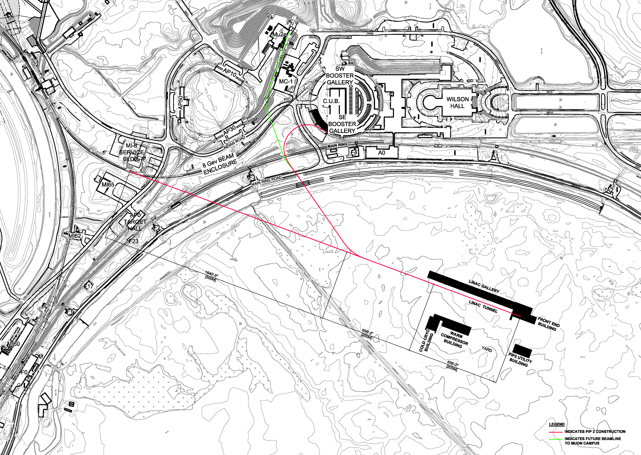
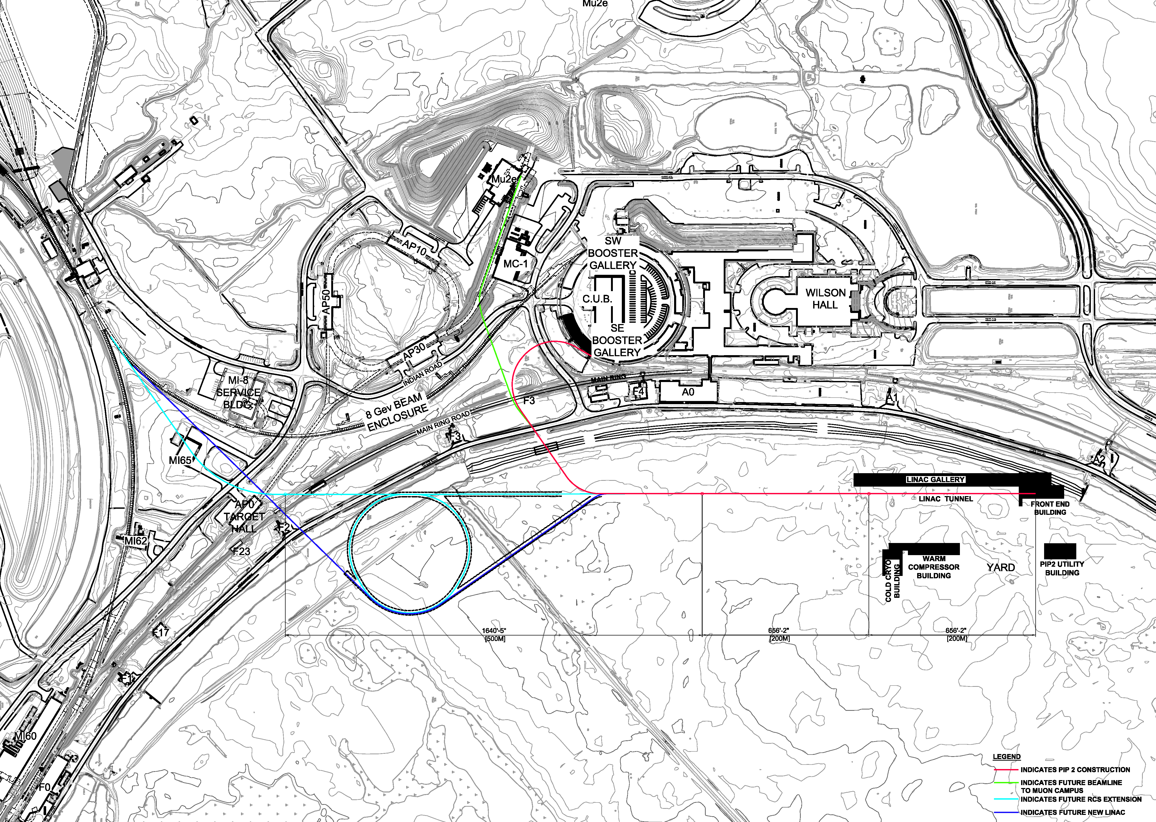
December 2016 Siting Alternatives Study
8 GeV Tangent Option
See PIP-II-doc-136 for Memo
Northward Shift Option

Slide 31
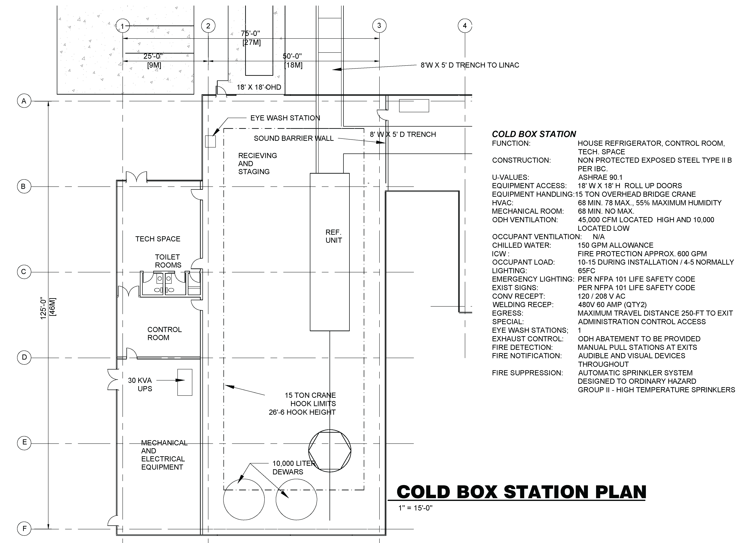
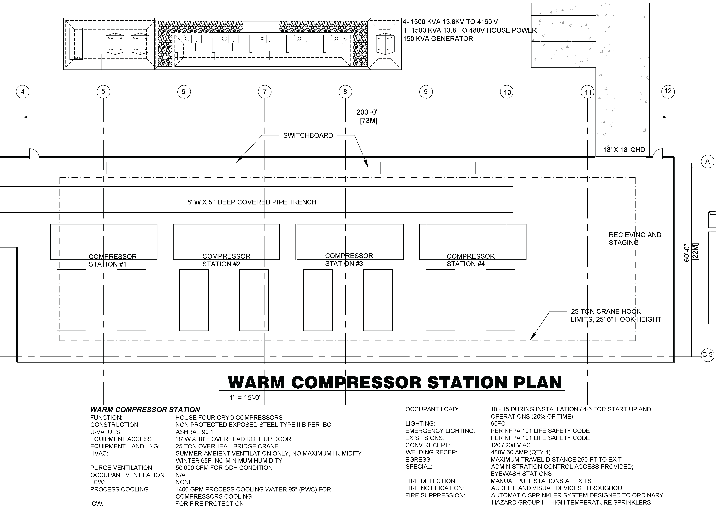
Cryo Plant Cooling Water
Cryo Compressors

Slide 32
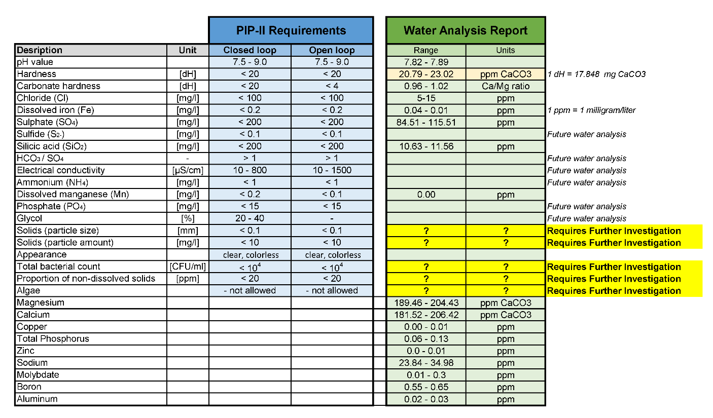
Cryo Plant – Water Quality Requirements
  Existing Data

Slide 33
Cryo Plant Cooling – Initial Analysis
Water Requirements
  ~2,000 gpm flow (ideal)
Pond System
  Chemical characteristics met by Pond system;
  Solids content characteristics NOT met by Pond system;
  No Pond Exists - ~$500-$700k per acre;
Industrial Cooling Water (ICW) System
  Testing indicates that ICW meets most requirements [4];
    Chemical characteristics met by existing ICW system;
    Solids content characteristics NOT met by ICW system;
  Only 1,400 gpm available per the ICW model
  Verified with Cryo that 1,400 gpm at 17 degree F delta T is acceptable
  [4] – ICW Water Quality Test Results study can be found at PIP-II-doc-155

Slide 34
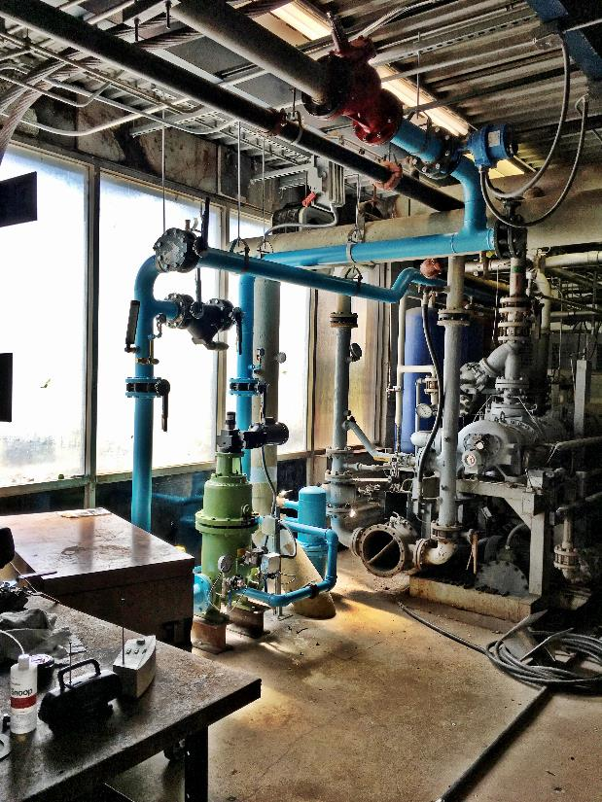
Cryo Plant Cooling – Additional Analysis
Summer/Fall 2016
Test Station, installed as part of the Mu2e Cryo work for CDF;
Installed test ports to sample the ICW before and after the strainer;
Three Options:
  Adams strainer with 250 micron slot sizes (baseline);
  Two month rental of a Lakos strainer to reduce the solids with 25 micron filter;
  Replacement filter elements in Adams strainer with 75 micron slot size;
Arranged for FESS/O water testing service to increase the testing to include solids;
Compare strainer options with water quality requirements.
Port for Rental Strainer
Port for Rental Strainer
Strainer
BZero Compressor Building

Slide 35
Cryo Plant Cooling - Results
Results:
Additional testing (chloride) and discussion with cryo folks;
Algae is likely seasonal, still requires a solution or better definition of requirements;
Baseline design will assume direct flow of ICW through cryo compressors;
Additive Option: heat exchanger to isolate the ICW from the cryo compressor side;

Slide 36
Pulsed Mode vs. Continuous Wave Operation
Driven by duty factor of the accelerator equipment
  15% for Pulsed Mode
  100% for Continuous Wave Mode
Common For Both Modes
  Physical arrangement of heat producing equipment;
  Electrical power supply (not usage);
  Conventional Facilities handles the heat load to air (HLA);
Difference is Primarily Cooling
  ~5.4 MW in pulsed mode;
  ~11.6 MW in continuous wave mode;

Slide 37
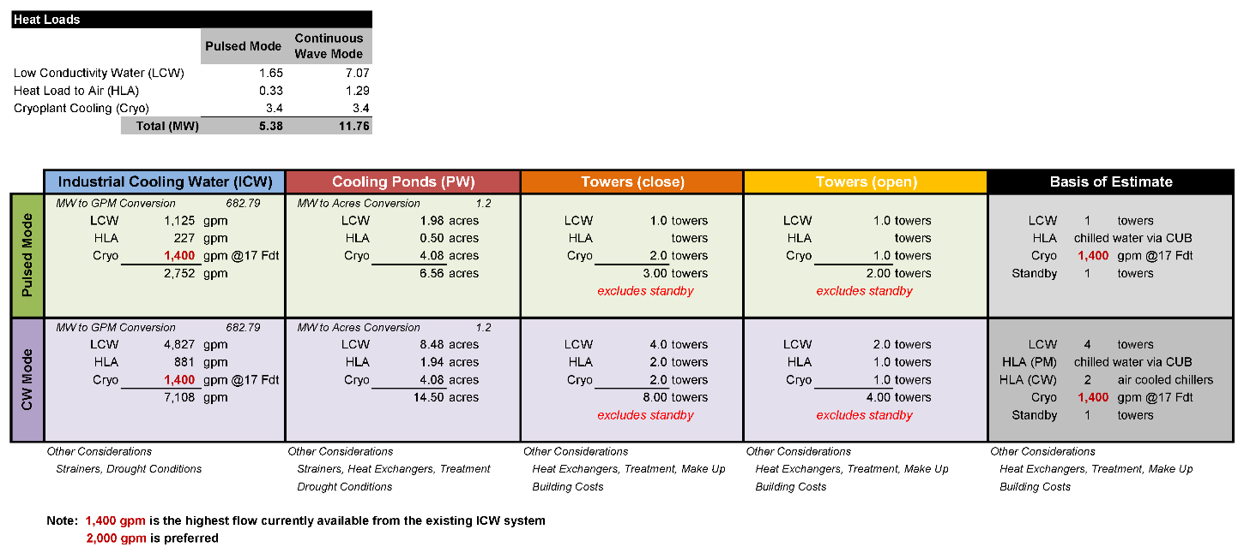
Pulsed Mode vs. Continuous Wave Operation

Slide 38
Pulsed Mode vs. Continuous Wave Operation
Goal: Modular approach that allows for efficient operation in both modes;
CUB Chilled Water Budget: ~250 tons total. Used for small equipment loads, building loads and RF heat load to air
Pulsed Mode
  Heat Load to Air (HLA): Utilize chilled water from existing CUB for equipment cooling;
  LCW: (1) Cooling Tower + 1 standby;
  Cryo: 1,400 gpm of ICW directly through the compressors.
Continuous Wave Mode
  Heat Load to Air (HLA): Install a chilled water loop to supplement the pulsed mode system with (2) air cooled chillers;
  LCW: (3) additional Cooling Towers;
  Cryo: No change

Slide 39
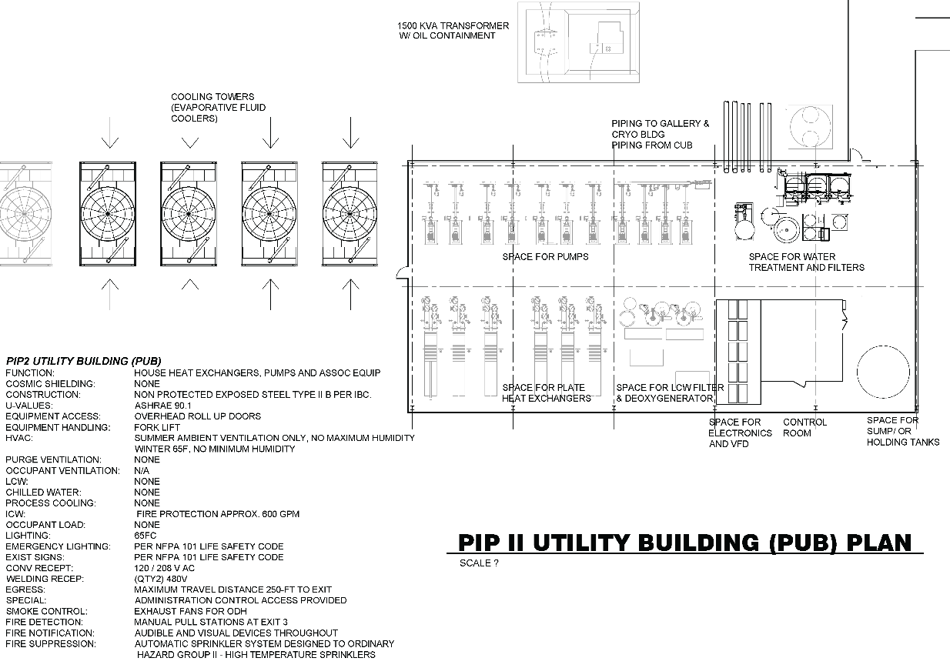
Pulsed Mode vs. Continuous Wave Operation
 | Basis of Estimate
Pulsed Mode
 | LCW | 1 | towers
 | HLA | chilled water via CUB
 | Cryo | 1,400 | gpm @17 Fdt
 | Standby | 1 | tower
CW Mode
 | LCW | 4 | towers
 | HLA (PM) | chilled water via CUB
 | HLA (CW) | 2 | Air Cooled Chillers
 | Cryo | 1,400 | gpm @17 Fdt
 | Standby | 1 | tower

Slide 40
Summary
Completed:
  Developed a conceptual design based on technical requirements from stakeholders;
  Investigated alternate siting locations;
  Investigated alternate means of cooling cryo compressors;
  Developed a modular approach to cooling during pulsed mode and continuous wave operation;
Next Steps
  Approvals of TRS and FRS (in process);
  Refine the design during Detailed Design phase;
  Value Engineering (purchase order in place);
  Update the cost/schedule estimate;
  Constructability Review at ~60%;

Slide 41
Questions

