Slide 1
Response to Committee Questions
PIP-II Management Team
Director’s Review
11 Oct 2017

Slide 2
1. Accelerator Support Systems: How are technical interfaces between systems being captured vs scope responsibilities being captured, particularly with respect to installation and commissioning? (Paul)
Scope responsibilities are captured in the WBS dictionary (pip2-docdb #599) and the assumptions in the BOE documents. Technical interfaces are then where scope boundaries meet. We have identified many (but as noted in the review not all) of these interfaces.
CDR and later TDR is/will be based and consistent with the FRSs and TRSs. Interface documents determine interfaces of systems to the outside world (HWR and SSR1 interface documents are written and represent an example)

Slide 3
2. How are externally interfaces (planned/assumed AIPs, GPPs, in-kind contributions, etc.) represented in the DOE funded schedule such that a full critical path analysis could be performed to determine where issues may exist? If using milestones, are these constrained. And if not in the plan currently, what’s the plan for the CD-1 Review? (Luisella)
Externally interfaces are in the RLS identify as milestones. We have 2 kinds of these milestones:
External Milestones → e.g. external constraints such as LBNF shutdown starts or CMTS available for PIP-II.
International Milestones → i.e. for international partners main deliverables.
Both types of Milestones are linked into the RLS.
In particular all the International Milestones have as predecessor the corresponding agreement signed date for construction phase and FDR, if already identified. Moreover they have as successor the corresponding integration activities. At the moment they are constrained to a technically driven date and they can drive a critical path if missed. Intermediate milestones will be added in the future reflecting the signed agreement with international partners (signature foreseen 6 m before CD-2).

Slide 4
3. Many of the cryomodules have a plan where the first item takes several years, and the remaining items can be completed in almost half the amount of time as the first. Can you please explain how this works in detail? An example is the SSR2 scope. (Allan)
The 1st SSR2 and HB650 Cryomodules and subordinate devices include time in the schedule for the prototype design cycle, procurement phase, and design verification activities prior to the production of the first CM. The 1st of a kind CMs take several years to produce. Production designs assume a design cycle following prototyping and design verification activities sufficient to prepare for an FDR → PRR for the production phase. This is followed by the production procurements and CM series production which is ultimately driven by the availability of cavities both from FNAL and collaborators. Inputs to final designs come from the outputs of the SSR1 CM(1) and HB650 CM(1). We assume that the Production efforts do not include any continuing design iterations following the Production FDR and yield a much shorter design/production schedule than the 1st of a kind. Production duration of 6 SSR2’s from CM2 string start to CM7 complete is 17 months. Prototoype Design → Prototype → Design Verification → CM1 → Production Design → Series Production

Slide 5
4. Provide sample language in existing MOU/SOW language detailing QA/ESH expectations along with verification/validation requirements for work being completed by outside entities. (Steve H)
The only language that exists in a formally executed document is in the Implementing Agreement with India:
“The sending Party shall supply, as early as possible, a detailed list of the equipment to be provided, together with the relevant specifications and appropriate technical and informational documentation related to use, maintenance, and repair of the equipment.”
Translating this into more specific language for application to specific deliverables is Fermilab’s highest priority discussion topic for the December meeting.
Suggestion in breakout session to incorporate QA on int’l deliverables, and presence of ESHQ in PRRs at partner labs
In the interim we have been providing requirements on a case-by-case basis, most notably the HTS-2 cryostat and the cryoplant

Slide 6
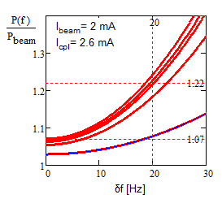
5. Present an analysis of the RF power headroom along the linac as a function of the specified allowed cavity microphonics (20Hz) (Valeri)
I_{b}=2.7 mA (I_{beam}=2 mA)
φ_{a}=0 (max. power)
Q₀ choice is irrelevant
CM type | Power trans-ferred to beam per cav. (kW) | Microphonics amplitude (Hz) | Cavity half-bandwidth, f /2Q_{L}, (Hz) | Power transfer efficiency | Power margin | Peak RF power per cavity (kW) | Requested powers of amplifiers
HWR | 4 | 20 | 35 | 90% | 80% | 6.6 | 7
SSR1 | 4.1 | 20 | 54 | 90% | 80% | 6.1 | 7
SSR2 | 10 | 20 | 32 | 90% | 80% | 17 | 20
LB 650 | 23.8 | 20 | 32 | 94% | 80% | 39 | 40
HB 650 | 39.8 | 20 | 33 | 94% | 80% | 64 | 70

Slide 7
6. What is the estimation/calculation tool that was used for creating the BOEs? Can we see more detail on what the inputs and outputs of the tool are? (Paul)
Each BOE entry in the docdb started with a Word and Excel document. The Word document had the WBS, title, and preliminary WBS dictionary definition, along with guidance on what information to provide. The Excel document had instructions on how to fill it out.
We can show you examples.

Slide 8
7. What AIPs and GPPs are required to be completed by the Lab to support PIP2, are these projects included in the current Lab plan and when must they be completed to support the PIP2 schedule? (Steve H)
There are a collection of planned imprvements to existing accelerators that go under the name of PIP-I+. We have reached agreement with Accelerator Division (and informed DOE) that the following scope that is useful to PIP-II will be covered by PIP-I+
Booster Damper Upgrade
Booster Collimation System Upgrade
Booster LCW Upgrade
MI gammat-t jump

Slide 9
8. Provide a summary list of what R&D work remains to be successful and how they are represented in the risk register with retirement dates. (Shekhar)
Resonance control and field regulation
Unable to maintain proper vacuum between MEBT absorber and SRF
MEBT scrapers unable to absorb amount of beam loss SRF Pre-Production Input Coupler Failure
162.5 MHz, 7 kW RF amplifier procurement delayed
High Power Coupler
PIP2IT does not meet overall requirement at CD-3
Risk register for R&D posted on review indico site.

Slide 10
8. And how does this tie to release of work to international partner labs? (Shekhar)
The development of PIP-II and our International partner program, especially with India, is joint development.
It is not a release of a final work package for fabrication
Indian scientists and engineers are involved in details of R&D
Example: Resonance Control in SRF Cavity
Cavity design: Jointly working to ensure that LDF is minimal)
Tuner: Jointly working on the design of the Tuner to ensure that it has enough strength to control the detuning)
LLRF: Jointly working on hardware and software so that all the lesson learned from SSR1, LCLS-II cavity and CM tests are included in the prototype development in DAE/BARC.)
SSRA: Jointly working on the interface to LLRF, RFPI and Machine controls in the prototype development.

Slide 11
9. Provide the project’s responses to Nov 2016 DOE IPR recommendations and the PIP-II Machine Advisory Committee reviews. (Steve H)
All recommendations are tracked in iTrack
Nov 2016 IPR has 15 recommendations of which 7 are currently closed.
Most of the balance require completion of CD-1 requirements (RLS, BOEs) which will only be finalized on the eve of the review
One recommendation cannot be closed until CD-2 (formalize agreements with international partners in advance of CD-2).
A summary of all recommendations downloaded from iTrack is posted to the review indico site (under Answers to committee questions from previous day)
April 2017 P2MAC has 12 recommendations of which 1 is currently closed
The balance are all assigned.
Several cannot be closed out by the next meeting, e.g. address all critical risks prior to CD-3
We take no particular issue with any of the recommendations and are actting on many already.
Need to update iTrack before DOE CD-1

Slide 12
10. Provide a draft Responsibility Assignment Matrix (Steve H)
We have not created this.
It is unclear to us that this is required for CD-1. Committee’s advice would be valuable on this point.

Slide 13
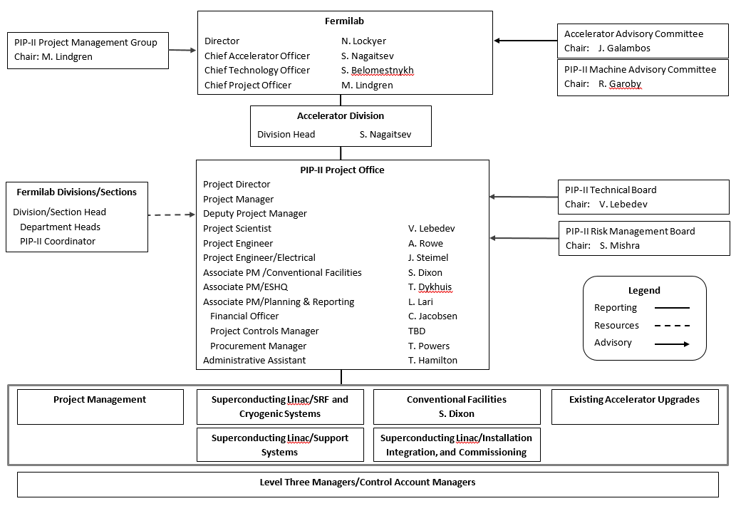
11. Provide draft revised management structure post CD1 with names as possible. This can be done in a closed session if necessary (Steve H)

Slide 14
12. Provide definitions/distinctions for the phases of R&D, preliminary design, final design, and construction. How does prototyping fit into this process? How does the DOE critical decision process overlay on this understanding? (Allan)
All R&D/prototyping/design verification activities are contained within the 1st CM WBSs and RLS. All production activities are contained within the 2nd – N^{th} CMs WBSs and RLS. Critical devices requiring prototyping are identified and considered in the scope within the 1st CMs (RF couplers, dressed cavities, tuners). Quantities of R&D/Prototype devices are identified in the BOEs and RLS as Prototype. Prototype devices are assumed to be consumed during the R&D activities and are not included for CM integration with the exception of the B.90 650 MHz cavities for HB650 CM(1). In some cases, to support pre-production efforts, funds are required in advance of CD3a to procure Nb and NbTi and RF cavities. Activity timing and associated funds availability was driven by technical need.

Slide 15
13. Is a CD3a anticipated with CD2? If so, what scope elements would be included, and provide a bar chart summary schedule showing how design completion fits into the CD3a timeframe. (Luisella)
the project is considering a tailored approach of a CD-2/3a Long Lead Procurement of conventional facilities, site preparation, and niobium procurements for SRF cavity fabrication, in order to mitigate risks. CD-2/CD-3a is foreseen in the present RLS for Nov 18.
For CF/site preparation the end of detailed design is foreseen for Oct 18 (A6020).
For Nb procurement is for SSR2 (1st CM & production) and HB650 (production). Nb can be procured if the thickness of the cavities is known and if material specifications exist. With respect to the present RLS both above requirements are satisfy before CD-3a foreseen date.
See Assumptions Document

Slide 16
14. Provide examples of interface documents that were referenced in Alan's plenary talk as being in TC (Allan)
Two interface documents have been posted to the Review indico site (under answers to committee questions from previous day)
Interface document for HWR: TC#0002529
Interface document for SSR1: TC#0004129

Slide 17
15. What is the scope contingency for the DOE portion of the project? (Steve H)
Primary scope contingency is represented by the threshold vs. objective KPPS
700 MeV vs 800 MeV
Shorten tunnel and gallery

Slide 18
16. Provide additional information on SRF limited resources and infrastructure availability as it relates to the PIP-II schedule. (Allan)
SRF resources and infrastructure are assumed available as needed and on-demand from Oct. 1, 2017 through the duration of the project.

Slide 19
17. What is the plan for assigning CAMs and the when the project will start practicing EVM, given the strategy to pursue CD-2 about a year or so from now? Do you have an idea of how many CAMs you may need and the appropriate cost levels for CAMs to management? (Paul and Steve)
Cost accounts will match up approximately with L3 WBS. Some L3’s will be combined as they are similar in scope (e.g., Beam Transfer Line / Beam Absorber Line, SSR1/2, GSS/IIC). CAMs may have responsibility for multiple cost accounts. CAMs are not necessarily the existing L3 technical managers, though some might be.
Scale is ~15-20 CAMs, with cost accounts from $5M to $50M
We will probably start status reporting Q3FY18 and practice EVMS approximately 3 months after that.

Slide 20
18. Explain why the Conventional Facilities escalation factor in 2017 is 1.00? (Steve D)
We don’t understand the question, and don’t believe we are doing this. Please confirm.

