Slide 1
RF Systems, Controls, and Instrumentation (121.3.9-10, 16-17)
James Steimel
PIP-II Director’s Review
10-12 October 2017

Slide 2
Outline
Requirements
Conceptual Design, Maturity
Scope/Deliverables
Organization
Interfaces
Technical Progress to Date
Plan for CD-2/Preliminary Design
ESH&Q
Risk
Cost
Schedule
Breakout Session topics
Summary

Slide 3
About Me:
Project Role
  Deputy Project Engineer (lead engineer for PIP-II electrical systems)
Relevant Experience
  RF systems engineer for Booster ring RF systems
  Designed high bandwidth, beam stability control (damper) systems for Booster, Main Ring, Main Injector, and Tevatron rings
  Instrumentation group leader for Tevatron Department (BPM upgrade)
  Deputy Department Head for HINS program (linear accelerator construction for testing RF concepts)
  Managed construction and commissioning of PIP2IT RFQ
  Extensive knowledge and experience in design and interfacing accelerator RF and instrumentation components.

Slide 4
Individual L3 System Requirements
Charge #1
RF Power and Integration (121.3.9 & 10):
  Regulate all linac accelerating cavity fields and beam synchronous phase to specified levels and precision.
  Protect linac cavity from potential damage incurred by RF power source.
Instrumentation (121.3.16):
  Measure, process, and record linac beam parameters required to verify and diagnose changes in beam quality and losses.
Controls (121.3.17):
  Provide the interface for operators and experimenters to control linac systems, and access real-time and archived diagnostics data.
Specific requirements for individual L3 covered in breakouts.

Slide 5
Combined L3 System Requirements
Charge #1
Machine Protection System:
  Protect linac beam line components from stray beam.
  Provide specialized diagnostic system to quickly identify source of trips and increase beam up time.
  FRS TC# ED0004250
Bunch Chopping System:
  Remove individual beam bunches in linac MEBT that will not be efficiently captured by booster synchronous buckets.
  Provide diagnostics to verify proper chopping pattern.
  FRS TC# ED0001305 & TRS TC# ED0002305
Beam Energy Control:
  Regulate linac beam output energy to match injection energy of booster during booster injection.

Slide 6
Conceptual Design and Design Maturity
Charge #1
Breakout
Individual Level 3 Design Status
  Functional requirements of all L3 subsystems borrowed heavily from experience with current linac, FAST, LCLSII, and PIP2IT operations.
  Majority of L3 subsystem components have mature specifications and preliminary designs, sufficient for testing prototypes in PIP2IT.
    Exception: Most of Controls components based on catalog of services already offered to operational systems. PIP-II system design is not mature enough to request new catalog items.
  Breakout talks will cover specific L3 component designs.

Slide 7
Conceptual Design and Design Maturity
Charge #1
Combined L3 Design Status
  Machine Protection System
    Functional requirements defined and established in CDR.
    Proof of principle model currently operating in PIP2IT.
    Largest piece of design effort will involve establishing formal interfaces for all systems affected (prior to final technical specification for system).
  Bunch Chopping System
    Proof of principle chopping successfully tested in PIP2IT.
    Requirements and allocation of design effort identified.
    Formal scope and functional design of control and instrumentation system needs to be completed.
  Beam Energy Control
    Requirements need to be identified.

Slide 8
Scope and Deliverables
Charge #1
Scope:
  This group of L3 activities covers all operator interfaces to all PIP-II remotely controllable devices and instrumentation with the exception of cryogenics control.
  It is also responsible for protecting all beam line and power equipment with the exception of cryogenics and DC power systems.
Deliverables:
  Hardware deliverables include RF power amplifiers, rack mountable electronics, individual computers, and interface cabling.
    Instrumentation is only group that provides beam line components.
  Software and firmware deliverables are involved with every system and are mainly responsible for delivering functional requirements.

Slide 9
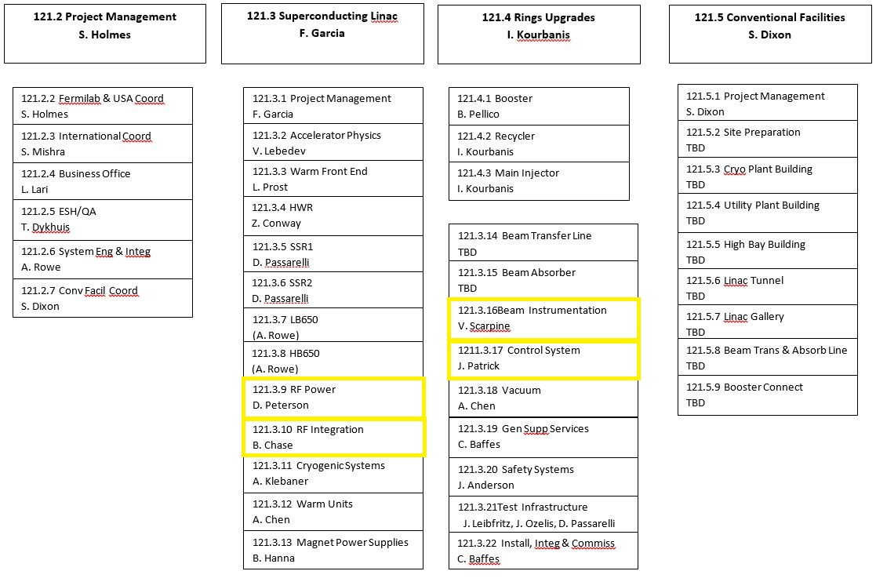
Organization
Charge #3
All four groups covered under Superconducting Linac L2.

Slide 10
In-kind Interfaces
Charge #1
RF Power
  FNAL provides all RF power amplifier requirements and testing procedures.
  DAE provides all RF power amplifiers for 325 MHz (BARC) and 650 MHz (RRCAT) systems.
RF Integration
  FNAL provides overall system and component design documentation.
  DAE/BARC provides turn-key RF Integration systems for 325 MHz and 650 MHz RF systems.
  LBNL to provide system, firmware, and software design assistance.
Instrumentation & Controls
  Final deliverables to be formalized in advance of CD-2.

Slide 11
System Interfaces
Charge #1
 | Warm Front End WBS 121.3.3 | HWR WBS 121.3.4 | SSR1 WBS 121.3.5 | SSR2 WBS 121.3.6 | LB650 WBS 121.3.7 | HB650 WBS 121.3.8 | RF Power WBS 121.3.9 | RF Integration WBS 121.3.10 | Cryo Systems WBS 121.3.11 | Warm Units WBS 121.3.12 | Magnet PS WBS 121.3.13 | Beam Trans. Line WBS 121.3.14 | Beam Absorber WBS 121.3.15 | Beam Instrum. WBS 121.3.16 | Controls WBS 121.3.17 | Vacuum WBS 121.3.18 | Gen.l Supt. Serv. WBS 121.3.19 | Instal. Integ. Com. WBS 121.3.22 | Safety Systems WBS 121.3.20
Warm Front End WBS 121.3.3
HWR WBS 121.3.4 | 2529
SSR1 WBS 121.3.5
SSR2 WBS 121.3.6
LB650 WBS 121.3.7
HB650 WBS 121.3.8
RF Power WBS 121.3.9 | Y | 2529 | 4129
RF Integration WBS 121.3.10 |  |  | 4129 |  |  |  | 4290
 | Y |  |  |  |  |  | 5489
Cryo Systems WBS 121.3.11 |  | 2529 | 4129 | Y | Y | Y
Warm Units WBS 121.3.12 |  |  |  |  | 3441 | 3441
Magnet PS WBS 121.3.13 |  | 2529 | 4129 | Y |  |  |  |  |  | 3441
Beam Transfer Line WBS 121.3.14 |  |  |  |  |  |  |  |  |  | 3441
Beam Absorber WBS 121.3.15
Beam Instrum. WBS 121.3.16 | Y | 2529 | 4129 |  |  |  | Y | Y |  | 3441
Control Sys. WBS 121.3.17 |  | 2529 | 4129 |  |  |  | 4290 | Y |  |  |  |  |  | Y
 | Y | Y | Y | Y | Y | Y | 5489 | Y | Y | Y | Y | Y | Y | Y
Vacuum WBS 121.3.18 | Y | 2529 | 4129 | Y | Y | Y |  |  | Y | Y |  | Y | Y | Y | Y
General Supt. Serv. WBS 121.3.19
Safety Systems WBS 121.3.20 | Y |  |  |  |  |  |  |  | Y |  |  |  |  |  | Y
Test Infrastructure WBS 121.3.21 |  | 2529 | 4129 |  | Y | Y | Y | Y |  |  |  |  |  |  | Y

Slide 12
Progress to date
Charge #1
RF amplifiers and integration components successfully commissioned for warm cavities with beam at PIP2IT.
325 MHz, 7kW and 650 MHz, 30kW prototype amplifiers successfully tested at DAE institutions.
325 MHz, 7kW and 650 MHz, 40kW amplifier preliminary design complete and awaiting approval.
Prototype RF protection system arrived from DAE/BARC collaborators.
Warm BPMs, wall current monitors, and DCCTs successfully tested with beam at PIP2IT.
Beam intercepting profile monitors successfully tested at PIP2IT.
Machine protection system signal processing and differential current monitor successfully tested at PIP2IT.

Slide 13
Next Steps toward CD-2
Charge #3
Complete high level system design and correlate combined L3 scope functional requirements with individual L3 functional requirements.
Complete interface specifications between L3 systems, followed by technical requirement specifications.
Derive a design and construction schedule for RF Integration, Instrumentation, and Controls.

Slide 14
ESH&Q
Charge #4
Almost all of the hazards associated with these systems are electrical in nature and are covered under the codes below listed in the PHAR (docdb# 140):
  National Electrical Code, NFPA 70
  OSHA 29 CFR, Part 1910, Subpart S, Electrical
  Fermilab ESH&Q Manual, Fermilab Electrical Safety Program
Domestically procured electrical equipment will be National Recognized Testing Lab (NRTL) certified.
RF Power Amplifiers will have more stringent requirements
  Act as critical device for personnel radiation safety interlocks.
    Requires approval of interlock design by Radiation Safety.
    Requires regular verification of interlock function when powering SRF cavities.
  All RF amplifiers are required to meet International Electrotechnical Commission (IEC) standard IEC 61010-1, safety requirements for electrical equipment for laboratory use.

Slide 15
Risk: RF, Controls and Instrumentation
Machine Protection System Fails (Allows Beam Event)
Resonance control and field regulation
Incompatibility in high performance electronic systems
IIFC LLRF hardware/software does not meet acceptance criteria
Beam current measurements for long pulse or CW operation
Title | Probability | Probability Score | P * Impact (k$) | P * Impact (months) | Impact Score - Cost | Impact Score - Schedule | Risk Rank
Machine Protection System Fails (Allows Beam Event) | 50.00% | 4 (H) | 1,258 | 3.1 | 2 (M) | 3 (H) | 3 (High)
Resonance control and field regulation | 40.00% | 4 (H) | 700 | 6.0 | 2 (M) | 3 (H) | 3 (High)
Incompatability in high performance electronic systems | 60.00% | 4 (H) | 630 | 9.0 | 2 (M) | 3 (H) | 3 (High)
IIFC LLRF hardware/software does not meet acceptance criteria | 50.00% | 4 (H) | 400 | 3.8 | 2 (M) | 3 (H) | 3 (High)
Beam current measurements for long pulse or CW operation | 50.00% | 4 (H) | 125 | 9.0 | 2 (M) | 3 (H) | 3 (High)

Slide 16
Cost Summary
Charge #2
Uncertainty based on project guidelines
Costs come from P6 and are estimated down to the L6 activity level with RF Power down to the L6-8 activity level
Budget variation between tasks dominated by ratio of design activity to collaboration hardware deliverables.

Slide 17
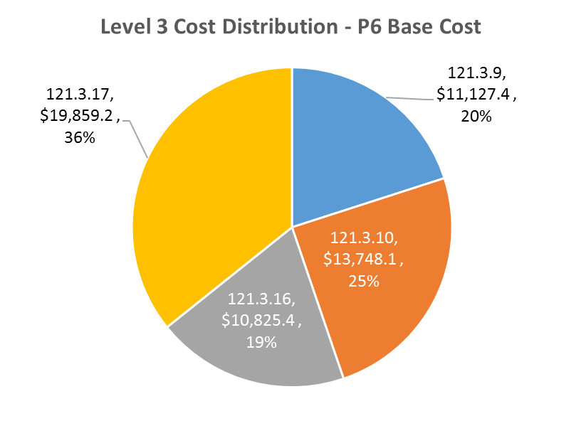
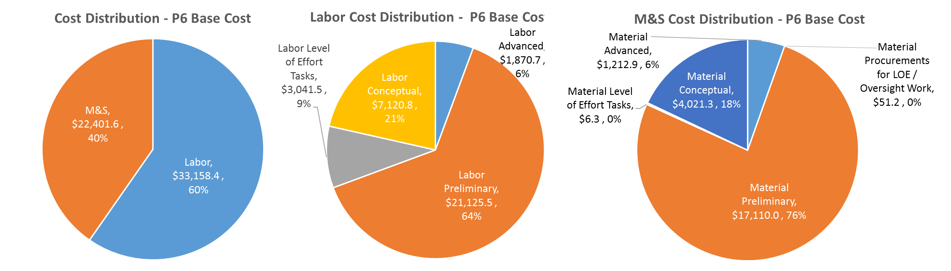
Cost Drivers and Estimate Maturity
Charge #2
P6 Base Costs = BOE + Overheads + Escalation

Slide 18
Cost Profile – P6 Base Cost Only
Charge #2
P6 Base Costs = BOE + Overheads + Escalation
Material cost ramps up significantly to start procurement of high power circulators and RF distribution hardware.

Slide 19
Labor Profile – P6 Hours/FTE
Charge #2
Labor profile technically driven with no smoothing.
L3 details in breakouts.

Slide 20
High Level Master Schedule

Slide 21
Breakout Sessions
Breakout Session: RF Systems, Controls, and Instrumentation
Session to begin on Tuesday and carry over to Wednesday if required
15:00-15:30 David Peterson 121.3.9 RF Power
15:30-16:00 Brian Chase 121.3.10 RF Integration
16:00-16:30 Vic Scarpine 121.3.17 Beam Instrumentation
16:30-17:00 Jim Patrick 121.3.16 Controls

Slide 22
Summary
L3 requirements for system hardware are defined and traceable. We still need to establish some requirements for higher level use cases.
Preliminary designs for most hardware approved and has been/will be partially validated in PIP2IT.
Milestone driven design review schedule is developed for RF Power WBS.
Cost, schedule critical paths, and risks are understood for all WBS’s.
Partnership with DAE laboratories is showing visible progress.
ESH&Q plans, risks, and mitigation strategies are developed.
We are ready for CD-1 and look forward to your feedback.
Thank you for your attention.

Slide 23
END

