Slide 1
Linac Accelerator Support Systems
Installation and Commissioning
121.3.3,12-15,18-22
Paul Derwent
PIP-II Director’s Review
10-12 October 2017

Slide 2
Outline
Requirements
Conceptual Design, Maturity
Scope/Deliverables
Organization
Interfaces
Technical Progress to Date
Plan for CD-2/Preliminary Design
ESH&Q
Risk
Cost
Schedule
Breakout Session topics
Summary

Slide 3
Paul Derwent
Role:
  Deputy Project Manager
Relevant Experience:
  Scientist , PhD 1990 University of Chicago
  20+ years in Accelerator Division
    Associate Project Manager for Accelerator & NuMI Upgrades, NOvA CD-4 2014 (2009-2014)
    Department Head: Recycler (2006-2009), PIP-II (2014-present)
    Antiproton source: design, fabrication, installation, commissioning of Accumulator stacktail stochastic cooling system, achieved record accumulation rates

Slide 4
WBS L3 System Requirements
Charge #1
121.3.3 Warm Front End
  Prepare and deliver 2.1 MeV beam to SC Linac
    Bunch pattern to match Booster Injection
    Emittance for efficient transfer
    2 mA, 550 microsecond pulse, 20 Hz
121.3.12 Warm Units
  Focusing between LB650 and HB650 Cryomodules
121.3.13 Magnet Power Supplies
  Regulation and control of cold and warm magnet Power Supplies
    Including Quench protection in cold magnets
121.3.14 & 121.3.15 Beam Transfer Line & Beam Absorber Line
  Transfer H⁻ beam from the exit of the SRF linac to the injection girder of the Booster
  50 kW beam dump
121.3.18 Vacuum
  UHV and Low Particulate Practice for SC Linac;
  UHV and Low Particulate Practice for the transition regions located upstream and downstream of the SC Linac;
  High Vacuum for the regions from Ion source to the MEBT absorber and the beam transfer line to Booster, Beam Absorb Line

Slide 5
WBS L3 System Requirements
Charge #1
121.3.19 General Support Services
  Fluids (LCW, RAW) Infrastructure
    Warm Front End, Magnets, Gallery Racks
  Electrical Infrastructure in Gallery
    Racks, Power distribution
121.3.20 Safety Systems
  Radiation, ODH, and Electrical Safety Interlocks systems for linac tunnel and Cryo buildings
121.3.21 Test Infrastructure
  Support for test areas for cryomodules
    Spoke Test Cryostat
    CryoModule Test Stand
    PIP2IT
121.3.22 Installation, Integration, and Commissioning
  Execute installation scope as defined in L3-L3 Interface Control Documents
  Execute commissioning (at super-system and machine levels)
Specific requirements for individual L3 covered in breakouts

Slide 6
Conceptual Design and Design Maturity
Charge #1
Breakout
Individual L3 systems
  Conceptual Design of L3 subsystems borrowed heavily from experience with current linac, transfer lines, FAST, LCLSII, and PIP2IT operations.
  PIP2IT serves as a test bed for many systems
  Breakout talks will cover specific L3 component designs

Slide 7
Conceptual Design and Design Maturity
Charge #1
Breakout
Warm Front End:
  Mature and stable design with focus on factors that may determine reliability and uptime
    Well past conceptual design – in commissioning & operation
650 Warm Units (between CryoModules):
  Magnets, stands, BPMs, vacuum have completed conceptual design
  Engineering analyses were done
    TRS: TC # ED0003401
    FRS: TC # ED0003403
    RA: TC # ED0005885

Slide 8
Conceptual Design and Design Maturity
Charge #1
Breakout
General Support Services:
  Conventional fluids systems with direct analogues to PIP2IT systems
  Conceptual Design understood, working closely on configurations with CF team
Test Infrastructure
  STC: Design is at advanced stage (FDR/PRR February 2017)
  CMTS1 & PIP2IT modifications
    Conceptual design complete
    Based on understanding of work for existing LCLS-II Test Stand

Slide 9
Conceptual Design and Design Maturity
Charge #1
Breakout
Individual L3 systems
  Conceptual Design of L3 subsystems borrowed heavily from experience with current linac, transfer lines, FAST, LCLSII, and PIP2IT operations.
  PIP2IT serves as a test bed for many systems
  Breakout talks will cover specific L3 component designs
  Conceptual design is complete and meets the requirements

Slide 10
Scope and Deliverables
Charge #1
Breakout
Scope:
  This group of L3 activities
    Warm Front End
    Conventional Magnets for transfer lines
    Infrastructure systems:
      vacuum, magnet power supplies
      Fluids and electrical
      Test facilities
        STC, CMTS1, PIP2IT
    Installation and Beam Commissioning
Deliverables:
  Tunnel Components
    Warm Front End
    Vacuum pumps, gauges
    Beam Pipe
    Magnets
    Collimators and Absorbers
  Gallery Components
    Power Supplies
  Test Stands
  Integration Documents
    3D Tunnel Model
  Software and firmware deliverables are associated with many systems

Slide 11
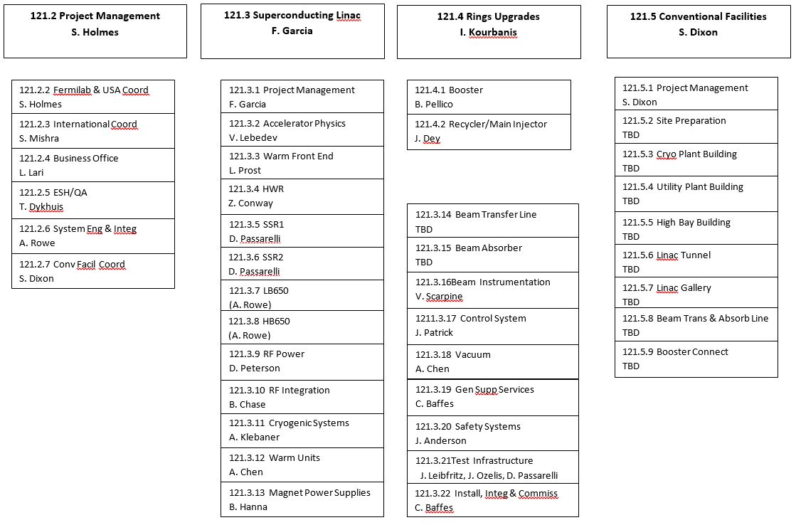
Organization
Charge #3

Slide 12
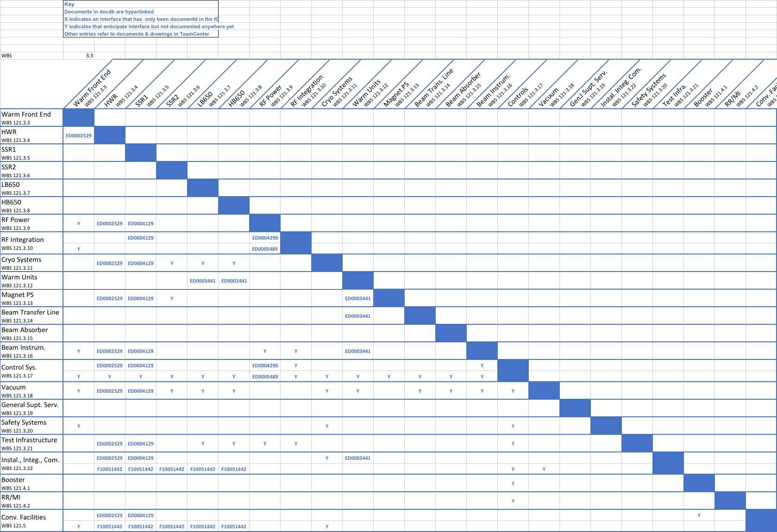
Interfaces
Charge #1
Breakout

Slide 13
Interfaces
Charge #1
Breakout
Internal interfaces : many, some already detailed and defined
Partner interfaces
  DAE (BARC) provides Warm unit magnets

Slide 14
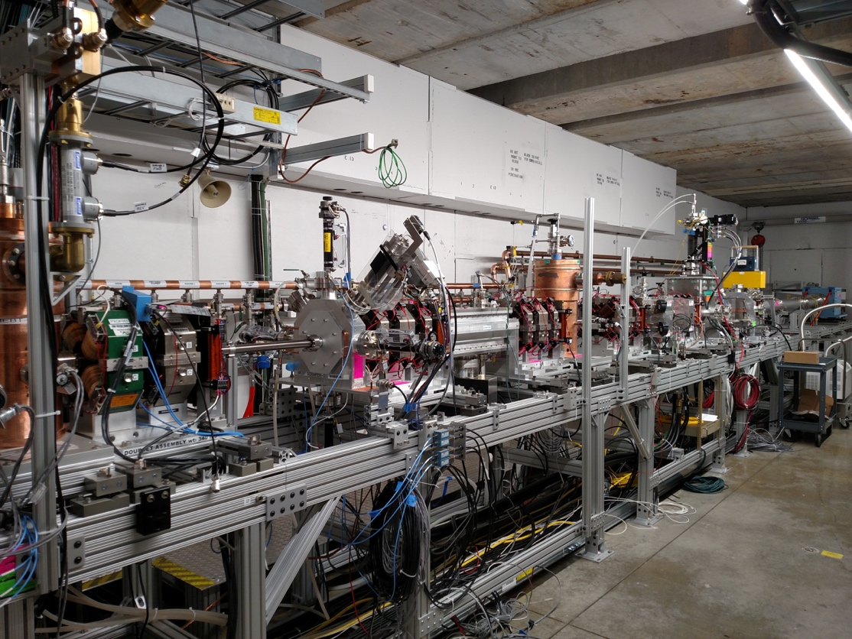
Progress to date: Warm Front End
Charge #1
Breakout
PIP-II Injector Test:
  Delivered 2.1 MeV beam pulses
    20 Hz, 550 microsecond, 2mA
    Demonstrated many necessary systems
Working towards testing additional systems over next several years at PIP2IT
    Vacuum, CM installation, Magnet PS, ODH & Rad Safety, Infrastructure

Slide 15
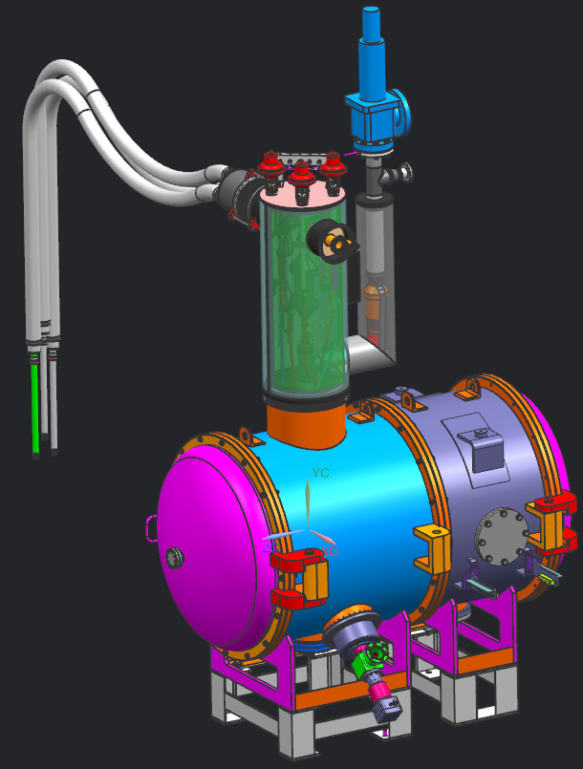
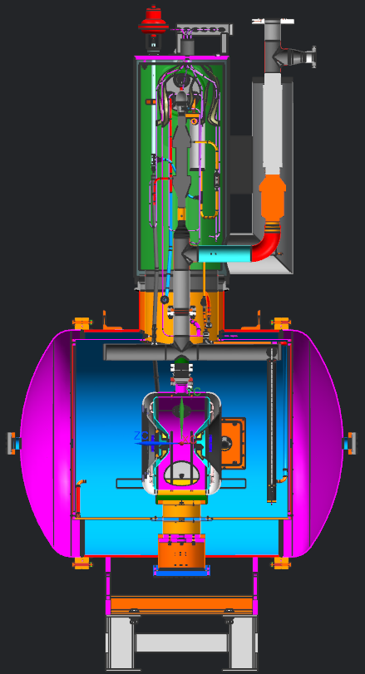
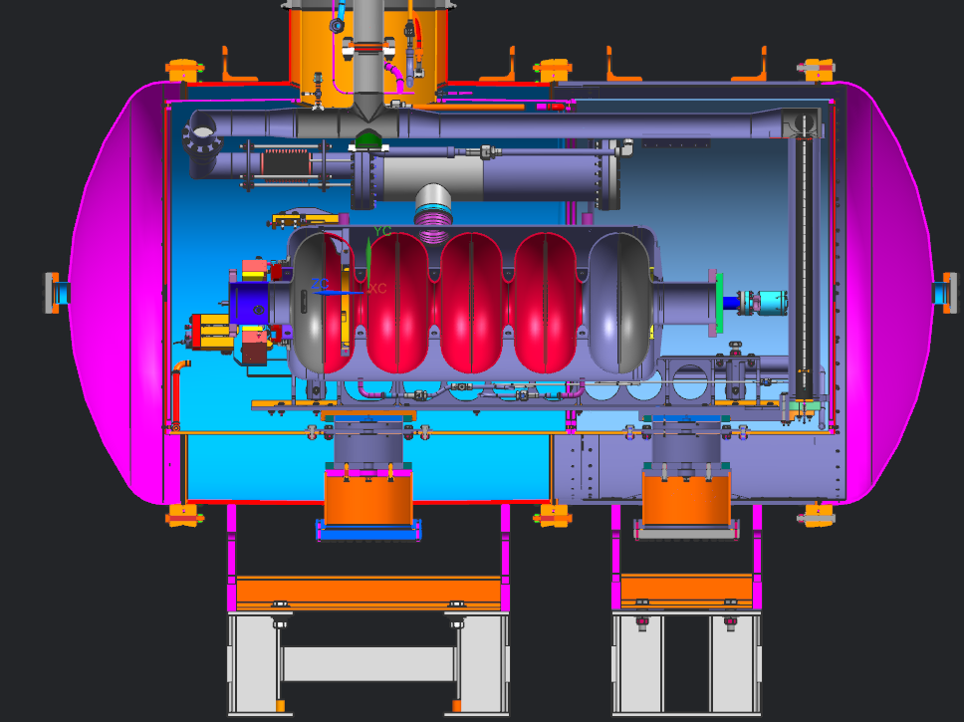
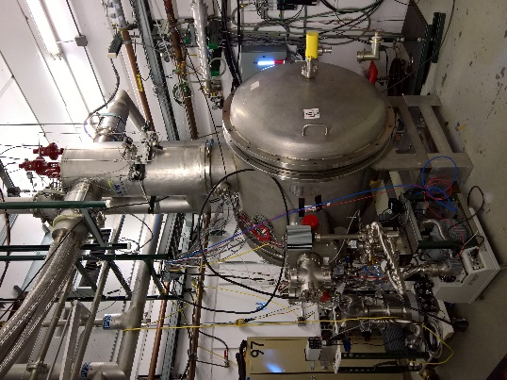
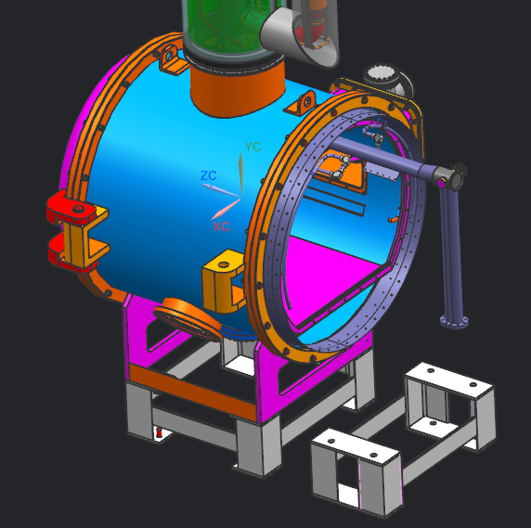
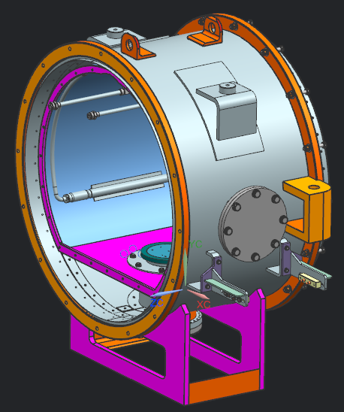
Progress to Date: STC TI
Breakout
Charge #1
Existing STC cryostat as used for SSR1 cavity testing
STC cryostat modified with extension to accommodate 650MHz cavities.
Existing cryostat modified with extended He piping,
SSR1 cavity
Cryostat extension

Slide 16
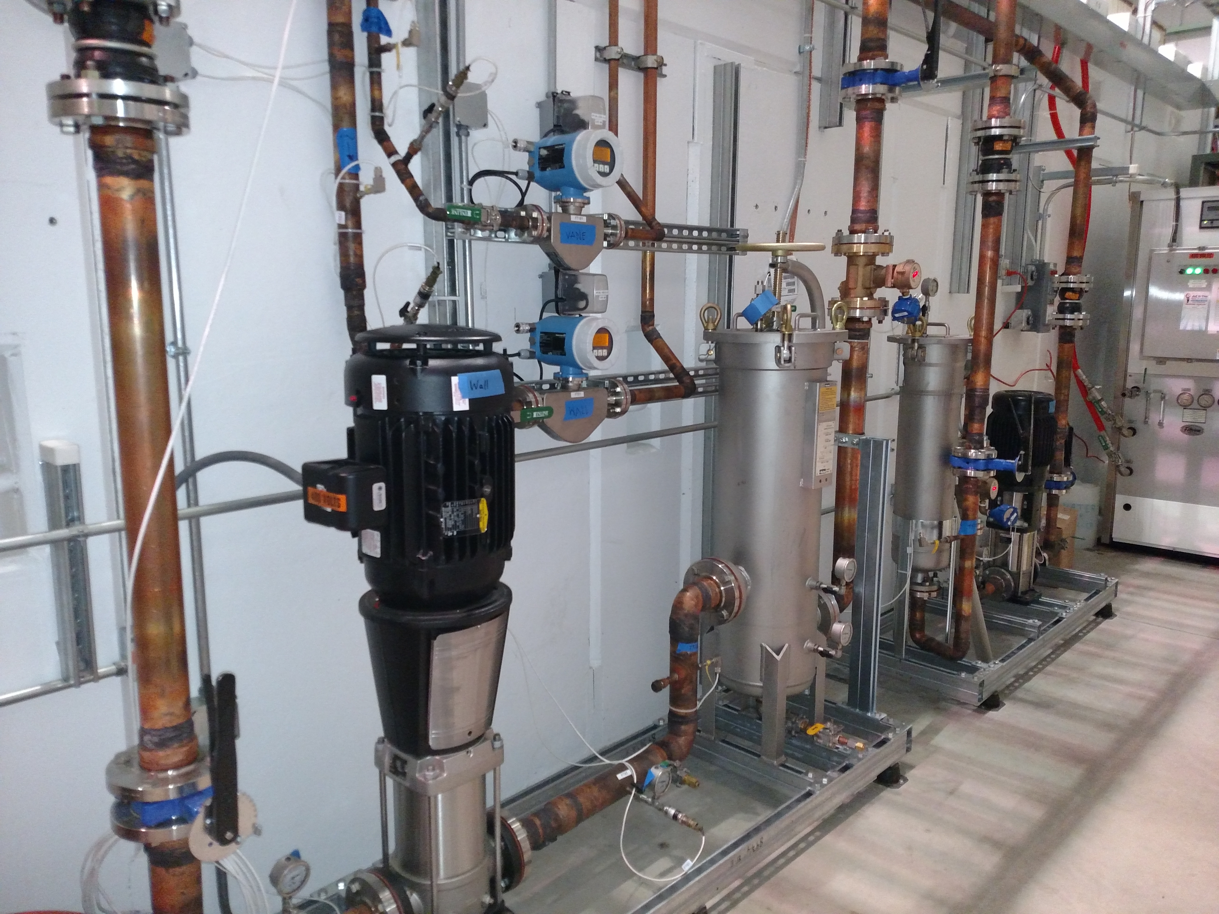
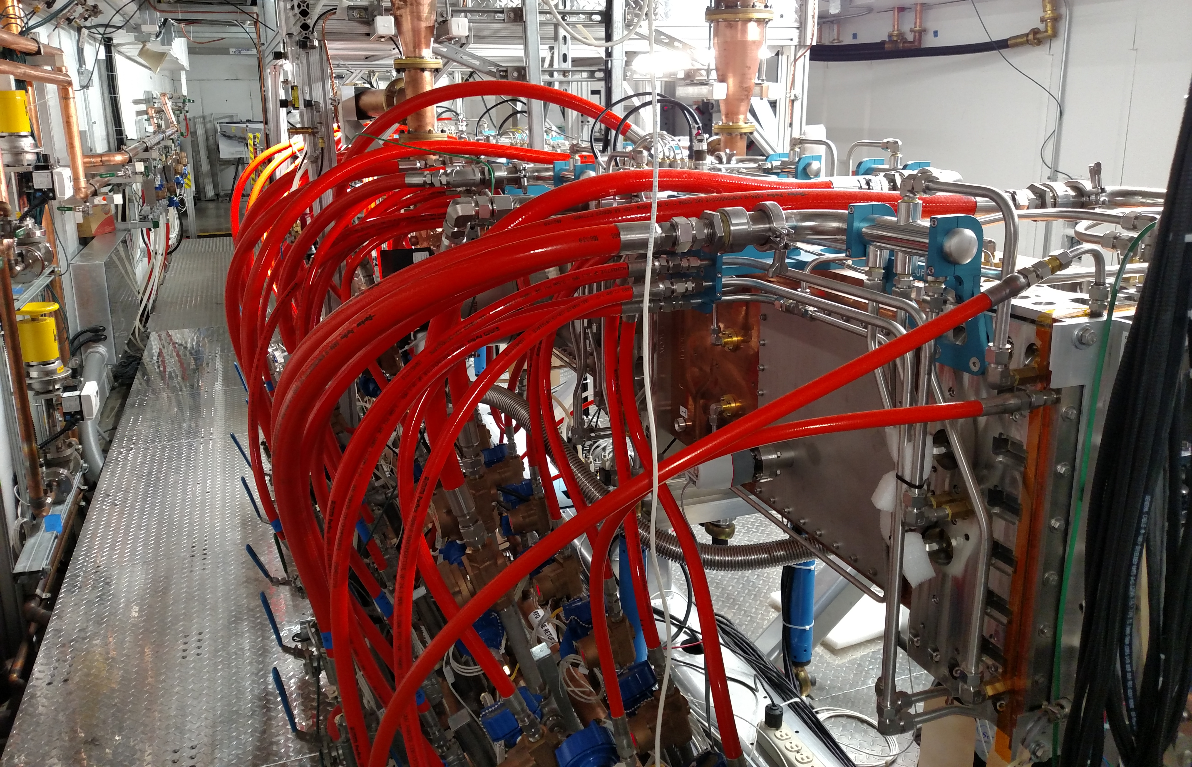
Progress to date: GSS - Cooling System
Charge #1
Breakout
Manifolding inside cave
Vane and wall skids outside cave

Slide 17
Next Steps toward CD-2
Charge #3
Complete high level system design and correlate combined L3 scope functional requirements with individual L3 functional requirements.
Complete interface specifications between L3 systems, followed by technical requirement specifications.
Derive a design and construction schedule for the various systems, installation, and integration.

Slide 18
ESH&Q
Charge #4
Project team is committed to construct PIP-II in a safe, environmentally respectful, and cost efficient manner that meets our stakeholder’s needs
Safety is an essential element in all work we do
  Project Integrated Safety Management Plan (docdb #141)
  Laboratory and DOE standards and practices
    Fermi Radiological Control Manual
    Fermi ES&H Manual
    DOE O402-2C
  Apply ”Lessons Learned” from internal and external project work
  Partner deliverables are required to meet Laboratory Safety Standards
Quality Assurance and Control
  Project Quality Assurance Plan (docdb #142)
  Communicate and work with vendors and collaborators

Slide 19
Risk: Linac Support System, Installation and Commissioning
Unable to maintain proper vacuum between MEBT absorber and SRF
MEBT scrapers unable to absorb amount of beam loss
MEBT kickers performance is unsatisfactory
Late subsystem delivery makes installation less efficient
Requirements or interface definition for LCW Less Than Adequate

Slide 20
Cost Summary – Level 3 – Linac
Charge #2

Slide 21
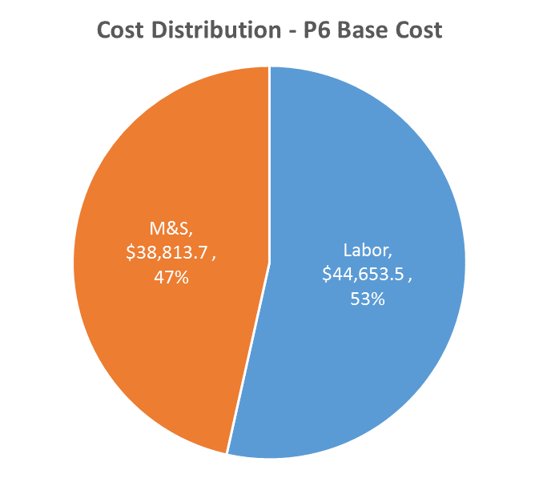
Cost Drivers – Labor vs M&S
Charge #2
P6 Base Costs = BOE + Overheads + Escalation
Different elements – different mix of Labor vs M&S

Slide 22
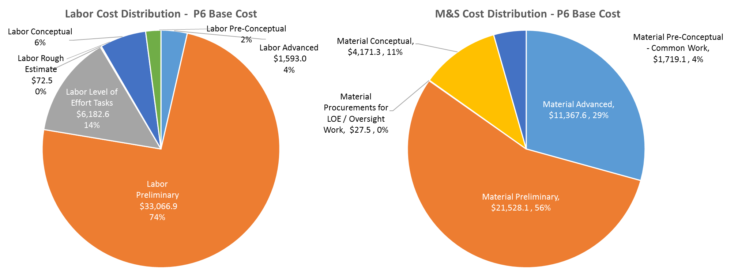
Cost Drivers – Estimate Maturity
Charge #2
P6 Base Costs = BOE + Overheads + Escalation
82% Labor Estimates and 85% M&S
  Advanced and Preliminary Stage (higher level understanding than Conceptual)

Slide 23
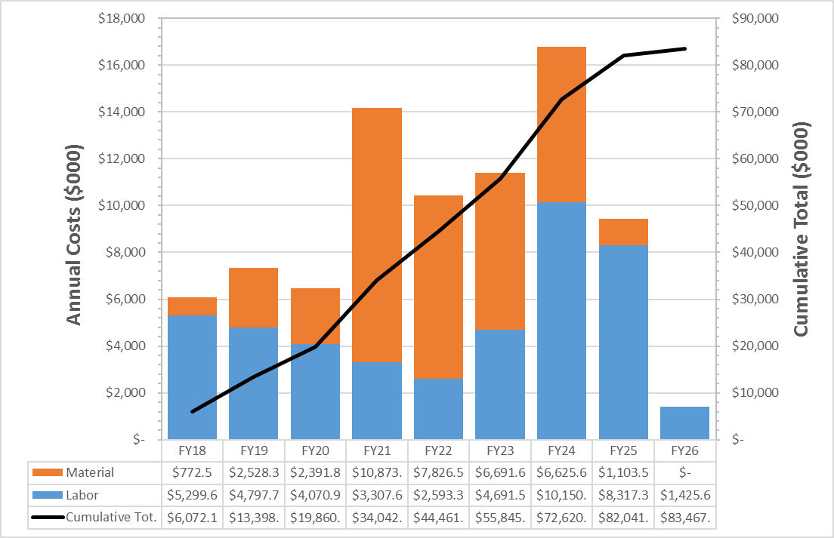
Cost Profile – P6 Base Cost Only
Charge #2
P6 Base Costs = BOE + Overheads + Escalation
Procurement peaks after CD-3
Labor effort peak in FY24 associated with installation

Slide 24
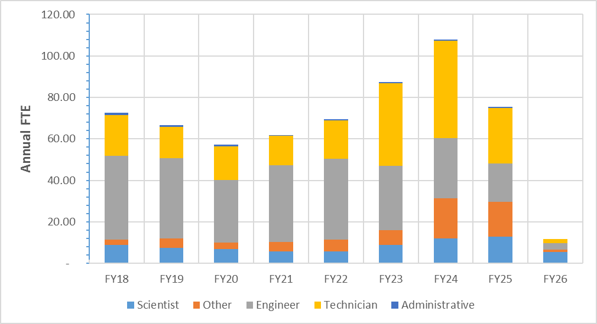
Labor Profile – P6 Hours/FTE
Charge #2
Labor effort peak in FY24 associated with installation
growth in technicians during that time period

Slide 25
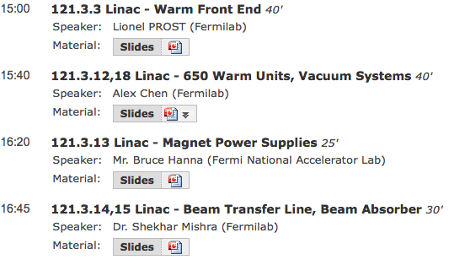
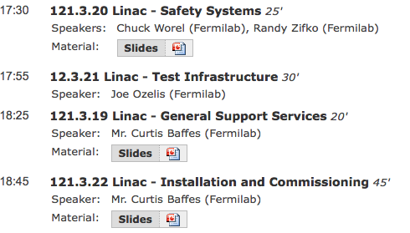
Breakout Sessions
Breakouts
Breakout Session Tuesday pm / Wednesday am
  More details on each topic available from these speakers

Slide 26
Summary
Requirements are defined and understood for these elements
Conceptual design is sound and meets the requirements
  PIP2IT beam operation
    Demonstrated requirements
    Test bed for continued work
  Many based on similar systems/facilities in operation at Fermilab
    CMTS1, Vacuum, STC
Cost, schedule, and risks are understood
  Not on critical path (until beam commissioning)
Safety is the number 1 priority
  ESH&Q elements addressed
We are ready for CD-1 and look forward to your feedback

Slide 27
END

