Slide 1
Booster/Recycler/Main Injector (WBS121.4.1-2)
Ioanis Kourbanis
PIP-II Director’s Review
10-12 October 2017

Slide 2
Outline
Requirements
Conceptual Design, Maturity
Scope/Deliverables
Organization
Technical Progress to Date
Design Review Plan
Plan for CD-2/Preliminary Design
ESH&Q
Risks
Cost
Schedule
Breakout Session topics
Summary

Slide 3
About Me:
Ioanis Kourbanis:
L2 Manager for Accelerator Upgrades.
Project Manager of two Muon Campus AIPs.
Level 3 Manager and CAM for the Main Injector Upgrades in the ANU (NOvA) Plan.
Main Injector Department Head.

Slide 4
WBS L2 System Requirements
Charge #1
Science requirements: Deliver 1.2 MW of proton beam power from Main Injector, over the energy range 60-120 GeV.
Technical requirements flow-down:
Booster requirements
Operate at 20 Hz
Accommodate 800 MeV Injection, and accelerate 6.5E12ppp.
Recycler requirements
Slip Stack at 20 Hz
Support Main Injector Operations from 60-120 GeV.
Main Injector requirements.
Accelerate up to 7.5E13ppp with a 0.6-1.2 sec cycle time.

Slide 5
Conceptual Design and Design Maturity (1)
Charge #1
Pellico
Booster Injection Girder operating at 800 MeV with a new foil system and a new dump.
Design described in CDR
Opportunities for improvement identified(better absorber, separate painting magnets)
Concept of an optimized design is presented at this review, and is costed
Booster magnet system capable of operating at 20 Hz.
Tests and measurements on a Booster magnet indicate concept is understood
Design for modifications is mature.
Modify and upgrade the Accelerator Control System to operate at 20 Hz.
Conceptual design complete

Slide 6
Conceptual Design and Design Maturity (2)
Charge #1
Dey
New Recycler 53 MHz cavities with higher voltage able to run CW in order to support slip stacking at 20 Hz and MI operation at 60 GeV.
Prototype cavity design exists.
Increase RF power in all 20 of the MI stations in order to be able to accelerate the design intensity.
Have identified two possible upgrade options.
Preferred option : two tube – costed
Backup: single tube – risk register

Slide 7
Scope and Deliverables
Charge #1
New Booster Injection Region (Girder) operating at 800 MeV
New stripping foil
New orbit bump magnets
Phase space painting magnets
New dump
New Booster Magnet power system operating at 20 Hz.
Upgraded Accelerator control system operating at 20 Hz.
3 new 53 MHz cavities (Recycler) along with their driver amplifiers.
20 upgraded MI RF stations along with their corresponding modulators and their solid state drivers.

Slide 8
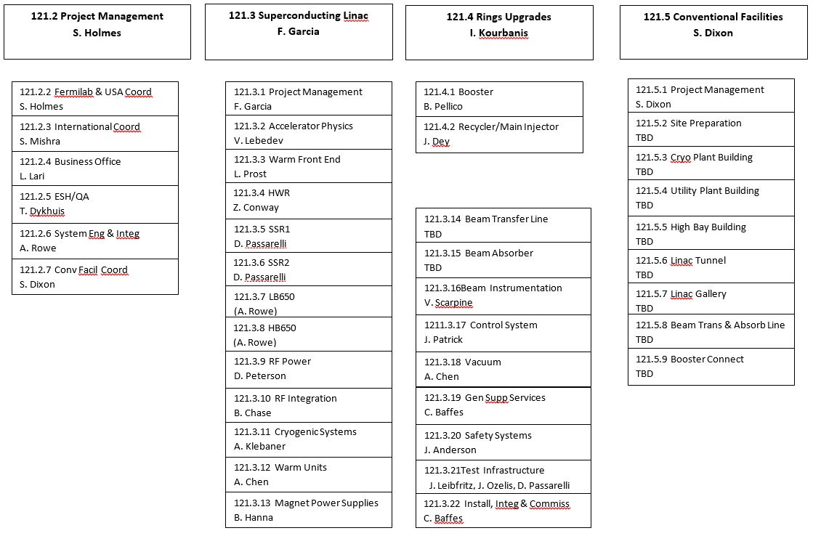
Organization
Charge #3
PIP-II Project Office

Slide 9
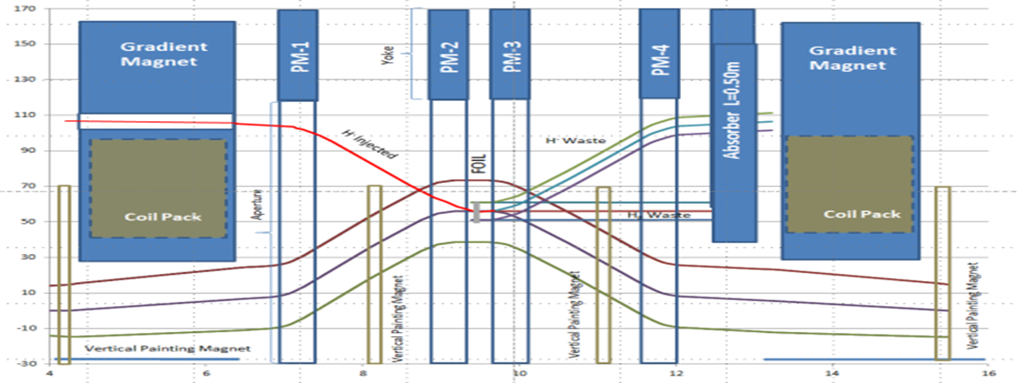
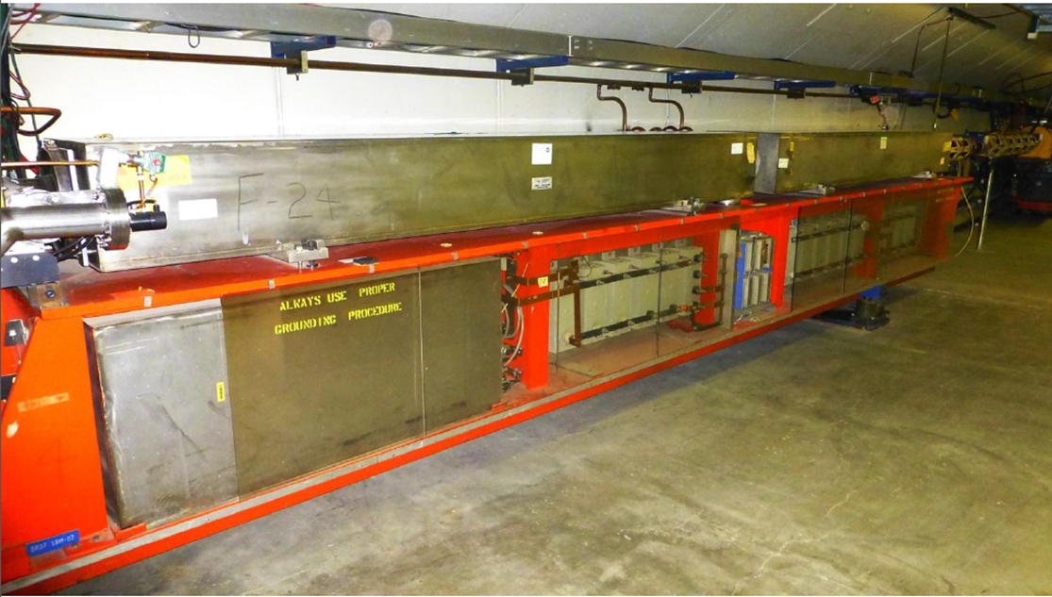
Progress to date (Booster)
Charge #1
Improved Booster Injection Girder with shorter gradient magnets
Completed 20 Hz Booster magnet measurements
New concept Design of the Booster Injection Girder
Booster Magnets
D-magnet
F-magnet
Choke
Resonant Capacitor

Slide 10
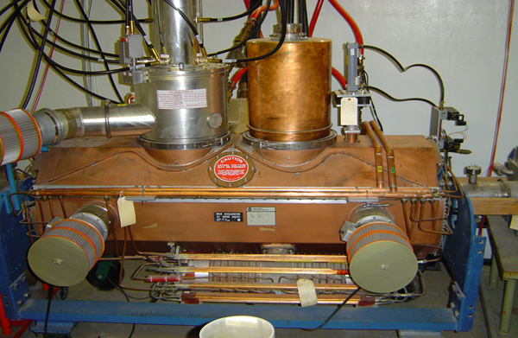
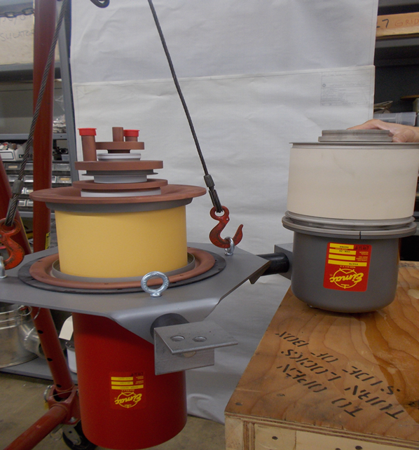
Progress to date (Recycler/Main Injector)
Made a mockup of the new Recycler 53 MHz cavity
Validated RF design.
We are ready to start low level tests of the spare MI RF cavity with two PAs.
Bought a new more powerful tube for the MI RF cavity (used as an alternative solution to the two PAs)
MI Cavity
RR 53 MHz Cavity mockup
New Power Tube
Current Tube
Place for extra PA

Slide 11
Design Review Plan
Charge #3
Design reviews are organized as follows:
Critical component, subsystem, and primary system all progress through Preliminary (PDR), Final (FDR), and Production Readiness Reviews (PRR). This cycle enables the procurement cycle to begin.
Non-critical components or subsystems are managed within the Division or Department review process as indicated by the FNAL Engineering Manual.
PIP-II Machine Advisory Committee (P2MAC) Review (April 2017).
Recommendations
“Flesh out and finalize the Booster injection girder design”.
“Develop milestones for hardware upgrade R&D including Main Injector RF system design down-selection and Recycler new 53 MHz RF cavity design”.

Slide 12
Next Steps toward CD-2
Charge #3
Complete high level system design.
Booster:
Start work on the optimized new Girder design for Booster Injection.
Complete the 20 Hz Booster measurements.
Recycler/MI:
Develop milestones for the Main Injector RF system design down-selection and Recycler new 53 MHz RF cavity design.
Work on making a prototype 53 MHz Recycler cavity.
Work on testing both power upgrade options for MI RF.
Derive a design and construction schedule for Booster/RR/MI upgrades.

Slide 13
ESH&Q
Charge #4
Safety is an essential element in all the work we do.
We follow Laboratory and DOE standards and practices.
Apply “Lessons Learned” from project work.
Hazards and mitigations associated with L2 work scope.
Quality Assurance and Control:
Following the Project Quality Assurance Plan
Communicate with vendors/collaborators
Test protocols in development
We are working with the project’s ESH&Q coordinator
Hazard Analysis Document

Slide 14
Risk Management
Charge #2
MR RF System Upgrade
Default option (two tubes) does not work.
Backup option (single tube) costs more.

Slide 15
Cost Summary
Charge #2
BOOSTER P6
MI/RR BOE BASED

Slide 16
Cost Drivers and Estimate Maturity (Booster Only)
Charge #2
P6 Base Costs = BOE + Overheads + Escalation

Slide 17
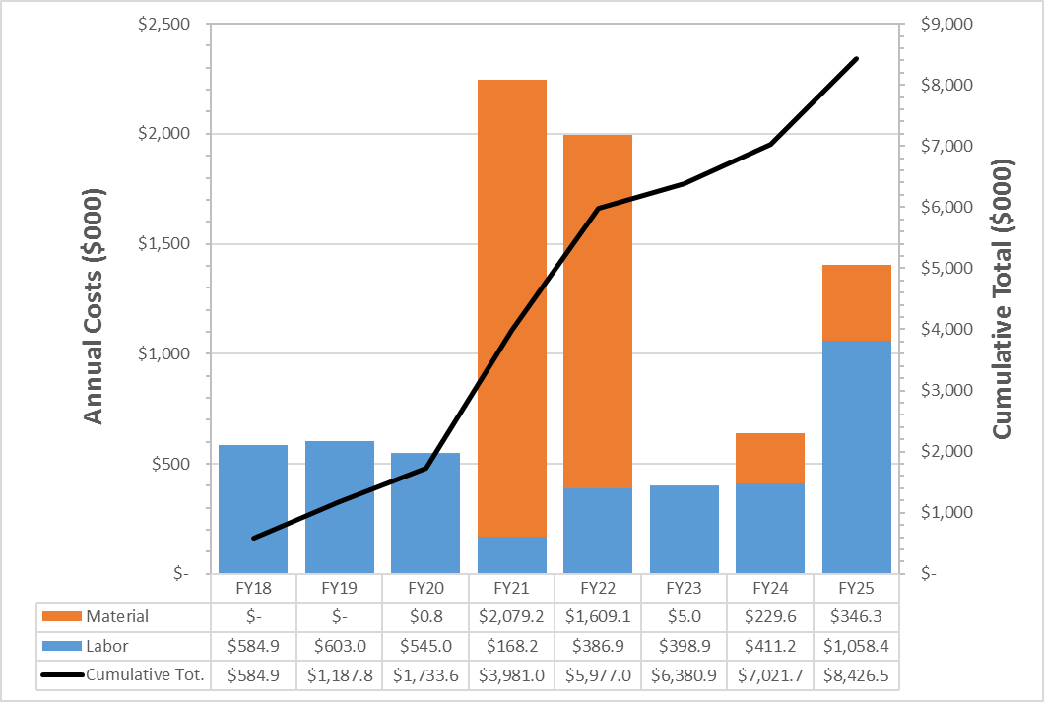
Cost Profile (Booster only)
Charge #2
P6 Base Costs = BOE + Overheads + Escalation

Slide 18
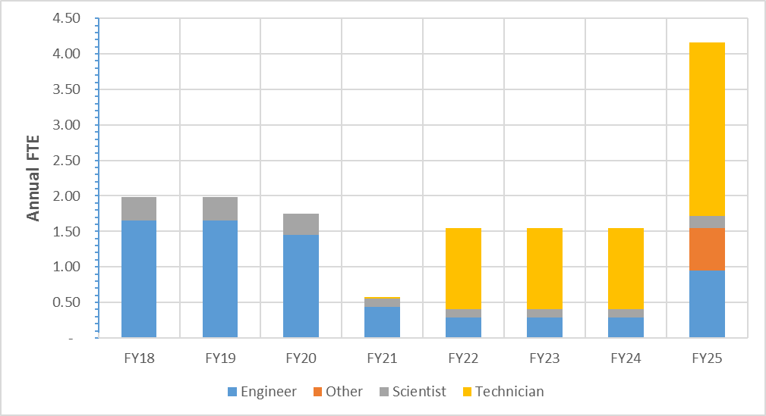
Labor Profile (Booster only)
Charge #2

Slide 19
Schedule (Booster Only)
Charge #2

Slide 20
Breakout Sessions

Slide 21
Summary
Requirements are defined.
Technical requirements flow down from the Science requirements
We have conceptual designs that meet the requirements, and working on finalizing them.
Improved design for Booster Injection Area.
Cost, schedule, and risks are understood
Second upgrade option for MI RF
ESH&Q elements addressed.
Project team is in place.

