Slide 1
121.3.22 – Linac – Installation, Integration and Commissioning (II&C)
Breakout Session: Linac Accelerator Support Systems, Installation and Commissioning
Curt Baffes
PIP-II Director’s Review
10-12 October 2017

Slide 2
Outline
Scope/Deliverables
Requirements
Interfaces
Conceptual Design
Technical Progress to Date
ESH&Q
Risk
Cost
Schedule
Summary

Slide 3
About Me:
PIP2 Roles
  L3 Manager for General Support Services
  L3 Manager for Installation, Integration and Commissioning
  Installation lead for PIP2IT
Other Fermilab experience
  Participated in build-out of FAST, PIP2IT, and CMTS1 machines
  Led design and installation of FAST 50 and 300MeV beamlines
  Led installation of 1.3GHz CC1 and CM2 cryomodules at FAST
  Led installation of first LCLS2 cryomodule in CMTS1 test stand

Slide 4
Scope and Deliverables for II&C WBS
Charge #1
Management and coordination (121.3.22.2)
Installation planning (121.3.22.3)
  Creation of an installation plan
  PIP2 3D CAD model
  CM and magnet stands, in-tunnel cryomodule mover
Linac Accelerator Installation (121.3.22.4)
  Installation at the tunnel elevation (WFE, SCL, BTL/BAL)
  Broken out as a WBS to match phasing of beneficial occupancy
Linac Gallery Installation (121.3.22.5)
  Installation at the gallery elevation (Highbay + SCL gallery)
  Broken out as a WBS to match phasing of beneficial occupancy
Linac Commissioning (121.3.22.6)
  Begins with ORC for power in a given subsystem
  Ends with achievement of project KPPs

Slide 5
KPPs in the II&C Phase
Charge #1
# | Description of Scope | Threshold KPP | Objective KPP | II&C Phase Comments
1 | SRF linac | 700 MeV beam delivered to the Booster Injection Region | 800 MeV beam delivered to Booster Injection Region | Linac II&C phase ends when KPP is achieved
2 | Booster upgrades | L11 Booster injection region hardware installed in the Booster. Linac beam injected and circulated in the Booster. | 8 GeV beam transmitted through Booster and delivered to Recycler Ring. | Booster beam commissioning is in II&C scope. Commissioning activities before beam are not.
3 | Cryogenic Infrastructure | Cryogenic plant and distribution lines ready to support pulsed RF operation, and operated to 2 K. | Cryogenic plant and distribution lines ready to support CW RF operation, and operated to 2 K. | Threshold KPP achieved when SCL achieves 2K. Cryo operations off-project thereafter
4 | Civil Construction |  |  | Not in II&C scope

Slide 6
II&C WBS L3 System Requirements
Charge #1
Functional
  Execute installation scope as defined in L3-L3 ICDs
  Execute commissioning (at super-system and machine levels)
  Achieve KPPs #3 (cryo), #1 (beam delivery to booster), #2 (beam extracted from booster)
Performance
  Perform value engineering to minimize cost, schedule, risk
  Take most direct path to achievement of KPPs
  In collaboration with Systems Engineering and ESH&Q, ensure all documentation is delivered and in place
ESH&Q
  Adhere to all FESHM requirements
  Adhere to the Integrated ES&H Management Plan (Doc 141)
  Adhere to the Quality Assurance Program (Doc 142)

Slide 7
Interfaces
Charge #1

Slide 8
Interfaces
Charge #1
II&C must interface with nearly every Linac L3
Currently, interface assumptions are negotiated, but documented in the CD1 BoE documents
Plan for CD2 is to develop L3-L3 ICDs documenting II&C interfaces and requirements

Slide 9
Conceptual Design and Design Maturity
Charge #1
Concepts for II&C are just beginning
  Plan is to allow cryomodule RLS to develop further, and use this as the framework to plan installation in more detail (pre CD2)
  Working within a time window dictated by the pace of cryomodule delivery

Slide 10
Conceptual Design and Design Maturity
Charge #1
After receiving BO of each area, begin a support services installation phase
  Alignment network creation
  Installation of electrical infrastructure
  Installation of fluids infrastructure
  Installation of cryo transfer line (assumed to be subcontracted)
  Installation of (empty) stands
Then begin installing accelerator components in sections
  WFE campaign
  SCL campaign (several chunks)
  BTL campaign

Slide 11
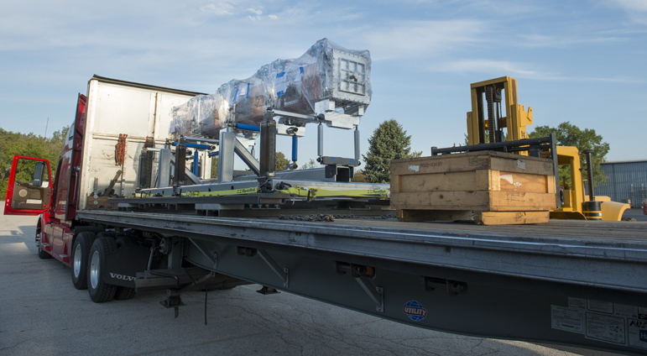
Warm Front End Installation
Charge #1
Removal from CMTF is part of II&C WBS
Philosophy: do disassembly and reassembly in one campaign as soon as highbay readiness allows, to minimize “memory loss” in PIP2IT team
Disassembly scheme
  Confirm labeling and documentation
  Disassemble to movable chunks (RFQ, HWR require dedicated transport fixtures, MEBT girders can be left largely intact)
Reassembly Scheme
  Reinstall major components
  Interleave addition of (new) utilities in highbay building
  Cable pull campaign
RFQ transport fixture

Slide 12
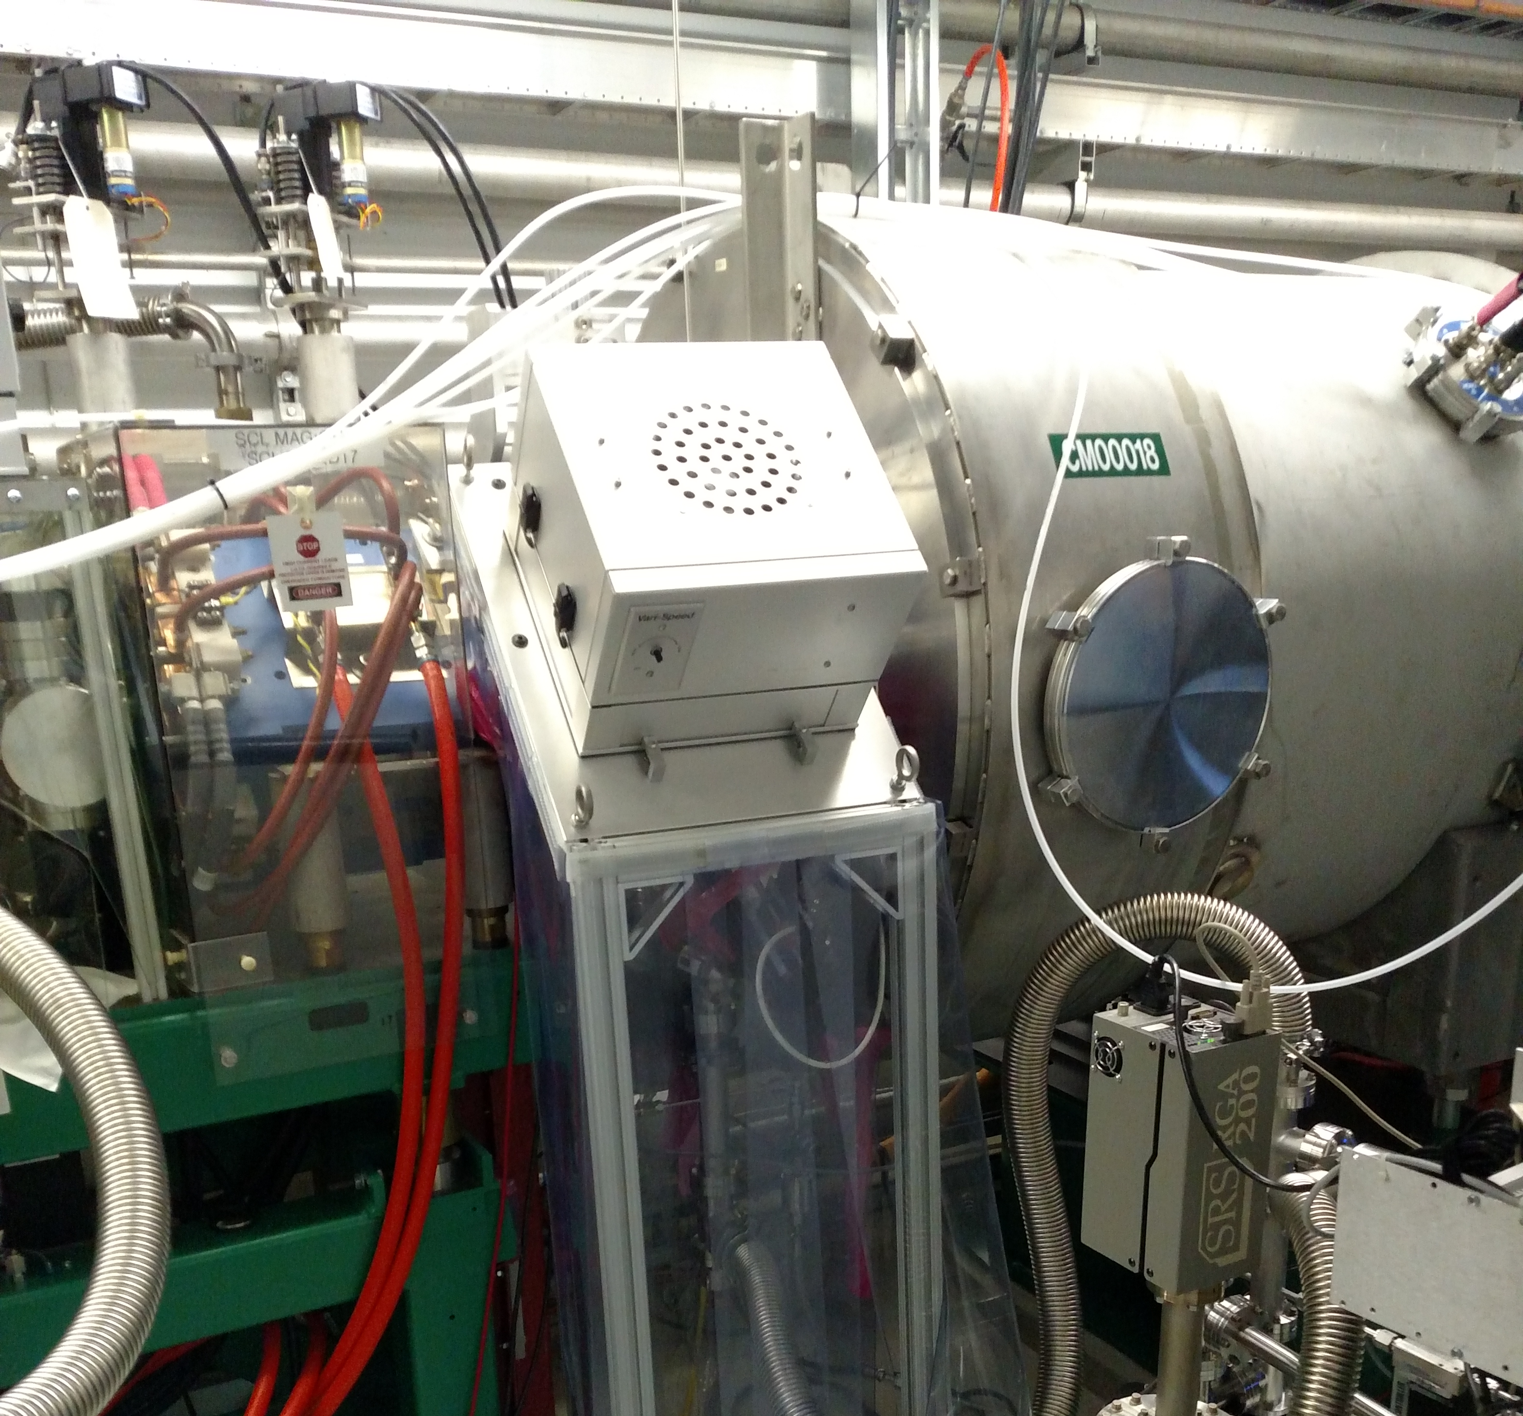
SCL Installation
Charge #1
Philosophy:
  After support services phase, do other heavy and “scissors lift” work
  Perform cryomodule + warm unit installation in chunks of similar cryomodules, at a pace dictated by cryomodule delivery
  Penetration work driven by gallery readiness
Notional chunking
  HWR (1 cryomodule)
  SSR1 (2 cryomodules)
  SSR2 1-3 (3 cryomodules)
  SSR2 4-7 (4 cryomodules)
  LB650 1-5 (5 cryomodules)
  LB650 6-11 (6 cryomodules)
  HB650 1-4 (4 cryomodules)
CM/Warm Unit interface setup at SNS

Slide 13
BTL Installation
Charge #1
Philosophy:
  Magnet installation requires magnet mover access through main linac aisle
  Move magnets during an intermission between cryomodule chunks
  BTL vacuum installation non-particle-free after first bend dipole

Slide 14
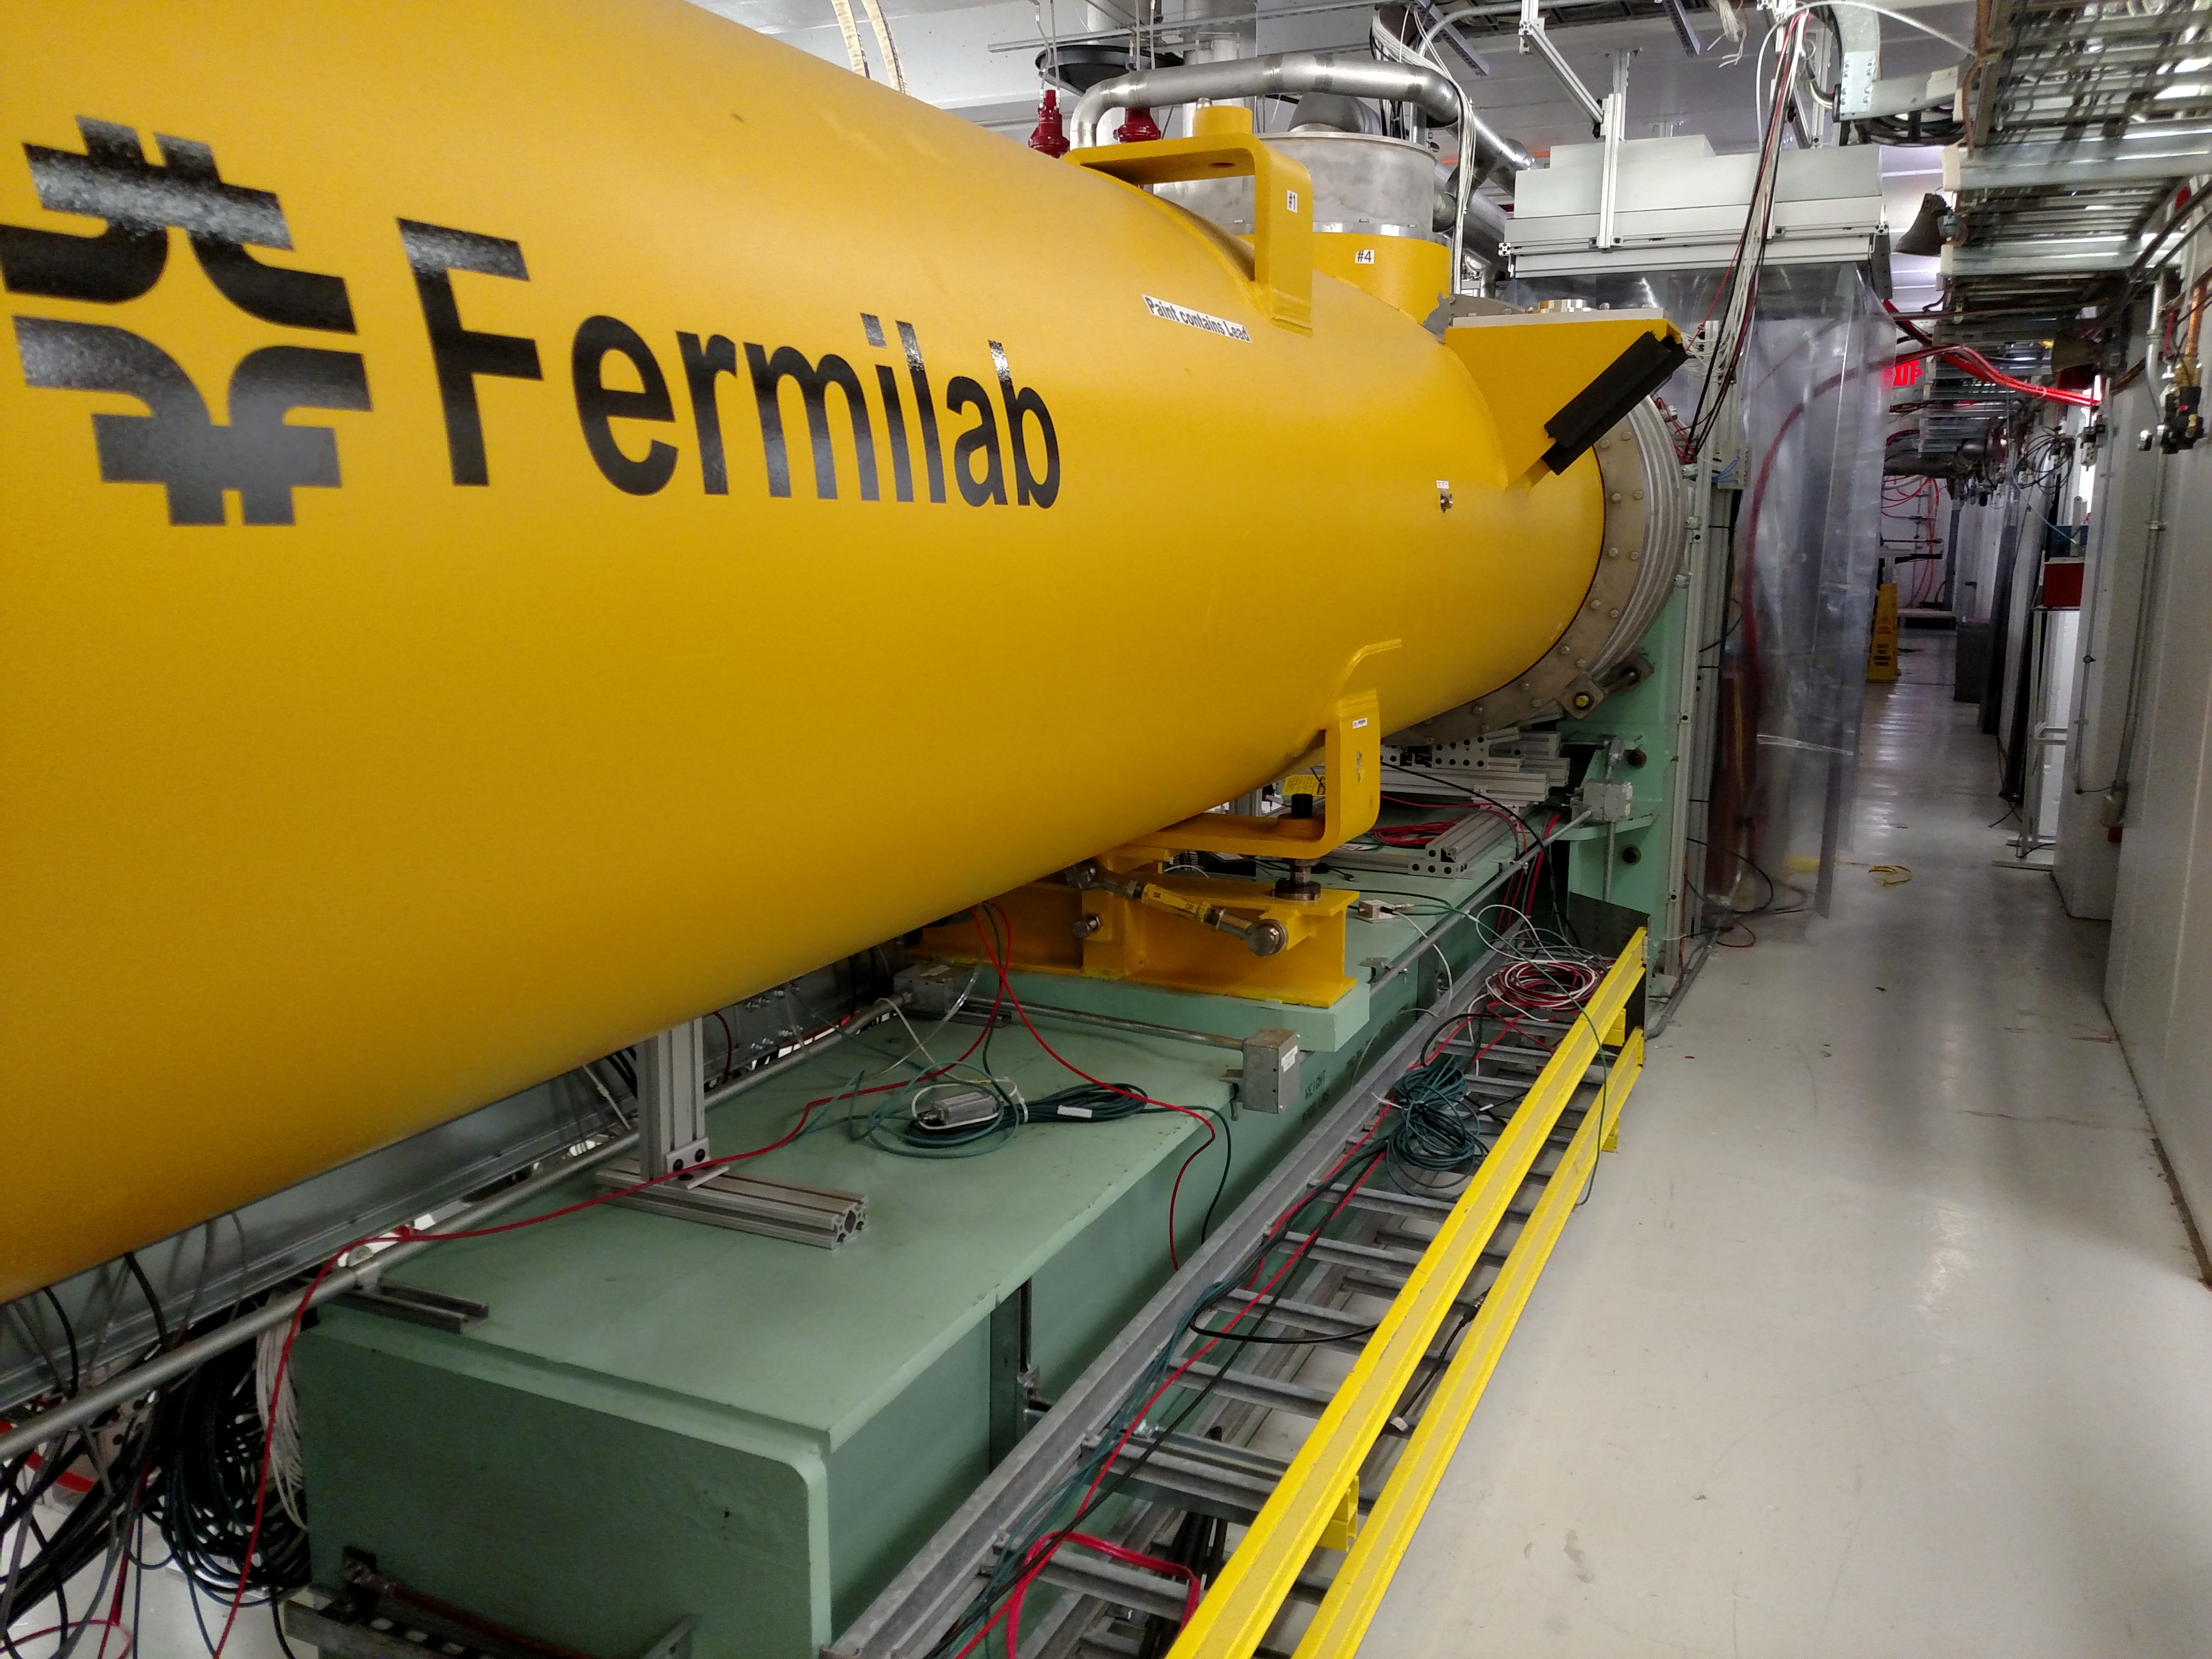
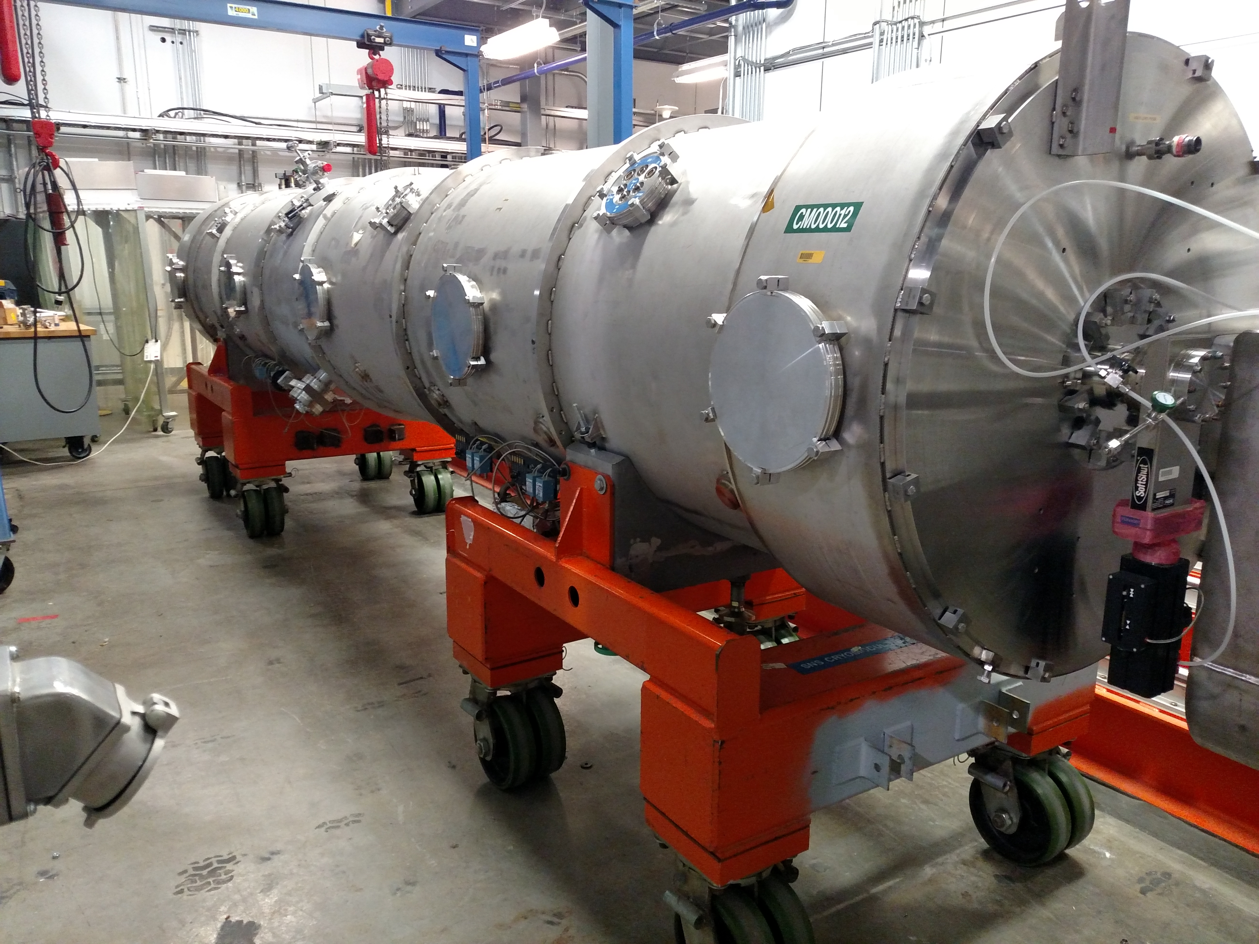
Conceptual Design – II&C Design Scope
Charge #1
II&C WBS element is responsible for some traditional “design” scope
  System-level 3D CAD model
  Cryomodule Stands
  Magnet Stands
  Cryomodule Mover
Will rely on existing tools, methods and designs as much as possible
FAST cryomodule stand
SNS cryomodule mover

Slide 15
Progress to date
Charge #1
Effort to date has been limited to scoping and cost estimation work in support of CD1 review
Begin ramp-up in FY18 to develop installation plan
Team has been involved in II&C of PIP2IT, lessons learned there will be carried forward

Slide 16
PIP2IT II&C Lessons Learned
Maintenance of complete volume envelopes in the CAD model is critical, especially for “non-mechanical” systems
Make sure the subsystems folks can populate the cable database, properly and consistently
Re-verify hardware documentation at the moment of delivery (EPDM, survey referencing, drawings, procedures are all complete and stored in the appropriate database)
Re-verify system pressure specifications prior to fluids connection and keep track of discrepancies
Confirm that machine protection features are fully implemented and tested at the subsystem level prior to responsible engineers handing off to operations

Slide 17
Design Review Plan - Installation
Charge #3
Division/Department review procedures apply
Installation Plan Reviews
  Preliminary – FY19
  Final – FY22
Installation readiness reviews (per area, phased to mirror beneficial occupancy)
  High Bay – FY22
  Linac – FY23
  Gallery – FY23
Other project-level reviews will be ongoing (P2MAC, DR, CD)

Slide 18
Design Review Plan - Commissioning
Charge #3
Commissioning Plan Internal Review – FY24
  Commissioning Plan then becomes a component to the Accelerator Readiness Review (ARR) process.
ARR to begin beam operation
  ARR and other DOE-order required documentation executed by the project/systems engineering team
ORCs at subsystem level
Other project-level reviews will be ongoing (P2MAC, DR, CD)
  2017 P2MAC Recommendation: “Consider the addition of a low power beam dump in a straight section at the end of the linac tunnel for beam tuning/study”
  Disposition: current straw-man solution is to build an absorber identical to the BTL absorber for temporary use. See BoE in doc 875

Slide 19
ESH&Q
Charge #4
ES&H
  Guided by the Project Integrated ESH Management Plan (Doc 141) and PIP-II Hazard Analysis Report: Doc 140
  Every identified hazard is relevant during the II&C phase
  Will work closely with ESH&Q staff to implement the identified hazard mitigations
  Will follow the Fermilab ES&H manual (FESHM) - Safety will be the primary consideration in all phases of II&C work
Quality
  Will adhere to Quality Assurance Program: Doc 142
    Many areas of IIC will be Level 1 or 2
  Models for hardware acceptance are in discussion
    E.g. Hardware Acceptance Review with complete walk-through of EPDM documentation index

Slide 20
Risk: Installation and Commissioning
Late subsystem delivery makes installation less efficient
Machine performance problems during commissioning
Mismatch between subsystem delivery and installation schedule creates need for storage

Slide 21
BOE Summary
Charge #2
WBS Number | Title | Docdb #
121.3.22.2 | Linac Installation, Integration and Commissioning PM and Coordination | 806
121.3.22.3 | Linac Installation Planning | 809
121.3.22.4 | Linac Accelerator Installation | 812
121.3.22.5 | Linac Gallery Installation | 815
121.3.22.6 | Linac Commissioning | 818

Slide 22
Cost Estimate Methodology
Charge #2
The cost estimate for each area was developed as follows
  PM and coordination (121.3.22.2)→Bottoms-up estimate (Baffes)
  Installation planning (121.3.22.3) → Bottoms-up estimate (Baffes)
  Linac Accelerator installation (121.3.22.4)
  Linac Gallery installation (121.3.22.5)
  Linac Commissioning (121.3.22.6)
    Pre-beam commissioning activities
    Commissioning with beam → Bottoms-up estimate (Garcia/Steimel/Pellico)
Mix of historical analogy and bottoms-up estimates

Slide 23
Analogy-Based Cost Model
Charge #2
Before beam, WFE, SCL and BTL commissioning are not strongly tied
We can build an analogy for each area as follows:
Scope to capture with analogy
WFE System
accelerator + gallery + 2.1MeV beam commissioning
SCL System
accelerator + gallery + warm/cold pre-beam commissioning
BTL System
accelerator,
shares SCL gallery, + pre-beam commissioning
PIP2IT build-out to “MEBT 3”
CMTS1 buildout + LCLS2 CM installation and test
Mu2e M4 line CD3a estimate (D. Still)

Slide 24
Cost Summary
Charge #2
Installation itself is ~65% of total cost
Commissioning is ~24% of total cost
Remaining ~11% is LOE, planning, stands, etc.

Slide 25
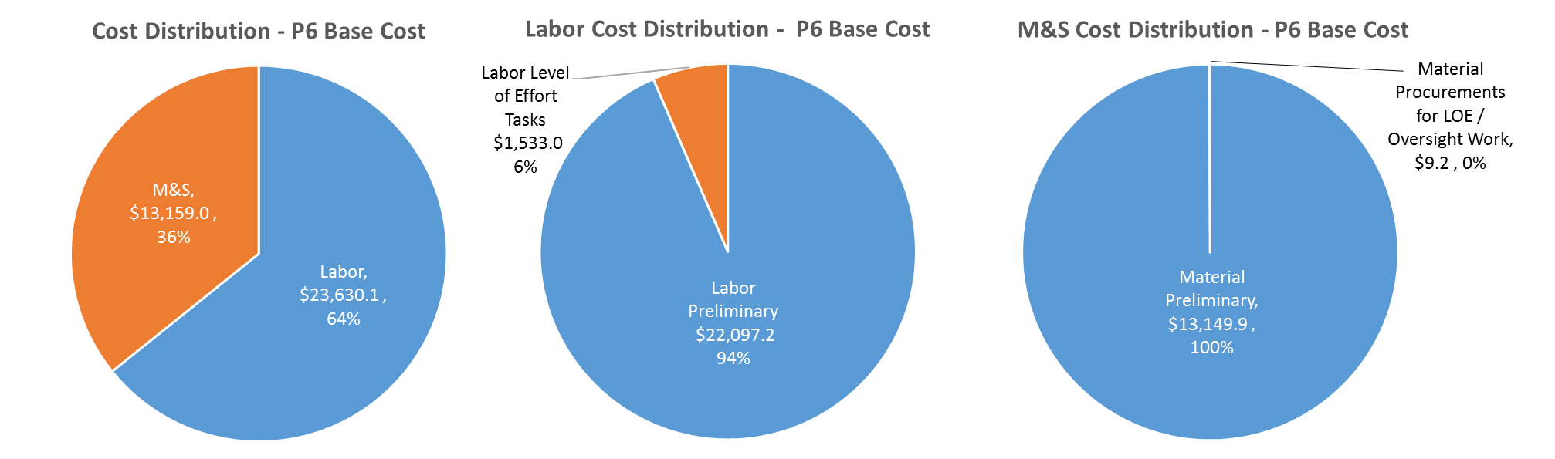
Cost Drivers and Estimate Maturity
Charge #2
P6 Base Costs = BOE + Overheads + Escalation
Labor cost is the driver
M&S costs are driven by T&M and subcontracted installation tasks, e.g. Cryo Distribution System installation

Slide 26
Cost Profile – P6 Base Cost Only
Charge #2
P6 Base Costs = BOE + Overheads + Escalation
Costs peak during the installation window

Slide 27
Labor Profile – P6 Hours/FTE
Charge #2
Labor peaks during the installation window

Slide 28
Schedule – Installation & Commissioning
Charge #2

Slide 29
Summary
Installation concepts will be developed in parallel with RLS development
Focus of the team in the near term will be interface documentation
The team’s past (and future) efforts at PIP2IT provide guidance and training for the PIP2 installation effort
We look forward to your feedback, thank you for your attention

Slide 30
END

