Slide 1
WBS 121.3.11 Cryogenics
SC Acceleration Modules and Cryogenics
Anindya Chakravarty and Arkadiy Klebaner
PIP-II Director’s Review
10-12 October 2017

Slide 2
Outline
System overview
About Me
Performance Requirements
Conceptual Design, Maturity
Scope/Deliverables
Interfaces
Organization
Technical Progress to Date/Design Review Plan
ESH&Q
Cost
Risk
Schedule
Summary

Slide 3
About Me:
Role in PIP-II: Scientist
- Superfluid Helium Cryogenic Plant and associated systems
Relevant experience:
- SO-G, CrTD, BARC (current position)
- Group Leader, CrTD, BARC
- Development of helium liquefaction and refrigeration systems at BARC
- Development of cryogenic turboexpanders at BARC
- Ph. D. in Cryogenic Engineering

Slide 4
System Overview
Fully segmented Linac
Single cold box with turbines and cold compressors
Distribution box located in the refrigerator room
Cryogenic transferline with bayonet cans that runs parallel to the cryomodules

Slide 5
WBS 121.11.3 Requirements flow down
PIP-II Conceptual Design Report
PIP-II Conceptual Design Report
➔Engineering Manual, Fermilab ESH&Q Manual
➔Cryomodules requirement documents
TC#ED0001313, TC#ED0001316, TC#ED0001829, TC#ED0001830, TC#ED0001322
➔Cryogenic System
Functional Requirements Specifications (TC#ED0003531)
Engineering Specifications (TC#ED0005493,5587, etc.)
Design Criteria Documents (TC#ED0004748, 6895, etc.)
Engineering Notes (TC#ED0003531,6860, 6901, etc.)
Interface Control Documents (TC#ED0006893)

Slide 6
Key Requirements
Details are in TC#ED0003531
Project Key Performance Parameters and Physics Requirements shall be met
Linac operating modes:
  CW or pulsed mode
  2.0 K in the standby mode
  4.5 K in standby mode
  Cool-down and warm-up
Cavity helium pressure – 31 mbar
Cavity helium pressure stability ➔ ± 0.1 mbar
Expected availability during scheduled beam operation – 98%
Support cool-down or warm-up of the Linac in < 20 days

Slide 7
Key Requirements
Cryomodule Static and Dynamic Heat loads
CM | No. of CM | 2K CW mode, (W) | 2K Pulsed mode, (W) | 5K Intercept, (W) | 70 K Shield, (W)
HWR | 1 | 61 | 61 | 60 | 250
SSR1 | 2 | 70 | 26 | 176 | 332
SSR2 | 7 | 429 | 83 | 434 | 882
650 MHz Lowβ | 11 | 633 | 54 | 176 | 528
650 MHz Highβ | 4 | 535 | 43 | 128 | 344
TOTAL |  | 1728 | 267 | 974 | 2336
  Requirements are defined and traceable

Slide 8
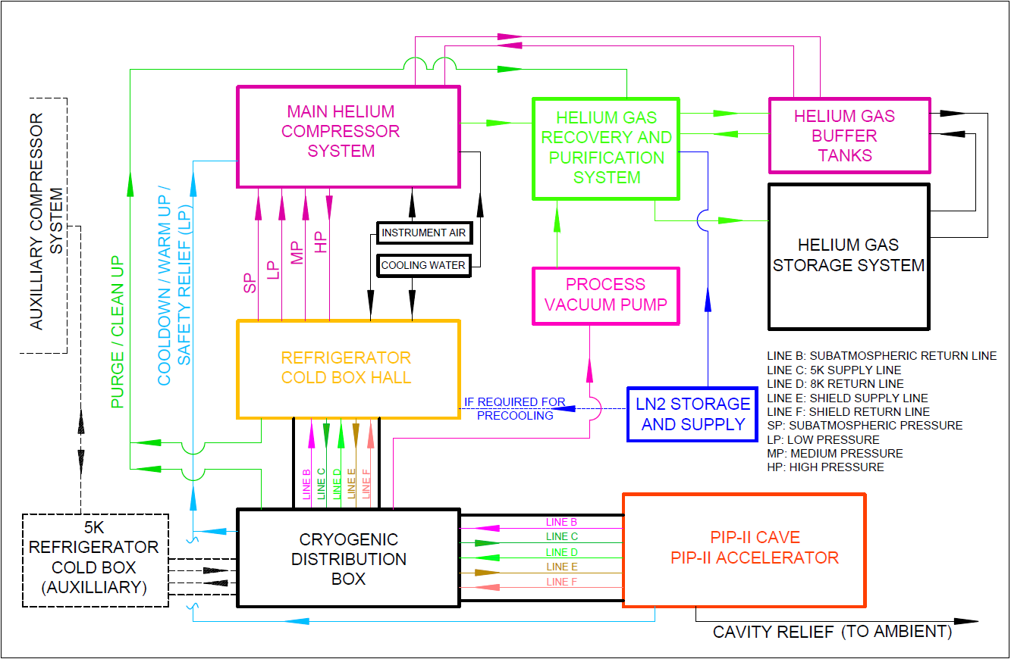
Cryogenic System Design – Conceptual Design
Used for pulsed mode only

Slide 9

Cryogenic Plant Design – Conceptual Design
Baseline
Alternative
Hybrid cycle design
Cold compression design

Slide 10
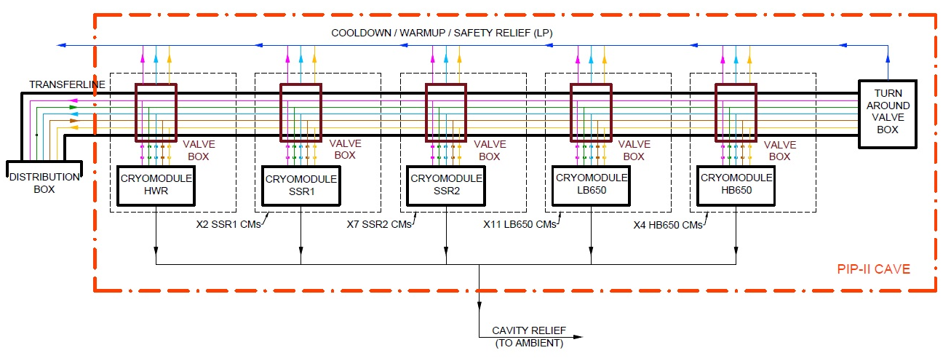
PIP-II Cryogenic Distribution System (CDS) – Conceptual Design
Fully segmented Linac
Distribution box located in the refrigerator room
Cryogenic transferline with bayonet cans that runs parallel to the cryomodules

Slide 11
Auxiliary Systems – Conceptual Design
Warm and cold interconnect piping
Warm helium storage tanks
Liquid helium Dewar
Helium recovery system
Initial system purification equipment
Reuse from the Tevatron
Charge #1
  Conceptual design is supporting key design requirements

Slide 12
Scope
  PIP-II Cryogenic Plant (121.3.11.2)
  PIP-II Cryogenic Distribution System (121.3.11.3)
  PIP2IT Cryogenic Distribution System (121.3.11.1)

Slide 13
Scope – Cryogenic Plant
2kW at 2.0 K Cryogenic plant
  Warm recirculation compressors with associated cooling, oil-removal systems and dryers, gas management system, refrigerator cold box(s) with heat exchangers, turbines, cold compressors, plant controls and instrumentation, acceptance test cryostat, and commissioning services ➔ DAE/BARC Deliverables
Ancillary support equipment
  Warm and cold interconnect piping, helium purification system, helium gas and liquid storage, liquid nitrogen storage – FNAL
Plant equipment installation services
  Rigging, welding, cabling, leak checking, pressure testing - FNAL

Slide 14
Scope – Cryogenic Distribution System (CDS)
Design and fabricate components needed to feed and return the cryogens to the Linac components in accordance with functional requirements and other applicable specifications including:
  Distribution Box
  Tunnel cryogenic transferlines
  Cryomodule bayonet can(s)
  Vacuum insulated jumpers
  Helium recovery headers
  Turn around box
  Pressure safety systems

Slide 15
Scope – PIP2IT Cryogenic Distribution System
Design, fabricate, install, and commission components needed to feed and return the cryogens to the PIP2IT cryogenic system in accordance with functional requirements and other applicable specifications including:
  External transferline
  Cave transferline and turn around box
  Vacuum insulated jumpers (u-tubes)
  Cryogenic instrumentation and controls
  Warm recovery headers
  Installation and commissioning services
  Transfer to operation services
Charge #2
  Cryogenic system technical scope is defined for FNAL and BARC

Slide 16
Interfaces
Cryogenic System interfaces with the following sub systems:
Conventional Facilities (WBS 121.5)
Control System (WBS 121.3.17)
HWR (WBS 121.3.4)
HB650 (WBS 121.3.8)
Installation, Integration, Commmisioning (WBS 121.3.22)
LB650 (WBS 121.3.7)
Safety Systems (WBS 121.3.20)
SSR1 (WBS 121.3.5)
SSR2 (WBS 121.3.6)
Vacuum System (WBS 121.3.18)
PIP-II DocDB doc#1160-v3 «PIP-II Interface Matrix »
    Cryogenic System Interface Control Document (ICD) TC#ED0006893
Interfaces are defined and documented
The level of interface details is commensurate for the current project stage

Slide 17
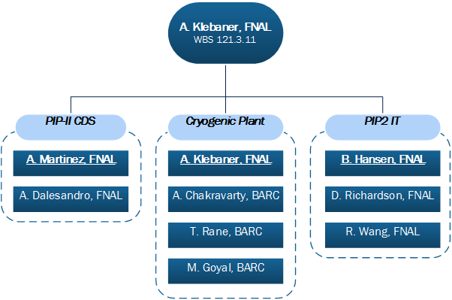
Organization
121.3.11.3
121.3.11.2
121.3.11.1
Qualified project personnel are in place at Fermilab and BARC

Slide 18
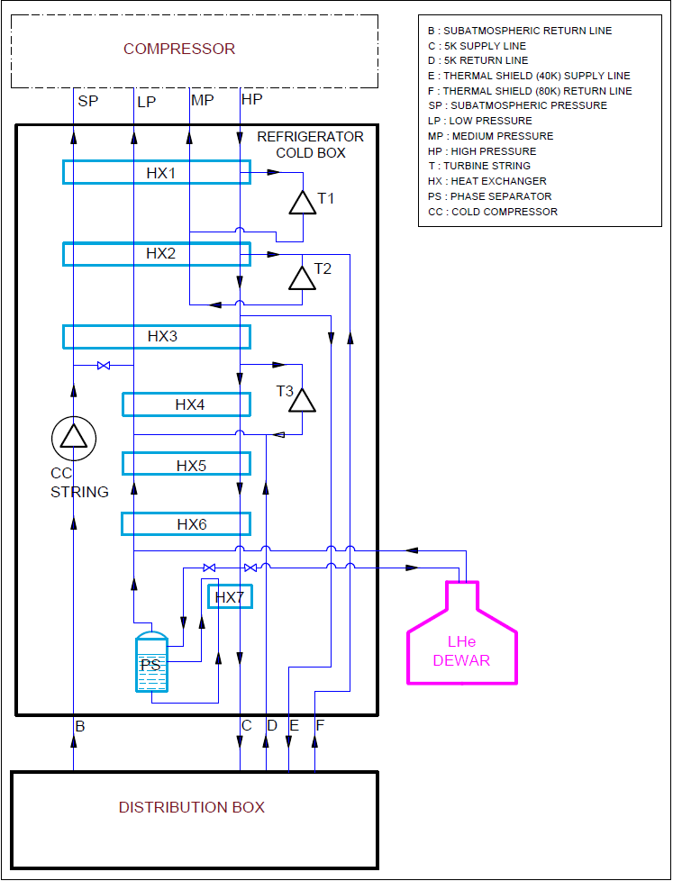
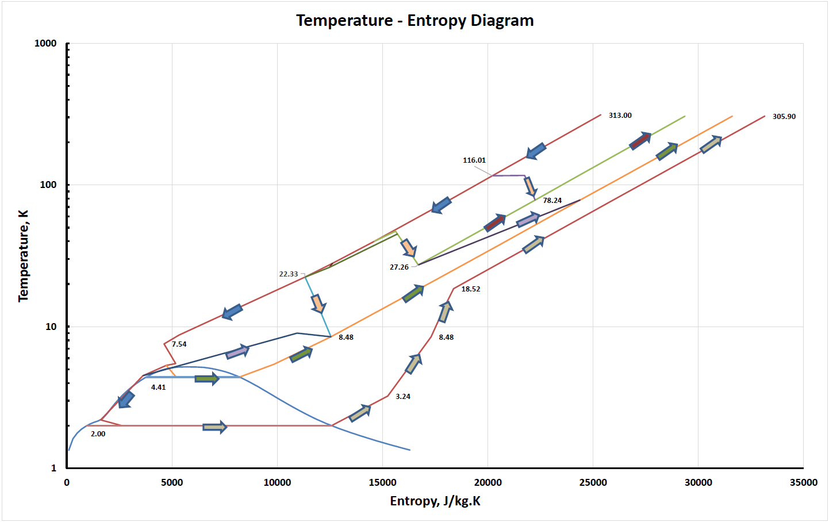
Technical Progress to Date - Cryogenic Plant
Hybrid compression cycle

Slide 19
Baseline Cryoplant Specifications
Refrigeration | 2K (W) | 5 – 9K (W) | 35 – 75K (W)
Capacity | 1,900 | 1,500 | 9,100
Supply Pressure | 2.2 ≤ P ≤ 4 bar | 2.2 ≤ P ≤ 4 bar | 3 ≤ P ≤ 18 bar
Return Pressure | 27 mbar | 2.2 ≤ P ≤ 4 bar | 3 ≤ P ≤ 18 bar
Supply Temp | ≤ 4.5 K | ≤ 4.5 K | 35 – 40 K
Return Temp | ≤ 3.8 K | ≤ 9 K | ≤ 80 K

Slide 20
Technical Progress to Date - PIP-II Cryogenic Distribution System
Developed preliminary detailed list of requirements
Defined preliminary loads, steady-state and transient modes – TC#ED0003531
Defined preliminary interfaces and boundaries – TC#ED0006893
Surveyed similar designs
Refined heat load estimates – TC#ED0003531
Interface Control Document – TC#ED0006893
Valve and Instrument List – TC#ED0006894
CDS Functional Analysis – TC#ED0006895
Bayonet Box Functional Analysis – TC#ED0006896
Cryomodule Bayonet Boxes P&ID - TC#ED0006897
Site Layout of Cryogenic Distribution Lines – TC#ED0006898
Pressure drop calculations – TC#ED0006899
Preliminary relief valves calculations – TC#ED0006900
Preliminary piping layout – TC#ED0006901

Slide 21
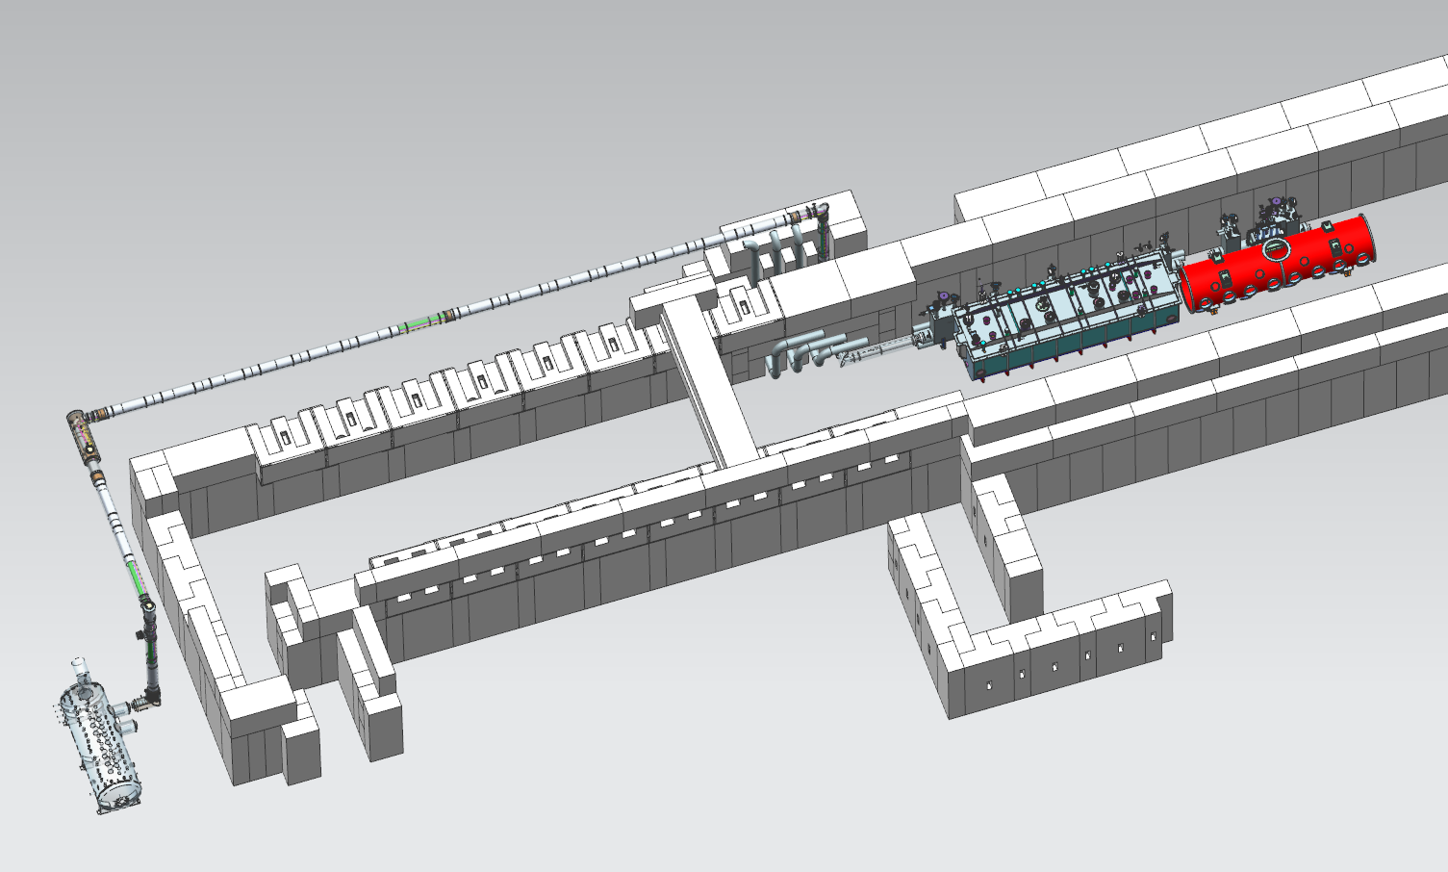
Technical Progress to Date - PIP2IT
External transferline is under fabrication at Fermilab
Cave transferline design-built contract was awarded to Demaco B.V. Holland
Integration and installation plans are being developed

Slide 22
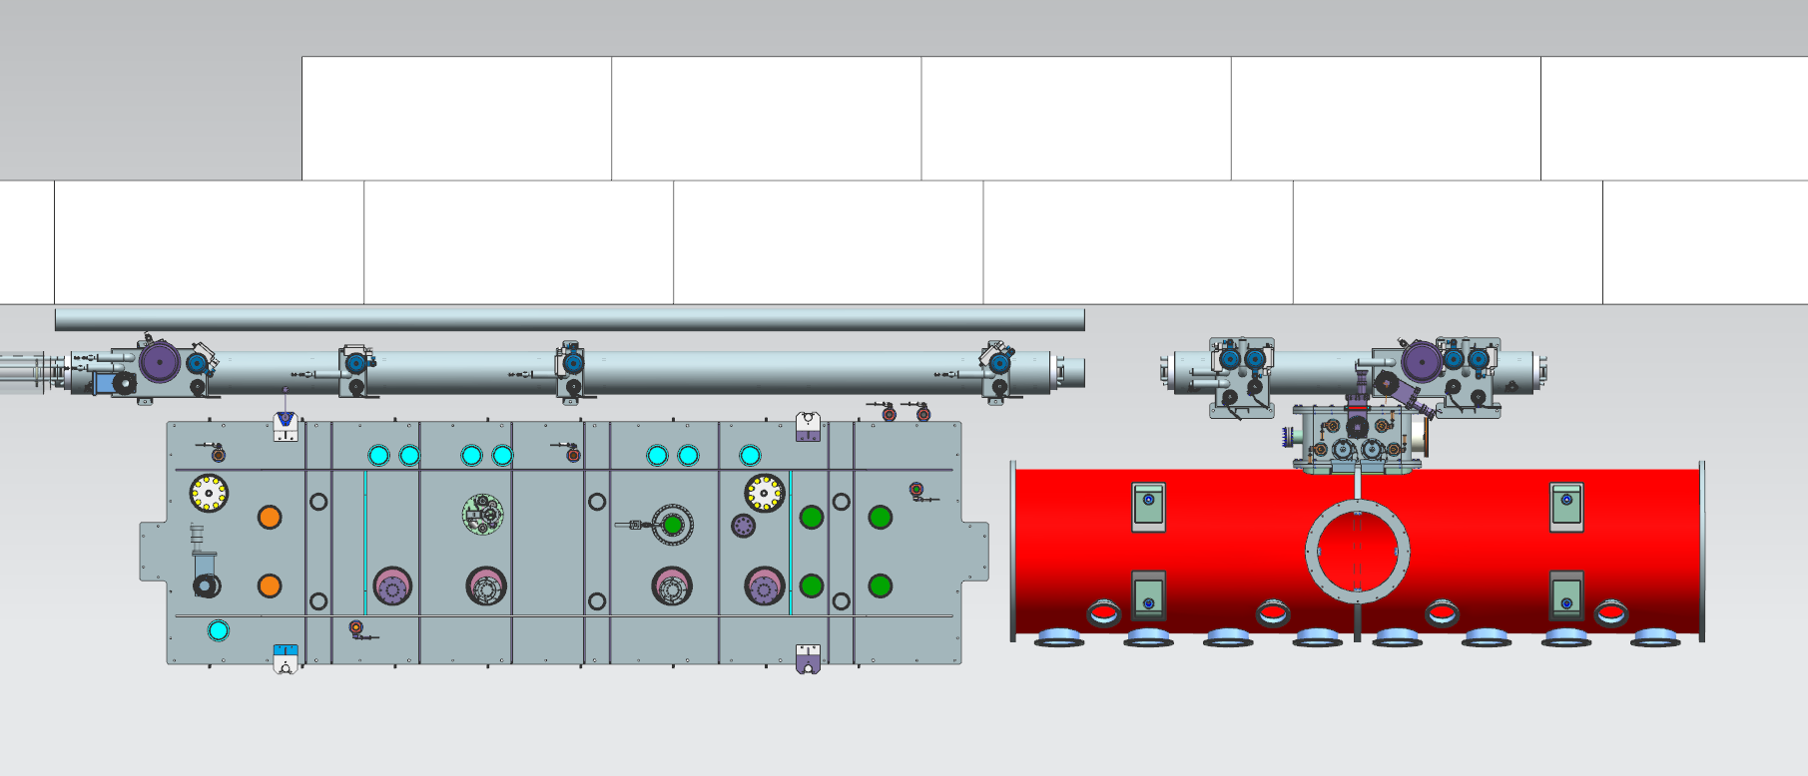
Technical Progress to Date - Cave transferline

Slide 23
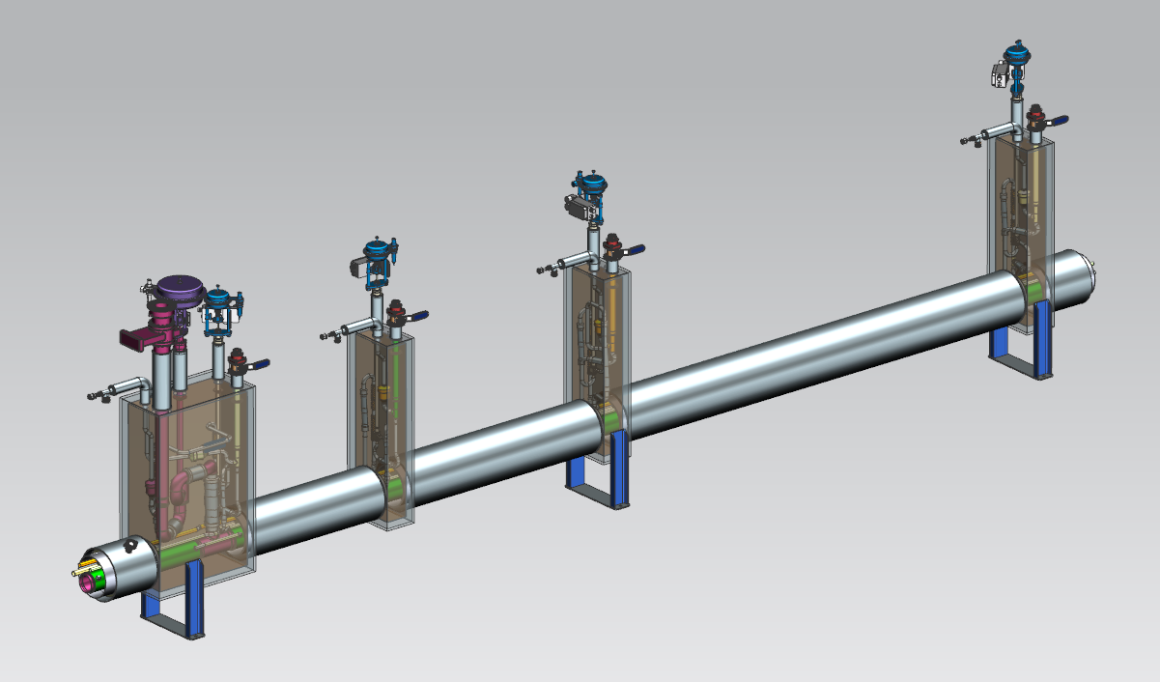
Technical Progress to Date - CM bayonet boxes

Slide 24
Cryogenic System Design
WBS 121.3.11 Design is sufficiently developed and supported for the current state of the project
Alternative solutions have been analyzed

Slide 25
Design Review Plan
Cryogenic System is subject to Project Reviews
Divi/Dept review procedures based on the Fermilab Engineering Manual
Technical reviews (PDR, FDR, PRR whenever appropriate)
PIP2IT CDS Internal Review – April 2017
  all recommendations are closed
PIP2IT Cave TL
  Preliminary Design Review – October 2017
  Final Design Review – November 2017
  Production Readiness Review – January 2018
Cryogenic Plant
  ESD review – April 2016
  BARC committee review – May 2016
  All recommendations are closed, RFP was issued December 2016
  PO likely to be released by mid 2018
Appropriate number of engineering and project reviews have been completed or planned

Slide 26
ESH&Q
PIP-II Cryogenic system will use compressed and liquefied Helium
This presents following potential hazards:
  Extreme cold hazard
  Oxygen Deficiency Hazard (ODH)
  Oxygen enriched hazard
  Over pressurization or explosion due to rapid expansion
  High noise levels
The approach to protection from hazards by minimizing potential hazards at levels as low as is reasonable will be incorporated in a design for the PIP-II Cryogenic system
  Utilizing National and International Codes and Standards for pressure systems design
  Segment insulating vacuum (reduces release rate)
  Move relief valves out of the tunnel wherever possible
  Pipe all relief valves outside (wherever possible)
  Reduce heat flux by adding insulation
  Provide barriers to minimize external effects/damages
  Project ISM and QA plans (docdb #141 and 142)
Cryogenic System is designed to be safe and to minimize impact on the environment

Slide 27
BOE Summary
WBS Number | Title | Docdb #
121.3.11.1 | PIP2IT CDS | 297-v4
121.3.11.2 | PIP-II Cryoplant | 300-v3
121.3.11.3 | PIP-II CDS | 309-v4
Labor and M&S estimate cover the entire scope of work defined in the WBS
Cost Estimating procedure #12.PM-005
TC#ED0003758 “Assumptions for Cryogenic Components Estimate”
Historical data and recent vendor quotes are used
No contingency is included
P6 contains raw hours and dollars
Cost Estimate is documented using consistent assumptions and is traceable

Slide 28
Cost Summary
Charge #2
Oversee delivery of all scope of WBS 121.11.3
  Costs generated from resource loaded schedule
  Estimate developed by people experienced with cryogenics. Estimate Uncertainty follows project guidelines
  Collaborative methods used while developing cost estimate assumptions
  Assumptions are realistic and used consistently

Slide 29
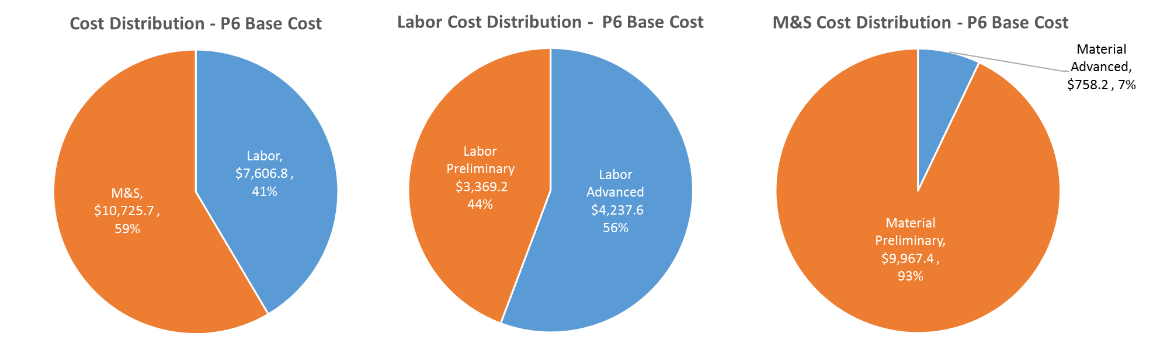
Cost Drivers and Estimate Maturity
Charge #2
  Design, fabricate, procure, and install PIP2IT CDS components
  Cryogenic plant contract oversight, cryogenic plant and associated auxiliary systems installation and commissioning
  Design, fabricate, procure, and install PIP-II CDS components
  Cost drivers identified

Slide 30
Cost Profile
Charge #2
P6 Base Costs = BOE + Overheads + Escalation
We understand our funding demands

Slide 31
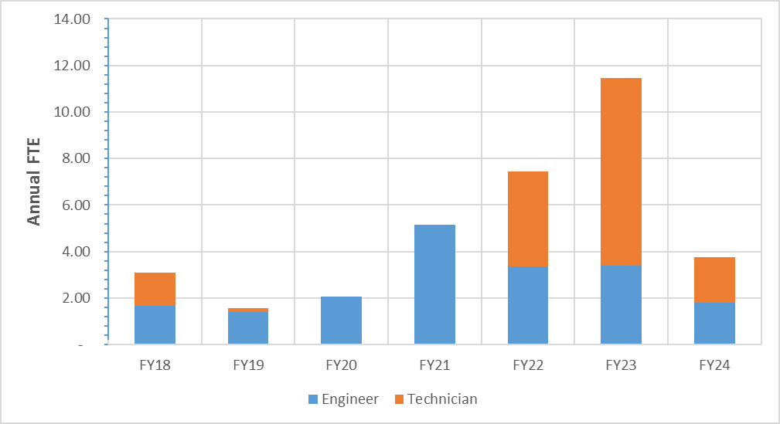
Labor Profile
Charge #2
Labor profile is consistent with WBS121.11.3 scope needs and can be supported

Slide 32
Risk
  Two high risks associated with Cryogenic System are documented in the Risk Register
  Pulsed and CW cryomodule operating modes cause cryogenic or mechanical instabilities
  Insufficient Cryogenic system vendor manufacturing capacity and priority
Risks associated with delay of the Cryogenic Plant delivery is included in the PIP-II Project Risk section of the Risk Register – see presentation by S. Mishra

Slide 33
Schedule
Charge #2

Slide 34
Summary
  Cryogenic system technical scope is defined
  Functional performance requirements and key interfaces are identified
  Strategy and technical solutions to support wide range of cryogenic load is developed
  WBS 121.3.11 design is sufficiently developed and is supported for the current state of the project
  CDS and Cryoplant are being designed as a single system with safety considerations in the design phase
  Cost and schedule are understood
  Detailed budget and schedule, in P6, are structured to achieve the technical scope
  Qualified project team is in place both at FNAL and BARC
  We are ready for CD-1

Slide 35
Thank you!

