Slide 1
International Collaboration
Project Management Breakout Session
Steve Holmes
PIP-II Director’s Review
10-12 October 2017

Slide 2
Outline
Context
Goals
IIFC Organization
Strategy
Challenges
Summary

Slide 3
Context/India
India Institutions and Fermilab Collaboration (IIFC) formed in 2009 to pursue R&D on technologies for high intensity superconducting proton accelerators:
BARC
IUAC
RRCAT
VECC
Governed by US-India agreements:
DAE authorized to commit up to $200M
(in-kind) for R&D + construction deliverables
R&D phase
Deliverables described in the “Joint Project Document for the R&D Phase of the IIFC under the Framework of Project Annex-I to the Implementing Agreement between DAE and DOE”
Construction phase deliverables to be formalized in advance of CD-2
U.S.-India S&T Agreement
Implementing Agreement
Annex I
Joint Project Documents

Slide 4
Context/Europe
Italy/INFN
INFN/Milano will fabricate two LB650 dressed cavities prototypes
Integrated with Fermilab and VECC to come to common design
Formalizing INFN LB650 cavities construction phase contribution
UK/STFC
Recently announced $88M (£65M, core accounting) contribution to LBNF/DUNE
Developing a plan for devoting a portion to PIP-II construction phase, with focus on HB650 cavities & cryomodules
CEA/Saclay
Discussion on assembling LB650 cryomodules based on cavities from INFN and/or VECC

Slide 5
Context
PIP-II Cost Estimate is based on the following assumptions with respect to international deliverables:
 | Component Fraction Provided
Component | India/DAE | Other Int’l
Dressed Cavities
SSR2 | 50%
LB650 | 50% | 50%
HB650 | 50%
Cryomodules
LB650 |  | 100%
Linac Warm Magnets | 100%
RF Amplifiers
325 MHz | 100%
650 MHz | 100%
Controls Hardware | 50%
LLRF, RFPI Hardware | 100%
Instrumentation | 50%
Cryoplant | 100%
From Assumptions Document: PIP-II-doc-144

Slide 6
Goals
R&D Phase
Develop capabilities, infrastructure, and working relationships at Fermilab and international partner labs and allied vendors to support construction of the PIP-II linac
Develop capabilities and infrastructure in DAE labs and allied vendors to support successful construction of high intensity proton accelerators in India
Construction Phase
Construct and commission PIP-II with a significant India/DAE in-kind contribution, and significant engagement of DAE staff
Construct and commission PIP-II with a significant European in-kind contribution, and significant engagement of European staff
Challenges
Success requires consistent attention and guidance from management
Constructive interaction at the technical level is essential in making this work

Slide 7
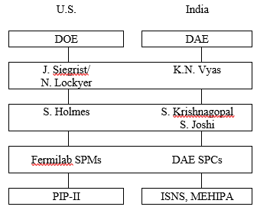
IIFC Organization
Scope and deliverables schedule for R&D phase are governed by the Joint R&D document
Signed by S. Basu and J. Siegrist
High level management via two Principal Coordinators, supported by two Technical Coordinators
TC weekly teleconference
Technical integration of work via Fermilab SPMs and Indian SPCs
SPM/SPC bi-weekly teleconferences
Semi-annual meetings initiated
January/July 2016/January 2017 (all at BARC)

Slide 8
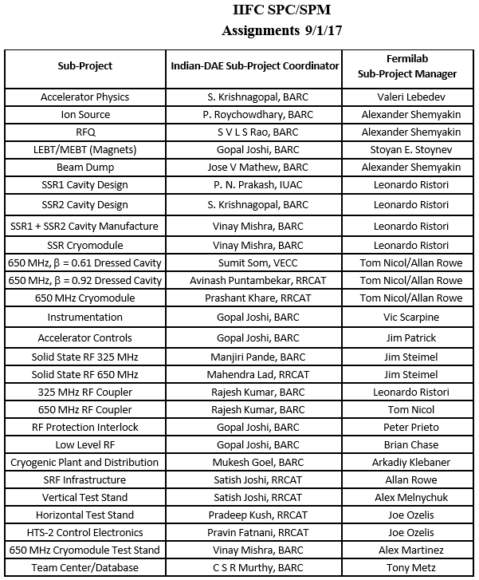
SPC/SPM Assignments
Within Fermilab SPMs are typically level 3 managers within PIP-II Project

Slide 9
Mapping onto PIP-II/Strategy
Assignments based on consideration of:
DAE, INFN, STFC technology interests
PIP-II risk mitigation strategies
R&D phase scope of work reflects vision of construction phase deliverables
Development and testing of prototypes
Development of infrastructure
Engineering documentation
DAE interests
Primary interest is acquiring capabilities, intellectual and physical, to construct high power proton accelerators domestically
Result: DAE is engaged in all critical systems
INFN, STFC, and CEA interests
Contributing to early realization of full capabilities of PIP-II to support MW+ neutrino program
Building/enhancing domestic capabilities in SRF technologies

Slide 10
Mapping onto PIP-II
The DAE laboratories are completely integrated into nearly all aspects of the PIP-II superconducting linac
INFN and STFC are more limited
IIFC areas of collaborative development include:
Superconducting radio frequency accelerating modules
Radio frequency power sources and RF controls
Super- and normal-conducting magnets
Cryogenic Plant
Beam diagnostics
Controls
INFN
STFC
IIFC
Notes:
Offset IIFC arrows

Slide 11
Major IIFC Deliverables
System/Component | DAE R&D Deliverable | Construction Deliverable*
SSR1 | 2 dressed cavities | NA
SSR2 | 2 dressed cavities | ✓
LB650 | 2 dressed cavities | ✓
HB650 | 4 dressed cavities | ✓
SC solenoids | 4 magnets (SSR2) | ✓
Warm magnets | All PIP2IT/MEBT magnets 2 focusing magnets (650) | ✓
RF Power Sources/325 | 9 sources (SSR1) | ✓
RF Power Sources/650 | 7 sources (HB650) | ✓
LLRF/RFPI | 4 systems (SSR1,2xHTS-2, CMTF) | ✓
HTS-2 | 2 test stands (FNAL & RRCAT)
LHe Cryoplant |  | ✓
* Scope to be formalized in advance of CD-2

Slide 12
Integration in R&D Program
DAE is strongly integrated into the R&D phase
SSR1 cryomodule to be constructed of 6-7 (Fermilab) + 1-2 (IUAC/BARC) cavities
HB650 cavity to be constructed of 4 (Fermilab) + 2 (RRCAT) cavities
325 MHz 7 kW SSRF amplifiers from BARC are required to power the SSR1 CM at PIP2IT
RFPI boards from BARC will be used in this system
650 MHz 40 kW SSRF amplifiers from RRCAT are required to power the HB650 CM at CMTS
RFPI boards from BARC will be us
INFN
Have completed LB650 cavity electromagnetic design
In close coordination with VECC and Fermilab
Approved by Fermilab and proceeding to mechanical design

Slide 13
Construction Phase
DAE is authorized to provide deliverables worth up to $200M (in-kind) for PIP-II
R&D + Construction phases
Cryogenic Plant procurement by BARC is currently underway
Bidding two plants, with intention of one coming to Fermilab
Capable of supporting CW operations
Balance of construction deliverables is not yet formalized, but we believe it will conform closely to the table on slide 11
A draft agreement covering both R&D and construction phase deliverables from INFN is currently providing basis for discussion
LB650 dressed cavities
Discussions just initiated with STFC on scope of construction phase deliverables
HB650 cavities
Discussions with CEA on possible construction phase deliverable have taken place among the technical managers
LB650 cryomodule assembly
Agreements need to be completed and formalized in advance of CD-2

Slide 14
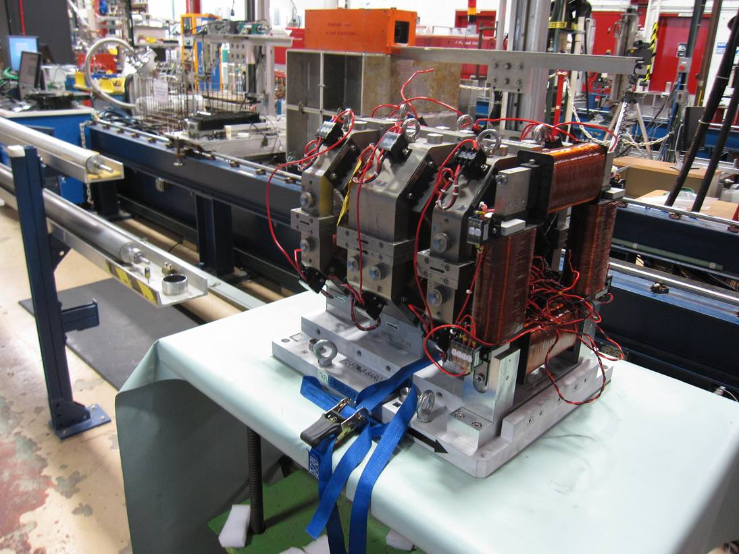
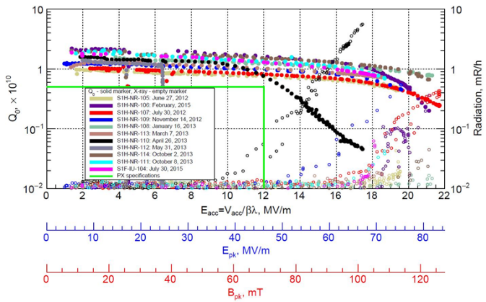
Progress to Date
DAE has delivered:
Complete set of focusing quadrupoles and correction dipoles required for the PIP2IT MEBT
Two SSR1 bare cavities
3 kW SSRF amplifier
RFPI board
DAE in process:
Prototype 5-cell HB650 cavity
325 MHz 7 kW SSRF amplifiers
650 MHz 40 kW SSRF amplifiers
SSR2 cavity design
LB650 5-cell cavity design and fabrication
LB650 cryomodule design
INFN in process:
LB650 cavity design and fabrication

Slide 15
Risks
Two entries in the risk register related to international contributions are categorized as Enterprise Risk, i.e. belong to DOE/HEP & Fermilab; not included in risk analysis:
RT-121-01-01-001: Failure to reach agreement on international in-kind contributions
RT-121-01-01-002: Delay in formalizing international in-kind contributions
International risks belonging to the project:
RT-121-02-01-002: In-kind contributions do not meet codes, standards and/or acceptance criteria
RT-121-02-03-002: Insufficient IIFC documentation
RT-121-02-01-005: Effect of US Funding delay of "In-Kind" design effort
RT-121-03-11-005: Minor modifications required for IIFC RF power amplifiers
RT-121-03-12-004: IIFC LLRF hardware/software does not meet acceptance criteria

Slide 16
Challenges
PIP-II, as far as I am aware, is the first attempt by DOE to construct a domestic accelerator incorporating international in-kind contributions
Creates a set of generic challenges in how to organize and manage
India also creates a number of specific challenges…
Conducting a collaboration between institutions separated by 11 time zones and 8000 miles
Communications/information flow
Visits/visas
Export regulations and Third-part IP
India is classified as a “sensitive country” with BARC subject to special scrutiny by the Department of Commerce
Differences in engineering and management cultures also need to be recognized
Many discussions on what “design” means
Control of documentation
(Fermilab processes codified in Fermilab Engineering Manual)

Slide 17
Moving Forward (1)
Most important: Establish and maintain confidence among the partners
Several things have been particularly successful (my opinion)
FRS/TRS
Establish basic requirements, including interfaces to other systems
Generally involve significant discussion and iteration
Signed off by both Fermilab and DAE lab
Guest engineers/scientists
See following slides
Weekly teleconferences
SPM/SPC
Integration of INFN into the LB650 teleconference
TC/TC

Slide 18
Visitor Program

Slide 19
Visitor Program
We have hosted six DAE engineers/scientist over the last two years
Our goal for these visits is to provide an experience that is both professionally and personally fulfilling
Assignments
PIP2IT
SRF
LLRF (2)
Cryogenics (2)
Provide direct support to efforts at Fermilab
Provide interface to home laboratories
Upon return they will be in unique position to facilitate interactions between Fermilab and DAE labs, as well as to carry home knowledge & experience
In process of identifying second cohort, to arrive early 2018

Slide 20
Moving Forward (2)
Areas requiring management attention:
Management of shared engineering documentation
Cryoplant
Procurement initiated by DAE – (very) long lead item
Export licensing
Involves multiple agency interactions: Dept of Commerce, DOE, (State)
Intellectual Property
Especially third-party
SPC/SPM interactions
This is the foundation of everything we do together
Formalization of construction phase deliverables in advance of CD-2

Slide 21
Summary
International engagement on multiple fronts
IIFC has been going for eight years
INFN has joined in the last year and STFC has announced intention
R&D deliverables are starting to arrive at Fermilab
MEBT magnets, SSR1 cavities, RFPI boards
Design efforts underway on multiple fronts
Based on jointly approved FRS and TRS
DAE staff at Fermilab for extended visits have had significant positive impact
Challenges remain, but all sides are committed to making this work

Slide 22
END

