Slide 1
RLS and BOE Development
Project Management
Luisella Lari
PIP-II Director’s Review
10-12 October 2017

Slide 2
Outline
Resource Loaded Schedule (RLS) Overview
Multi-Phases RLS
Multi-Levels RLS
  High Level Master Schedule
Deliverable Oriented RLS
Technically Limited RLS
  PIP-II Critical Path
  PIP-II Obligation Profile
Basis of Estimate (BOE) data integrated in the RLS
Summary
Next Steps

Slide 3
About Me:
Role in PIP-II:
  PIP-II Associated Project Manager for Planning and Reporting
Relevant Experience:
  16 years working experience in scientific (PhD in Physics) and Project Management (PMP certified) fields:
    Leader Project Planning Manager for ESS Linac, Sweden.
    LHC Main Ring Installation Reference Project Planning Engineer, CERN, Switzerland.

Slide 4


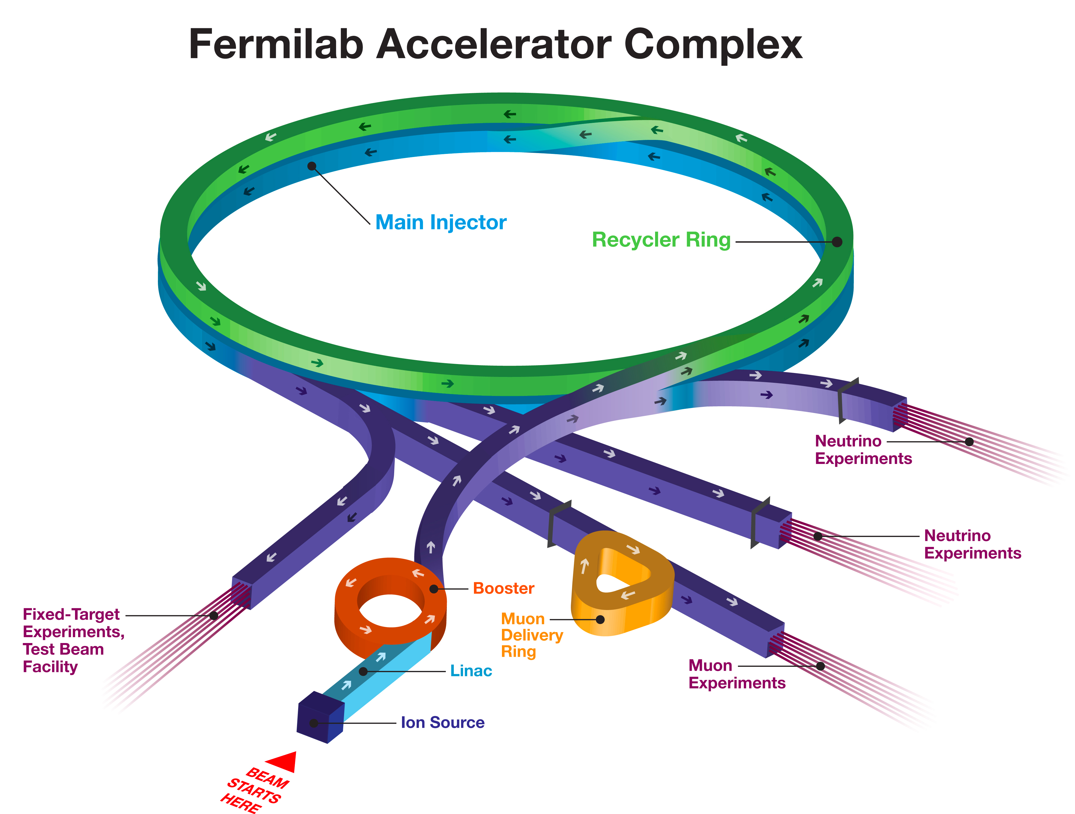


The complex RLS for PIP-II Project
*FONSI= Funding of No Significant Impact
External Constraints
LBNF Shutdown
CMTS
Available
Deliverables from USA laboratories
FONSI*
Civil Engineering
Booster Upgrade
In-kind Contributions
A new 800 MeV Linac
4
11/15/2016

Slide 5
The complex RLS for PIP-II Project
The PIP-II RLS is a Multi-Phases, Multi-Levels, Deliverable Oriented and Technical Limited plan developed with the scope of reporting to DOE the progress with respect to the DOE given budget.
The RLS timeframe is from Oct 1st, 2017 to April 1st, 2026
(i.e. early CD-4 date).
RLS and BOEs covers this timeframe.
Actual costs are recorded from CD-0 to Oct 1st, 2017

Slide 6
The complex RLS for PIP-II Project
Multi-Phases
R&D phase and Construction phase
Milestones with Different Levels and it is coupled with the Different Levels of Responsibilities for the PIP-II Managers
Multi-Levels
Working schedule @ Level 4 that includes all the major technical deliverables from Fermilab (T4) and from International Partners (I4)
Deliverable Oriented
Technically
Limited
The present RLS is not constrained by a funding profile, but is constrained by ending on Q2 FY26

Slide 7
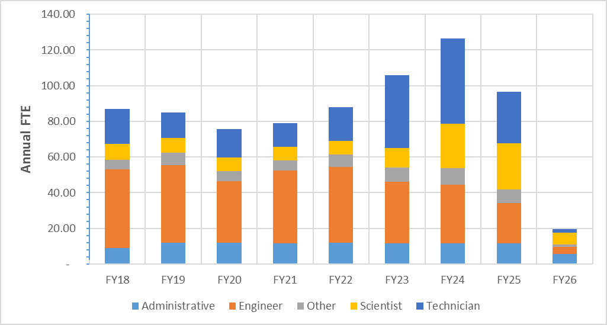
Multi-Phases RLS
PIP-II Staff Plan
S. Holmes - Plenary
R&D Phase
Major Milestones:
    WFE commissioned to meet CDR Parameters [FY19]
    HWR/SSR1(CM1) RF tested in PIP2IT [FY20]
    HB650 (CM1) RF tested in CMTS [FY21]
Construction phase
Major Milestones:
    Meet KPPs Parameters [Early CD-4 date FY26]
L. Prost – BS*2
Z. Conway, D. Passarelli - BS4
A. Rowe - BS4
S. Holmes - Plenary
*BS= Breakout Session

Slide 8
Multi-Phases RLS
The Phases are identified in P6 through:
  Activity String Name
  Funding Type
R&D Phase
Construction phase

Slide 9
Multi-Levels RLS
The PIP-II RLS is built in P6 following the structure of the Organization chart.
L2M @ L2 in P6

Slide 10
Multi-Levels RLS
L3M @ L3 in P6

Slide 11
Multi-Levels RLS - Milestones
T MS = Project MS
I MS = International MS
Ex = External Constraints
T Milestones have float
I Milestones have 0 float
Ex Milestones have 0 float
T4
3 m
T3
Working schedule
ends
April 1st, 2026
PIP-II PM
6 m
T2
DOE Fermi
1 y
T1
DOE direction / 2.5y
T0

Slide 12
Multi-Levels RLS - Milestones
External Milestones | 4
I4 Milestones | 89
I3 Milestones | 6
T4 Milestones | 355
T3 Milestones | 108
T2 Milestones | 40
T1 Milestones | 5
T0 Milestones | 1

Slide 13
High Level Master Schedule

Slide 14
Deliverable Oriented RLS
Each T4 Milestone represents a goal for each L2/L3 Manager in the PIP-II Project:
  Performance achieved
  Ready For Installation
Intermediate Milestones to reach these major goals are identify in the RLS as T5 Milestones in P6.
Each I4 Milestones represent a major delivery from our International Partners:
  Possible delays in delivery can produce a cascade effect on the RLS
  RLS includes resources to oversight, coordination, QA/QC acceptance testing of International Deliverables

Slide 15
Deliverable Oriented RLS
The present RLS contains 5137 activities of which 4297 are in the Linac WBS
Distribution of activities in %

Slide 16
Technically Limited RLS
i.e. the present RLS is not constrained by a funding profile, but is constrained by ending on Q2 FY26 i.e. when the LBNF shutdown ends
PIP-II Assumptions Doc (docdb n. 144)
Major impact on funding in the earlier Fiscal Years.

Slide 17
Escalation and Overhead
Escalation Rates
Overhead
PIP-II Assumptions Doc
Fermilab EVMS System Description Doc

Slide 18
Resulting Cumulative Obligation Profile
Estimation to Complete $490M
=($458M (P6)+ $32M (AC))
600
Millions
500
Including:
Actual costs for FY16 and FY17
Escalation
Overhead
400
300
200
75 Major/Significant/Critical procurement identified
100
T. Powers – BS1
0
Q4 FY16
Q3 FY17
Q2 FY18
Q1 FY19
Q1 FY17
Q3 FY16
Q2 FY17
Q2 FY16
Q4 FY17
Q4 FY18
Q1 FY18
Q2 FY19
Q3 FY19
Q4 FY19
Q1 FY20
Q2 FY20
Q3 FY20
Q4 FY20
Q1 FY21
Q2 FY21
Q3 FY21
Q4 FY21
Q1 FY22
Q2 FY22
Q3 FY22
Q4 FY22
Q1 FY23
Q2 FY23
Q3 FY23
Q4 FY23
Q1 FY24
Q2 FY24
Q3 FY24
Q4 FY24
Q1 FY25
Q2 FY25
Q3 FY25
Q4 FY25
Q1 FY26
Q2 FY26
Q3 FY26
Q4 FY26
Q3 FY18
Q1 FY27
Obligations
Planned Value / Budgeted Cost of Work Scheduled (BCWS)

Slide 19
Critical Path
The Critical Path assumes that each International Partner during the Construction Phase is delivering in time.

Slide 20
Critical Path
SSR2 L3M, D. Passarelli – BS4
Inst. L3M, C. Baffes – BS2
FY18
FY19
FY20
FY21
FY22
FY23
FY24
FY25
FY26
CD-2
CD-2
CD-3a
BO tunnel
Early
CD-4
SSR2 BCAV Des.
SSR2
Proc. 2 Prot. Nb & BCAV
And BCAV Cold Test
SSR2
1st Prot DCAV STC
SSR2 DCAV Des. Final.
SSR2
CM1 DCAV Prod
SSR2 String
ColdMass, CM assembled
Inst.
All 7th SSR2 CMs
The Critical Path goes through the construction & installation of SSR2 CMs
Cool-down Beam Comm

Slide 21
BOE for RLS Development: A reminder
Follows DOE Cost Estimating Guide (DOE-G-413.3-21)
S. Holmes - Plenary
BOEs are the basis for developing the RLS
RLS and BOEs contain the same
  direct M&S costs (in FY16$)
  labor hours

Slide 22
BOE for RLS Development: Some details
134 Basis of Estimate documents
  Each BOE consists of:
    Word document:
      WBS Dictionary definition
      Assumptions
      Explanation behind the estimate
    Excel document:
      Labor and M&S estimates at Level 5
      Estimate Uncertainty
  Base year FY16
  Each BOE was reviewed for consistency / understanding
    Checklist for validation of the BOE
P. Derwent – BS1

Slide 23
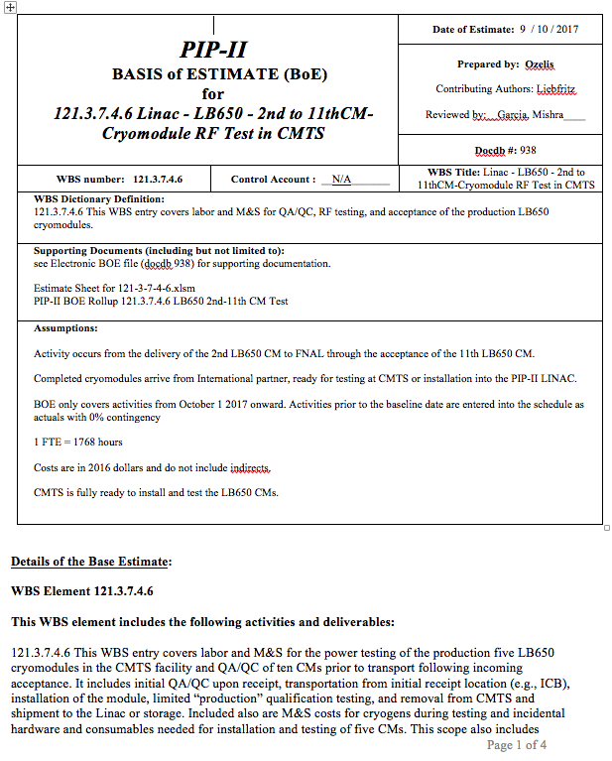
BOE for RLS Development: Some details
Word Document:
WBS #
Title
Dictionary definition
Supporting documents
Assumptions
Docdb #
Details of the estimate

Slide 24
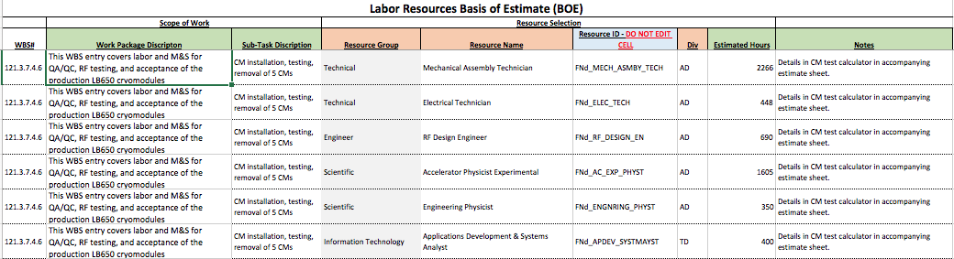
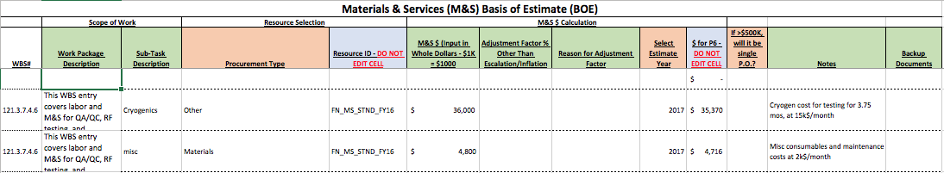
BOE for RLS Development: Some details
Excel document:
Labor hours
Material Costs

Slide 25
BOE data integrated in P6 per WBS
134 BOEs integrated in P6
Chart per BOE costs
Chart per BOE numbers
S. Holmes - Plenary

Slide 26
BOE data integrated in P6 per WBS
70% in cost BOEs integrated in P6 with a Detailed Plan, including the Critical Path
30% in cost BOEs integrated in P6 as Planning Packages

Slide 27
Summary
The PIP-II RLS is developed and aligned with:
  PIP-II Alternative Selection
  PIP-II Assumptions Document
  PIP-II CDR
  PIP-II Procurement Management Plan
  Project Annex 1 for IIFC deliverables
  DOE Cost Estimating Guide (DOE-G-413.3-21)
  Fermilab Guidelines 12.PM-004.DT-01; 12.PM-004.DT-03;

Slide 28
Summary
RLS Estimate to Complete costs is $458M, including escalation and overhead. $490M including Actual Costs.
RLS starts from Q1 FY18. It contains 5137 activities with 30% in cost in Planning Packages.
RLS is describing the whole PIP-II Project, identifying as critical path the SSR2 CMs and their installations.
RLS integrated the major deliveries by our international partners, under the hypothesis that the deliveries are in time with respect to the RLS needs.
RLS is technically limited i.e. not constrained by a funding profile, but is constrained by ending on Q2 FY26.
RLS is aligned with the present organization chart and it fully integrates the BOEs data, as reported in the PIP-II Cost Book.

Slide 29
Next Steps
Before CD-1
Update BOEs and modify P6 to include:
  Recycler and Main Injector Upgrade
  UK in-kind contribution
Align P6 with funding profile agreed upon with DOE/HEP
Provide information as request by the Independent Cost Review
Perform the Primavera Risk Analysis (PRA)
Before CD-2
Prepare for EVMS implementation
Align the RLS with the new organizational structure
Develop a full RLS Detailed plan

