Slide 1
Project Cost Range
Project Management Breakout
Paul Derwent
PIP-II Director’s Review
10-12 October 2017

Slide 2
Paul Derwent
Role in project:
  Deputy Project Manager
Relevant Experience
  Scientist , PhD 1990 University of Chicago
  20+ years in Accelerator Division
    Antiproton source: design, fabrication, installation, commissioning of Accumulator stacktail stochastic cooling system, achieved record accumulation rates
    Department Head: Recycler (2006-2009), PIP-II (2014-present)
    Associate Project Manager for Accelerator & NuMI Upgrades, NOvA CD-4 2014 (2009-2014)
    Deputy Project Manager

Slide 3
Cost Estimate Process
FY16/17: $32M
WBS Definition
  Dictionary & Work Scope
Basis of Estimate
  Labor and M&S resources necessary to perform the work scope
  Reasoning behind the estimate
  Estimate uncertainty
Resource Loaded Schedule
  Labor rates, Overheads, Escalation
Estimate to Complete: $458M

Slide 4
Cost Estimate Process
Contingency:
  Estimate Uncertainty from the Basis of Estimates
  Risk Uncertainty from the Risk Analysis
  Design Maturity from Expert Analysis

Slide 5
Estimate Uncertainty
Defined in PIP-II docdb #345
  Categories
    M&S: 8 levels
    Labor: 8 levels
    Civil: 5 levels
  OPSS Procedure as of March 2017
    Procedure_12.PM-005
    Cost Estimating Contingency Tables

Slide 6
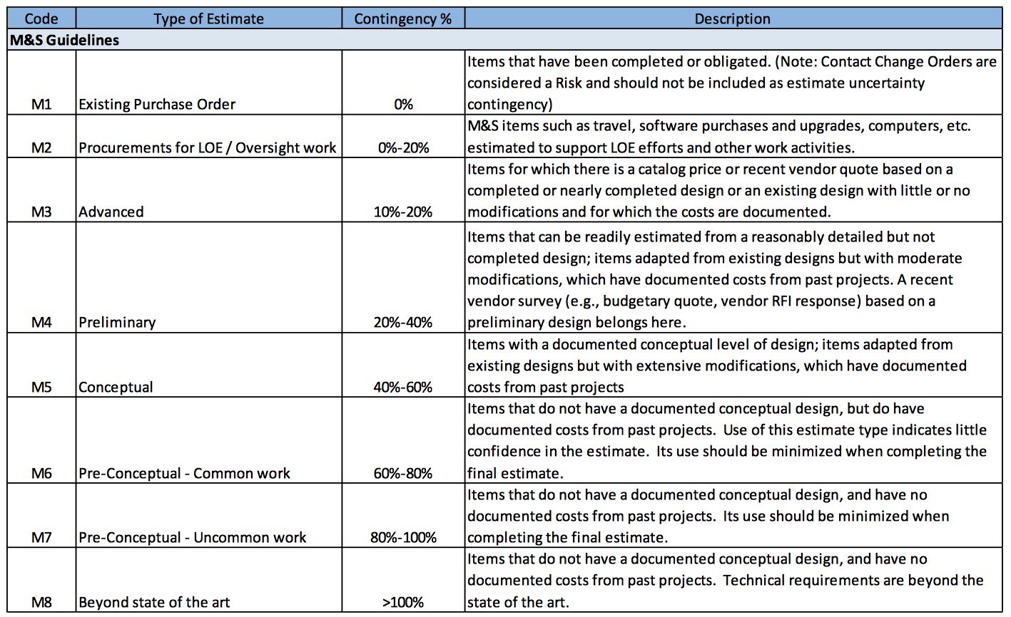
Estimate Uncertainty

Slide 7
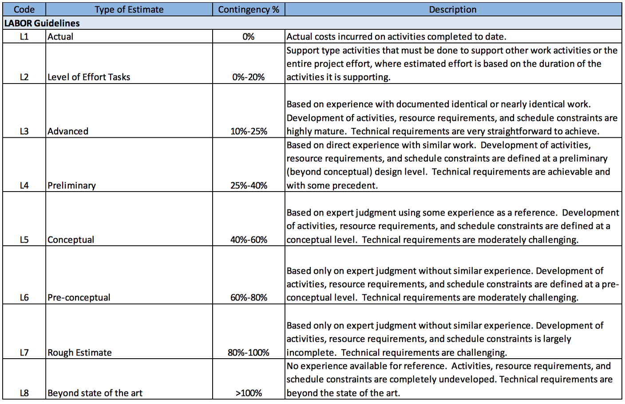
Estimate Uncertainty

Slide 8
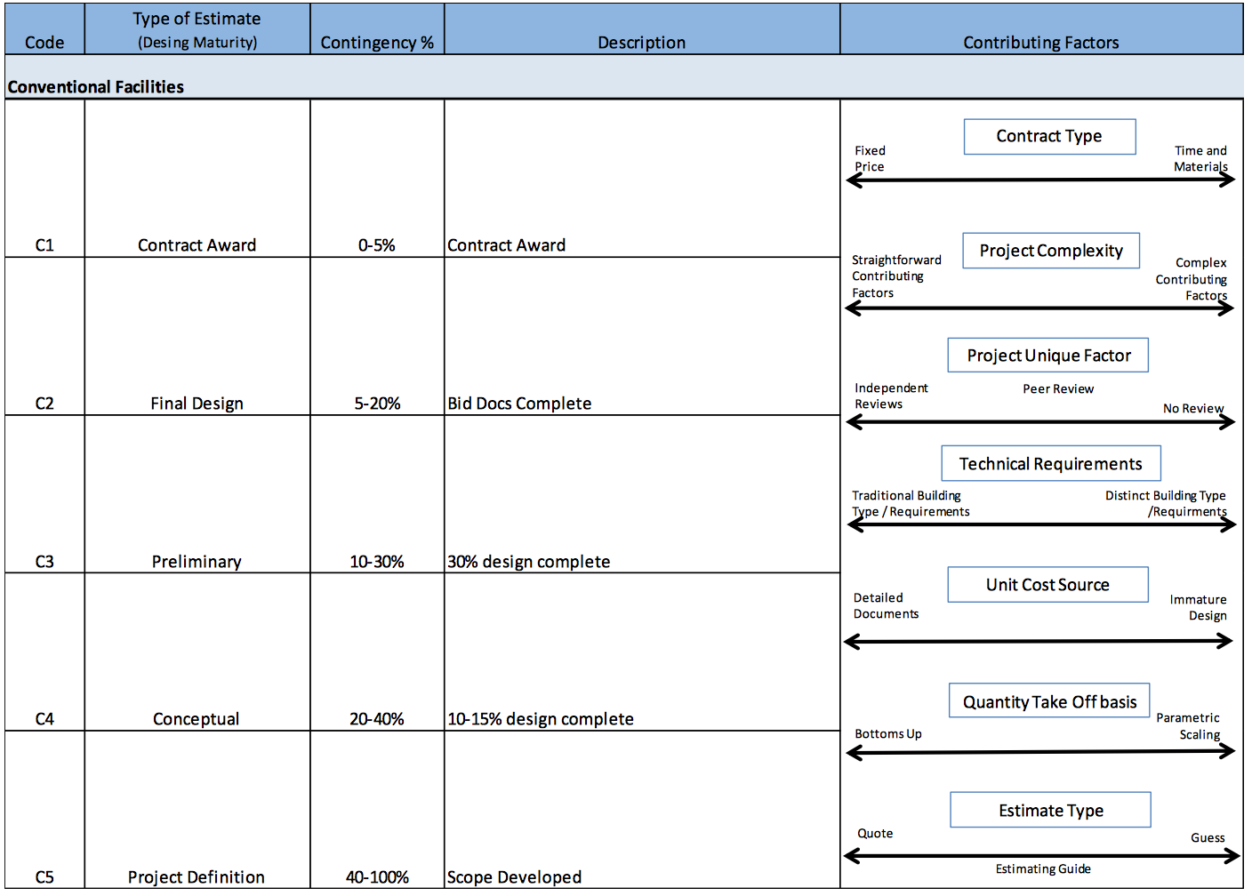
Estimate Uncertainty

Slide 9
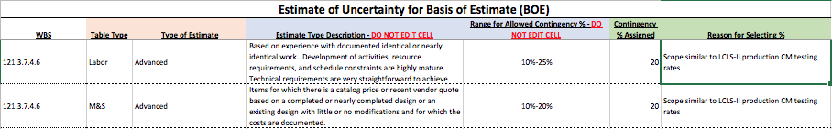
Basis of Estimate: Estimate Uncertainty
Example: Docdb #938
  121.3.7.4.6 LB650 2nd-11th CM Test
WBS #, Resource Type, Type of Estimate, Description, Range, Assigned Uncertainty, Justification
Notes:
Coordinate with Luisella

Slide 10
Estimate Uncertainty
Cost Weighted Percentages
Labor, 21.7%, M&S 23.6%, CF 20%, overall 22.8%
  Technical components only (no PM or CF) 28%

Slide 11
PIP-II Risk Cost and Schedule Impact
PIP-II Project has carried out a Qualitative analysis of the Risk and its impact on cost and schedule.
  Cost Impact = ∑Risk Cost * Probability
  Schedule Impact (Cost) = ∑Risk Schedule * Probability (Schedule delay not added linearly. Converted to cost for the FTE project has to pay for delay)

Slide 12
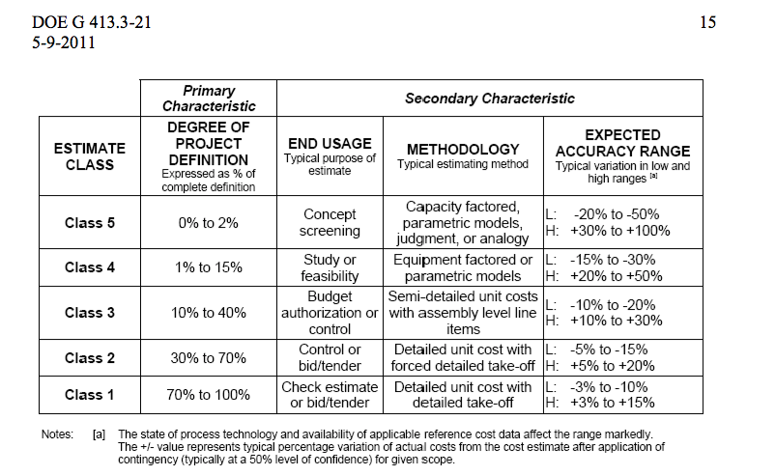
Project Definition: DOE Cost Estimating Guide

Slide 13
Three approaches to Project Definition
  Estimate Uncertainty from Basis of Estimate documents
  Technology Readiness Levels
    As defined in DOE G413.3-4A Technology Readiness Assessment Guide
    Apply to technical scope in project
  Project Definition Rating Index
    As defined in DOE G413.3-12 Project Definition Rating Index Guide for Traditional Nuclear and Non-Nuclear Construction Projects
    Apply to Conventional Facilities scope in project

Slide 14
Design Maturity : Project Definition
Technical accelerator scope:
  Technological Readiness Level
    Scale 1-9
    Defined in DOE G413.3-4A Technology Readiness Assessment Guide
  Project Engineers assessed TRLs at WBS L4

Slide 15
Technology Readiness Levels
Level | Definition | Description
TRL 1 | Basic principles observed and reported | This is the lowest level of technology readiness. Scientific research begins to be translated into applied R&D. Examples might include paper studies of a technology’s basic properties or experimental work that consists mainly of observations of the physical world. Supporting Information includes published research or other references that identify the principles that underlie the technology.
TRL 2 | Technology concept and/or application formulated | Once basic principles are observed, practical applications can be invented. Applications are speculative, and there may be no proof or detailed analysis to support the assumptions. Examples are still limited to analytic studies.
TRL 3 | Analytical and experimental critical function and/or characteristic proof of concept | Supporting information includes publications or other references that outline the application being considered and that provide analysis to support the concept. The step up from TRL 1 to TRL 2 moves the ideas from pure to applied research. Most of the work is analytical or paper studies with the emphasis on understanding the science better. Experimental work is designed to corroborate the basic scientific observations made during TRL 1 work.
TRL 4 | Component and/or system validation in laboratory environment | The basic technological components are integrated to establish that the pieces will work together. This is relatively "low fidelity" compared with the eventual system. Examples include integration of ad hoc hardware in a laboratory and testing with a range of simulants and small scale tests on actual waste2. Supporting information includes the results of the integrated experiments and estimates of how the experimental components and experimental test results differ from the expected system performance goals. TRL 4-6 represent the bridge from scientific research to engineering. TRL 4 is the first step in determining whether the individual components will work together as a system. The laboratory system will probably be a mix of on hand equipment and a few special purpose components that may require special handling, calibration, or alignment to get them to function.
TRL 5 | Laboratory scale, similar system validation in relevant environment | The basic technological components are integrated so that the system configuration is similar to (matches) the final application in almost all respects. Examples include testing a high-fidelity, laboratory scale system in a simulated environment with a range of simulants1 and actual waste2. Supporting information includes results from the laboratory scale testing, analysis of the differences between the laboratory and eventual operating system/environment, and analysis of what the experimental results mean for the eventual operating system/environment. The major difference between TRL 4 and 5 is the increase in the fidelity of the system and environment to the actual application. The system tested is almost prototypical.
Level | Definition | Description
TRL 6 | Engineering/pilot-scale, similar (prototypical) system validation in relevant environment | Engineering-scale models or prototypes are tested in a relevant environment. This represents a major step up in a technology’s demonstrated readiness. Examples include testing an engineering scale prototypical system with a range of simulants.1 Supporting information includes results from the engineering scale testing and analysis of the differences between the engineering scale, prototypical system/environment, and analysis of what the experimental results mean for the eventual operating system/environment. TRL 6 begins true engineering development of the technology as an operational system. The major difference between TRL 5 and 6 is the step up from laboratory scale to engineering scale and the determination of scaling factors that will enable design of the operating system. The prototype should be capable of performing all the functions that will be required of the operational system. The operating environment for the testing should closely represent the actual operating environment.
TRL 7 | Full-scale, similar (prototypical) system demonstrated in relevant environment | This represents a major step up from TRL 6, requiring demonstration of an actual system prototype in a relevant environment. Examples include testing full-scale prototype in the field with a range of simulants in cold commissioning1. Supporting information includes results from the full-scale testing and analysis of the differences between the test environment, and analysis of what the experimental results mean for the eventual operating system/environment. Final design is virtually complete.
TRL 8 | Actual system completed and qualified through test and demonstration. | The technology has been proven to work in its final form and under expected conditions. In almost all cases, this TRL represents the end of true system development. Examples include developmental testing and evaluation of the system with actual waste in hot commissioning. Supporting information includes operational procedures that are virtually complete. An Operational Readiness Review (ORR) has been successfully completed prior to the start of hot testing.
TRL 9 | Actual system operated over the full range of expected mission conditions. | The technology is in its final form and operated under the full range of operating mission conditions. Examples include using the actual system with the full range of wastes in hot operations.

Slide 16
Process
Project engineers (A. Rowe, J. Steimel) assessed TRL for each L4 in the WBS
Histograms of Level
  Mean : 5.88
  Cost weighted Mean: 5.24
System | WBS # | WBS Description | Technology Readiness Level
Warm Front End | 121.3.3 | Linac - Warm Front End (WFE)
 | 121.3.3.3 | Linac - WFE - Ions Source (IS) | TRL 8
 | 121.3.3.4 | Linac - WFE - Low Energy Beam Transfer (LEBT) | TRL 8
 | 121.3.3.5 | Linac - WFE - Radio Frequency Quadrupole (RFQ) | TRL 7
 | 121.3.3.6 | Linac - WFE - Medium Energy Beam Transfer (MEBT) | TRL 7

Slide 17
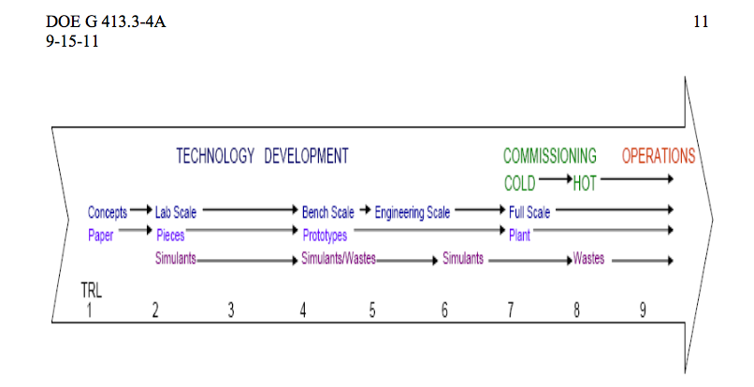
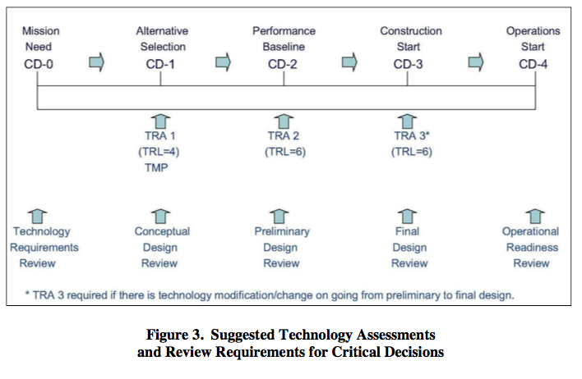
Technical Maturity : DOE G413.3-4A
TRL 5: Engineering scale prototypes (PIP-II ~ 5.5)
  CD-1: TRL 4 CD-2: TRL 6
Above the expectation at CD-1
  TRA are the Tech Readiness Assessment as part of 413
TRL 5: Engineering scale prototypes (PIP-II ~ 5.2)
  CD-1: TRL 4 CD-2: TRL 6
Above the expectation at CD-1
  TRA are the Tech Readiness Assessment as part of 413

Slide 18
Design Maturity : Project Definition
Conventional Facilities:
  Project Definition Rating Index
    Spreadsheet with levels for each Critical Decision
  DOE 413.3-12 PDRI Guide for Traditional Nuclear and Non-Nuclear Construction Projects
  Assoc PM for CF filled out spreadsheet
  Utilize the tool as ongoing process

Slide 19
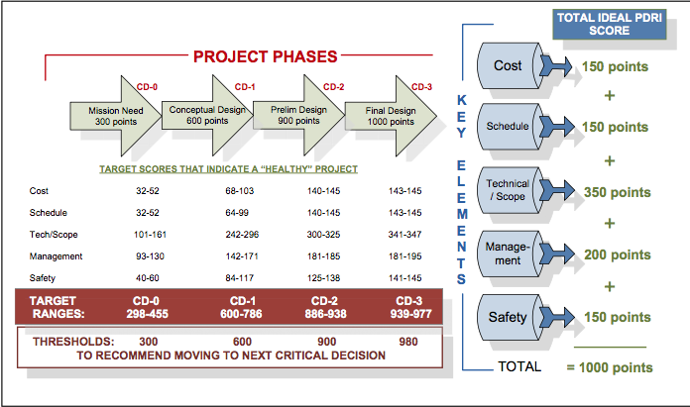
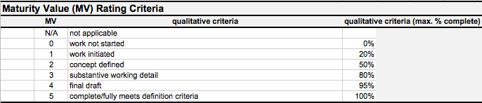
Conventional Facilities: Project Definition Rating Index
Target Ranges for each section, as well as a sum
DOE 413.3-12
73 question template
  Cost
  Schedule
  Scope
  Management
  Safety
0-5 scale for readiness

Slide 20
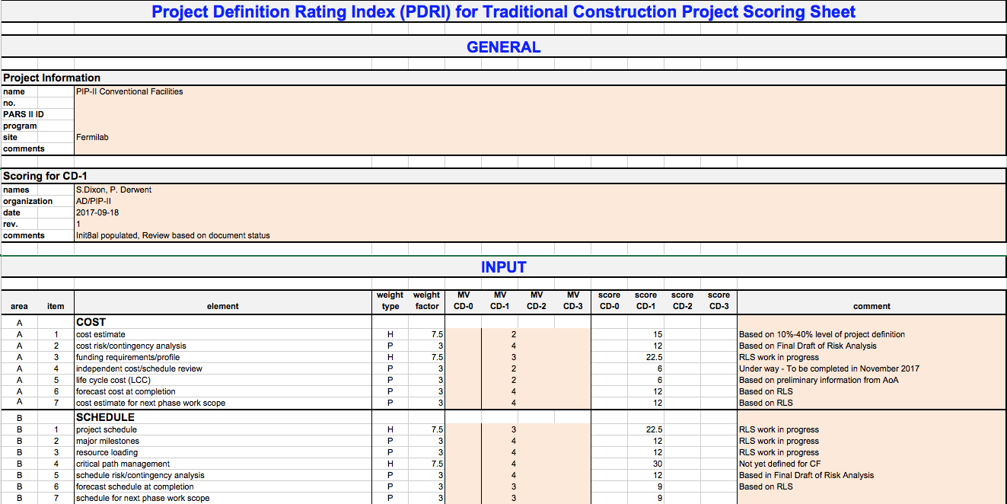
PDRI

Slide 21
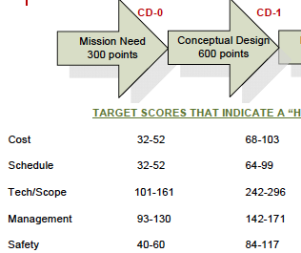
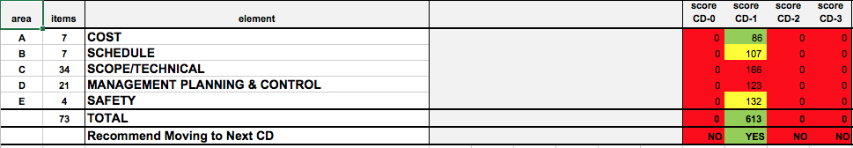
PDRI
At CD-1, 613 with readiness value > 600
  Cost, Schedule, Safety > threshold
  Technical, Management < threshold

Slide 22
Project Definition
Estimate Uncertainty on technical components is 28% upper end of preliminary-> at 40% or better
TRL -> at 40% or better
PDRI -> at 25% or better
Range of 25-40% project definition
  Class 2 – Class 3

Slide 23
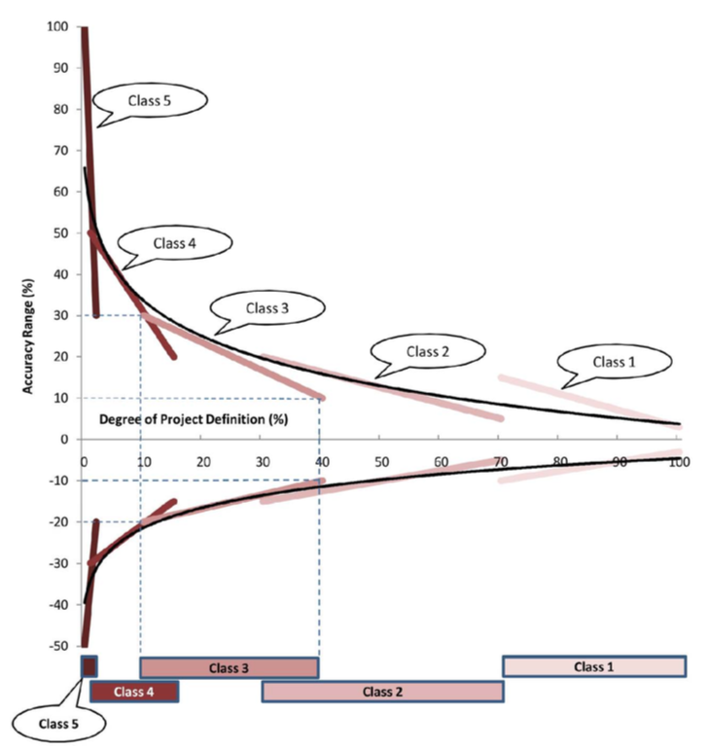
Accuracy Range vs Project Definition
25-40% project definition
  Lower range
    - (10 – 18%)
  Upper range
    + (20 – 25%)
Utilize -10%, +20% for cost range

Slide 24
Summary: Methodology
Estimate to Complete comes from the Resource Loaded Schedule
Estimate Uncertainty as part of the Basis of Estimate
Risk Uncertainty included as discussed in Risk Management presentation
Three approaches to understand Project Definition
  Estimate Uncertainty
  Technology Readiness Level
  Project Definition Rating Index

Slide 25
Summary TPC
FY16/17: $32M
Fully Loaded Estimate to Complete: $458M
Include Estimate Uncertainty : $563M
Include Risk Uncertainty : $616MM
Point Estimate (add FY16/17) : $648M
Apply Cost Range: -10% + 20% on work to complete ($616M) + FY16/17 ($32M)
Total Project Cost Range: $586M – $771M

Slide 26
Cost Range w/Scope Changes
Charge #2
Recycler and Main Injector Upgrades
  BOEs exist and have been validated
  TPC Point Estimate = $31M
  TPC/UCR = $37M
UK/STFC contribution
  Assumption is $28M in-kind in “European accounting”
    i.e. does not include salaries
  Highest priority is to deliver HB605 CM 2-4
    M&S against STFC account: $5M
    Savings to DOE (UCR metric): $18M
  Balance to-be-discussed
    Additional $23M of M&S should translate to somewhere between $45 - $65M reduction in UCR
  TPC/UCR = -$63M - -$83M
PIP-II TPC/UCR = $771M + $37 - $63-83M = $725M - $745M

Slide 27
END

Slide 28
Basis of Estimates
135 Basis of Estimate documents
  Each BOE consists of:
    Word document:
      WBS Dictionary definition
      Assumptions
      Explanation behind the estimate
    Excel document:
      Labor and M&S estimates at Level 5
      Estimate Uncertainty
  Base year 2016
  Reviewed for consistency / understanding
    Checklist for validation of the BOE
  ‘Signed’ documents in the pip2-docdb
    With validated checklist
    89 approved as of 25 September (NEED TO CROSS CHECK)
Notes:
Add BOEs start 10/1/17 . May not need this slide – coordinate with Luisella

Slide 29
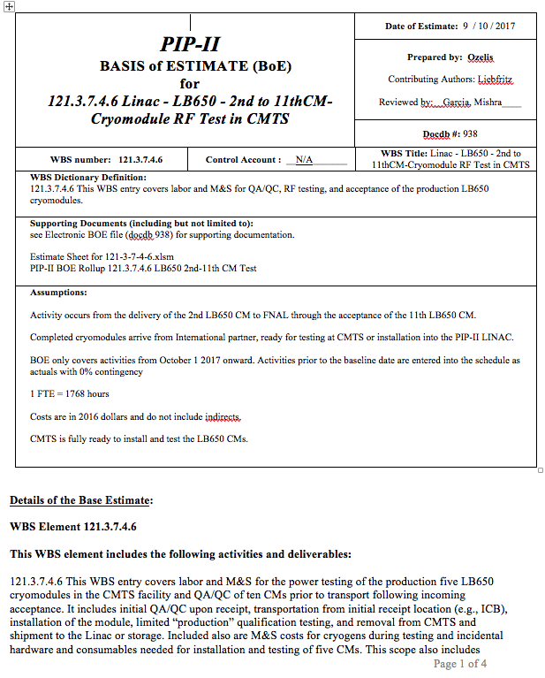
Basis of Estimate
WBS #
Title
Dictionary definition
Supporting documents
Assumptions
Docdb #
Details of the estimate

Slide 30
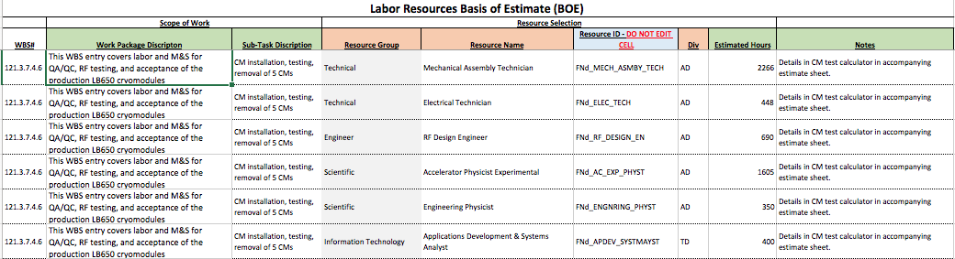
Basis of Estimate: Labor
WBS #, Description, Resource information (for P6), Hours, Notes

Slide 31
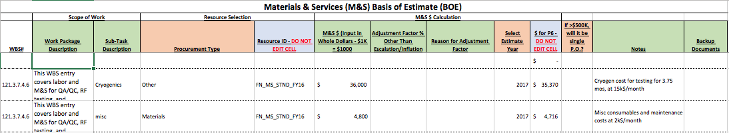
Basis of Estimate: M&S
WBS #, Description, Procurement Type(for P6), M&S input, estimate year, Notes

Slide 32
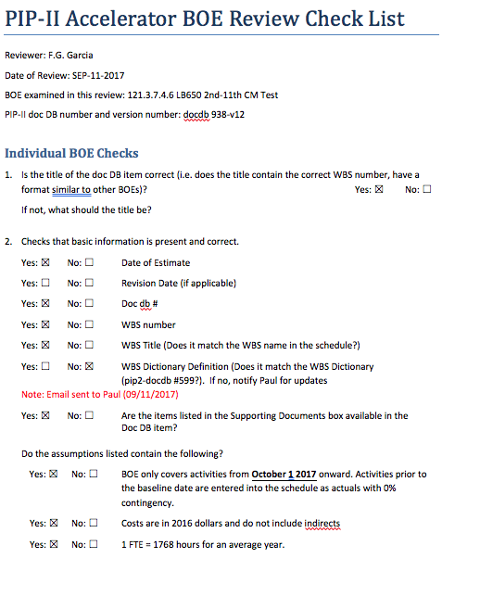
Basis of Estimate Checklist
Reviewer
Date, docdb version
Questions to answer
  A 2nd page also

