Slide 1
Risk Management
Project Management
Shekhar Mishra
PIP-II Director’s Review
10-12 October, 2017

Slide 2
Outline
Overview
Risk Management Plan
Risk
Identification (Register)
Workshop
Analysis and Validation
Approval
Risk Impact Analysis
Risk Response
Integral part of PIP-II R&D
Risk Monitoring and Control
Summary
Charge #2
Charge #3

Slide 3
About Me:
PIP-II
Deputy Project Manager
SRF Linac R&D
Risk Manager
Chair, PIP-II Risk Management Board
Relevant Experience
Indian Institutions and Fermilab Collaboration
International Linear Collider, Deputy Director/Fermilab
Main Injector and Recycler Ring Department Head
Main Injector and Recycler Ring Commissioning Team Leader
Experimental High Energy Physics
28 Years at Fermilab

Slide 4
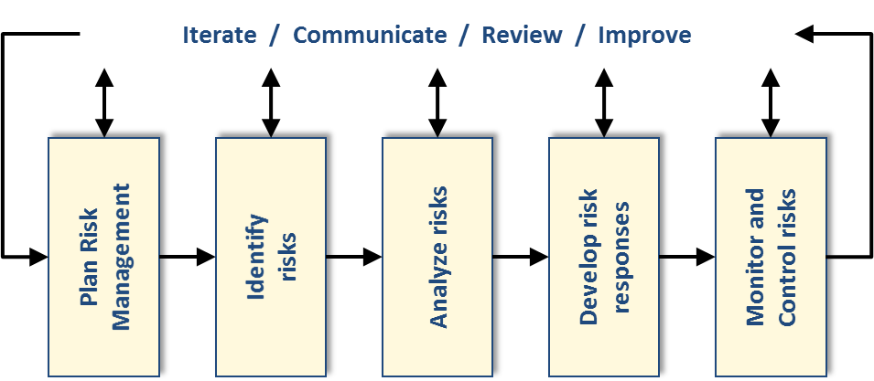
Overview: Risk Management
Charge #3
Risk Management is an iterative process for managing and minimizing the impact
PIP-II Project has a established a Risk Management Plan following the Fermilab and DOE guidelines.
PIP-II Risks have been categorized as:
Enterprise Risk (Fermilab and DOE)
Project Risk (Project Office)
Superconducting Linac
Conventional Facility
Rings (Booster/Main Injector/Recycler)

Slide 5
Risk Management Plan
Charge #3
Link to this document
Link to this document
PIP-II Risk Management Plan follows procedures established by the Fermilab.

Slide 6
Risk Ranking
Charge #3
Risk are analyzed on
Technical impact
Cost impact
Schedule impact
Probability
Risk are to be Ranked with Cost, Schedule and than Probability
PIP-II Risk Matrix |  | Risk Impact
 | Technical | Low | Medium | High
 |  | Slightly Sub-standard | Moderately Sub-standard | Significantly Sub-standard (or Jeopardies KPP)
 | Cost | <100 K$ | (0.1 - 5)M$ | > 5M$
 | Schedule | < 4 Months | (4-9) months | > 9 Months
Recast the above number to the Probability Ranking (Highest of Cost or Schedule)
 |  | Risk Ranking
Very High | 64-100% | Medium | High | High
High | 39-64% | Medium | High | High
Medium | 21-39% | Low | Medium | High
Low | 9-21% | Low | Medium | Medium
Very Low | 0-9% | Low | Low | Medium

Slide 7
Roles and Responsibilities
Charge #3
The PIP-II Project Manager (PM) has the ultimate responsible for all aspects of the project risk management.
Deputy Project Manager, who also serves as Risk Manager and chair the Risk Management Board (RMB).
The RMB membership will include
PM, DPMs, L2 Managers, Project Engineers, the Accelerator and Technical Division representatives, Fermilab Project Office Representative and Federal Project Director.
The Level 3 Managers (L3M) and Control Account Manager (CAM) (In PIP-II project L3M and CAM are the same person) are the Risk Owners.
L3M in consultancy with the Subject Matter Expert is responsible for developing/iterating the Risk Register, analyze the risk, develop and manage the risk mitigation plan.

Slide 8
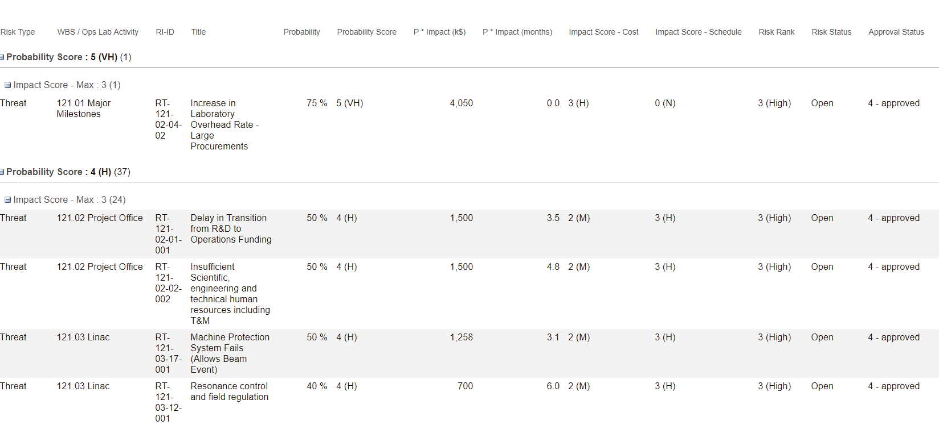
Risk Register
Charge #2
Fermilab Office of Project Support Services has established a Fermilab-Standard Risk Database
PIP-II PM/L2/L3/L4 Identified 150+ Risks and there impact.
Entered in the Risk Registered.

Slide 9
PIP-II Risk Workshop
Charge #2
PIP-II held a Risk Workshop (6-7 April & 28 April 2017)
Bring together the projects’ leadership as well as external experts to focus on risks.
12 experts from LCLS-II, LHC Upgrade, LBNF/DUNE, Fermilab Project Management Office
Dialog and exchange ideas, not just present and review.
Discussed only a subset of Risks to really review the input
Do this in an open, transparent, and inclusive manner.
Considerable technical discussion
Ensure that all known risk threats and opportunities are appropriately characterized.
Classify threats in order to identify those that need to be actively managed in the near term.

Slide 10
PIP-II Risk Workshop
Charge #2
The Risk Owners Interactively worked in the Risk Registry
Discussed and agreed on
Technical Impact
Probability
Cost Impact
Schedule Impact
Cause or Trigger
Initial thoughts on Risk Mitigation Plan
Input from Subject Matter experts and other projects helped finalize the entries in the risk register

Slide 11
Risk Analysis and Approval
Charge #2
The PIP-II Project Management Team went over all the risk.
Consolidated Risks (International Deliverables, Human Resources and ES&H)
Approve or Disapproved
Suggest Modifications before approval
Risk Manager met with L2/L3 and approved the Risk
Risk Registry Ready for qualitative analysis
Rank the risks
Cost and schedule impact

Slide 12
PIP-II Risk Matrix
Charge #2
PIP-II Risk Matrix |  | Risk Impact
 | Technical | Low | Medium | High
 |  | Slightly Sub-standard | Moderately Sub-standard | Significantly Sub-standard (or Jeopardies KPP)
 | Cost | <100 K$ | (0.1 - 5)M$ | > 5M$
 |  | 39 | 88 | 4
 | Schedule | < 4 Months | (4-9) months | > 9 Months
 |  | 50 | 29 | 52
Recast the above number to the Probability Ranking (Highest of Cost or Schedule)
 |  | Risk Ranking
Very High | 64-100% | Medium | High | High
 |  | 0 | 0 | 1
High | 39-64% | Medium | High | High
 |  | 3 | 11(1) | 23
Medium | 21-39% | Low | Medium | High
 |  | 3 | 8 | 10
Low | 9-21% | Low | Medium | Medium
 |  | 13 | 22(1) | 18
Very Low | 0-9% | Low | Low | Medium
 |  | 4 | 12(1) | 3
Very High Probability and Cost Impact Risk: Increase in Laboratory Overhead Rate - Large Procurements
Low Probability, high cost and schedule impact: In-kind contributions do not meet codes, standards and/or acceptance criteria

Slide 13
PIP-II Risk Cost and Schedule Impact
Charge #2
PIP-II Project has carried out a Qualitative analysis of the Risk and its impact on cost and schedule.
Cost Impact = ∑Risk Cost * Probability
Schedule Impact (Cost) = ∑Risk Schedule * Probability (Schedule delay not added linearly. Converted to cost for the FTE project has to pay for delay)

Slide 14
Top 15 Risks
Charge #3
Impact
M&S Cost = $13M (FY16) (>1/2 of all the Risk)
Schedule Impact = 30% of total schedule delay
8/15 Risks are integral part of the PIP-II R&D program
5/15 are non technical risks, Project Office is working with laboratory management to address other risks.

Slide 15
Risk Monitoring and Control
Charge #3
Risk Management Board is evaluating Risk
Risk Manager is meeting with Project Engineers and L3M
Following High probability Risks to retire this FY
Resonance control and field regulation
Insufficient Cryogenic system vendor manufacturing capacity and priority
Unable to maintain proper vacuum between MEBT absorber and SRF
MEBT scrapers unable to absorb amount of beam loss SRF Pre-Production Input Coupler Failure
162.5 MHz, 7 kW RF amplifier procurement delayed
We Continue to evaluate, retire and add risks.
Not RF testing all the Cryomodule (Added this week)

Slide 16
Next Steps
Review all the Risks with L3M
Present and approve all the Risks with Risk Management Board
Prepare Risk Register for the Primavera Risk Analysis
Perform the Primavera Risk Analysis

Slide 17
Summary
PIP-II has established a Risk Management plan following the DOE and Fermilab approved procedure.
Risk Management Plan
Risks have been evaluated, approved, being monitored based on Technical, cost and schedule impact
Risk Register
PIP-II R&D program is working to mitigated most of the technical Risks.

