Slide 1
121.3.12 Warm Units for LB650 and HB650
Breakout Session: Linac Accelerator Support Systems, Installation and Commissioning
Alex Chen
PIP-II Director’s Review
10-12 October 2017

Slide 2
Outline
Requirements
Conceptual Design, Maturity
Scope/Deliverables
Interfaces
Technical Progress to Date
ESH&Q
Risk
Cost
Schedule
Summary

Slide 3
About Me:
Roles on PIP2
  L3 Manager for Vacuum Systems
  L3 Manager for 650 Warm Units
  Vacuum lead for PIP2IT
Other Fermilab Experience:
  20 Years of mechanical design and vacuum support on Booster, Tevatron etc.
  2 years L4 managers for both Vacuum and Magnet Installation of LBNF Primary Beamline
  2 years Mechanical Lead for HINS
  AD/MSD vacuum group leader

Slide 4
WBS L3 System Requirements
Charge #1
Warm Unit is the warm insertion in between CMs; it is composed of magnets for focusing and correction, BPM or other beam instrumentation, and beamtube with vacuum pump and gauges.
Magnets
  a quadrupole doublet, and X, Y steering correctors
  Minimum Beam Aperture: 44mm
  individually fiducilized
  magnetic axes of both quadrupoles in a doublet are aligned within ±0.1 mm and ±0.5 mrad
  dipole corrector is aligned within ±0.5 mm and ±3 mrad
BPM
  a two-coordinate 4-button BPM
  Limited space: 95mm Dia. 70mm Long

Slide 5
WBS L3 System Requirements
Charge #1
Vacuum
  2” beam tube
  Low particulate Vacuum with <1x10⁻⁹ Torr residual gas
  Maximize pumping port sizes within the limit of space
  Provide adequate conductance for pumping CM
  Cold Cathode gauge to avoid hot filament
  Bakeble to 150C
FRS: ED0004853

Slide 6
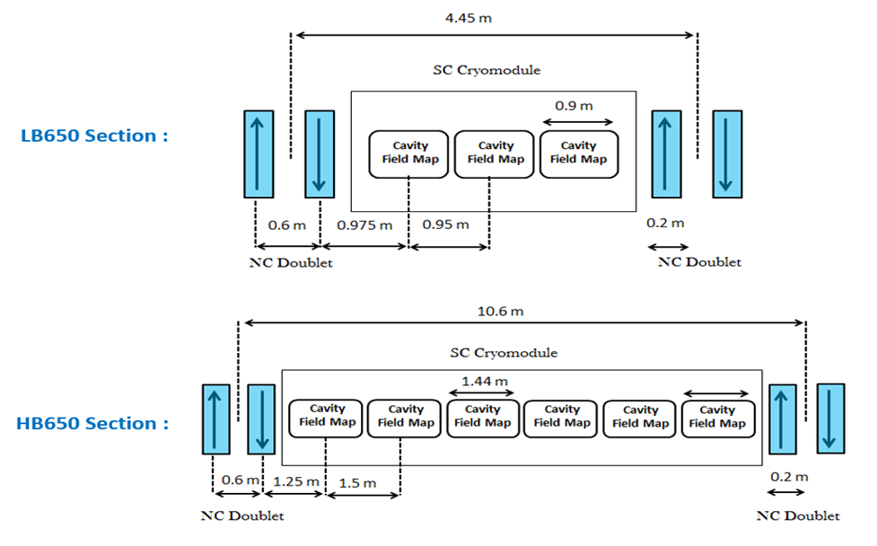
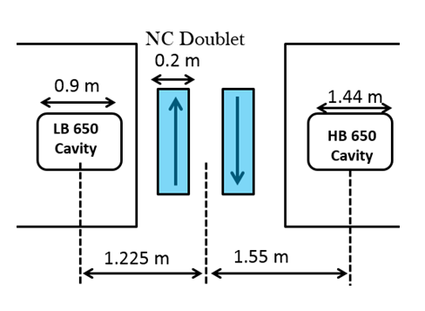
Conceptual Design
Charge #1
Interface between LB650 and HB650 sections:

Slide 7
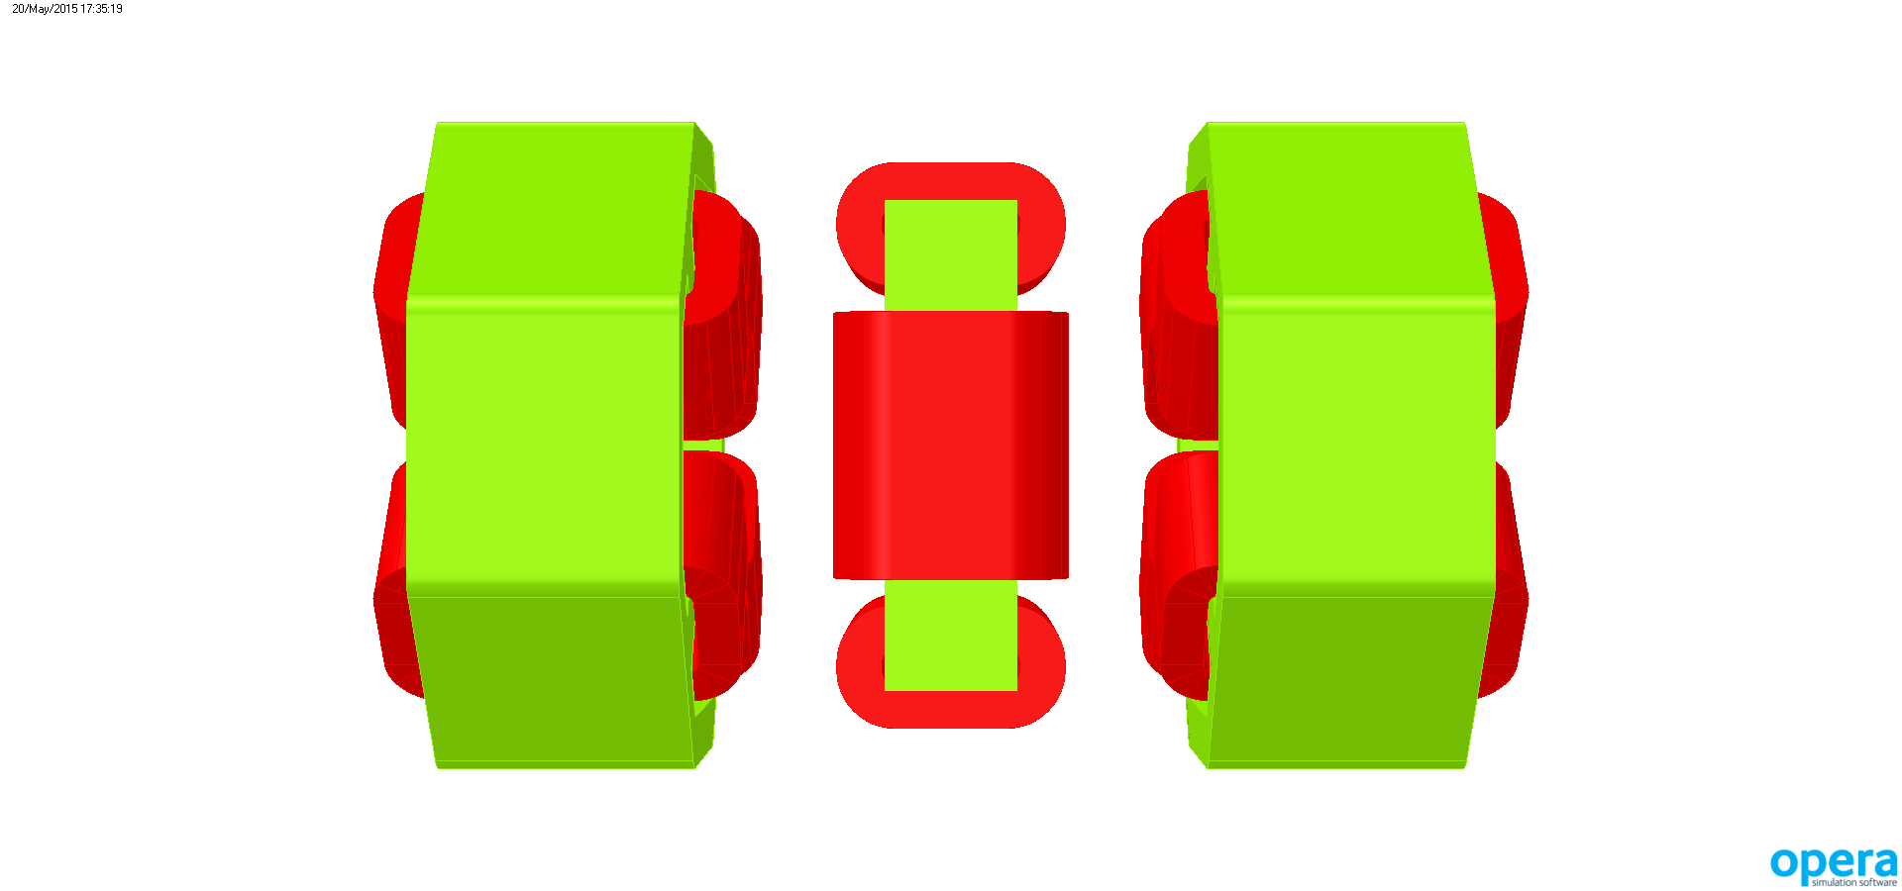
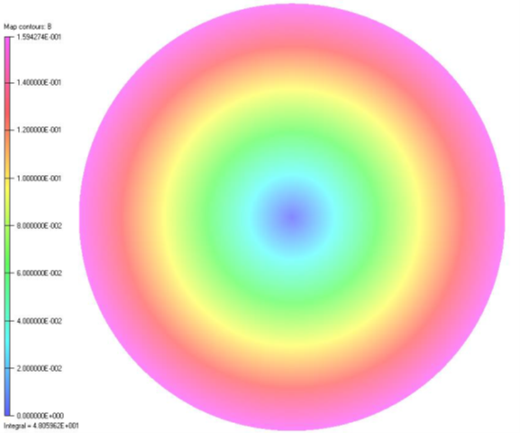
Conceptual Design
Charge #1
3-D Model and Magnetic field
Distribution in the yoke
Magnet conceptual Design by Vikas Teotia, BARC
600
400
500
400
Magnetic field profile in the beam aperture
35
180
350
Quadrupole
Dipole Corrector
Quadrupole

Slide 8
Conceptual Design
Charge #1
Centroid trajectory corrections by Dipole Correctors
Arun Saini

Slide 9
Conceptual Design
Charge #1
Magnet doublet conceptual design
  The upper components of the quadrupoles and dipole corrector are dismountable without breaking vacuum for vacuum chamber assembly, leak check, BPM repairs, possible 120ºC bake, and for assembling / disassembling of neighboring components Drawings/3D models (layouts, exploded views, sections) annotated with WBS numbers
  The mounting system provides a rigid alignment of the magnets and allows an adjustment of their transverse positions with a resolution of 0.05 mm and the total travel range of ±2 mm.
  Engineering analyses were done
    TRS: ED0003401
    FRS: ED0003403
    RA: ED0005885

Slide 10
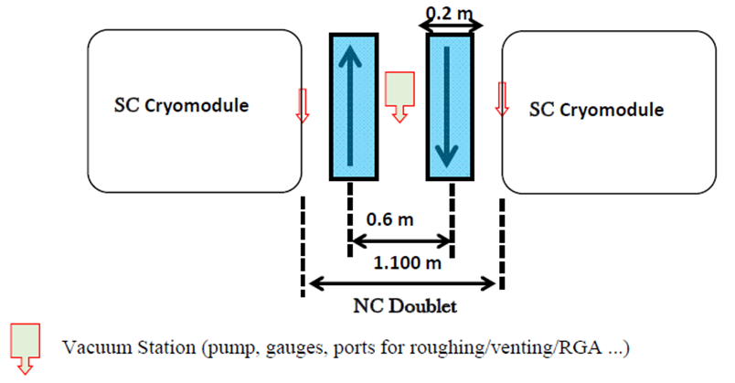
Conceptual Design
Charge #1
Vacuum
  Conceptual Design established
  Key components estimated
BPM design is the scope of Beam Instrumentation

Slide 11
Scope and Deliverables
Charge #1
11 warm units for LB650, and 9 for HB650
Assumed India Deliverables
    Magnet Doublets with magnetic mapping wrt fiducials
    The details concerning deliverables and schedule will be finalized by CD-2.”
Entire warm unit will be assembled on a single supporting girder.
The individual warm unit will be vacuum certified before tunnel installation

Slide 12
Interfaces
Charge #1
  650 Warm Unit will interface with:
    Beam Instrumentation: BPM imbedded in between magnet, and integrated with beam tube
    CM: end flanges of beam tube connect to gate valves at the end of CMs
    Vacuum design is integrated into VACUUM SYSTEMS
    Installation: tunnel installation and commissioning
    Accelerator lattice: Insertion length, beam aperture, and magnetic parameters
    Magnet Power Supply: electrical connection
    infrastructure, use of cleaning facility, cleanroom, slow pumping cart
    Control: PLC and ACNET
  Planned interface control documents for all above

Slide 13
Interface Matrix (Warm Unit)
Charge #1
 | Warm Front End WBS 121.3.3 | HWR WBS 121.3.4 | SSR1 WBS 121.3.5 | SSR2 WBS 121.3.6 | LB650 WBS 121.3.7 | HB650 WBS 121.3.8 | RF Power WBS 121.3.9 | RF Integration WBS 121.3.10 | Cryo Systems WBS 121.3.11 | Warm Units WBS 121.3.12
Warm Front End WBS 121.3.3
HWR WBS 121.3.4 | ED0002529
SSR1 WBS 121.3.5
SSR2 WBS 121.3.6
LB650 WBS 121.3.7
HB650 WBS 121.3.8
RF Power WBS 121.3.9 | Y | ED0002529 | ED0004129
RF Integration WBS 121.3.10 |  |  | ED0004129 |  |  |  | ED0004290
 | Y |  |  |  |  |  | ED0005489
Cryo Systems WBS 121.3.11 |  | ED0002529 | ED0004129 | Y | Y | Y
Warm Units WBS 121.3.12 |  |  |  |  | ED0003441 | ED0003441
Magnet PS WBS 121.3.13 |  | ED0002529 | ED0004129 | Y |  |  |  |  |  | ED0003441
Beam Transfer Line WBS 121.3.14 |  |  |  |  |  |  |  |  |  | ED0003441
Beam Absorber WBS 121.3.15
Beam Instrum. WBS 121.3.16 | Y | ED0002529 | ED0004129 |  |  |  | Y | Y |  | ED0003441
Control Sys. WBS 121.3.17 |  | ED0002529 | ED0004129 |  |  |  | ED0004290 | Y
 | Y | Y | Y | Y | Y | Y | ED0005489 | Y | Y | Y
Vacuum WBS 121.3.18 | Y | ED0002529 | ED0004129 | Y | Y | Y |  |  | Y | Y
General Supt. Serv. WBS 121.3.19
Safety Systems WBS 121.3.20 | Y |  |  |  |  |  |  |  | Y
Test Infrastructure WBS 121.3.21 |  | ED0002529 | ED0004129 |  | Y | Y | Y | Y
Instal., Integ., Com. WBS 121.3.22 |  | ED0002529 | ED0004129 |  |  |  |  |  | Y | ED0003441
 |  | F10051442 | F10051442 | F10051442 | F10051442 | F10051442
Booster WBS 121.4.1
RR/MI WBS 121.4.2
Conv. Facilities WBS 121.5 |  | ED0002529 | ED0004129
 | Y | F10051442 | F10051442 | F10051442 | F10051442 | F10051442 |  |  | Y

Slide 14
Progress to date
Charge #1
Magnets
  TRS, FRS and RA completed
  Design beyond the conceptual level
  Engineering analyses have covered magnetic field, thermal,
Vacuum
  Concept established
Integration:
  Concept established
FRS established (ED0004583)
Cost was estimated
Interface Documentation to be created

Slide 15
Design Review Plan
Charge #3
  Prelimary Design review
  Final Design Review
  Following Div/Dept review procedures
  Procurement Readiness Reviews where appropriate

Slide 16
ESH&Q
Charge #4
  Following project ISM and QA plans (docdb #141 and 142)
  Hazard Analysis for tasks
  QA/QC activity such as:
    Flowdown to vendors/collaborators
    Specific Test procedures or protocols in development

Slide 17
BOE Summary
Charge #2
WBS Number | Title | Docdb #
121.3.12.2 | Linac Warm Unit PM and Coordination | 902
121.3.12.3 | Linac Warm Unit Design | 905
121.3.12.4 | Linac LB650 Warm Units | 911
121.3.12.5 | Linac HB650 Warm Units | 914

Slide 18
Cost Summary
Charge #2
Total Cost $2.2M
Estimate uncertainty assigned according project guidance

Slide 19
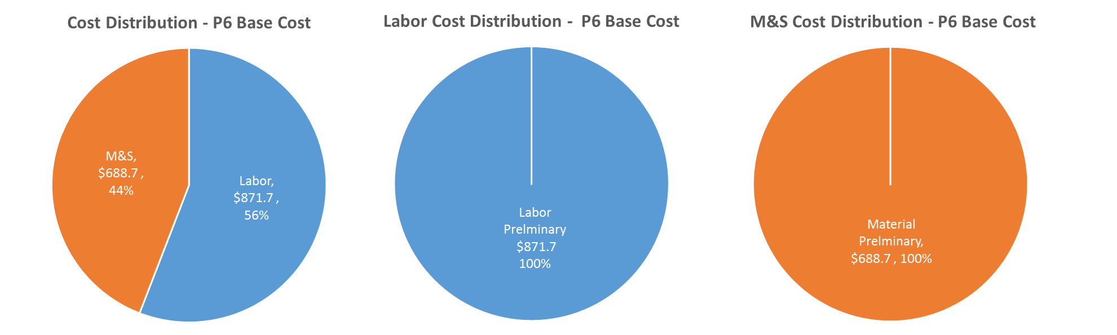
Cost Drivers and Estimate Maturity
Charge #2
P6 Base Costs = BOE + Overheads + Escalation
M&S cost relatively low due to in-kind contribution

Slide 20
Cost Profile – P6 Base Cost Only
Charge #2
P6 Base Costs = BOE + Overheads + Escalation
MS cost peaks before Labor
Significant Labor effort for cleanroom assembly

Slide 21
Labor Profile – P6 Hours/FTE
Charge #2
Engineering effort is heavy during design phase
Tech effort is heavy during construction

Slide 22
Schedule – LB650 and HB650 Warm Units
Charge #2

Slide 23
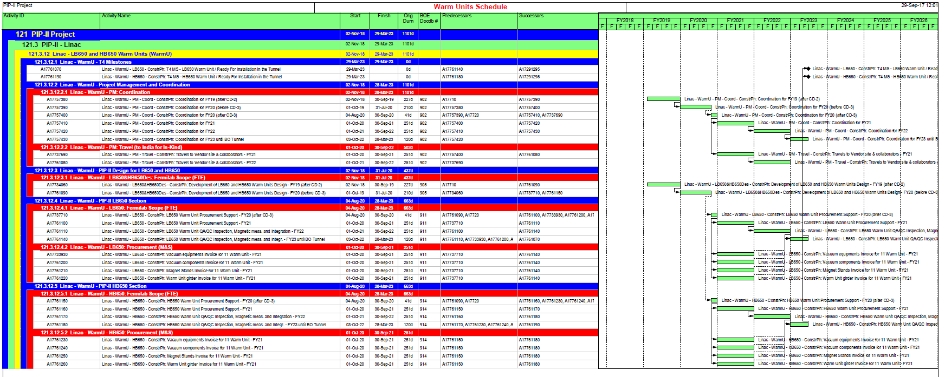
Schedule
Charge #2

Slide 24
Summary
  Requirements for Warm Units are defined
  Conceptual design completed and can meets the requirements
  Cost, schedule, and risks are understood
  Sincerely look forward to your feedback
  Thank you

Slide 25
END

