Slide 1
121.3.18 Vacuum Systems
Breakout Session: Linac Accelerator Support Systems, Installation and Commissioning
Alex Chen
PIP-II Director’s Review
10-12 October 2017

Slide 2
Outline
Requirements
Conceptual Design, Maturity
Scope/Deliverables
Interfaces
Technical Progress to Date
ESH&Q
Risk
Cost
Schedule
Summary

Slide 3
About Me:
Roles on PIP2
  L3 Manager for Vacuum Systems
  L3 Manager for 650 Warm Units
  Vacuum lead for PIP2IT
Other Fermilab Experience:
  20 Years of mechanical design and vacuum support on Booster, Tevatron etc.
  2 years L4 managers for both Vacuum and Magnet Installation of LBNF Primary Beamline
  2 years Mechanical Lead for HINS
  AD/MSD vacuum group leader

Slide 4
Vacuum System Requirements
Charge #1
FRS: ED0004444
UHV and Low Particulate Practice for SC Linac;
UHV and Low Particulate Practice for the transition regions located upstream and downstream of the SC Linac;
High Vacuum for the regions from Ion source to the MEBT absorber and the beam transfer line to Booster, Beam Absorb Line
Match vacuum level of BTL to Booster
All components that shares vacuum environment shall be vacuum certified accordingly before being installed in tunnel.

Slide 5
(Low particulate Requirement)
Charge #1
Low particulate vacuum handling and assembly practices should be employed for the specified regions. Special procedures include
  all preassembly/assembly work done in Class 10 or 100 cleanrooms
  open beamline work always to be done in a portable cleanroom
  stricter gowning requirements
  blow down all parts/hardware as being assembled according to procedure
Pumping/venting ports away from CMs to reduce particle migration
Fast Closing valve to prevent or reduce the damage from vacuum failures in adjacent warm section

Slide 6
(Requirement)
Charge #1
  Vacuum System indirectly support KPPs
  FRS: ED0004444

Slide 7
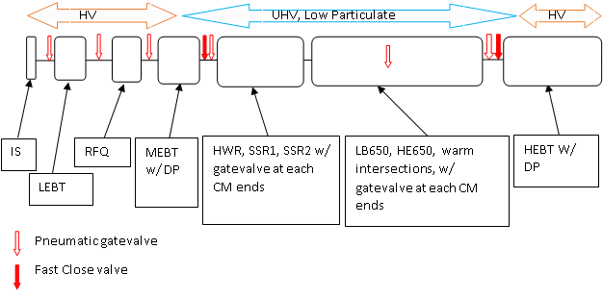
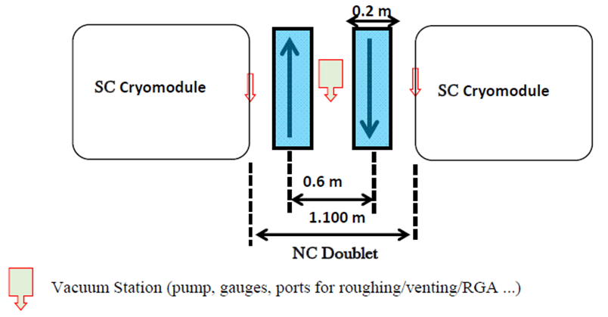
Conceptual Design
Charge #1
BTL and
BAL

Slide 8
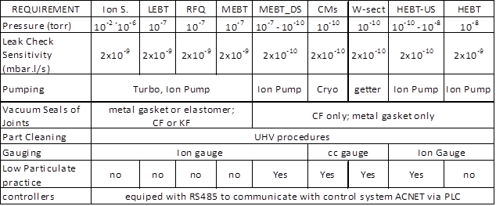
Conceptual Design
Charge #1
BTL-US
BTL

Slide 9
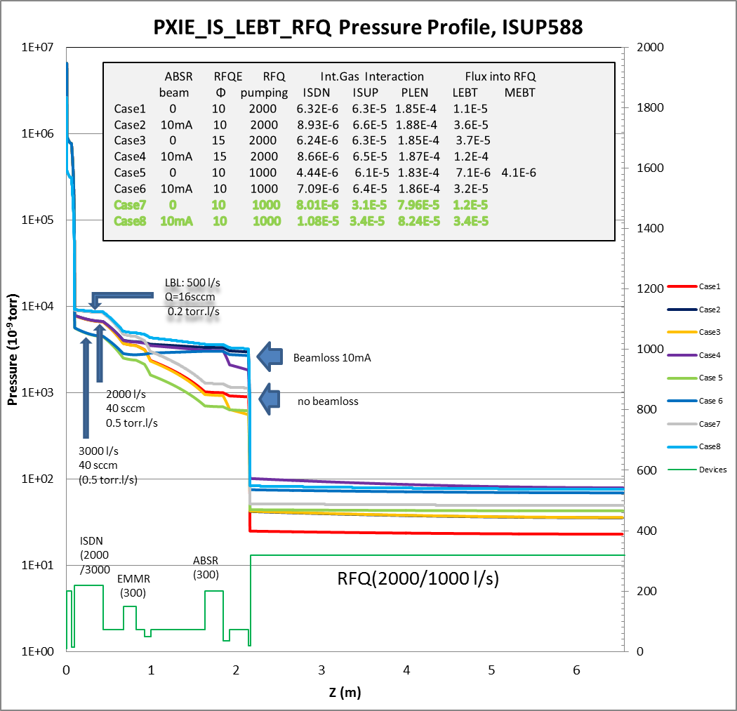
PIP2IT Vacuum(Pressure profile of Ion Source-RFQ)
Charge #1

Slide 10
PIP2IT Vacuum(Pressure profile of MEBT)
Charge #1

Slide 11
PIP2IT Vacuum(Pressure profile of HEBT-DUMP)
Charge #1

Slide 12
Scope and Deliverables
Charge #1
Beam Vacuum:
  Achieve Vacuum levels as required
  Reliable equipment such Pumps, Gauges, Valves etc
  Meet the cleanness requirement in SC region and its vicinity
  Capable of vacuum preservation in power outage or equipment failure
  Capable with MPS
Insulation vacuum
  Reliable pumping station for CM operation

Slide 13
Interfaces
Charge #1
Interfaces are identified as following
    Lattice
    Beam instrumentation
    CM, and other key devices shared beam vacuum
    Control
    General Support Service
    Installation
    Booster
    MPS
    Magnets

Slide 14
Interface Matrix (Vacuum)
Charge #1
 | Warm Front End WBS 121.3.3 | HWR WBS 121.3.4 | SSR1 WBS 121.3.5 | SSR2 WBS 121.3.6 | LB650 WBS 121.3.7 | HB650 WBS 121.3.8 | RF Power WBS 121.3.9 | RF Integration WBS 121.3.10 | Cryo Systems WBS 121.3.11 | Warm Units WBS 121.3.12 | Magnet PS WBS 121.3.13 | Beam Trans. Line WBS 121.3.14 | Beam Absorber WBS 121.3.15 | Beam Instrum. WBS 121.3.16 | Controls WBS 121.3.17 | Vacuum WBS 121.3.18
Warm Front End WBS 121.3.3
HWR WBS 121.3.4 | ED0002529
SSR1 WBS 121.3.5
SSR2 WBS 121.3.6
LB650 WBS 121.3.7
HB650 WBS 121.3.8
RF Power WBS 121.3.9 | Y | ED0002529 | ED0004129
RF Integration WBS 121.3.10 |  |  | ED0004129 |  |  |  | ED0004290
 | Y |  |  |  |  |  | ED0005489
Cryo Systems WBS 121.3.11 |  | ED0002529 | ED0004129 | Y | Y | Y
Warm Units WBS 121.3.12 |  |  |  |  | ED0003441 | ED0003441
Magnet PS WBS 121.3.13 |  | ED0002529 | ED0004129 | Y |  |  |  |  |  | ED0003441
Beam Transfer Line WBS 121.3.14 |  |  |  |  |  |  |  |  |  | ED0003441
Beam Absorber WBS 121.3.15
Beam Instrum. WBS 121.3.16 | Y | ED0002529 | ED0004129 |  |  |  | Y | Y |  | ED0003441
Control Sys. WBS 121.3.17 |  | ED0002529 | ED0004129 |  |  |  | ED0004290 | Y |  |  |  |  |  | Y
 | Y | Y | Y | Y | Y | Y | ED0005489 | Y | Y | Y | Y | Y | Y | Y
Vacuum WBS 121.3.18 | Y | ED0002529 | ED0004129 | Y | Y | Y |  |  | Y | Y |  | Y | Y | Y | Y
General Supt. Serv. WBS 121.3.19
Safety Systems WBS 121.3.20 | Y |  |  |  |  |  |  |  | Y |  |  |  |  |  | Y
Test Infrastructure WBS 121.3.21 |  | ED0002529 | ED0004129 |  | Y | Y | Y | Y |  |  |  |  |  |  | Y
Instal., Integ., Com. WBS 121.3.22 |  | ED0002529 | ED0004129 |  |  |  |  |  | Y | ED0003441
 |  | F10051442 | F10051442 | F10051442 | F10051442 | F10051442 |  |  |  |  |  |  |  |  | Y | Y
Booster WBS 121.4.1 |  |  |  |  |  |  |  |  |  |  |  |  |  |  | Y | Y
RR/MI WBS 121.4.2 |  |  |  |  |  |  |  |  |  |  |  |  |  |  | Y
Conv. Facilities WBS 121.5 |  | ED0002529 | ED0004129
 | Y | F10051442 | F10051442 | F10051442 | F10051442 | F10051442 |  |  | Y

Slide 15
Progress to date
Charge #1
PIP2IT
  Vacuum system is working , along with commissioning of Ion source, LEBT, RFQ, MEBT
  DPI designed, in process of Fabrication,
  In preparation of optimizing DIPI -Fast Closing Valve-Cold Trap configure
  Cold Traps next to HWR and ending CM of HB650

Slide 16
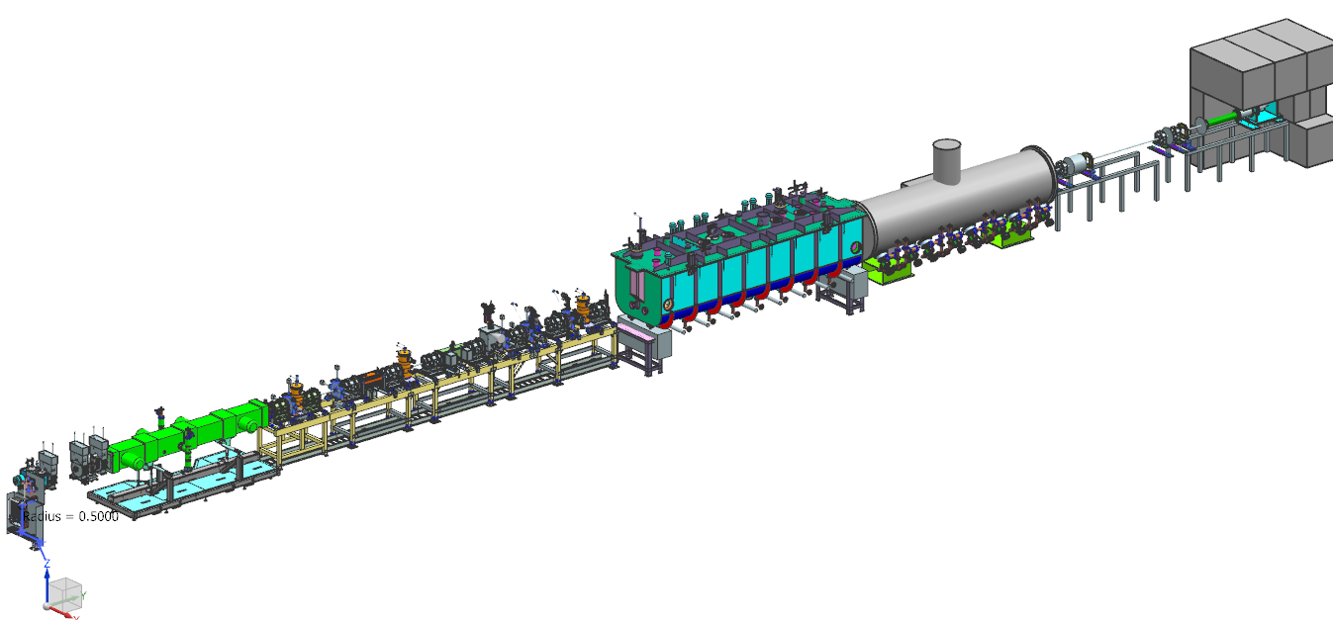
Progress to date (PIP2IT Vacuum)
Charge #1
CM: HWR(6m), SSR1(6m)
MEBT(10m):10⁻⁷-10⁻¹⁰
Torr, Cavities, Kickers, Absorber, DPI, etc.
Ion Source: H2 30sccm
Low Particulate Region
HEBT(6m): DPI, Beam Dump
RFQ(4m, 10⁻⁷ torr)

Slide 17
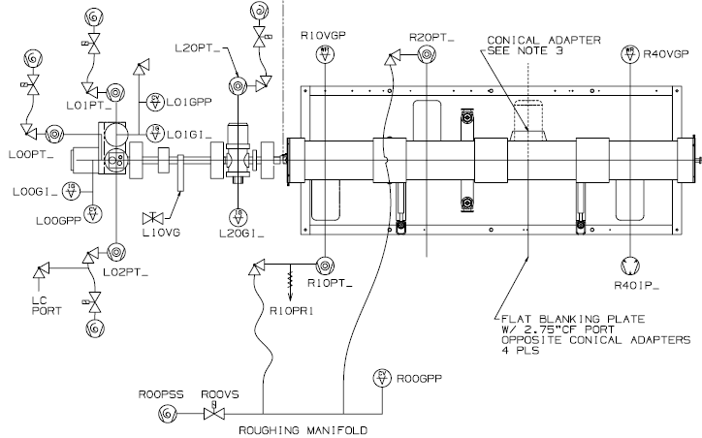
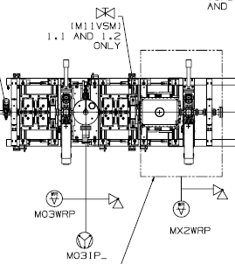
Progress to date (PIP2IT Schematic of Turbo Stations)
Charge #1
Ion Source
LEBT
RFQ
MEBT1
2
4
1
3
Typical Conf.
PLC
Reset box
6
5

Slide 18
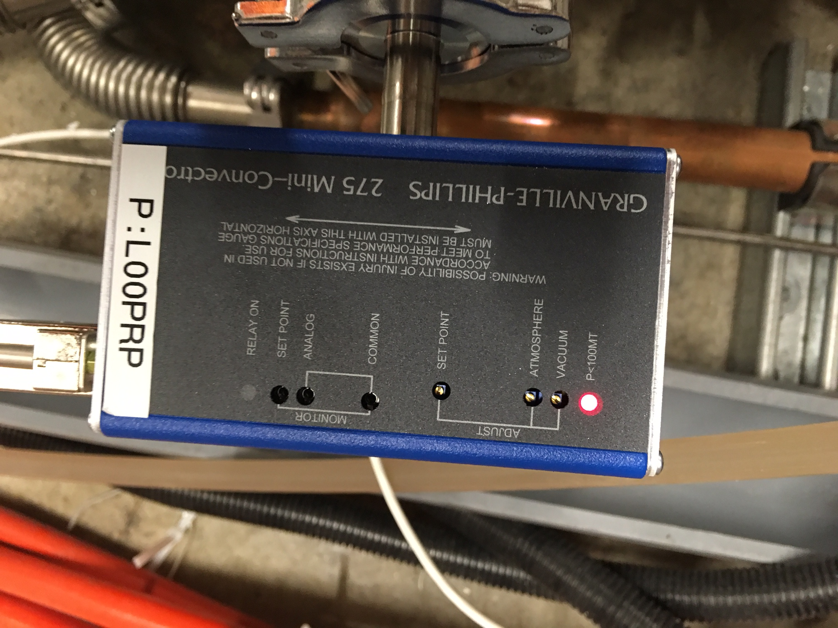
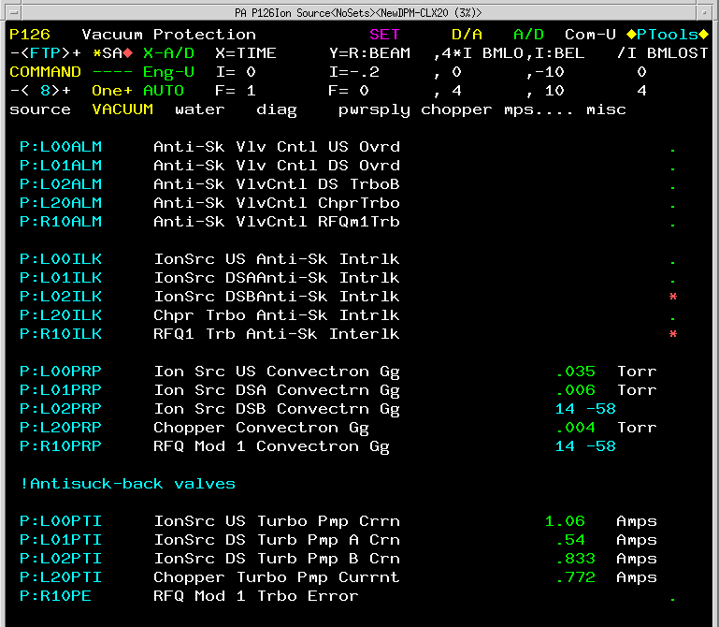
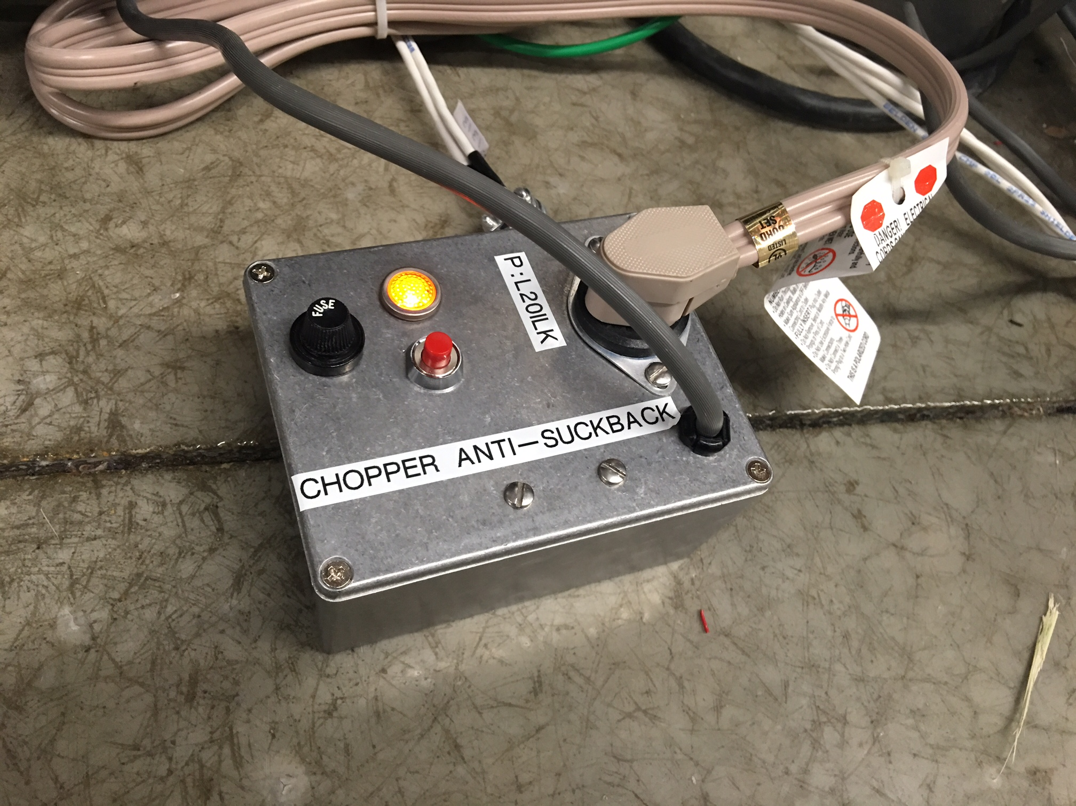
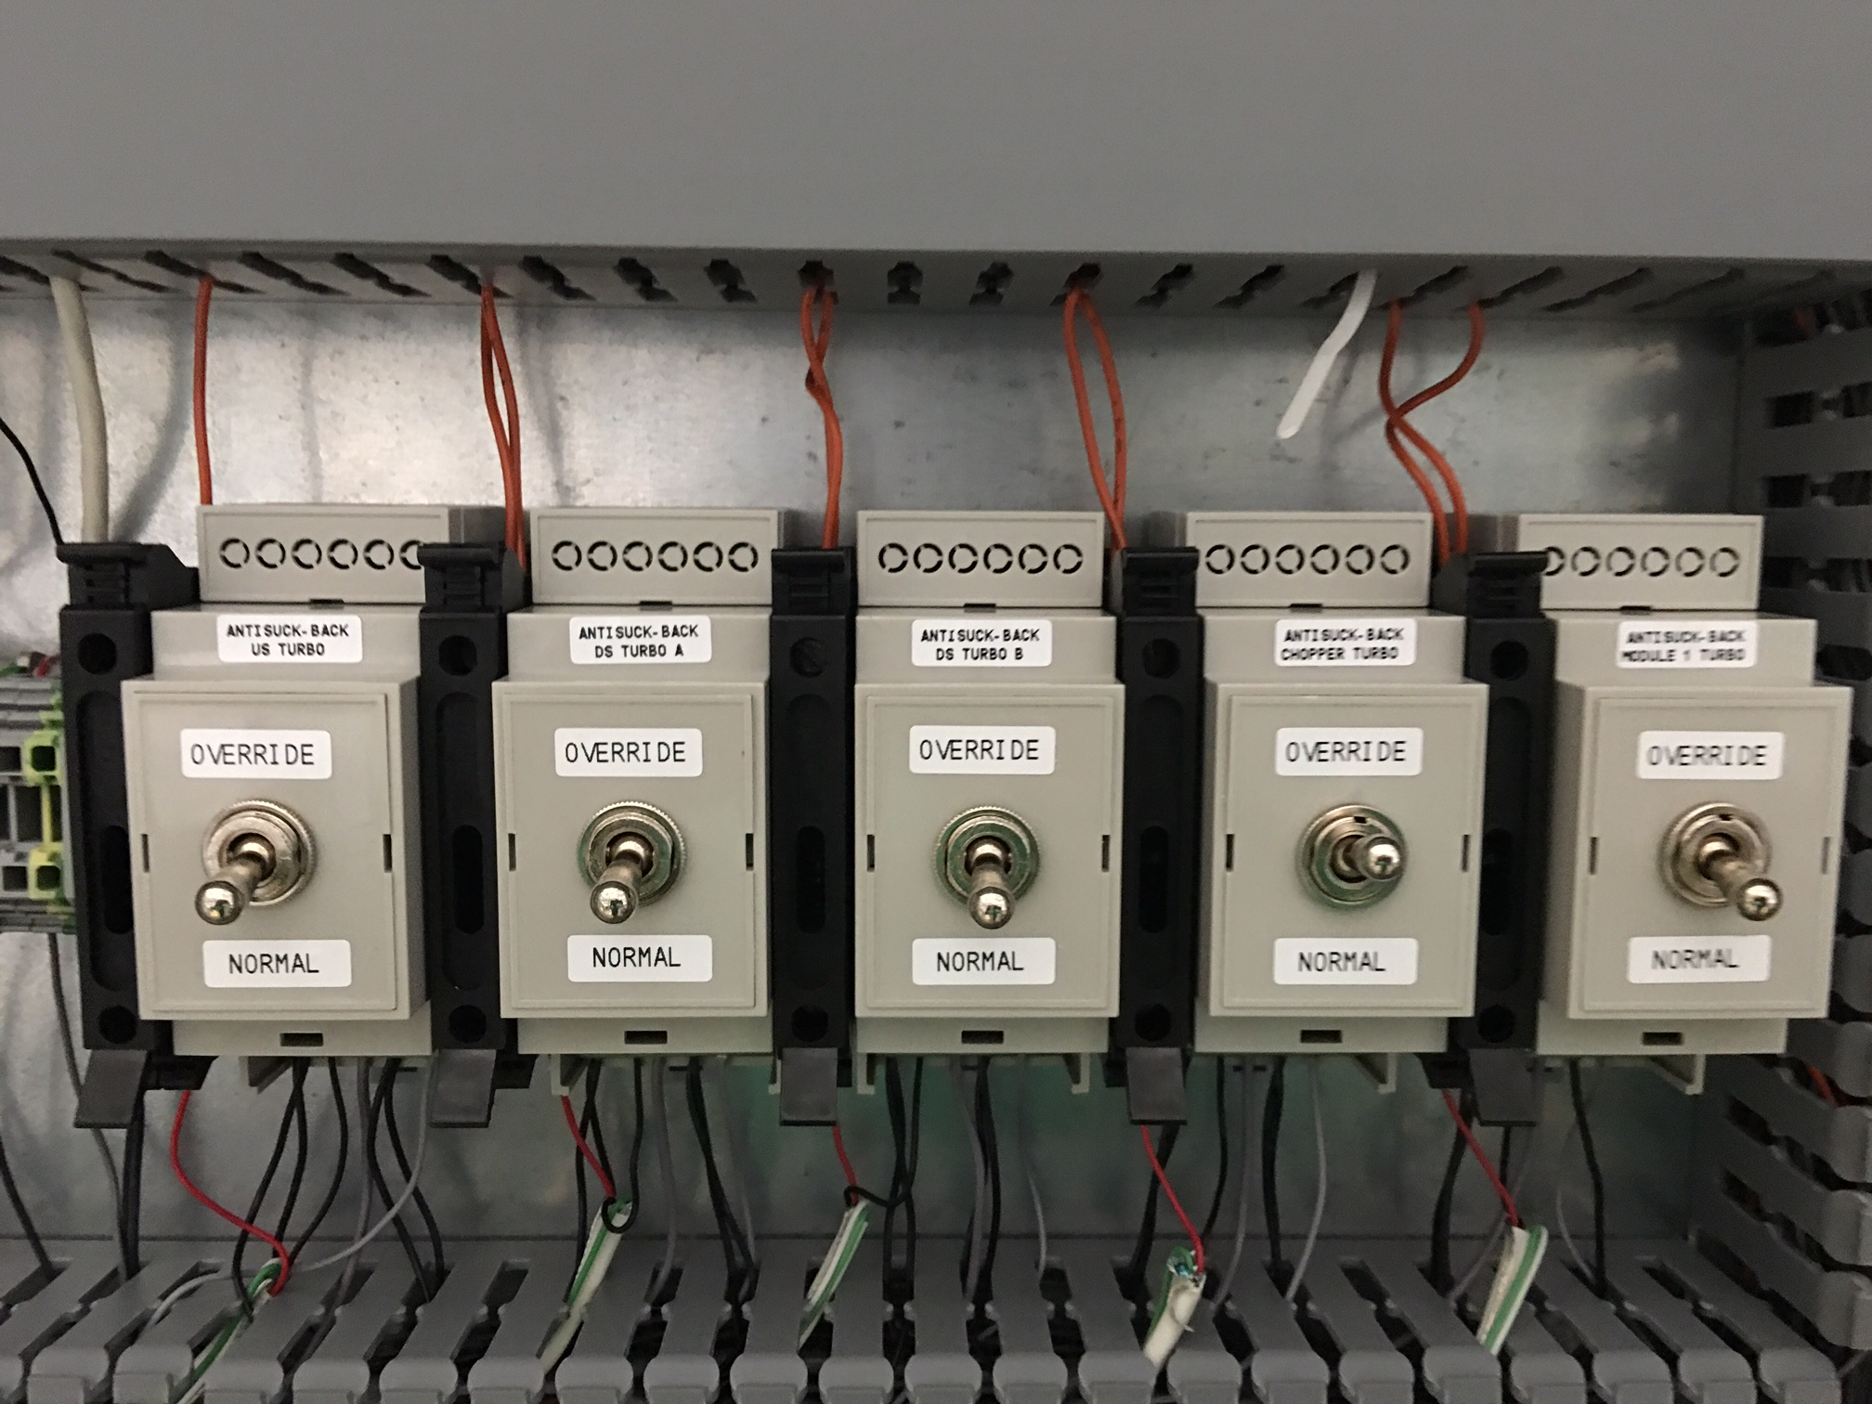
Progress to date (Vacuum Interlock status)
Charge #1
Light on when P<0.1 Torr
Light on when power on
Override switch

Slide 19
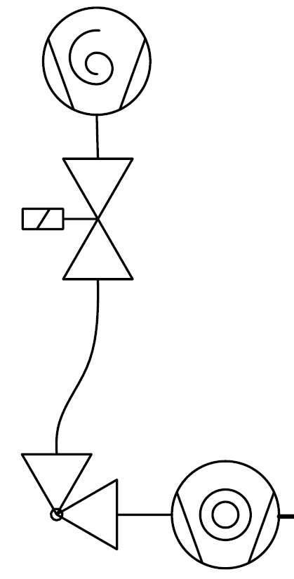
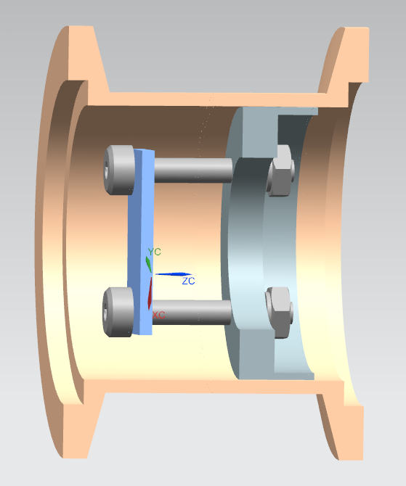
Progress to date (Turbo Station)
Charge #1
Add Protection Valve to stop air rush sooner than 0.5s
PLC
close anti-suckback valve by de-energizing the solenoid, when either situation occurs
Foreline vacuum 0.1 Torr
~0.5s
Beam Vacuum
Turbo current 2A

Slide 20
Progress to date (Scheme of Interlock Turbo-Station in Operation)
Charge #1
 |  |  | actions | Send alarms to mobile devices | Close solenoid valve | Power down turbo
events
1 | P>5x10⁻⁵ Torr in Beam Vacuum Foreline P>1x10⁻¹ Torr System Power Outage |  |  | ●
2 | Foreline P>1x10⁻¹ Torr (with 1s glitch filter) |  |  | ● | ●
3 | Turbo current >2A (with 1s glitch filter) or Turbos of RFQ has error code |  |  | ● | ● | *
4 | Power outage of reset box |  |  | ● | ●
5 | Power outage of rougher only, or bad rougher |  |  | Protection valve close; Foreline pressure >0.1 torr

Slide 21
Design Review Plan
Charge #3
Completed Review
  DPI Design Review (2017, ED0006709)
  Followed AD/MSD internal peer reviews
Planned Reviews
    Preliminary Design Reviews
    Final Design Reviews
    Installation Readiness Reviews

Slide 22
ESH&Q
Charge #4
  Pressure/Vacuum Vessels and Piping (FESHM 5031)
  Following project ISM and QA plans (docdb #141 and 142)
  Hazard Analysis for tasks
  QA/QC activity such as:
    Flowdown to vendors/collaborators
    Specific Test procedures or protocols in development

Slide 23
Risk: Warm Front End (Vacuum)
Unable to maintain proper vacuum between MEBT absorber and SRF

Slide 24
BOE Summary
Charge #2
WBS Number | Title | Docdb #
121.3.18.2 | Vacuum System PM and Coordination | 944
121.3.18.3 | PIP2IT Vacuum Systems | 947
121.3.18.4 | Linac and Beamline Vacuum Systems | 950

Slide 25
Cost Summary
Charge #2
estimate uncertainty assigned according to Project Guidance

Slide 26
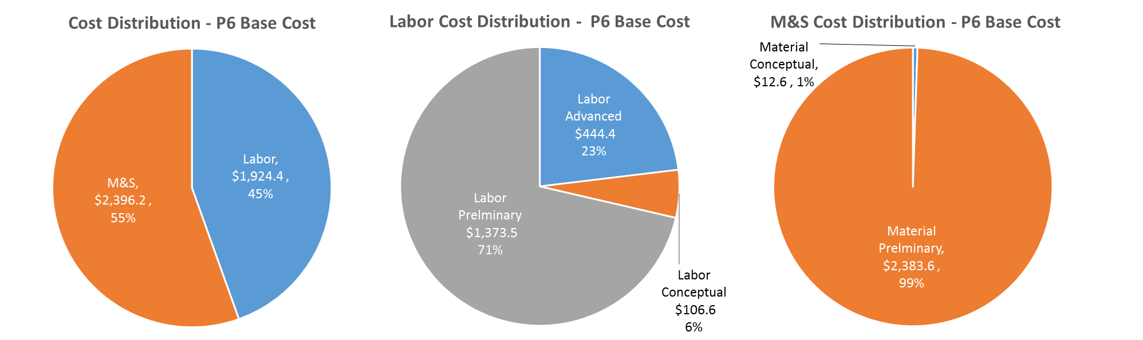
Cost Drivers and Estimate Maturity
Charge #2
P6 Base Costs = BOE + Overheads + Escalation

Slide 27
Cost Profile – P6 Base Cost Only
Charge #2
P6 Base Costs = BOE + Overheads + Escalation
MS cost mainly occurs in construction phase, except for PIP2IT

Slide 28
Labor Profile – P6 Hours/FTE
Charge #2
Engineering effort is mainly in design phase
Tech effort need in construction phase

Slide 29
Schedule - Vacuum
Charge #2

Slide 30
Summary
Conceptual Design of Vacuum System is complete
Effort focus on reducing risks to CM.
PIP2IT demonstration helps to optimize the final configuration
Your advices or comments are very welcomed
Thanks

Slide 31
END

