Slide 1
121.3.21 Linac - Test Infrastructure
Linac Accelerator Support Systems, Installation and Commissioning
Joe Ozelis
PIP-II Director’s Review
10-12 October 2017

Slide 2
Outline
Requirements
Test Infrastructure
  CMTS1
  PIP2IT
  STC
  VTS
Scope/Deliverables/Technical Progress
Interfaces
ESH&Q
Cost
Schedule
Summary

Slide 3
About Me:
PIP-II Manager for Test Infrastructure at Meson Detector Building (STC@MDB)
  WBS 121.3.21.1
Sr. Engineering Physicist, joined FNAL in 1989
  Previous experience/activities
    Horizontal Test Facility Manager (HTS, STC) (current)
      Operations, maintenance, upgrades
    VTS Area Leader (2006-2012)
      Facility design and construction, operations, maintenance, upgrades
    LHC/SSC Magnet & Detector Programs (1989-2000)
      SSC & LHC Magnet performance measurements, test system design and implementation
      SSC SDC Detector Hadron Calorimeter optics development, prototyping, and cosmic ray test stand design and development,
    Test Facility Coordinator, QA Group Leader (SNS @ JLab, 2000-2006)
    Cryomodule Proj Engineer, Sr. SRF Coord (MSU/FRIB, 2012-2014)

Slide 4
About Jerry Leibfritz:
PIP-II Manager for Test Infrastructure at Cryomodule Test Facility (CMTF)
  WBS 121.3.21.2, 121.3.21.3
Senior Principal Engineer, joined FNAL in 1992
Current Responsibilities/Roles
  Project Leader for Accelerator Division SRF Test Facilities
    CMTF - Cryomodule Test Stand #1 (CMTS1) & PIPII Injector Test (PIP2IT)
    Fermilab Accelerator Science and Technology Facility (FAST/IOTA)
  CMTS1 Project Manager for LCLSII Project
  SRF Systems Group Leader (Accelerator Division)

Slide 5
WBS L3 Overview
Charge #1
This WBS covers the design, preparation, installation and commissioning of the Linac Test Infrastructure to facilitate PIPII cavity and cryomodule testing.
There are 4 separate test facilities that make up the PIPII Test Infrastructure
  CMTS1 (to be re-configured for 650MHz CM testing)
  PIP2IT (to be configured for SSR2 CM testing)
  STC (to be modified for 650MHz and SSR2 cavity testing)
  VTS (no modifications necessary), not part of this WBS
Each facility will test a specific component or system for PIPII
The requirements, and status of each facility will be discussed in detail in subsequent slides.
Test Infrastructure contributes to achieving KPP#1

Slide 6
WBS L3 System Requirements
Charge #1
Requirements are captured in FRS/TRS documentation, controlled on Teamcenter:
  CMTS1 : LCLS-II Document LCLSII-4.5-FR-0246-R0 (FRS for CMTS1 configured for LCLS-II CMs – PIP-II version will be very similar)
  STC : TC # ED0006117
  PIP2IT : To be developed
Interface documents
  Interface documents for CMTS1 and PIP2IT will be derived from CM-specific interface documents (under development).
Design Reviews
  The Test Infrastructure WBS activities adhere to the PIPII Project Management Plan for reviews.
    Preliminary and Final Design Reviews and Procurement Readiness Reviews will be held in accordance with policies/criteria established by the PIPII PMP and FNAL Engineering Manual.
    Appropriate review milestones will be integrated and tracked in P6

Slide 7
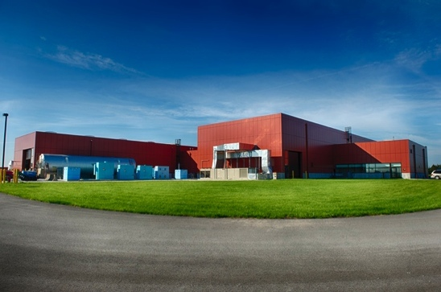
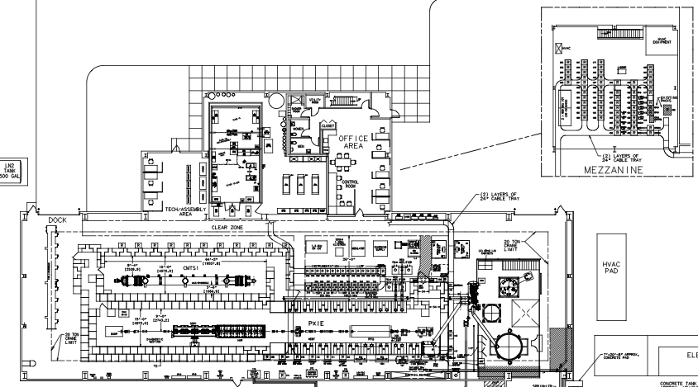
CMTF Facility – CMTS1 & PIP2IT
Charge #1
The CMTF Building contains two of the Test Infrastructure test stands (CMTS1 and PIP2IT)
CMTF Building
CMTS1
650MHz Test Cave
PIP2IT 325MHz Test Cave
Cryogenic Plant

Slide 8
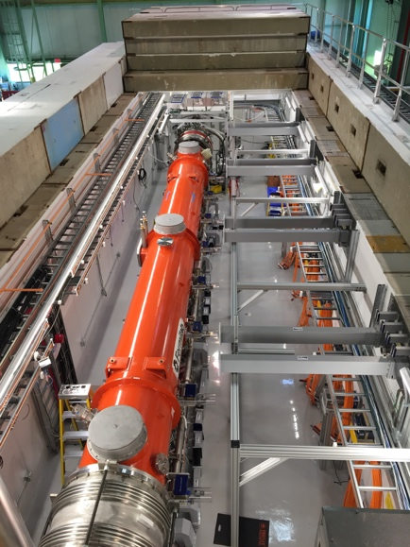
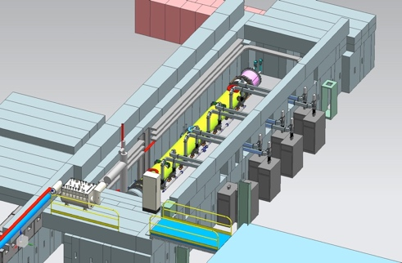
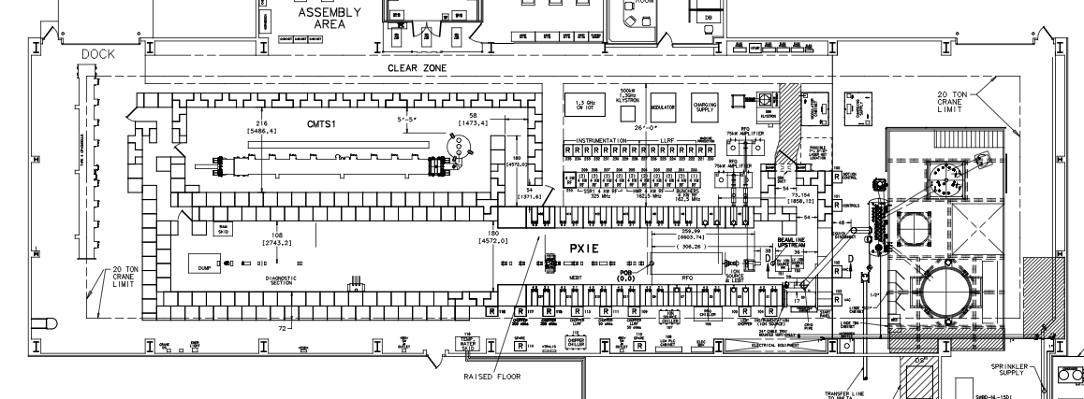
CMTS1 – 121.3.21.2
Charge #1
CMTS1 (Cryomodule Test Stand #1)
  Fully operational test stand for cold RF testing of cryomodules (no beam)
  Currently testing LCLS-II cryomodules (1.3 & 3.9 GHz, CW)
  After LCLS-II testing is complete, infrastructure will be reconfigured to test PIP-II 650 MHz cryomodules
  WBS Deliverable: CMTS1 ready to begin 650 MHz cryomodule testing
CMTS1 650 MHz Cave
650MHz RF Stations
CMTS1 Test Stand
3-D model of current CMTS1

Slide 9
CMTS1 – 121.3.21.2
Charge #1
Scope
  After LCLSII cryomodule testing is complete, infrastructure will be reconfigured to test PIP-II 650 MHz cryomodules
    Cryogenic distribution, RF power, mechanical & electrical infrastructure, controls, safety systems, etc.)
Schedule
  The duration is estimated to be 6 months to install the new systems, followed by 2 months of commissioning. This is based on experience from configuring the CMTS1 test cave for the LCLS-II project
Design Maturity
  The plan is at a conceptual stage and the details are under development. Scope of work is similar in nature to configuring CMTS1 for LCLS-II testing, and all estimates are based on previous experience/costs from constructing and commissioning CMTS1 for LCLS-II
There is an experienced team already in place that developed, operates and maintains all systems associated with CMTS1and this same team of experts will be involved in the modification of CMTS1 for PIP-II

Slide 10
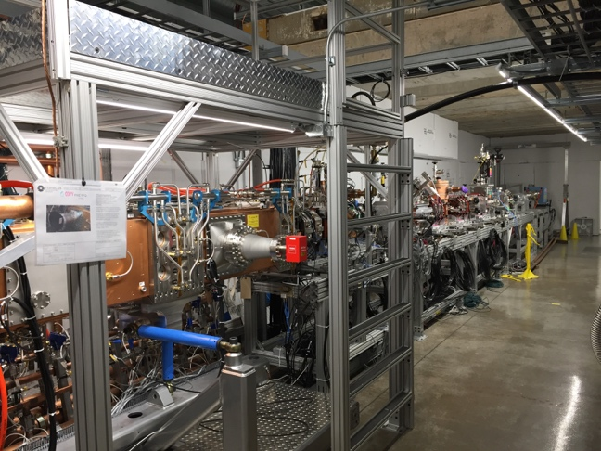
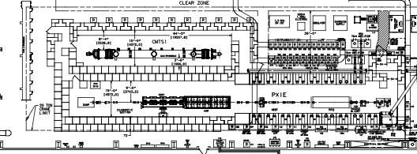
PIP2IT – 121.3.21.3
Charge #1
PIP2IT (PIP2 Injector Test)
  Full scale test of PIP-II front-end with beam
  1st 325 MHz cryomodule (SSR1) will be tested in PIP2IT as part of front-end test
  PIP2IT will eventually be converted to RF test SSR2 cryomodules (no beam)
  SSR1 test stand will require minimal modifications to accommodate SSR2 cryomodule testing
  WBS Deliverable: PIP2IT ready to begin SSR2 cryomodule testing
SSR 325MHz Test Stand
PIP2IT Test Cave
PIP2 Injector Test

Slide 11
PIP2IT – 121.3.21.3
Charge #1
Scope
  After initial SSR1 cryomodule testing is complete, infrastructure will be modified to accommodate testing PIP-II SSR2 cryomodules.
    Cryogenic distribution, mechanical & electrical infrastructure, controls, etc.
Design Maturity
  The plan is at a conceptual stage and details are under development. Scope of work is similar in nature to configuring CMTS1 for LCLS-II testing, and all estimates are based on previous experience/costs from constructing and commissioning CMTS1 for LCLS-II
PIP2IT Infrastructure
  This WBS also includes the general infrastructure associated with PIP2IT for FY18-FY20. The estimates for this portion of the WBS are based on actual PIP2IT infrastructure costs from previous years
  There is an experienced team already in place that developed, operates and maintains all systems associated with PIP2IT and this same team of experts will be involved in the modification of PIP2IT for SSR2 testing

Slide 12
STC – 121.3.21.1
Charge #1
The Spoke Test Cryostat (STC) was designed, and has been used, for testing 325MHz SSR1 cavities at 4K and 2K.
  10kW Bruker SSA
  200W Ophir SSA
  Full complement of diagnostics, interlocks, controls, instrumentation
STC is used for comprehensive “system-level” tests of cavity+coupler+tuner
  Jacketed cavity performance (gradient, Q₀, FE, flux exclusion)
  Coupler performance (power handling, thermal performance)
  Tuner performance (range, resolution, hysteresis)
  Microphonics/Resonance Control studies
  Presently in use testing cavities for SSR1 CM#1.
  Will be used for design verification studies and initial cryomodule cavity qualification for SSR1, SSR2, and HB650 cavities.

Slide 13
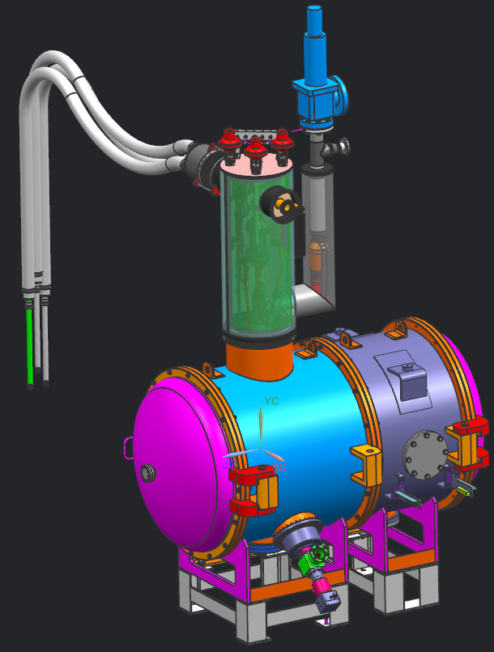
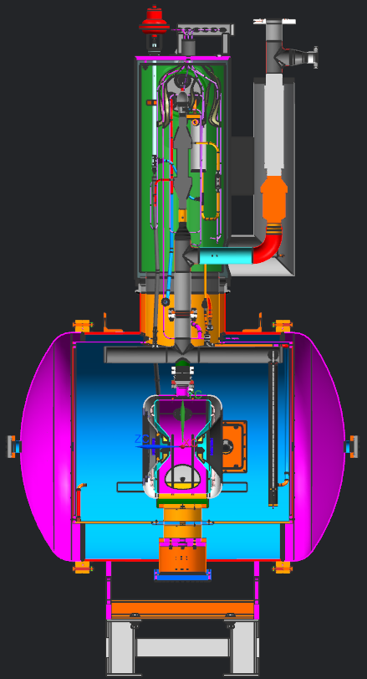
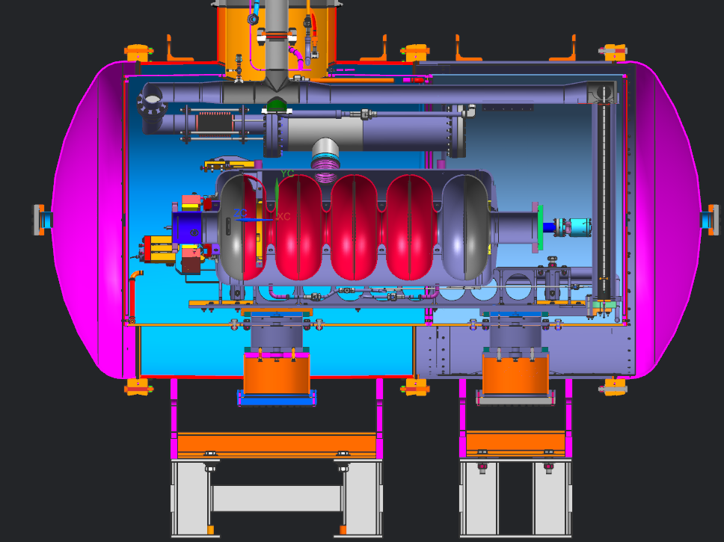
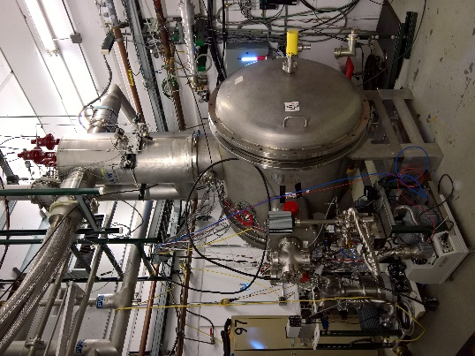
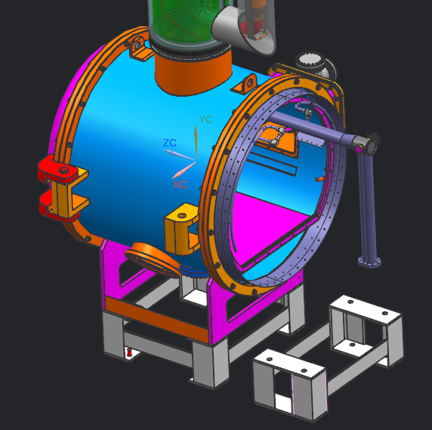
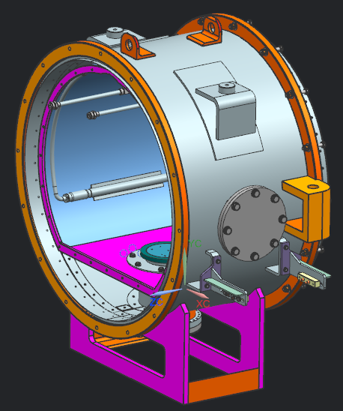
STC – 121.3.21.1
Charge #1
Existing STC cryostat as used for SSR1 cavity testing
STC cryostat modified with extension to accommodate 650MHz cavities.
Existing cryostat modified with extended He piping,
SSR1 cavity
Cryostat extension

Slide 14
STC – 121.3.21.1
Charge #1
Scope
  After SSR1 CM#1 cavity testing is completed, infrastructure will be modified to accommodate testing 650MHz elliptical cavities, and SSR2 cavities.
    Cryostat modifications (lengthening cryostat, modifying support structure, modifying LHe header)
    Installation of 650MHz RF distribution and integration of existing 650MHz IOT with controls/interlocks (covered under WBS 121.3.9.4.1, in parallel with this activity)
    No changes to cryogenics, instrumentation, or vacuum systems
Design Maturity
  The plan is at an advanced stage. Components for cryostat modification/extension have been designed and are on order. (FDR/PRR held February 2017)
Deliverable/Schedule
  A modified STC capable of testing dressed HB 650MHz Elliptical cavities and SSR2 cavities.
  Modifications will commence with the completion of the SSR1 CM1 cavity testing program in 3QFY18, and completion (cryo commissioning) is expected 3 months later, in time to test the first jacketed HB650 (β=0.9) cavity.
  There is an experienced team already in place that developed, operates and maintains all systems associated with STC and this same team of experts is involved in the modification of STC for HB 650MHz Elliptical and SSR2 cavity testing.

Slide 15
Interfaces
Charge #1
All of the Test Infrastructure facilities involve installing and commissioning the infrastructure necessary to test cavities/cryomodules. As such, they must interface with all the sub-systems necessary for testing :
  Cryogenics
  Utilities (water, air, nitrogen)
  RF Power
  Controls
  LLRF
  Safety systems (interlocks, access controls)
  Vacuum systems (beamline, coupler, insulating)
As their requirements and designs become finalized, documents for CMTS1 and PIP2IT will be prepared detailing these interfaces based upon the Interface Specifications developed for the relevant CMs as well as the existing support systems.

Slide 16
ESH&Q
Charge #4
The construction/operation of all the Test Infrastructure facilities will be in full compliance with the PIP-II ISM program (DocDb # 141).
Construction/assembly activities use the appropriate Hazard Analyses and Work Planning processes, LOTO procedures, etc.
Procurement, fabrication, and acceptance of components will follow the Project’s QA Plan (DocDB # 142) utilizing established Project/Division mechanisms regarding acceptance testing, control of non-conformances, vendor feedback, etc.
Prior to commissioning any new systems/facilities, a series of reviews and approvals take place, culminating in an official Operational Readiness Clearance (ORC) approval.
  These reviews cover systems such as:
    Oxygen Deficiency Hazards (ODH)
    Radiation Shielding/Radiation Safety
    Interlocks (PPS)
    Machine (Device) Protection Systems
    Mechanical & Electrical Safety
    Cryogenic Safety

Slide 17
BOE Summary
Charge #2
WBS Number | Title | Docdb #
121.3.21.1.2 | Test Infrastructure STC PM and Coordination | 851
121.3.21.1.3-5 | Test Infrastructure STC Design, Prep, IIC | 857
121.3.21.2.2 | Test Infrastructure CMTS PM and Coordination | 839
121.3.21.2.3-5 | Test Infrastructure CMTS Design, Prep, IIC | 842
121.3.21.3.2 | Test Infrastructure PIP2IT Mods PM and Coordination | 845
121.3.21.3.3-5 | Test Infrastructure PIP2IT Mods Design, Prep, IIC | 848
All relevant BOE Documents (estimate roll-ups, WBS dictionaries, descriptions) exist and have been reviewed and approved.

Slide 18
Cost Summary
Charge #2

Slide 19
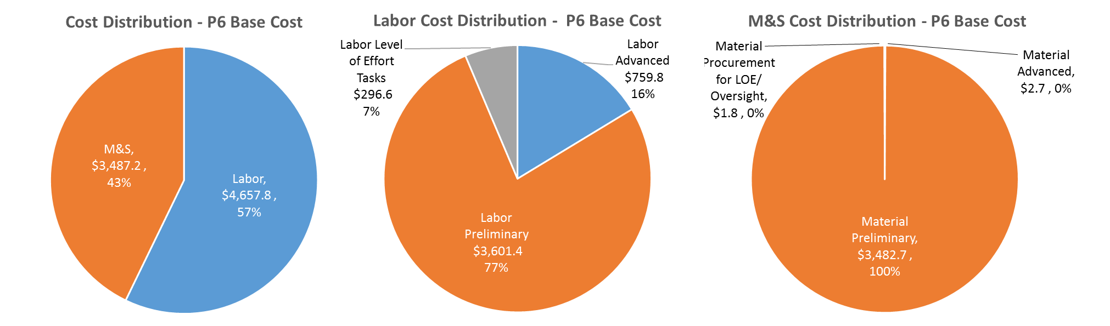
Cost Drivers and Estimate Maturity
Charge #2
P6 Base Costs = BOE + Overheads + Escalation
Costs are essentially evenly split between labor and M&S.
Most cost estimates (labor and M&S) are at the preliminary stage reflecting the conceptual design of the CMTS and PIP2IT modifications.
  Exception is STC Modifications, which is at an advanced stage.

Slide 20
Cost Profile – P6 Base Cost Only
Charge #2
P6 Base Costs = BOE + Overheads + Escalation
Cost profile reflects need to prepare the Test Infrastructure at an earlier stage in the project, to meet availability requirements.

Slide 21
Labor Profile – P6 Hours/FTE
Charge #2
Labor profile indicates about 2:1 ratio of Tech to Engineer labor, reflective of the nature of the project.
Engineering effort (as a %) remains higher in FY20-22 due to ORC preparations, commissioning, initial ops.

Slide 22
Schedule – Test Infrastructure
Charge #2
STC Modifications
CMTS Modifications
PIP2IT Preparations for SSR2

Slide 23
Summary
Fermilab currently operates an array of world-class SRF test facilities, all of which are critical to the success of the PIP-II project.
Several of the existing Test Facilities will require various modifications to accommodate PIP-II components.
The specific details of the modifications for PIP-II exist at the conceptual (and in some cases advanced) level, being similar in nature to the current and historical use of this Test Infrastructure for LCLS-II, ILC, etc.
  All cost and schedule estimates are based on historical data from initial construction or recent modifications of these facilities and are well understood.
  Experienced personnel, many of whom have been involved in the original development, construction, and operation of these facilities, are in place and available to carry out the modifications and operation.
  Activities are planned so that modifications are completed and can be commissioned before cavities and cryomodules arrive for testing.
We are ready to proceed to CD-1

Slide 24
END

