Slide 1
121.3.14 and 15: Beam Transfer Line, Beam Absorber Line
Linac Accelerator Support Systems, Installation and Commissioning
Shekhar Mishra
PIP-II Director’s Review
10-12 October, 2017

Slide 2
Outline
Overview
Requirement
Conceptual Design and Specifications
Scope and Deliverables
Interfaces
ESH&Q
Cost
Schedule
Summary

Slide 3
About Me:
PIP-II
Deputy Project Manager
SRF Linac R&D
Risk Manager
Chair, PIP-II Risk Management Board
Relevant Experience
Indian Institutions and Fermilab Collaboration
International Linear Collider, Deputy Director/Fermilab
Main Injector and Recycler Ring Department Head
Main Injector and Recycler Ring Commissioning Team Leader
Experimental High Energy Physics
28 Years at Fermilab

Slide 4
Overview
Charge #1
The Beam Transfer Line (BTL) is to designed to transfer H⁻beam, without stripping, from the exit of the SRF linac to the injection girder of the Booster.
It is composed of dipoles, quadrupoles, specialty magnets, two dimensional scraper and instrumentations.
The Beam Absorber Line to the main PIP-II Beam Dump
A fork in the BTL, composed of dipoles, quadrupoles, instrumentations and a 50 kWatt beam dump.
The Straight Linac Beam Absorber line to beam dump
A straight beam pipe from the exit of the SRF linac to dump has only beam instrumentation.
The accelerator physics design of the beam lines are documented in the PIP-II Conceptual Design Report.

Slide 5
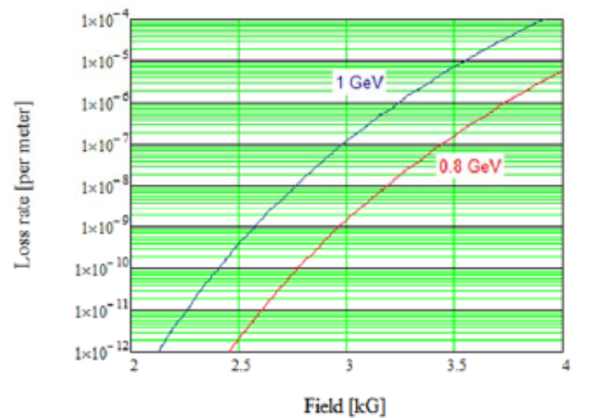
Beam Transfer Line Main Requirement
H- stripping due to magnetic bend is a dominant loss mechanism.
Minimization of H- stripping
Keeping the residual loss rate to~0.1 W/m
Requires the Loss rate of 5x10⁻⁶
particle/meter for pulsed and
5x10⁻⁸ p/m for CW operation
The sets the limit
Of 2.8 kG of maximum Dipole
Field (20.4 m bending radius)
The vacuum requirement is
10⁻⁸ Torr.
The SRF Linac to the Booster Beam transfer line elements are designed to transport up 1 GeV of CW beam, which has higher requirements than 0.8 GeV.

Slide 6
Conceptual Design of the Transfer Lines
Beam Transfer Line
Two Arcs
Straight section connecting them
Straight section splits into two additional lines
Beam Absorber Line
Mu2e experiment line (future upgrade)
Injection Point in Booster
Beam Dump
Extraction Point

Slide 7
Transfer Line Magnet Specifications
Beam Transfer Line to Booster | Number | Length | Field | Gradient
 |  | mm | kG | kG/cm
Dipoles | 32 | 2450 | 2.406
Power supply for dipole bends | 1
Quadrupoles central line (F-D) | 45 | 200 |  | 0.61, 0.69
Transport line one plane (V or H) dipole corrector | 52 | 100 | 1
Injection Line Quadrupole | 6 | 200 |  | 0.11--0.84
Injection line dog-leg Dipole | 2 | 1800 | 2.475
Injection line C-Dipole | 1 | 1800 | 3.258
Fast Dipole Corrector | 1 | 2000 | 0.079
Large Aperture Quadrupole | 2 | 200,400 |  | 0.69, 0.30
Lambertson | 1 | 2600 | 1.389
Beam Absorber Line | Number | Length | Field | Gradient
 |  | mm | kG | kG/cm
Dipole Magnets of the same design as transfer line | 5 | 2450 | 2.406
Quadrupoles of the same design as Transfer Line | 4 | 200 |  | 0.61, 0.69
Transport line one plan dipole corrector | 4 | 100 | 1
Beam Dump Sweeping Magnet | 1 | 500 | 1

Slide 8
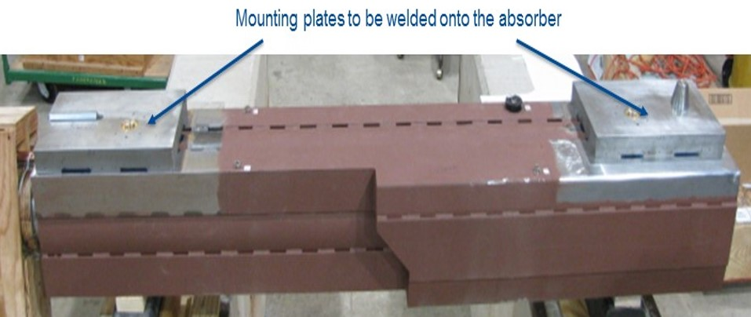
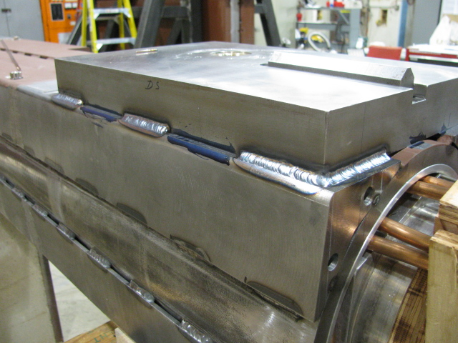
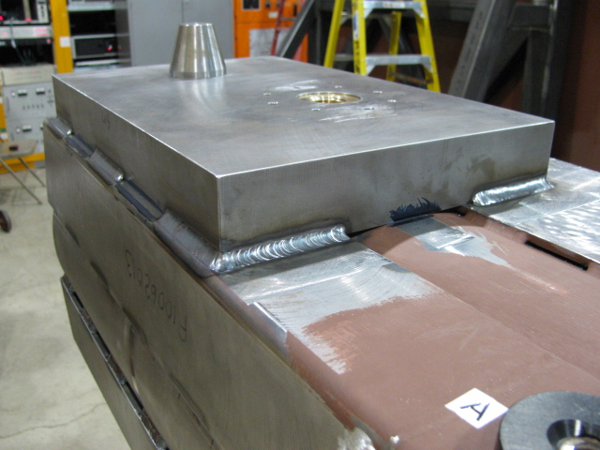
Beam Dump
PIP-II plans slightly modified design of the recently build g-2 (80kW) beam dump.
PIP-II requirement is 50 kW

Slide 9
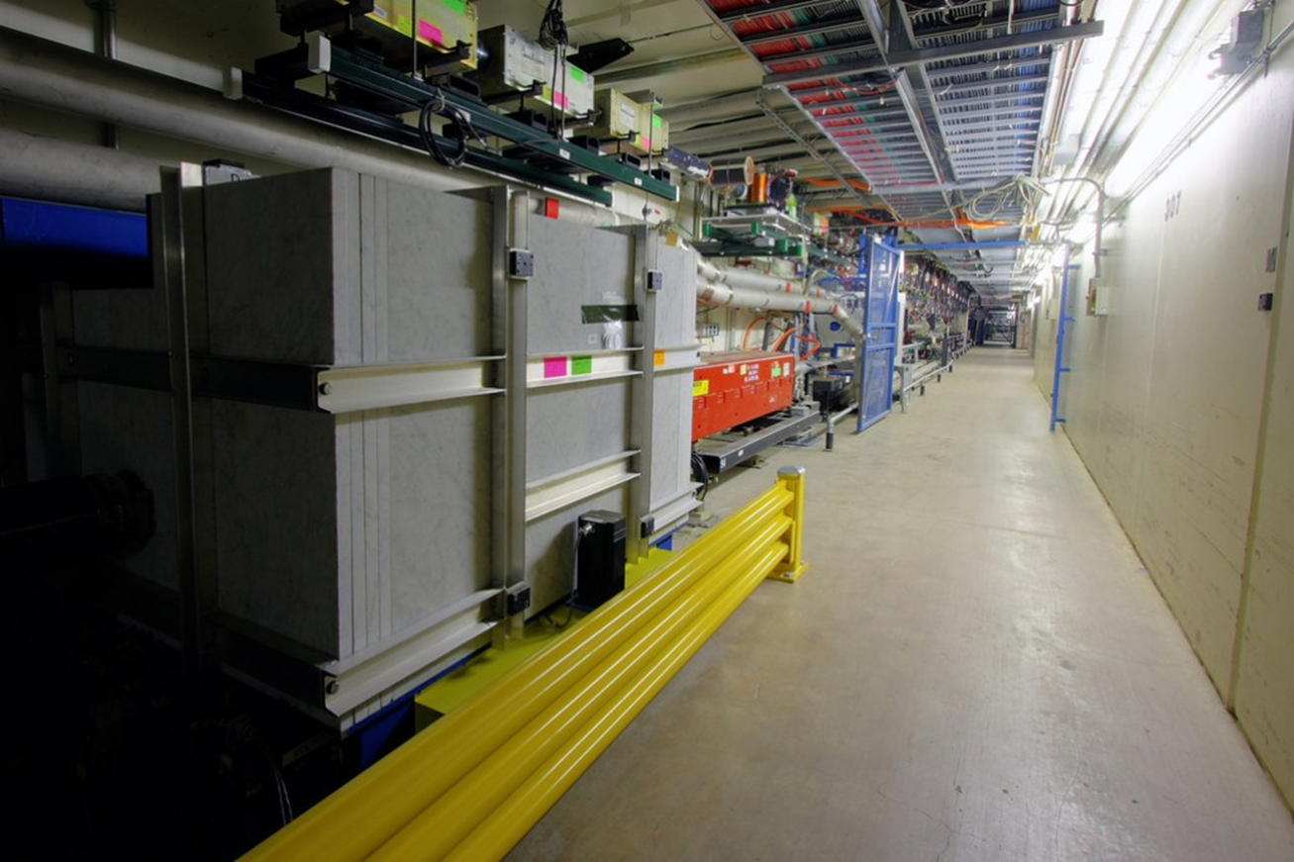
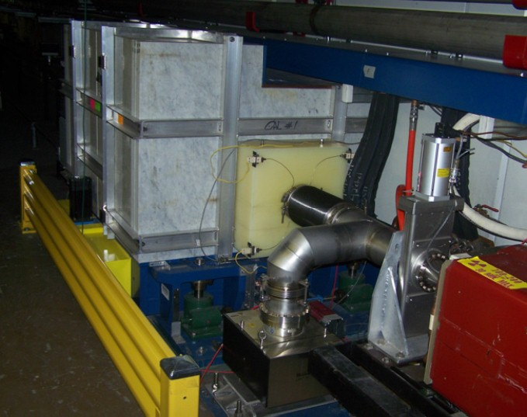
Beam Transfer Line Collimator
PIP-II plans to use the MI/RR collimator (2 kW) design for collimating the beam before injection it to the Booster.
PIP-II requirement is 1 kW

Slide 10
Scope
Charge #1
Management:
Approval of design specifications for vendors
Review and Approval of vendors design
Overseeing of the hardware fabrication at vendors
QA/QC acceptance approval
Design and Fabrication
Magnet: Detailed Design Specification for procurements based of the Technical Design Report.
Acceptance measurement and verification
Dump: Modifications to the g-2 dump and shield design
Collimator: Modification of MI/RR design for PIP-II beam pipe size.

Slide 11
Deliverables
Magnets
2 Beam Dumps
2 (1X and 1Y) Collimators
Device | Quantity
3 Way Septum Magnet | 1
Dipole | 32
Dipole, C-magnet | 1
Dipole, dog-leg | 2
Dipole, fast corrector* | 1
Dipole, Beam Dump | 1
V & H dipole corrector | 52
Quad, large aperture 2 | 1
Quad, large aperture 1 | 1
Quad, cental line F-D | 45
Quad, Inj line | 6

Slide 12
Interface

Slide 13
Interfaces
Charge #1
Beam Transfer Line and Beam Absorber Line
Installation WBS (121.3.22) covers
All installations
All survey
All stands
Magnet Beam Pipe and Vacuum pumps are provided by Vacuum WBS (121.3.18).
In case of quadrupole magnet beam pipe, BPM should be integral part of the beam pipe.
Water to the magnets are provided by Support Services WBS (121.3.19).
Magnet power supplies are provided by Power supply WBS (121.3.13).
Powering and commission are provided by commissioning WBS (121.3.22)

Slide 14
ESH&Q
Charge #4
Personnel Safety and environmental and equipment protection are the highest priorities in the PIP-II Project.
All activities will be in full compliance with the PIP-II ISM program defined in DocDb# 141.
–Laboratory and DOE standards and practices
Fermi ES&H Manual
Division/Area specific Hazards Analyses and Training
Procurement, fabrication, and acceptance of components will follow the Project’s QA Plan (DocDB# 142) utilizing established Project/Division mechanisms regarding acceptance testing, control of non-conformances, and vendor feedback.

Slide 15
BOE Summary
Charge #2
WBS Number | Title | Docdb #
121.3.14.2 | Beam Transfer Line PM and Coordination | 863-v10
121.3.14.3 | Beam Transfer Line Magnets | 866-v13
121.3.14.4 | Beam Transfer Line Collimators | 869-v12
121.3.15.2 | Beam Absorber Line PM and Coordination | 872-v9
121.3.15.3.1 | Straight Linac Beam Absorber | 875-v9
121.3.15.4.1 | Linac Primary Beam Absorber Magnets | 878-v12
121.3.15.4.2 | Linac Primary Beam Absorber | 881-v16
Basis of Estimate were generated by technical input, discussions of similar project and vendor quote
All the BOEs and supporting documents, available in PIP-II Docdb, were reviewed and approved by PIP-II Project members

Slide 16
Cost Summary: WBS 121.3.14 and 121.3.15
Fermilab has significant expertise in the design, fabrication, installation and running of all the elements in this BOE.
In order to minimize cost we are reusing the existing design for the beam dump and scrapers.
There are no technical or cost risk associated with these WBS.
Estimate Uncertainty follows project guidelines
Methodology for cost based on experience, similar magnets, beam absorber and collimator and vendor quotes is sound and understood
~ 25% Contingency is appropriate for CD-1
There is no Cost drivers, all technologies are understood
Costs summary is generated from P6 resource loaded schedule which uses BOEs Labor and Cost Estimates.

Slide 17
Cost Summary
Charge #2
121.3.14
121.3.15

Slide 18
Cost Drivers and Estimate Maturity
Charge #2
121.3.14
121.3.15

Slide 19
Cost Profile – P6 Base Cost Only
Charge #2
121.3.14
121.3.15
Cost profile is dominated by M&S.
We plan to design and build all the components in US industries.
Labor is for design specification and supervision at industries and QA/QC at Fermilab

Slide 20
Labor Profile – P6 Hours/FTE
121.3.14
121.3.15
Fermilab Labor resources required for this WBS is very small.
Fermilab Technical Division has human resources with expertise in the design, fabrication and testing of electromagnets.
Fermilab Accelerator Division has human resources with expertise in the design, fabrication and testing of the Beam Absorber and Collimator.

Slide 21
Schedule
Charge #2

Slide 22
Next Steps:
Charge #4
Initiate work on detailed design specifications
Convert the conceptual design specifications to design specification for industrial design and fabrication.
Magnet Fabrications
Initiate paper work for industrial design
Beam Absorber
Initiate MARS calculations for minor engineering drawing modifications
Engineering drawing modifications
Collimator
Initiate paper work for industrial fabrication

Slide 23
Summary
The PIP-II Beam Transfer Line and Beam Absorber lines elements Accelerator Physics Design specifications are complete in the Conceptual Design Report.
The design specification meets the H- stripping requirement and has been validated by design reviews.
Specified magnet, collimator and beam absorber designs are similar to what Fermilab has designed, built and operates.
Fermilab Technical and Accelerator division has qualified staff to undertake this sub-project.
US Industry is capable in fabricating these hardware.
Cost, schedule derived from similar projects are understood.
There is no risk/opportunity in these two WBS.
We are ready for CD-1 and look forward to your feedback.

