Slide 1
121.3.19 – Linac - General Support Services (GSS)
Breakout Session: Linac Accelerator Support Systems, Installation and Commissioning
Curt Baffes
PIP-II Director’s Review
10-12 October 2017

Slide 2
Outline
Scope/Deliverables
Requirements
Conceptual Design
Interfaces
Technical Progress to Date
ESH&Q
Risk
Cost
Schedule
Summary

Slide 3
About Me:
PIP2 Roles
  L3 Manager for General Support Services
  L3 Manager for Installation, Integration and Commissioning
  Installation lead for PIP2IT
Other Fermilab experience
  Participated in build-out of FAST, PIP2IT, and CMTS1 machines
  Led design and installation of FAST 50 and 300MeV beamlines
  Led installation of 1.3GHz CC1 and CM2 cryomodules at FAST
  Led installation of first LCLS2 cryomodule in CMTS1 test stand

Slide 4
Scope and Deliverables
Charge #1
121.3.19.3 – Fluids Systems Scope
  LCW pump room in PIP2 Utility Building
  LCW distribution to Linac, BTL, and gallery
  RAW cooling system for BTL absorber
  Compressed air system for Linac/BTL
    including coupler cooling
  Utility nitrogen system for Linac/BTL
  Special cooling systems for Ion Source and RFQ
121.3.19.4 – Electrical Systems Scope
  Electrical distribution from CF-provided panels to racks
  Cable tray infrastructure
  Cable database administration

Slide 5
WBS L3 System Requirements
Charge #1
Fluids Systems Requirements (121.3.22.3)
  FRS ED0006218 Rev- (LCW)
  Conventional performance for LCW systems: ±1º C
  All permanent fluids infrastructure sized for CW
  Challenging requirements of RFQ cooling system (e.g.±0.1º C stability) demonstrated at PIP2IT.
  All fluids systems requirements can be met with conventional systems with direct analogue at CMTF
Electrical Infrastructure Requirements (121.3.22.4)
  At a high level, this is a conventional, connective system
  Requirements to be defined at rack level in subsystem ICDs
Both systems indirectly support KPP#1 – SRF Linac delivery of 700MeV (threshold) / 800MeV (objective) beam to booster

Slide 6
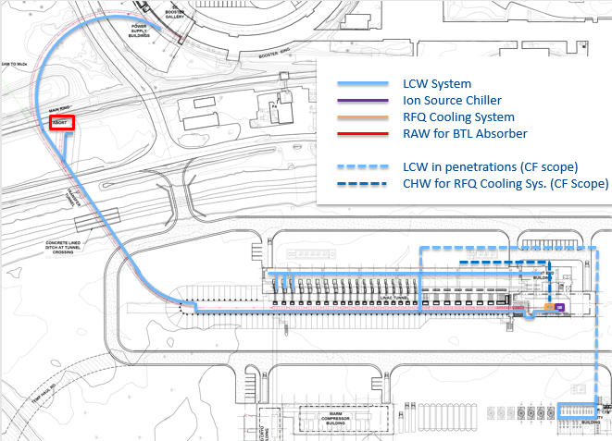
Conceptual Design and Design Maturity
Charge #1
Fluids Systems
  Configuration evolving in collaboration with CF team

Slide 7
Conceptual Design and Design Maturity
Charge #1
Electrical Infrastructure
  Design work to be initiated post-CD2
  Volume envelopes currently being managed in collaboration with CF team

Slide 8
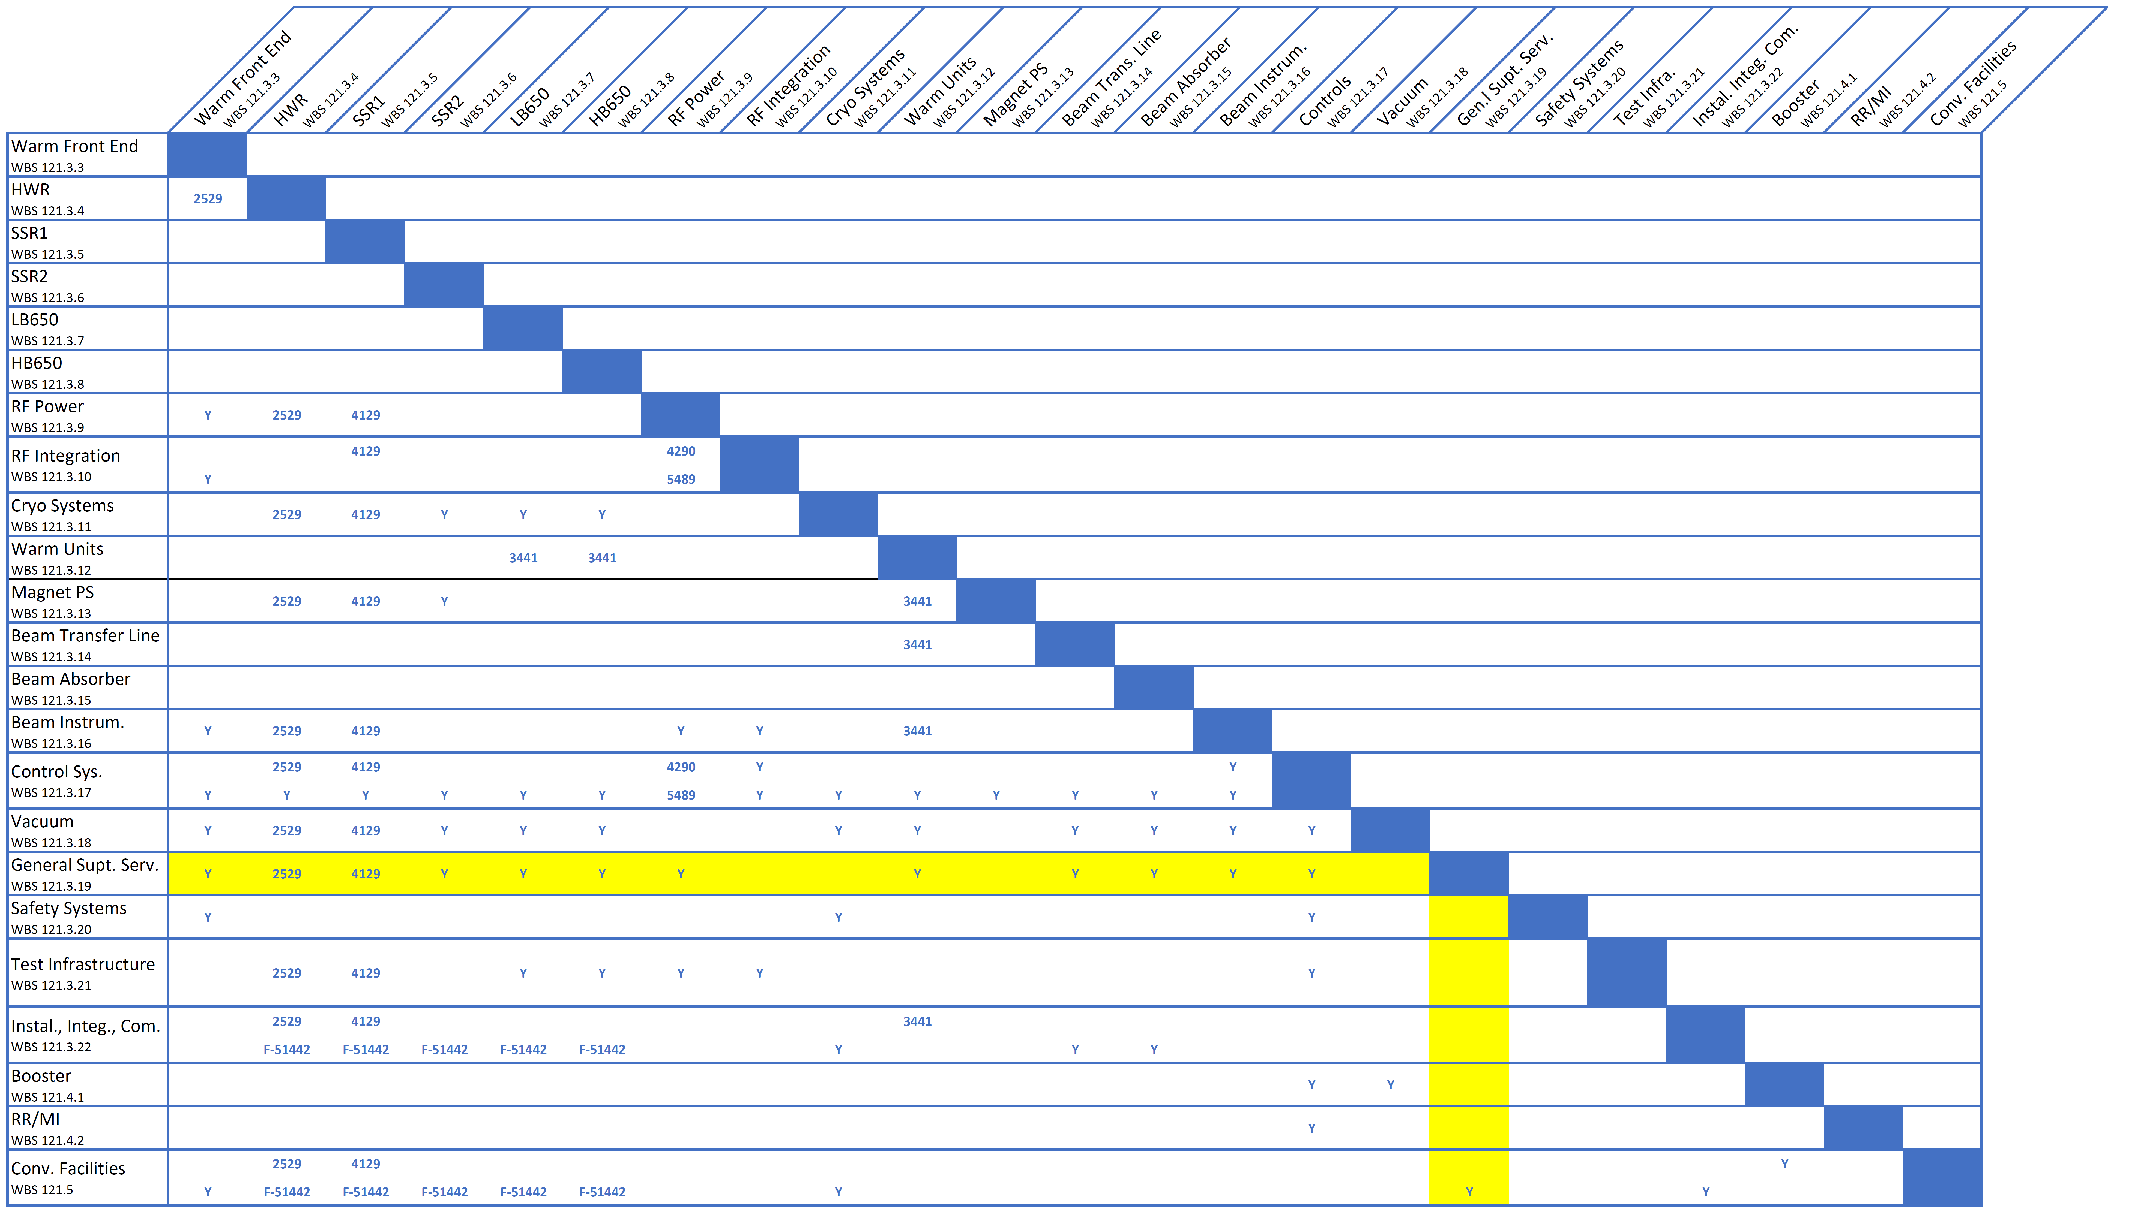
Interfaces
Charge #1

Slide 9
Interfaces – Fluids Systems
Charge #1
Conventional Facilities
  Volume envelopes
  Heat exchange in the utility building
  Penetrations
  To be defined in system-level ICD (e.g. CF - GSS Fluids)
Controls
  GSS provides physical instrumentation
  Controls provides control, human interfaces, interlocks, permits
  To be defined in subsystem-level ICD (e.g. GSS Fluids LCW - Controls)
Customer Systems
  Fluids systems do not read customer-internal devices (e.g. amp integral flow meter)
  Fluids systems do provide required external instrumentation (e.g. flow interlocks)
  Interfaces to be documented in device-level ICDs
  Most significant customer is RF power in the gallery
Interfaces at PIP2IT provide a model for Fluids-Controls-Customer Systems interfaces and scope

Slide 10
Interfaces – Electrical Infrastructure
Charge #1
Conventional Facilities
  Volume envelopes
  Power interface at CF-provided panel in each facility
  Electrical Infrastructure responsible for design from the panel out
  Installation WBS responsible for electrical installation from the panel out
  Configuration to be defined in system-level ICD
Customer Systems
  Electrical infrastructure must provide racks (including utility power) and tray to meet customer needs
  To be defined in system-level ICDs (e.g. LLRF – GSS EI)
Cable Database
  During the installation window, the cable database becomes the documentation for each individual cable
  Creation of the database (within the AD system) is the responsibility of the GSS Electrical Infrastructure WBS

Slide 11
Progress to date
Charge #1
Electrical Infrastructure
  Dedicated design work planned to start post-CD2
  Participating in ongoing configuration work being driven by the CF design
Fluids
  Close interface with CF team during conceptual design phase
  Collection and compilation of requirements
  Design of fluids systems for PIP2IT
    Executed by this team, paid for by PIP2IT infrastructure code
    Complete LCW and compressed air systems
    Ion source chiller procurement and operation
    RFQ cooling system design, assembly, and operation

Slide 12
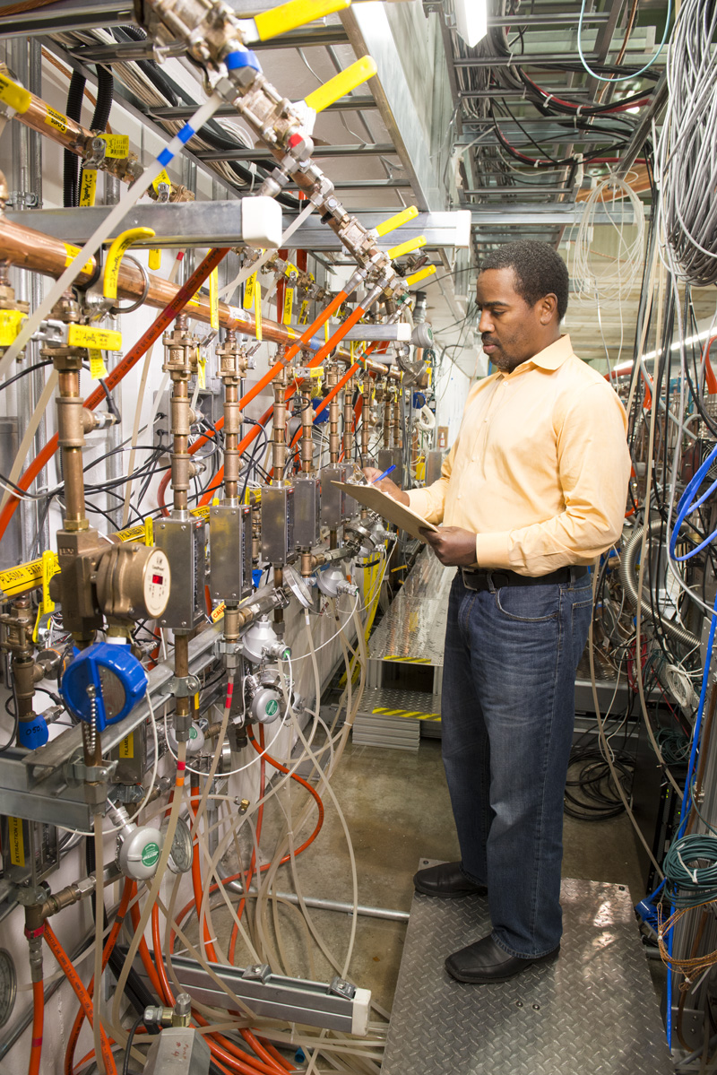
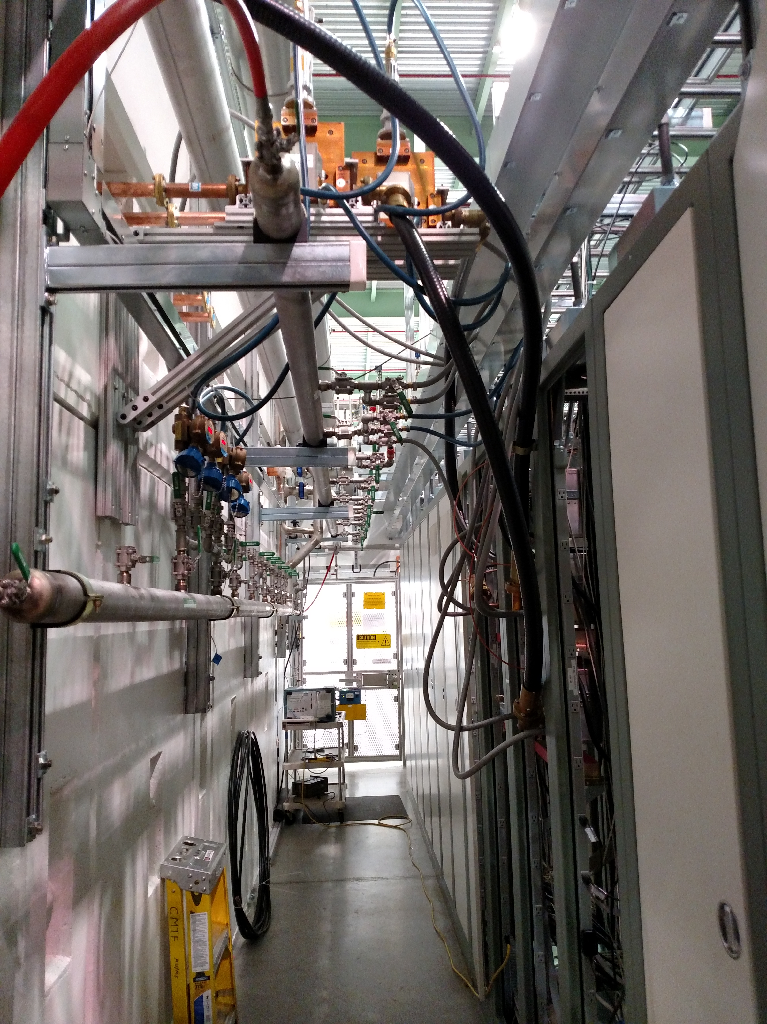
Progress to date – PIP2IT Fluids
Charge #1
PIP2IT LEBT LCW Manifold
PIP2IT RF Gallery

Slide 13
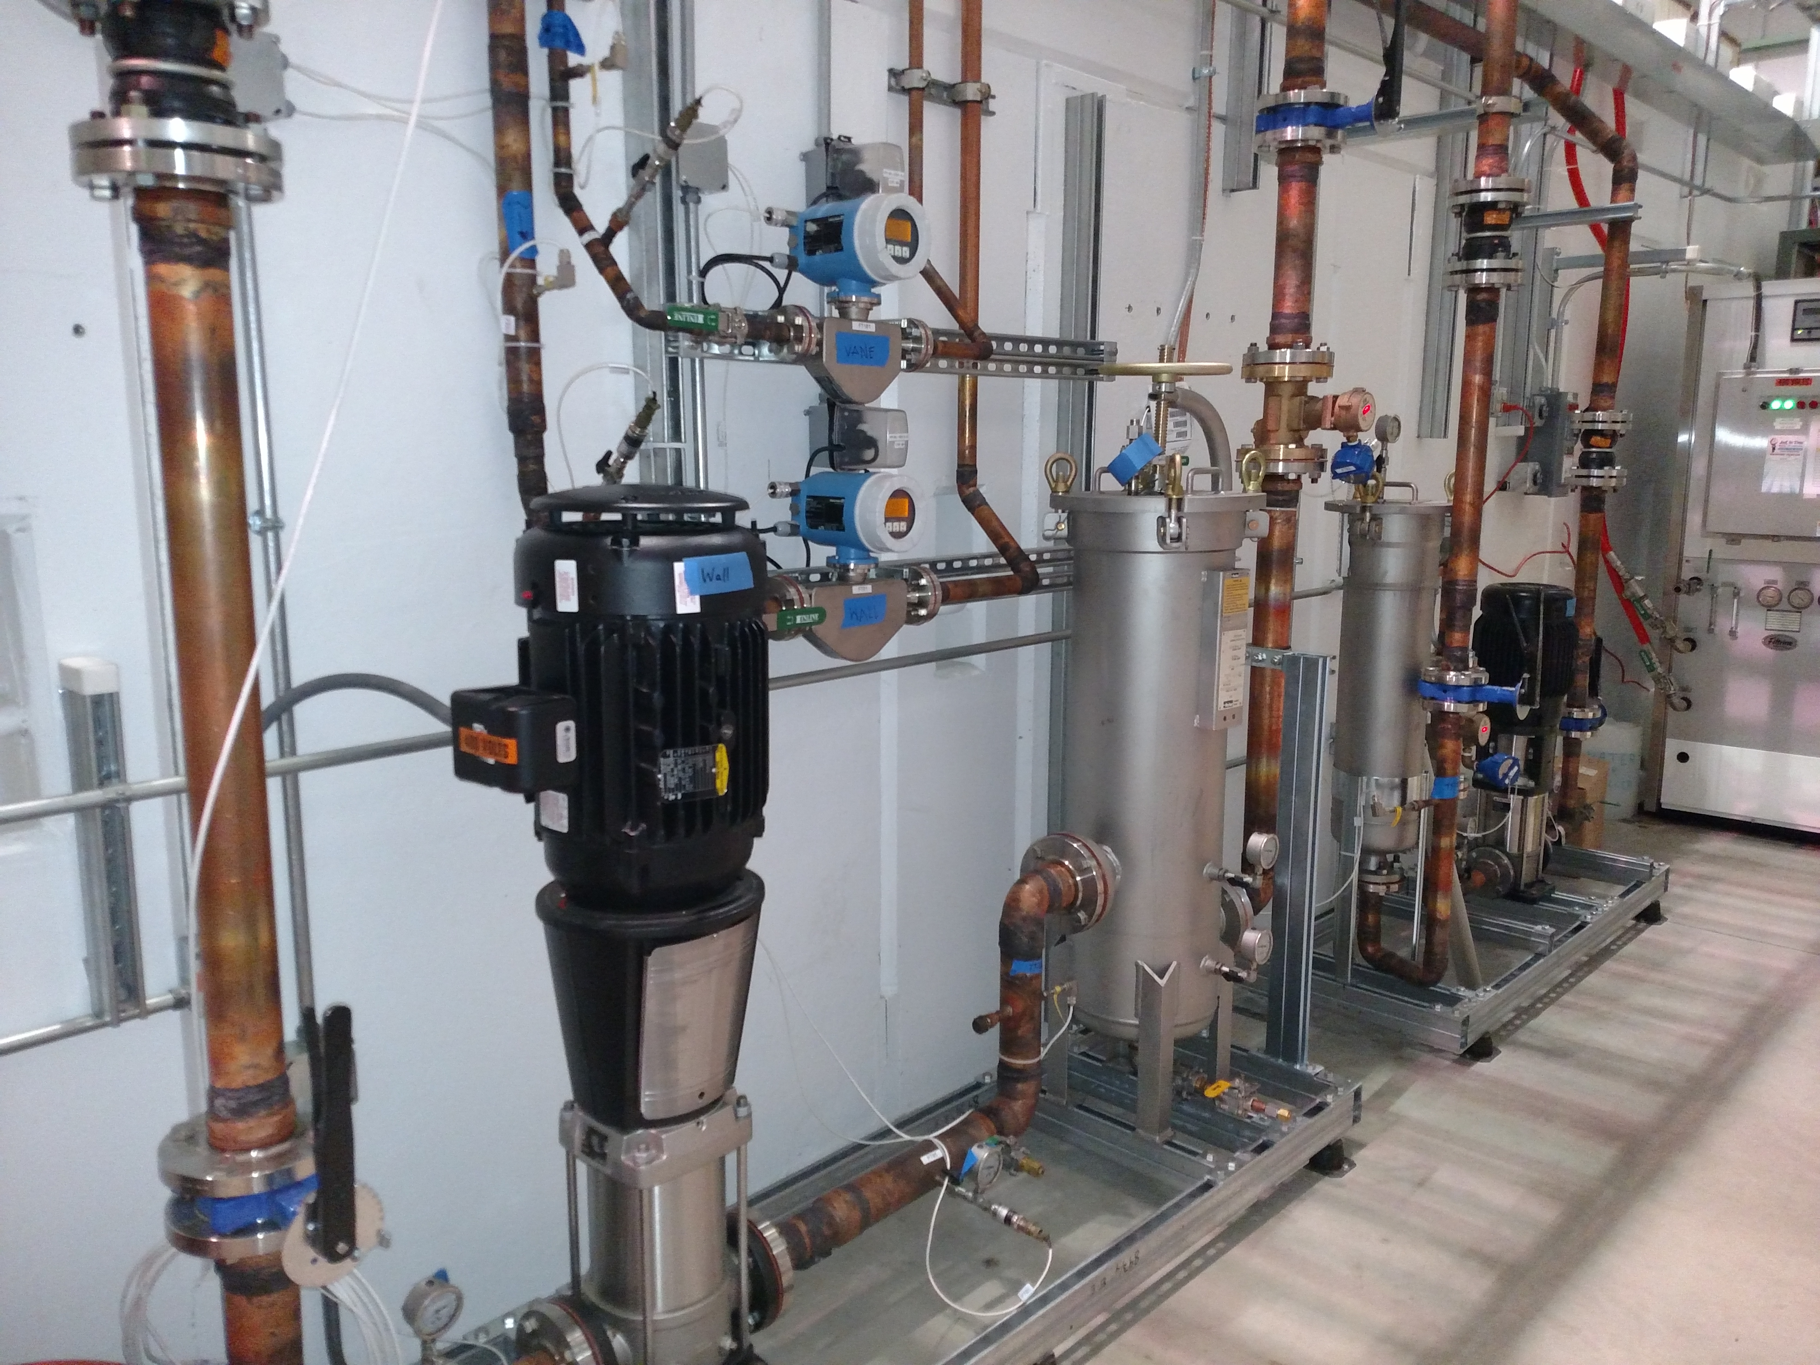
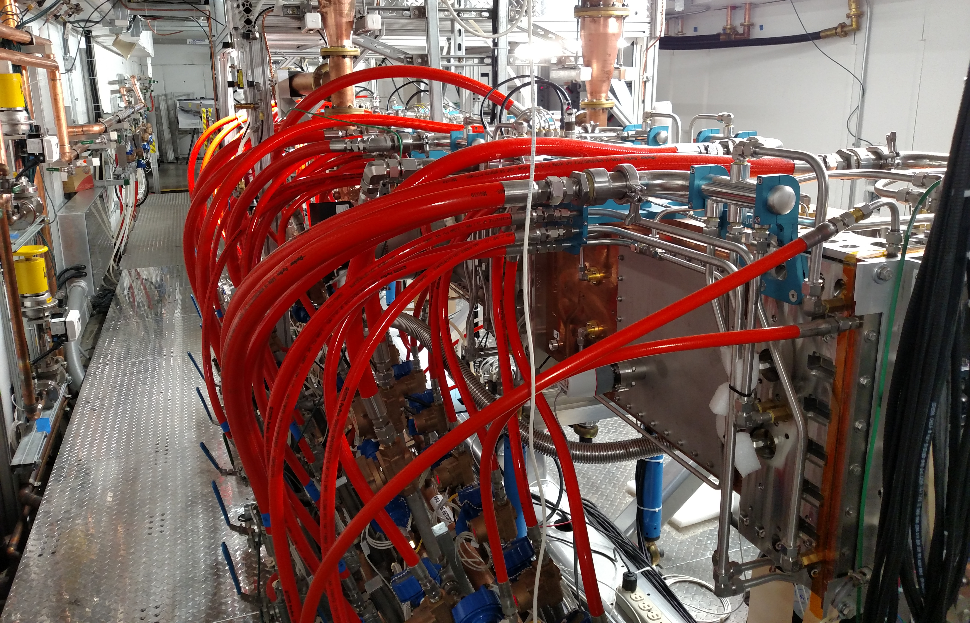
Progress to date – RFQ Cooling System
Charge #1
Manifolding inside cave
Vane and wall skids outside cave

Slide 14
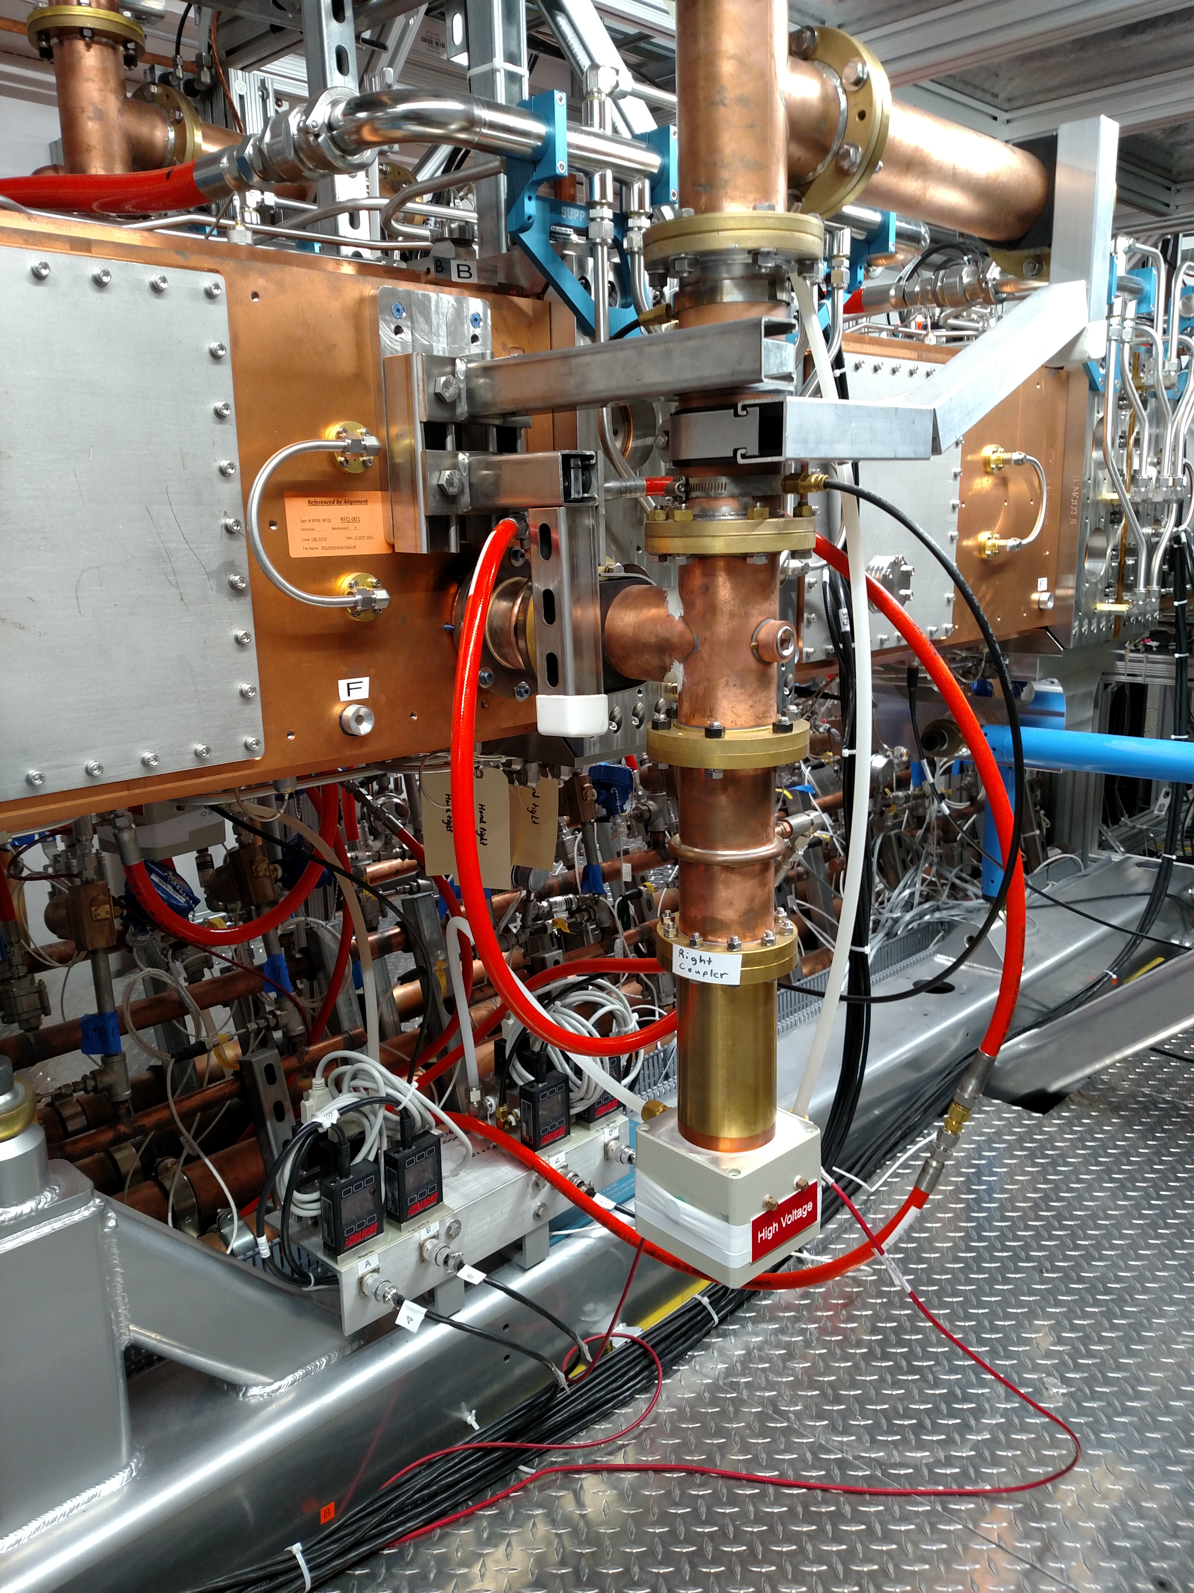
Progress to date – RFQ coupler cooling
Charge #1
Supply
Return air flow measurements for interlocks

Slide 15
Design Review Plan
Charge #3
Completed Review
  RFQ Cooling System Design Review (2015, ED0002899)
Planned Reviews
  Division/Department review procedures apply
  Delineation of systems for reviews
    LCW System
    RAW System
    Air + N₂ Systems reviewed together
    GSS Electrical Infrastructure
  Each system will receive the standard battery of reviews
    Preliminary Design Reviews (FY20)
    Final Design Reviews (FY22)
    Procurement Readiness Reviews for fixed-price contracts (FY23)

Slide 16
ESH&Q
Charge #4
GSS systems are subject to standard safety considerations
Will follow the the Project Integrated ESH Management Plan (Doc 141) and Fermilab ES&H manual (FESHM)
  Pressure/Vacuum Vessels and Piping (FESHM 5000)
    Mechanical hazards “Low” post-mitigation risk per per project HA (PHA-7)
  Electrical systems safety (FESHM 9000)
    Electrical hazards “Moderate” post mitigation risk per project HA (PHA-6)
Some specific considerations
  LOTO scheme is critical, to receive explicit consideration in ICDs
  Grounding scheme is critical, to receive explicit consideration in ICDs
  Cable management, a frequent weakness, is a high priority
Safety will be the paramount consideration throughout the design, procurement, and installation of GSS equipment.

Slide 17
Risk: General Support Services
Requirements or interface definition for Low Conductivity Water (LCW) Less Than Adequate (LTA)
LCW system does not achieve temperature stability requirements

Slide 18
BOE Summary
Charge #2
WBS Number | Title | Docdb #
121.3.19.2 | Linac General Support Services PM and Coordination | 791
121.3.19.3 | Linac General Support Services Fluids Systems | 794
121.3.19.4 | Linac General Support Services Electrical Infrastructure | 800

Slide 19
Cost Summary
Charge #2
Uncertainties chosen attempt to strike a balance between systems that are not yet designed, but fully conventional

Slide 20
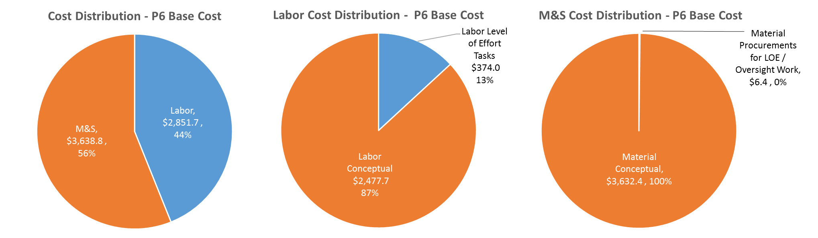
Cost Drivers and Estimate Maturity
Charge #2
P6 Base Costs = BOE + Overheads + Escalation
Labor is driven by design and documentation efforts
M&S is primarily material and equipment purchases
Installation labor not included (captured on 121.3.22)

Slide 21
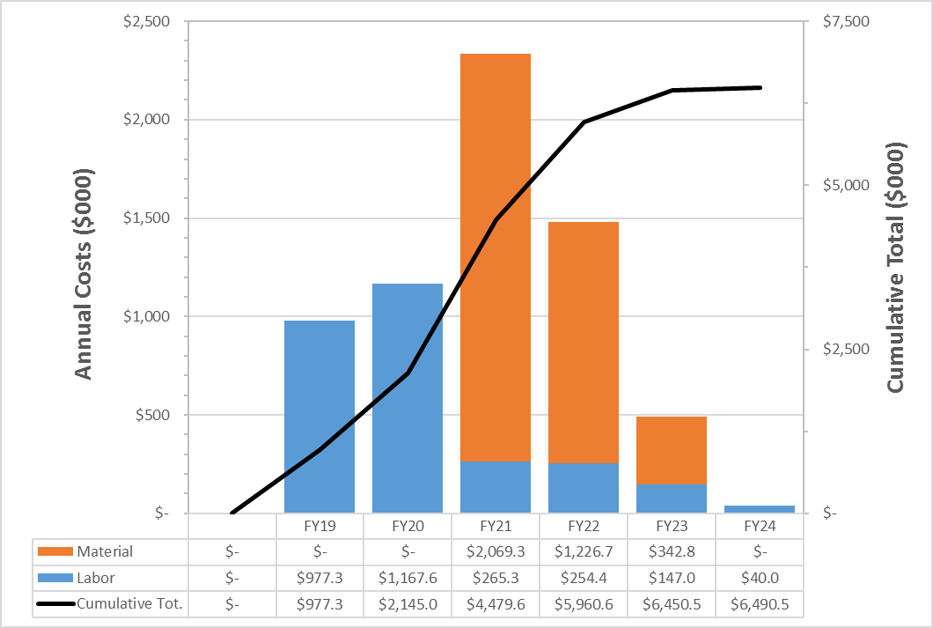
Cost Profile – P6 Base Cost Only
Charge #2
P6 Base Costs = BOE + Overheads + Escalation
Labor peaks in design phase
M&S peaks in procurement phase before installation window

Slide 22
Labor Profile – P6 Hours/FTE
Charge #2
Labor effort driven by design
Note that designers are categorized as “engineers” on this plot

Slide 23
Schedule – General Support Services
Charge #2

Slide 24
Summary
GSS systems are conventional, no further R&D is required
CMTF/PIP2IT systems provide a good design basis for PIP2
Focus of the team in the near term will be interface documentation
We look forward to your feedback, thank you for your attention

Slide 25
END

