Slide 1
121.3.12 Linac Magnet Power Supplies
Linear Accelerator Support Systems,Installation and Commissioning
Bruce Hanna
PIP-II Director’s Review
10-12 October 2017

Slide 2
Outline
Requirements
Conceptual Design, Maturity
Scope/Deliverables
  (Include IIFC !)
Interfaces
Technical Progress to Date
ESH&Q
Risk
Cost
Schedule
Summary

Slide 3
About Me:
I have been involved in PIP2IT since 2013 and have worked on the LEBT and MEBT as well as on preparations for cryomodule installation.
Before working on PIP2 I was involved in Tevatron operations. This work required knowledge of cryogenic systems and their diagnosis as well as beam tuning taking care not to induce beam losses that would result in quenches.
  Involved in the technical aspects of the Separator project and the A0 Abort Project
  Project Manager for the Proton Injection Kicker Upgrade
  Project Manager for the Pbar Kicker Upgrade Project

Slide 4
WBS L3 System Requirements
Charge #1
Documentation:
  HWR PS :FRS# ED0004391; PIP II Doc DB doc # 64-v3
  SSR1 PS: ICD# ED0004129 ; FRS # ED0005929
  SSR2 PS: PIP II Conceptual Design Report, page 141
  High and Low Beta PS: ED0004354
  Beam Line: “Magnets for the SC Linac to Booster Transfer Line draft by V. Lebedev (BoE # 644 Supporting Document)
The power supply requirements for the SC linac have been extensively studied and documented and a summary can be found in the CDR web site

Slide 5
WBS L3 System Requirements
Charge #1
There are five major systems:
  Half Wave Resonator (HWR)
    Cryogenic magnets will require Quench Protection (QPM)
    HWR solenoids must operate up to 70 amps
      Must be able to de-gauss: requires bipolar supplies
    HWR dipole correctors must operate +/- 5 amps (10 A/s)
  Single Spoke Resonator (SSR1)
    Cryogenic magnets will require Quench Protection (QPM)
    SSR1 solenoids must operate up to 70 amps
      Must be able to de-gauss: requires bipolar supplies
    SSR1 correctors must operate +/- 50 amps (25 A/s)
  SSR2
    Cryogenic magnets will require Quench Protection (QPM)

Slide 6
WBS L3 System Requirements
Charge #1
    SSR2 solenoids must operate up to 75 amps
      Must be able to de-gauss: requires bipolar supplies
    SSR2 correctors must operate +/- 50 amps (25 A/s)
  High and Low Beta Sections (warm magnets)
    Quadrupoles must operate up to 15 amps
    Dipole correctors must operate up to +/- 15 amps
  Beam line to Booster
    Five dipole circuits which must operate up to 500 amps.
    Eleven quadrupole circuits that must operate up to 13 amps
    Three “specialty” power supplies for Fast Dipole Switch, 3 way septum magnet and Beam Dump Sweep Magnet
    Fifty Seven corrector magnets

Slide 7
WBS L3 System Requirements
Charge #1
  These power supplies relate to the Linac Key Performance Parameter (Delivery of beam to the Booster) in that they control the optics of the Linac and allow for control of the beam trajectory.

Slide 8
Conceptual Design and Design Maturity
Charge #1
All cryogenic magnet systems (HWR,SSR1 and SSR2) will be similar and will be composed of 1) a bulk supply, 2) switcher modules to provide current to the magnets and 3) a Quench Protection Monitor (QPM)
Switcher module
Bulk Power Supply
Switcher module
Load
QPM Control chassis

Slide 9
Conceptual Design and Design Maturity
Charge #1
The Bulk supply and Switcher modules are a mature technology
  Similar systems are in use at Fermilab
    Booster, PIP2IT,Muon Campus
  We are in the process of redesigning the standard 40 A & 65 A switchers to be able to go up to 50 and 80 amps
QPM system is in the process of being designed
  We have had one internal review to finalize the overall design
  As each component is designed an internal review is done
    So far four boards out of seven have been reviewed and are being drawn up.
  Each QPM Control chassis can handle up to six inputs
Quench analysis is needed for SSR2 solenoids to determine if a dump is necessary to remove stored energy from the magnet during a quench
  This work will begin early in FY 18

Slide 10
Conceptual Design and Design Maturity
Charge #1
The warm corrector magnets in the High Beta and Low Beta sections will use standard switcher module technology that is mature. The quads will use commercially available power supplies
Beam line magnets will need an assortment of high power supplies that are commercially available and switcher modules for correctors
  For dipoles these supplies range from 10 kW to 250 kw
  For quadrupoles the supplies range from 100 to 500 watts
  Three Way Septum Magnet will require a 10 kW supply
  The fast Dipole Switch magnet is a system similar to the MI Gamma-T jump and will help guide the power supply design.
  May need additional current regulation and control interfaces

Slide 11
Scope and Deliverables
Charge #1
For HWR (1 cryomodule, 8 solenoids and 16 correctors):
  Eight 80 amp switcher modules
  Sixteen 10 amp switcher modules
  Four QPM Control Chassis
  Two Bulk supplies
For SSR1 (2 cryo modules,8 solenoids and 32 correctors):
  Eight 80 amp switcher modules
  Thirty-two 50 amp switcher modules
  Eight QPM Control Chassis
  Three Bulk supplies
Both the HWR and SSR1 power supplies will be tested at PIP2IT

Slide 12
Scope and Deliverables
Charge #1
For SSR2 ( 7 cryo modules, 21 solenoids and 84 correctors):
  Twenty-one 80 amp switcher modules
  Eighty-four 50 amp switcher modules
  Twenty-one QPM Control Chassis
  Nine Bulk supplies
For 650 MHz Low Beta (11 cryo modules, 22 quads and 22 correctors):
  Twenty-two 750 Watt TDK-Lambda power supplies
  Twenty-two15 amp switcher modules (modified 10 amp switcher modules) for correctors
  One Bulk supply
For 650 MHz High Beta (4 cryo modules, 18 quads and 18 correctors) (this include empty slots at the end of the Linac):

Slide 13
Scope and Deliverables
Charge #1
  Eight-teen 750 watt TDK Lambda power supplies
  Eight-teen 15 amp switcher modules (modified 10 amp switcher modules)
Beamline Dipoles (all operate up to 500 amps)
  One 250 kW supply (string of 24 dipoles)
  One 100 kW supply (string of 13 dipoles)
  Two 15 kW supplies (end of line dipoles)
  One 7.5 kW supply (end of line dipole)
Beamline Quadrupoles ( all operate up to 15 amps)
  Eleven 750 watt supplies
Beamline Correctors
  Fifty-seven 10 amp switcher modules
  Two bulk supplies

Slide 14
Scope and Deliverables
Charge #1
Specialty Devices
  The magnet design is not mature so these power supply parameters are estimates based on some assumptions
  Three way Septum magnet
    One 10 kW supply capable of 1000 amps
    Assume a scaled version of the existing Recycler Lambertson Magnet
  Fast Dipole Switch
    IGBT pulser capable of 300 amps and 20 volts
    Assume a single turn kicker style magnet
  Beam Dump Sweep Magnet
    60 Hz device capable of 500 amps
    Assume a low inductance magnet

Slide 15
Interfaces
Charge #1
The 650 MHz section will contain warm magnets from the India Collaboration
  We will monitor magnet specs to insure the power supplies will provide the necessary voltage and current
We will monitor design of Beamline elements to insure that the power supply design is consistent with the magnet
All power supplies will need to interface with the Controls System
Power Supply status will need to interface with the Machine Protection System (MPS)
Cryogenic magnet power supplies will need to interface with the cryogenics system

Slide 16
Interfaces; Matrix
Charge #1

Slide 17
Progress to date
Charge #1
A team of electrical engineers is working on the PIP2IT power supply/QPM system
  Conceptual design meetings have been held
  Cost estimate was done and reviewed internally
  QPM boards are being designed and reviewed internally
  Switcher modules are being upgraded to meet our demands based on testing at the maximum PIP2IT currents.
    Re-design is in progress
  We have been doing tests on power plugs used for connecting the power supply cables to the cryo vessel feed-thrus.
  QPM software development is in progress

Slide 18
Design Review Plan
Charge #3
We are following all Division/ Department procedures
EE Support Department has done several internal design reviews:
  Cost review for PIP2IT has been completed
  Design of QPM components are reviewed after the design is completed.
    Currently 4 board designs are complete and reviewed
    Drafting of these boards is in progress
Once the QPM design is complete and drawn up there will be additional EE Support Internal reviews
Switcher module re-design will be reviewed.
Procurement Readiness Reviews will be performed as appropriate.

Slide 19
Risk: Power Supply
Quench calculations indicate inadequate QPM system
  May need to add dumps for SSR2
Design/construction of a QPM system for superconducting solenoid and correction elements is delayed
Quench analysis shows SSR1 protection is insufficient
  Would require design and construction of dumps for SSR1

Slide 20
ESH&Q
Charge #4
All power supply systems will conform to Fermilab electrical standards
  Switcher module supplies already are in extensive use at Fermilab
  All necessary LOTO procedures will be documented
  All cabling will be in accordance with NEC code
  Grounding will be reviewed as systems are installed
We will follow the project Integrated Safety Management and Quality Assurance Plans(DocDB #141 and 142)
  Components will be tested accordingly
Safety is a high priority and we will coordinate activities with ESH&Q

Slide 21
BOE Summary
Charge #2
WBS Number | Title | Docdb #
121.3.13.2 | Linac-Magnet PS Project Management and Coordination | 719
121.3.13.3 | Linac-Magnet PS PIP2IT Power Supply Systems for HWR and SSR1 | 632
121.3.13.4 | Linac-Magnet PS SSR1 (CM2)Power Supply System | 635
121.3.13.5 | Linac-Magnet PS SSR2(1st-7th CM)Power Supply System | 638
121.3.13.6 | Linac-Magnet PS Warm Units Power Supply System | 641
121.3.13.7 | Linac-Magnet PS Beam Transfer Line Power Supply System | 644

Slide 22
Cost Summary
Charge #2
Costs are generated from resource loaded schedule
  Costs for switcher supplies is well known
Estimate uncertainty follows from project guidelines

Slide 23
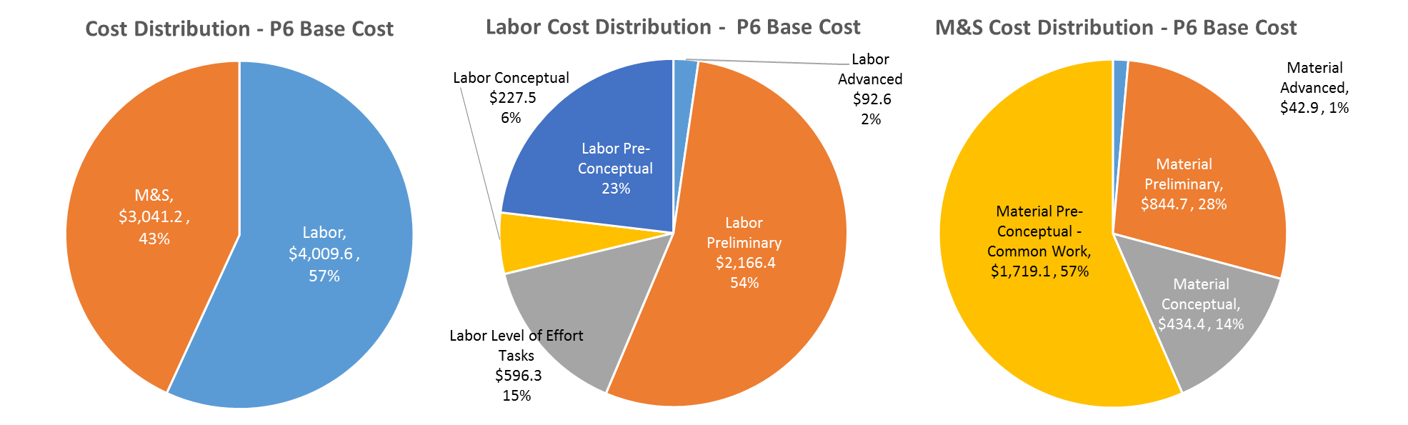
Cost Drivers and Estimate Maturity
Charge #2
Cost is driven by labor
Major M&S costs are for bipolar switcher supplies
  Used for all correctors, HWR,SSR1 and SSR2 solenoids
Main uncertainties are in the Beamline power supplies

Slide 24
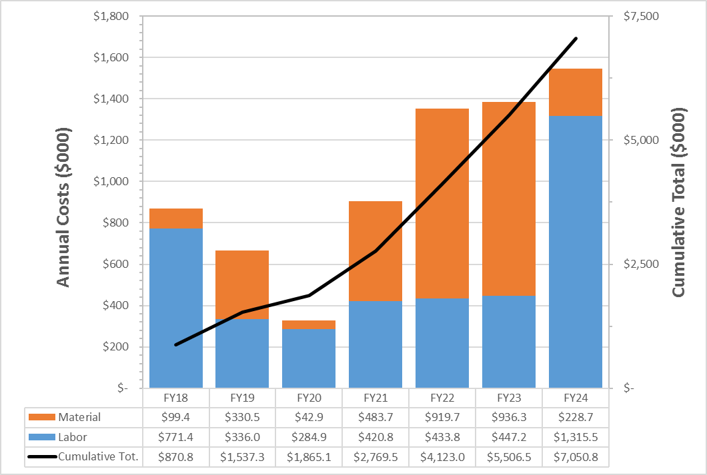
Cost Profile – P6 Base Cost Only
Charge #2
- Peak in FY18 is for initial procurement for PIP2IT and R&D for QPM
- Material costs rise after FY20 as we purchase power supplies past PIP2IT Linac

Slide 25
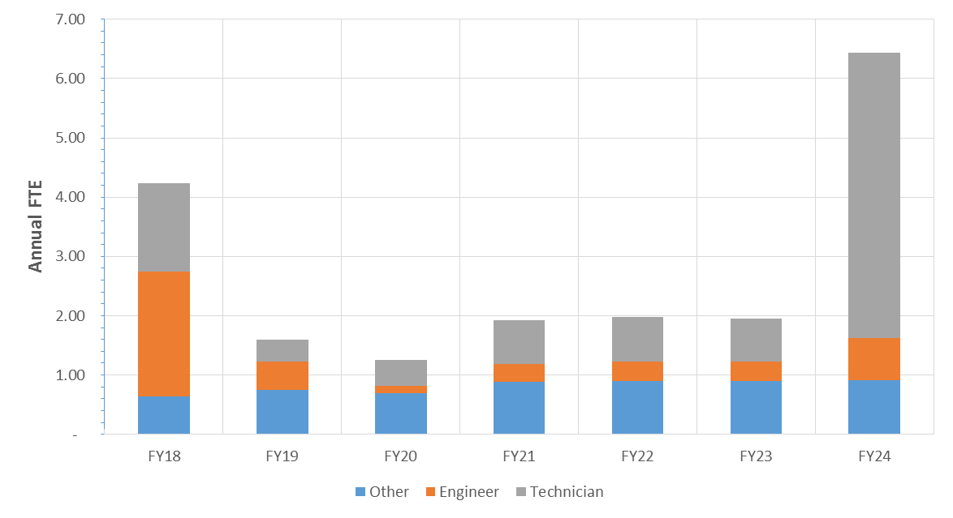
Labor Profile – P6 Hours/FTE
Charge #2
  Large FTE in FY18 is for QPM design, testing, quench analysis and procurement

Slide 26
Schedule – Magnet Power Supply
Charge #2
-Switcher power supplies will take 1.5 years to complete from start of procurement
  -QPMs and power supplies are not the critical path
- For PIP2 Linac power supplies, need beneficial occupancy of gallery

Slide 27
Summary
Requirements have been defined for all power supply systems
Project team for PIP2IT power supplies has been assembled and is actively working on the project
Conceptual design of QPMs has been completed.
  Once prototyping and testing are complete we will know better what we need for SSR1 CM #2 and SSR2
The need for a QPM analysis is understood and will commence in FY18.
Costs and schedule are well understood
  Similar switcher supply systems are in use at Fermilab
We are ready for CD-1 and look forward to your feedback
Thank you for your attention

Slide 28
END

