Slide 1
DUNE-SP Cable Feedthrus
Jim Stewart
Far Detector Technical Board
Sept 29 2017

Slide 2
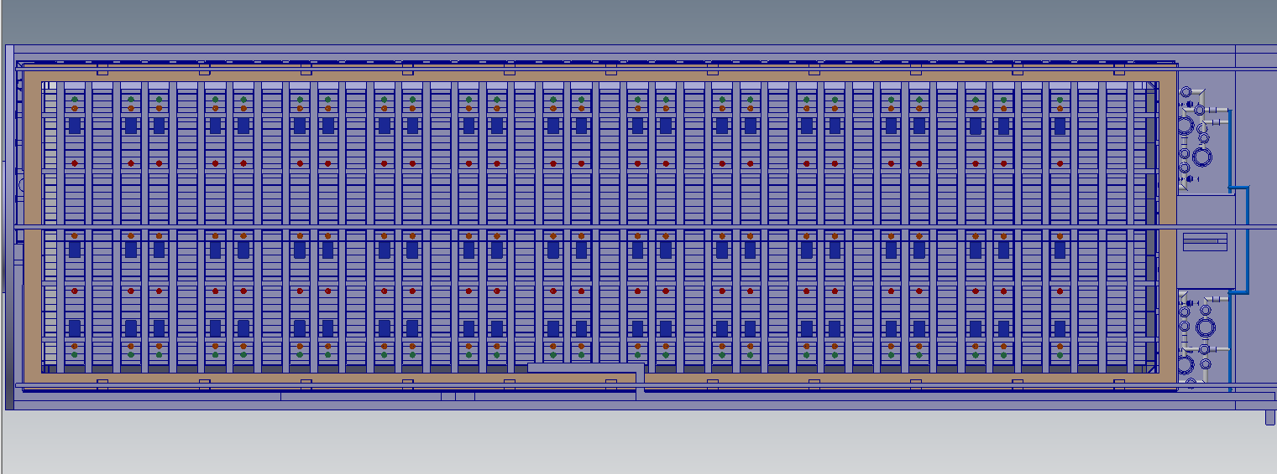
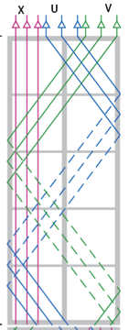
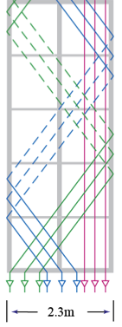
Present Rack Feedthru Layout
APA
CPA
RACKS
APA
CPA
APA
The present layout has feedthrus for 24 APA pairs per row.
We need 25 APA pairs per row so a change is needed.
We need 1 penetration per APA pair (Top APA-Bottom APA).
We show one rack per cable penetration. There are no slow control racks in this model.

Slide 3
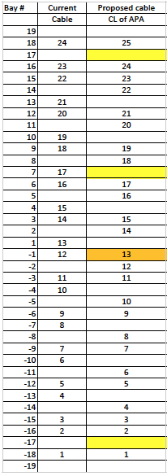
Cartoon of the APA Placement
18
17
16
15
14
13
12
11
10
9
8
7
6
5
4
3
2
1
1
2
3
4
5
6
7
8
9
10
11
12
13
14
15
16
17
18
Jack is adopting a bay numbering scheme for the gaps between I-Beams. The bay numbers are shown at the top. Red is negative.
The Proposed Bay slots for the cabling is shown in the table.
There are 11 empty slots.
The feedthrus are centered in the bays and ~1m inbound from the DSS supports. This gives space to work and ensures that access to the ports is un-impeded.

Slide 4
Penetration Diameter
The remaining consideration is the diameter of the penetrations.
As neither the design of the Cold Electronics (CE) not the Photon Detector (PD) are complete the space requirements must be based on assumptions and then we need to look at how much margin we have.
As a starting point we have taken cables from ProtoDUNE-SP and created a strawman design of the feedthru assuming that we have cables for two APAs and 20 PD detectors (with Spares).
I also assume that the cables cannot run up the wall of the cryostat. Feedback from the cryostat team indicate that attaching support points to the walls is impossible. The only support points available are using small bolts at the edges. The cable mass of the detector is large – (the CE power cables alone are ~100 lb).

Slide 5
CE cables
ProtoDUNE-SP Data Cable
7m long custom edge card cable assembly. The DUNE-SP cables will be 25m long.
ProtoDUNE-SP Power Cable
The ProtoDUNE-SP cables are 7m long. The DUNE cables are 25m long.
Each APA will have 22 CE data cables and 22 CE power cables.
This assumes 2 spare cables per APA pair.
Extensive tests have been done and the Samtec 26 gauge cables are the only cables to have adequate data transmission capability over the 25m with acceptable cost. We assume here we will use these cables.

Slide 6
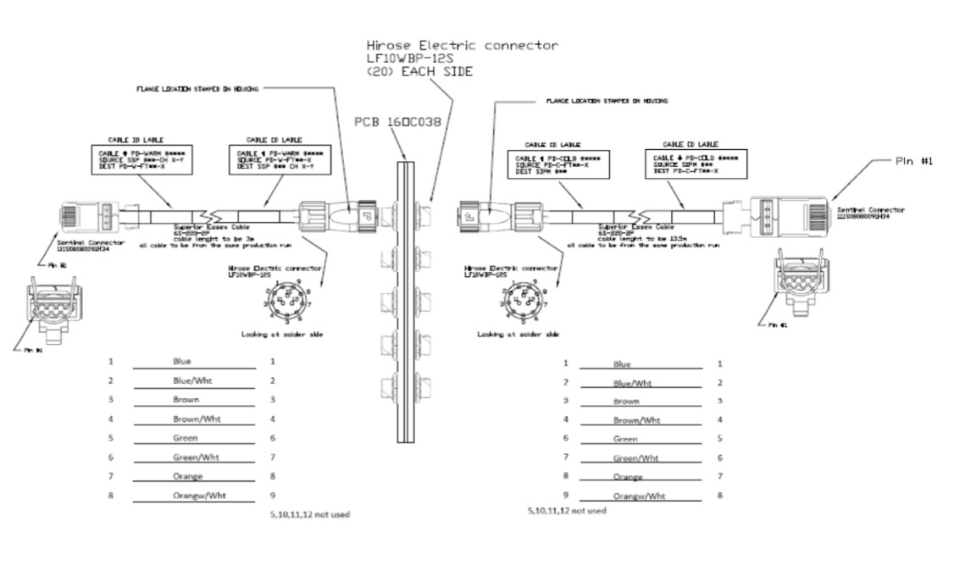
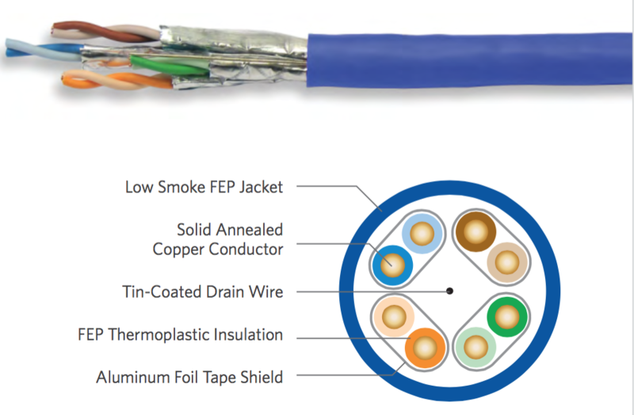
ProtoDUNE-SP Cable Assembly
WARM SIDE
COLD SIDE
WARM-COLD
INTERFACE
Teflon® Jacket Cat-6
RJ-45 Connector
(SiPM Board and SSP)
Hirose Twist-Lock
Bayonet (Flange)

Slide 7
DUNE PD cables
It is unlikely that the ProtoDUNE-SP PD cables will be used for DUNE. They are very expensive and take significant space.
For the purpose of estimating the space needed in the feedthru I assume that the final PD cable volume will be roughly equal to the existing cable bundle.
The changes to the PD system will either then need to fit in this space allotment or need to negotiate using the spare space.

Slide 8
Strawman Signal Feedthrough Design

Slide 9
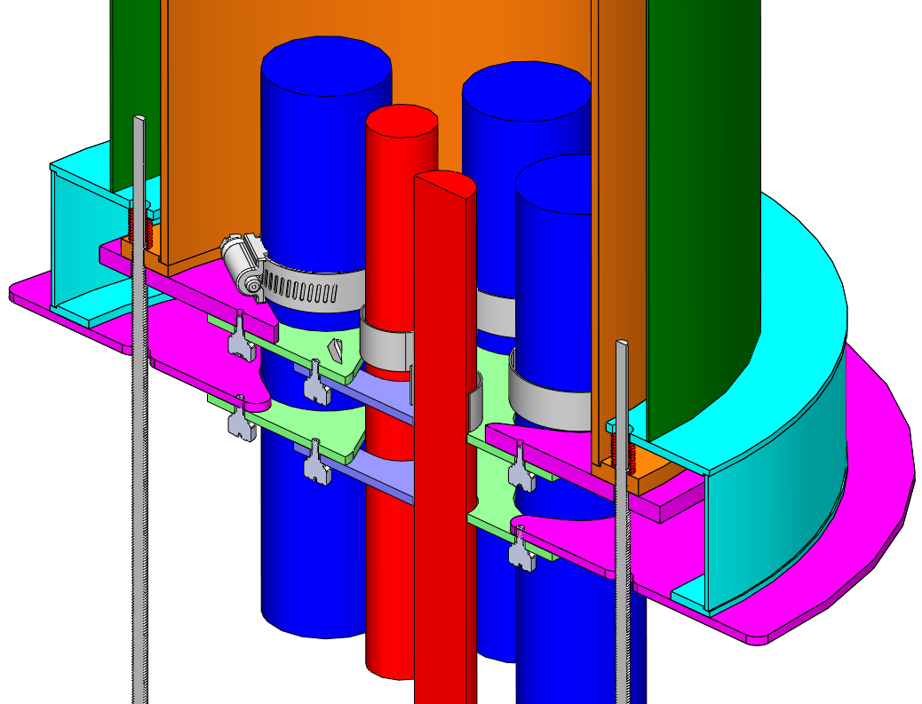
Cable Strain Relief Installed on CERN Crossing Tube
Tube alignment screws
Current CERN crossing tube: 250 mm (OD), 230 mm (ID).
Tip angle of the crossing tube and flange flatness are irrelevant
Inner tube confines contaminates
CERN crossing tube
CE cables
Inner tube 203mm (8in OD)
GAr Flow
PD cables
13.5 mm
GAP
(SPARE)
Clamp plate

Slide 10
Penetration Cabling Plan
PD cable bundle
8 PD cables
φ25mm
Assume 3 bundles
(4 spare cables)
CE cable bundle
8 CE data/power cables
φ44mm
Assume 6 cable bundles
(8 Spare Power and data cables)
Click to watch animation

Slide 11
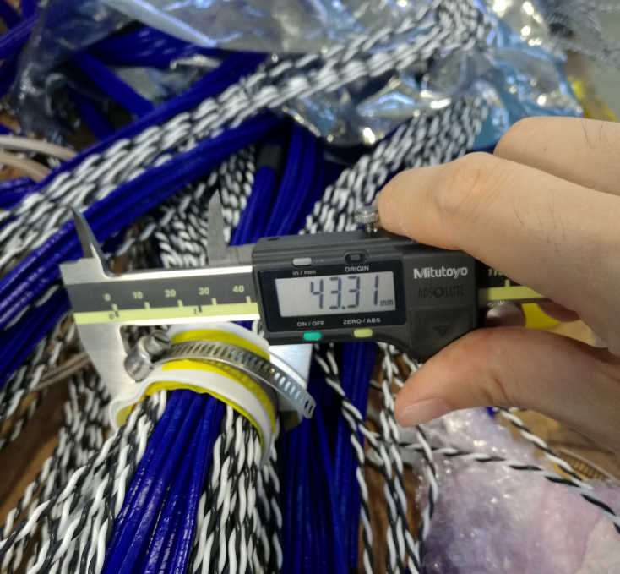
Validation and contingency
The ultimate contingency is defined by the diameter of the crossing tube.
Given the diameter of the cable and the connectors Manhong has estimated there is roughly 20% contingency on the cable bundle cross section through the crossing tube.
Diameter of the bundle of 8 CE cables is 44 mm.
Pull tests indicate the strain relief is adequate.

Slide 12
Summary
A change order is needed to increase the number of penetrations from 24 to 25 for each APA row.
Add 4 penetrations
The existing 250mm diameter (230mm ID) are sufficient for the APA cable plant.
A feedthru concept based on ProtoDUNE-SP cables with 10% spares was presented.
A space contingency of roughly 20% was estimated but this is very rough.
Prototyping is necessary to be sure this works. This is planned in 2018.

Slide 13
Backup Slides

Slide 14
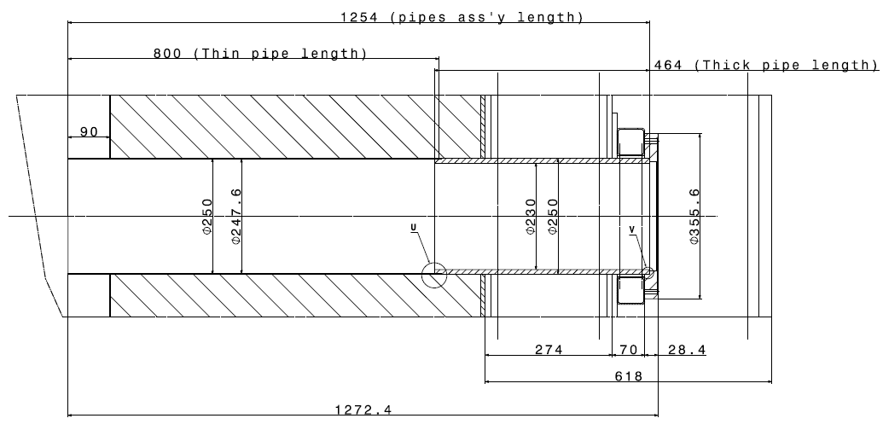
CERN Crossing Tube for ProtoDUNE
OD: 250mm
ID: 230mm

Slide 16
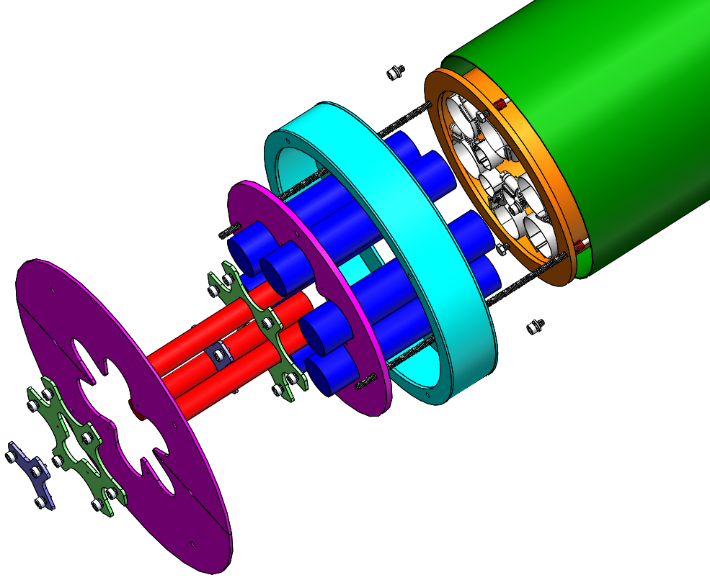

Slide 17
