Slide 1

TPB Solubility in Liquid Argon
B.J.P Jones, Jonathan Asaadi, Hunter Sullivan, Andrzej Szelc, Zach Williams

Slide 2
The motivation
High rate of random light in MicroBooNE, apparently uncorrelated (or correlated w/ very long time constant) to events.
Neither argon nor TPB appear to have such time constants
TPB dissolved in liquid argon may be part of the solution*.
* Pun intended.

Slide 3
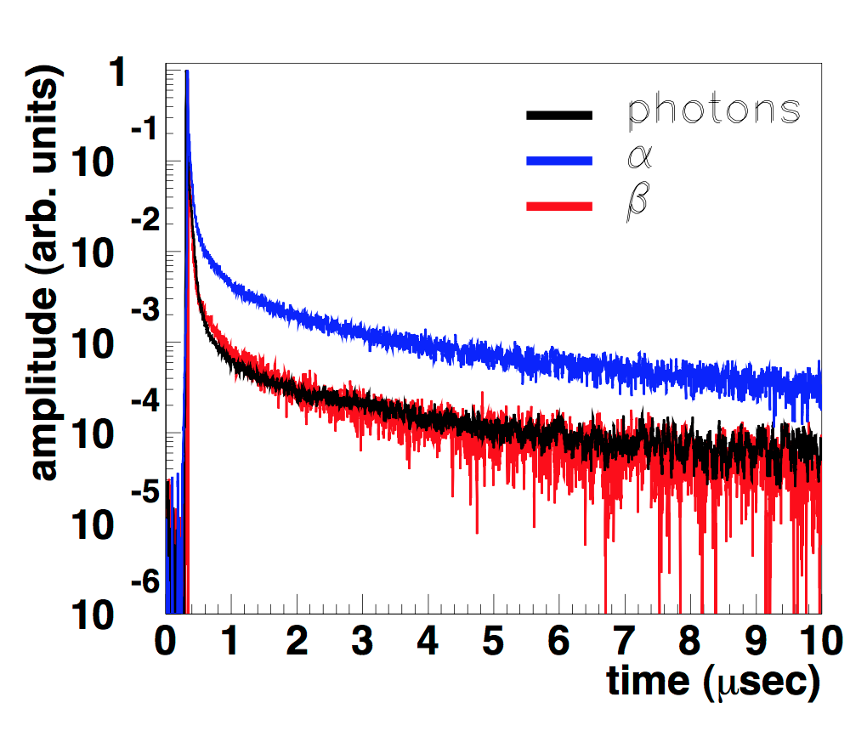
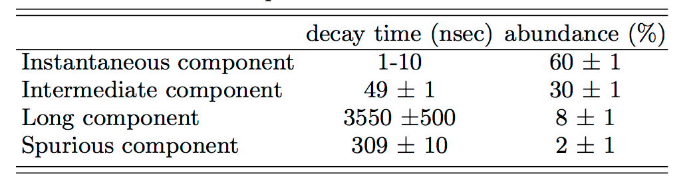
TPB time constants
Phys.Rev. C91 (2015) no.3, 035503
Short (ns) for visible near UV excitation.
Ettore showed TPB time constants O(microseconds) at 128nm
Not O(>100 ms) needed to explain MicroBooNE light as delayed emission

Slide 4
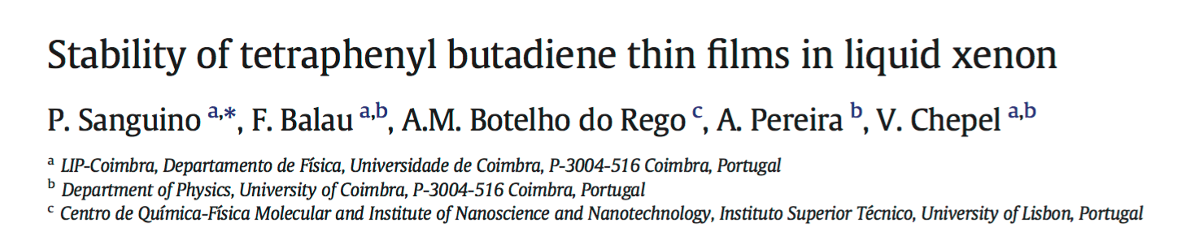
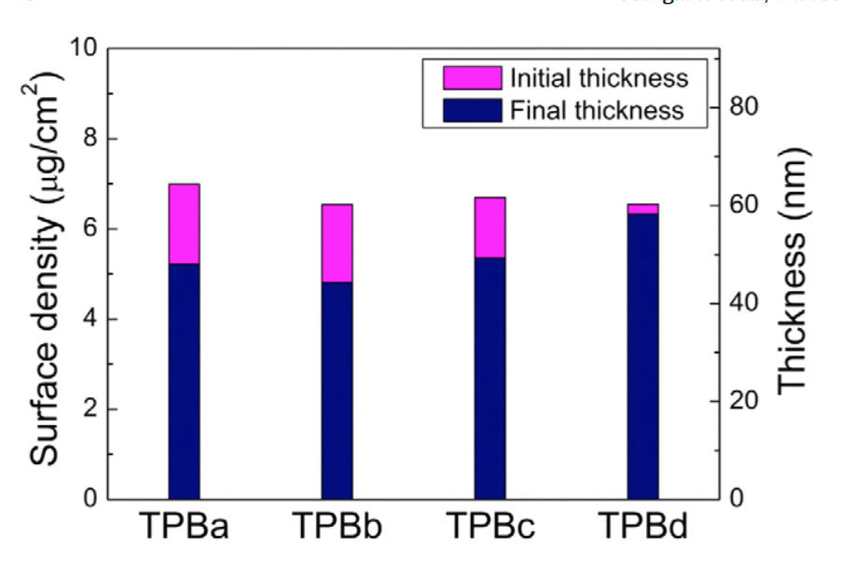
Solubility of TPB in xenon
A known effect in xenon is TPB solubility:
Thin Solid Films Volume 600, 1 February 2016, Pages 65-70
← Coating thickness is reduced after 20hr soak in xenon

Slide 5
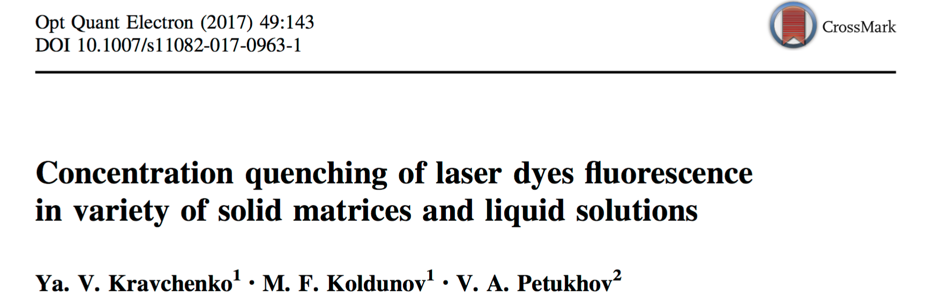
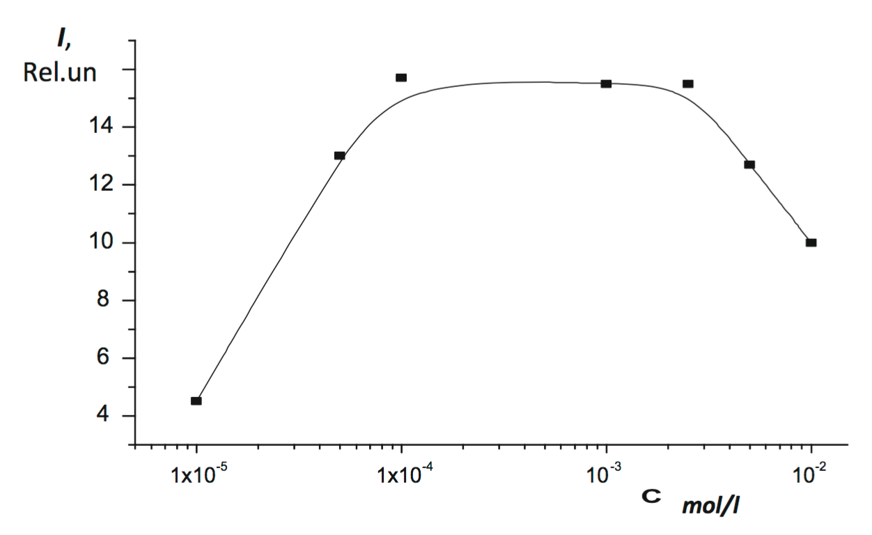
Why might solubility be related to time constants?
A common effect in many fluors is self-quenching against neighbors. At some point, more concentration→ less light.
← A solid coating is likely to be highly self-quenched for long time constants.
But a diffuse solution, maybe not so much.
Self-quenched regime

Slide 6
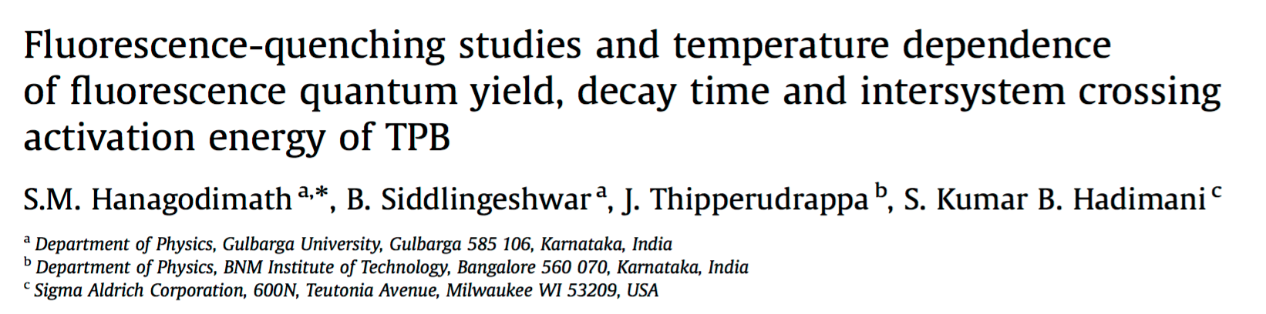
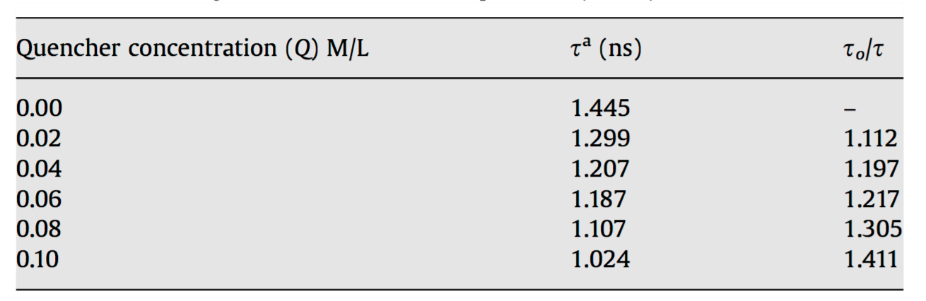
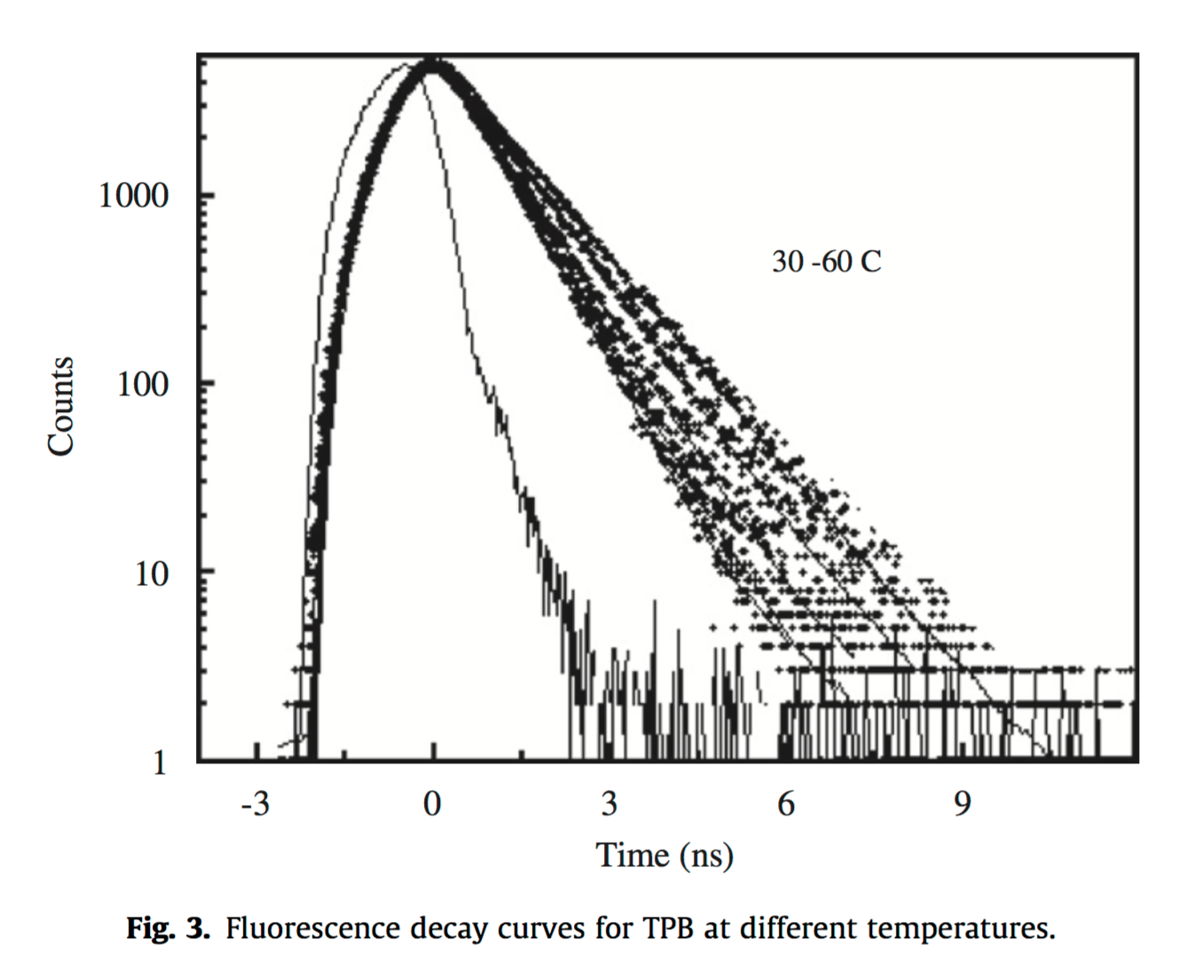
At high enough concentrations even the short component of TPB is known to be self-quenched.
At very low conc. in argon, could there be a very long TPB component, which is completely quenched in the solid?

Slide 7
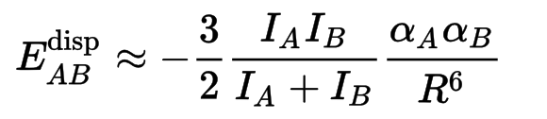
Is TPB likely to be soluble in argon?
Solubility in noble gases is dominated by Van Der Waals forces.
The strength can be estimated from the London dispersion equation:
Ionization potentials of each species
Polarizibilities of each species

Slide 8
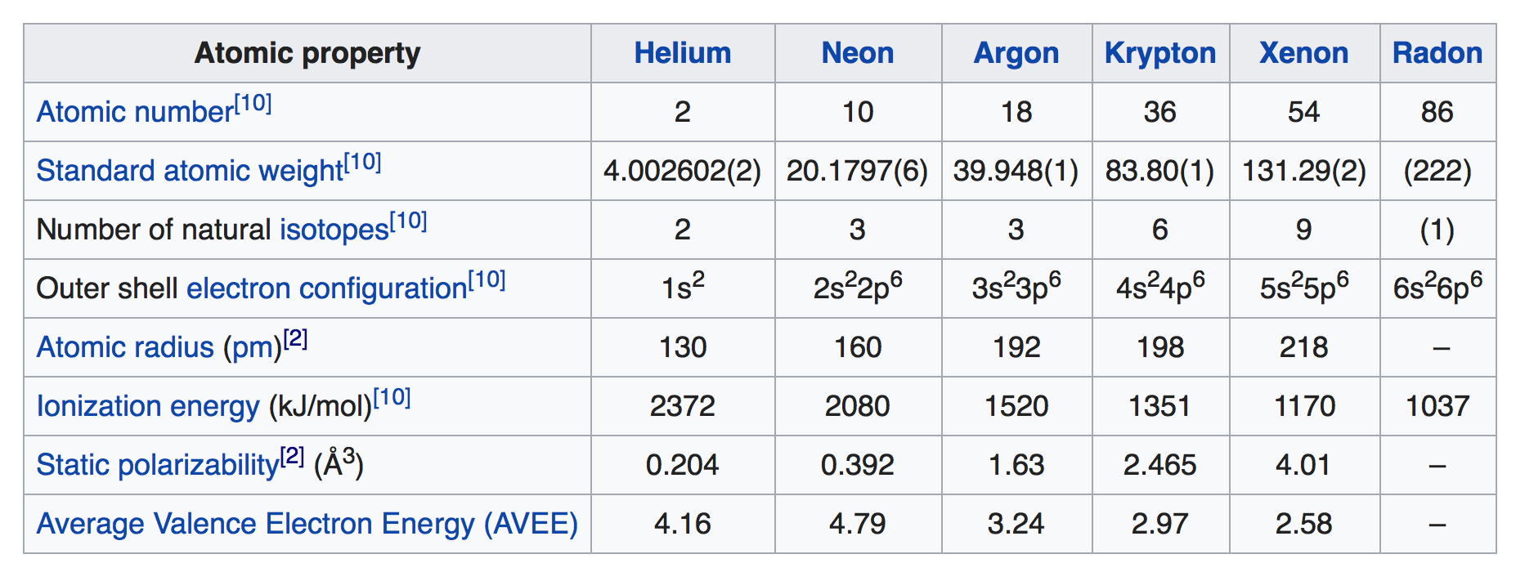
Vital Statistics (from wikipedia, obvs):
+Estimate ionization energy of TPB is around 5eV →
F_{VDW}(Xe) / F_{VDW}(Ar) ~ 2.6
Van-Der-Waals forces which cause solubility 2.6 times weaker in argon than xenon.
This seems small enough to reasonably expect solubility in LAr, given precedent in LXe

Slide 9
Is TPB actually soluble in liquid argon?
Our plan:
  1) Check for solubility
  2) If observed, check for light emission from TPB+Ar solutions
  3) If confirmed, measure relevant time constants

Slide 10
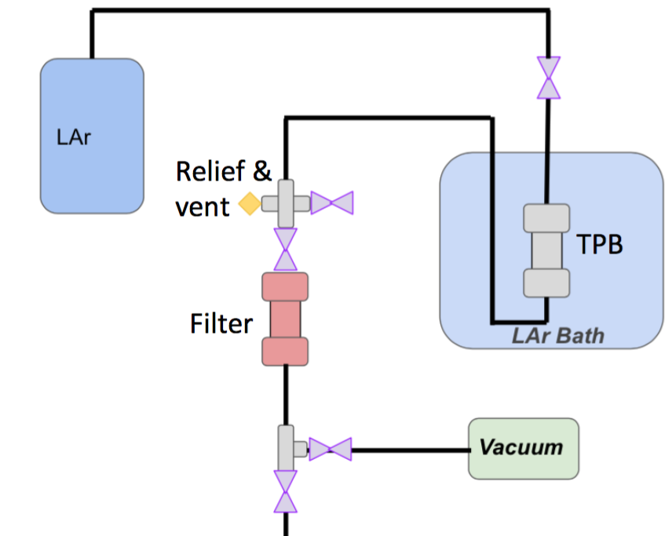
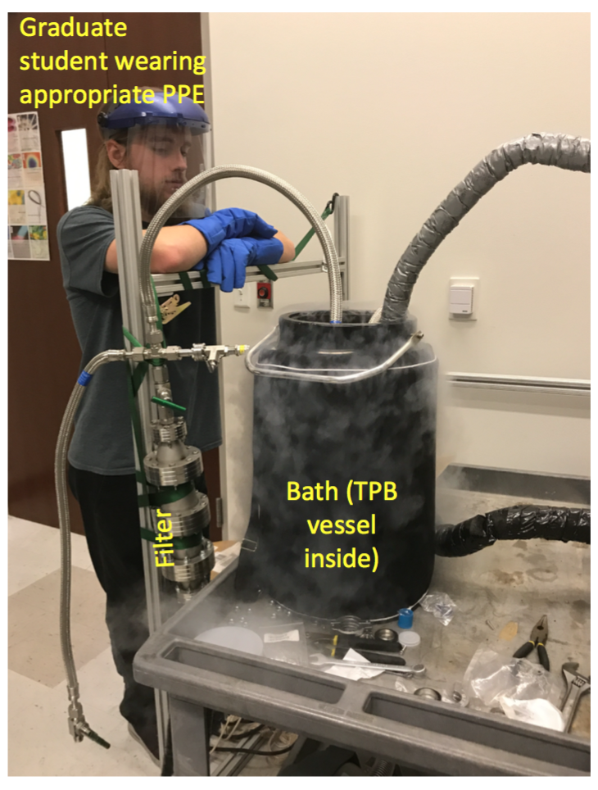
TPB
coated
stuff
Sintered disk
(remove flakes)
Assay sieves w/fluorescence and GCMS
Measurement strategy:
- Soak TPB coating in argon for ~24 hours
Push out through sintered disk (to remove grains) and molecular seives (to catch TPB)
Assay the seives to measure how much TPB dissolved.

Slide 11
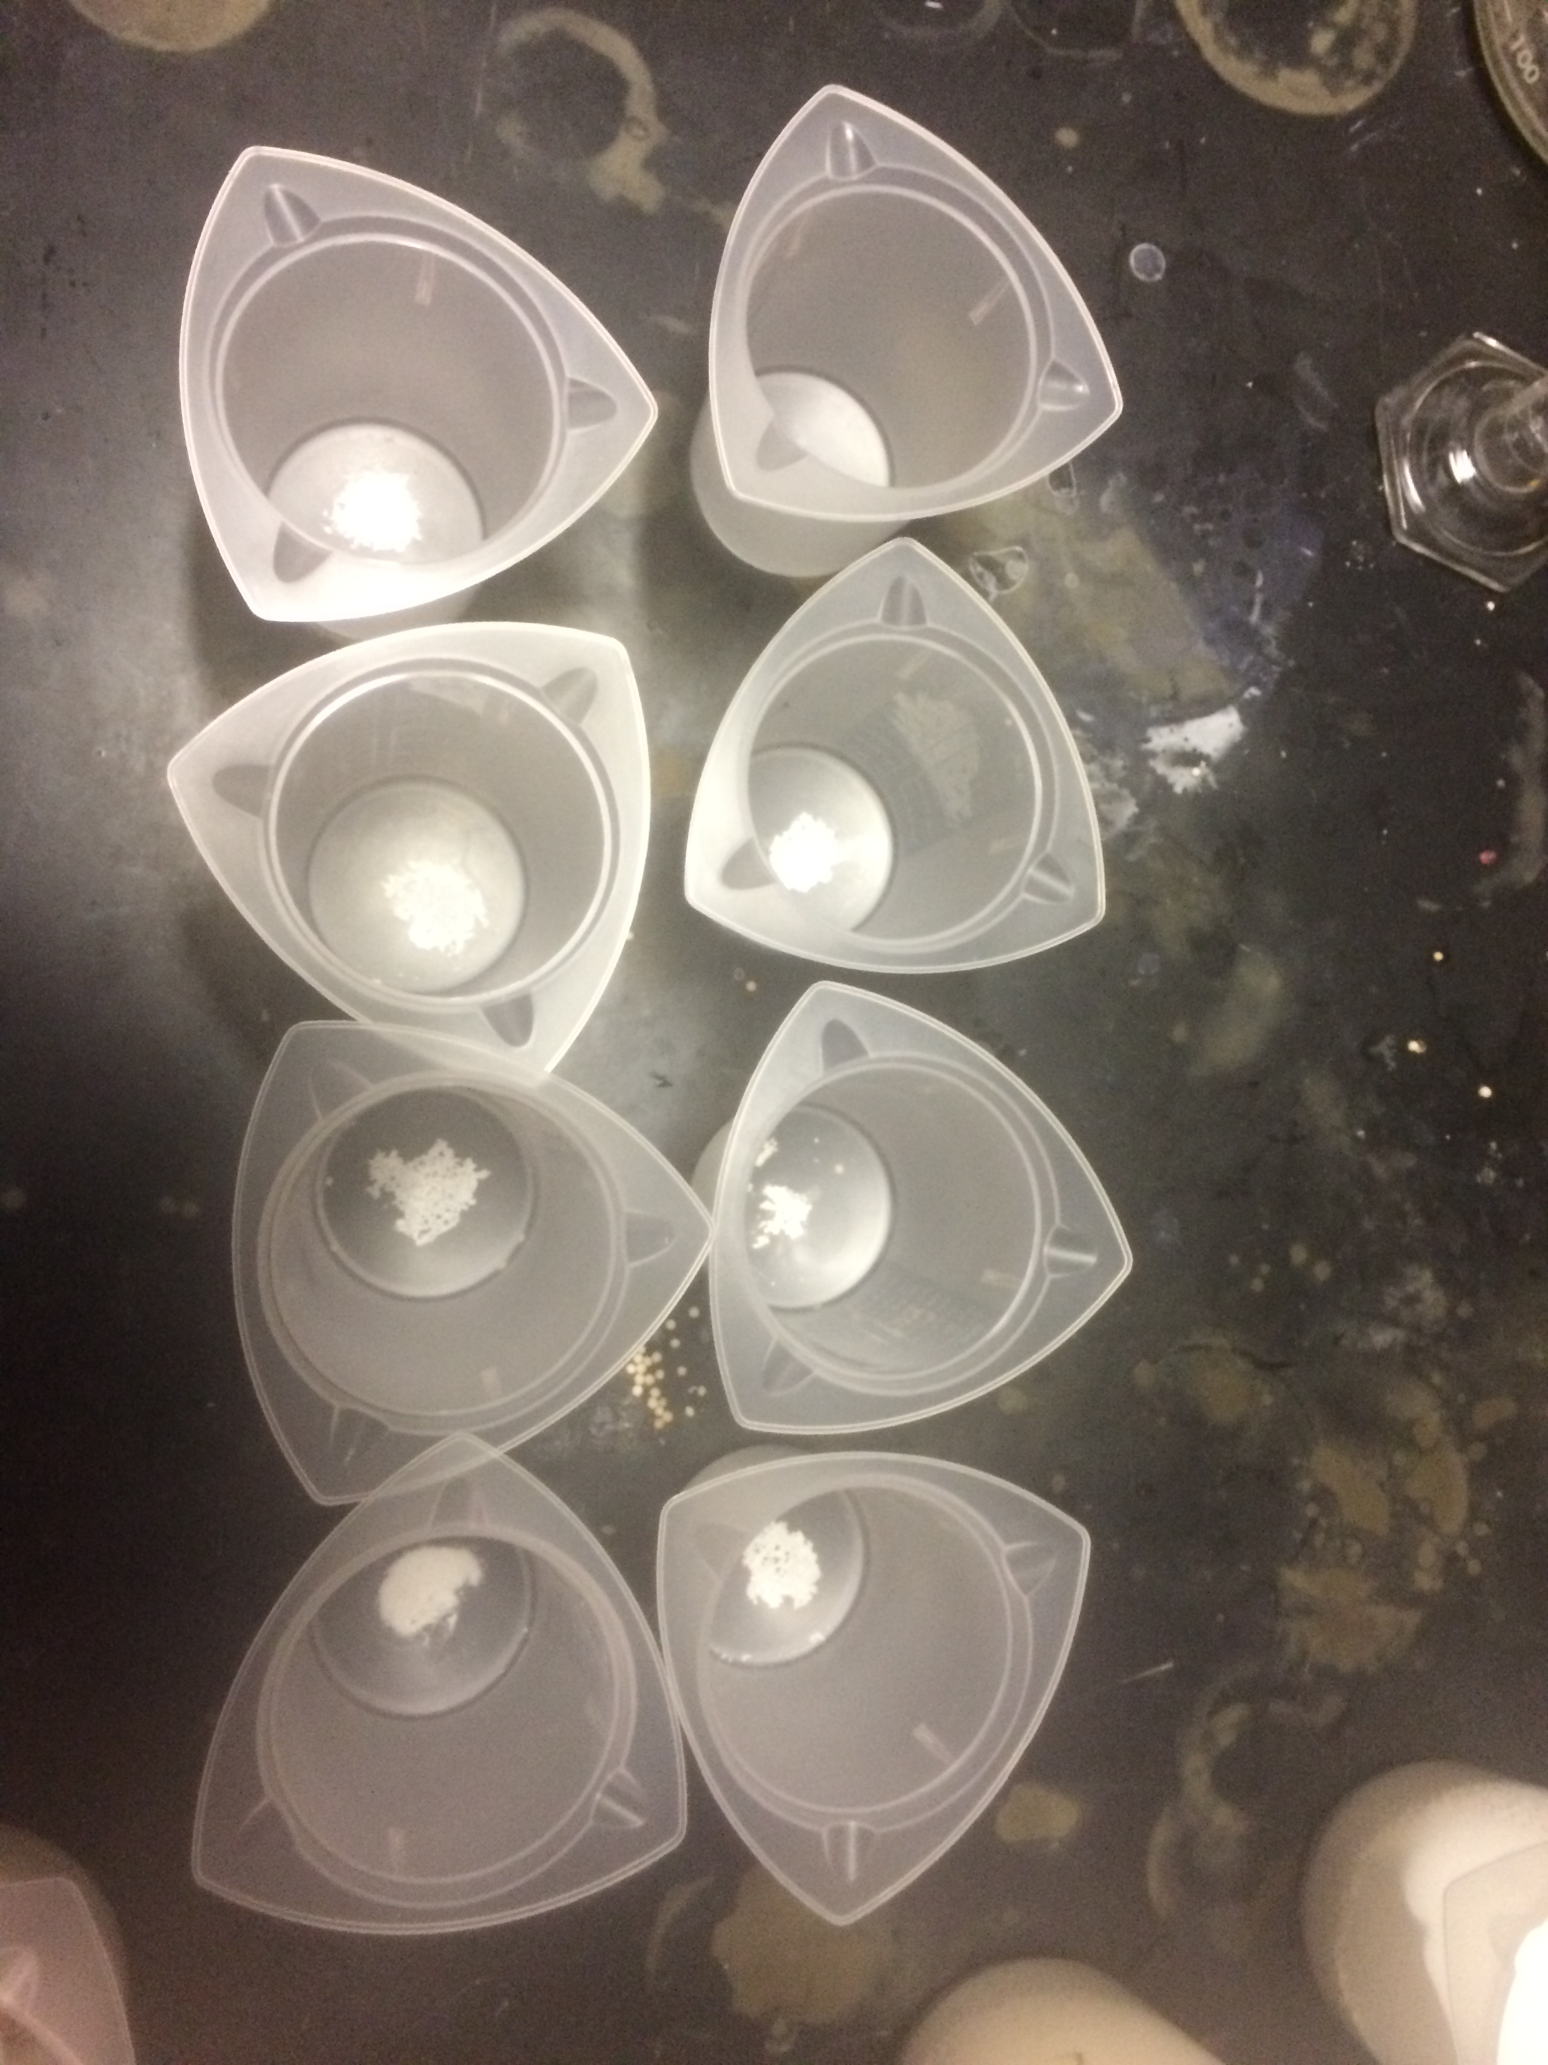
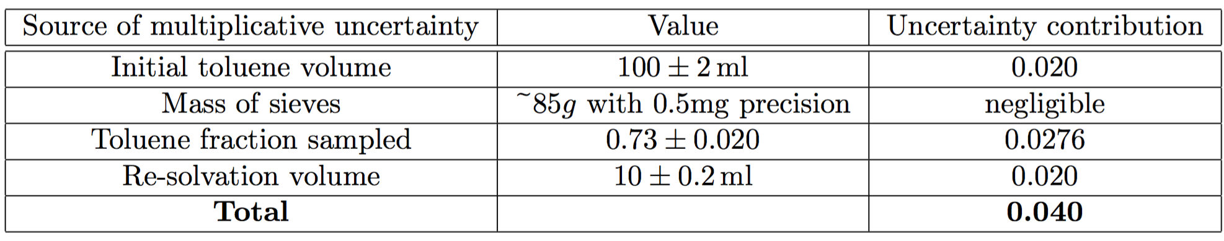
Assay procedure
Extract seives in ~90mg batches. Throw away a little from each batch to get 85±1g.
Soak in 100 ml toluene for 1 hour, stirring every 15 minutes
Filter with fine filter paper into a clean beaker
Allow to evaporate at room temp for ~8 hours (no heating - heat degrades TPB)
White residue of seive dust remains in beaker. Re-dissolve in 10ml toluene
Scan in 3ml quartz cuvettes using Cary Agilent Eclipse spectrophotometer, 350nm excitation.
^ Residue (mostly sieve dust, present also with control)

Slide 12
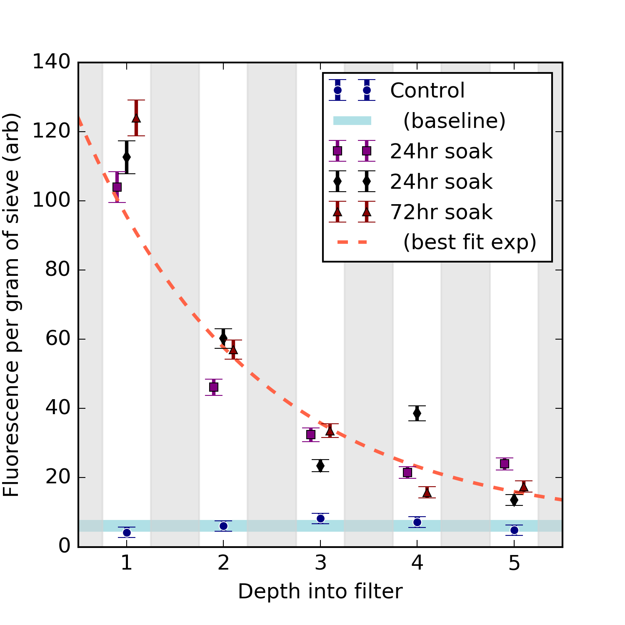
Main Results:
← Clear fluorescence as a function of depth into filter material
Not present in control – comes from TPB.
We conclude:
1) TPB is soluble in Lar
2) TPB is removed by filters
Also, 72 hour soak did not extract more than 24 hour, so:
3) Solubility limit appears to be reached in <24hr

Slide 13
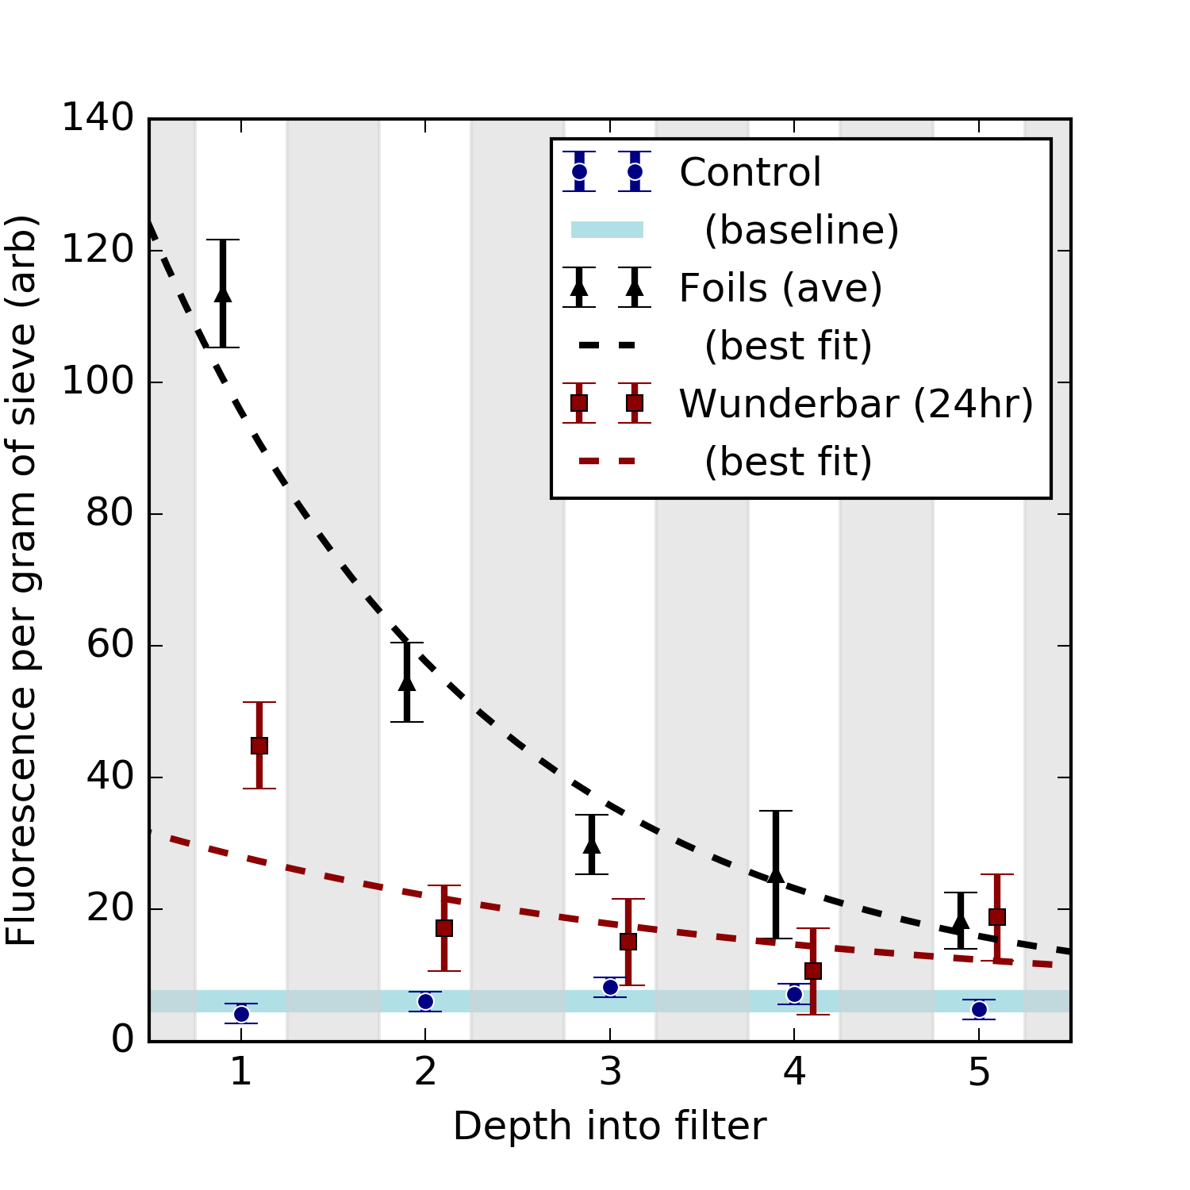
Is it only foils?
Apparently not a phenomenon which is limited to foils, but wunderbar did not reach saturation level in 24hr.

Slide 14
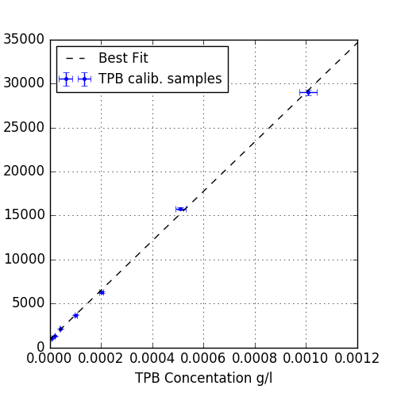
How much TPB is that?
110 CC of argon in chamber deposited TPB with this level of fluorescence.
After crunching the numbers, this is about 6ppb in LAr
On the other hand, losses inherent in our method:
  A) Some TPB remains in sieves
  B) Some dissolved TPB will have stuck in sintered disk.
So result is a lower limit:
At least 6 ppb of TPB can be dissolved in liquid argon.
Observed integrated fluorescence
Inferred TPB concentration
(after resolvation)

Slide 15
Anything else?
We assayed both control and with-TPB samples with GCMS to identify any other possible fluors or contaminants.
TPB confirmed at retention time ~8.3 min in with-TPB samples with expected fragmentation spectrum
No other compounds except TPB were observed at significant levels in any samples with GCMS.

Slide 16
Will it emit light?
If we knew the molecular absorption cross section for TPB fluorescence, and we know the concentration, we can estimate the photon mean free path in the bulk for WLS.
Cross section not measured, but can back it out on an envelope to OOM precision:

Slide 17
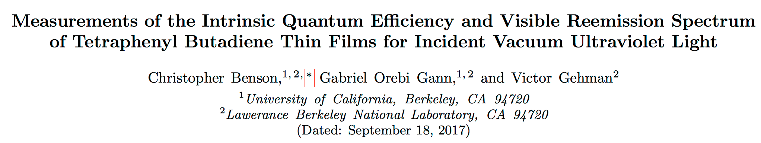
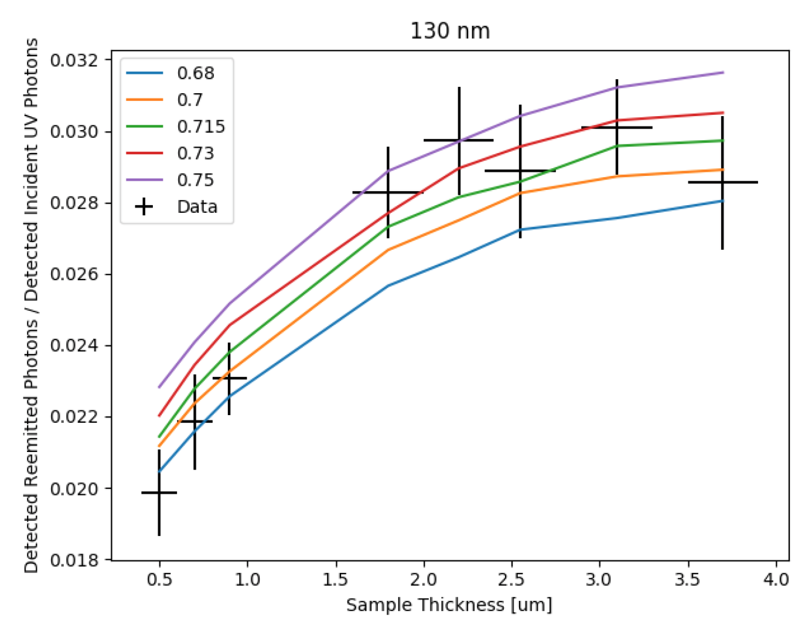
https://arxiv.org/pdf/1709.05002.pdf
About ¾ of saturated efficiency reached for 0.5 um coatings.
So absorption depth for fluorescence is about 0.5 um.
Given known density of TPB of 1.079 g cm⁻³, this tells us cross section is probably about:
σ ~ 1.1*10⁻¹⁷cm²

Slide 18
Path length estimate
So, one 128nm photon would have to travel about:
σn ~ 7m
To meet a TPB molecule.
This is an extremely annoying scale, because its hard to probe in test stands but serious in experiments.
Also, because of Rayleigh scattering driving path length, problem gets worse much faster than linearly with detector scale.

Slide 19
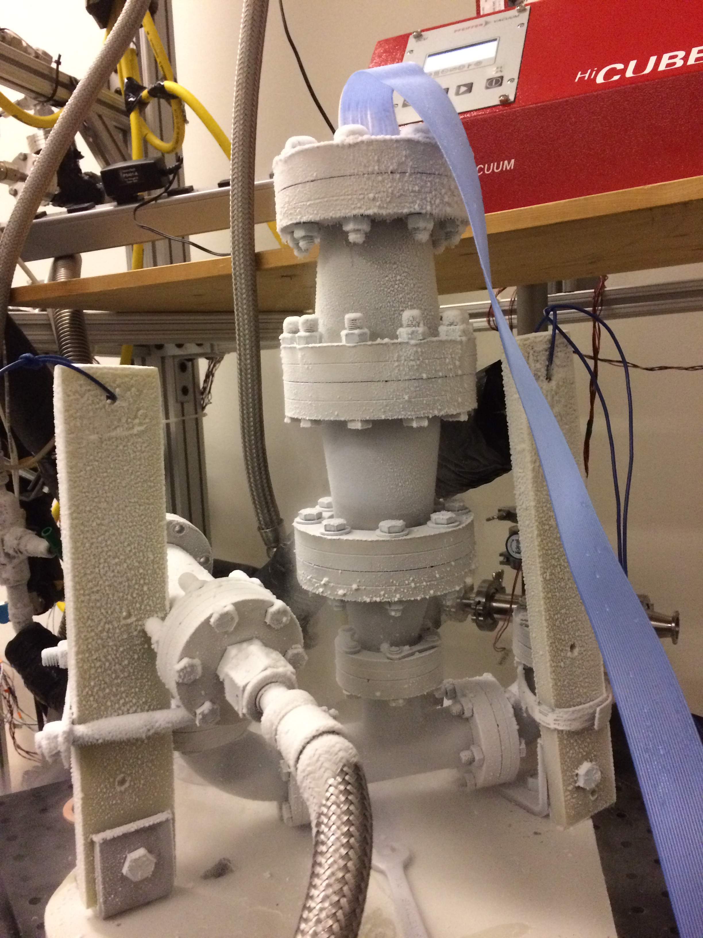
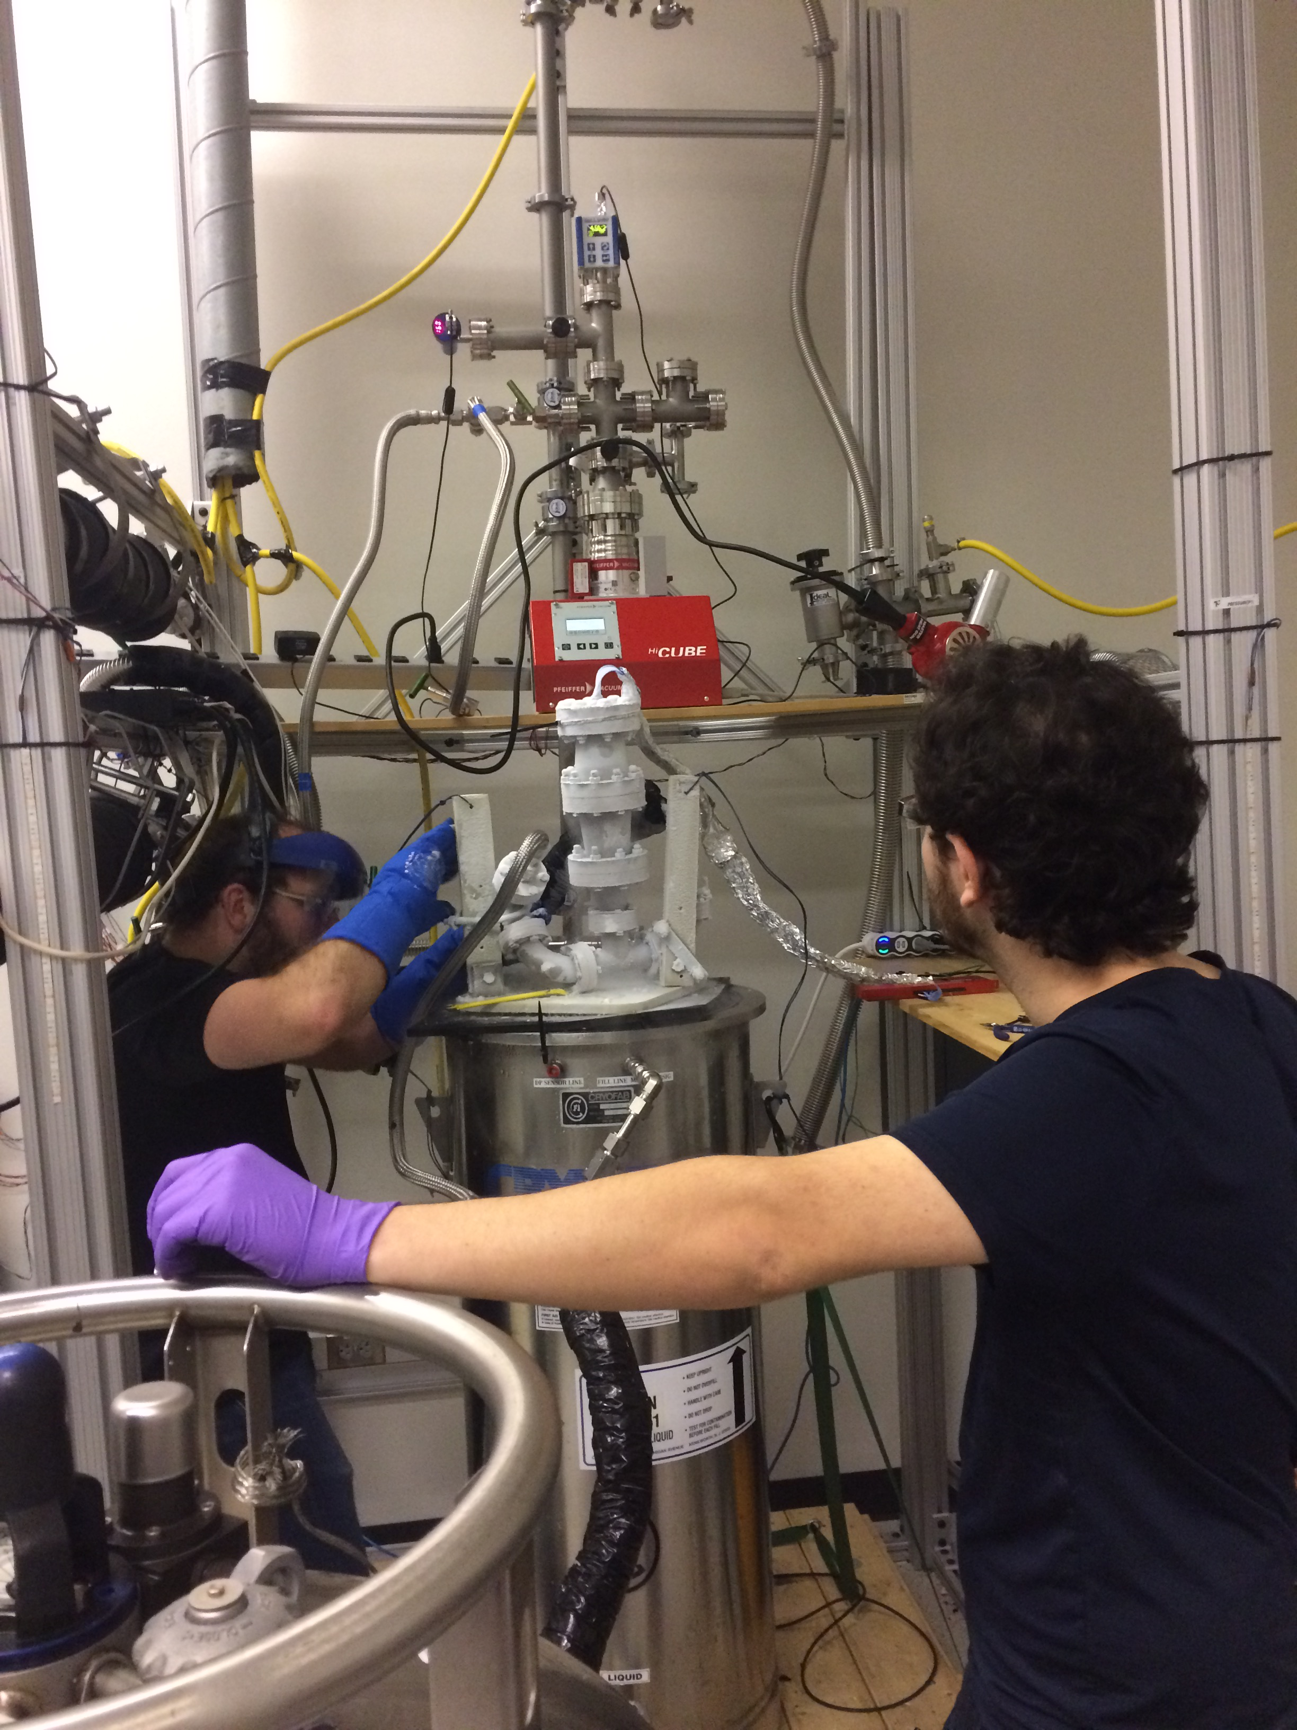
First attempt to measure it was not fruitful because polonium alpha source → too few photons for this path length / solid angle.
Vacuum system
(5*10⁻⁷ before any fill)
12 SiPMs
TPB
²¹⁰Po
Bath
Argon in

Slide 20
Options:
1) Brighter excitation light source (not necessarily @128)
2) Longer argon path length (though hard to maintain solid angle for light collection)
We are pursuing the former, using a bright 350 nm excitation. Observation of emission spectrum of TPB consistent with expected yield and spectral shape, would be evidence for light from argon bulk and extrapolatable to 128 nm.
In progress now – more to come soon!

Slide 21
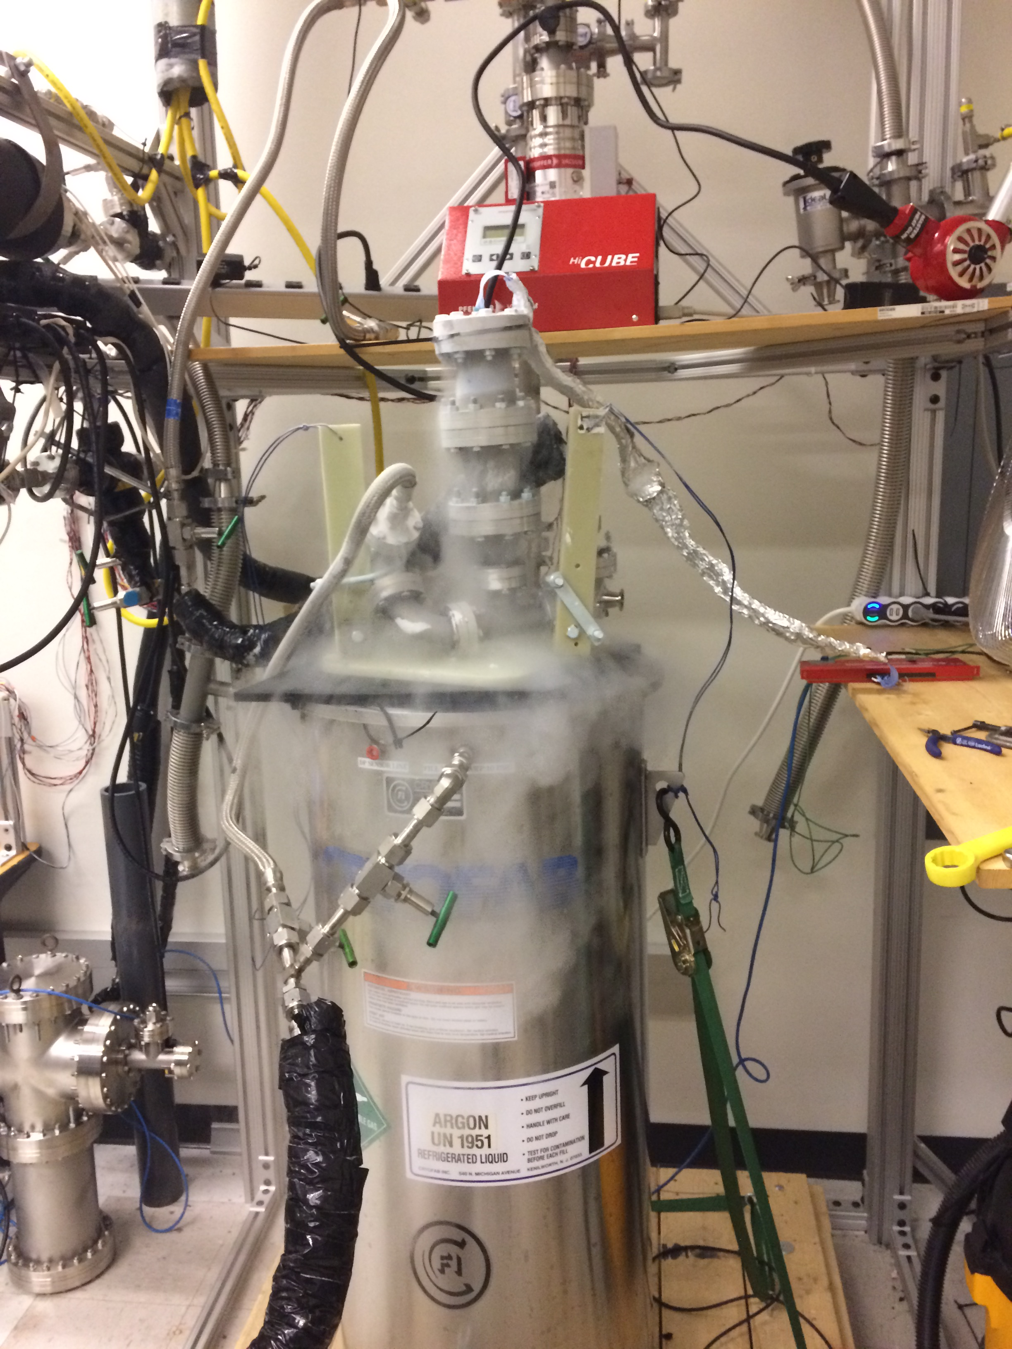
Thanks for your Attention

