Slide 1
Summer Shutdown Status
10/9/17
Cons Gattuso

Slide 2
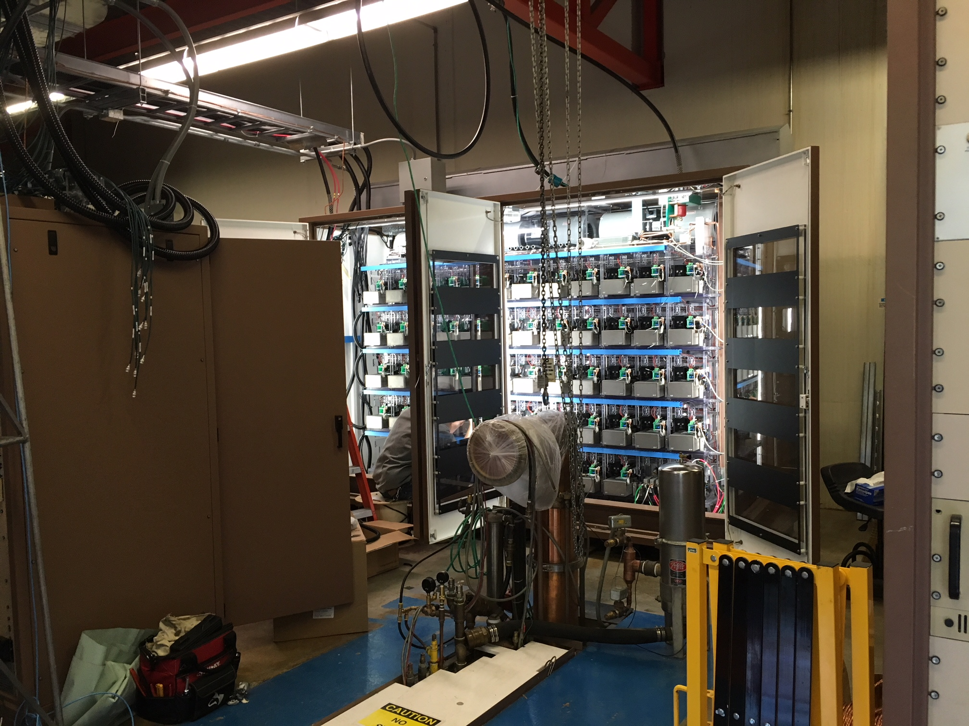
Linac LRF3 Marx Installation
Marx Modulator
This week
Connection being made into the controls system
Safety system testing will occur this week
Next week
Commission of the LLRF side of the station
High level to follow

Slide 3
Main Injector/Recycler
MI
Replace MI RF station 4 ~95% Done
~1.5-2 weeks
Ion pump maintience ~90% Done
~1-2 Weeks
8 Gev line
Ion pump replacement ~100% Done
~1-2 weeks
Vacuum leak check~100% Done
~1-2 Weeks
Multi wire replacement (2)
~1 Week -Cancelled
General maintience for MI/RR ~80% Done
~2-3 weeks
Tunnel and service building
Replace the beam pipe in Q504 -95% Done
Vacuum leak on BPM feed through
Switching Flourinert in the MI-10 and 60 kicker systems 100% Done
Replacing FC-77 to FC-40
RR
TSP upgrade from 106-229 -~100% done
10-11 weeks
Aperture improvement at the RR 402 and 520 locations
~3 weeks at the 402 – ~40%Done
~1.5 weeks at the 520 ~100% Done
Recycler Abort lamberstons replacement
~3 weeks at the 402
Recycler Sextupole stand change out ~100% Done
~3 weeks
New Pinger installation in the 10 region ~95% Done
Rebuilding and putting back into operations RRRF Anode power supply ~50% Done

Slide 4
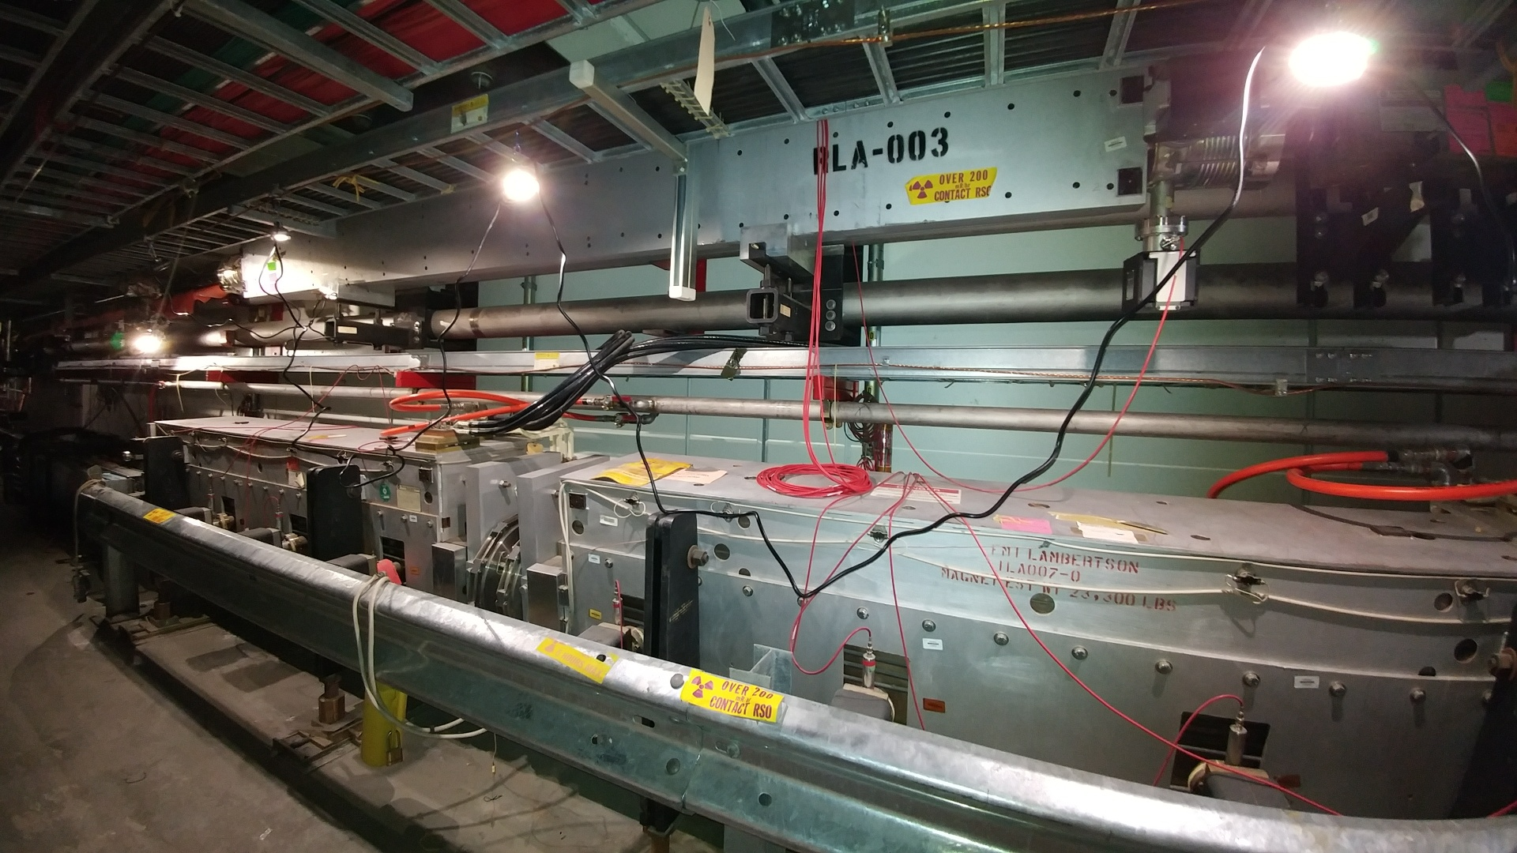
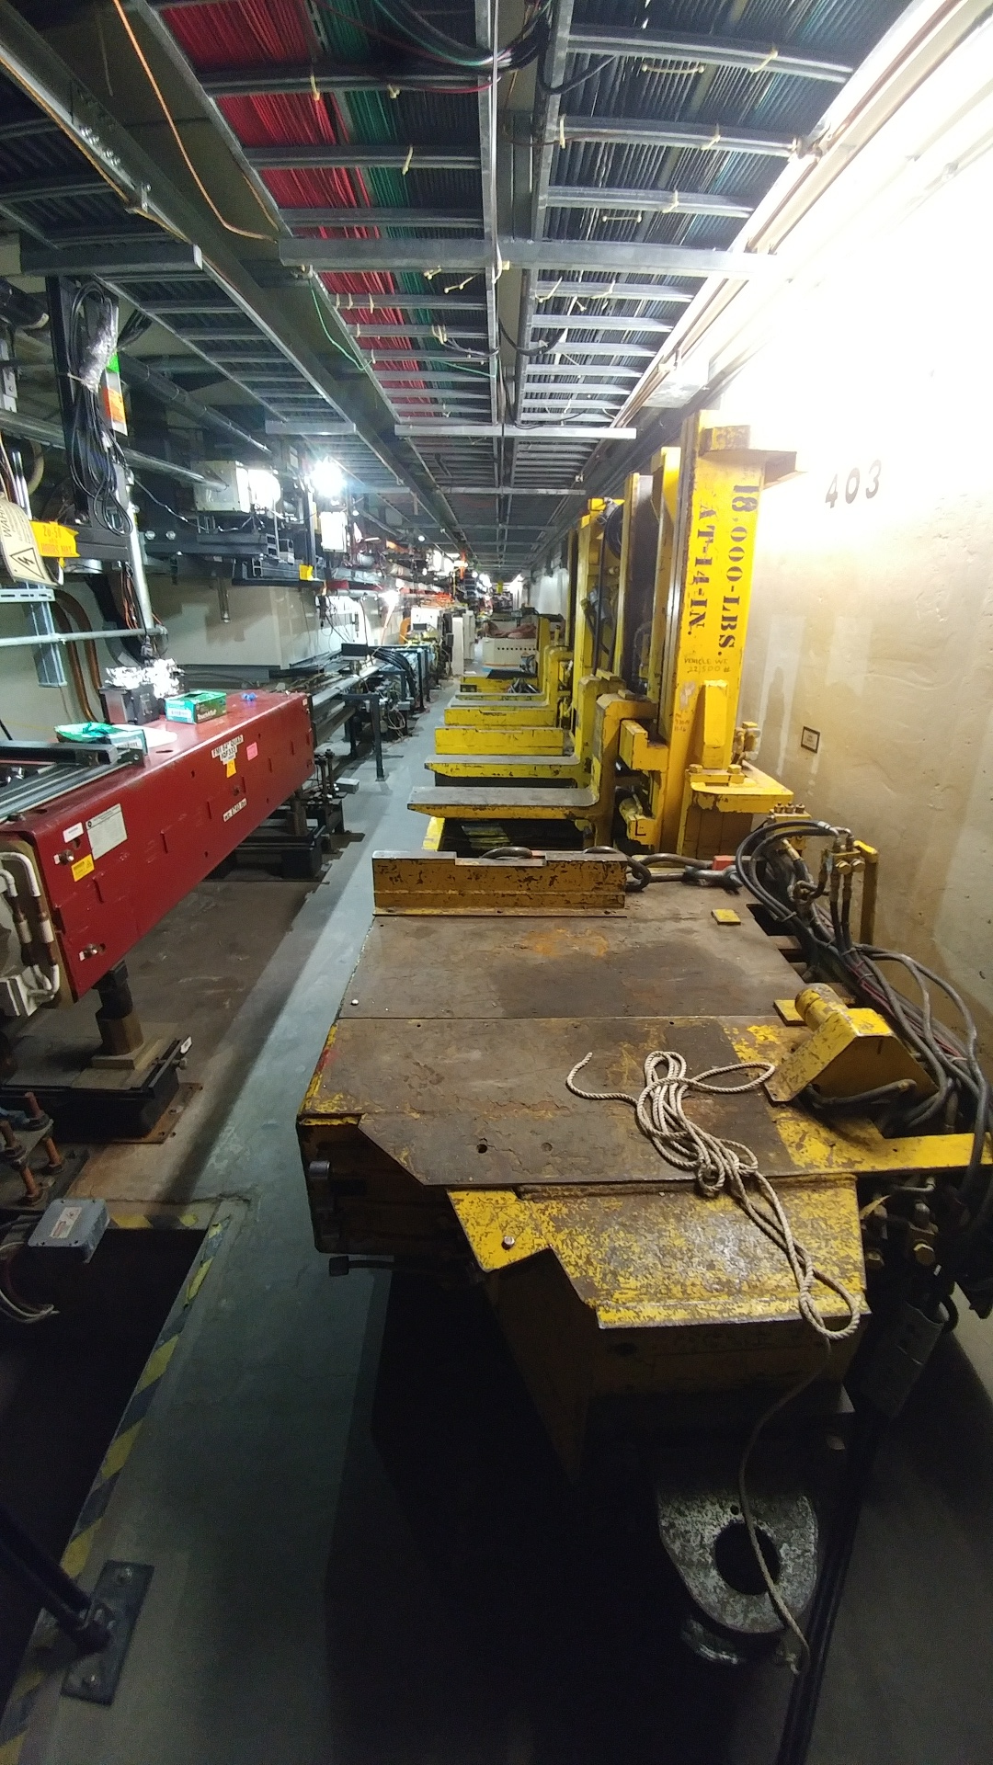
RR-40/Abort Before

Slide 5
LCW Header relocation Completed
Lambertson stands installed and load tested
Installation schedule to occur Wednesday

Slide 6
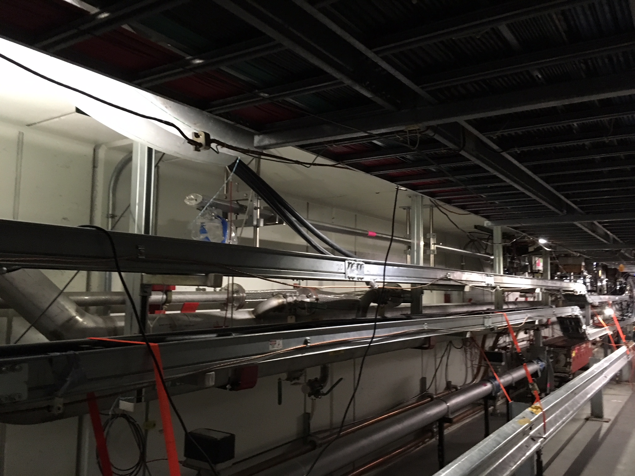
Upstream beam pipe
Installed and aligned
Welding will start Tuesday

Slide 7
Muon Campus Work
Mu2e work
M4 line installation ( first half to absorber)
Stand and magnet 95% complete
Cable pulls/termination installation (7-9 weeks) 100% complete
In support of g-2
Delivery ring straight section 60% complete
D30 Injection septa (1-2 weeks) -90% complete
Removal and reinstallation of ring for the M4 line installation ~ 2 days 30% complete
D10 Straight PWC/IC removed for repair, Installation will occur tomorrow
D50 Straight Section ( will be done at the same time as the abort line)
Abort line
Extraction septa
Take delivery this week
Instrumentation Repair 75% complete
PWC and IC’s ~ 10-12 weeks
Beam Pipe Aperture Inspection 90% complete

Slide 8
Switchyard
4 inch Aluminum header leak

Slide 9
2017 Shutdown Pocket Dosimeter Reports – Week 11
SHUTDOWN SO FAR:
4,024 person-mrem
147 people reported some dose, with average dose of 27.37 mrem

Slide 11
Week of Oct 9th (this week)
Safety System Testing
Completed today
Linac/NTF
Booster
Prevault/Pretarget, transport (all 3 section)
Tuesday
NuMI enclosures
Later in the week
MI12 A/B
8 GeV line
Meson enclosure
F-Sector, Transfer Hall, CDE and J
Complete/Verify Enclosure cleaning
Needs to be cleaned
Main Injector, Muon Campus Rings and M4 extraction Line

Slide 12
Week of Oct 9th (this week)
Get Major LCW systems on to operational levels
Booster
Slowly raising pressure and flow to operational levels
MI
Monday
MI RF LCW system is up and running
NuMI closed loop system is up an running
Tuesday
Fill and pressurize system
Wednesday
Turn on Ring Wide LCW and Pond pumps
Switchyard
Monday
Complete Enclosure C repairs
Tuesday
Fill and pressurize system
Wednesday
Turn on the Switchyard system and balance flows and pressure

Slide 13
Next week
Complete Cleaning
Main Injector
Muon Campus
Complete remaining System Testing
Out of all enclosure by 16:00 hrs Friday Oct 20th

Slide 14
Shutdown Duration Drivers
Linac Marx Modulator installation
Station 2 upgrade commissioning underway
Production 1 moved to LRF3 location
Commissioning process
Main Injector
Recycler Abort Lamberstons
Muon Campus Work in general
Additional crews will be added
Re-structing the workflow

