Slide 1
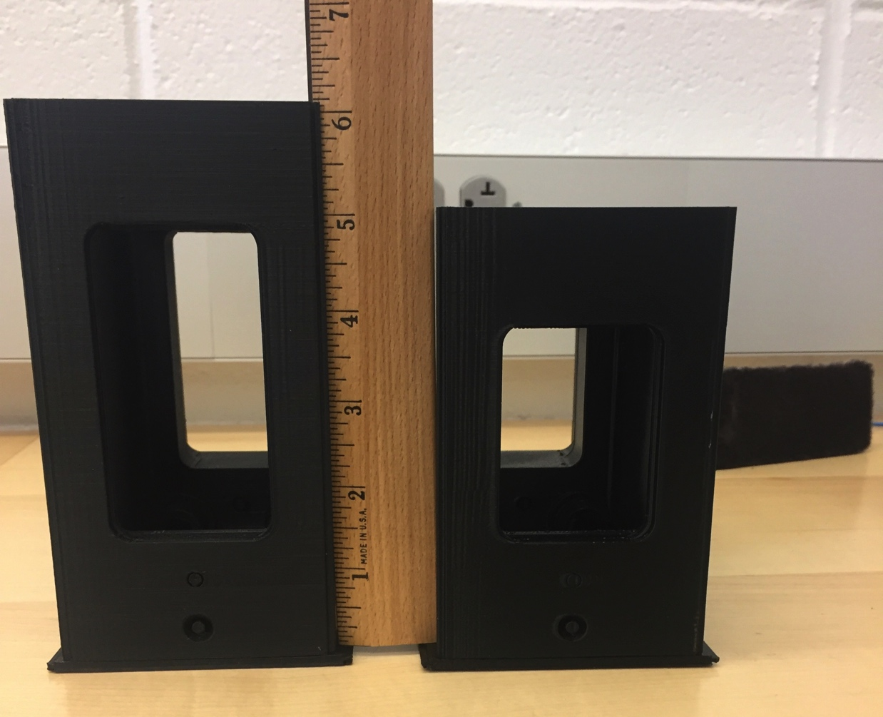
Modified APA corner
Created modified mockup of the APA end tube. Widened the side tube by one inch.

Slide 2
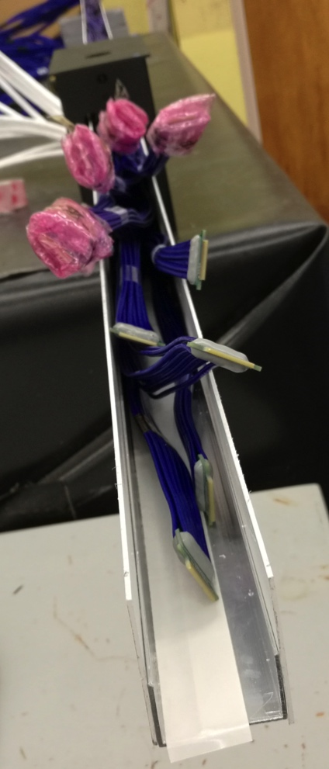
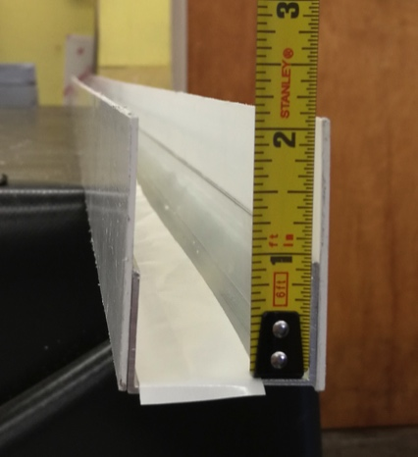
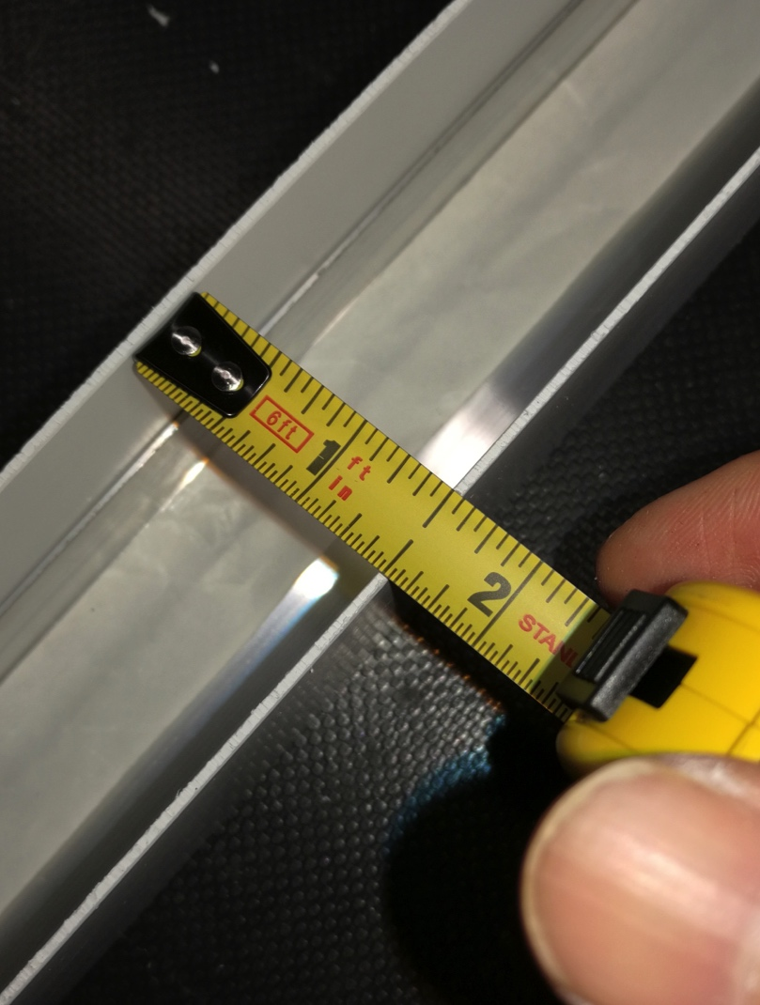
Cable Duct for CE
Constructed a test cable duct.
1.5” by 2 1/16” duct

Slide 3
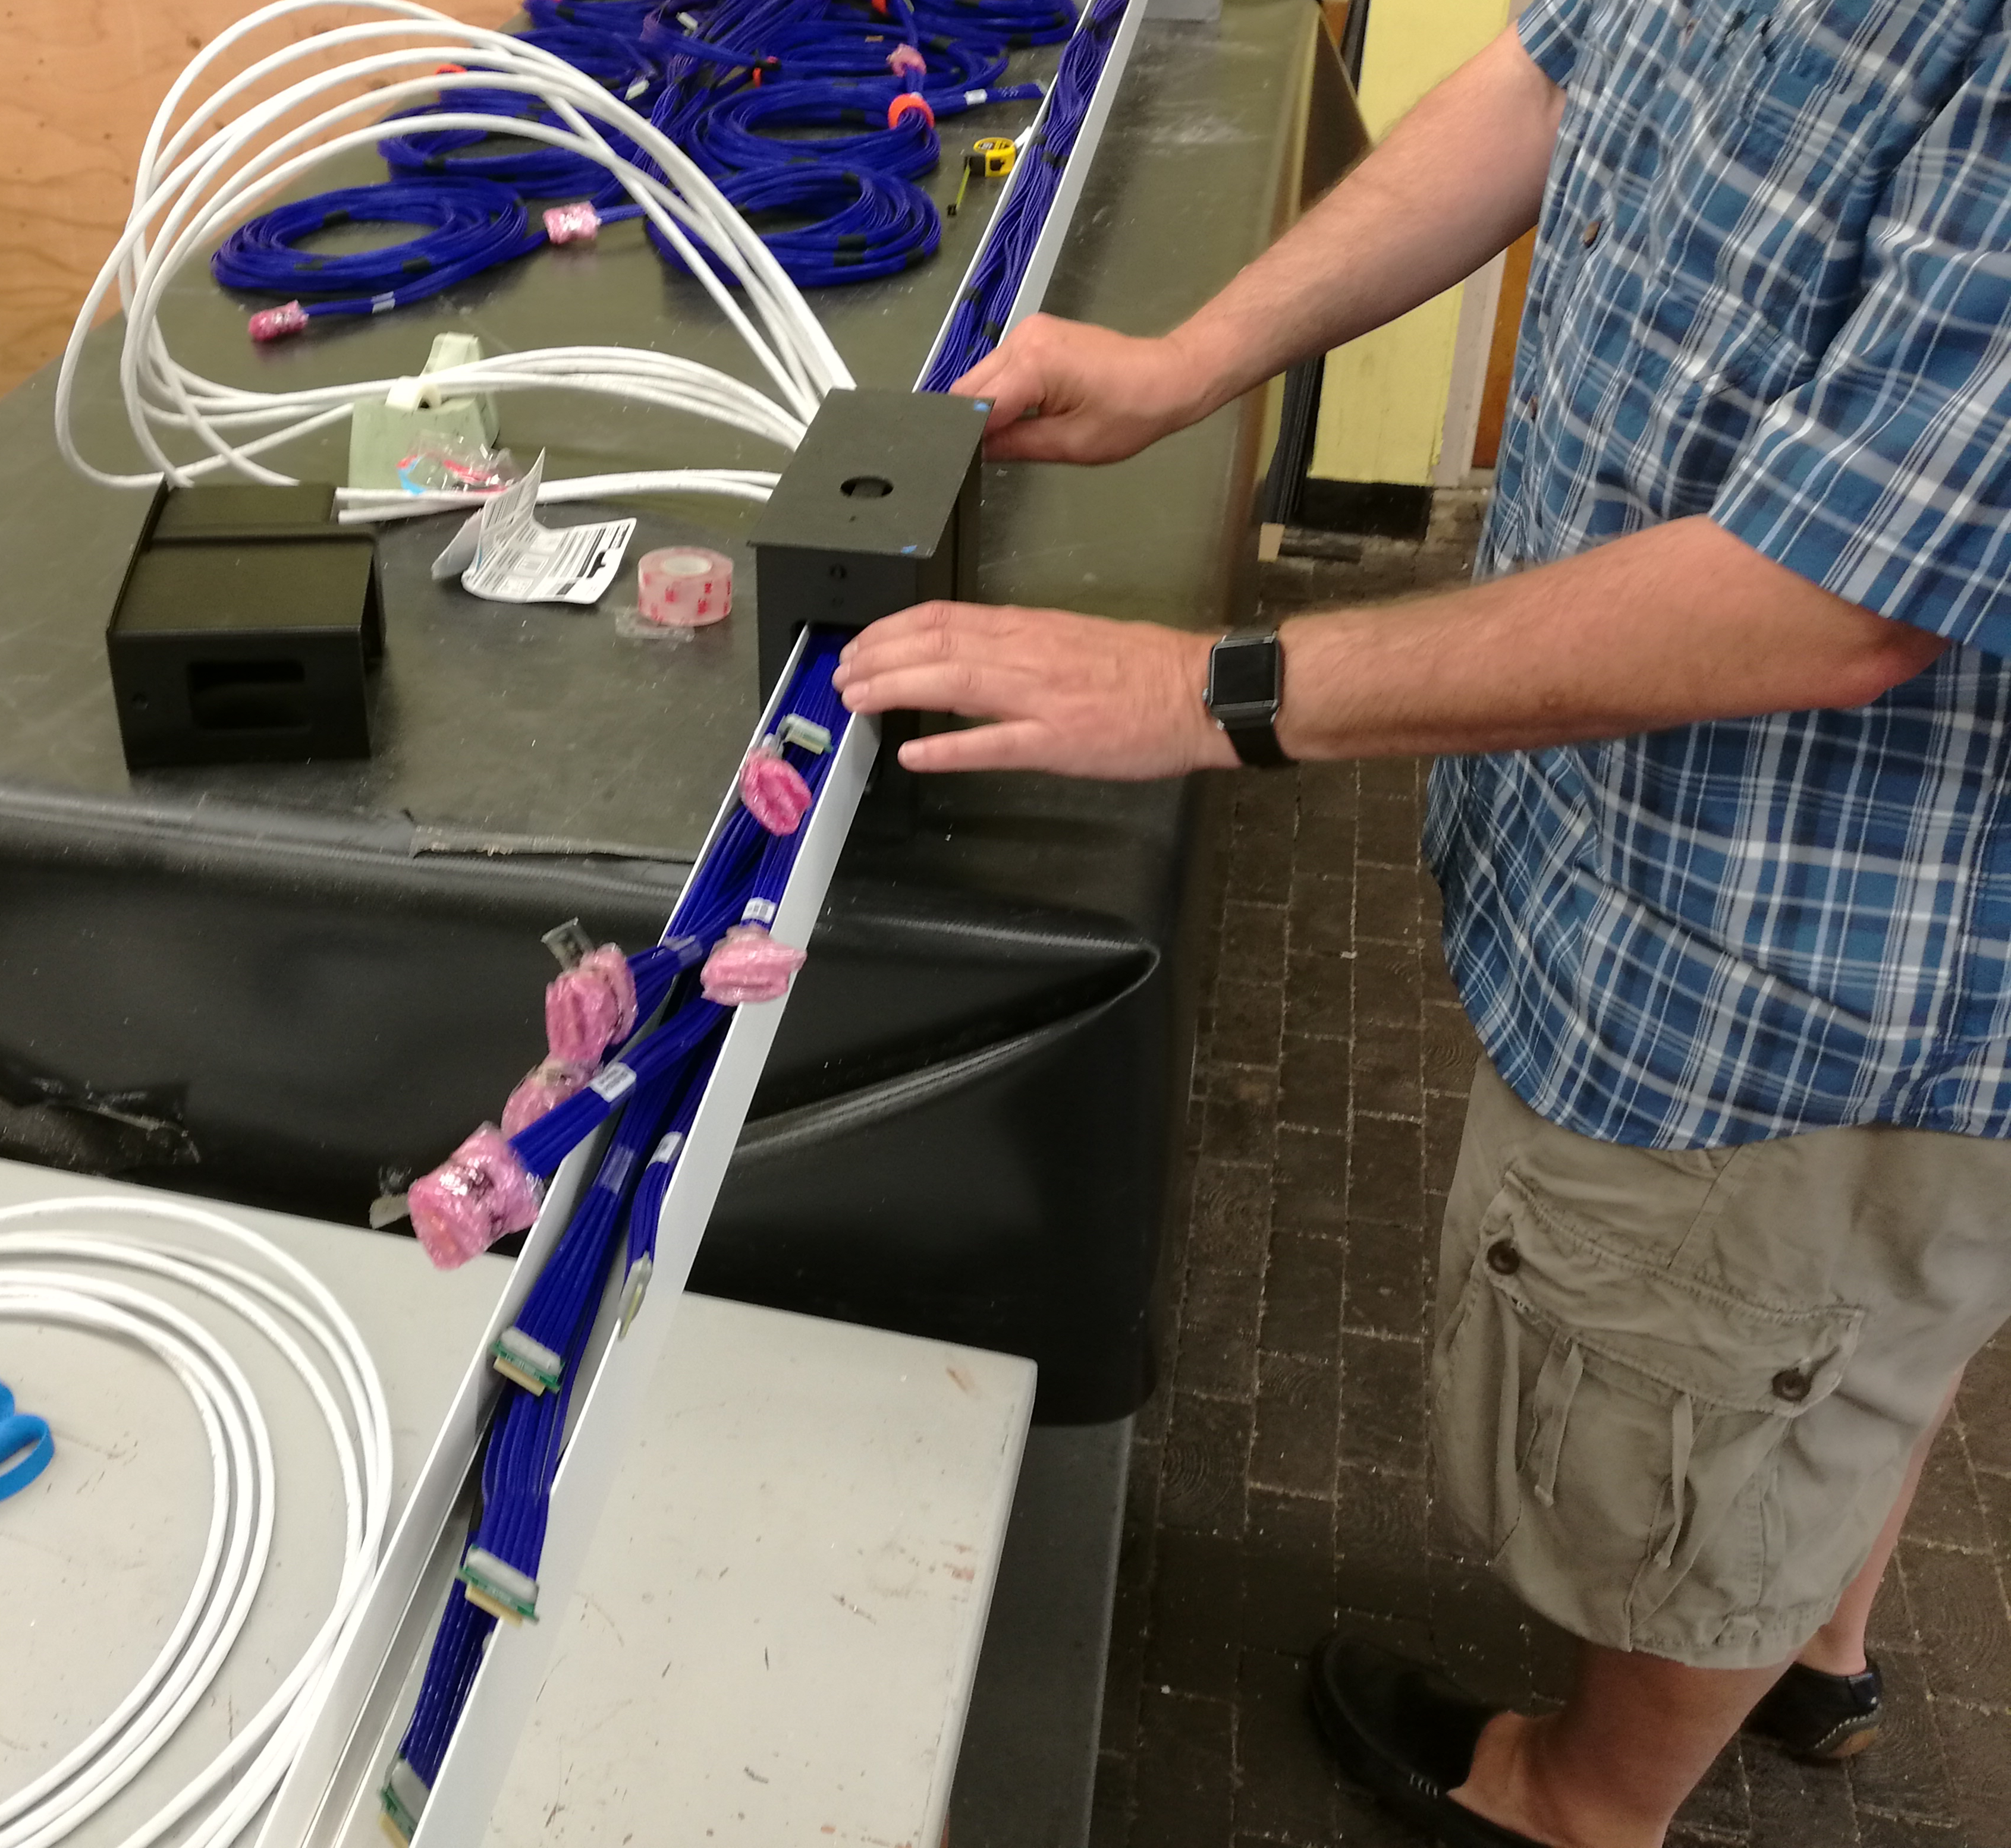
Cable Test
Little bit of extra space
1.5 in by 2.06 in Duct
12 CAT6 PD Cables
6mm Linkage
Inserted 12 PD cables. A 6mm shim to mockup the APA linkage and the 1.5 by 2 cable duct. Then installed 11 CE data cables in the duct.
Cables are not super straight and are taped into round bundles. This means they take up more space than expected. We started with a 1” wide duct but needed to go to 1.5”

Slide 4
Cabling Proposal
Modify the APA side tubes to make them 1 in wider.
Design the APA linkage so it does not stick out more than 6mm.
Make a boss and put the Rivnut on the boss. This recesses the bolt head to keep everything flush.
Could also move the linkage further inside the APA. Under investigation.
Route the PD cable near the link and inside ~15mm region.
Find a way to run the power cables through the center tube.
Fabricate 2.06 by 1.5 inch cable duct sections roughly 2m long out of 0.5-1mm perforated SS with cover.
Manhong has sketches of this.
Install the cables by putting the cables into the 2m long duct section and then insert the duct into the APA. Then connect another 2m duct section and repeat the process.
Need to find a way to get the power up the middle tube

Slide 5
Power Cable Mockup

Slide 6
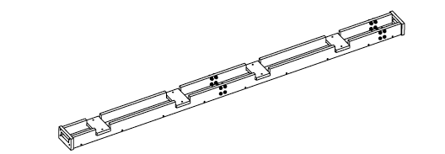
Center tube mock-up
Constructed a wood mockup of the APA center tube
Mockup an 8’ section of half the APA center tube .
Investigated a 5 in wide option for the center tube.
A 44mm high cutout was used

Slide 7
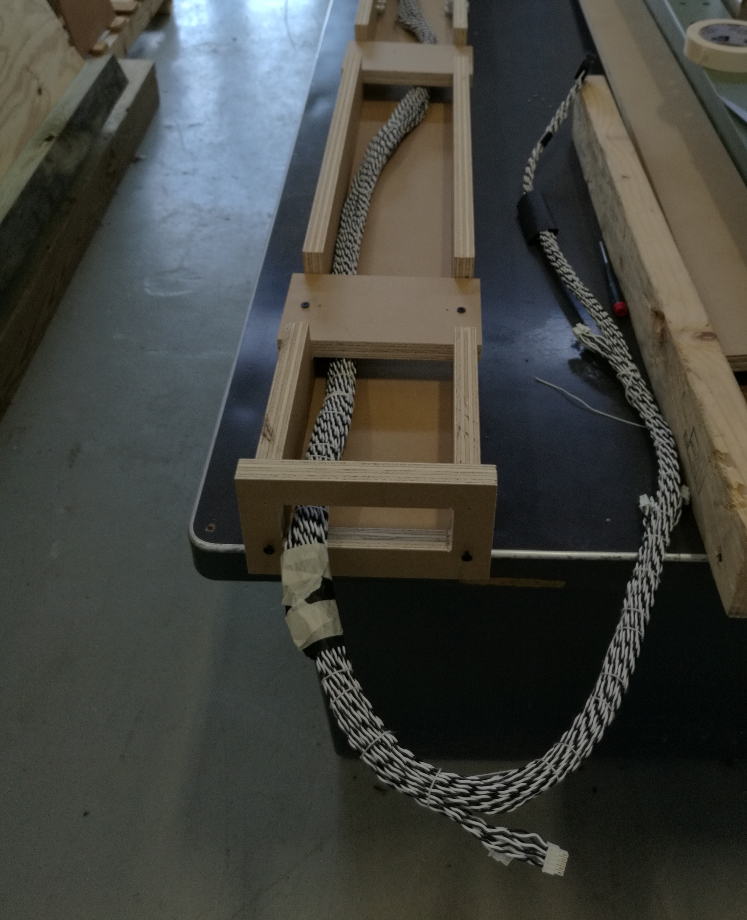
Make Laced Cable Bundles
Use cable lacing technique to bundle the cables together.
Tried to make of bundle of 6 power cables.
4 of these are needed per APA.
Printed a protective guide for the first connector pair.

Slide 8
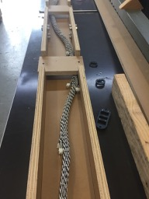
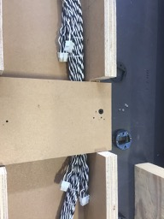
First Experience with Lacing
Technique works well and is fairly fast but does require training.
With the NASA spec lace separation of 1 in you get a nice tight bundle.
When the separation gets more than 3-4 inches you get bulging of the cables.
It is easy to lace around the connectors.
Some kind of guide is needed to keep the individual bundles separated until they get laced together or the ends will tangle. Maybe a set of troughs or spools for each bundle.
A means to hold the connectors safely against the cable needs to be found.
A means to protect the PD needs found.

Slide 9
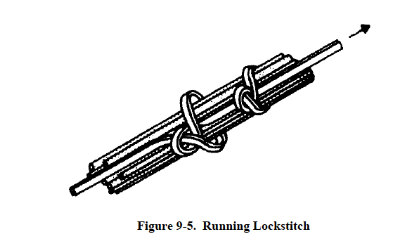
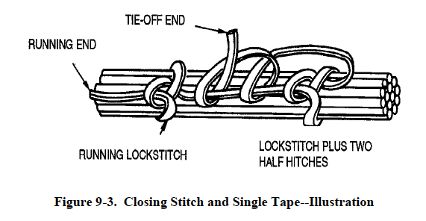
Lacing Techniques
The NASA standard has the needed knots.
NASA-STD-8739.4 w/Change 5
A suitable string is needed. We tried normal twine but an alternate is needed.

Slide 10
Cable Harnes

Slide 11
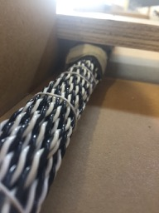
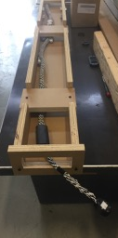
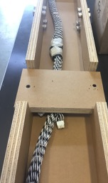
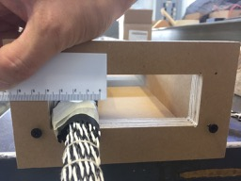
First test with the mockup
Space for 3 more?
The bulk cable bundle was roughly 1in in diameter and went around the PD mockup relatively easily.
The last connectors were taped to the bundle making a 1x1.5 in object. This had to pass lengthwise under the PD model. A good holder guide here is needed.
The setup required a bit more than a 1.5 by 1 inch area to get through the end. Both the first guide and the last bundle/connectors were 1.5 in wide.

Slide 12
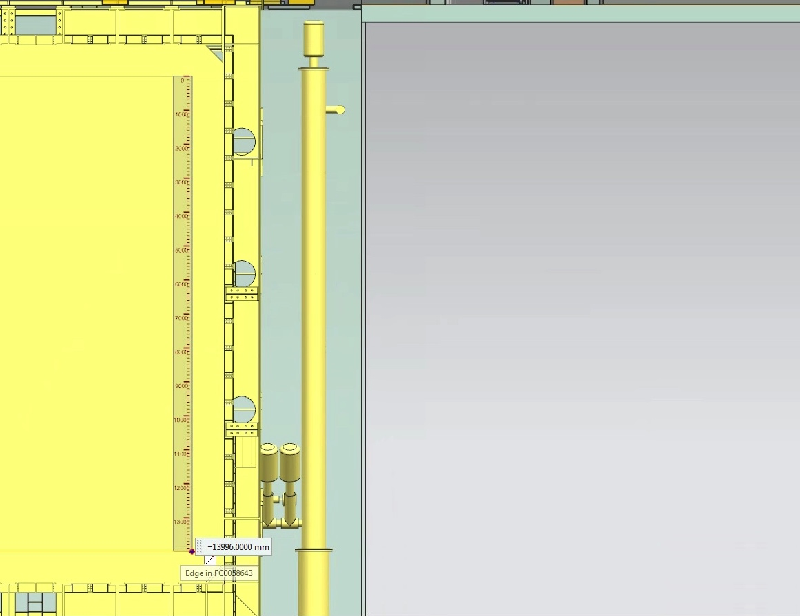
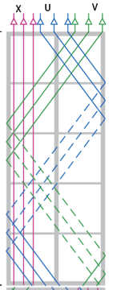
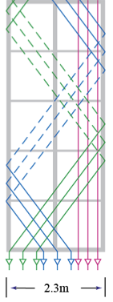
Issues concerns
The connectors need held against the bundle.
Will heat shrink work when the bundle is small?
How to hold the last connectors against the bundle so it guides past the PD plates?
What string to use? Kevlar is strong at LN temp and is denser than LAr. Is it good?
How to handle the cable bundle? A bundle of 6 25m cables is 50 lb.
Can the wire support its own weight for 14 meters? There are 90 lb of cable in the APAs. Strain relief is needed.
How to modify the APA to get the cables through the ends?
Heat
shrink

Slide 13
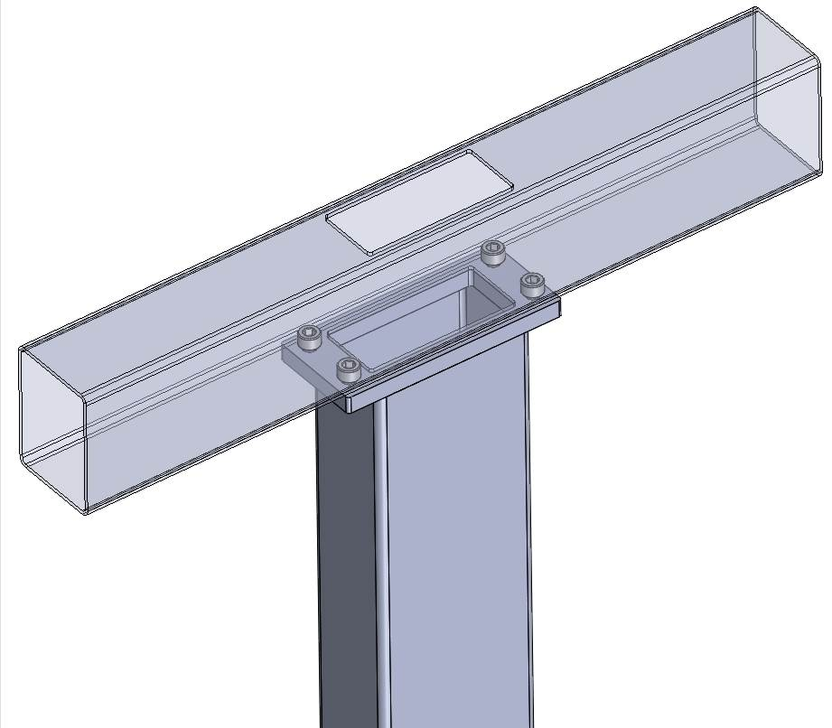
APA end opening
The size of a penetration in the APA frame needs determined.
Sufficient space is needed for the end boards, glue joints and solder.
Need to get 4 bundles of 6 cables through
One big slot or multiple smaller slots?

Slide 14
Status
Questions needing answers now.
Will the cable hold its own weight.
How can we hold the bundles.
How to hold the connectors against the bundle and guide the bundle by the photon.
Questions needing serious engineering
How to modify the APA
Detailed planning for installation
Questions needing a serious prototype
Fabricating the cables need done with real 25m cable.
The cable installation will need a serious prototype.
Real bundles
Real APA tube
Platforms and installation equipment

Slide 15
Installation Sequence

Slide 16
Assume APA have PD inserted and FEMB boxes installed.
1) Lift APA up and lower it into the toaster region.
2)Anchor it in position.

Slide 17
3) Bring second APA into Toaster

Slide 18
4) Bolt linkage to top APA

Slide 19
5) Install Power Cables
6) Lower Top APA into position and connect the linkage

Slide 20
7) Install PD cables
8) Install CE data cables.
For data cables insert the cables in 2m cable duct sections then rivet sections together.
Dress the cables
Test
Took about 30 min to fill the 2m cable duct.

Slide 21
9) Move the APA into the cryostat

Slide 22
Installation questions
Do we need a connector in the power cables between APA? Assume no
Do we need to leave a gap between APA temporarily to make connections? Assume yes for power cables.

Slide 23
Time Sequence
2hr Transporting all boxes for CPA-FC construction and moving one APA column to the Switchyard.
2hr to mount 2 APA in the toaster.
3hr to connect PD cables
4hr to connect CE data cables
4 hr to connect the CE power cables
2hr to test APA and PD before transport
17 hr total time. Assume 2 days for each APA pair. Or 1 day and two 10hr shifts.
Huge uncertainty in the time estimate. Need a prototype!

