Slide 1
A2D2 Operational Meeting
Michael Geelhoed

Slide 2
Last Week’s Measurement Ozone Production
30 CFM fan on
64.22 m³ enclosure
1.2 kW machine
Measurement were inconclusive based on sensitivity of the reading
Working with Rob Bushek and Jonny Staffa on new device

Slide 3
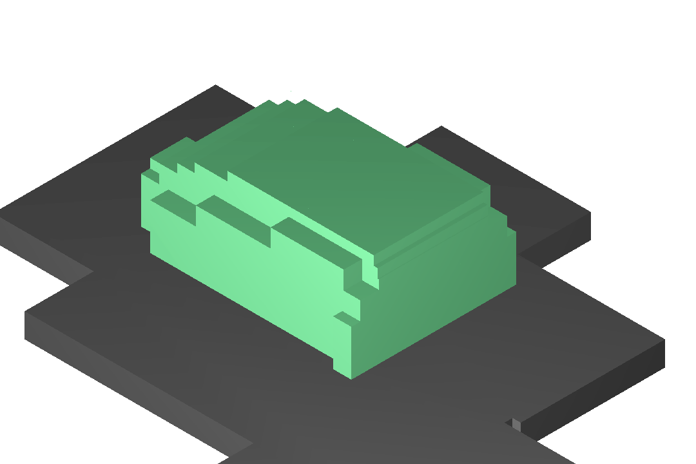
Last Week’s Measurements Beam On Rad Survey
Accident Case Scenarios tripped off the beam with Tungsten Target
North Wall Chipmunk did it’s job
Should have results this week
Activated the target based on IAEA TR 188 (pg 104/pdf 115, 87/98)
1.2 kW for ~2 minutes (0.05 mrem/hr on contact)

Slide 4
Vector Server’s for Sample Tracking
Computing Division is claiming they duplicated the server’s
I don’t have access yet, need service desk help for this
Talked with Jan Szal, he indicates that the servers were NOT duplicated as described
Will discus with Irene Shiu

Slide 5
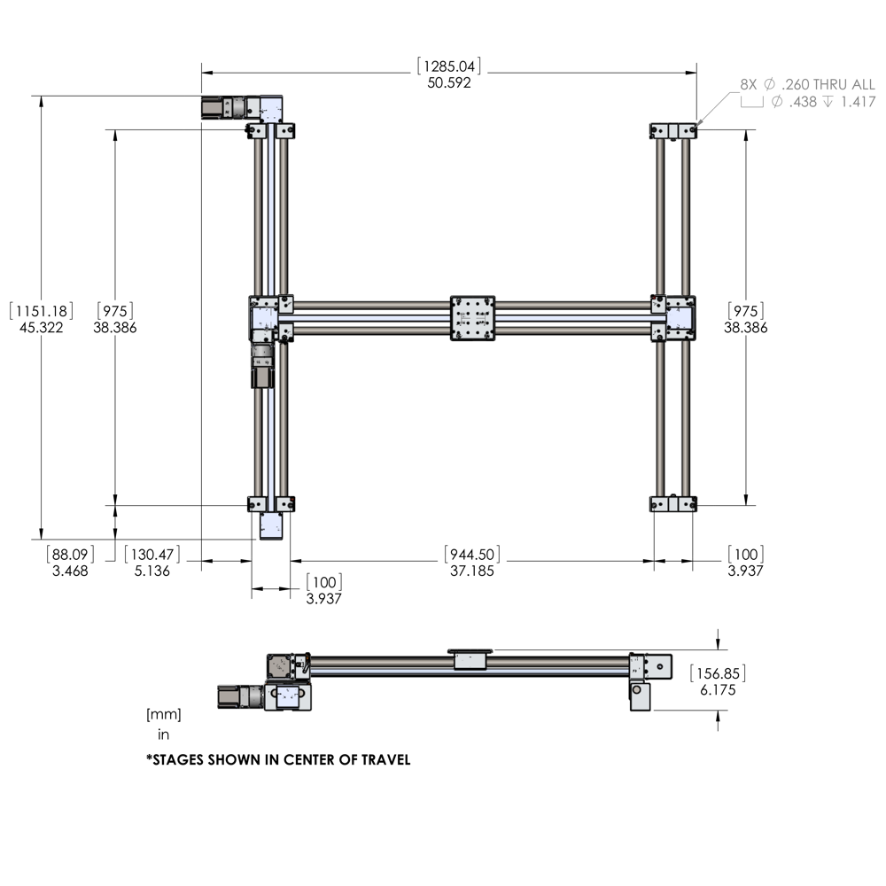
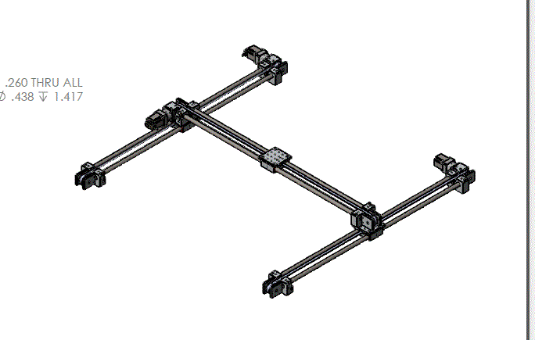
Table Positioning
Drafted a structure to contain the moveable table Tom has re-ordered
Computing Division is claiming they duplicated the server’s
I don’t have access yet, need service desk help for this
Talked with Jan Szal, he indicates that the servers were NOT duplicated as described

Slide 6
This week
Continue with movable table structure
Vent fan (Discuss with Charlie)
Review Beam-on rad survey measurements with ESH&Q (Mike)
Schedule better Ozone measurement data runs (Mike)
Continue ordering of 800 mm table (Tom)
Follow-up with Server duplication (Mike)

