Slide 1
Director’s Review Post Mortem and Next Steps
Steve Holmes
PIP-II PMG
18 Oct 2017

Slide 2
Director’s Review Major Themes
Review showed considerable progress since the DOE IPR from November 2016
How to mitigate risk associated with partner deliverables
Credibility of partner deliverables milestones
QA
Re-evaluate strategy on power testing of fraction of CMs
Speakers appear more comfortable talking about technical achievements and plans, than costs and schedules
L3Ms need to “own” their scope, costs, and schedules
Too many talks in the Linac systems and installation breakout
BOEs and P6 not completely consistent
Lack of (M&S) backup in BOEs
TPC Point Estimate: $648M
UCR: $771M
UCR after adding MI/RR and subtracting UK: $725-745M

Slide 3
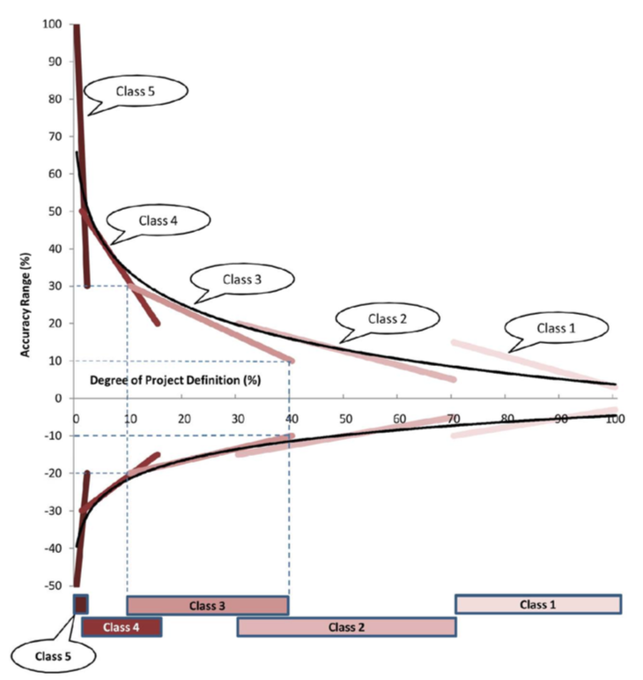
Cost Range
Charge #2
Derwent
Paul’s presentation established a project definition of 25-40%
Lower range
- (10 – 18%)
Upper range
+ (20 – 25%)
Suggest -10%, +20%
Point Estimate $648M
Cost Range
$586M - $771M (20%)
Notes:
Need to make numbers consistent.

Slide 4
Cost Range w/Scope Changes
Charge #2
Derwent
Recycler and Main Injector Upgrades
BOEs exist and have been validated
TPC Point Estimate = $31M
TPC/UCR = $37M
UK/STFC contribution
Assumption is $28M in-kind in “European accounting”
i.e. does not include salaries
Highest priority is to deliver HB605 CM 2-4
M&S against STFC account: $5M
Savings to DOE (UCR metric): $18M
Balance to-be-discussed
Additional $23M of M&S should translate to somewhere between $45 - $65M reduction in UCR
TPC/UCR = -$63M - -$83M
PIP-II TPC/UCR = $771M + $37 - $63-83M = $725M - $745M

Slide 5
Next Steps
DOE Independent Cost Review (ICR) on-site visit is scheduled for Dec 5-7
Note this review has already been initiated (Oct 4)
On-site visit will be for purpose of conducting detailed drill-downs in selected areas
IIFC meeting is scheduled for Dec 7-8
DOE Independent Project Review (IPR) is scheduled for Dec 12-14
33 working days until talks are due to be posted

Slide 6
Next Steps/IPR
Following the Director’s Review we would be in reasonably good shape for proceeding to a DOE Review in two months if the scope and funding profile were stable.
However, they are not. We need to:
Incorporate scope modifications
Add Recycler and Main Injector upgrades
Identify and remove potential UK deliverables
Adjust the P6 schedule to match the DOE-provided funding profile
Due next Monday
(We provided DOE with the funding profile corresponding to the current, technically limited, schedule on Oct 3)

Slide 7
Next Steps/IPR Scope Modification
Adding Recycler and Main Injector upgrades should be straightforward
Reviewed/validated BOEs exists
Can be incorporated into P6 as planning packages
Identifying and removing UK deliverables is more complex
I would like to do this in a manner that avoids modification of BOEs and rework of P6
Discussed three options with OPPS and DOE. Preferred option:
Incorporate as a “below-the-line” subtraction to the P6-generated budget profile.
Document anticipated savings in a BOE-like document in docdb
Awaiting feedback from DOE on whether this is acceptable
Teleconference with Peter Mcintosh (Daresbury) scheduled for Friday

Slide 8
Next Steps/New Funding Profile
Goal is to adopt to a new profile while minimizing delay in completing the project, i.e. minimize disruption to the critical path
~73% of tasks in P6 have float ≥1 year
Will look at delaying these first
Expect major delays in currently scheduled FY18 activities – we will work on these first
$14-20M vs $44M
Will work downstream from here

Slide 9
Next Steps/TPC Upper Cost Range
Funding profile at the review (technically limited)
We received the CD-1 funding profile from HEP on Monday (as promised)
Note: Increases project duration by ~9 months and adds $80M in FY25-27
I do not believe it will be possible to defend an UCR<$750M with this profile
May not be able to complete the work in early FY27 with this profile
 | FY16 | FY17 | FY18 | FY19 | FY20 | FY21 | FY22 | FY23 | FY24 | FY25 | FY26 | FY27 | TOTAL
Actual Cost to Date | $13,800 | $18,200 |  |  |  |  |  |  |  |  |  |  | $32,000
P6 Obligations |  |  | $35,500 | $45,000 | $50,700 | $73,500 | $83,200 | $69,200 | $56,200 | $37,700 | $7,400 |  | $458,400
Annual Obligation | $13,800 | $18,200 | $35,400 | $45,000 | $50,700 | $73,500 | $83,200 | $69,200 | $56,200 | $37,700 | $7,400 |  | $490,300
Contingency |  |  | $8,300 | $10,800 | $17,600 | $24,500 | $29,000 | $25,600 | $22,600 | $16,900 | $2,500 |  | $157,800
Annual Obligations w/ Cont | $13,800 | $18,200 | $43,700 | $55,700 | $68,300 | $97,900 | $112,200 | $94,900 | $78,800 | $54,500 | $9,900 |  | $647,900
DOE Funding Guidance (10/16/17) | FY16 | FY17 | FY18 | FY19 | FY20 | FY21 | FY22 | FY23 | FY24 | FY25 | FY26 | FY27 | TOTAL
TEC-PED | - | - | - | 4,000 | 60,000 | 40,000 | - | - | - | - | - | - | 104,000
TEC-Construction | - | - | - | - | - | 40,000 | 100,000 | 102,500 | 90,000 | 85,000 | 50,000 | 8,565 | 476,065
OPC | 18,715 | 15,220 | 20,000 | 31,000 | - | - | - | - | - | - | - | - | 84,935
Budget (BA) | 18,715 | 15,220 | 20,000 | 35,000 | 60,000 | 80,000 | 100,000 | 102,500 | 90,000 | 85,000 | 50,000 | 8,565 | 665,000

Slide 10
Timeline
See timeline

