Slide 1
Status of the Fermilab Test Beam
Mandy Rominsky
FTBF Committee Meeting
03 November 2017

Slide 2
Recommendations from last year
Prepare and plan for a spike in requests at the FTBF during the next long CERN shutdown. The period during 2019/2020 will be crucial for the LHC HL-LHC upgrades, and a time where the CERN facility will be unavailable.
  Develop criteria ahead of time to deal with the expected increase of requests and deal with possible over-subscription
  Ask the large experiments (CMS, ATLAS, mu2e, PHENIX) to bundle their requests with prioritization to ensure that the received beam time is in line with the priorities of the experiments.
This is an ongoing conversation. The groups are aware of this as a problem and we’ll continue to discuss this.
  We would appreciate committee help (especially other test beam coordinators) with criteria

Slide 3
Recommendations
Formalize the procedure for getting credit for the FTBF in papers and conference with FNAL PUB numbers.
  Each user who submitted a paper to us this year was also pointed to the FNAL website to get a number
  Will send this information to users throughout the year this year
  Finish FTBF paper and put on ArXiv to provide actual reference
    This is ongoing

Slide 4
Recommendations
Consider increasing dedicated FTBF labor
  Augment the FTBF staff with another physicist for six months
  lab should provide labor not “as needed” but dedicated to facility. “As needed” allows facility to run but prevents any improvements to be done.
Recently submitted a job requisition to hire a new full time applications physicist.
Were given some time with engineering physicist, but unable to get some of the assigned projects done (due to his working on other high priority projects)

Slide 5
Recommendation
Continue to work on the characterization of the beam, and understand from user community if the purity and resolution of the beam is adequate for user needs
Discussed in future slides
  Beam characterization continues to be a joint effort between ourselves and our users

Slide 6
Recommendation
Start tracking user needs for the “proton tax” discussion that will occur in the future. For instance, are users sensitive to total number of protons or beam time? How would “proton tax” changes be implemented?
See FY18 portion for information

Slide 7
Recommendation
Continue to focus on the MIDAS platform and integrate the Si telescope into this platform.
Continues to be a back and forth but the computing division has come up with a DAQ and are willing to develop and support it.
  See next section for FY17 progress for details

Slide 8
Recommendation
Consider increasing the M&S budget for smoother running of the facility, and include both ongoing maintenance and future upgrades in this budget
M&S budget steady from previous years, but did request more
This past year we purchased DRS4 boards, 3 new DAQ servers, and more control room computers

Slide 9
Recommendation
FNAL management should consider defining its Accelerator Safety Envelope such that routine FTBF activities do not constitute a change of this document
While we haven’t visited this issue recently, we are finding that the ORCs go more quickly with the new tool. We’ve also started inviting inspections earlier in the process, this seems to be making the issues less of a problem.

Slide 10
Questions?
Comments?

Slide 11
FY17 Report
General statistics
Specific users
Facility projects

Slide 12
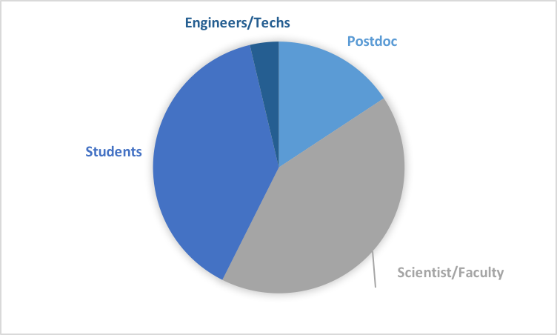
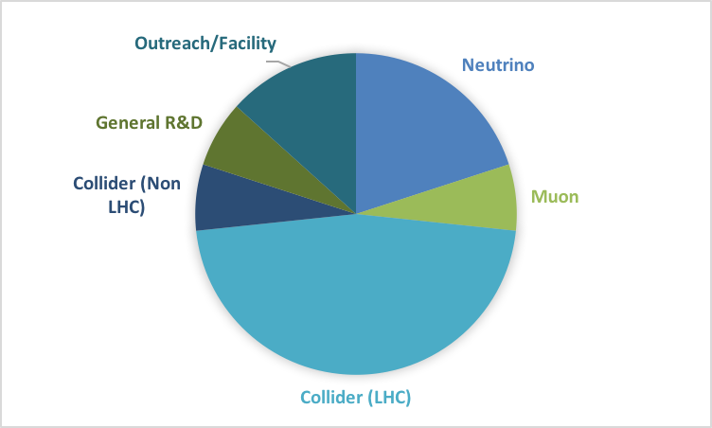
FY17 Users
Continued to have a broad base of users and research topics.
  Many students came this year
  Users from 3 out of 4 LHC experiments

Slide 13
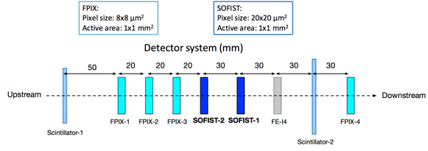
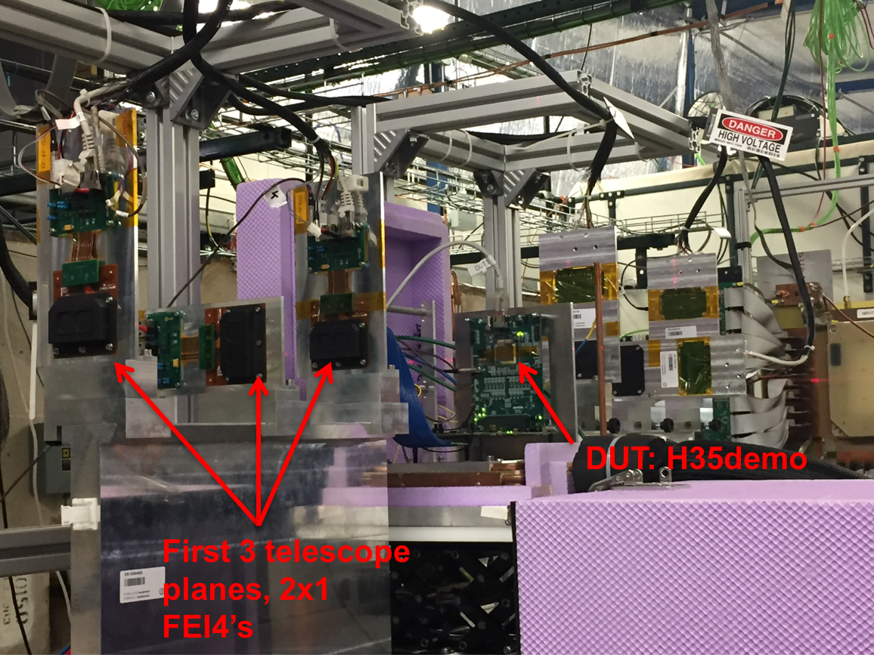
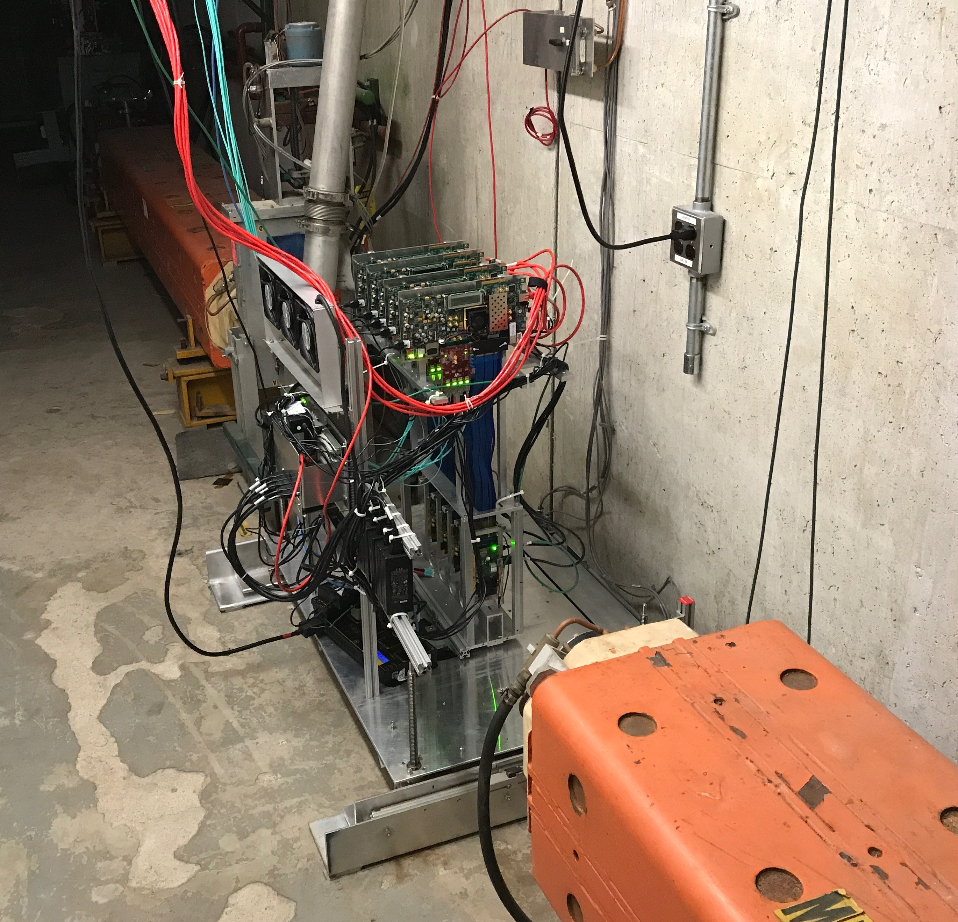
LHC Groups
ATLAS (T1068 and T1224)
  Both groups testing radiation effects on sensors for the HL-LHC upgrade
  Results from the test beams are used for selection of appropriate technology
  T1224 intends to build a telescope at FTBF for future use over the next few years.
LHCb
  Testing irradiated sensors

Slide 14
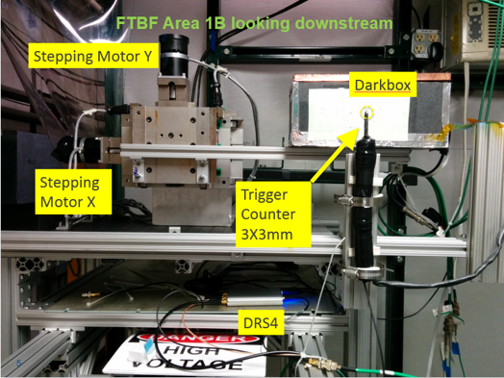
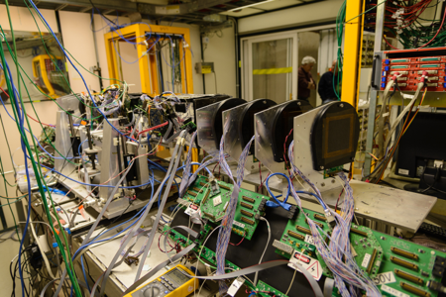
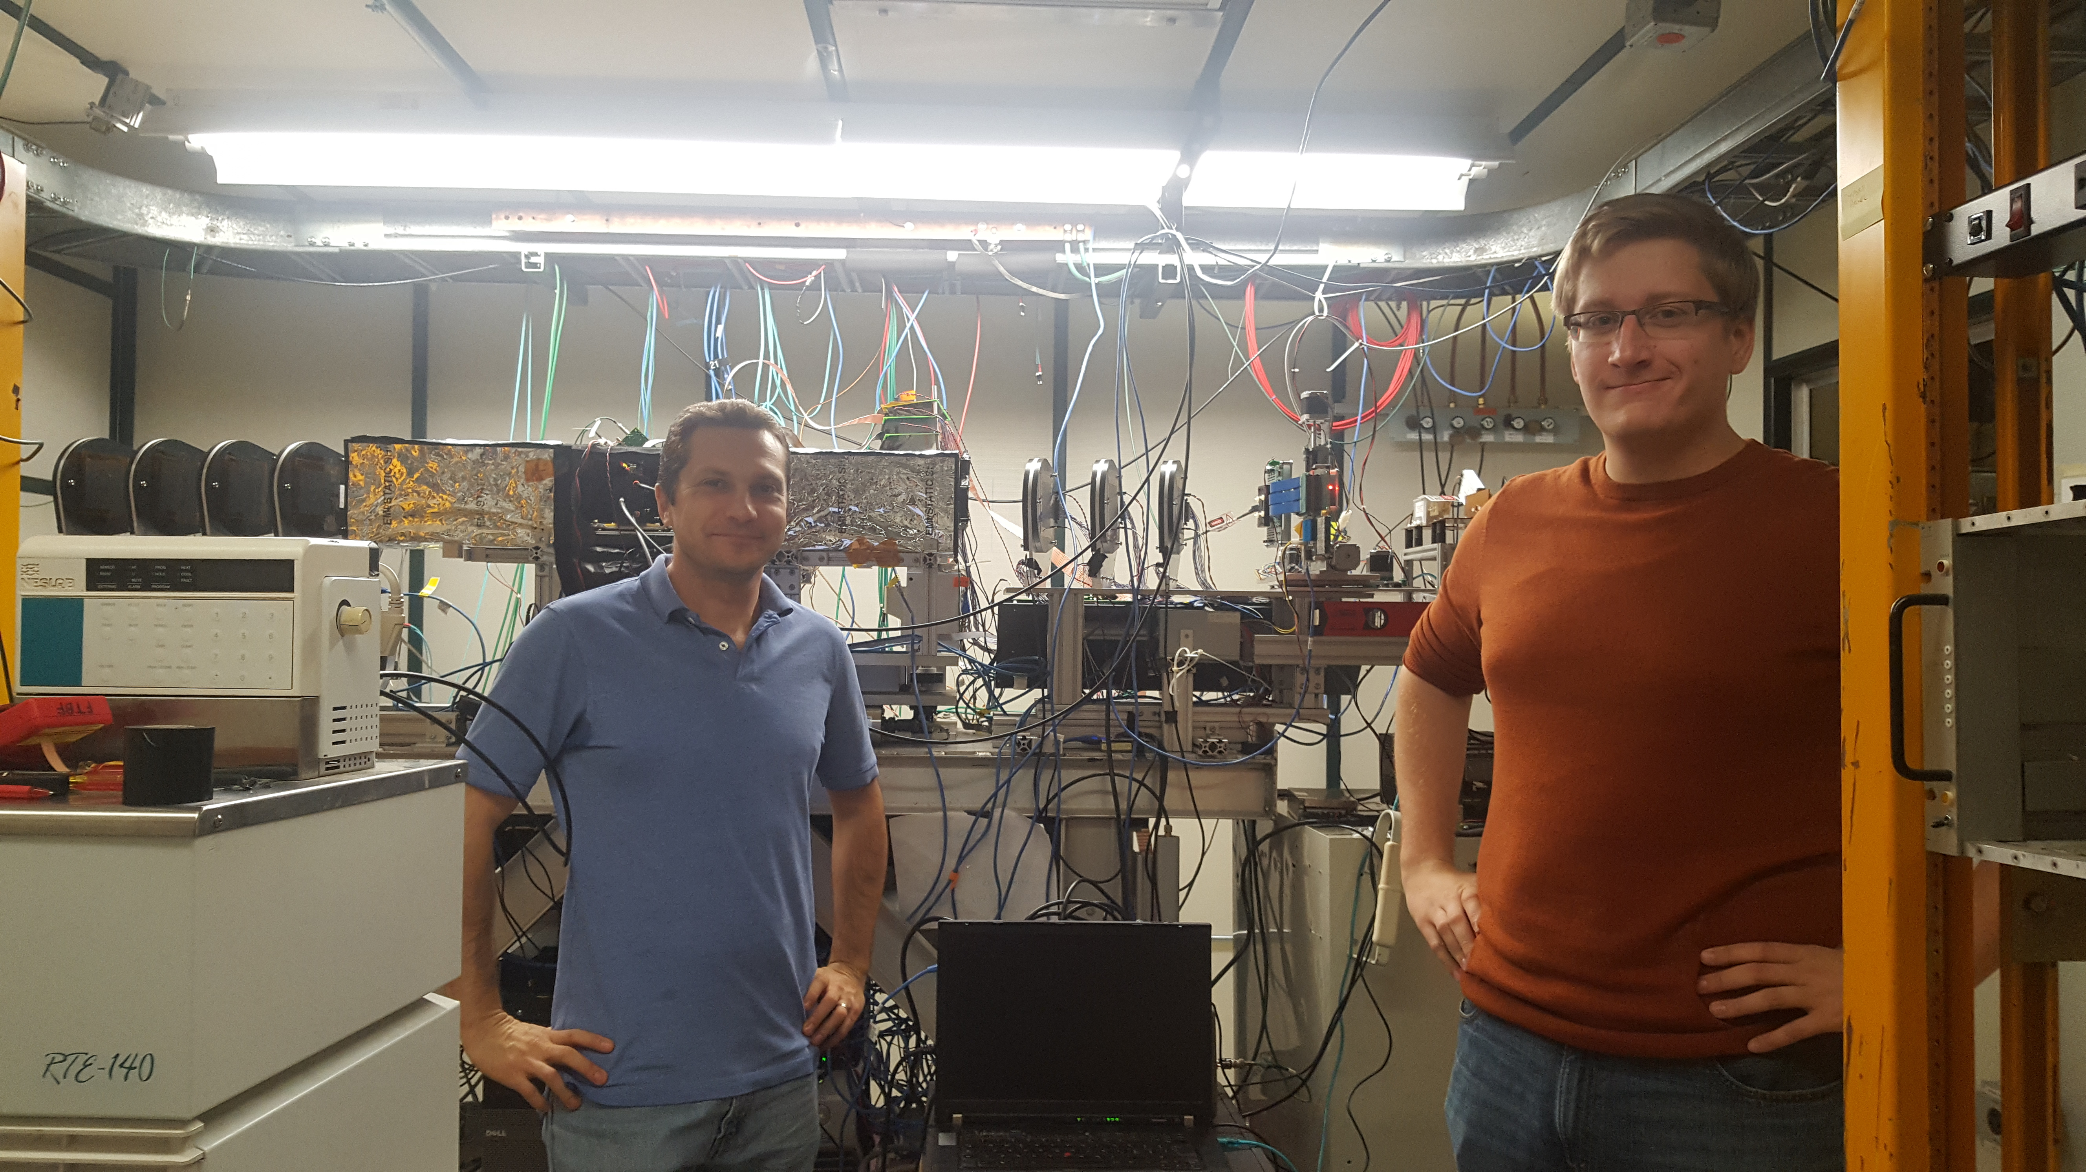
LHC
CMS
  Testing irradiated sensors
  Testing Outer Tracker readout chip
  Testing properties for SiPMs and scintillator for HGCal

Slide 15
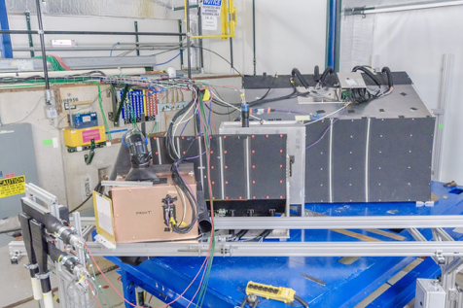
Non LHC Collider
sPHENIX
  Continuing tests of EMCal and Hadronic calorimeter including new readout electronics
  Using this information for their upcoming CD review
  Will be returning this year for last test
  Continues to send other users our way as well.

Slide 16
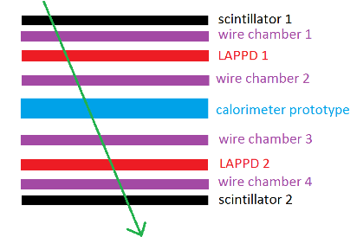
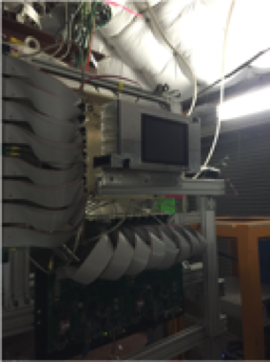
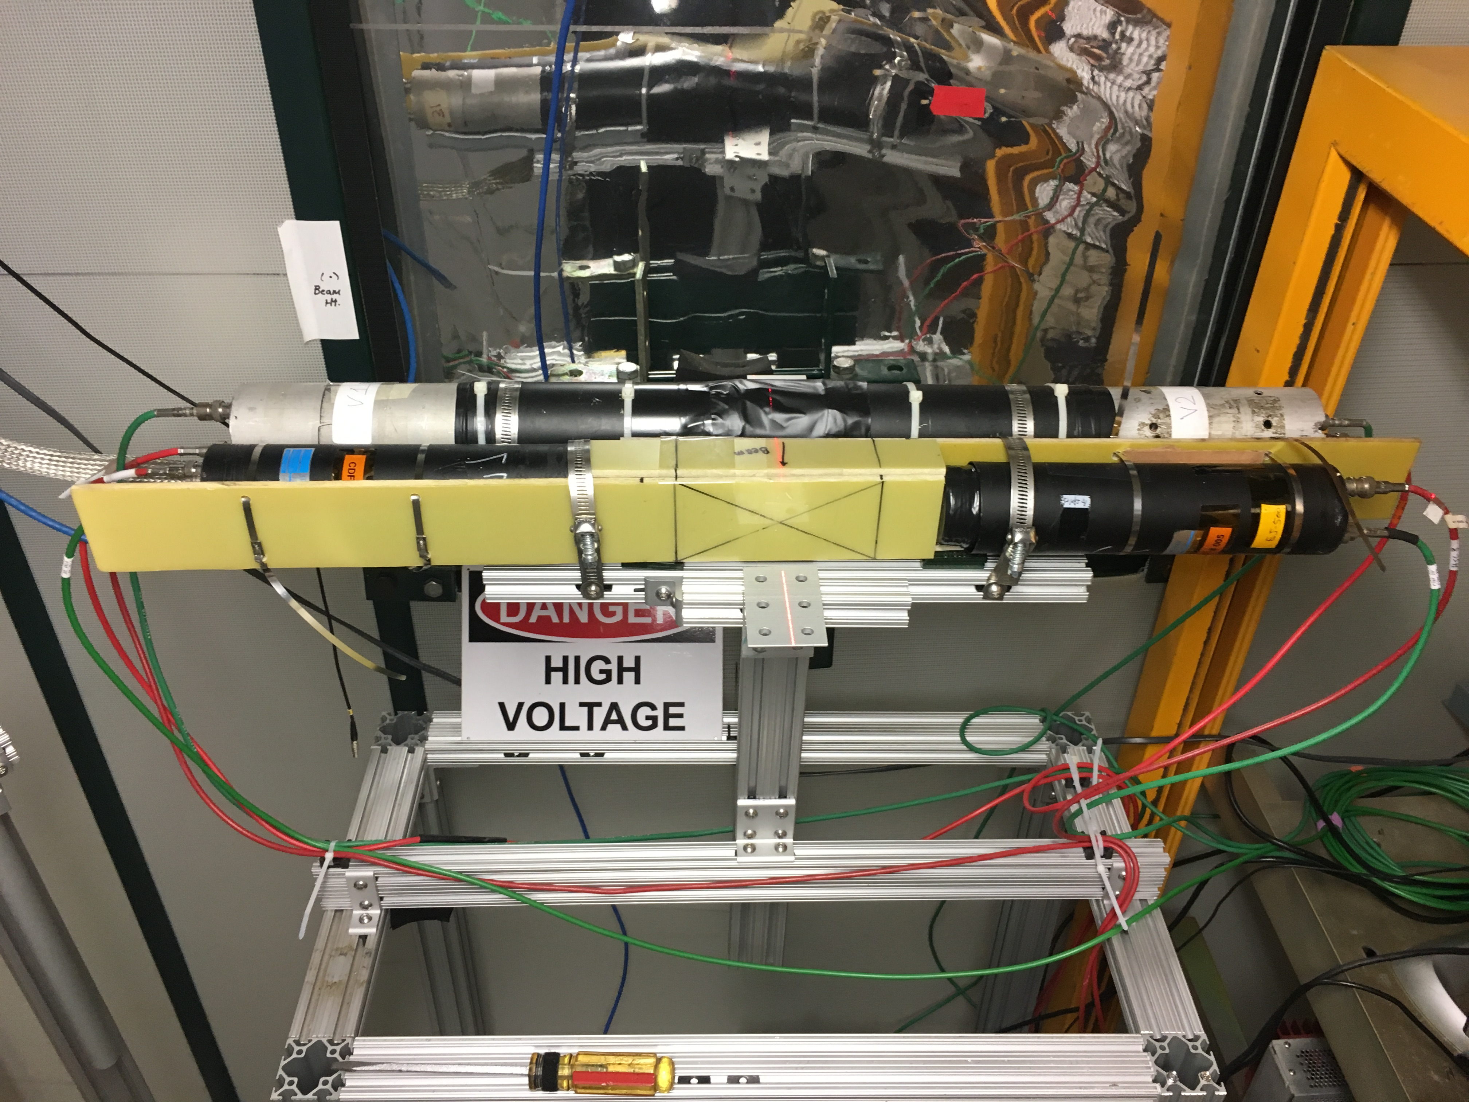
Neutrino experiments
LAFTBFToF for ProtoDUNE
  Testing in and out of beam
  Possible ToF detector for ProtoDUNE
LBNF Spectrometer
  Testing DAQ duty cycle
  Prelimiary R&D for a LBNF horn testing facility
  Understanding available beam for future studies

Slide 17
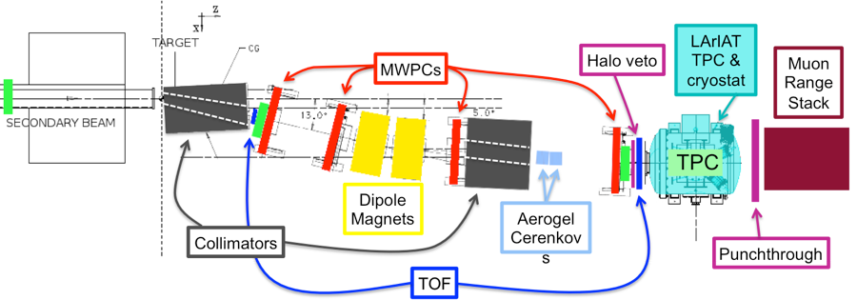
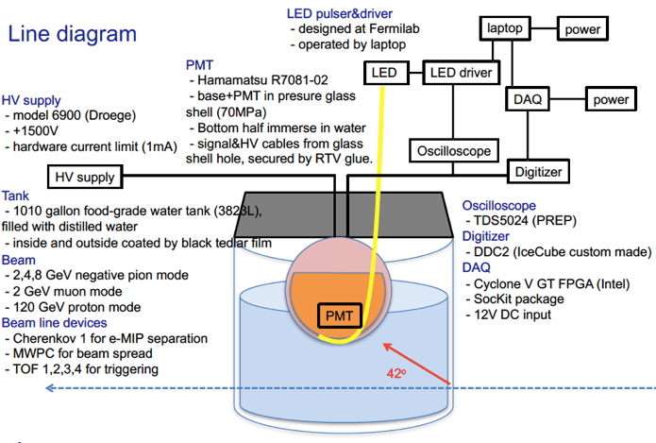
Neutrino Experiments
LArIAT
  Continued their program
  Did R&D for other experiments during their run (SBND, DUNE)
  Running for a few weeks this fall with a pixel detector
IceCUBE
  Studying electronics for their 10 inch DOM
  Interesting challenge to locate 1000 gallons of DI water
  Successful test for this group

Slide 18
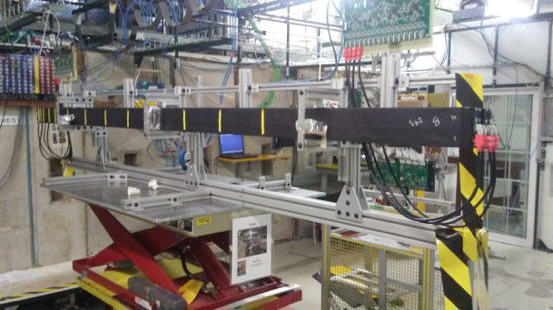
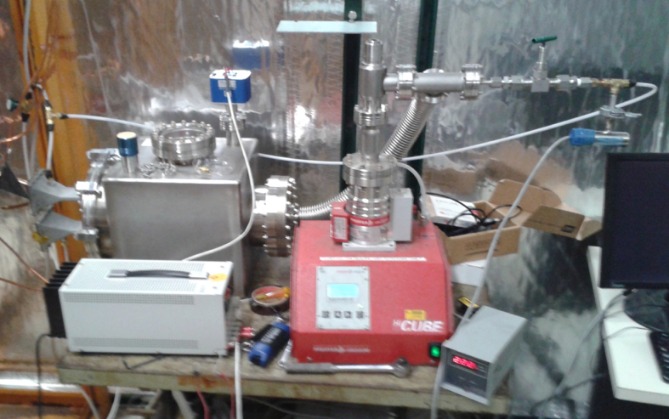
Muon Experiments
Mu2e
  Final test for CRV
  Integration of all components
  Results will be used in upcoming TDR
g-2 no beam
  Testing modules for leaks in vacuum
  All modules installed tested first at FTBF

Slide 19
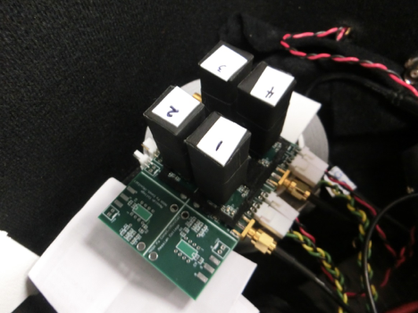
General R&D
Mini EM Calorimeter
  Located in the MT6.2b area
  Testing construction and readout for mini calorimeter to be used in space.
  Small college group, mostly students
FastHCal muon stuff
  Located in MT6.2c
  Testing muon counter technology for future colliders
  Have used the facility before and will continue program for the new few years.

Slide 20
FY17 Facility improvements
Built up our office space area for users
  Heavily used for staging
  Had racks in there ready to go, users would set up equipment
  Allowed for preliminary electrical safety inspections
Bought DRS4 boards
  Initially on recommendation for EDIT school
  Used by 2 separate experiments as their primary DAQ system
  Plan to buy more
Summer projects
  Leveraged our student helpers
  Slides follow with information about our projects

Slide 21
Summer Projects: Computing access for offsite users
Users need to register nodes and have Kerberized machines
  This is complicated
  Computing division developed a virtual machine to provide a Kerberized environment.
2 Summer students (Bella and Violet) refined the instructions and the procedure
All the subsequent students tested it (17!)
    Windows 7, Windows 10, Ubuntu, Mac all tested
    Instructions: https://docs.google.com/document/d/1z2ZofJoA7z24dXkFr7L5XARK71rE6cjVexukrlTYKro/edit?usp=sharing
    Will upload more instructions for other operating systems this year

Slide 22
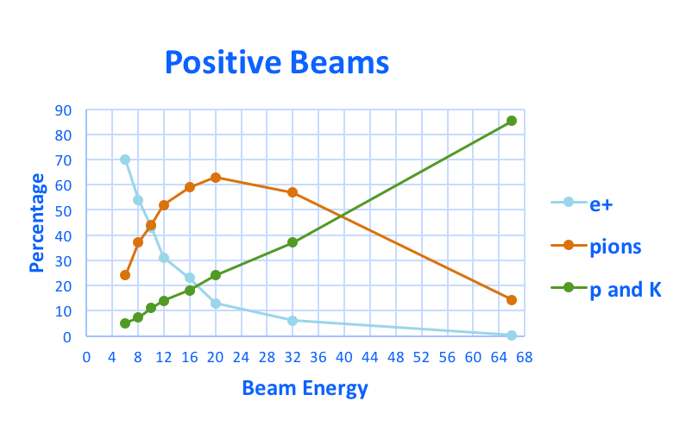
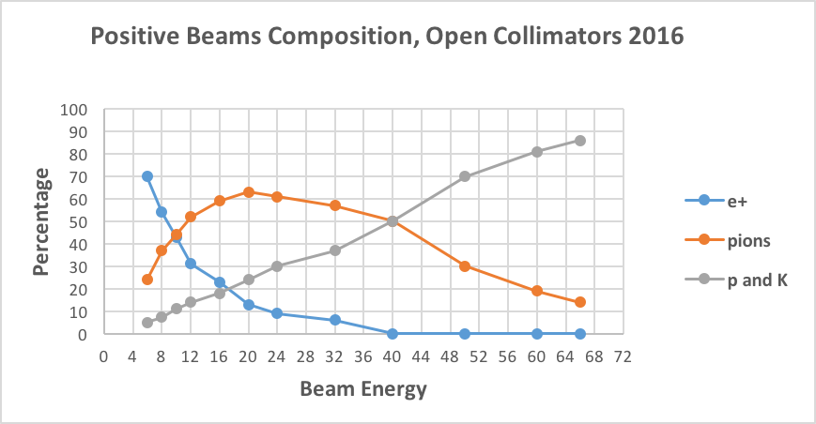
Summer Projects: Beam Studies
Spent the last few weeks of the beam sneaking in studies
  Karla (Summer Student) was able to take data and produce updated plots
FY16
FY17

Slide 23
Summer Projects: Simulations
Livio (Italian Summer student) worked on simulating the MCenter beamline wit G4Beamline
  Already have some work done on MTest as well
  Working to get information in a format easy for users to access
Target cage;
Collimators;
Q3 quadrupoles;
Dipoles;
Q4 quadrupoles;
Trims
MC6 Simulation

Slide 24
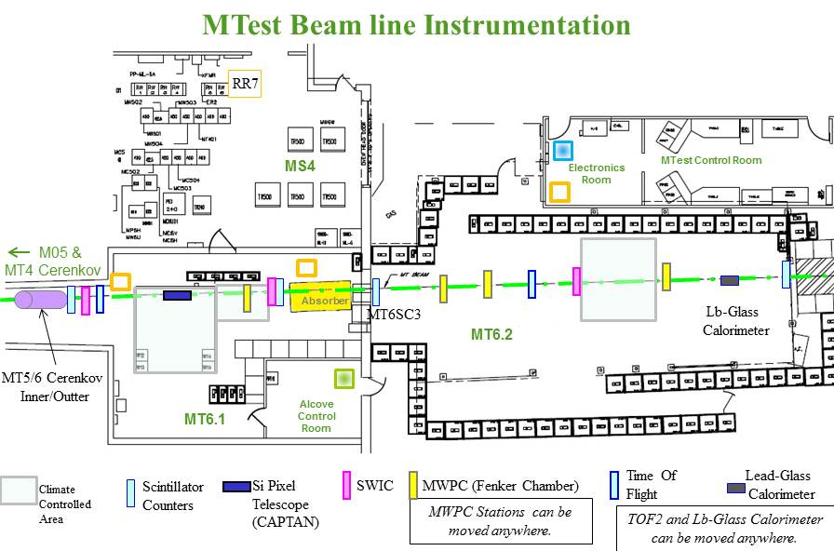
FTBF Facility DAQ
MTest beamline is instrumented with scintillator counters, MWPCs, a lead-glass calorimeter, and the CMS strip telescope.
The goal of the Facility DAQ is to create a single DAQ system integrating all these detectors, with particle path reconstruction and synchronized readout
The Facility DAQ serves as black-box source of MTest detector data and reconstructed objects to FTBF experiments
FTBF DAQ is based on the otsdaq toolkit,
leveraging artdaq, art, and CMS XDAQ,
demonstrating SCD common DAQ
strategy
Showcases DAQ toolkit functionality and
otsdaq capabilities
MWPCs and Strip Telescope will be
integrated into the DAQ first, with the other
detectors following later

Slide 25
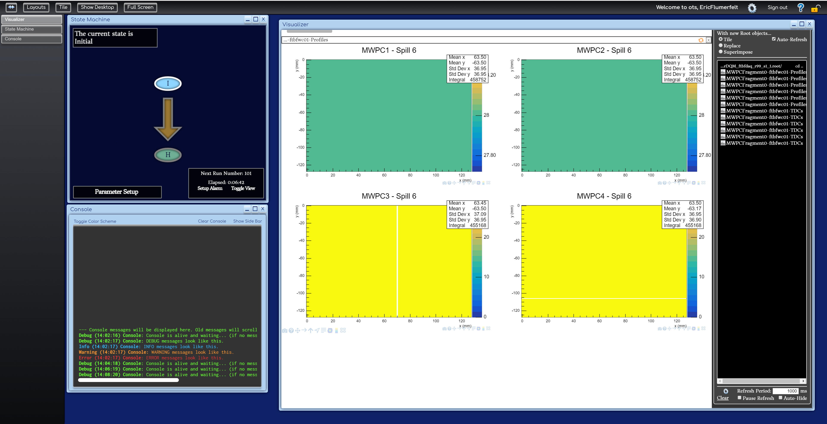
Facilty DAQ - Readout
Detectors readout is performed on a spill-by-spill basis
art software splits data trigger-by-trigger, performing analysis on each trigger
NIM+ from the PREP Modernization project allows trigger signal fan-out
  Essential for event synchronization
NIM+
MWPCs
Facility DAQ
XDAQ Web Display
Trigger signal from Scintillators
Strip Telescope
Other Users

Slide 26
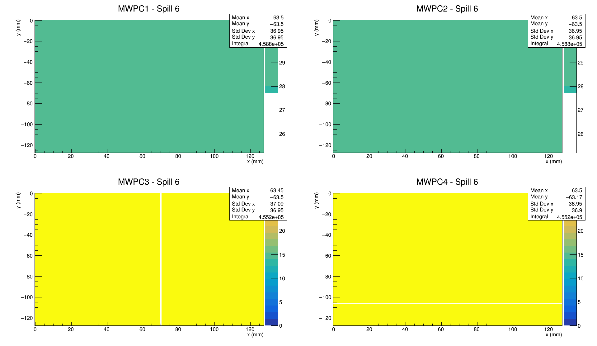
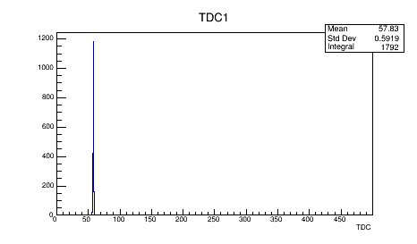
Facility DAQ - MWPC DQM
otsdaq uses art to generate DQM images on a spill-by-spill basis, then displays them on a web-based control room desktop, accessible anywhere on-site
Hit profile DQM image from MTest MWPCs. White lines on lower plots indicate bad TDC channel/broken wire.
TDC distribution DQM image from MTest MWPCs.

Slide 27
Facility DAQ - Status and Plans
October Milestone (Complete)
  Read out MWPC planes using otsdaq
  Recreate MWPC analysis in art modules
  Demonstrate Facility DAQ using all FTBF DAQ servers
November Milestone (In Progress)
  Integrate Strip Telescope DAQ
  Create initial event data server for FTBF experiments
  Install trigger fan-out to detectors
December Milestone
  Create user-level tutorials and instructions
  Implement reconstruction code and make reconstructed data available to experiments
Future Plans
  Use NOνA TDU to provide GPS timestamps to beam triggers
  Integrate Scintillator Counter, Lead glass calorimeter and muon wall readout
  Integrate Slow Controls data into DAQ stream

Slide 28
Questions?
Comments?

Slide 29
FY18 Schedule and Plans
Reminder – during FY17, we receive 10% of the time line when we request beam
  This is a negotiated amount between program planning and SeaQuest.
  When we change experiments or are otherwise down, that beam goes to the rest of the complex
Restricting Switchyard (MTest and MCenter) to 12 hours a day is detrimental to our program
  Severe restriction on how many users we can have
  Impacts cost as users will need to stay longer to get the amount of necessary beam.

Slide 30
Our Schedule so far
We currently have at least one user per week for the FY18 running period
  Many users (but not all) have requested 24 hour running and have the manpower to staff that
  Users that make sense to double up have doubled up already (2 or users during the same 12 hour period)
Started requesting users for FY18 in May of 2017
  MTest Schedule: https://web.fnal.gov/experiment/FTBF/Mtest/2018_schedule.aspx
  MCenter Schedule: https://web.fnal.gov/experiment/FTBF/Mcenter/2018_schedule.aspx
  More requests are coming in (and this will likely continue)

Slide 31
FY18 Users
CMS: Timing, Pixels, Outer tracker
  This is both a high priority at the lab and time critical
  Results are needed by the end of the year
ATLAS
  Ramping up US test beam efforts
  Argonne group building telescope to stay at facility
NOvA
  Ramping up their test beam efforts
  Will be commissioning in the spring, running next Fall/Winter
US/Japan funded groups
  One ATLAS group
  One group working on Hadron measurements for Neutrinos using emulsion detectors

Slide 32
FY18 Plans
Will continue to support our current groups
Will work to implement DAQ system
We have 2 groups working on facility ToF
We built a muon tagger wall
Working on fast trigger for the facility and users
We will continue to work with users to plan for the LHC shutdown in a few years.

