Slide 1
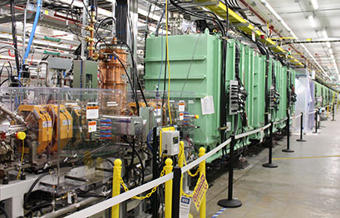
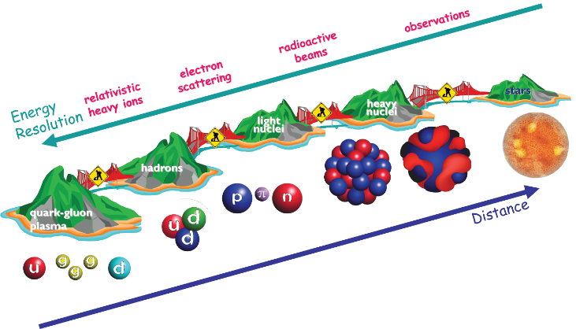
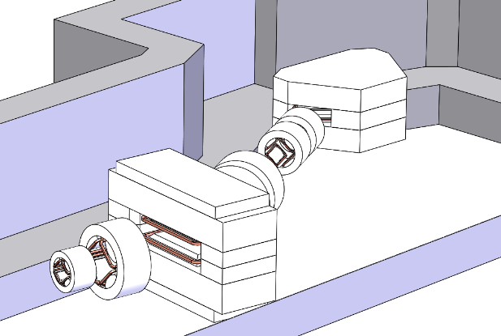






Science with a 400 MeV/u upgrade of FRIB
Advantages for reactions and reaction mechanisms
Remco G.T. Zegers
with many thanks to all who provided input and answered my questions!

Slide 2
Content
FRIB@400 MeV/u - context
Reaction mechanisms – broad perspective
Short-range correlations – (p,pN) experiments
Matter & charge radii measurements
(Heavy-ion) electromagnetic excitations: pygmy resonances and neutron skins
Charge-exchange reactions and applications in astrophysics and neutrinophysics
Luminosity gains at 400 MeV/u
The High Rigidity Spectrometer for experiments at FRIB@200 MeV/u and @400 MeV/u
Conclusions

Slide 3
FRIB@400 MeV/u – what does it mean?
Primary beams of up to ~540 MeV/u
Secondary beams of up to ~500 MeV/u
Ion species | Charge state | Energy (MeV/u), FRIB | Energy (MeV/u), FRIB-U
⁴⁰Ar | 18 | 320 | 540
⁴⁸Ca | 20 | 264 | 508
⁸⁶Kr | 35 | 257 | 497
¹²⁴Sn | 47 | 235 | 464
¹⁹⁸Au | 68 | 210 | 421
²³⁸U | 78 | 200 | 403

Slide 4
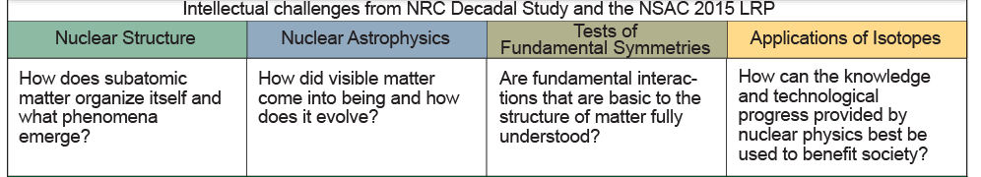

Reaction studies with rare-isotope beams in excess of 250 MeV/u address the major scientific questions posed by the community and contribute to building bridges between nuclear science subfields

Slide 5
The interface between nuclear structure and reactions
Strong progress in understanding the connection between NN interactions and QCD, and the calculations from nuclear spectra and properties from basic principles; continued progress in DFT, configuration-interaction model etc.
Many experimental techniques rely on modeling and interpreting reactions and scattering data
Frameworks used to model and interpret the information gained about the structure are distinct and usually rely on different assumptions from the frameworks used for describing the scattering processes
If not controlled, this mismatch hinders the interpretation and can lead to misinterpretations of the data
To avoid such problems:
  Test the structure calculations for degrees of freedom left out of the model
  Improve the reaction models and assess the consequences of assumptions made
  Reduce the uncertainties in the interpretation of data by performing experiments that suffers least from degrees of freedom that are difficult to control/constrain/model → experiments between 250-500 MeV/u are very beneficial for this purpose

Slide 6
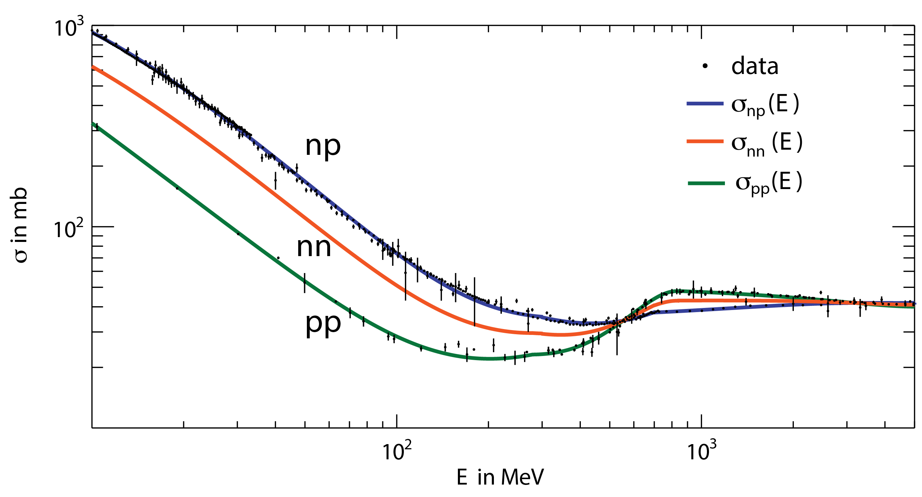
Nucleon-Nucleon (NN) cross sections
NN cross sections minimize at 200-500 MeV
Reaction mechanism simplify
Final-state interactions are reduced
Δ
π

Slide 7
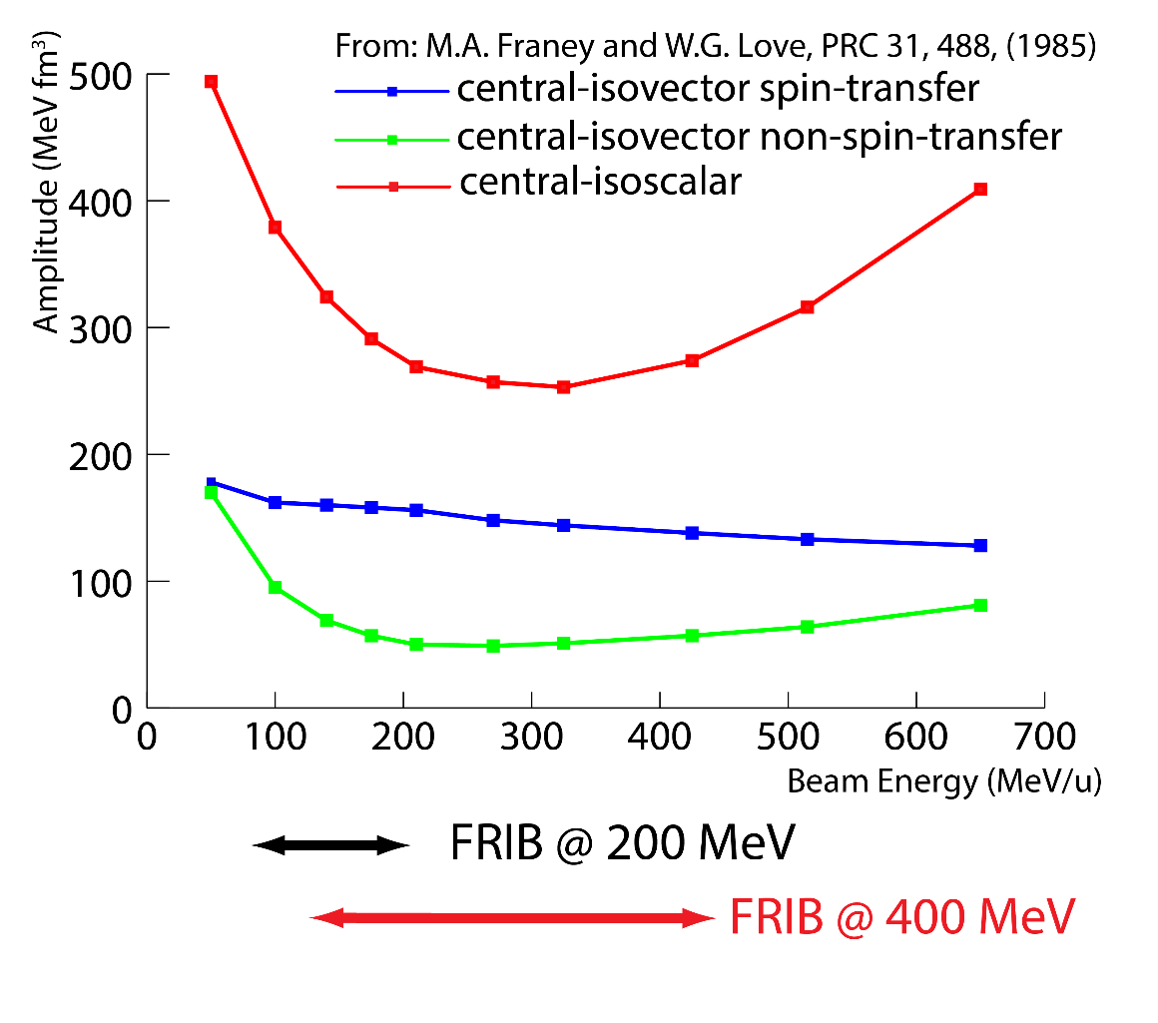
NN interactions and nuclear reactions
Central-isoscalar component of the NN interaction minimizes at about ~300-350 MeV
Reaction mechanisms simplify:
Reduction of distortions/final state interactions by mean field of nucleus
Reduction of multistep contributions for experiments that rely on single-step description of reaction mechanism

Slide 8

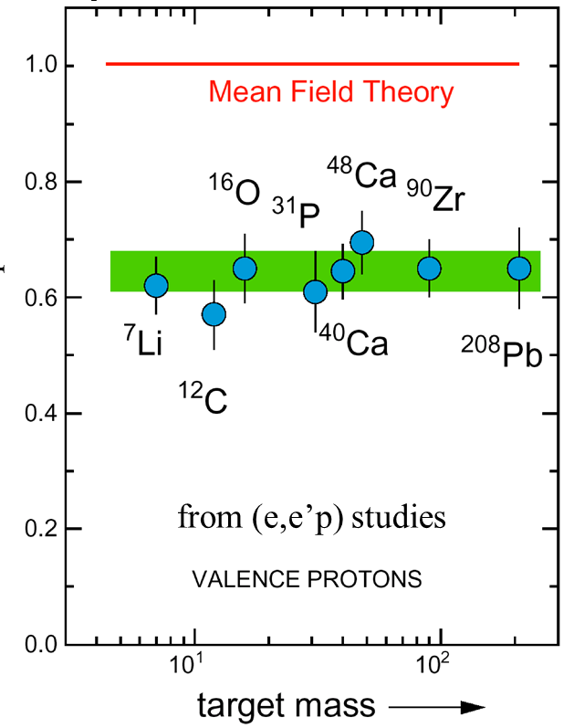

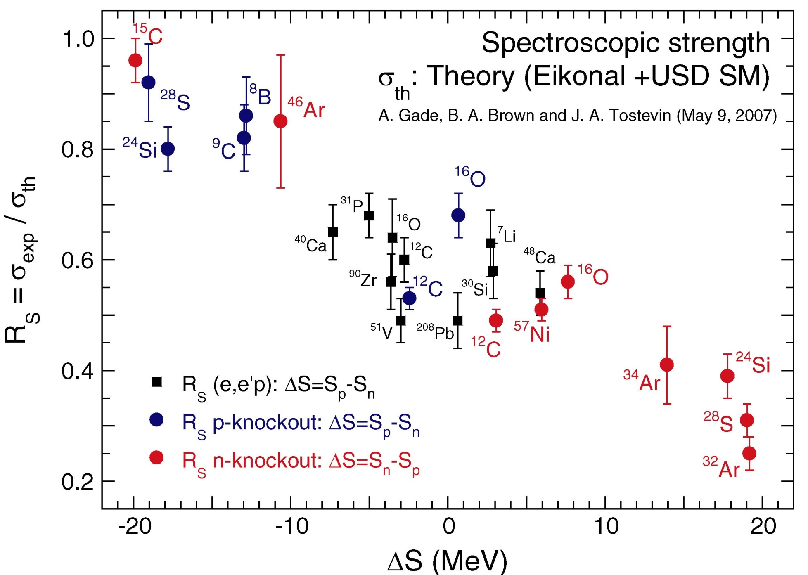
High momenta and short-range correlations
Or Hen et al., RMP 89, 045002 (2017)
In novel theoretical treatments, high-momentum contributions are cut-off or integrated out: nuclear wave-functions could lack important high-momentum components/short-range correlations
Results from low-energy and medium energy experiments for spectroscopic factors suggest the need for (short-range) correlations
Reaction-analysis frameworks used (Eikonal, Glauber, Impulse approximation etc) rely on the simplicity of the reaction at high momenta and momentum transfers – but these methods assume that correlations are maintained in the wave function
One either needs a uniform treatment of the physics at low and high momenta (hard!) or to gain sufficient understanding of the impacts of approximations (in structure and reaction theories)
Experiments up to ~500 MeV/u involving (very) asymmetric nuclear systems will be an important tool for elucidating the role of short-range correlations in nuclei as the reactions mechanism simplify
Progress in understanding reaction mechanisms are important for interpretation of the data AND to better comprehend shortcomings in theory of NN interactions
Lapikas, Dickhoff
HI knockout A. Gade et al., PRC 77, 044306
(p,2p) L. Atar et al., PRL 120, 052501

Slide 9
(p,pN) reactions
Quasifree (p,pN) knock-out experiments are complementary to heavy-ion knock-out experiments for studying evolution of single- particle structure as (p,pN) reactions also probe the nuclear interior
A simple reaction mechanism for both the in- and out-going channels is important for analyzing (p,pN) data: operate at beam energies at the upper end of the 200-500 MeV/u regime Aumann, Bertulani, Ryckebusch, PRC 88, 064610 (2013)
Proton-proton correlations exhibit characteristics of co-planar quasifree scattering
Transverse momentum distribution ¹⁶O(p,2p) from ¹³⁻²³O(p,2p) experiments at 300-450 MeV/u at GSI
L. Atar et al., PRL 120, 052501 (2018)

Slide 10
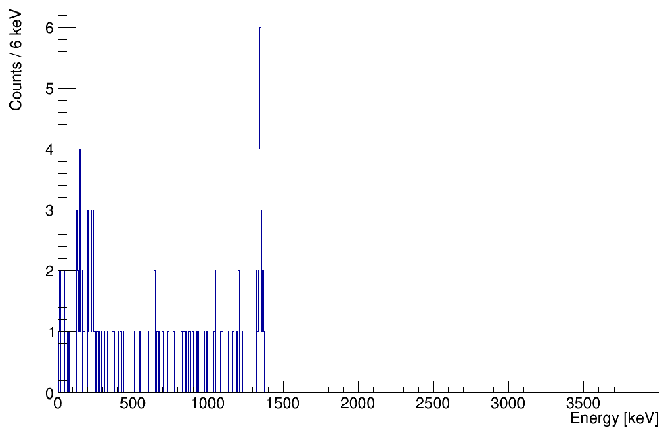
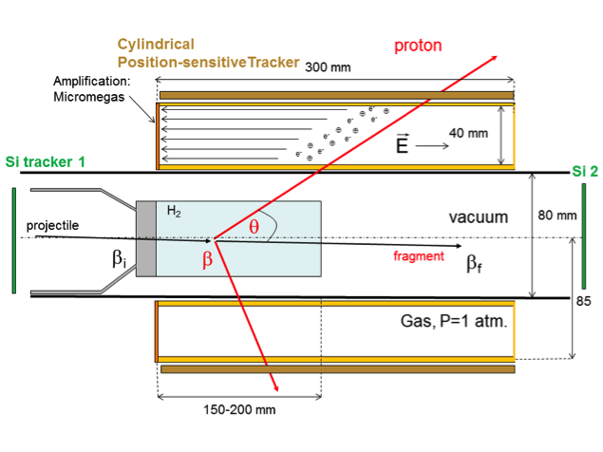
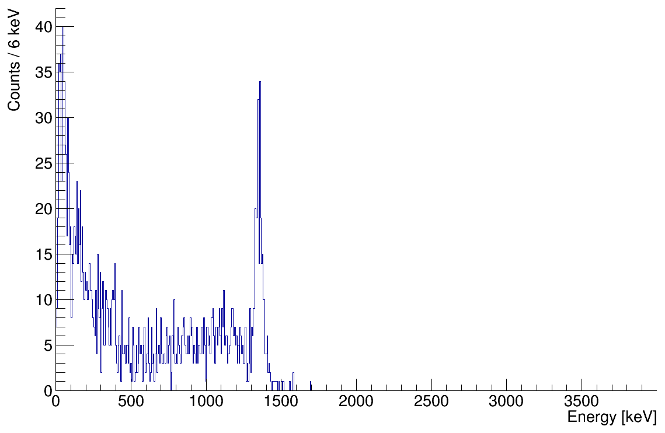
High beam energies allow for thick targets and high luminosities: very beneficial for experiments far from stability
Example: MINOS, liquid hydrogen target and vertex tracker for (p,pN) experiments
Up to 15 cm thick liquid hydrogen target strongly increases luminosity
Vertex tracking capability determines velocity at reaction point and improves Doppler reconstruction for γ-ray spectroscopy
Planned development for similar system at FRIB
⁶⁰Ca
(GRETA + Be target)
Knockout from ⁶¹Sc
⁶⁰Ca
(GRETA +
LH2 tracking target)
⁶¹Sc (p,2p) reaction
A. Obertelli et al., EPJA 50, 8 (2014)
Olivier et al., PRL 119, 192501 (2017)
Doppler-reconstructed γ-ray spectra from ⁸⁰Zn(p,2p)⁷⁹Cu by using MINOS inserted in the DALI2 NaI array @ RIBF
A device such as MINOS in combination with GRETA would result in unprecedented sensitivities, especially for FRIB@400 MeV

Slide 11

Matter and Charge Radii measurements of rare isotopes
Information about the matter radii can be extracted from measurements of interaction (σ_{i}) and reaction (σ_{R}) cross sections (σ_{R}=σ_{I}+σ_{inelastic}) and provide important information about nuclear sizes, skins, and halos of rare isotopes
Extraction of radii relies on Glauber theory (few-body Glauber for halo nuclei), requiring the highest energies available at FRIB after a 400 MeV/u upgrade
Method to extract matter radii has recently been extended to charge radii, by measuring charge-changing (σ_{CC}) cross sections
Complementary to electron scattering and laser spectroscopy methods and applicable far from stability
See e.g. Ozawa et al., NPA 693, 32 (2001)
matter radii from σ_{I}
Tanihata et al., PLB 206, 592 (1988); Al-Khalili & Tostevin, PRL 76, 3903
Tanihata et al., PRL 55, 2676 (1985)
T. Yamaguchi et al., PRL 107, 032502; Estrade et al., PRL 113, 132501
¹²⁻¹⁷B charge radii from σ_{cc}
Estrade et al., PRL 113, 132501

Slide 12
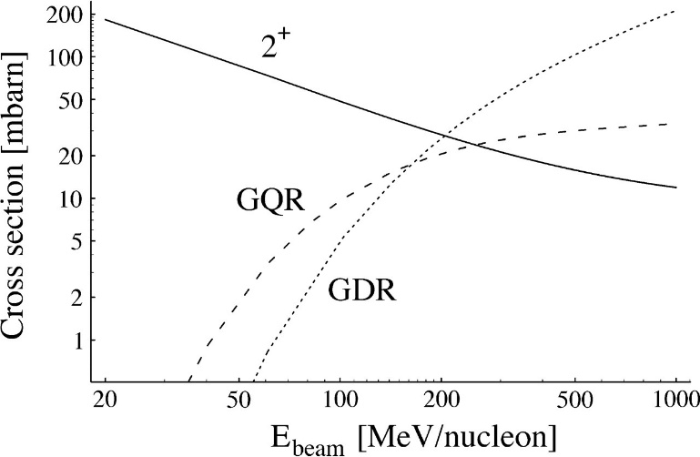
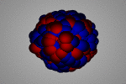
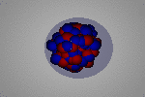
Heavy-ion electromagnetic excitations
T. Glasmacher, Annu. Rev. Nucl. Part. Sci. 48, 1 (1998)
Coulomb excitation: tool for understanding collective degrees of freedom
FRIB@400 MeV/u: strong sensitivity to excitation of the Giant Dipole (GDR) and Quadrupole Resonances (GQR) is obtained
GDR: probe of charge-distribution in nuclei: for neutron-rich systems, low-lying dipole strength is observed associated with the pygmy dipole resonance (PDR), e.g. Coulumb excitation of ¹³⁰Sn and ¹³²Sn
Properties of PDR are important for astrophysical r-process as it enhances the radiative neutron-capture cross section
FRIB@400 MeV
GDR
Adrich et al., PRL 95, 132501 (2005)
PDR
D. Savran, T. Aumann, and A. Zilges, Prog. Part. Nucl. Phys. 70, 210 (2013)

Slide 13
Dipole polarizability and neutron skins
The extraction of E1 strength allows for the extraction of the dipole polarizability α_{D} , which depends strongly on the low-lying E1 strength including the PDR
Extraction of α_{D} provides measure for neutron-skin thickness
Successfully used for the case of ²⁰⁸Pb by using ²⁰⁸Pb(p,p’) data
Measurements can be extended to systems with very thick neutron skins by using HI Coulomb excitation and/or (p,p’) scattering at FRIB – in both cases, beam energy of 300 MeV/u or higher are required for clean extraction of E1 distribution
Comparison to parity-violating elastic electron scattering experiments at JLAB for stable system provides calibration and cross check (PREX I/II and CREX)
Piekarewicz, PRC 73, 044325 (2006)
Tamii et al., PRL 07, 062502 (2011)
Reinhard &Nazarewicz, PRC 81, 051303(R) (2010)
C. Horowitz, K. S. kumar, R. Michaels EJPA 50, 48 (2014)

Slide 14

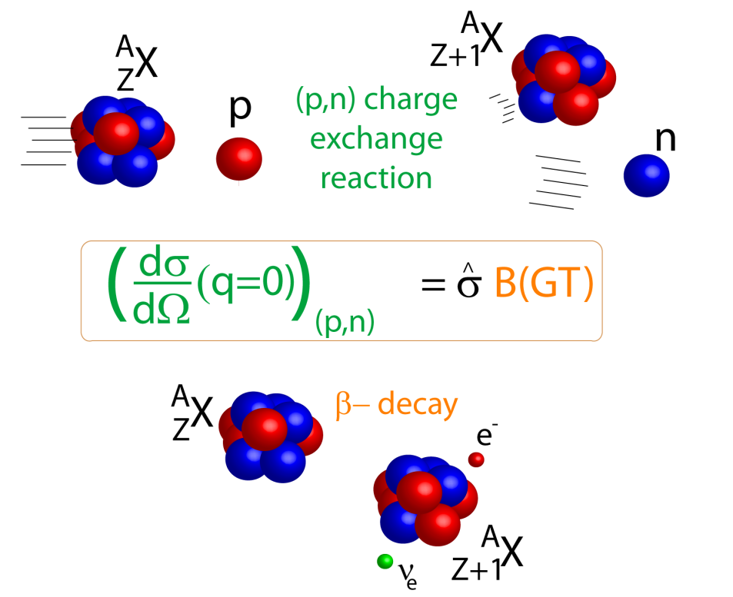

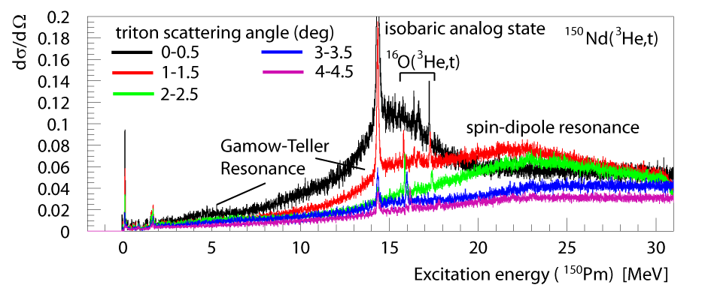
Charge-exchange reactions
Gamow-Teller (GT) strengths can be extracted by using a well-established proportionality between the CE cross section and B(GT) for E~100 MeV/u and above, based on Eikonal approximation
At 300 MeV/u uncertainties are minimized due to minimum in central-isoscalar component of NN interaction: reduction of distortions and isovector non-spin-transfer and isovector tensor amplitudes in the NN cross section
Simplified reaction mechanisms make it possible to extract dipole (forbidden) transition strength up to high excitation energies, which is important for astrophysical applications & neutrino physics

Slide 15
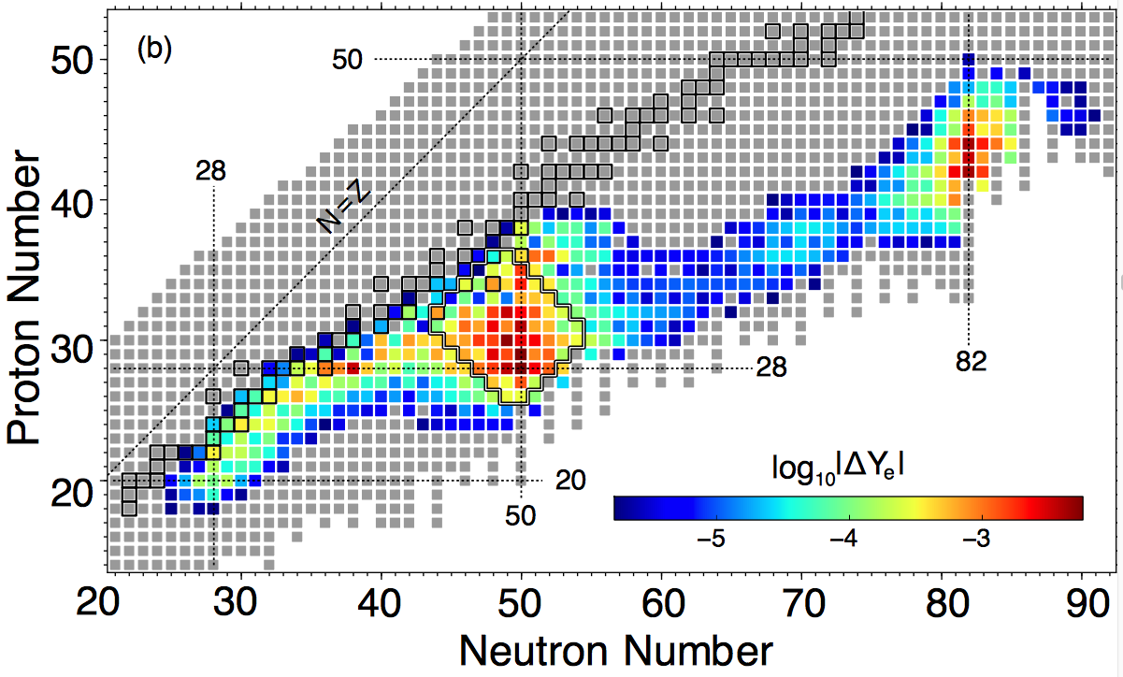
Electron-capture rates on neutron-rich systems
Electron-capture rates in neutron-rich systems are critical for late-stage evolution of core-collapse supernovae
(t,³He) experiments near N=50 indicate that Gamow-Teller strengths are strongly blocked/hindered
Forbidden transitions become important for estimating electron-capture rates and the late stages of evolution of core-collapse supernovae
Extraction of forbidden transition strengths at high excitation energies from charge-exchange experiments benefits from high beam energies for a simplified reaction mechanism
R. Titus et al. , J. Phys. G 45, 014004 (2017)
C. Sullivan et al., Ap. J., 816, 44 (2015)
Zamora et al., to be published

Slide 16
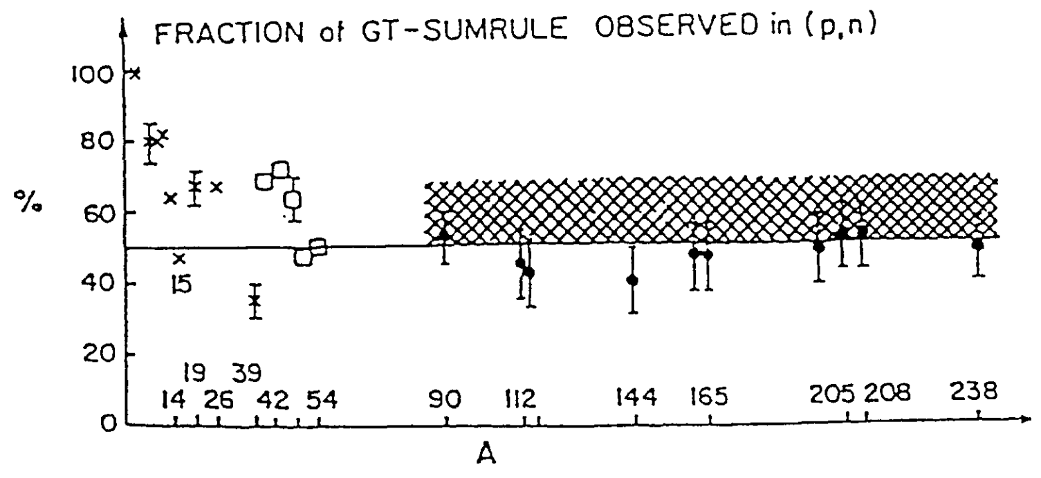
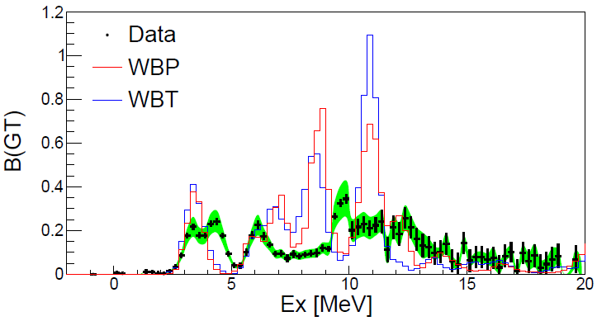
Quenching of the weak axial vector-coupling constant g_{A}
For recent review: J. Suhonen, Frontiers in Physics 5 (2017) 55
Quenching of g_{A} manifests itself in the quenching of the observed Gamow-Teller sumrule strength: S_{β-}-S_{β+}=3[N-Z]
Important implications for astrophysics and neutrinophysics: half-lives of neutrinoless double beta decays are proportional to the g_{A}⁴
Evidence by using ⁹⁰Zr(p,n) and (n,p) data for coupling to 2p-2h configurations that push strength up in excitation energy
Recent results from ¹⁶C(p,n) in inverse kinematics indicate that neutron-rich light nuclei might be ideal laboratories for detailed investigations: S_{β+}=0 and GT excitations dominate yield. Medium-heavy systems (e.g ⁷⁸Ni) could also be suitable
High-lying GT strength is best studied if the reaction mechanism is simple: FRIB at 300 MeV/u would be preferable given experience with forward kinematics experiments
F. Osterfeld, Rev. Mod. Phys. 64, 2 (1992)
S. Lipschutz et al., to be published
High-lying
GT strength
K. Yako et al., Phys. Lett. B 615, 193 (2005).
Robin and Litvinova, arXiv:1702.00044

Slide 17
Landau-Migdal parameter g’_{NN}
g’_{NN} represents the strength of the repulsive short-range component of the spin-isospin interaction
The collectivity of the Gamow-Teller resonance (GTR) is strongly correlated with g’_{NN}: the excitation-energy of the GTR increases with increases g’_{NN}
g’_{NN}=0.64 for ²⁰⁸Pb and 0.6±0.1 for ⁹⁰Zr – isospin asymmetry dependence not well know
Important for neutron star physics: EoS is softened and cooling through modified URCA process is faster if g’_{NN} is reduced
Recent result for ¹³²Sn: g’_{NN}=0.68±0.07 from ¹³²Sn(p,n) in inverse kinematics: g’_{NN} appears stable for (N-Z)/A=0.11-0.24
Yasuda, Sasano et al., to be published
(p,n) in inverse kinematics at RIBF using the SAMURAI spectrometer
Yasuda, Sasano et al., to be published
Results show that GTR can be extracted with very high quality from neutron-rich isotopes – high beam energy is beneficial for the extraction of the GTR strengths

Slide 18
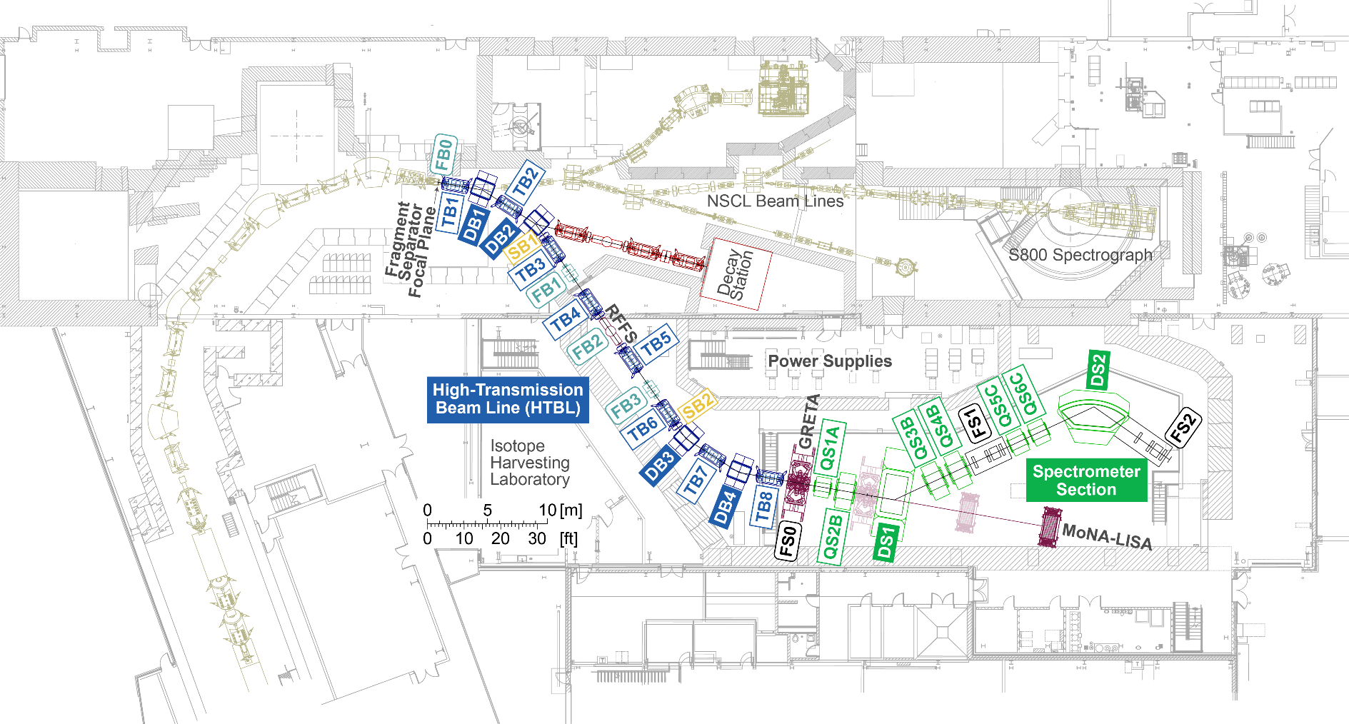
High-Rigidity Spectrometer at FRIB
Satisfies the scientific requirements for a broad program with fast rare-isotope beams at FRIB
Offers increases in luminosity by factors 2-100 compared to using existing spectrometers for FRIB at 200 MeV/u, with the highest gains for the most neutron-rich isotopes.
For FRIB at 400 MeV/u, luminosity gains further increase, affecting ALL experiment types
Please join the HRS Session on Friday 4:45 pm for details on the HRS

Slide 19
The layout and specifications of the HRS was optimized for the broad science program envisioned by the community, including a possible upgrade to FRIB@400 MeV/u
Experiments with a wide variety of community-developed experimental devices will benefit

Slide 20

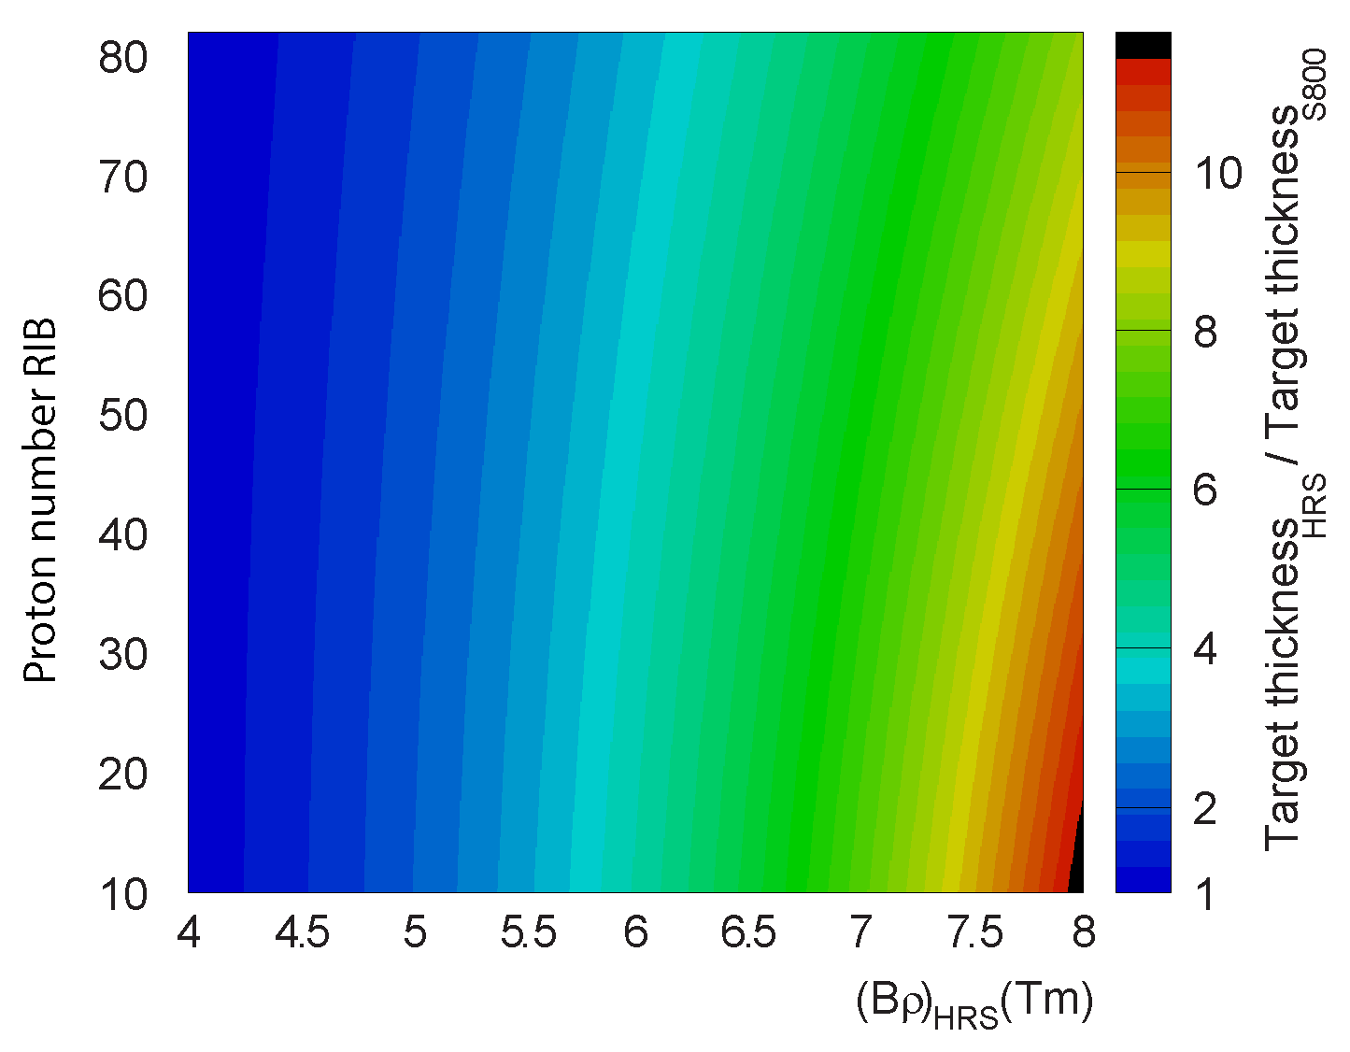
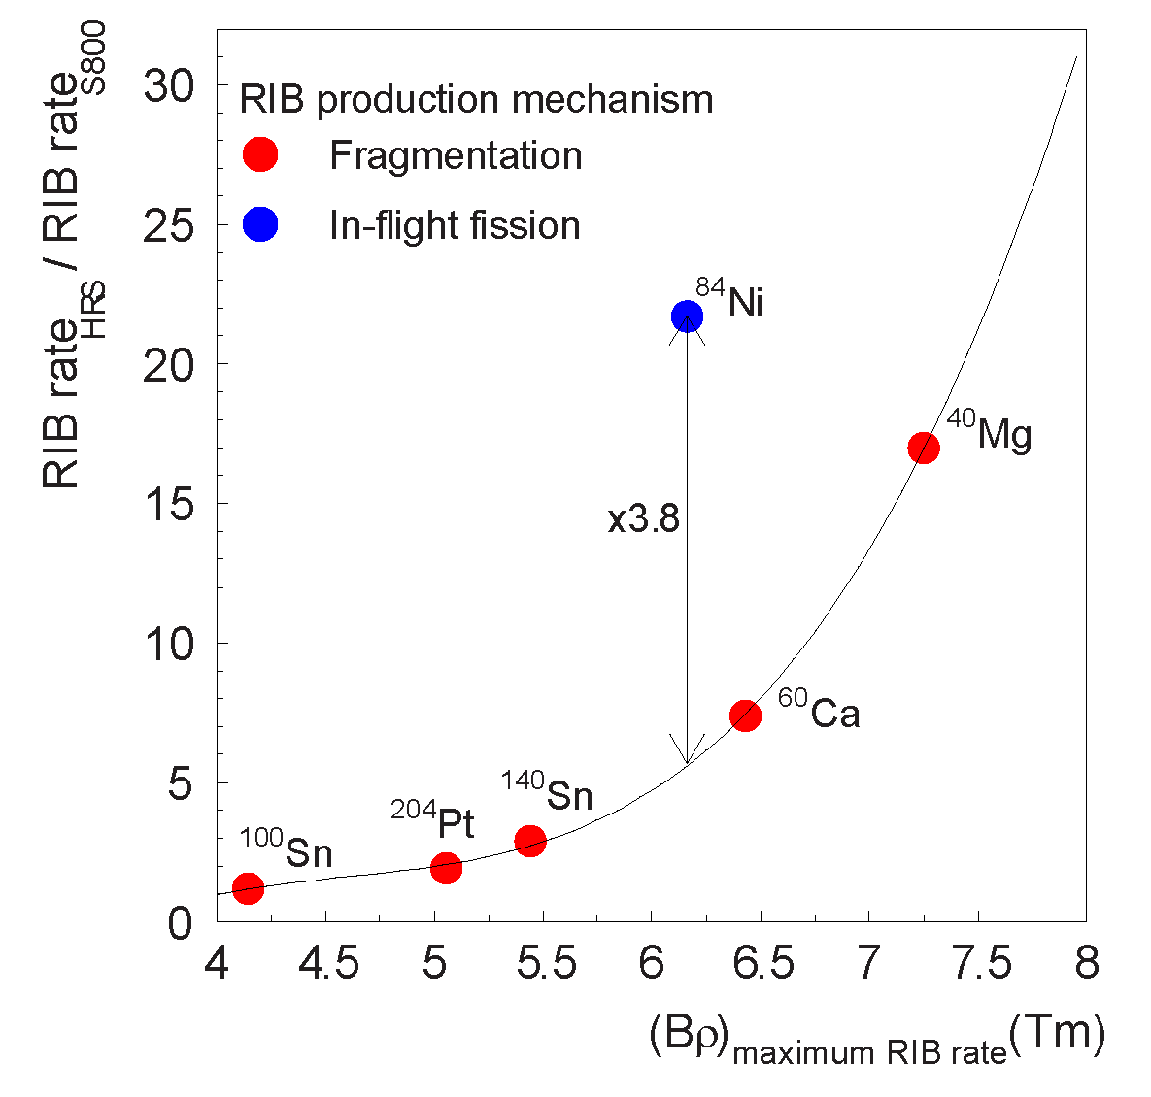
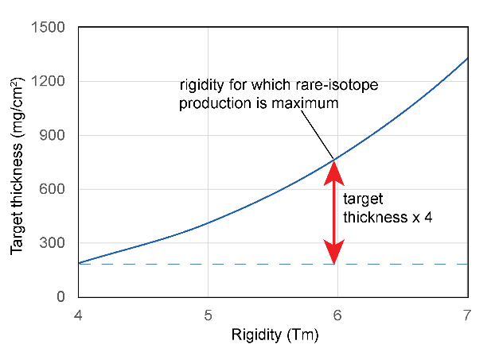
Luminosity gains with the HRS
Existing Spectrometers used with fast beams at NSCL are limited to a magnetic rigidity of 4 Tm
The magnetic rigidity of the HRS will enable experiments up to 8 Tm, strongly benefiting the FRIB science program at 200 MeV/u and at 400 MeV/u
Gains in luminosity are due to:
  Higher RI production yields since beams can be produced and transported at rigidities for which the yield is maximal
  The use of thicker reaction targets

Slide 21
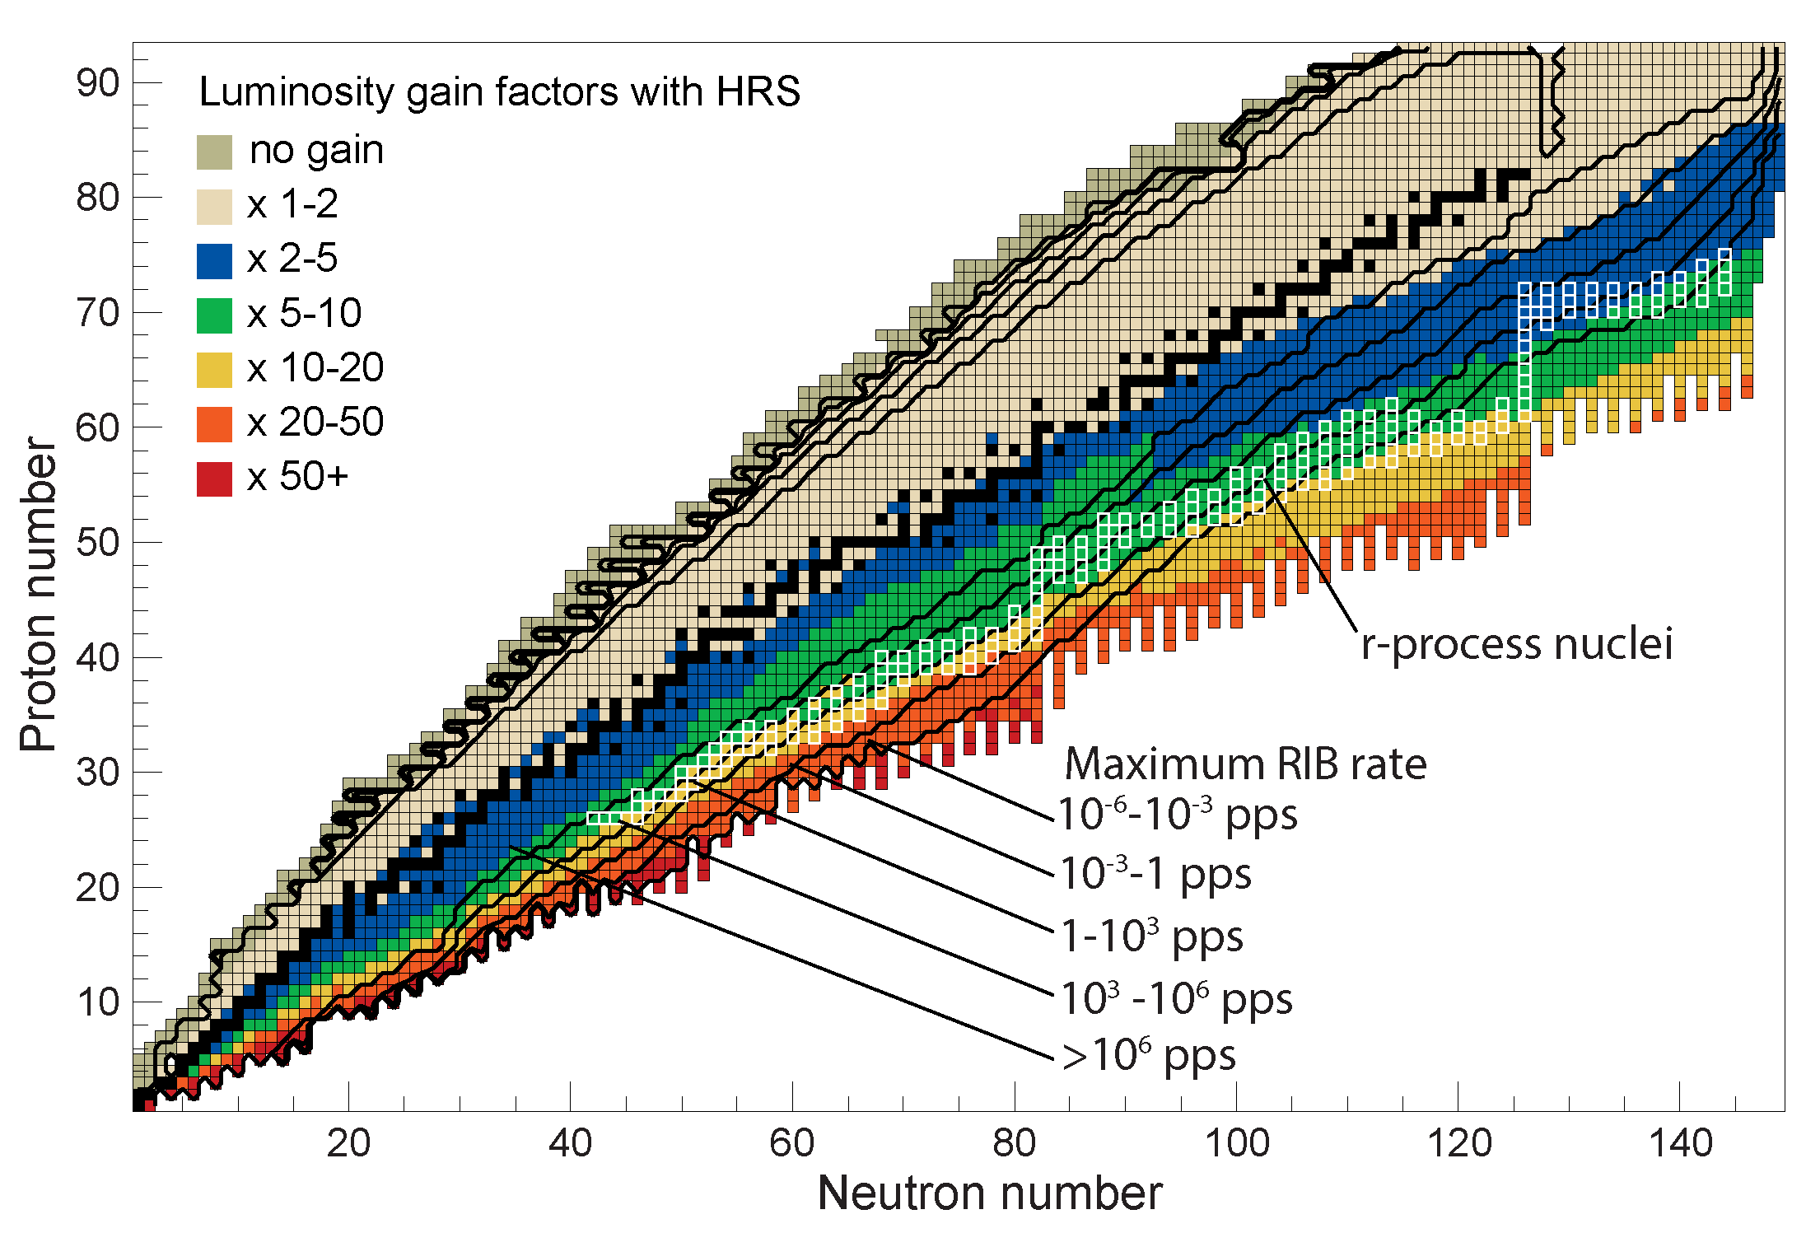
HRS@FRIB – 200 MeV/u
For over 90% of neutron-rich isotopes gain factors of 2-100 are achieved; on average about 10
For the most asymmetric neutron-rich systems, gain factors are larger than 50
For nuclei in the path of the astrophysical r-process gain factors are 5-20
On the proton-rich side gain factors are 1-2, with an average of 1.5

Slide 22
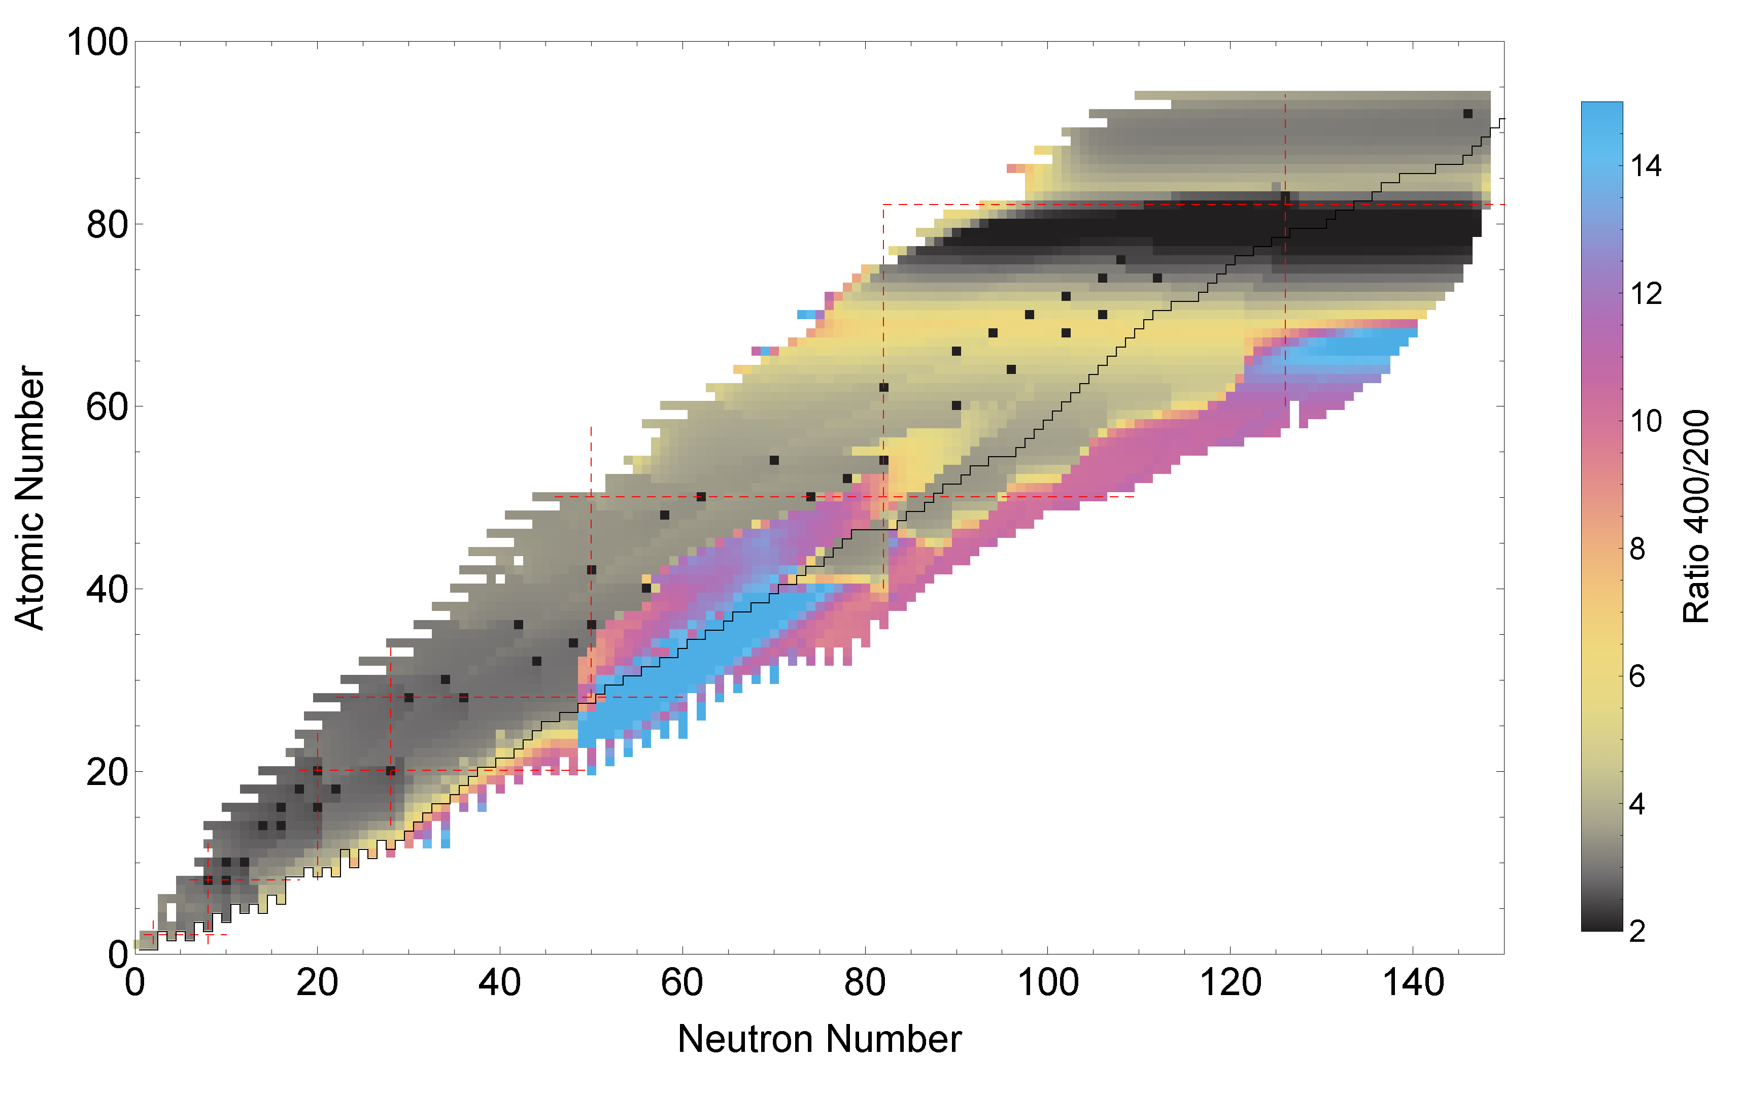
HRS@FRIB – 400 MeV/u
RI beam intensity gains at 400 MeV/u compared to 200 MeV/u range from 2 to 15
An additional gain factor of 3 in luminosity is achieved on average by being able to use thicker reaction targets for experiments
The gains are highest for the most neutron-rich systems and for isotopes produced by in-flight fission.
For a large fraction of the nuclear chart, experiments become simpler because the production of charge states by beam passing through detectors and targets reduces at the higher beam energies.

Slide 23
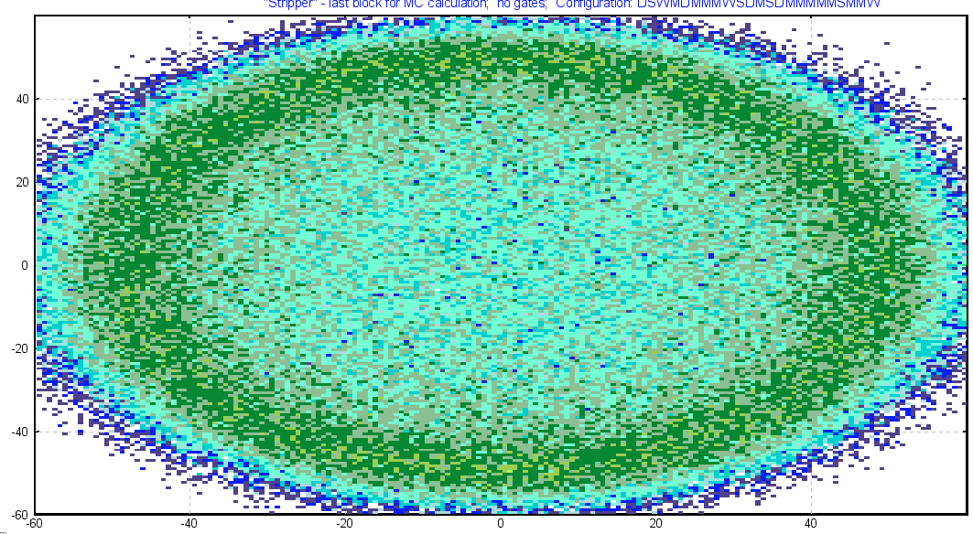
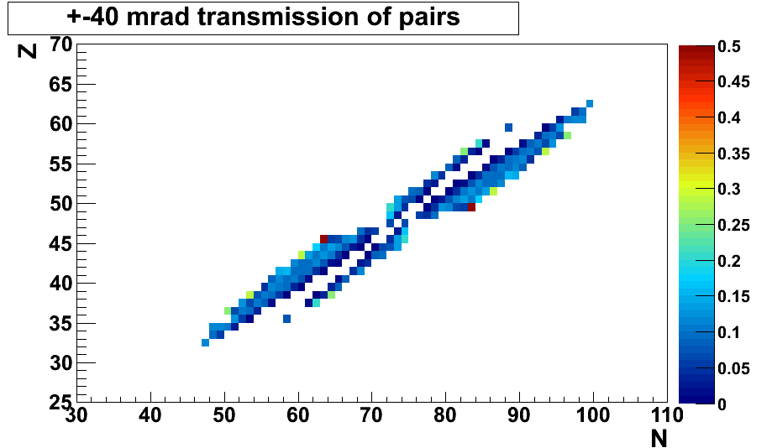
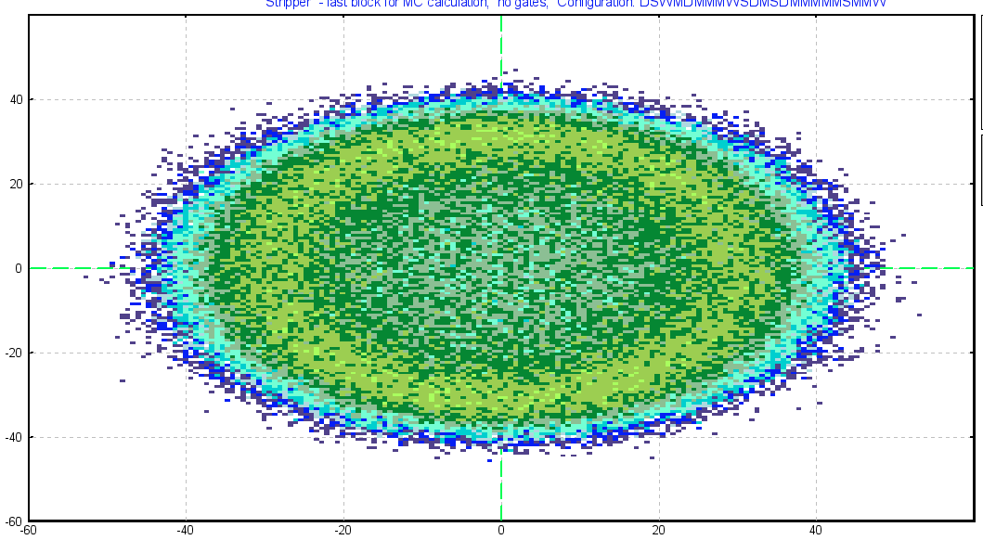
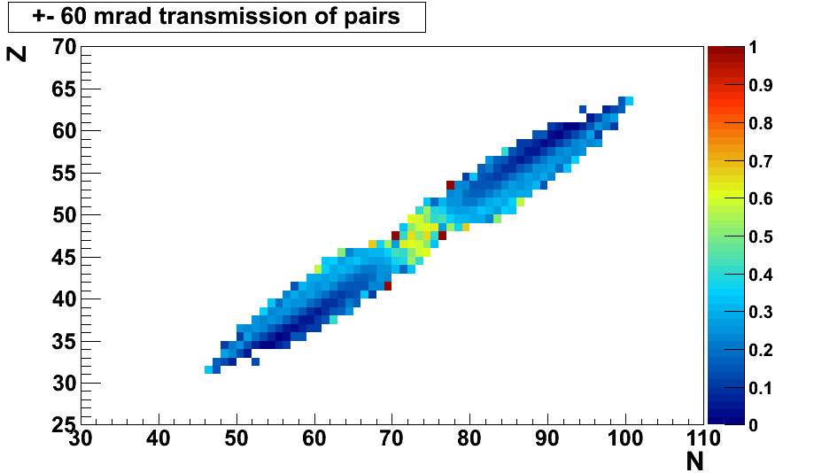
Increased beam energies strongly benefit the production rate of rare isotopes from in-flight fission and opportunities for fission research
More strongly forward-peaked fission cone at higher beam energies…
…increases the transmission of rare isotopes to the experimental stations
…will enhance opportunities for many-body structure, astrophysical and application driven (nuclear energy, defense, and homeland security) research
FRIB 200 MeV/u
More forward-peaked fission cone allows for the more efficient coincident detection of both fission fragments in the HRS. In combination with coincident neutron and gamma detection, it will provide detailed information to test models and provide necessary data for applications
-40 mrad
+40 mrad
-40 mrad
+40 mrad
-40 mrad
+40 mrad
FRIB 400 MeV/u

Slide 24
Conclusions
An upgrade of FRIB that allows the delivery of RI beams of up to ~500 MeV/u instead of up to ~250 MeV/u expands the scientific opportunities at FRIB and enables a stronger connection to the medium-energy and high-energy nuclear subfields
The increased beam energies of FRIB@400MeV/u increases the yield of rare isotopes for all experiments and the luminosity for (reaction) experiments with fast beams in particular due to the use of thick reaction targets
The High Rigidity Spectrometer provides an outstanding environment for performing (reaction) studies for FRIB@200 MeV/u and FRIB@400 MeV/u by providing the necessary bending capability of 8 Tm and the environment to accommodate the diverse program envisioned by the user community

