Slide 1
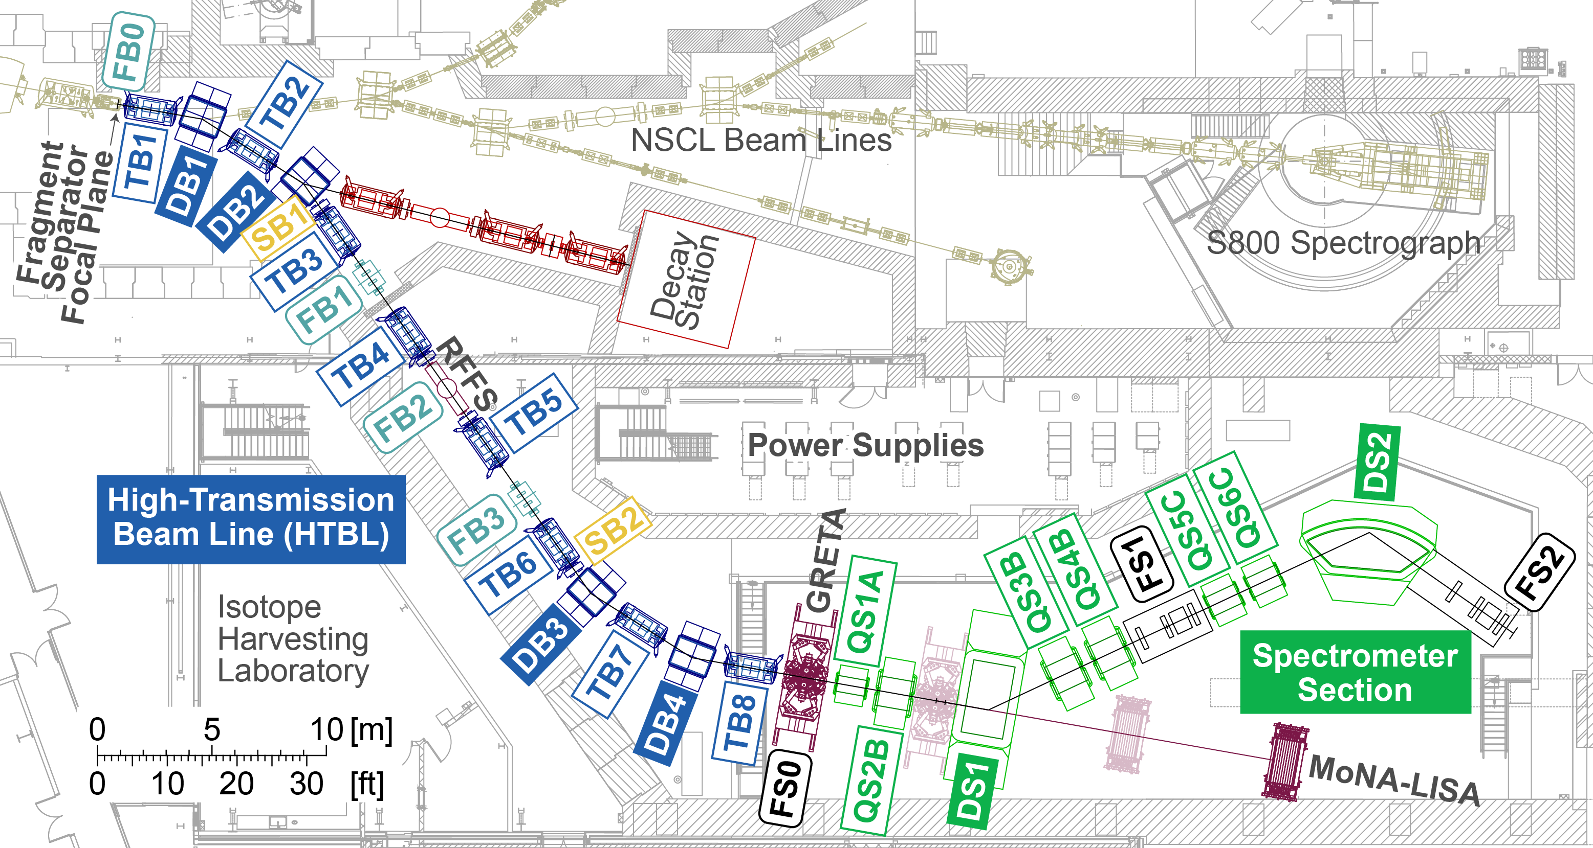
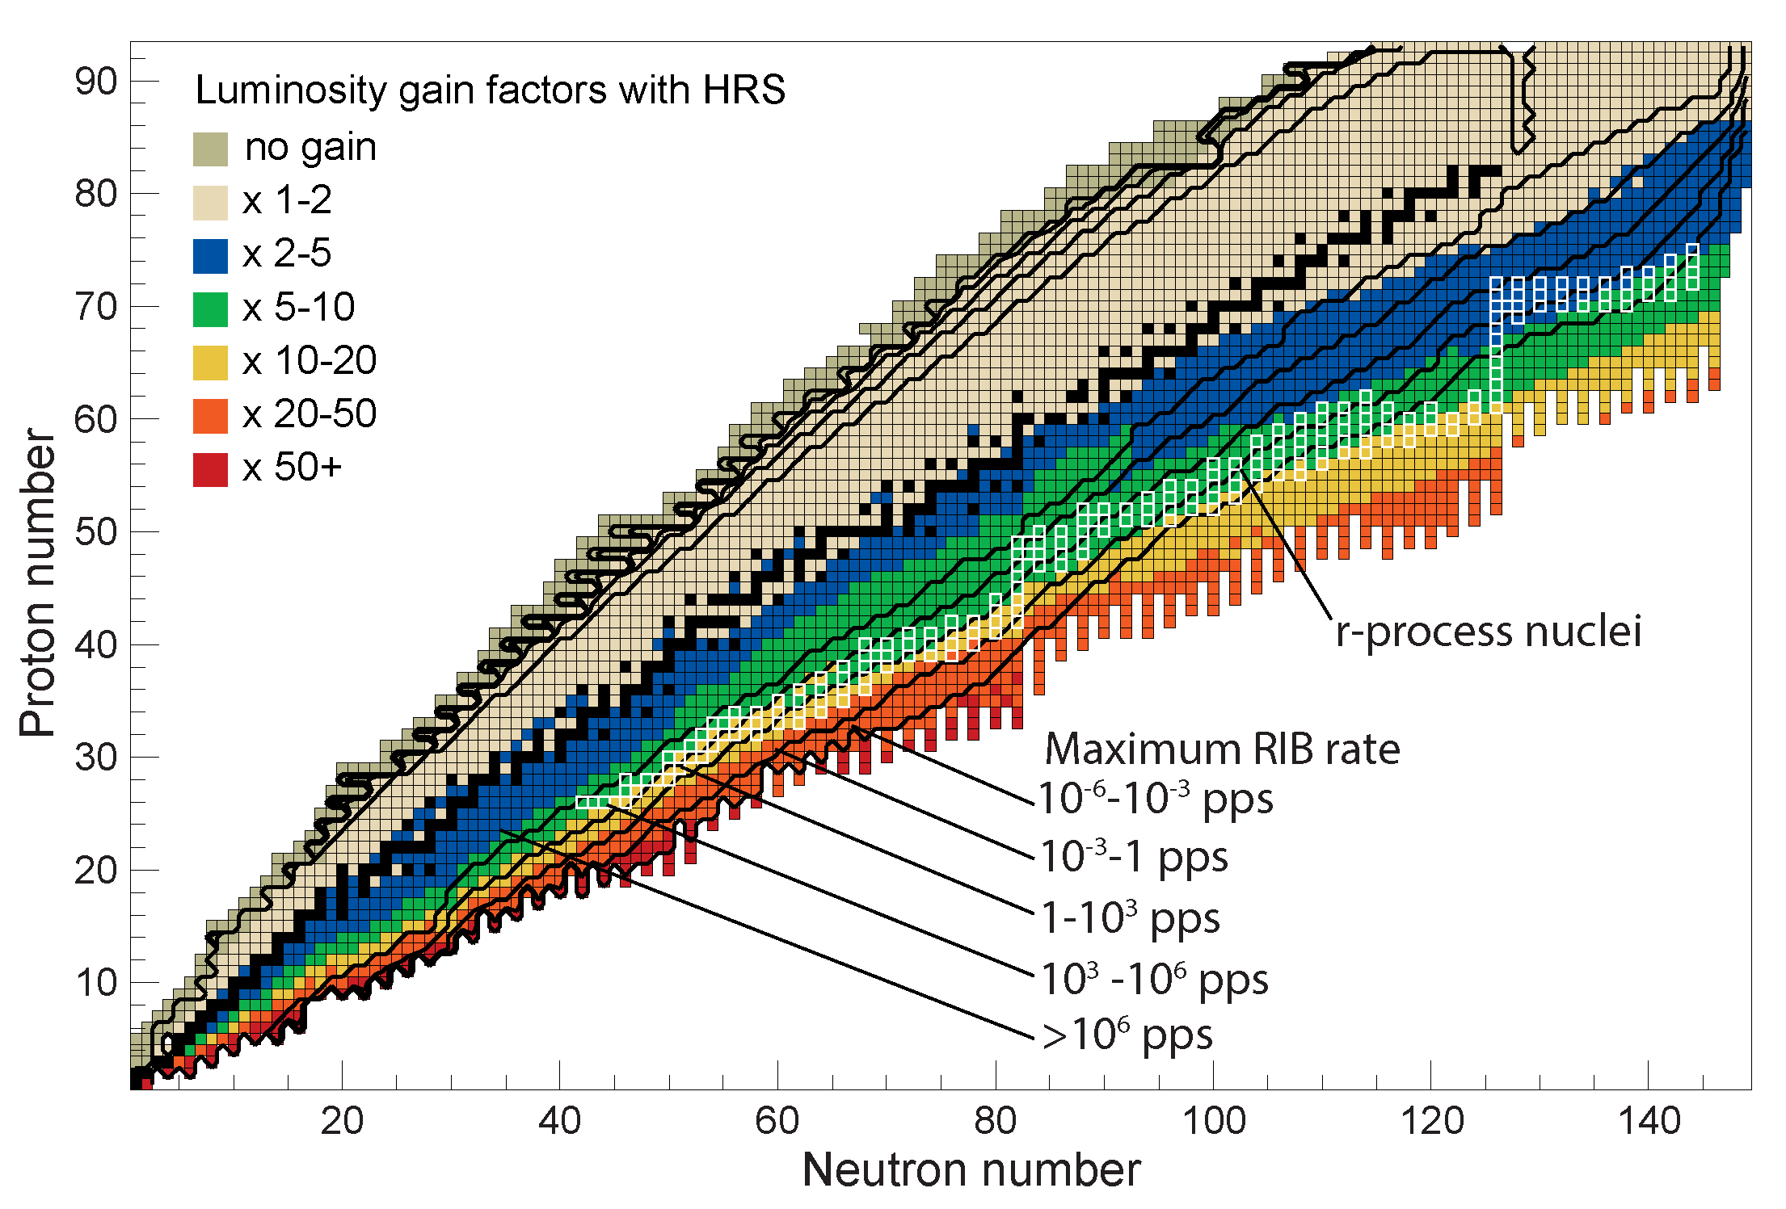
High Rigidity Spectrometer (HRS) Working Group
The Pre-Conceptual Design of the HRS meets the requirements defined based on the scientific program articulated by the FRIB User Community, including in the 2014 HRS whitepaper
The pre-conceptual design studies show that for over 90% of neutron-rich isotopes luminosity gain factors of 2-100 are achieved, with an average gain factor of 10. For the most asymmetric neutron-rich systems, luminosity gain factors exceed 50. For neutron-rich systems in the r-process path, the gain factors range from 5-20.

