Slide 1
2018 LEC Meeting - Closeout
Heather Crawford for the LECM Organizing Committee:
Baha Balantekin (U. Wisconsin), Jill Berryman (NSCL/FRIB), Maxime Brodeur (Notre Dame), Paul Fallon (LBNL), Alex Gade (MSU), Krzysztof Rykaczewski (ORNL), Guy Savard (ANL), Hendrik Schatz (JINA), Nick Scielzo (LLNL), Brad Sherrill (NSCL/FRIB), Alan Wuosmaa (U. Conn.), and Sherry Yennello (Texas A&M)

Slide 2
Meeting Overview
More than 240 participants registered in advance, to participate in:
  Science with a 400MeV/u FRIB Upgrade workshop; ATLAS Long Range Planning Meeting
  13 working group sessions in addition to the parallel FRIB-TA annual meeting
  Plenary talks highlighting the status at major user facilities (ATLAS and NSCL), ARUNA laboratories and the FRIB project
  Plenary talks discussing the impressive work of the USNDP, JINA-CEE and FRIB-TA, and highlighting the importance of diversity and education
LEC Meeting continues to be the place that our community gathers to exchange ideas, get updated on the status of large projects and plan for our future

Slide 3
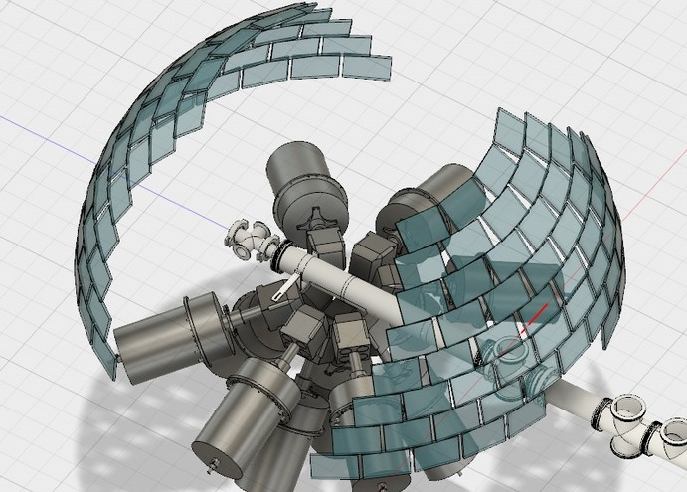
Working GrouPs - I
ISLA
  Design is moving forward with preliminary design of first dipole complete
  For operation in 2023, design should start in 2019
Precision Measurements
  Diverse and engaged community – heard about activities at facilities across the country and internationally
Decay Station
  Aim toward complete and simultaneous spectroscopy on multiple isotopes – staged approach building on existing equipment as the station develops from “FRIB Advance” to “FRIB Explorer” and “FRIB Precision”
Silicon Arrays
  9 contributions/devices presented
  Discussions around electronics, best methods for compatibility and commonality between systems/devices

Slide 4
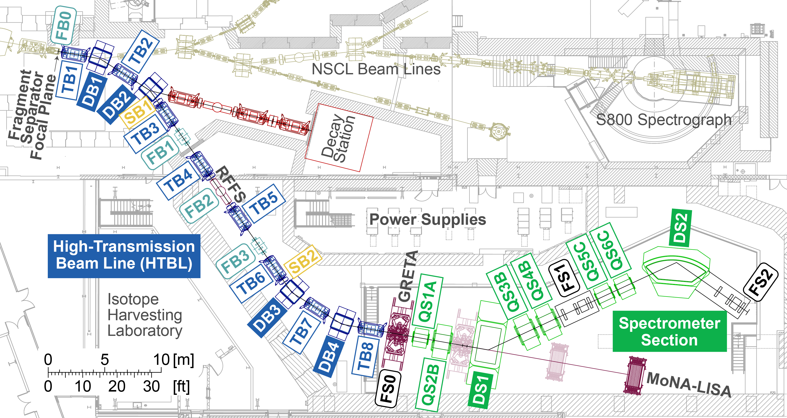
Working GrouPs - II
Data Acquisition
  Talks meant to encourage collaborations within the FRIB (and broader) scientific community on DAQ, encourage SBIR activities and enhance communication with vendors
High Rigidity Spectrometer (HRS)
  Update on pre-conceptual design (complete), which shows luminosity gain factors of 2-100 for over 90% of neutron-rich isotopes
Neutron Detection
  Neutron detection will play a key role – existing systems are being aggressively improved, and new technologies with novel capabilities were discussed
Nuclear Data
  More detailed discussion of USNDP programs and NNDC services, as well as overview of data-motivated experimental activities
Solenoid Detectors
  Discussions around existing solenoid-based devices (HELIOS, ISS, AT-TPC, SSNAP) and the use of gas-jet targets in solenoids
  Big take home: SOLARIS! Proposal submitted, with possible FY18 $ to move solenoid early

Slide 5
Working GrouPs - III
Equation of State
  Discussed recent experimental and theoretical developments in the studies of EOS of asymmetric nuclear matter (symmetry energy) and future plans at FRIB (including FRIB Upgrade)
  FRIB 400MeV/u particularly of interest to probe at densities relevant to neutron-star merger (2ρ₀)
High Resolution In-beam Gamma Spectroscopy
  Updates on GRETINA, Gammasphere and CloverShare
  Siting decision made for GRETINA for third science campaign at ANL in advance of FRIB Day 1
Neutron, Gamma and Plasma Experiment
  Included contributions from HiGS, OMEGA, LANSCE and OU’s neutron facilities and CASPAR
  Diverse set of facilities offer unique capabilities and potential for LENP to answer key physics questions
Nuclear Astrophysics, SECAR and JENSA
  Focused on opportunities for the community to engage in equipment or facility collaborations with new capabilities to address science questions about stellar explosions and nucleosynthesis in multiple astrophysical scenarios
  Also included discussions on the need for data evaluations and FRIB first-day experiments

Slide 6
Resolutions
FRIB remains our top priority. The community is impressed by the progress in construction and eagerly anticipates the completion of FRIB and the forefront science this facility will enable.
We strongly endorse the vision expressed in the draft ATLAS Strategic Plan for the future of the ATLAS facility and the proposed development of accelerator- and equipment-related initiatives that will enhance the scientific reach and efficient utilization of the ATLAS facility. These initiatives include the upgrade of ATLAS to provide multi-user capabilities which should be supported at a sufficient staffing level for its efficient operation.
The ARUNA facilities are a central part of the low-energy science program and their continued operation is crucial. The community strongly supports the funding of these facilities and the associated research.
The FRIB Theory Alliance is an essential component of our field. The bridge faculty and theory fellowship positions at universities and national laboratories help to grow capability in this important aspect of our community. We strongly endorse continued support of the FRIB-TA, its programs, and investment in computational theory and related astrophysics.
The community endorses the prompt initiation and timely completion of the High Rigidity Spectrometer (HRS) construction project, an essential instrument for fast-beam experiments at FRIB.
We strongly support pursuit of the 400 MeV/u energy upgrade of FRIB. It will open new scientific opportunities and is timely given the recent neutron-star merger observation.

Slide 7
Thank You!
Heather Crawford for the LECM Organizing Committee:
Baha Balantekin (U. Wisconsin), Jill Berryman (NSCL/FRIB), Maxime Brodeur (Notre Dame), Paul Fallon (LBNL), Alex Gade (MSU), Krzysztof Rykaczewski (ORNL), Guy Savard (ANL), Hendrik Schatz (JINA), Nick Scielzo (LLNL), Brad Sherrill (NSCL/FRIB), Alan Wuosmaa (U. Conn.), and Sherry Yennello (Texas A&M)

Slide 8
Thank You!
Heather Crawford for the LECM Organizing Committee:
Baha Balantekin (U. Wisconsin), Jill Berryman (NSCL/FRIB), Maxime Brodeur (Notre Dame), Paul Fallon (LBNL), Alex Gade (MSU), Krzysztof Rykaczewski (ORNL), Guy Savard (ANL), Hendrik Schatz (JINA), Nick Scielzo (LLNL), Brad Sherrill (NSCL/FRIB), Alan Wuosmaa (U. Conn.), and Sherry Yennello (Texas A&M)

Slide 9
Thank You!
Heather Crawford for the LECM Organizing Committee:
Baha Balantekin (U. Wisconsin), Jill Berryman (NSCL/FRIB), Maxime Brodeur (Notre Dame), Paul Fallon (LBNL), Alex Gade (MSU), Krzysztof Rykaczewski (ORNL), Guy Savard (ANL), Hendrik Schatz (JINA), Nick Scielzo (LLNL), Brad Sherrill (NSCL/FRIB), Alan Wuosmaa (U. Conn.), and Sherry Yennello (Texas A&M)
Safe Travels!

Slide 11
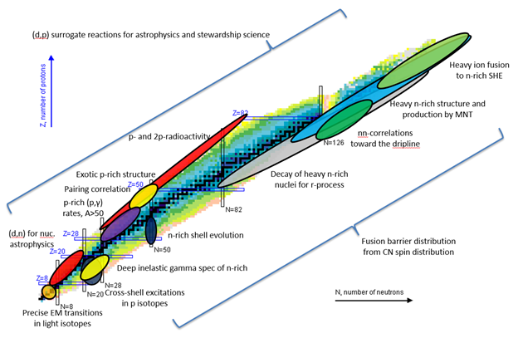
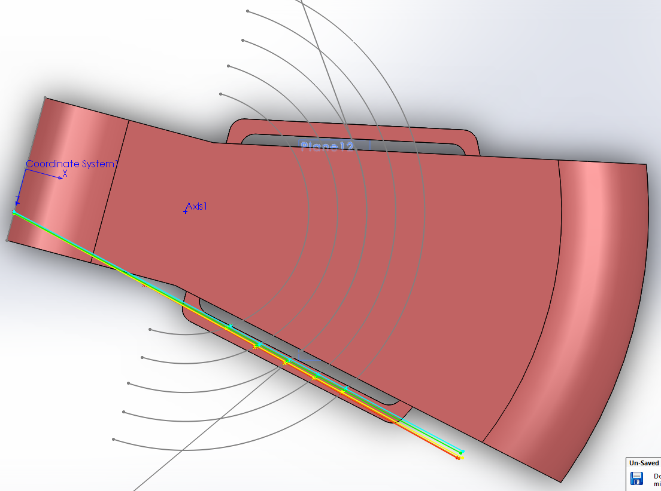
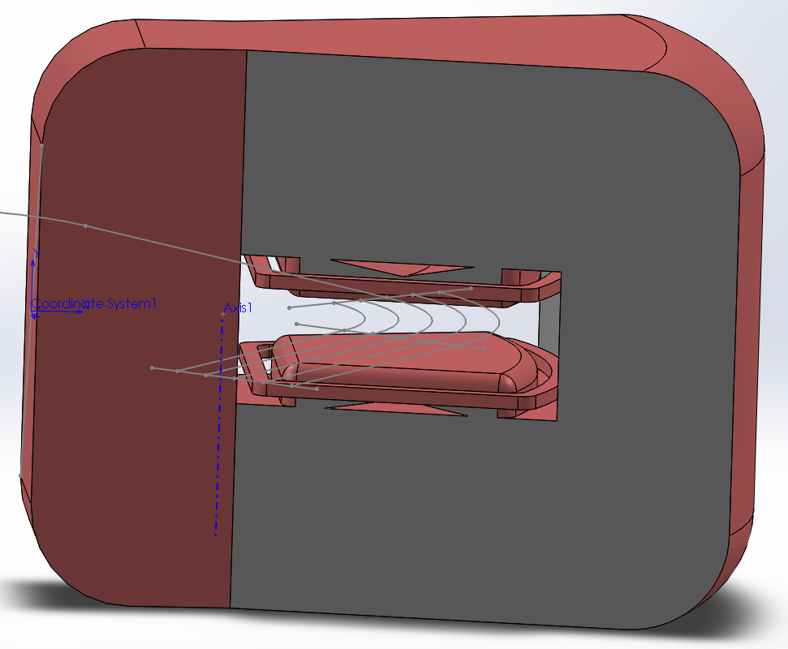
ISLA – the recoil separator for ReA
A powerful tool to accomplish the science goals of FRIB
ISLA concept selected July 2014
Meets the needs of ALL proposed physics cases (ISLA whitepaper 2015)
Will address a majority of the
NSAC RIB taskforce benchmarks
Successful preliminary dipole design achieves 5th order resolving power R_{M} > 1000 (full acceptance).
*Selected cases
ReA + FRIB beams + ISLA for filtering and tagging.
ReA6 (expected completion 2020) will enable significant work in almost all areas!
Design funds needed in 2019
for ISLA completion by 2023
Notes:
Here are shown a selection of some of the physics cases that have been proposed for study at a ReA12 recoil separator. These were used to define the needed performance of the recoil separator design. They range from

Slide 12
Precision Measurements working group
Very diverse and engaged community.
Combination of measurements done at several facilities. Includes both national laboratories and University labs.
  Current precision half-life measurements (¹¹C and ²⁰F) and future beta-neutrino angular correlation measurements using St-Benedict at Notre Dame.
  CHIPTRAP development at CMU for ultra-high precision mass measurements to test E = mc² and help determine the neutrino mass.
  Prototype TAMUTRAP at Texas A&M has performed ²³Na ToF-ICR measurement. New trap under construction for T = 2 future beta-neutrino angular correlation measurement.
  BECOLA at NSCL performed several measurements in Ca isotopes. Pulsed laser has been installed. Design of UV light transport system underway.
  LEBIT at NSCL has performed several mass measurement for nuclear astrophysics and structure in the past year. The FT-ICR Penning trap SIPT is under commissioning and the first signal at cryogenic temperature has been observed.
  Several superallowed beta-decay measurements has been measured at TRIUMF including recently the ¹⁰C and ²²Mg half-lives. In the future measurements of the branching ratio for ¹⁰C and ¹⁴O at high precision are needed as well as complete ab-initio calculations of the isospin symmetry breaking correction on a wider sample of nuclei.

Slide 13

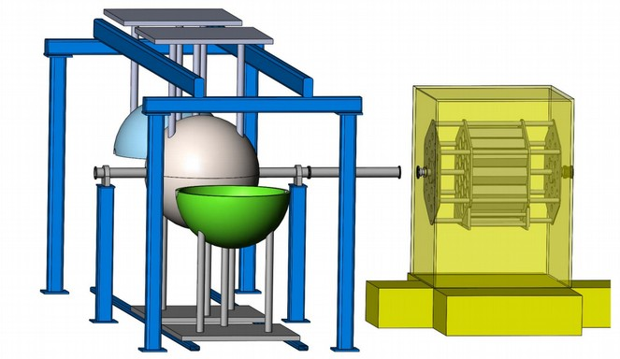
FRIB Radioactive Decay Station working group
World class decay station with unique capability to perform complete and simultaneous spectroscopy measurements on multiple isotopes.
The science themes
Emergence of new patterns in nuclei
The cosmic origins of nuclei
Applications and fundamental interactions
Staging
FRIB- Advance
(2020-2022)
FRIB-Explorer
(2022-2024)
FRIB Precision
(2024-2026).
Cost range (M$ FY18) 16-24 (2π or 4π)
Implantation stack/Clover array/Neutron arrays/Total absoroption spectrometer
Hybrid detector systems with flexible configurations
will enable measurements with multiple arrays in the same experimental campaign.
Talks:
1. R. Grzywacz - updates and White Paper status
2. S. Marley - Report on Workshop on Stopped-Beam Experiments
3. M. Allmond - Clover detector array optimization
4. B. Rasco - Status of MTAS/3Hen detector developments
5. A. Estrade - Experiments and experiences with AIDA/WAS3ABi/YSO at RIBF RIKEN

Slide 14
Silicon Arrays Working Group Summary
Nine contributions
ANASEN Ingo Wiedenhoever FSU
Arrays for JENSA Kelly Chipps ORNL
SOLARIS Ben Kay ANL
GODDESS+ORRUBA Steve Pain ORNL
GET electronics for Si Tony Ahn TAMU
Thin entrance Si Kelly Chipps ORNL
HiRA Sean Sweany MSU
HINP ASICs Bob Charity WashU
DRACULA for Gavin Lotay, Surrey
Dan Doherty & Wilton Catford
Topics
Direct astrophysics, ReA beams
Direct astrophysics, transfer, ReA beams
Transfer, ReA beams
4π Si array for GRETA, fast and ReA
High channel count electronics for Si
Decay measurements for astrophysics
Transfer, fast beam
High channel count electronics for Si
Newly-proposed highly-segmented Si for fast-beam GRETA experiments, 1500 ch digital system, + possible S800 upgrade
Talking points
Generally, two electronics approaches planned and in use – ASICs and digitizers
Need articulated for dedicated thin-entrance-window low-threshold detectors to measure decay proton branches for astrophysical states
Need for more dedicated electronics to remove constraints between shared instrumentation
Attempt at keeping compatibility/commonality between systems/devices (detectors, electronics)

Slide 15
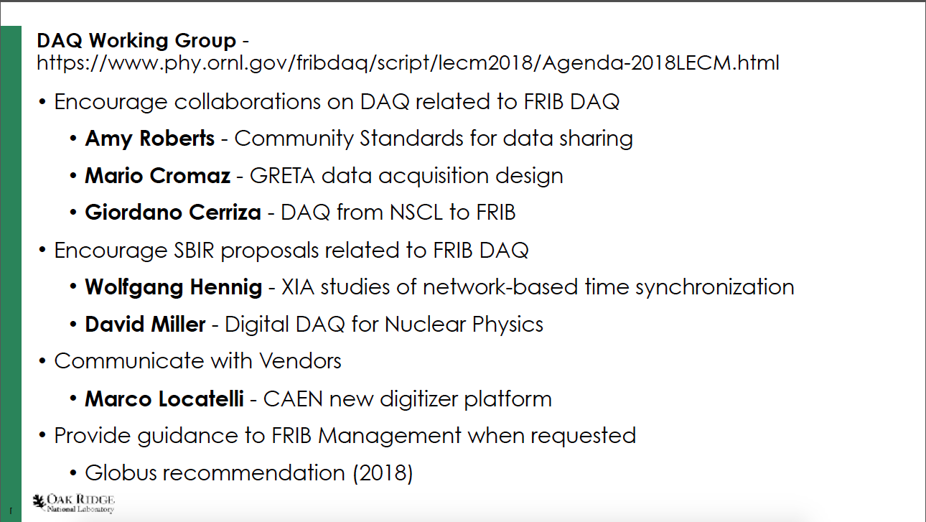

Slide 16
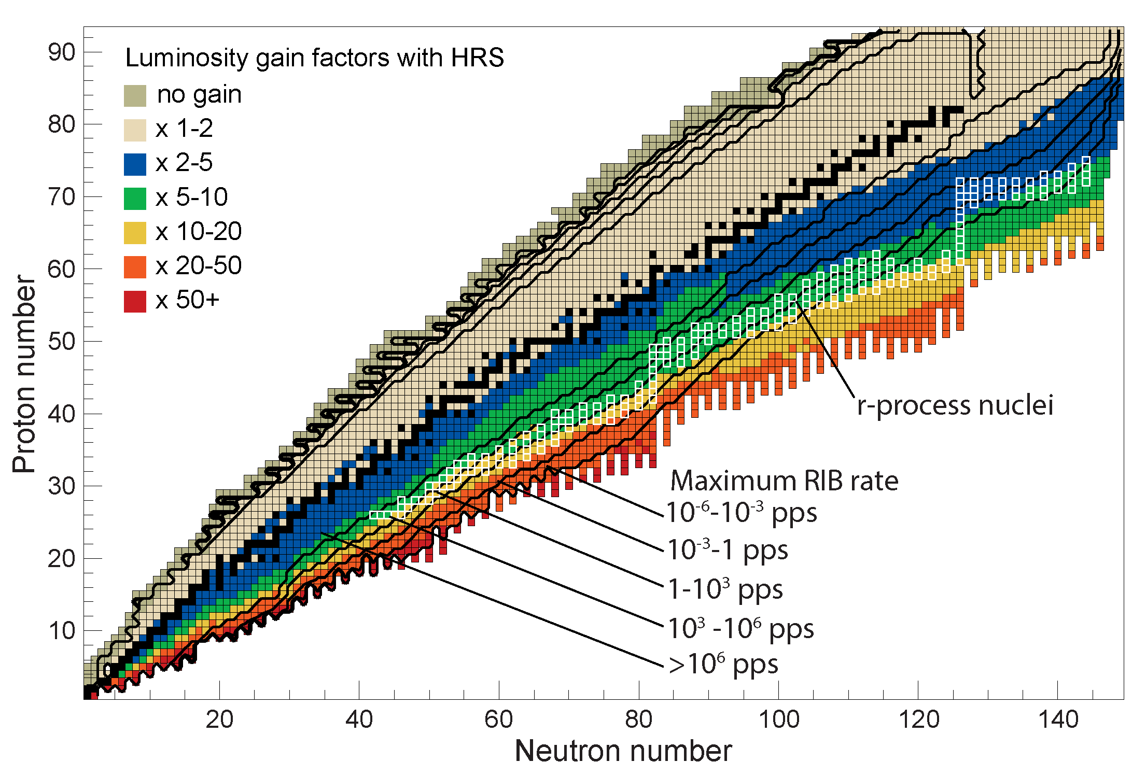
High Rigidity Spectrometer (HRS) Working Group
The Pre-Conceptual Design of the HRS meets the requirements defined based on the scientific program articulated by the FRIB User Community, including in the 2014 HRS whitepaper
The pre-conceptual design studies show that for over 90% of neutron-rich isotopes luminosity gain factors of 2-100 are achieved, with an average gain factor of 10. For the most asymmetric neutron-rich systems, luminosity gain factors exceed 50. For neutron-rich systems in the r-process path, the gain factors range from 5-20.

Slide 17

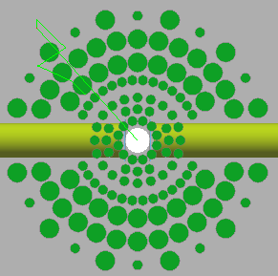
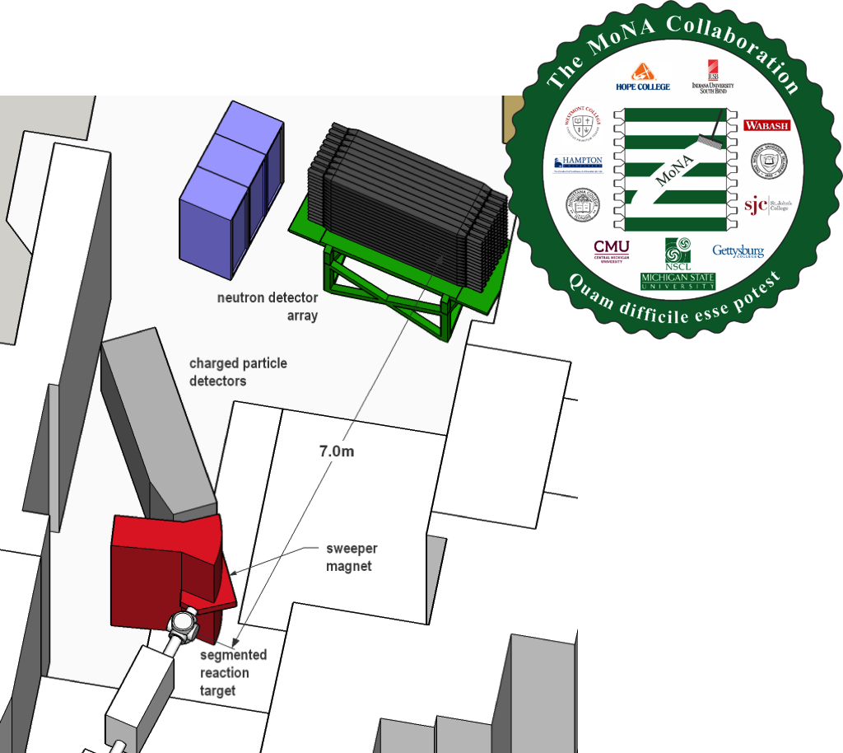
Neutron Detector Working Group
Neutron detection recognized as a required key capability at FRIB
  Nuclear structure at the neutron dripline
  Nuclear astrophysics of the r-, rp- and nu- process
  Nuclear stockpile and reactor safety.
Current capabilities being expanded
  Hybrid-3Hen (ORNL), MONA/LISA (NSCL), VANDLE (UTK) and BPT (LLNL/ANL) being aggressively improved.
New detectors currently in development to offer unique novel capabilities
  NEXT: high resolution ToF spectroscopy
  CENTAUR neutron detector: high granularity detector for nuclear reactions
  UM Lowell CLYC array: Neutron PSD and spectroscopy without ToF
  New super-bright scintillator materials developed at ORNL, LLNL and U. Michigan.

Slide 18
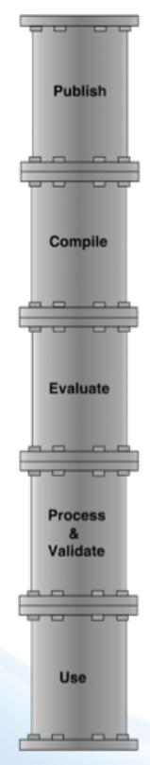
Nuclear Data Working Group
Session included:
Data motivated experimental activities
  Fission product g ray branching ratios (K. Kolos)
  Neutron reaction rates (H.Y Lee)
USNDP evaluators
  Intro to ENSDF utilities of potential interest for Low Energy Community (J. Chen)
  ENDF B-VIII cross section library (G Nobre)
NNDC services
  Overview of products available from NNDC & discussion of response to users needs (L. McCutchan)
  New Nuclear Wallet Cards and Long-Lived RadioNuclide Booklets are underway…

Slide 19
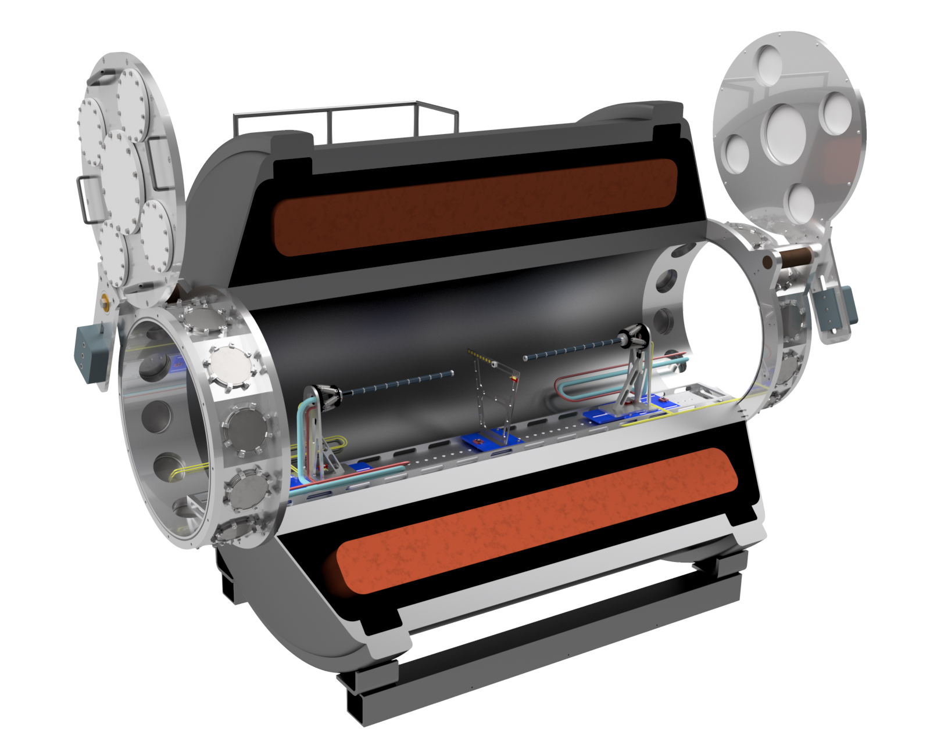
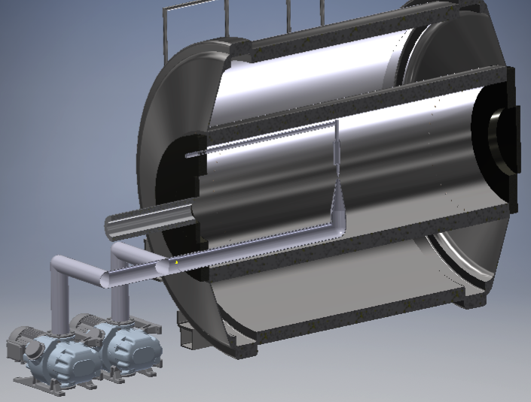
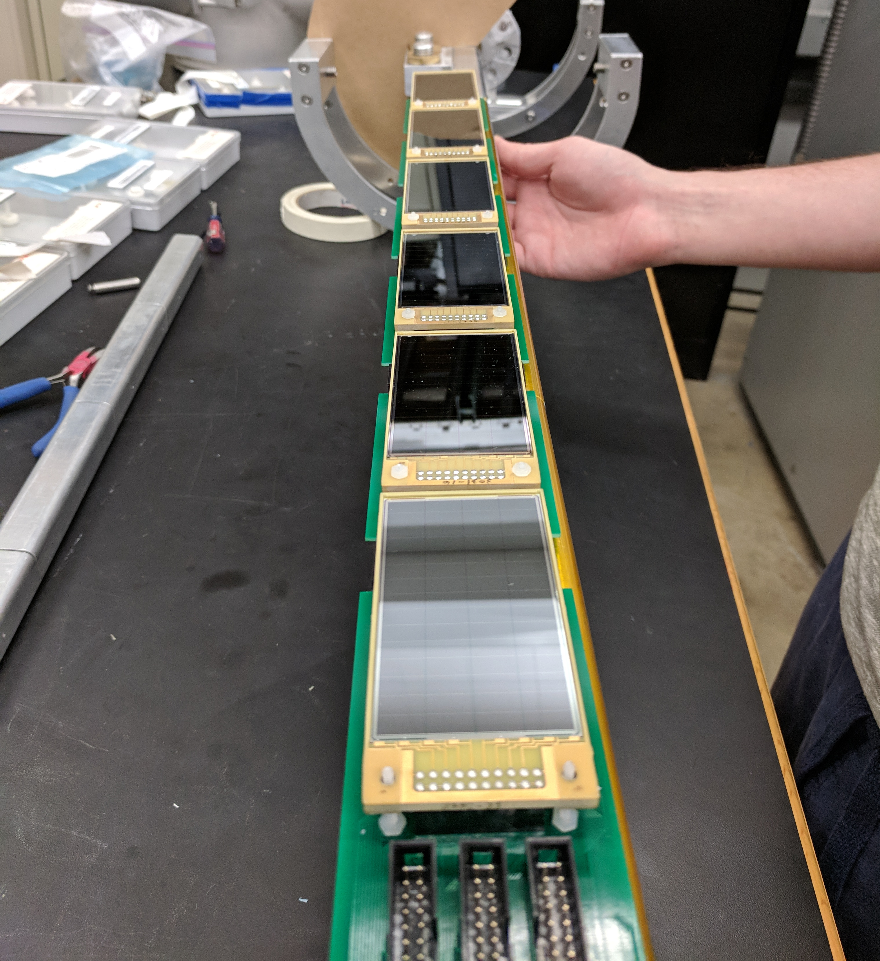
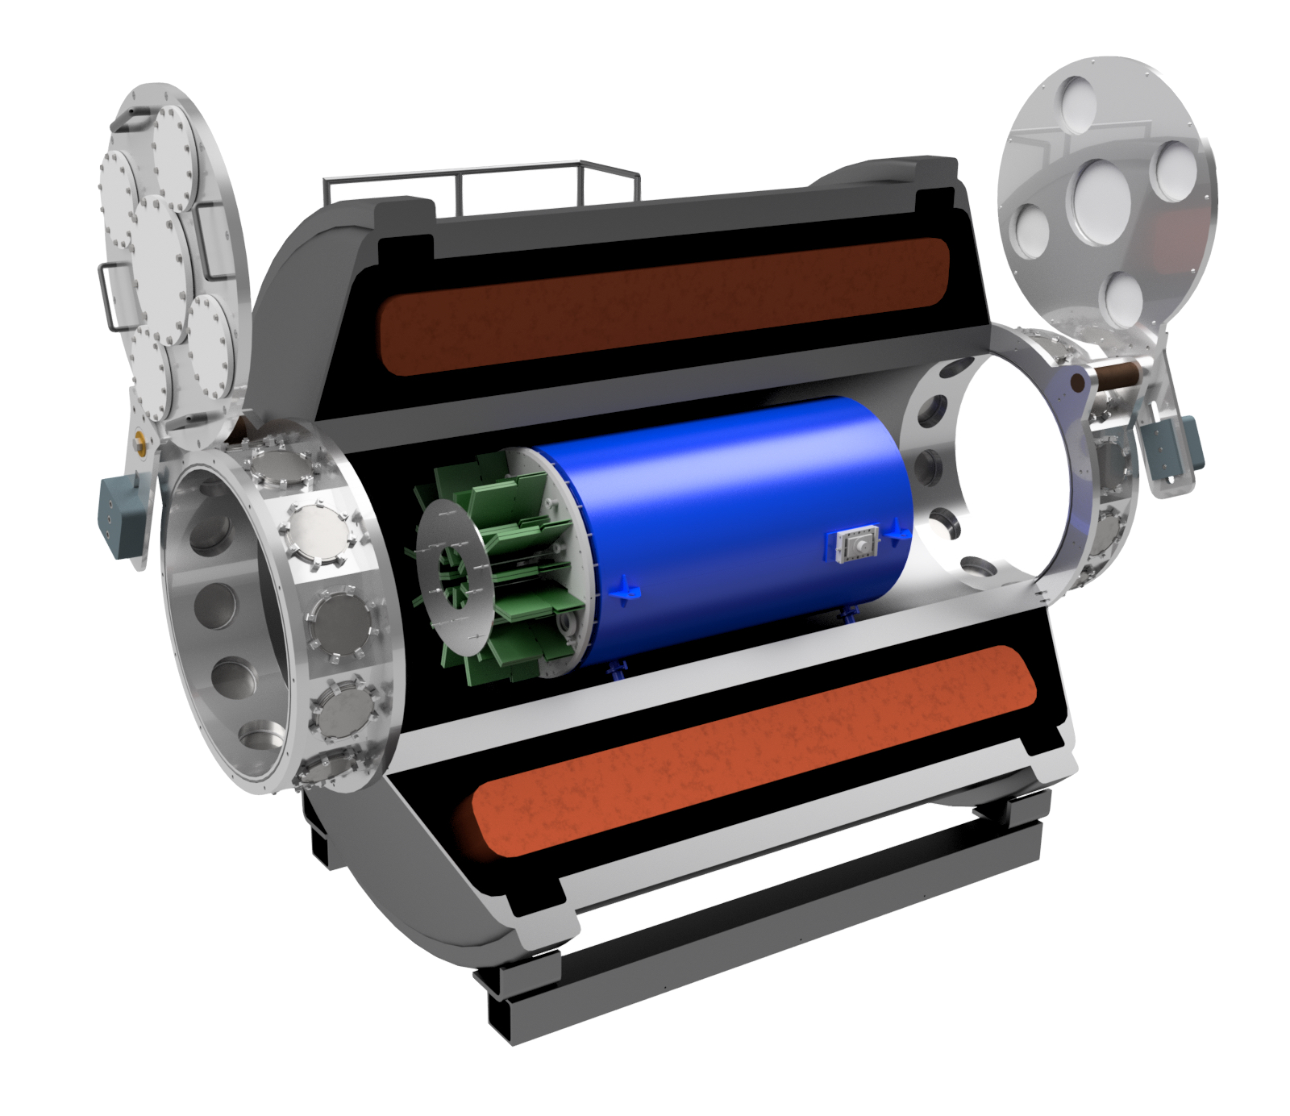
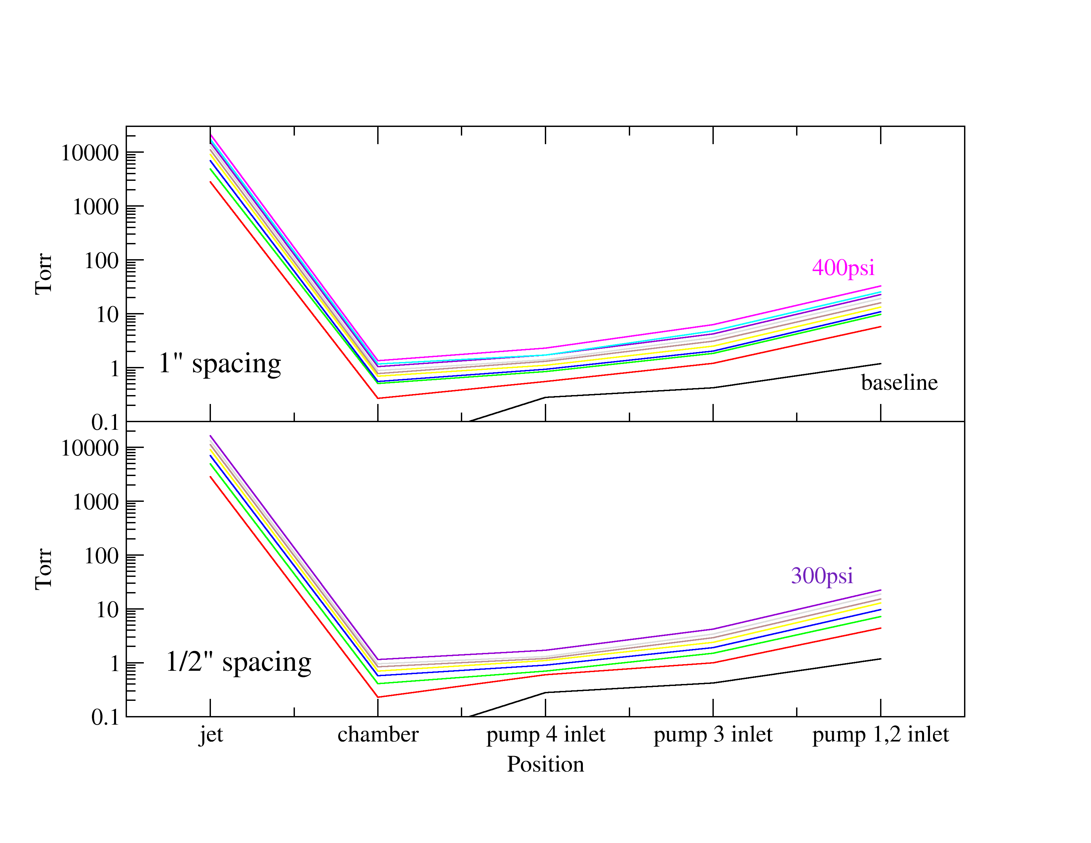
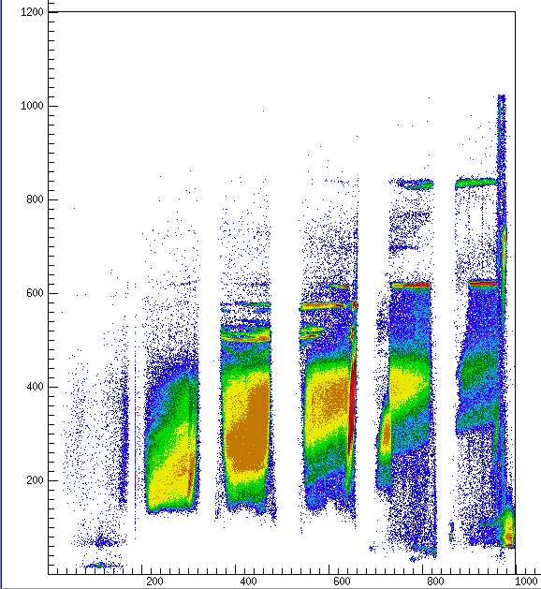
Solenoidal Detectors Working Group Summary
Covered: SOLARIS, ISS, AT-TPC, Gas-jet targets in solenoids, HELIOS, SSNAP (selected snapshots below)
Si-array mode
AT-TPC mode
SOLARIS: White paper, proposal submitted, …, possible FY18 funds to move solenoid to NSCL
AT-TPC: commissioned with RI beams, looking forward to ReA6 and SOLARIS
Gas-jet target: DOE early-career award. Test with HELIOS, possible use with SOLARIS
SSNAP: Several recent and upcoming experiments, improving understanding of set up in TWINSOL

Slide 20
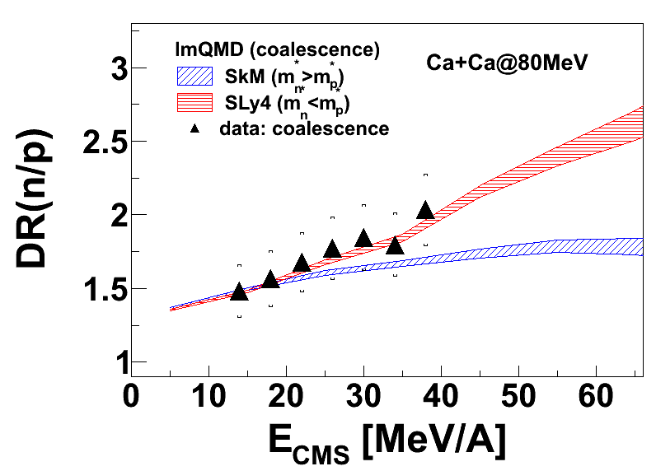
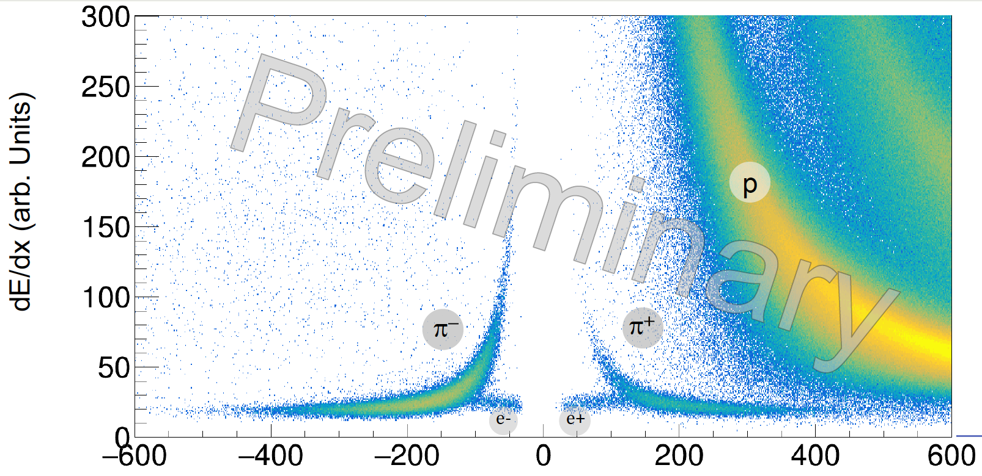
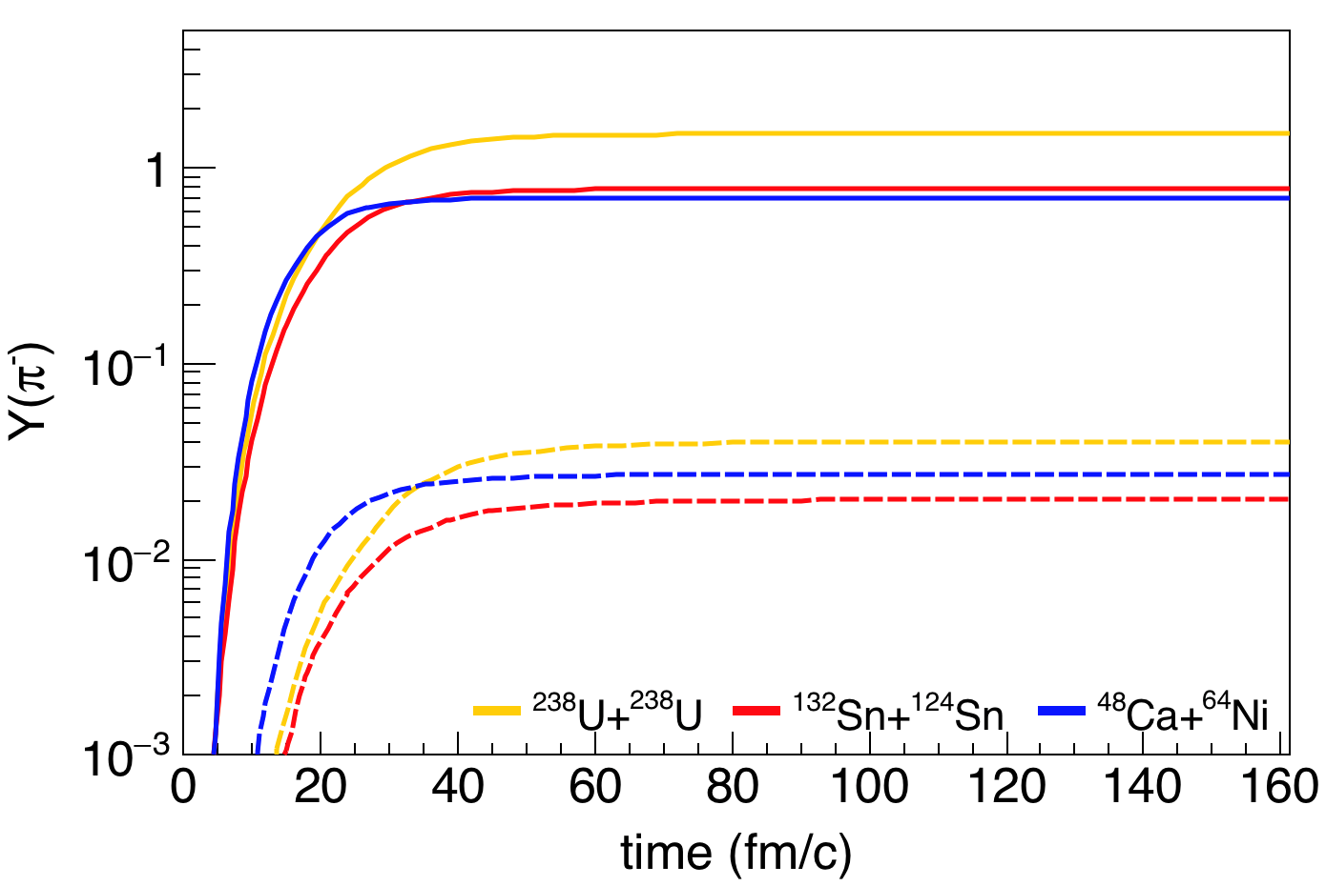
EoS Working group: Discussed recent experimental and theoretical developments in the studies of EOS of asymmetric nuclear matter (symmetry energy) and future plans at FRIB (including FRIB Upgrade)
Neutron star merger and radii are sensitive to 2ρ_{0.} Tighter constraints on deformability and radius of neutron star merger can only be obtained in Laboratory from heavy-ion collisions.
Current status and future plans
Low densities: ρ < ρ₀
Higher densities: ρ ~ 1.5 ρ₀
FRIB Upgrade : ρ ~ 2 ρ₀
effective mass from n/p, charged particles (NSCL),
AsyEOS from fragments (Texas A&M, ….)
symmetry energy can be obtained from the charged-pion ratio from S𝛑RIT TPC (RIKEN) and FRIB
Density region specifically relevant to NS merger.
FRIB Upgrade will boost intensities, asymmetry and pion cross-sections
Energy increase: yields increase exponentially above pion thresholds
FRIBU
FRIB
Momentum [MeV/c²]
Sensitivity of n/p to
effective mass
Analysis is ongoing
Production of pions via Δ resonance
π⁻/π⁺ ratio biggest sensitivity to symmetry energy and for more neutron rich systems
Analysis from S𝛑RITPC ongoing
Pion production enhanced by over 10x at FRIBU comparing to FRIB
Expected results from
a recent experiment at NSCL
Intensity increase: Allow explorations of more asymmetric systems.
Many more results not shown here

Slide 21
2018 LECM High-resolution γ-ray spectroscopy WG
Conveners: M. Allmond, M. P. Carpenter, P. Fallon, A. Gade, M. A. Riley
GRETINA is now in action at ATLAS-ANL and experiments with GRETINA for the first time coupled to the FMA have begun. GRETINA counting rate has achieved up to 50 kHz/crystal and data throughput has been doubled with insignificant lose of energy resolution and position resolution. FMA entrance quad has been upgraded to allow GRETINA target be positioned 30 cm in front of the quad so that the efficiency of collecting recoils has been substantially enhanced. The GRETINA and CHICO combination continue to be an important part of this campaign. In addition, ORRUBA Si-array will be coupled to GRETINA for programs of (d,pγ) and (p,p’) studies.
GRETINA siting recommendations endorsed by the community:
  A third GRETINA science campaign at NSCL, as planned, in the period from Spring 2019 through December 2020, for approximately 12-18 months
  Following the third GRETINA campaign at NSCL, a third GRETINA campaign coupled to the FMA at ANL, for ~12 months
  GRETINA returns to MSU and is installed at FRIB for the beginning of the “Day 1” Science Program
Gammasphere has begun a campaign coupled to AGFA to study trans-fermium nuclei. Upgrades to the device are also underway to replace aging electronics used for slow control and provide a tape station for β-decay measurements with CARIBU beams.
Clovershare has had multiple successful campaigns at various institutions. TAMU, ND, MSU and RCNP. More on the horizon.
The GRETA project continues full steam ahead with CD-3a decision anticipated this month!

