Slide 1
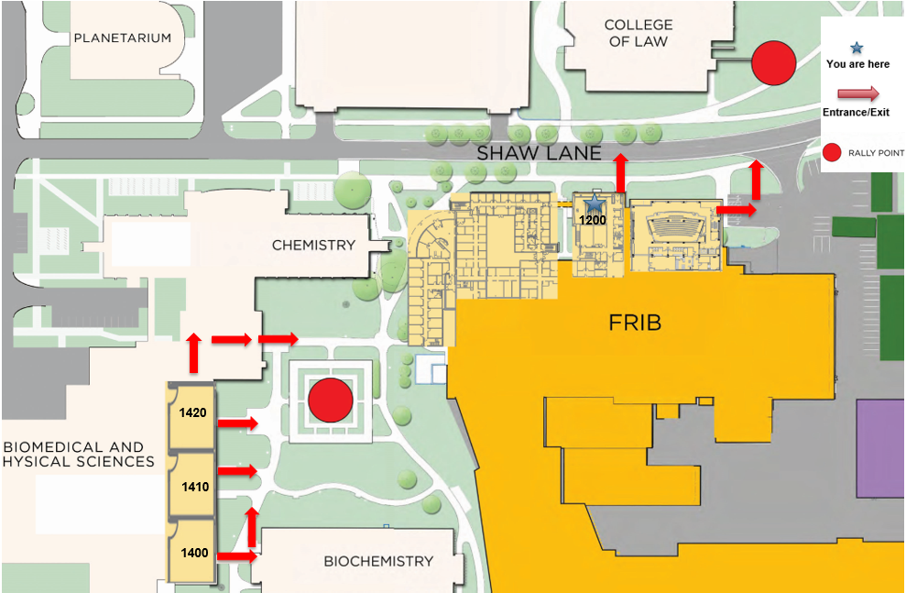
Safety Briefing

Slide 2
Introduction: 400 MeV/u upgrade for FRIB
Brad Sherrill

Slide 3
Outline
Welcome
Upgrade of FRIB to > 400 MeV/u
Advantages
Next steps

Slide 4
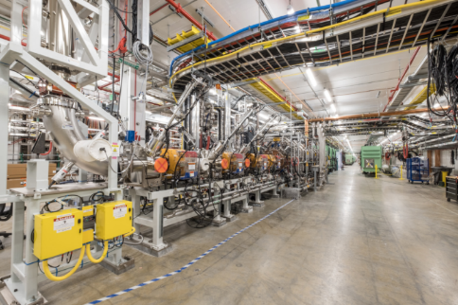
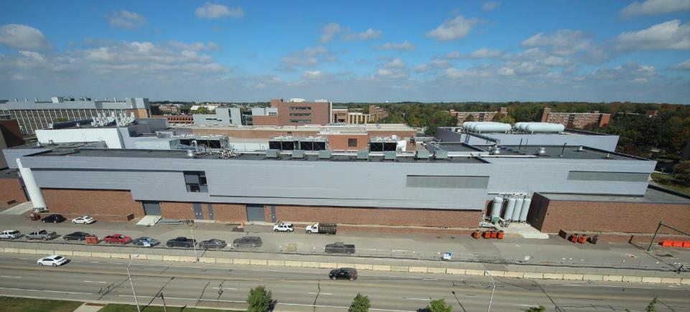
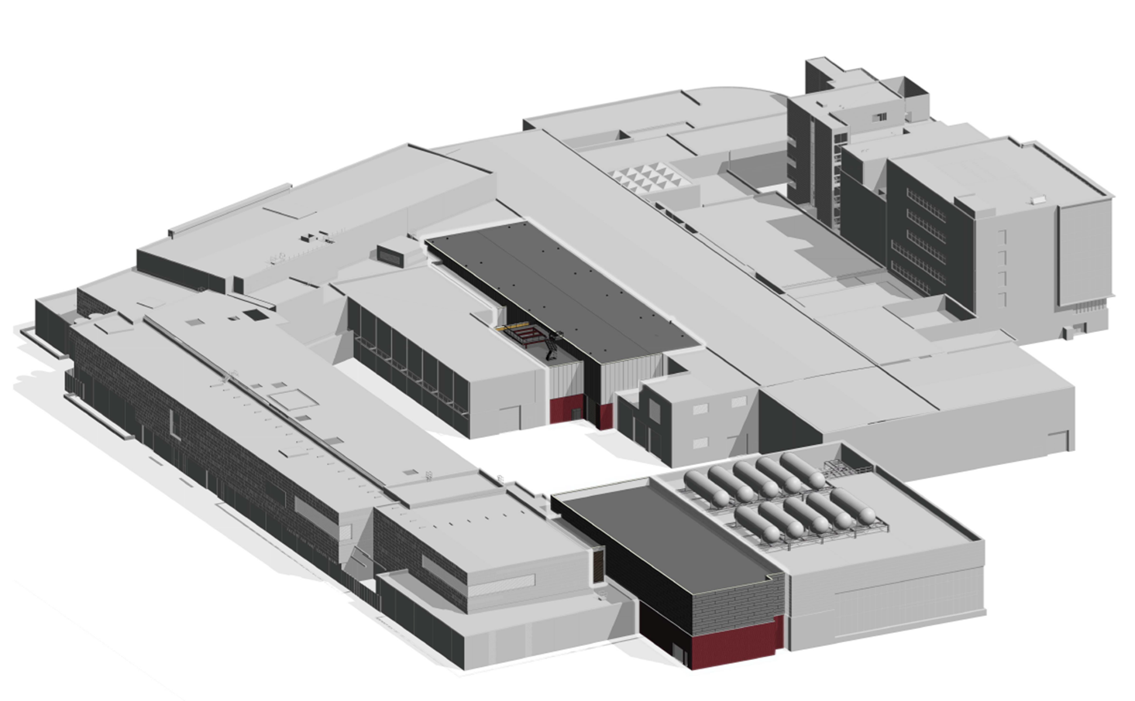
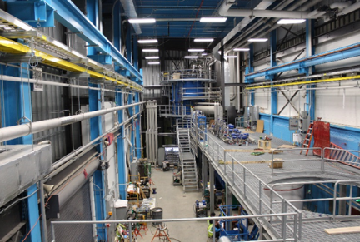
FRIB Project is 85% Complete
Civil construction done in 2017
October 2017: First ion beams accelerated by RFQ, argon ⁴⁰Ar⁹⁺ and krypton ⁸⁶Kr¹⁷⁺
December 2017: Cryoplant operational
July 2018: Beam accelerated to 2 MeV/u in first three cryomodules

Slide 5
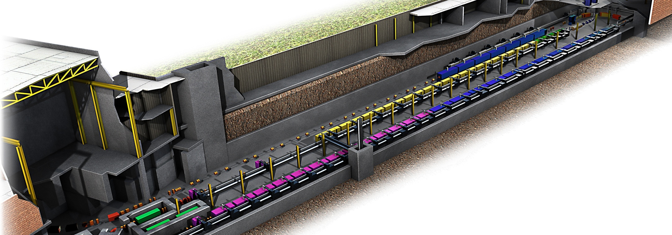
FRIB Opportunity for Upgrade to 400 MeV/u
Space available for upgrade
FRIB design allows the opportunity to operate at higher energy
11 cryomodules with total 55 superconducting elliptical cavities operating at 644 MHz will provide 400 MeV/u uranium
Team exists to deliver the needed cryomodules
P. Ostroumov et al.

Slide 6
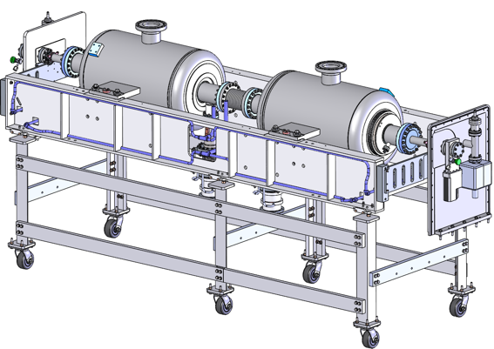
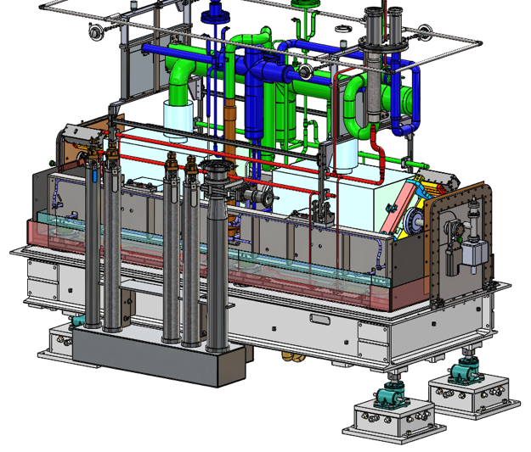
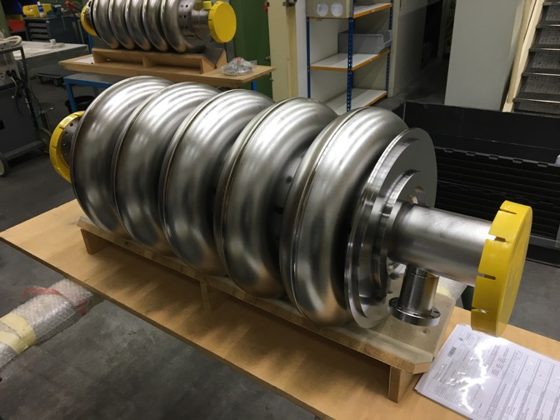
Prototype Cryomodule Under Design (~60%)
The cryomodule is modified from HWR matching cryomodule
2 elliptical cavities instead of 4 HWRs
Design and fabrication of components is proceeding
Testing of the first cavity is planned this year
Clean room assembly
P. Ostroumov et al.

Slide 7
FRIB-Upgrade Beam Energy
Ion species | Charge state | Energy (MeV/u), FRIB | Energy (MeV/u), FRIB-U
⁴⁰Ar | 18 | 320 | 540
⁴⁸Ca | 20 | 264 | 508
⁸⁶Kr | 35 | 257 | 497
¹²⁴Sn | 47 | 235 | 464
¹⁹⁸Au | 68 | 210 | 421
²³⁸U | 78 | 200 | 403
Higher primary beam energy means fragment energy of typically 350-400 MeV/u.

Slide 8
More than 2x Increase in Rare Isotope Beam Rates from the Upgrade for Most Isotopes
O. Tarasov
Ratios are estimates
2x additional luminosity from thicker secondary targets
Beam dump is easier
Does not include limitations of the production target
One atom/week limit

Slide 9
Example: Production of ⁶⁸Ca from ⁸²Se Primary Beam
Case | Target Thickness g/cm² | ⁶⁸Ca Rate /s | Gain | Brho Tm
Baseline 200 MeV/u | 1110. | 9.39E-8 | 1.0 | 6.716
120 kW C 400 MeV/u | 4190. | 7.10E-7 | 7.6 | 10.94
200 kW C 400 MeV/u | 6510. | 1.13E-6 | 13. | 9.86
Optimum C 400 MeV/u | 8900. | 1.16E-6 | 13. | 7.73
Optimum Li 400 MeV/u | 10900. | 5.43E-6 | 58. | 7.69

Slide 10
400 MeV/u at FRIB Science Themes
Scientific rationale for an upgrade of the FRIB energy:
Extends the reach of FRIB along the drip lines. Extremely neutron- or proton-rich nuclei provide sensitive tests of nuclear models. Nuclei with skins of 0.7 fm can be produced
Will improve the constraints on r-process models given by elemental abundance data from stellar observations; access to more neutron rich nuclei important given NS merger results
Laboratory study of the neutron-matter equation of state at near 2ρ₀ and 10x higher pion cross sections; made timely due to observation of gravitational waves from NS mergers
Significant advantages for nuclear reactions; mapping of nucleon wave functions, excitation of particular channels, …
Experiments along the drip line can be completed in one day instead of 7 days
Following talks will discuss these points in detail

Slide 11
Status and Next Steps
400 MeV/u cryomodule is under development and proceeding well (Ostroumov); the team is in place to deliver the upgrade in a cost-effective manner. Timely to consider the upgrade.
The 400 MeV/u upgrade was presented to FRIB SAC; closeout comments were positive
This dedicated workshop on August 9th at the Low Energy Community Meeting
Discussion at the close of the workshop
Thoughts and consensus to move forward
Recommendation from the full LECM to explore the opportunity
Community white paper on the science opportunities by end of the year
Please send your input to Alexandra Gade or Brad Sherrill

Slide 12
Summary
Upgrade of FRIB to > 400 MeV/u
Advantages – higher energy, higher yields for most isotopes
Next steps – Community white paper on the opportunity

Slide 13
Backup

Slide 14
Main Cavity/Cryomodule Parameters
Frequency (MHz) | 644
$$β_{opt}$$ | 0.65
Number of cells | 5
$L_{eff}$, (cm) | 71
V₀ (MV) | 12.4
Expected residual resistance (nΩ) | 5
Dynamic heat load per cavity at 2K (W) | 17.1
Number of cryomodules | 11
Number of cavities per cryomodule | 5
Number of cavities required for FRIB upgrade | 55
Length of the focusing period (cryomodule plus warm section) (m) | 7.25
Total dynamic heat load at 2K in upgraded segment of FRIB linac (W) | 938

Slide 15
Beam Energies and Cryogenics Heat Load Estimate
 | Parameter | Value
1 | Number of cryomodules | 11
2 | Number of SC elliptical cavities | 55
3 | Focusing | RT doublets
4 | Uranium beam energy | 403 MeV/u
5 | Proton | 910 MeV
6 | Argon | 530 MeV/u
7 | Krypton | 490 MeV/u
Temperature | FRIB | Upgrade
2K | 2349 | 1048
4.5K | 1195 | 104
38/55K | 7331 | 3803*
*Distribution losses are not included

