Slide 1
Summer Shutdown Status
10/23/17
Cons Gattuso

Slide 2
Linac and Booster
Beam signs were scheduled for 14:30 hrs. this afternoon
Linac has 2-3 days of studies and commissioning that will occur
Booster has 3-4 days of studies and commission that will occur

Slide 3
BNB beam
8 Gev Line
Ready to go
MI12A/B and target Hall
Ready to go
MI/RR
MI-10 section
MI LCW water leaks (completed by Wednesday)
MI 126 Downstream Quad Manifold
MI 102 Downstream Quad Manifold
MI 848 Upstream Fitting Leak

Slide 4
MI Work Remaining
MI
RR 40 Lamberston installation
Beam pipe shielding
Replace a damage BPM feed through
Fix in place
MI20-62 section
MI307 Injunction kicker B failure
~2 days to replace
~600-700 person mr to complete this task
LCW leaks (3-4 days)
MI/RR-402 New MLAW Magnet
MI 400 Area Lambertson Magnet Leak
MI 637 Dipole Upper Bus leak
MI 428 Quad Magnet Leak
MI 503 Quad Magnet Leak

Slide 5
RR BPM 302 location

Slide 6
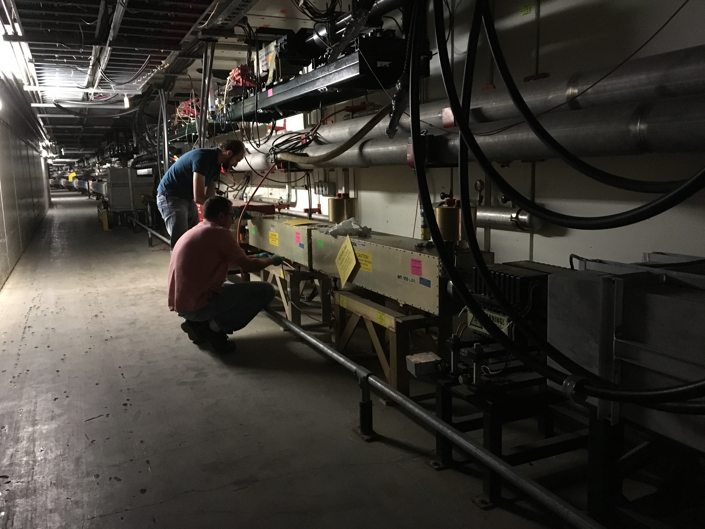
MI307 Injection Kickers

Slide 7
Muon Campus Work
Delivery ring straight section 80% complete
D30 Injection septa -95% complete
Testing of the system,
Removal and reinstallation of ring for the M4 line installation ~ 2 days 30% complete
Abort line 80% complete
Extraction septa
Installed under vacuum, leak check remaining
Electrical connections and water
Instrumentation Repair 90% complete
M5 line installation has completed
Waiting on alignment
M3 line correction element installation 80% complete
Corrector installation 4 of 5 done
Last corrector most difficult installation
This Week
Install abort septa cable
Final walk throughs
Power supply commissioning
Oct 30th – Beam start up

Slide 8
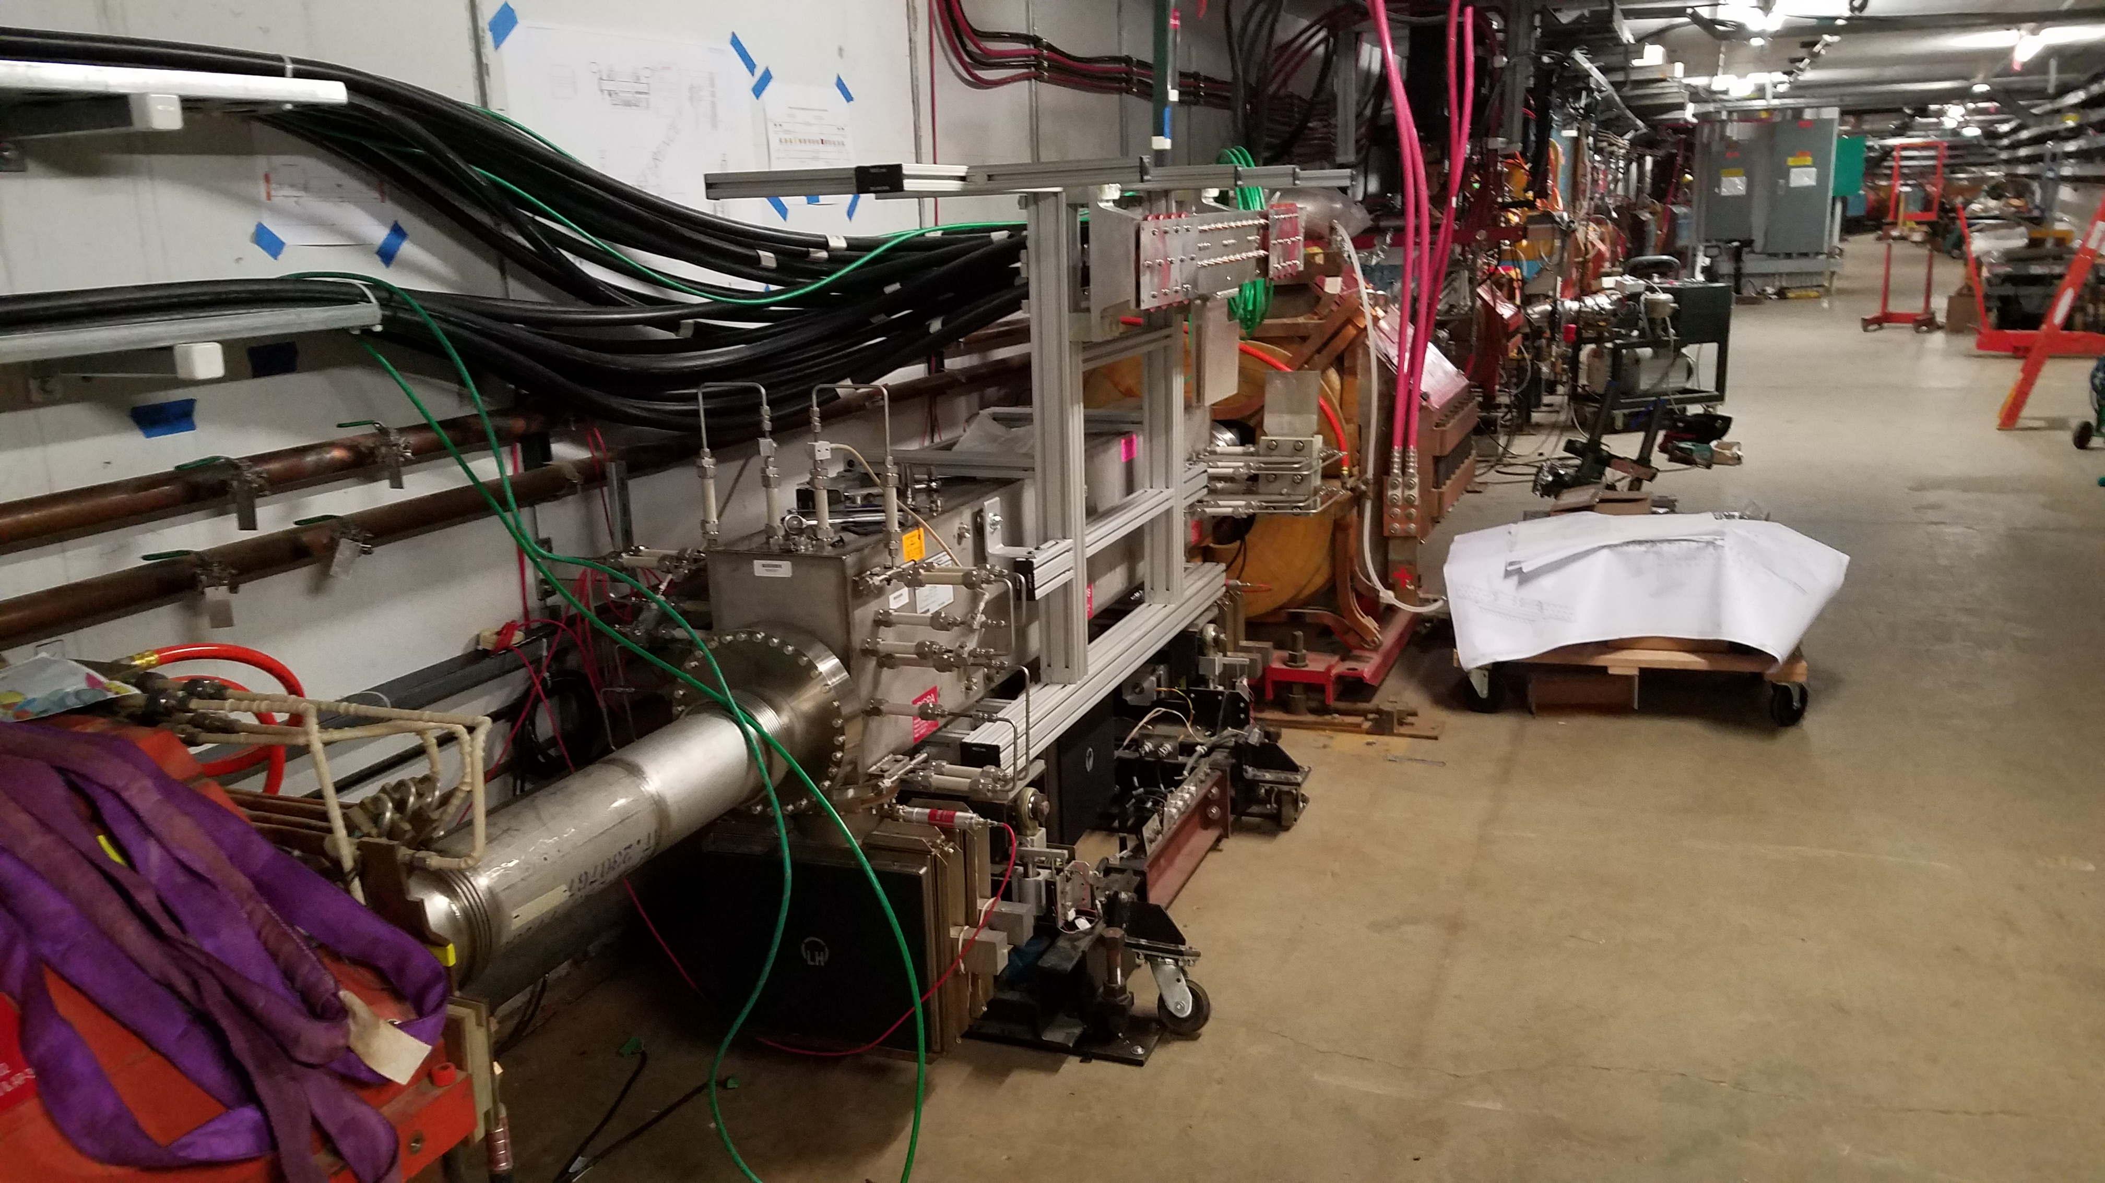
Injection Septa

Slide 9
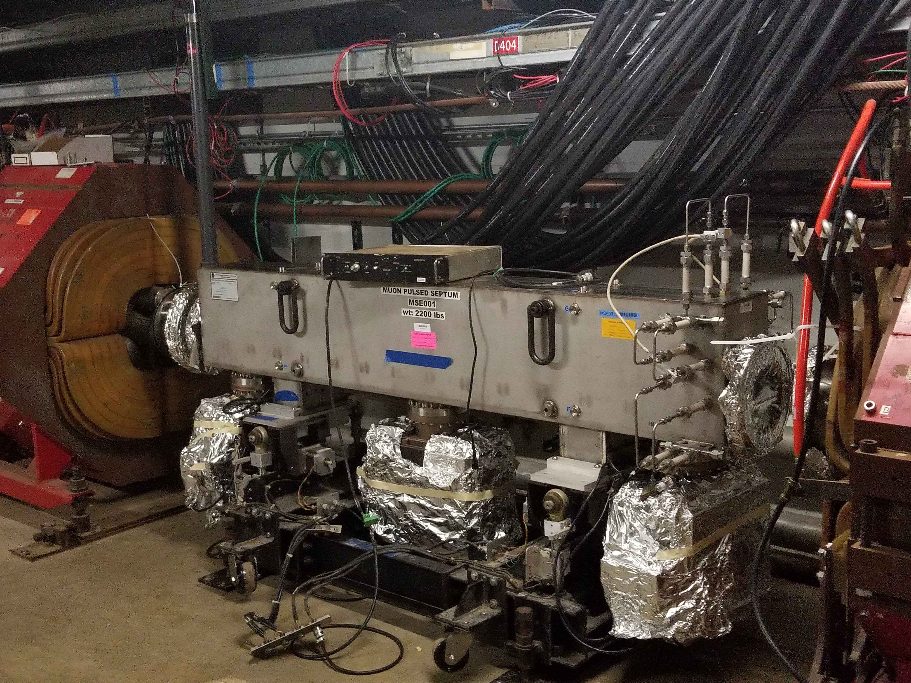
Abort Septa

Slide 10
M3 line corrector

Slide 11
M5 line PWC

Slide 12
Schedule
This week
Install Abort Septa
Tunnel cleaning
Return to safety system keys by Friday
Safety System tests Friday
Install abort septa cable
Final walk throughs
Power supply commissioning
Oct 30th – Beam start up

Slide 13
2017 Shutdown Pocket Dosimeter Reports – Week 13
SHUTDOWN SO FAR:
4,4785 person-mrem
157 people reported some dose, with average dose of 30.48 mrem

Slide 15
Week this week
Linac
Beam commissioning
Booster
Beam commissioning
MI/RR (out of the tunnel by Thursday)
40 lamberstons installation
BPM replacement
LCW leak repairs
Start commissioning RF system
BNB
ready for beam
NuMI
Power outage on Wednesday
Ready for Beam scans (week of October 30th)
SY
MS2 water system commissioning

Slide 16
Shutdown Duration Drivers
Linac Marx Modulator installation
Station 2 upgrade commissioning underway
Production 1 moved to LRF3 location
Commissioning process
Main Injector
Recycler Abort Lamberstons
Muon Campus Work in general
Additional crews will be added
Re-structing the workflow

