Slide 1
Status of ICR
Paul Derwent
Friday Meeting
19 October 2017

Slide 2
Independent Cost Review
Kicked off week of October 2
Michael Fenn (DOE/PM) is lead (4 other members)
Adam Bihary (DOE/FSO) is Point of Contact between review and project teams
Paul Derwent is project POC
List of documents requested to be available at the start
Created a web site dedicated to ICR documents
Requests for additional documents/information
Conference calls with ICR team in advance of on site review
Week of Oct 30th
Cost and Schedule development
Risk Development
On site review 4-7 December
Overview presentations
Drill Downs in agreed upon areas
Closeout report
Final Report February/March time frame

Slide 3
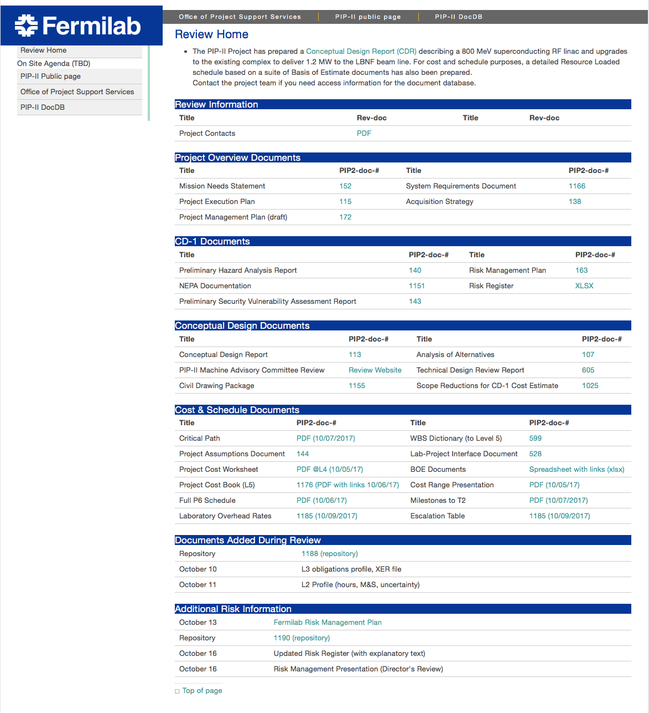

Slide 4
Proposed Agenda: On Site Review
Day | Date (2017) | Location | Time | Activity
1 | Tuesday, Dec 5 | Fermi/ Site | 8 am – 9:15 am | -PM Team In-brief -Project Overview and Briefing
 |  |  | 9:15 am – 11:15 | Site Tour
 |  |  | 11:15am – noon | Analysis of Alternatives
 |  |  | 1pm – 4:45pm | Cost Estimating, Schedule, Risk and Procurement Plan Discussions
2 | Wednesday Dec 6 | Fermi/ Site | 8 am – 12 am | Drilldown Interviews
 |  |  | 1 pm – 4:30pm | Drilldown Interviews
 |  |  | 4:30 pm – 5 pm | PM Status Mtg
3 | Thursday, Dec 7 | Fermi/ Site | 8:15 am – 9 am | Drilldown Interviews
 |  |  | 9 am – 10:30 am | GAO 12-step Cost Estimating Review/GAO Schedule Review
 |  |  | 10:30am – 11:30 am | PM ICR Close-Out Brief Prep
 |  |  | 11:30am - noon | Outbrief

Slide 5
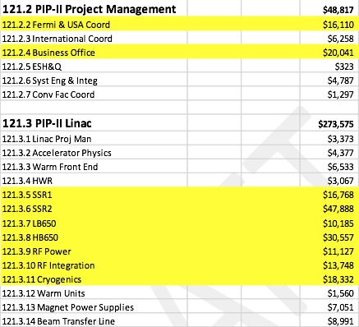
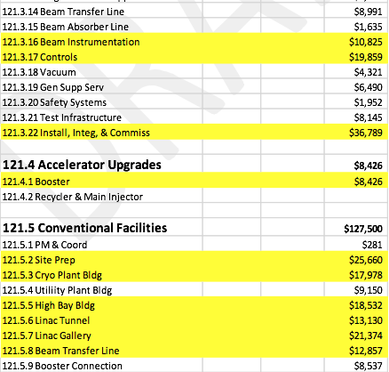
Identified Drill Down Areas
19 L3 areas
5 reviewers , 9 hours

