Slide 1
Integration Test Status with
40% APA and ProtoDUNE-SP APA
Shanshan Gao on behalf of the LArTPC CE Group

Slide 2
ProtoDUNE-SP TPC Front End Electronics
Cold Electronics
  120 Front End Mother Board (FEMB) assemblies
  6 sets of cold cable bundles
  6 sets of signal feed-throughs
Warm Interface Electronics
  6 warm interface electronics crates

Slide 3
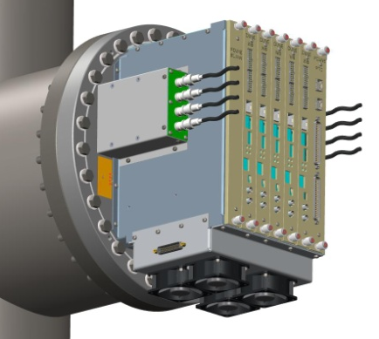
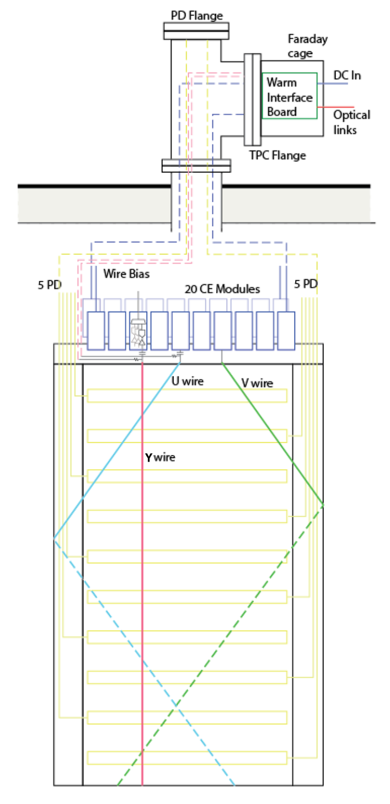
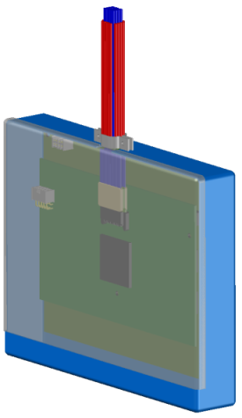
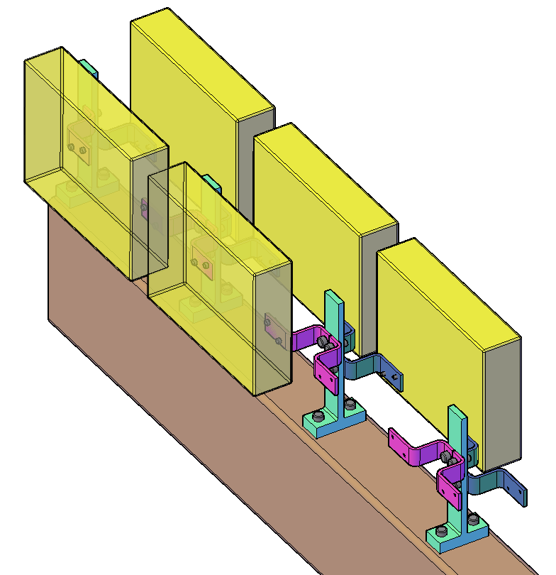
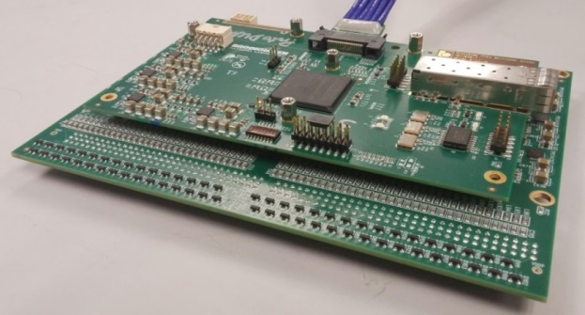
Integral APA + CE + WIEC Concept
ProtoDUNE-SP
Local diagnostics with complete data readout at the feed-through for test and commissioning
Cold electronics module and its attachment to the APA frame

Slide 4
40% APA Cold Test Result
@BNL

Slide 5
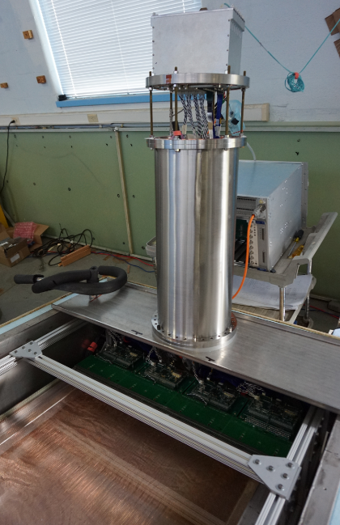
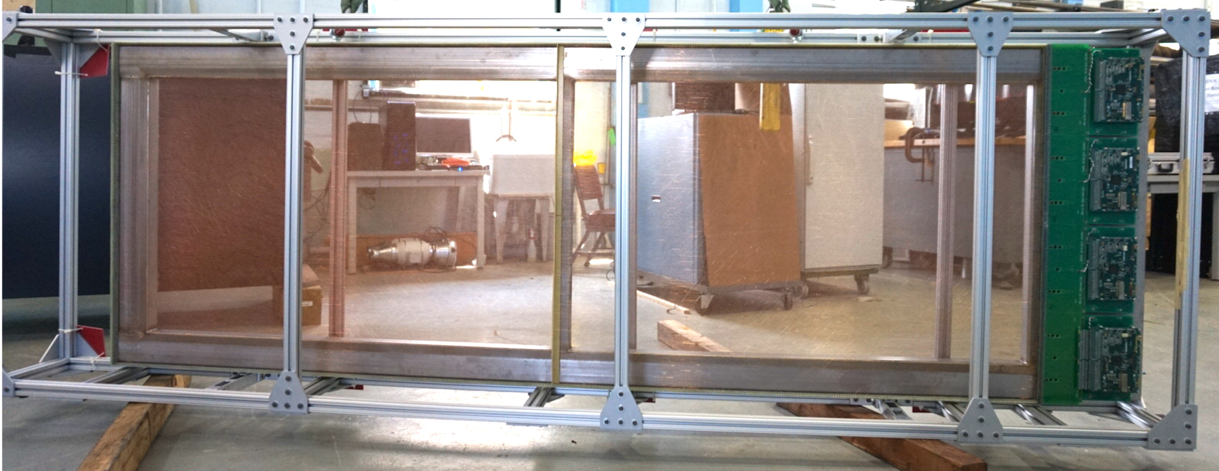
40% APA Integration Test Stand at BNL
40% APA
  2.8m × 1.0m Area ~ 2.8m²
  40% of original LBNE APA of 7m × 2.5m
  ~45% of DUNE APA of 6m × 2.3m
  1024 sensing wires → 8 FEMBs required
SBND APA
  4m × 2.5m
WIEC
  Length of collection wire (4m) of SBND APA is same as induction wire of 40% APA
Flange
Cold box
WIENER PS
40% APA and FEMBs
Integration test stand

Slide 6
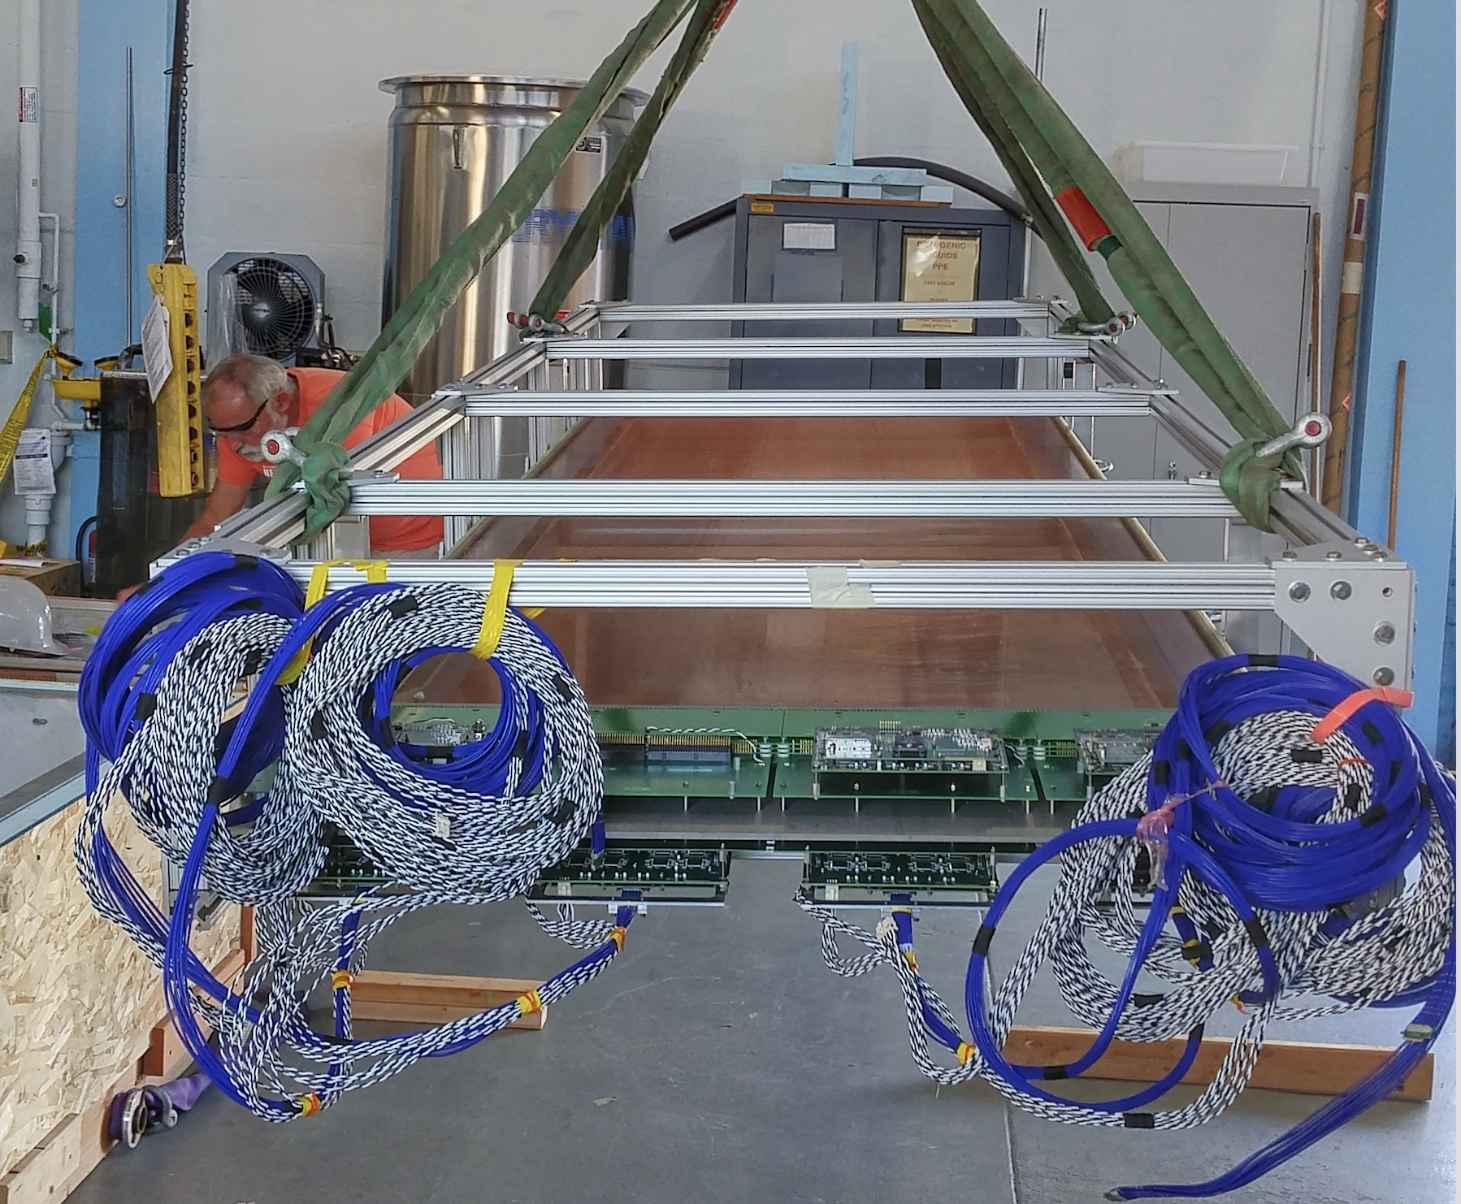
40% APA with 8 FEMBs was moving into cold box
8 FEMBs with 7m cold cables
Cold power cable is not shielded and confirmed no effect on ENC measurement
  Hucheng Chen. Electronics and Noise: Experience from MicroBooNE and SBND/ProtoDUNE status. Joint DUNE/SBN Metting: Lesson Learned. May 15, 2017

Slide 7
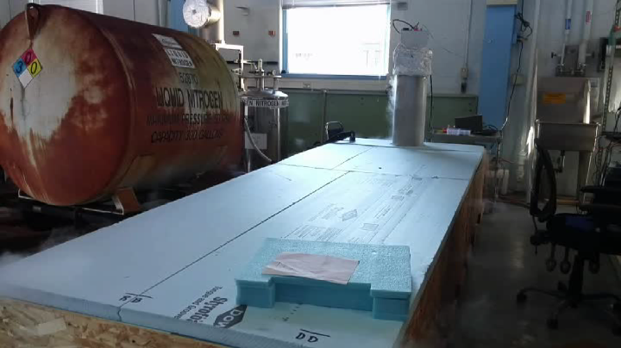
Video: LN2 filling in cold box

Slide 8
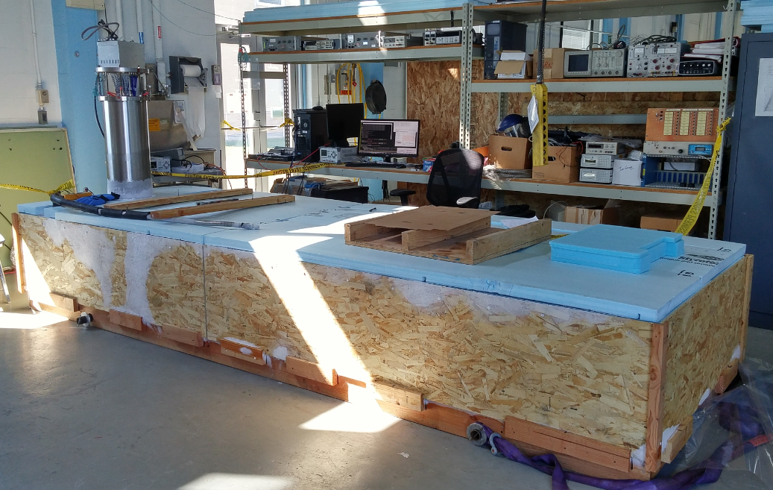
Cold test of 40% APA fully submerged in LN2
Feed-through + WIEC
Cold box with 40% APA

Slide 9
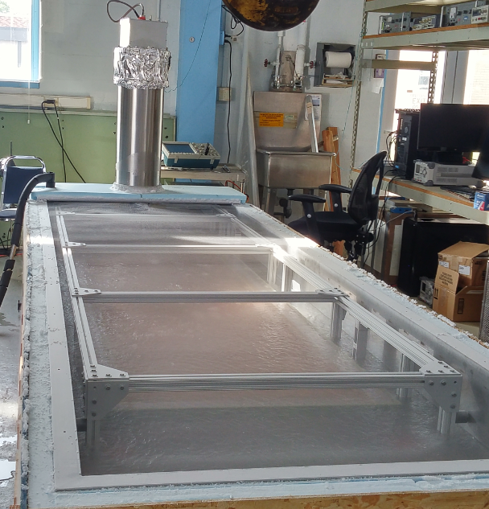
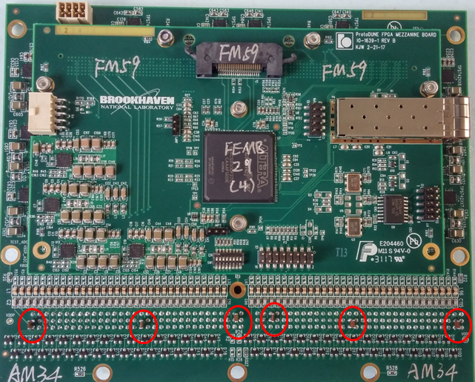
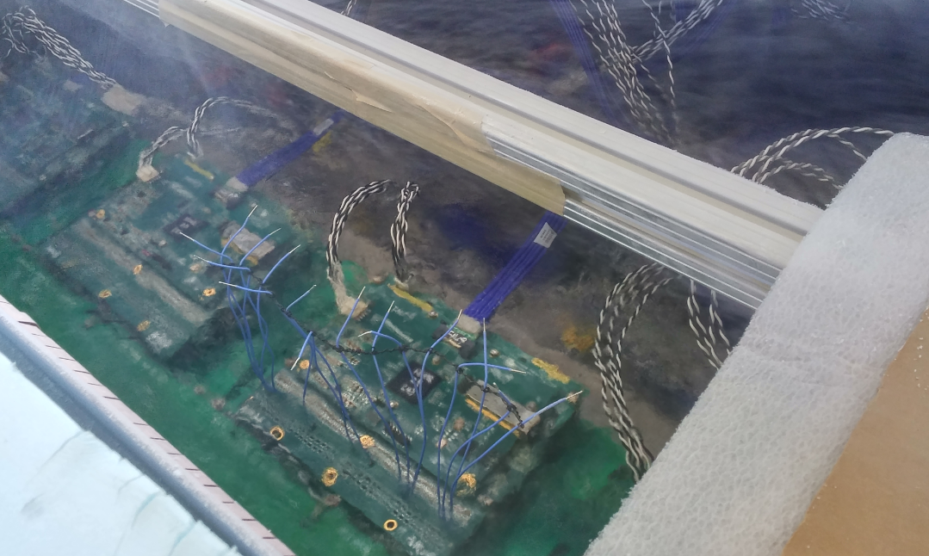
More Pictures
Some channels with extra 82pF/150pF MICA caps
After cold test, 40% APA were still fully submerged in LN2
(~ 400 gallons LN2 was consumed)
APA and FEMBs were fully submerged in LN2

Slide 10
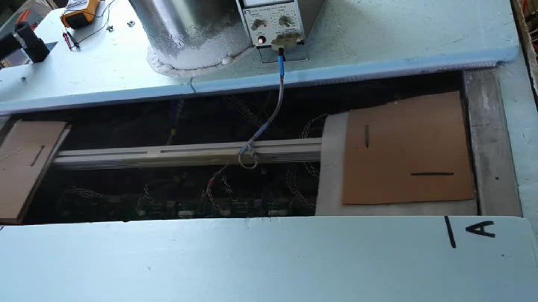
Video: APA and FEMB fully submerged in LN2

Slide 11
40% APA Test Grounding Scheme
Only fiber and power cables are coming out of warm interface electronics crate

Slide 12
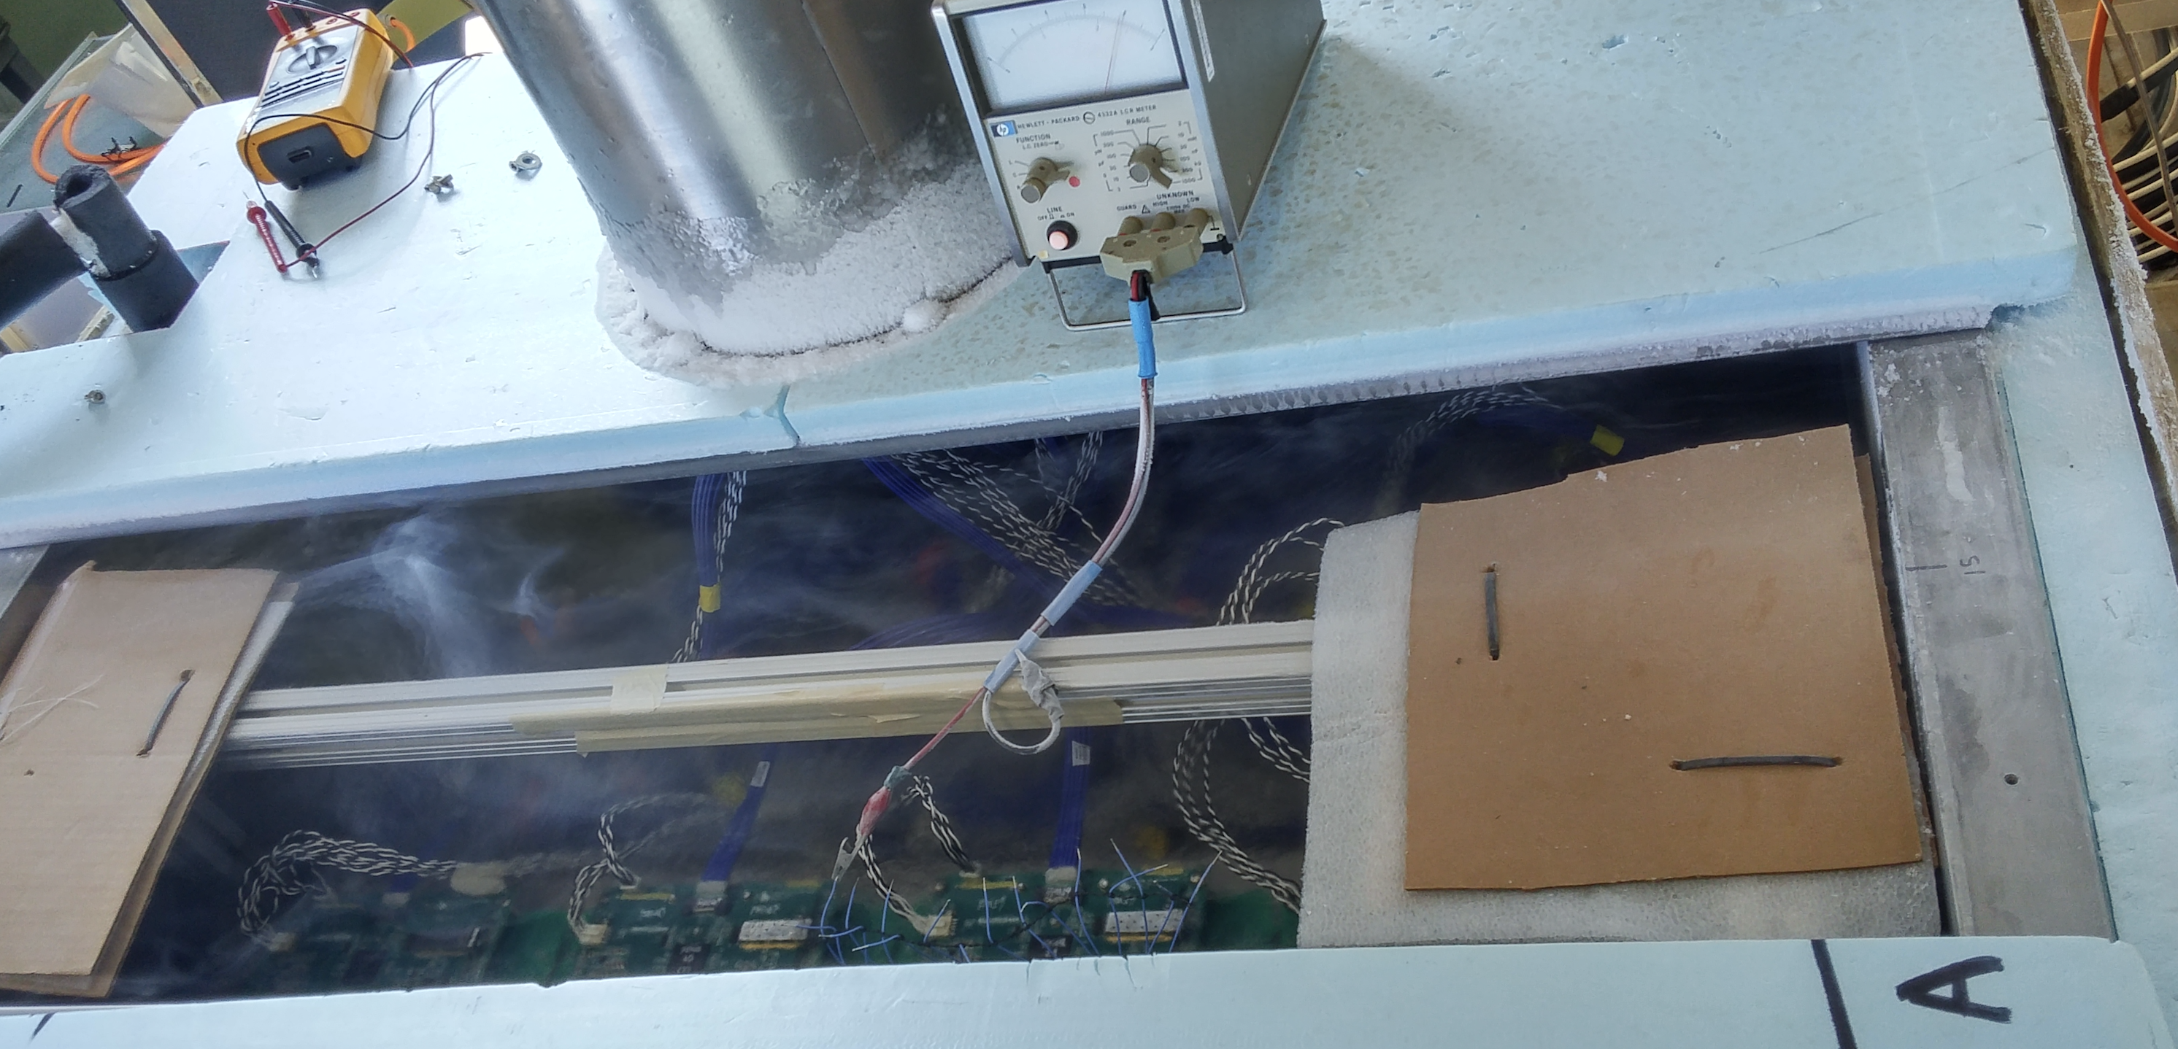
Capacitance Measurement at LN2
FE input capacitance on FEMB
  ~38 pF
Total capacitance of APA + FEMB
  Y plane: ~100 pF
  U/V plane: ~125 pF
  All measurements were done with APA fully submerged in LN2

Slide 13
40% APA Test Stand Status Overview
Total number of channels: 128*8 =1024
  Y channels: 56 * 8 = 448
  V channels: 36 * 8 = 288
  U channels: 36 * 8 = 288
Total number of FE channels read out: 1023
  1 FE channel is broken
Among 1023 readout channels
  Short channels: 3 (3V) → high noise
  Open channels: 5 ( 1Y+3V+1U)
  Y channels: 442
  Y channels with 150pF caps: 2
  Y channels with 82pF caps: 2
  V channels: 278
  V channels with 150pF caps: 2
  V channels with 82pF caps: 2
  U channels: 283
  U channels with 150pF caps: 2
  U channels with 82pF caps: 2

Slide 14
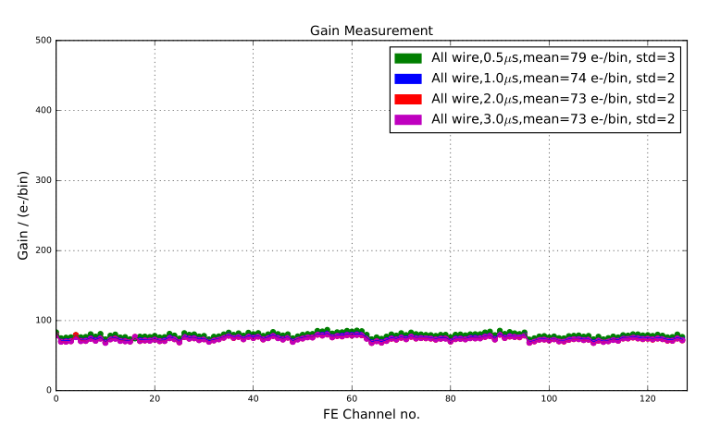
Gain_{(e-/ADC)} is stable at LN2
Top FEMB slot0 (25mV/fC)

Slide 15
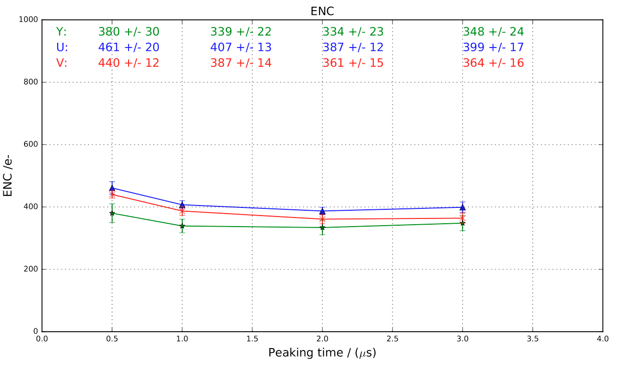
ENC Measurement at LN2
Top FEMB slot0 (25mV/fC)

Slide 16
ENC Measurement at LN2
40% APA test is using 8 ProtoDUNE-SP FEMBs
  128 FE channels per FEMB
ProtoDUNE-SP decided to use P1 ADC, given the short time scale
DNL of P1 ADC has not been resolved
  The ENC measurement could be affected.
  However, by avoiding the stuck code regions, as will be seen, good noise results have been obtained

Slide 17
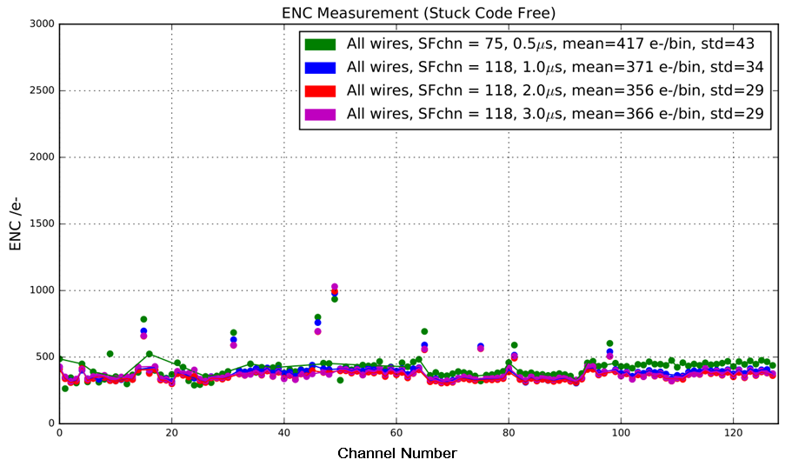
ENC Measurement at LN2
Channels affected by stuck code
V+150pF
U+150pF
Y+150pF
U+82pF
Y+82pF
V+82pF
When ADC offset adjustment is enabled, pedestal could have offset to avoid stuck

Slide 18
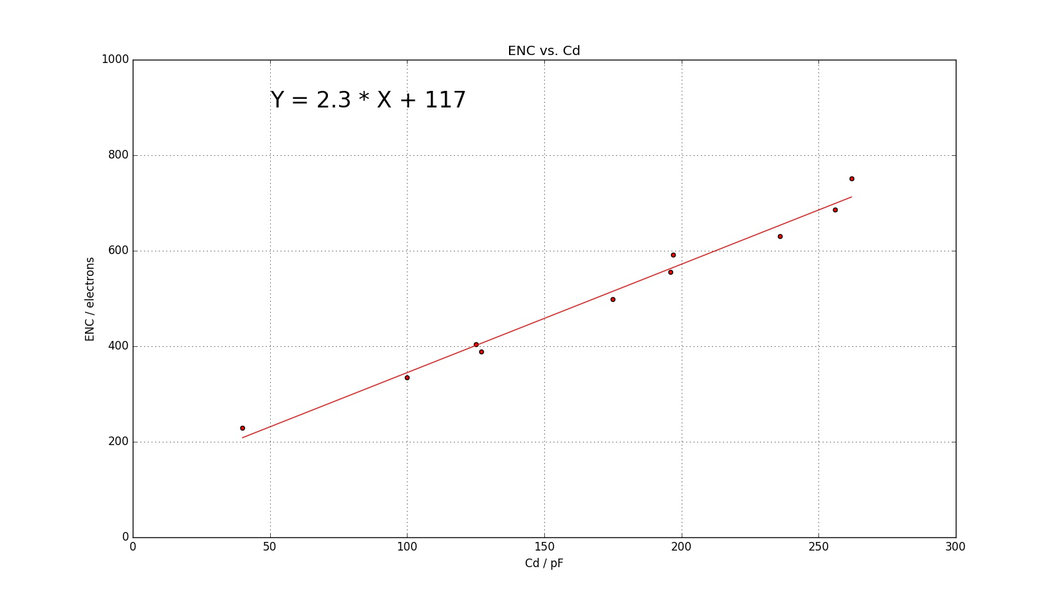
ENC vs. Cd @ LN2 (raw data)
2.3 e⁻/pF
V+150pF
U+82pF
U+150pF
Y+150pF
V+82pF
U
Y+82pF
V
no wire
Y
ENC is measured with 1us peaking time and 25mV/fC gain

Slide 19
ENC Projection for SBND/ProtoDUNE-SP (based on raw data)
ProtoDUNE-SP
Induction Plane ~600e⁻
V+150pF
SBND
Induction Plane ~500e⁻
U+82pF
×
U+150pF
×
Y+150pF
O
V+82pF
U
O
Y+82pF
V
no wire
ProtoDUNE-SP
Collection Plane ~500 e⁻
Y
SBND
Collection Plane ~400e⁻
ProtoDUNE-SP APA
  U/V wire: 7.39m
  Y wire: 6.0m
SBND APA
  U/V wire (max): 5.77m
  Y: 4.0m

Slide 20
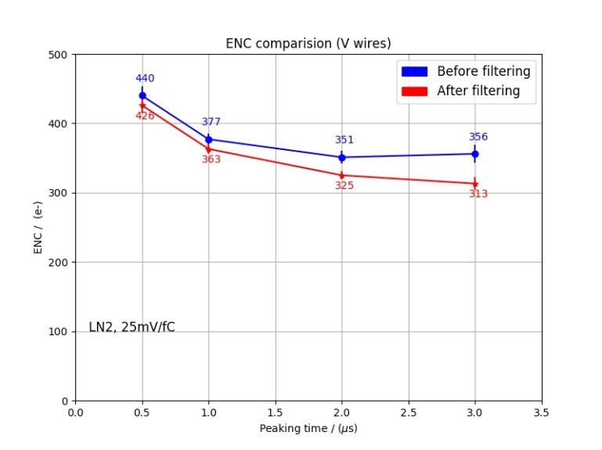
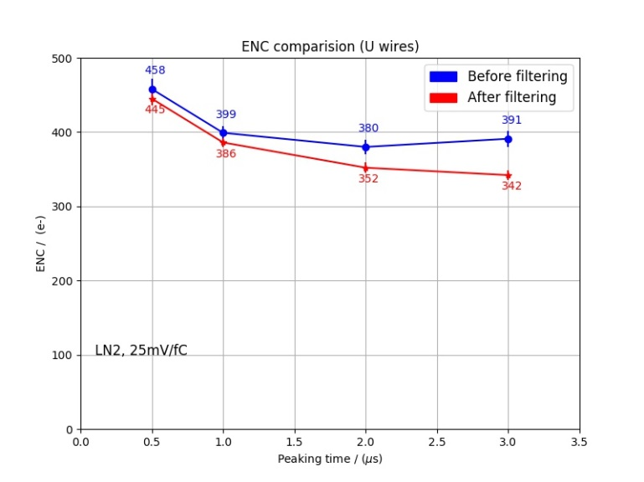
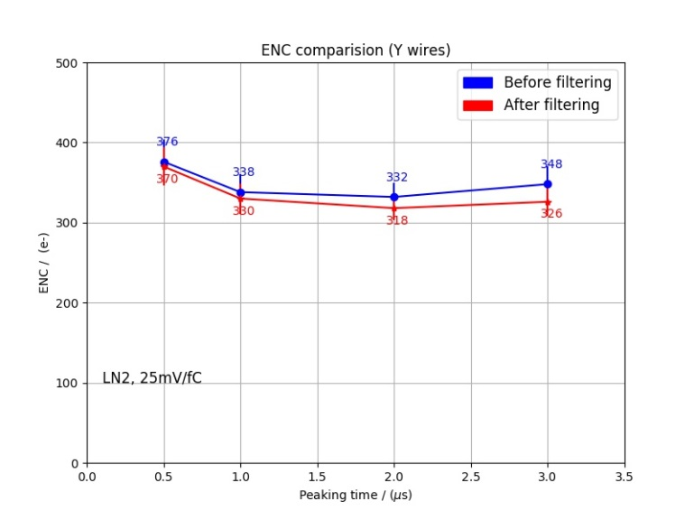
Coherent Noise Diagnostics
Coherent noise filter can be applied to the noise analysis of 40% APA test
Notes:
Top FEMB0,

Slide 21
Comparison of coherent noise in MicroBooNE and 40% APA
As a reference, when T_{p} = 2us
MicroBooNE
 | Y | V | U
Length /m | 2.5 | 4.8 | 4.8
Pre-filtering / e- | 350 | 490 | 480
Post-filtering /e- | 300 | 380 | 400
40% APA
 | Y | V | U
Length /m | 2.8 | 4.0 | 4.0
Pre-filtering / e- | 332 | 351 | 380
Post-filtering /e- | 318 | 325 | 352
Noise performance is comparable with MicroBooNE

Slide 22
ProtoDUNE-SP CE Installation and Check Out
@CERN

Slide 23
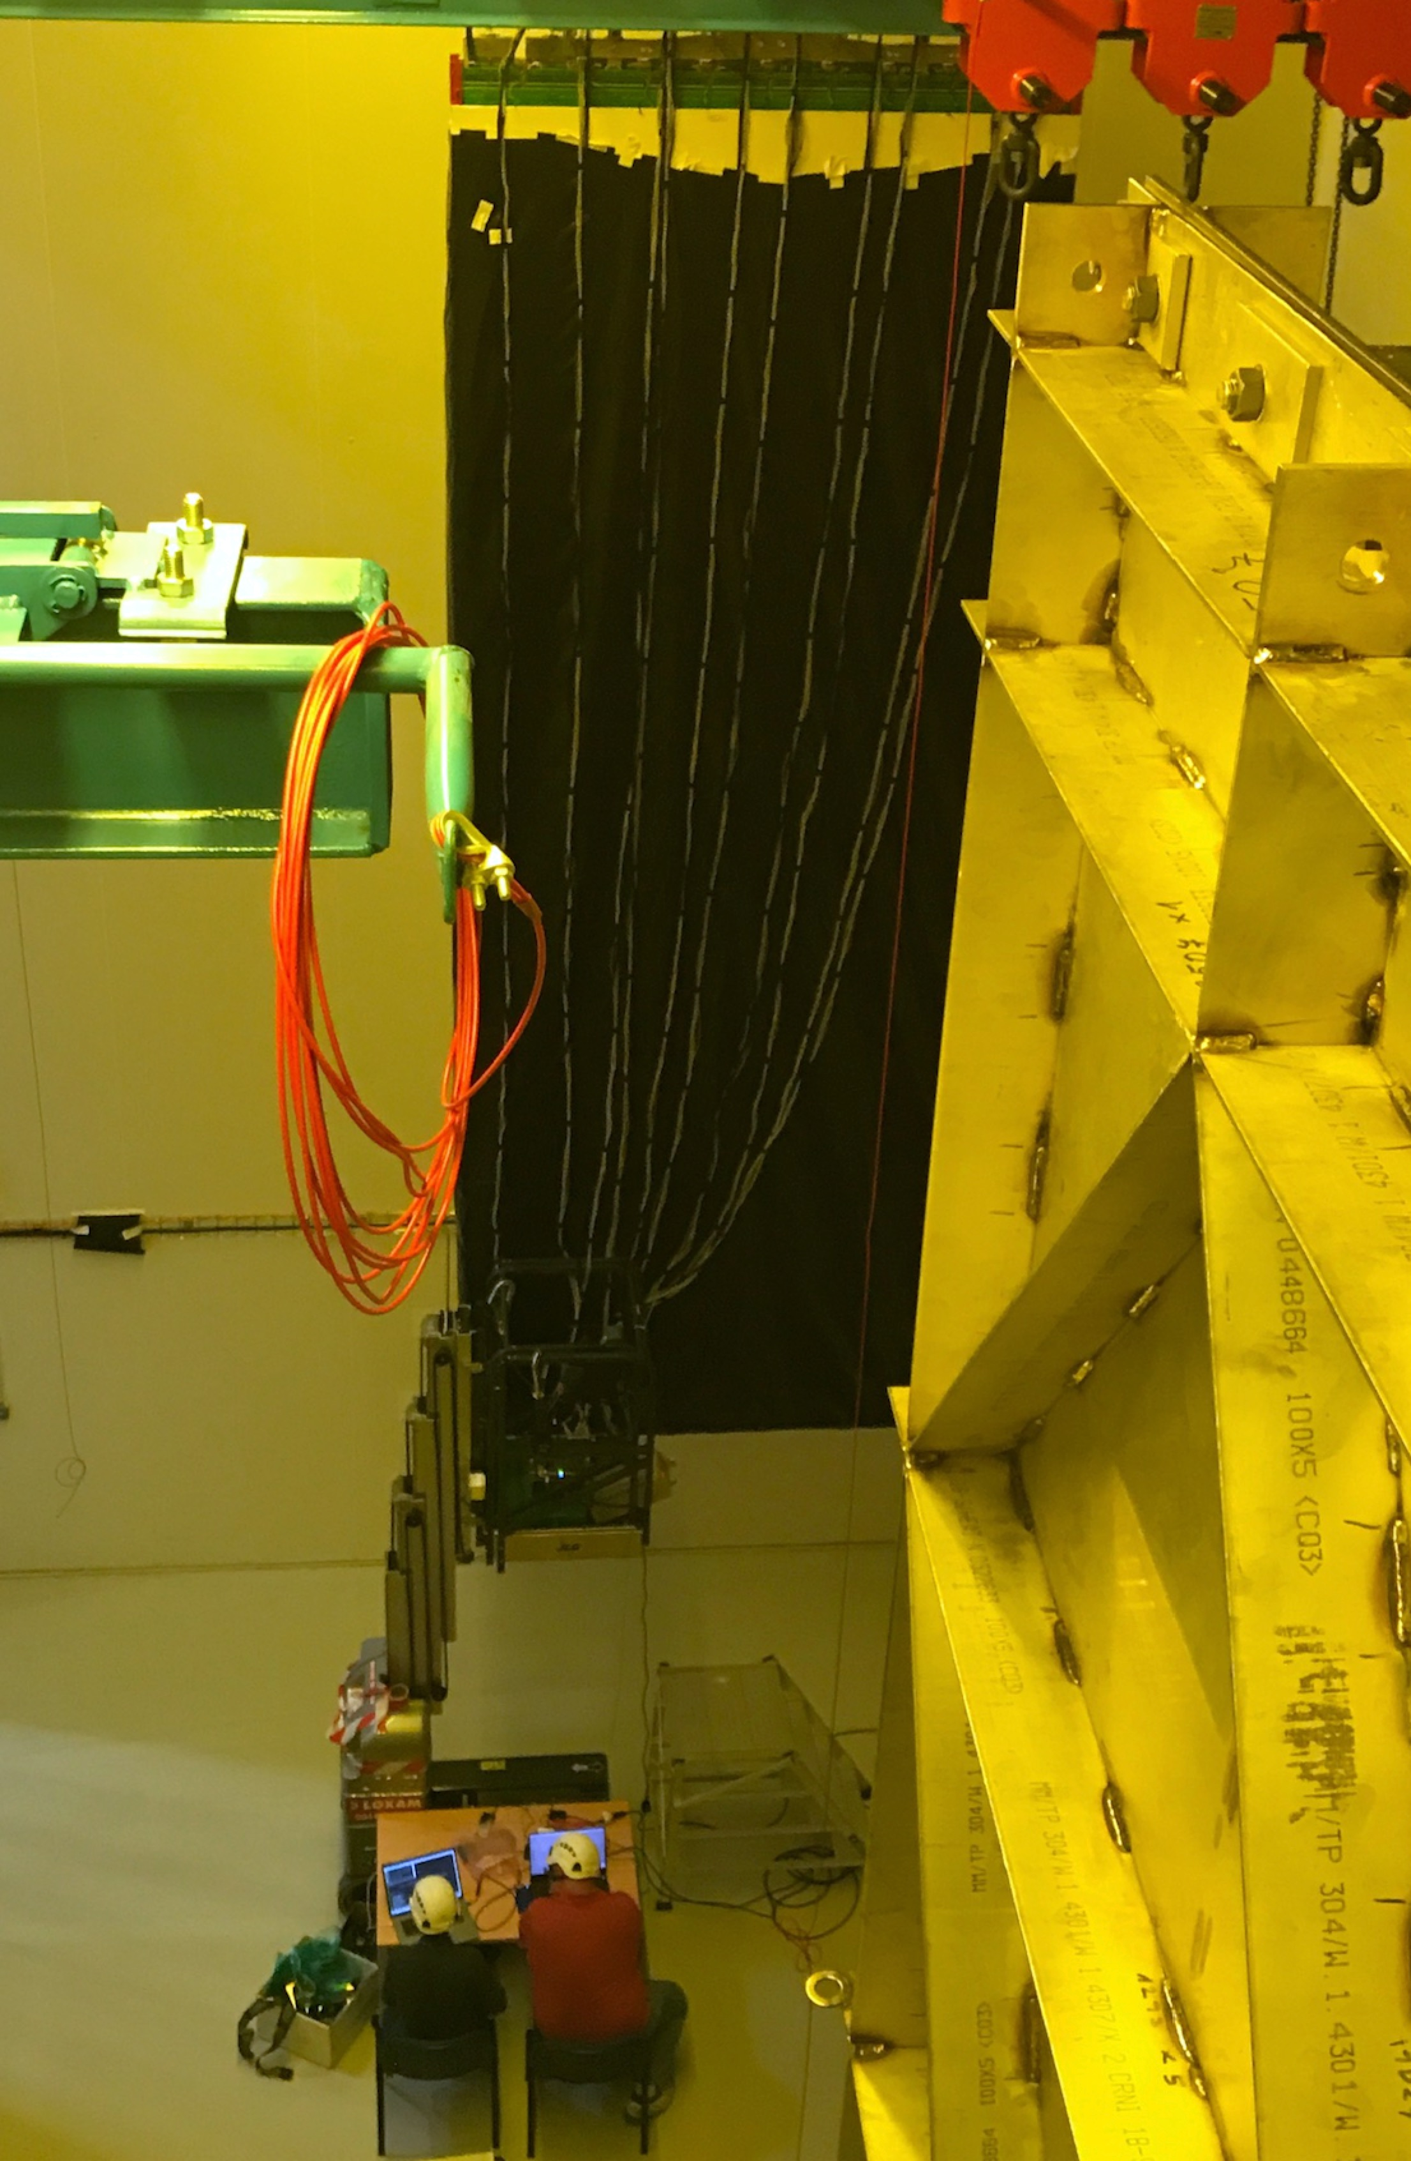
ProtoDUNE-SP CE Installation
20 FEMB + CE box assemblies installed on the first APA @ CERN
A check out test has been done on all FEMBs in the week of 09/04
    Built-in electronics calibration circuit has been used to characterize the readout electronics system
    Through averaging calibration response, which is necessary to cope with environmental pick-up to the unshielded APA, functionality of each channel can be checked out
      All 2560 front end channels are confirmed to be 100% functioning well
      Only one front end channel is not connected to APA properly from upstream of cold electronics
Jack Fried and Shanshan Gao – check out test

Slide 24
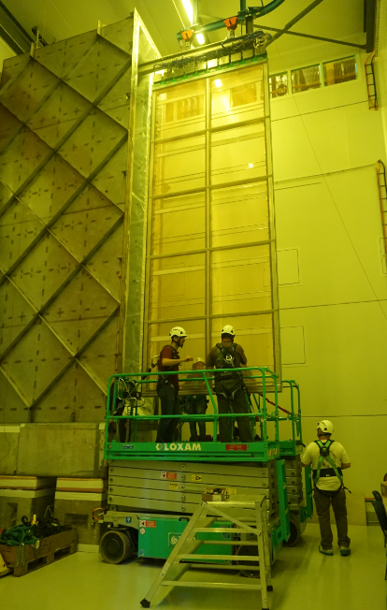
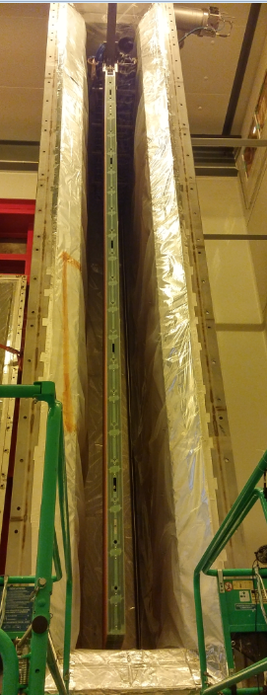
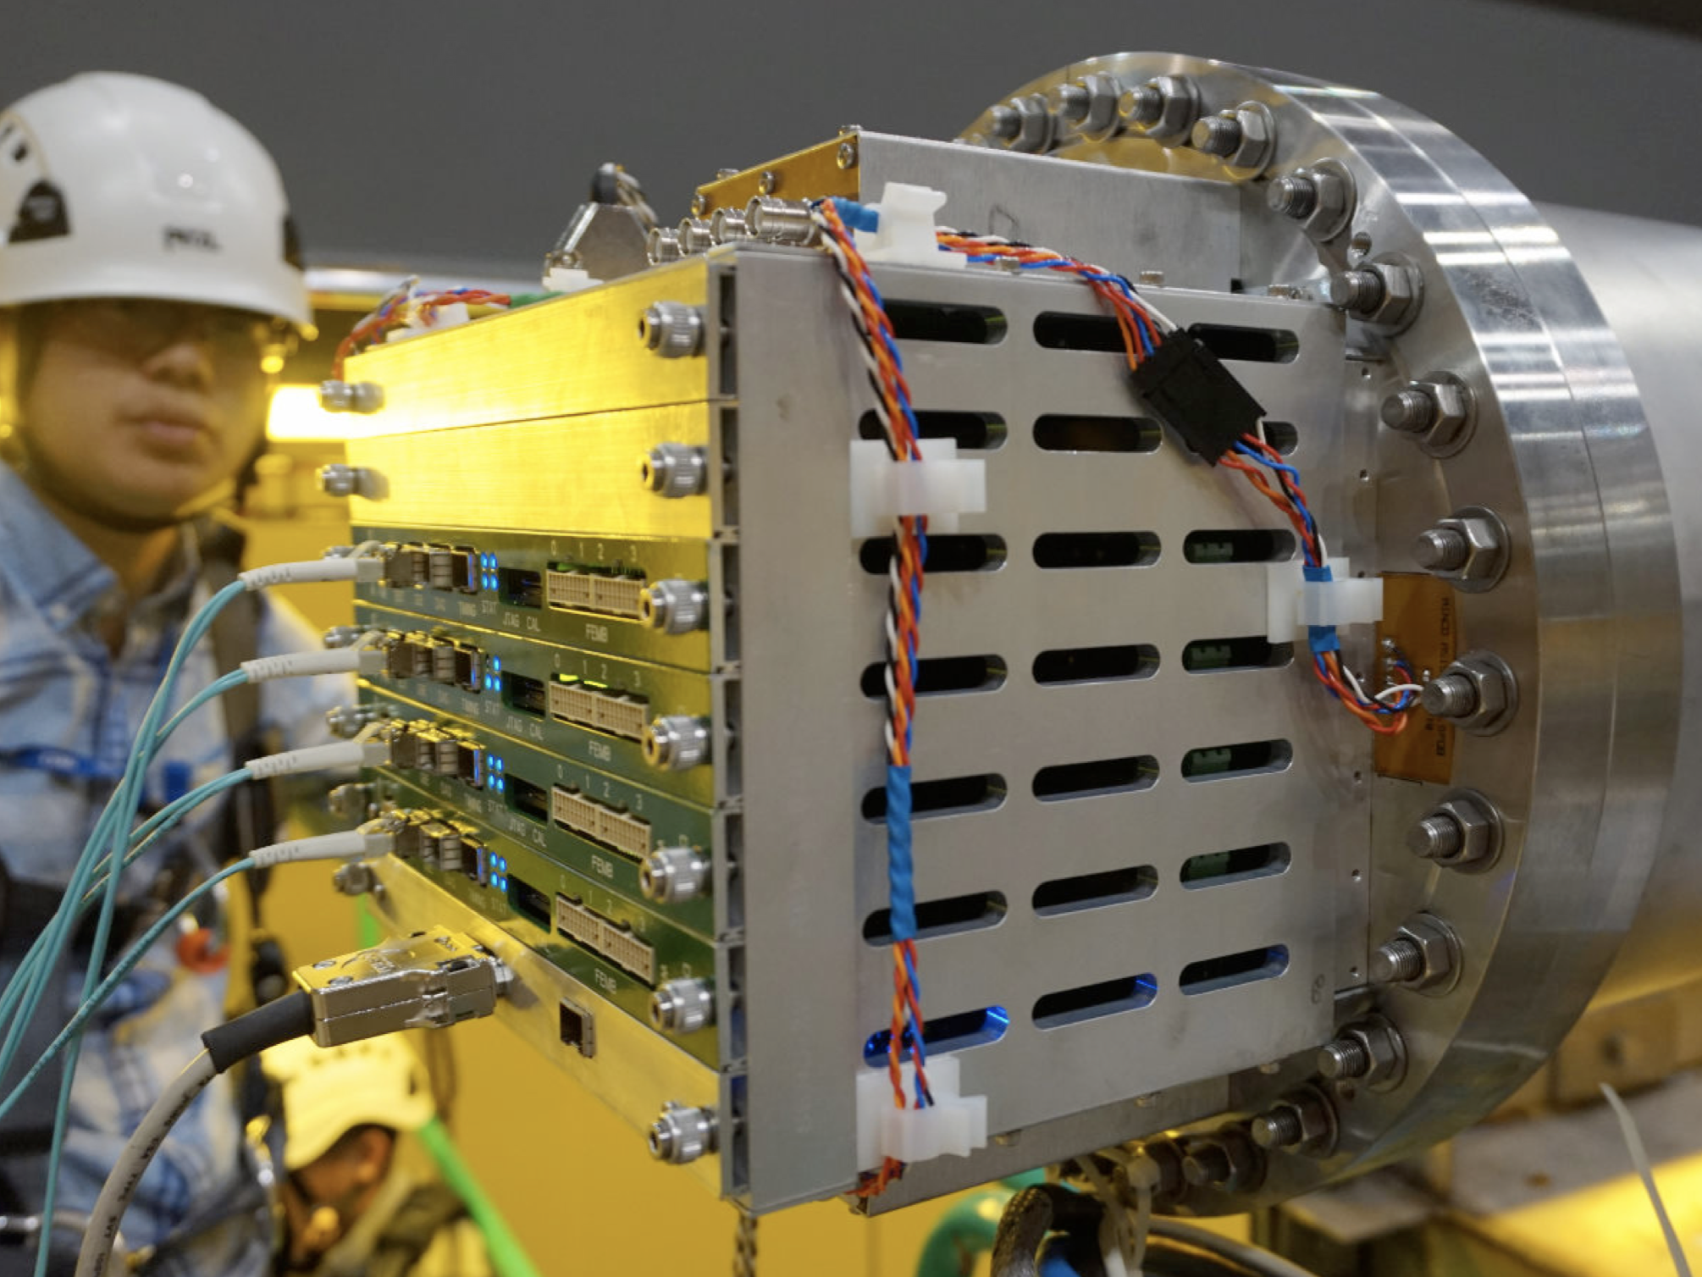
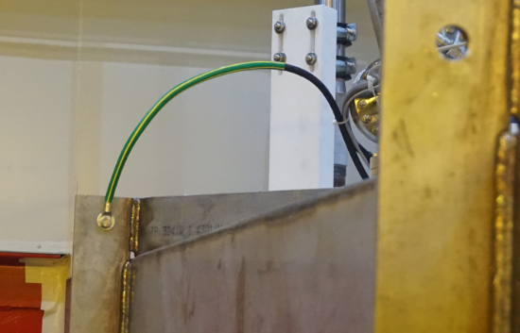
ProtoDUNE-SP Cold Box Test @ RT
WIEC
(Only power cables and fibers coming out)
APA moved into Cold box on 10/13
Cryostat reference

Slide 25
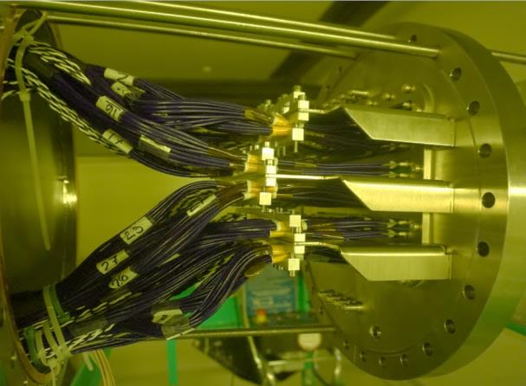
Feed-through flange and cold cables

Slide 26
Capacitance Measurement @ RT
Capacitance of 128 APA wires (APA B side slot 3) is measured @ RT
  Measurement was done without FEMB plugged in APA
  Y wires (48 channels) —> 87 ± 1.0 pF
  V wires (40 channels) —> 115 ± 2.0 pF
  U wires (40 channels) —> 112 ± 1.8 pF
  Above capacitance values include capacitance from APA wire, CR board and PSL adapter board.
  Capacitance of wire sections in the liquid argon will be increased by 1.5
    A fraction of the wire capacitance is to the frame from the wire wrapping
APA A side | 11 | 12 | 13 | 14 | 15 | 16 | 17 | 18 | 19 | 20
APA B side | 10 | 9 | 8 | 7 | 6 | 5 | 4 | 3 | 2 | 1

Slide 27
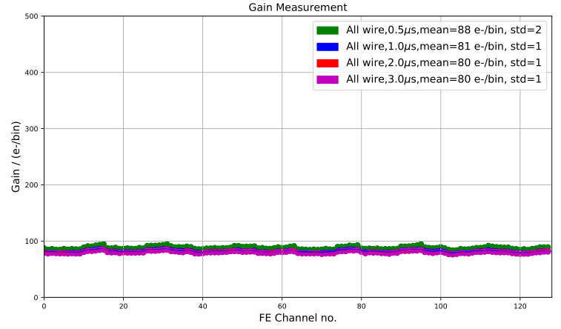
Gain_{(e-/ADC)} is stable at RT (Preliminary)
FEMB + CE box on APA B side
APA A side | 11 | 12 | 13 | 14 | 15 | 16 | 17 | 18 | 19 | 20
APA B side | 10 | 9 | 8 | 7 | 6 | 5 | 4 | 3 | 2 | 1
25mV/fC

Slide 28
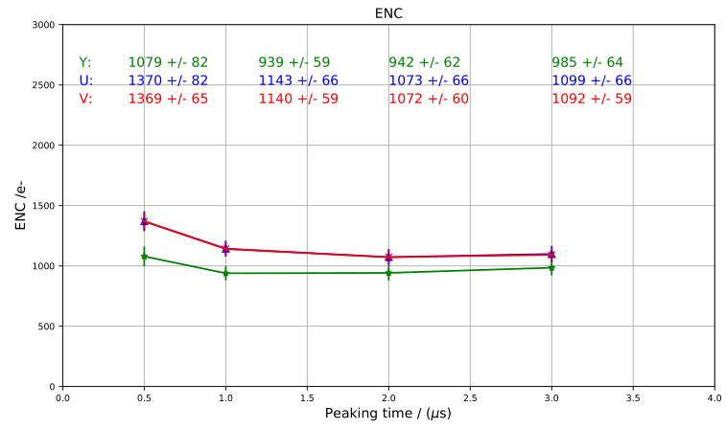
ENC Measurement at RT (Preliminary)
FEMB + CE box on APA B side
APA A side | 11 | 12 | 13 | 14 | 15 | 16 | 17 | 18 | 19 | 20
APA B side | 10 | 9 | 8 | 7 | 6 | 5 | 4 | 3 | 2 | 1
25mV/fC

Slide 29
Summary
ENC measurement of 40% APA fully submerged in LN2 at BNL shows satisfactory noise performance
  Noise is comparable to MicroBooNE measurement
Projection of ENC for ProtoDUNE-SP and SBND looks promising
Cold test of ProtoDUNE-SP APA in the cold box at CERN will be performed at CERN when the gas cooling system is ready
40% APA studies will continue at BNL

Slide 30
Backup

Slide 31
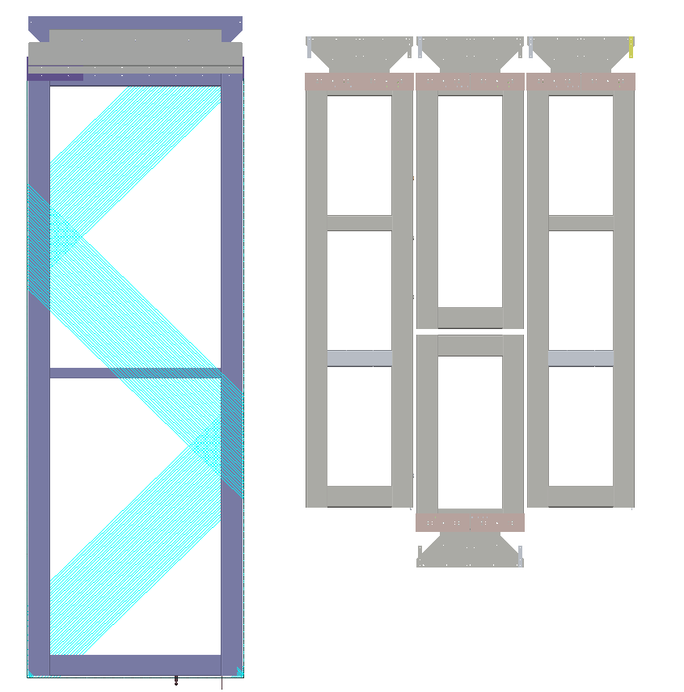
APA Size Comparison
DUNE APA
  6m x 2.3m
40% APA~
  2.8m x 1.0m ~ 2.8m²
  40% of original LBNE APA of 7m x 2.5m
  ~45% of DUNE APA
35ton has 3 sizes of APA
  2m x 0.5m
  1.2m x 0.5m ~ 3m²
  0.8m x 0.5m
SBND APA
  4m x 2.5m
35ton APA
40% APA

