Slide 1
LBNF Value Engineering Process
Joshua Willhite
LBNF FSCF Project Manager
November 2017

Slide 2
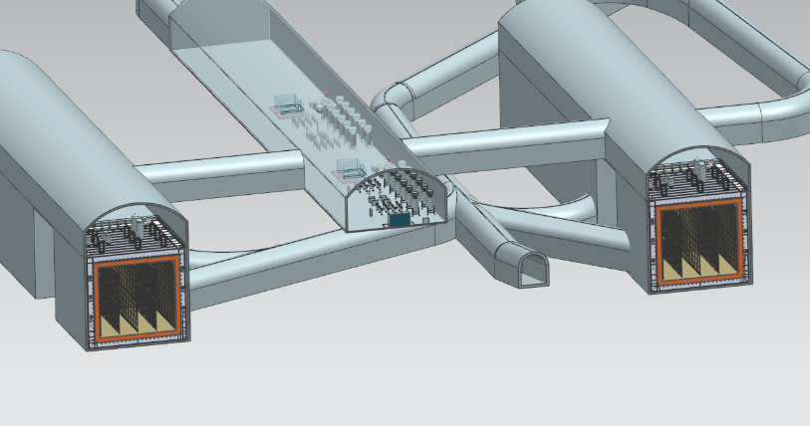
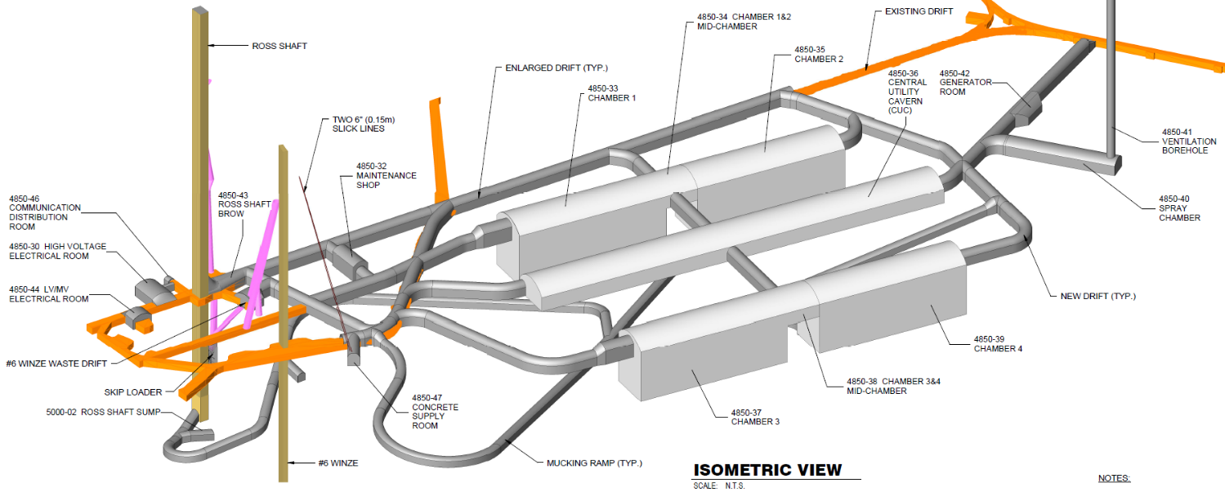
Outline
Meetings and Workshops
Change Process
North Cavern
Central Utility Cavern
South Cavern

Slide 3
Meetings and Workshops
FRA is hosting a VE workshop next week (November 14-15) with KAJV and SDSTA at SURF. This is being facilitated by a Certified Value Specialist.
Arup has been intentionally excluded from this as a standard practice to promote views by “fresh eyes”.
As discussed in the final design presentation, each design review workshop following the 30, 60, and 90% deliverables will include opportunities for VE suggestions
No focused VE workshops beyond these are planned, and we recognize that the impact of changes at this point in the project is significant.

Slide 4
Change Process
The LBNF project is baselined, and therefore no changes can be made without following a change process.
Any VE concepts must be presented (by me) to the LBNF team for discussion and approval.
Any change exceeding $5MM (up or down) must be approved by the DOE

