Slide 1
WBS Update and Upcoming tasks
David Warner, Ettore Segreto and Leon Mualem
10/24/17

Slide 2
WBS Status
We have received WBS updates from all the working groups-- Thank you!
Leon and I are working to integrate them into the draft unified WBS today
New WBS draft must be sent to TB by the end of today (Tuesday, 10/24/17)
A new draft of the WBS will be posted Wednesday AM 10/25. We will need to have initial interests/aspirational responsibilities appended to it by FRIDAY 10/27!!!
WBS format was modified at the request of project management
Integration and photo sensor groups already modified to fit new structure

Slide 3
High-Level Structure
L0 (now):
SP
DP
L1:
APA
SP-ELE
SP-PDS
CRP
DP-ELE
DP-PDS
HVS
DAQ
SC/CI
TC
L0 (future):
SP1
DP1
SP2
DP2
PD Consortium
WBS lines start
With 1.3

Slide 4
High-Level Structure
L2:
Management (includes milestones & review dates)
Physics & Simulations
Design, Engineering, and R&D (includes subsystem test facilities & QA)
Production Setup (includes tooling)
Production (includes component production, assembly, testing, & QC)
Integration (contributions to activities at global integration facility)
Installation (contributions to activities at SURF)
SO: FD1 SP Photosensor Management would be 1.3.1

Slide 5
Mid-Level Structure
L3: Working group divisions
.1 Light Collector WG
.2 Photo Sensor WG
.3 Electronics/Cable/Calibration WG
.4 Integration WG
.5 Software and Physics WG
WBS Entries also color-coded for clarity (?)
WBS 1.3.1.1 = FD1, Photon Detector, Project Management, Light Collector

Slide 6
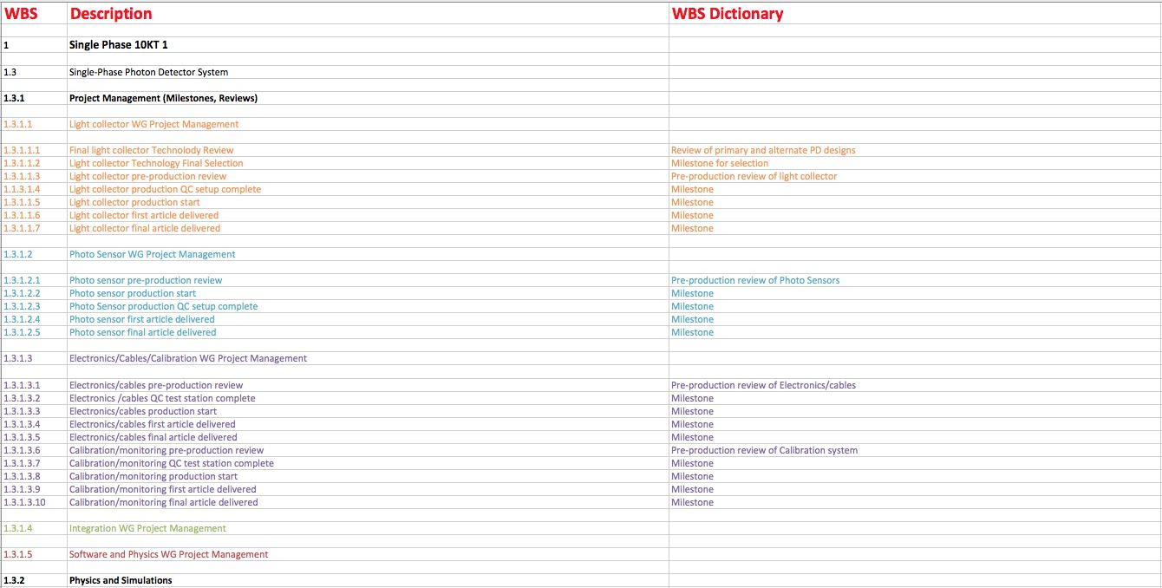

Slide 7
Institutional Interests
Once the WBS draft is finalized, the consortia will be asked to attach institutional interests to specific WBS items where appropriate
It’s understood that not every WBS element will have an attached institutional interest at this point in time
Need to have these in place by Friday, October 27
At the RRB, we will show pie charts that attempt to summarize institutional interests within each consortia (example on next slide)
The information contained within the pie charts will be qualitative rather than quantitative, and we will plan to discuss these with each consortia leadership team

Slide 8
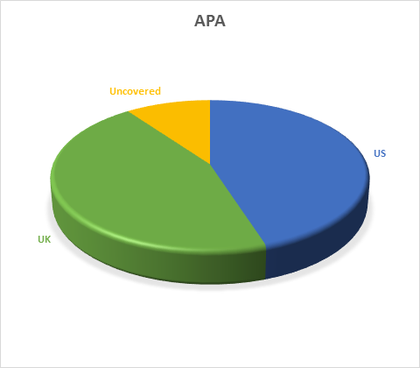
Example Pie Chart

Slide 9
Other Activities
We still need required consortia R&D activities in 2018/2019 for producing TDRs
We will need to coordinate and prioritize these activities within the consortium and present a coordinated plan to management along with our funding request.
Each consortia should be preparing a schedule of activities in 2018/2019-- By Monday 10/30

Slide 10
Post-RRB
The next major milestone for the consortia will be completing the Technical Proposal by April, 2018
Technical proposal will include
Written description of proposed subsystems and any alternatives under consideration
Updated WBS and associated list of institutional interests
Initial subsystem cost estimates
Initial draft of schedule for construction activities
Will need to start planning in early November for how to accomplish this in the six months available

