Slide 1
A2D2 Operational Meeting
Michael Geelhoed

Slide 2
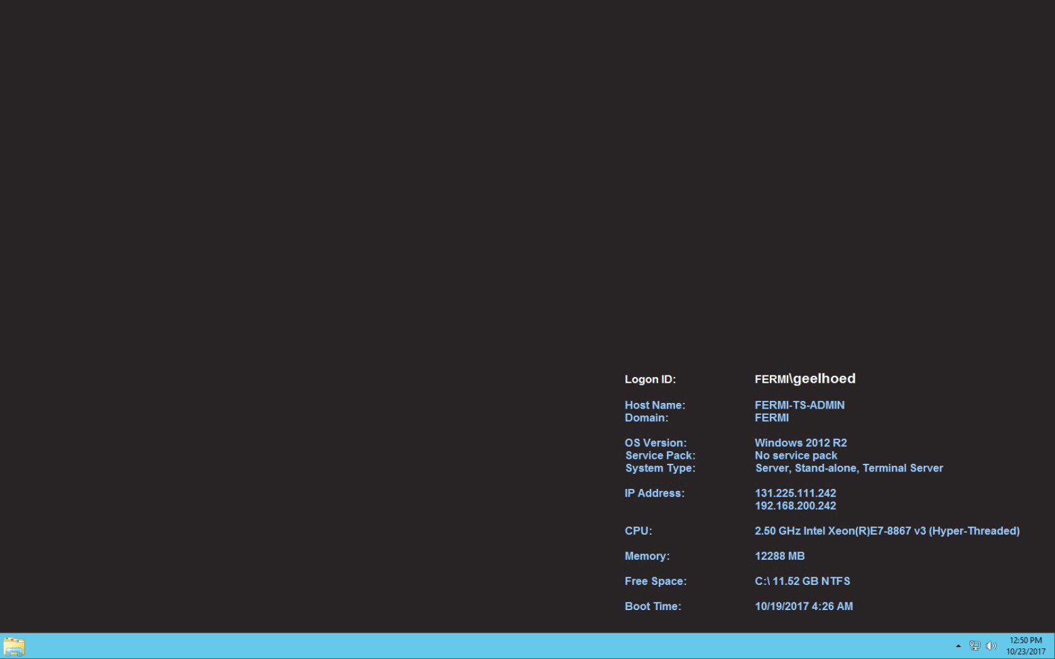
ESH&Q and Vector Server’s for Sample Tracking
Safety has not complete beam-on rad survey measurements report
Sue has not replied to my request for an Operational RWP
Computing Division duplicated the TD server
I don’t have access, need service desk help for this
Talked with Jan Szal, he indicates there is still more work to be done

Slide 3
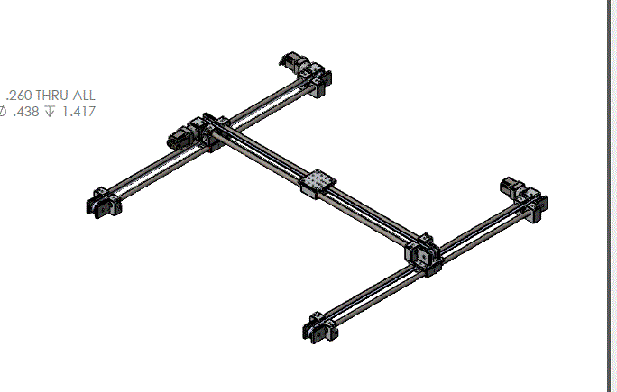
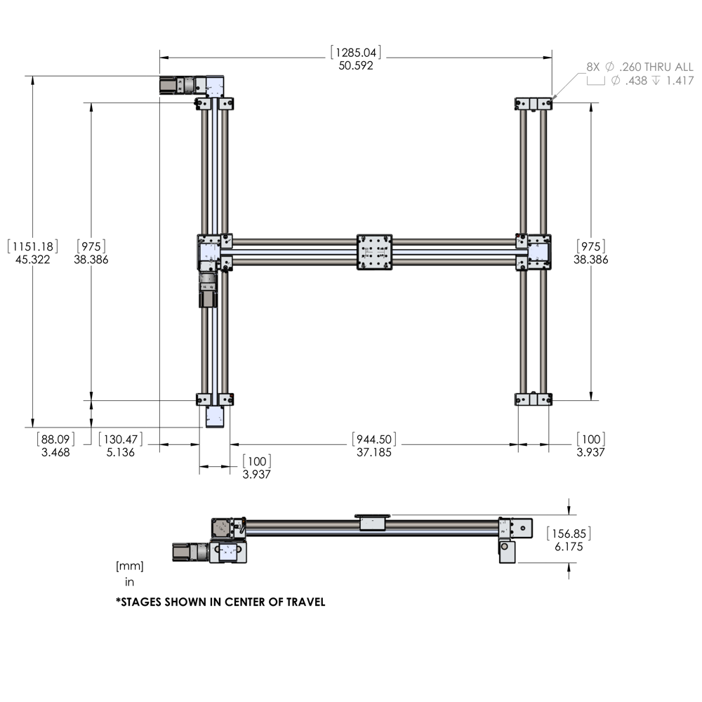
Table Positioning
Started to construct the 80-20 frame to house the moveable table Tom has re-ordered

Slide 4
Upcoming Samples
Started to construct the hydraulic floor press at HAB in Tech Shop
Need to know the size of the ERDC samples and others
Estimated receiving time…?

